Slide 1
BSc Software Engineering Capstone — Progress Review
Umubyeyi
A Kinyarwanda-Language AI Chatbot for Maternal Mental Wellness in the Postpartum Window
Raissa Irutingabo · African Leadership University
Supervisor: Samiratu Ntohsi
Progress presentation — June 2026

Slide 2
AGENDA
Outline
• Introduction
• The Need
• Data
– Training corpus, framing dataset, response templates
• Data Preprocessing & Exploration
• The Approach
– System pipeline + the model ladder (floor → embeddings → transformer)
• Results
– Baseline & the cross-lingual degradation finding
• Discussion
• Conclusions & Next Steps
Umubyeyi · Kinyarwanda Maternal Mental-Wellness Chatbot · R. Irutingabo (ALU)
2

Slide 3
INTRODUCTION
What is Umubyeyi?
• A browser-based chatbot that talks to first-time Rwandan mothers in Kinyarwanda about their mental wellbeing.
• Scope: the 0–6 month postpartum window — when low mood, anxiety and feeling overwhelmed peak.
• Informational and supportive — never diagnostic. Every reply carries a disclaimer and a safety pathway.
• Template-based, not generative: each intent maps to one guideline-sourced, human-reviewed response template (avoids LLM hallucination).
• Designed for low-resource deployment — classical ML, no GPU at inference, runs on Streamlit Community Cloud.
In one sentence
“Meet mothers in their own language, route them to safe, expert-validated guidance, and measure exactly what translation costs us along the way.”
Umubyeyi · Kinyarwanda Maternal Mental-Wellness Chatbot · R. Irutingabo (ALU)
3

Slide 4
THE NEED
Why this matters
• Perinatal mental-health conditions are common and under-served in sub-Saharan Africa, yet rarely screened in routine postpartum care.
• First-time mothers face the steepest adjustment, often in isolation and without a safe, private place to ask questions.
• Language is the barrier: almost all digital maternal-health tools are English-only.
• Kinyarwanda is severely under-resourced in NLP — no public mental-wellness intent dataset exists.
• Existing maternal-health chatbots are English-only and physical-health focused, and name translation as an unsolved limitation.
The gap = Kinyarwanda × mental wellness × Rwanda — exactly where Umubyeyi sits.
Umubyeyi · Kinyarwanda Maternal Mental-Wellness Chatbot · R. Irutingabo (ALU)
4

Slide 5
DATA
Two data sources, two distinct roles
TRAINING DATA
RESPONSE TEMPLATES
Amod counseling Q&A
WHO / UNFPA guidance
• 3,512 rows of real therapist Q&A
• 995 unique questions (heavy duplication)
• Filtered to maternal-relevant subset
• Labeled into 6 wellness intents
• Tier-1 global authorities
• Source of every user-facing answer
• Pre-translated + human-reviewed
• 6 response templates (1 per intent)
Umubyeyi · Kinyarwanda Maternal Mental-Wellness Chatbot · R. Irutingabo (ALU)
5

Slide 6
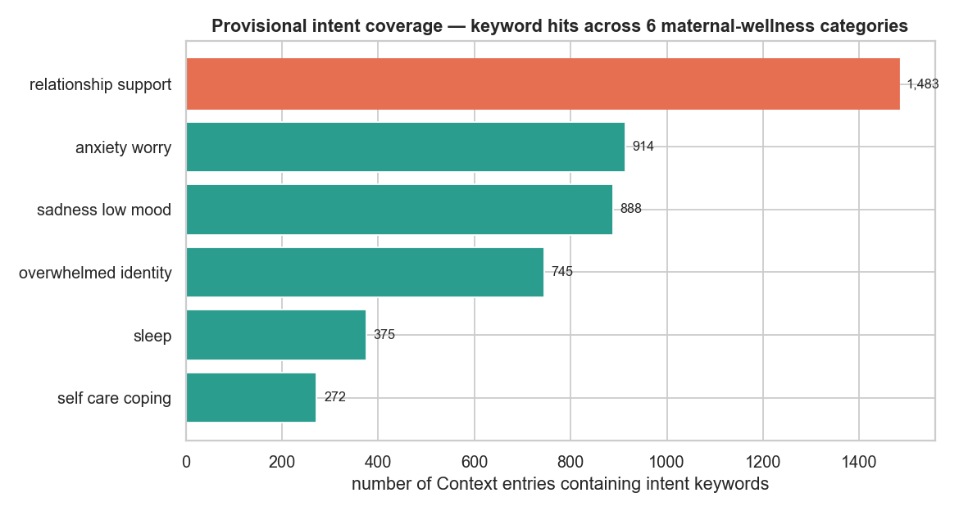
DATA PREPROCESSING & EXPLORATION
What the data told us
• Deduplication finding: 3,512 rows collapse to 995 unique questions — 2,517 are the same question answered by different counselors.
• Consequence: split on unique questions (GroupShuffleSplit) to avoid leakage and inflated accuracy.
• Intents are imbalanced — relationship/support dominates, self-care is scarce.
– This is why we report F1, not just accuracy.
• Cleaning: scope filtering, lowercasing, TF-IDF features.
Intent coverage across the maternal subset (class imbalance)
Umubyeyi · Kinyarwanda Maternal Mental-Wellness Chatbot · R. Irutingabo (ALU)
6

Slide 7
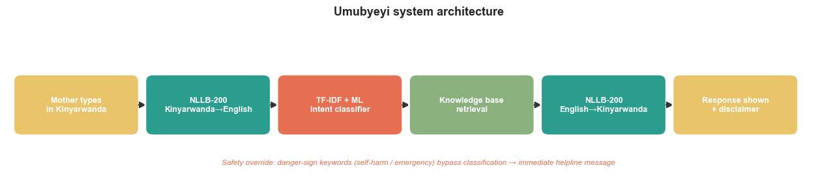
THE APPROACH (1/2)
The system pipeline
• Kinyarwanda in → NLLB-200 translates to English → TF-IDF + ML classifier assigns 1 of 6 intents → return that intent's response template → translate back → display the Kinyarwanda response with a disclaimer.
• Two safety gates: (1) confidence gate — low-confidence inputs fall back to general self-care; (2) danger-sign keywords bypass everything → Rwanda helpline escalation.
• Deployment MVP built: architecture diagram, web mockup, a Streamlit app and a FastAPI sketch (Swagger UI for testing).
Umubyeyi · Kinyarwanda Maternal Mental-Wellness Chatbot · R. Irutingabo (ALU)
7

Slide 8
THE APPROACH (2/2)
The model ladder: floor → embeddings → transformer
Three classifiers on the SAME labels and SAME 80/20 split — each adds exactly one idea and must beat the one below it.
1
TF-IDF + Logistic Regression (English)
FLOOR — simple, fast, interpretable; the currently deployed path.
Done · 0.61 acc / 0.60 F1
2
FastText cc.rw.300 + MLP (Kinyarwanda)
EMBEDDINGS — dense subword vectors capture meaning + Kinyarwanda morphology / out-of-vocabulary words.
Coded · pending 4.5 GB vectors
3
AfroXLMR fine-tune (Kinyarwanda)
CEILING — contextual transformer pretrained on Kinyarwanda; classifies directly, no translate-then-classify hop.
Coded · pending GPU run
Umubyeyi · Kinyarwanda Maternal Mental-Wellness Chatbot · R. Irutingabo (ALU)
8

Slide 9
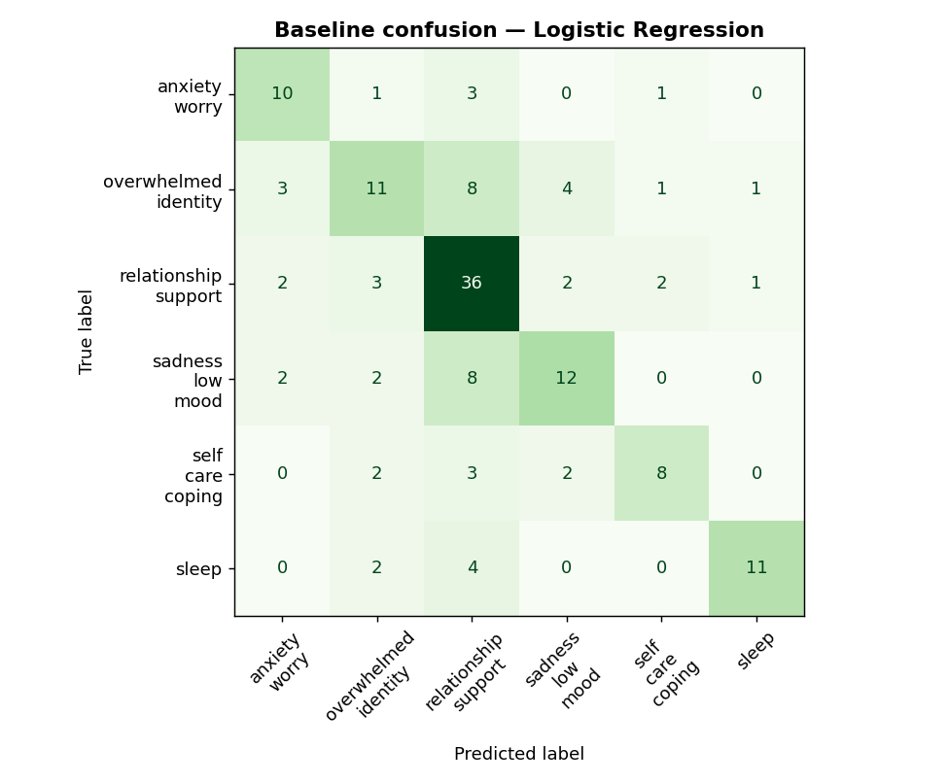
RESULTS
Baseline — the floor model (Model 1)
Floor model — established
Accuracy: 0.61
F1: 0.60
Precision: 0.63
Recall: 0.59
Reading the matrix
• Strong on relationship/support & sleep (clear cues).
• Confusion: overwhelmed ↔ relationship & sadness — overlapping language, the hard intents.
• F1 < accuracy → the minority intents are where the work is.
Honest INITIAL baseline. Models 2 & 3 (FastText, AfroXLMR) are coded and pending compute.
Umubyeyi · Kinyarwanda Maternal Mental-Wellness Chatbot · R. Irutingabo (ALU)
9
Confusion matrix — TF-IDF + Logistic Regression, 6 intents

Slide 10
RESULTS
The core scientific contribution
• Central research question: how much accuracy do we lose to translation?
• Method: classify the English test set directly vs. after an EN→Kinyarwanda→EN round-trip through NLLB-200 — the gap is the degradation coefficient.
• This would be the first published Kinyarwanda mental-wellness classification benchmark.
Live demo finding
Input (Kinyarwanda):
“umugabo wanjye ntamfasha” (my husband does NOT help me)
NLLB dropped the negation →
“my husband is helping me” — meaning inverted
Confidence fell to 0.31 → the safety gate caught it → safe fallback. Live proof of both the risk AND the mitigation.
Umubyeyi · Kinyarwanda Maternal Mental-Wellness Chatbot · R. Irutingabo (ALU)
10

Slide 11
DISCUSSION
Discussion
• Translation hallucination is the real risk — not classifier accuracy. Dropped negations can invert meaning.
• The two-gate design (calibrated confidence + danger-sign override) turns that risk into a controlled, safe fallback rather than a wrong answer.
• Open finding: the proposed fixed 0.40 confidence threshold abstains ~88% of the time — it needs empirical tuning, not assumption.
• “Strong ML” here = rigor + a genuinely novel measurement, not model size. Classical models are the right call for low-resource deployment.
Umubyeyi · Kinyarwanda Maternal Mental-Wellness Chatbot · R. Irutingabo (ALU)
11

Slide 12
CONCLUSIONS
Conclusions & Next Steps
Where we are
Next steps
• End-to-end Kinyarwanda pipeline works (NLLB + classifier + response templates + safety).
• Floor baseline established: 0.61 acc / 0.60 F1 (Model 1).
• Principled model ladder designed; embedding + transformer arms coded.
• Translation-risk demonstrated live, and contained by the safety gate.
• Measure the cross-lingual degradation coefficient.
• AfroXLMR fine-tune as a comparison arm.
• Future: build a true evidence-sourced retrieval KB (beyond the 6 templates).
• SUS usability study with 10 proxy users (target > 70).
Contribution: the first Kinyarwanda maternal mental-wellness classifier + a quantified benchmark of what translation costs.
Umubyeyi · Kinyarwanda Maternal Mental-Wellness Chatbot · R. Irutingabo (ALU)
12

Slide 13
Murakoze — Thank you
Questions & discussion
Raissa Irutingabo · github.com/IrutingaboRaissa/UMUBYEYI

