Slide 1

ICP presentation two
Group 4
Brahian ramon
Irvin jimenez
Alanzi, Ahmed,MS
University of Missouri-Kansas City
Kansas City, MO, USA.

Slide 2
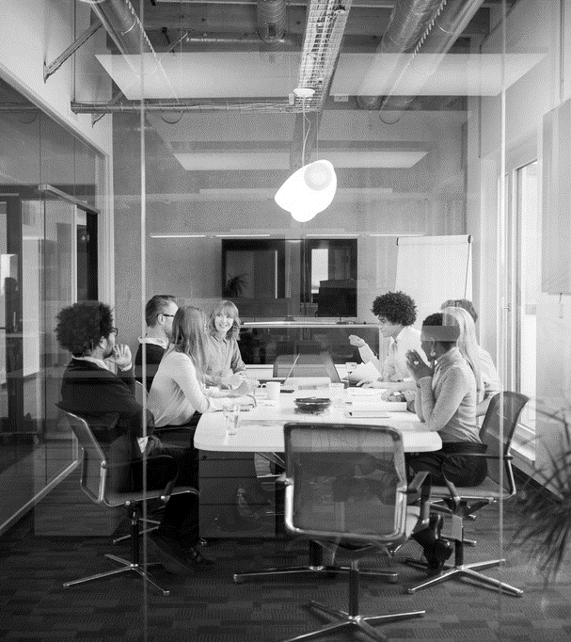
Agenda
Introduction
ICP9
ICP10
Conclusion

Slide 3
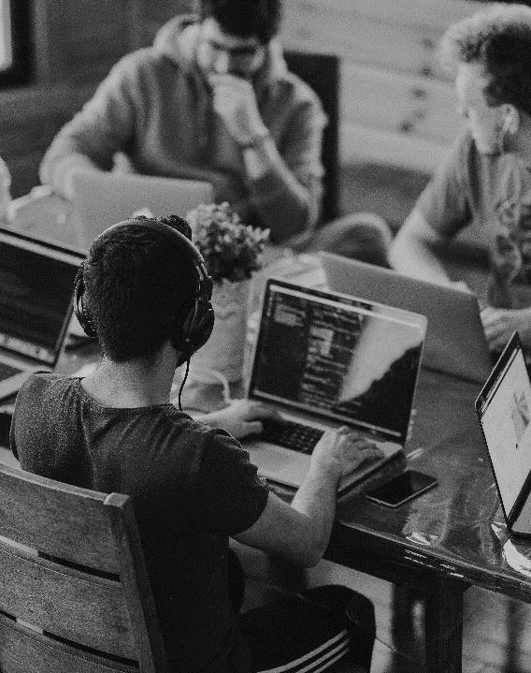
INTRODUCTION
Mobile development
In this ICP presentation we are going to cover two ICPs regarding the different mobile lessons, the purpose is to show our understanding of each lesson. Dominant topics in this presentation are the following : android studio, XML, Java, UI.
ICP9, ICP10 will be covered.

Slide 4
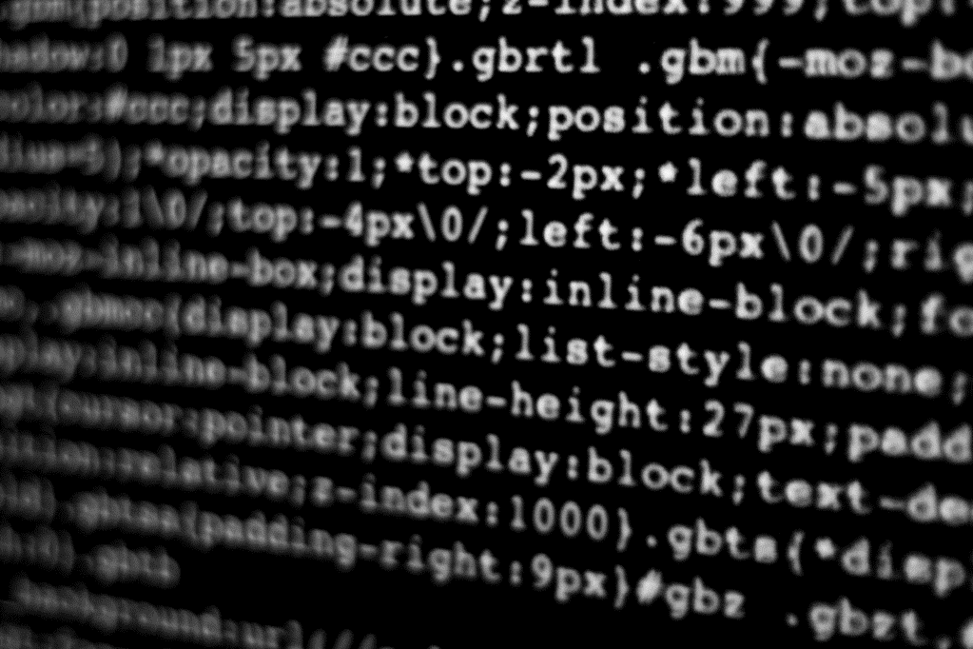
ICP9
Food application using android

Slide 5
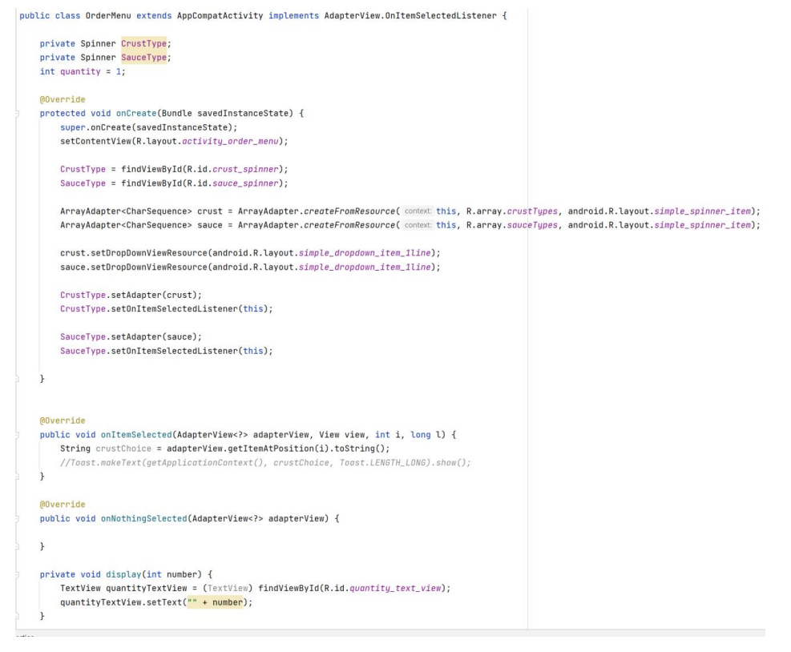
ICP9
JAVA

Slide 6
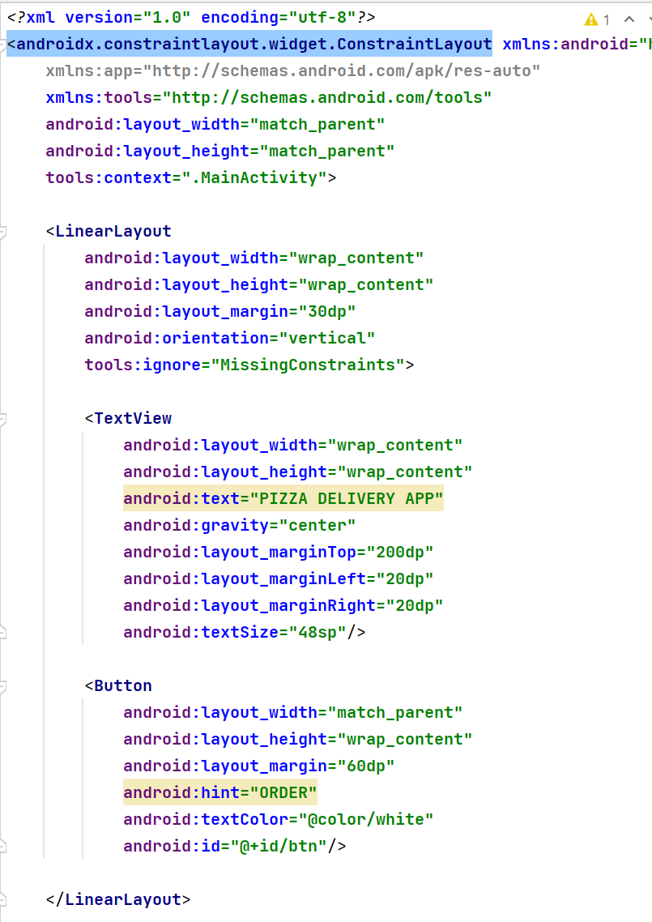
ICP9 cont’d
XML

Slide 7
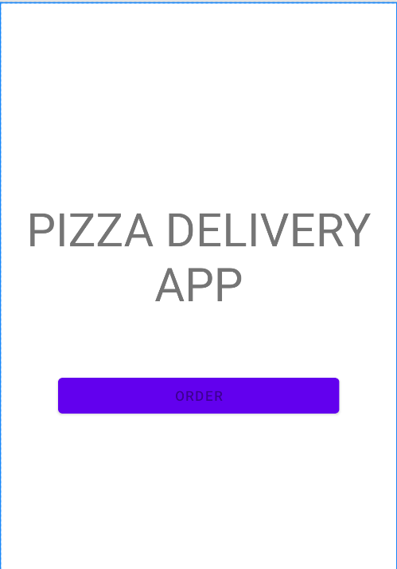
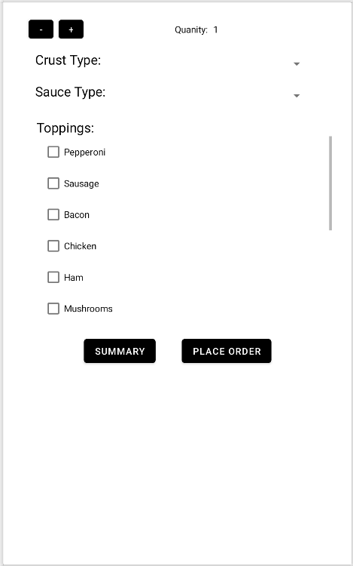
UI

Slide 8
ICP10
RESTful API

Slide 9
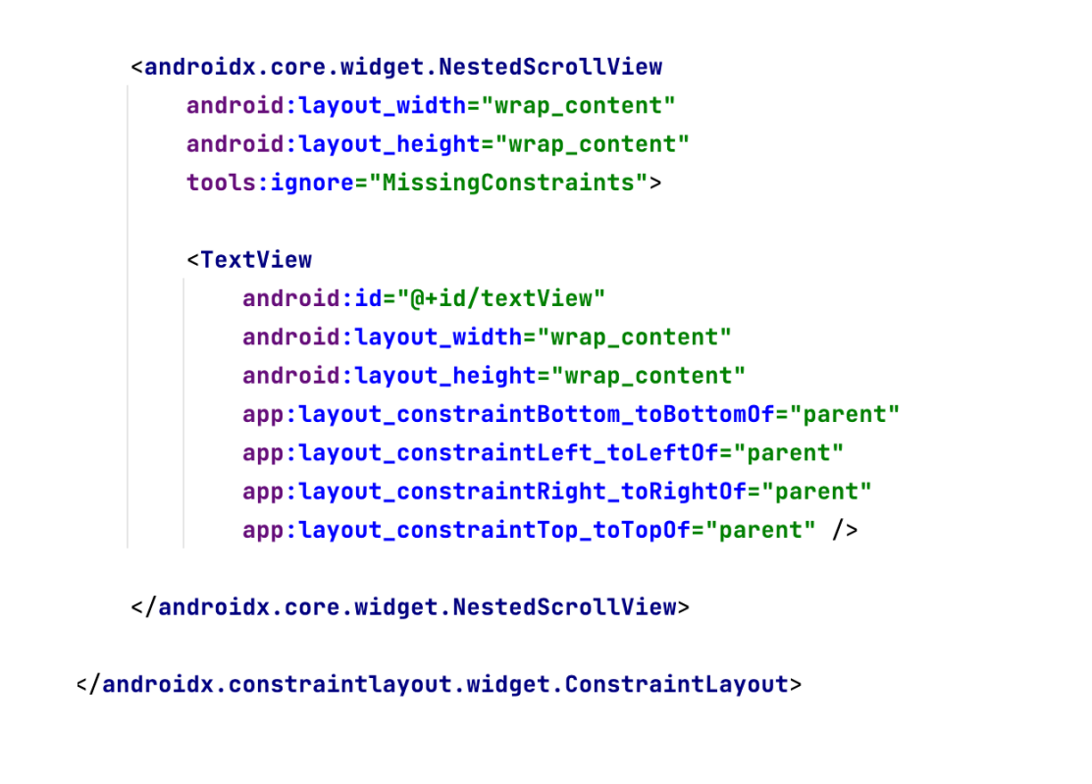
icp10
XML

Slide 10
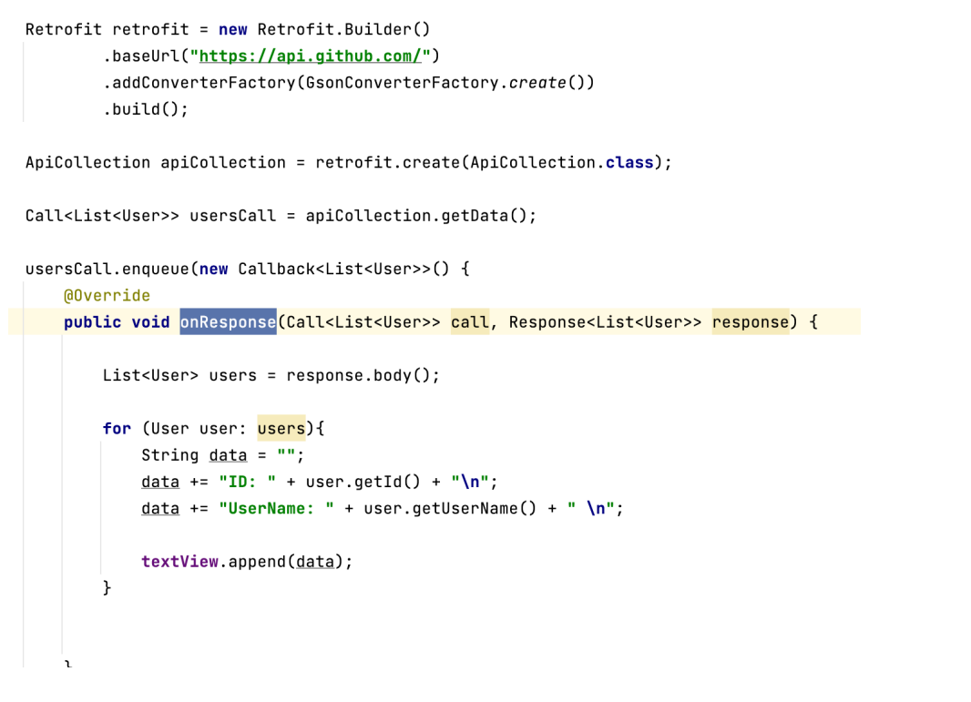
java

Slide 11
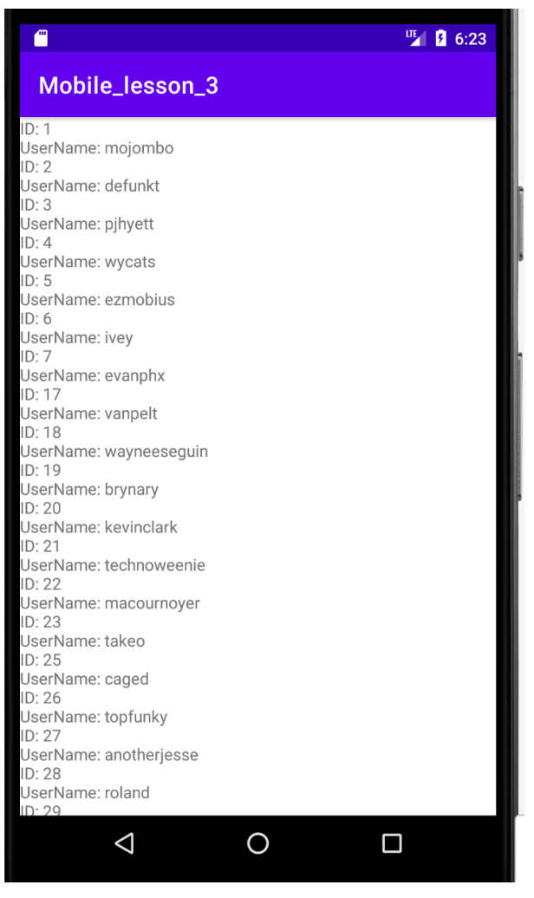
UI

Slide 12

Conclusion
In this ICP presentation we covered two ICPs, ICP9 and ICP10. We chose this ICPs based on our interest for each particular ICP, We found for ourselves that these two ICPs were really interesting and taught us some interesting skills. Furthermore, ICP9 required of us to build a food application with the topic of our preferences, and we decided for a pizza order application.
Also, in ICP10 we updated dependencies to include retrofit and convert-Json and created an interface to do our API call.

Slide 13

THANK YOU
Brahian Ramon & Irvin Jimenez
Web and Mobile development

