Slide 1
Pitch 2.54mm Model
Jun, 2019

Slide 2
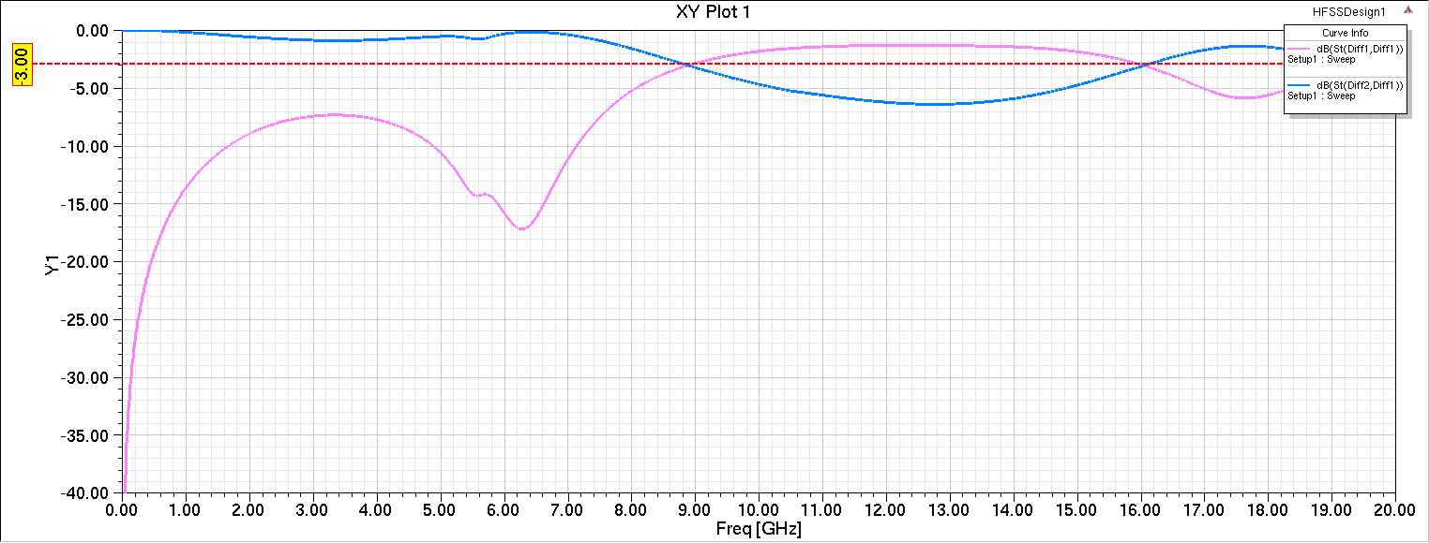
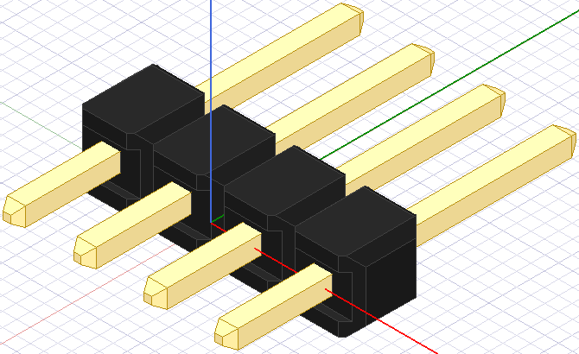
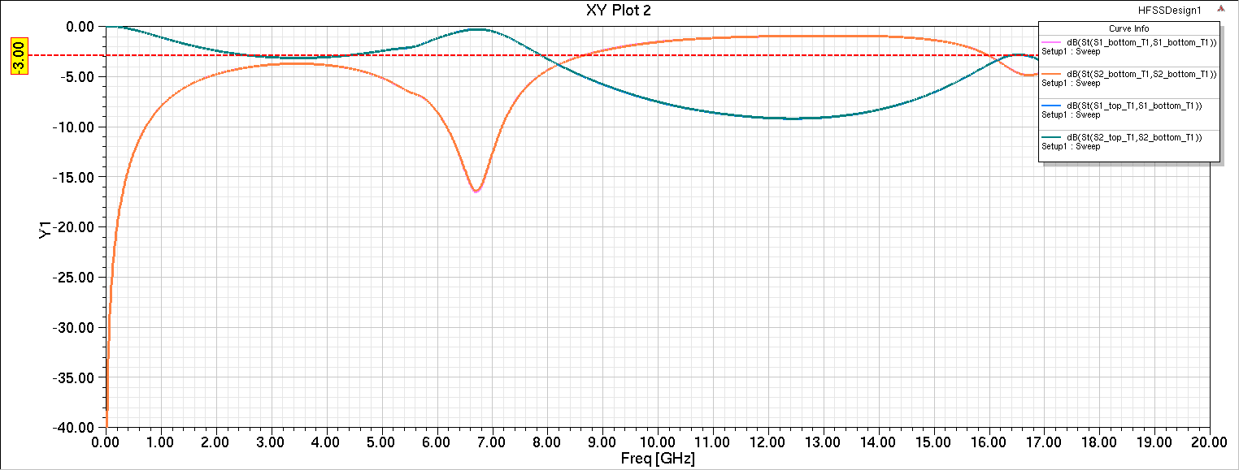

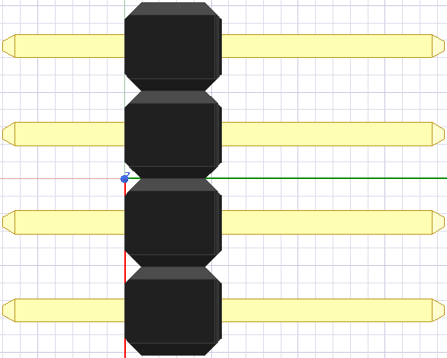
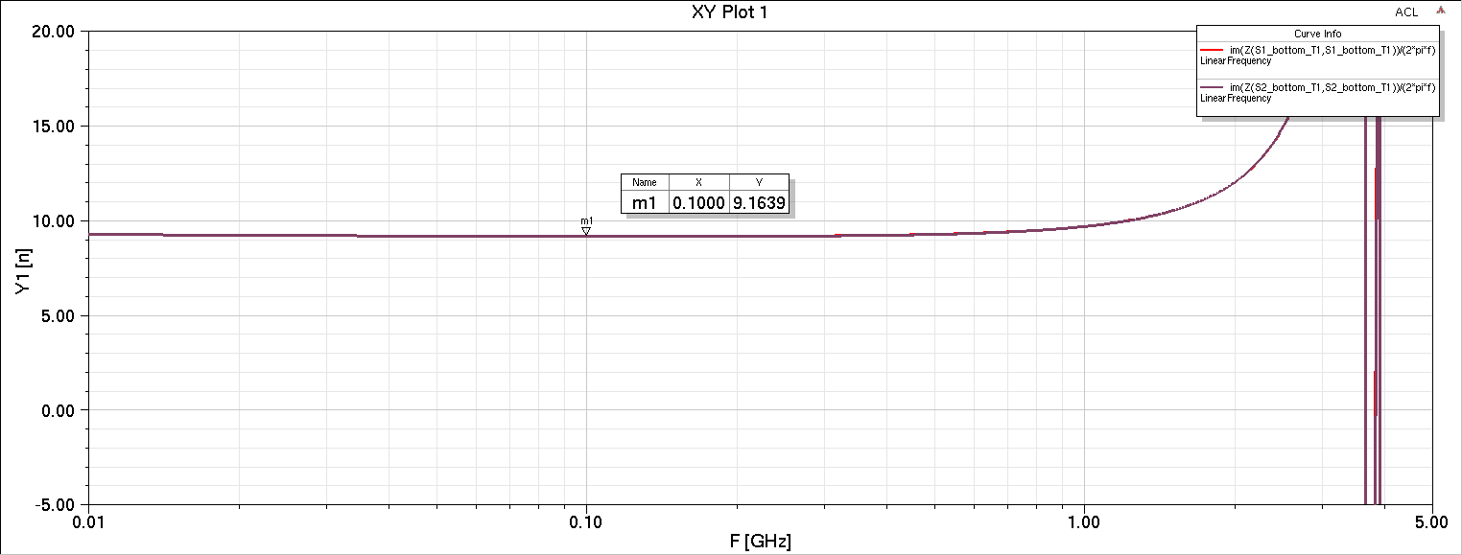
Pitch 2.54mm male
1x4
G
S1
top
S2
G
Sddxx
bottom
12mm
Sxx
3mm
6mm
9.2nH @100MHz
ACL
Note. 1mil~20pH

Slide 3
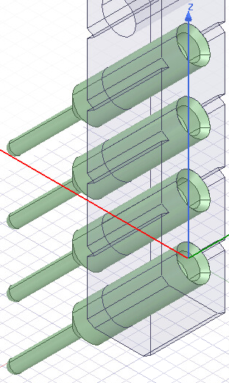
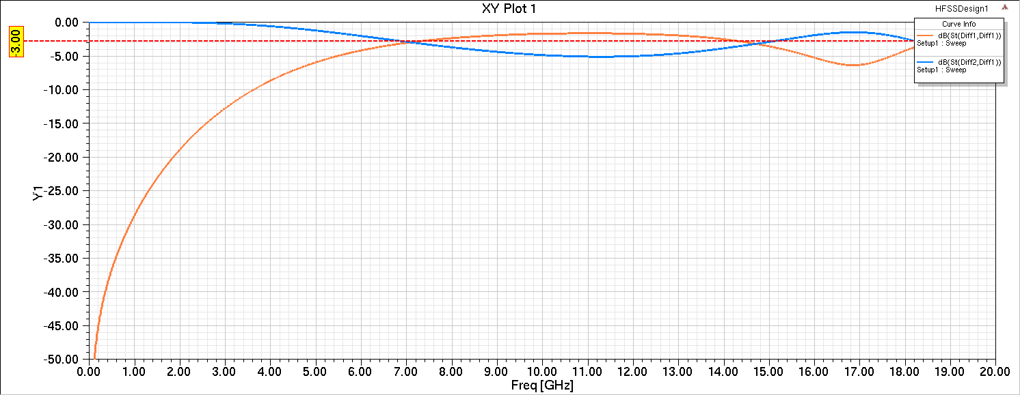
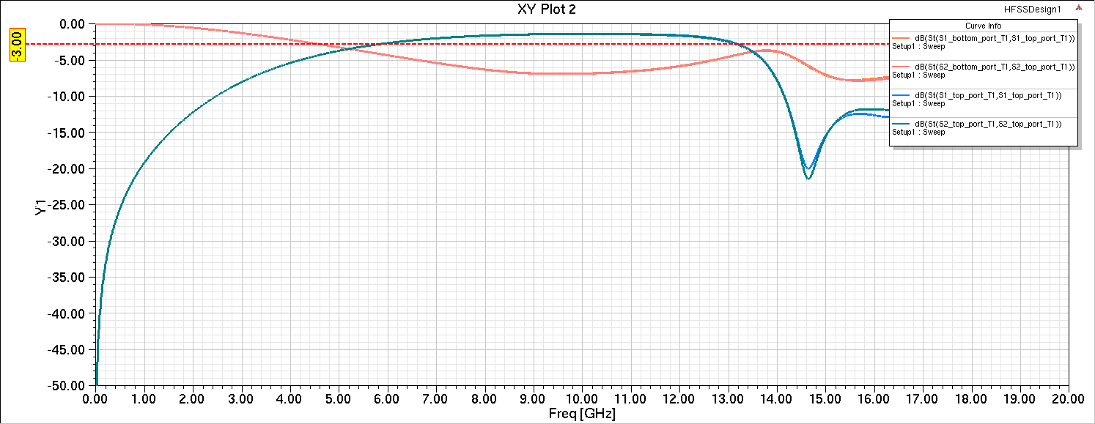

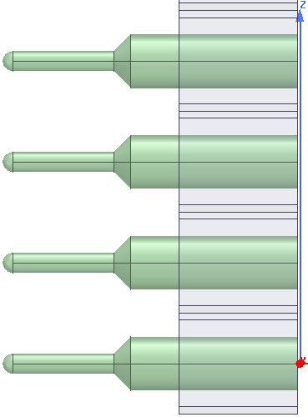
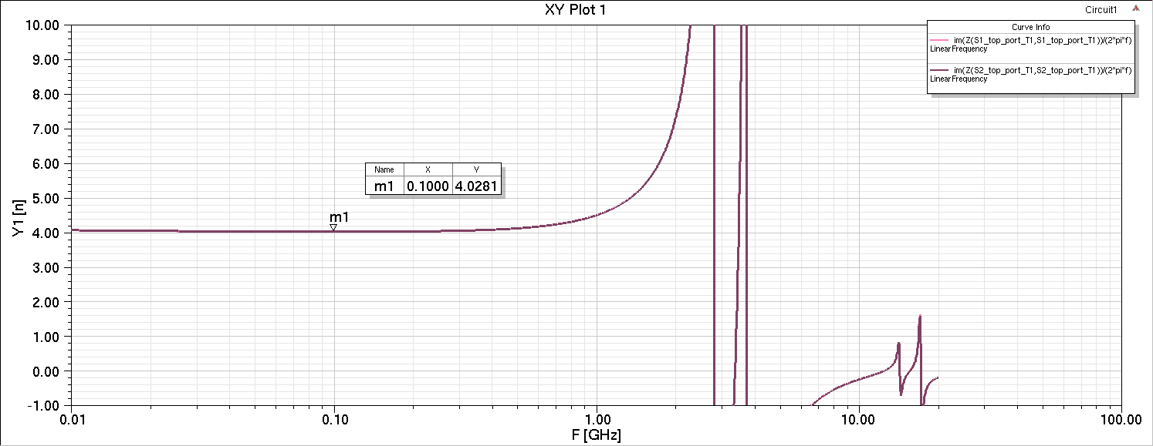
Pitch 2.54mm male
1x4
top
G
S2
S1
G
Sddxx
bottom
Sxx
4nH @100MHz
7.45mm
ACL

Slide 4

Drive for better vision

