Slide 1

Thermal CAE
Recipe
2017-09-18, 김동호

Slide 2
기초데이타

Slide 3
기초 데이타
Min Seok Ha, THERMAL ANALYSIS OF HIGH POWER LED ARRAYS, 2009
https://smartech.gatech.edu/bitstream/handle/1853/31803/ha_minseok_200912_mast.pdf
광원 | 형태 | 발광 능률 (Luminous efficacy) [lm/W] | 발광 효율 (Luminous efficiency) [%] | 일반적인 보증 수명 [Hours] | 백색광의 파워 변환 비율 [%]
백열등 (Incandescent) | 40W 텅스텐 백열등 (120V) | 12.6 | 1.9 | 750-2000 | 가시광선 8 IR 73 UV 0 발열 19
 | 100W 텅스텐 백열등 | 17.5 | 2.6
 | 석영 할로겐 (12-24V) | 24 | 3.5 | 3000-4000
형광등 (Fluorescent) | 9-16W 소형 형광등 | 57-72 | 8-11 | 8000-10000 | 가시광선 21 IR 37 UV 0 발열 42
 | T8 튜브 자석 밸러스트 | 80-100 | 12-15 | 20000-30000
HID (High-intensity discharge) | 메탈 할라이드 (Metal Halide) | 65-115 | 9.5-16.8 | 7500-20000 | 가시광선 27 IR 17 UV 19 발열 37
LED | 고출력 백색 LED | -115 | -16.8 | 35000-50000 | 가시광선 15-25 IR 0 UV 0 발열 75-85
LED는 발광효율과 수명이 가장 좋지만, 발열이 상당히 많다는 특징이 있다.
발열 문제를 해결하는 것이 핵심.
T_J가 높아지면, 광도가 저하되고 수명이 단축된다. 보통 보증 T_J는 130~185도씨로 설정되고, 이를 넘어서면 즉각 파괴된다.

Slide 4
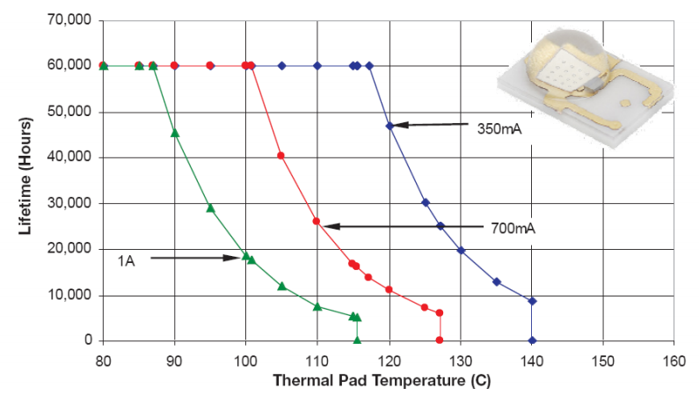
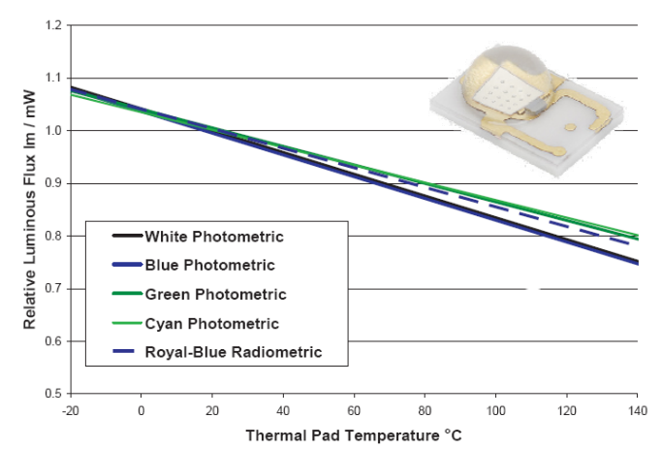
기초 데이타
T_J에 따른 기대수명의 단축 양상 사례
이 사례에서는 T_J를 85도씨 이하로 관리해야 함을 알 수 있다.
T_J에 따른 광도 저하의 양상 사례
이 사례에서는, 온도에 따라 광도가 선형적으로 저하되고 있으므로, 기대수명에서 설정한 T_J 관리온도 85도씨일 때의 광도를 보증 광도로 잡아야 할 것이다.

Slide 5
단순화모델

Slide 6
MCPCB
IMS
(Insulated Metal Substrate)
DBC
(Direct Bonded Copper)
Copper
Copper
Dielectric
Ceramic
Aluminium
Copper
Dielectric의 소재
FR4 : k=0.35 [W/mK]
Prepreg (Preimpregnated Material, 강화섬유)
Bergquist사 HT-04503 : k=2.2[W/mK], 76um
Ceramic 소재
AlN(Aluminium Nitride) : k = 180 [W/mK]
Alumina(Al2O3) : k = 35 [W/mK]
Beryllium Oxide(BeO) : 분말상태에서의 독성으로 인해 잘 사용되지 않음

Slide 7
Simplified Model of LED Thermal System
Uniform Heat Flux = 1 [W]
Z
Y
GaN, T=4 [um], k=130 [W/m^2K]
LED-chip
Au, T=10 [um], k=301 [W/m^2K]
Bonding Layer
LED Package
Size = 1x1 [mm]
Si, T=375 [um], k=127 [W/m^2K]
Die
Au-20Sn, T=50 [um], k=57 [W/m^2K]
Die-attach
Adiabatic
Copper, T=127 [um], k=385 [W/m^2K]
Copper
Prepreg, T= 75 [um], k=1.1 [W/m^2K]
Dielectric
Aluminium
IMS
Size=10x10 [mm]
Al, T=1000 [um], k=150 [W/m^2K]
Thermal Grease, T=50 [um], k=3 [W/m^2K]
TIM
HeatSink
Size=20x20x2 [mm]
Aluminium, T=? [um], k=150 [W/m^2K]
Uniform h
= 10 [W/m^2K]
Ref.
Natural Conv. = 2-25
Forced Conv.=25-250
18 [mm]
4 [mm]
1.5 [mm]
Ambient = 25C

Slide 8
Materials
<material name=“GaN (LED)" >
<parameter name="Density" >6100.0</parameter>
<parameter name="Youngs modulus" >1.8456863E10</parameter>
<parameter name="Poisson ratio" >0.352</parameter>
<parameter name="Tensile strength" >19374608</parameter>
<parameter name="Heat expansion coeff." >6.66e-06</parameter>
<parameter name="Heat capacity" >930.37</parameter>
<parameter name="Heat conductivity" >130</parameter>
</material>
<material name=“Prepreg, GlassFiber (MCPCB)" >
<parameter name="Density" >1850.0</parameter>
<parameter name="Youngs modulus" >2.5492905E+09</parameter>
<parameter name="Poisson ratio" >0.2</parameter>
<parameter name="Tensile strength" >4.4867513E+10</parameter>
<parameter name="Heat expansion coeff." >11.6e-6</parameter>
<parameter name="Heat capacity" >1000.0</parameter>
<parameter name="Heat conductivity" >1.1</parameter>
</material>
<material name=“Au, Gold (LED)" >
<parameter name="Density" >19300.0</parameter>
<parameter name="Youngs modulus" >7.9537865E+09</parameter>
<parameter name="Poisson ratio" >0.44</parameter>
<parameter name="Tensile strength" >8.0047723E+09</parameter>
<parameter name="Heat expansion coeff." >14.1e-6</parameter>
<parameter name="Heat capacity" >129.0</parameter>
<parameter name="Heat conductivity" >318.0</parameter>
</material>
<material name=“Thermal Grease (MCPCB)" >
<parameter name="Density" >1000.0</parameter>
<parameter name="Youngs modulus" >1000.0</parameter>
<parameter name="Poisson ratio" >0.3</parameter>
<parameter name="Tensile strength" >1.0e3</parameter>
<parameter name="Heat expansion coeff." >1.0e-6</parameter>
<parameter name="Heat capacity" >300.0</parameter>
<parameter name="Heat conductivity" >3.0</parameter>
</material>
<material name=“Si (LED)" >
<parameter name="Density" >2330.0</parameter>
<parameter name="Youngs modulus" >185.0e9</parameter>
<parameter name="Poisson ratio" >0.28</parameter>
<parameter name="Tensile strength" >7.1380135E+08</parameter>
<parameter name="Heat expansion coeff." >4.68e-6</parameter>
<parameter name="Heat capacity" >555.8</parameter>
<parameter name="Heat conductivity" >127.0</parameter>
</material>
Red Characters : Not proper values yet
<material name=“Au-20Sn (LED)" >
<parameter name="Density" >14510.0</parameter>
<parameter name="Youngs modulus" >6.9340702E+09</parameter>
<parameter name="Poisson ratio" >0.136</parameter>
<parameter name="Tensile strength" >28042196</parameter>
<parameter name="Heat expansion coeff." >16.1e-6</parameter>
<parameter name="Heat capacity" >388.0</parameter>
<parameter name="Heat conductivity" >57.0</parameter>
</material>

Slide 9
테스트해석

Slide 10
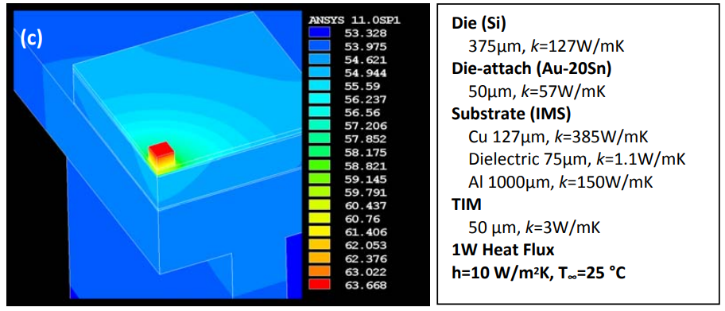
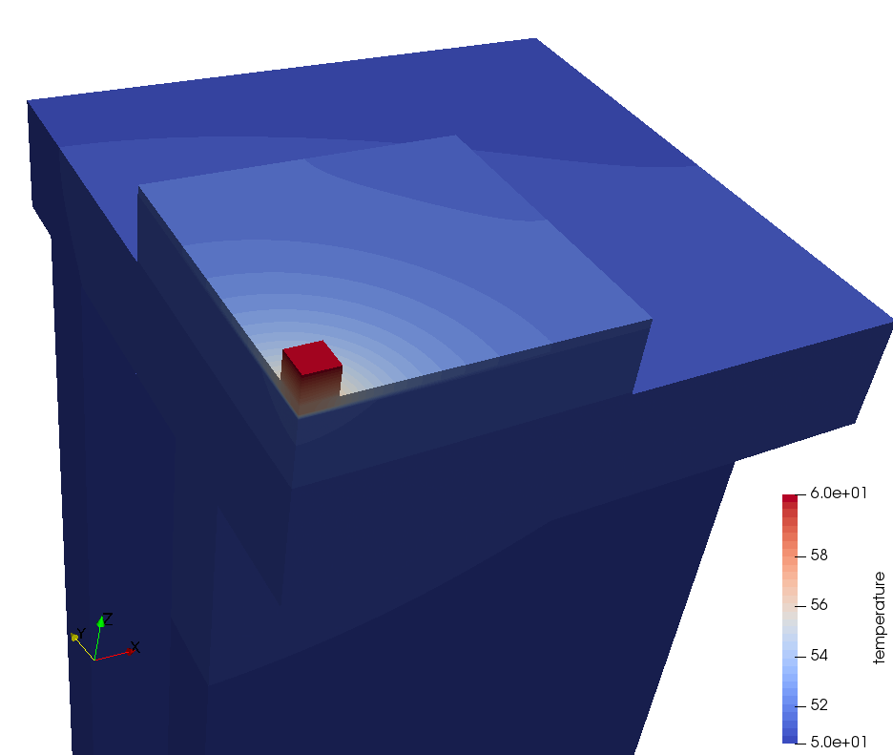
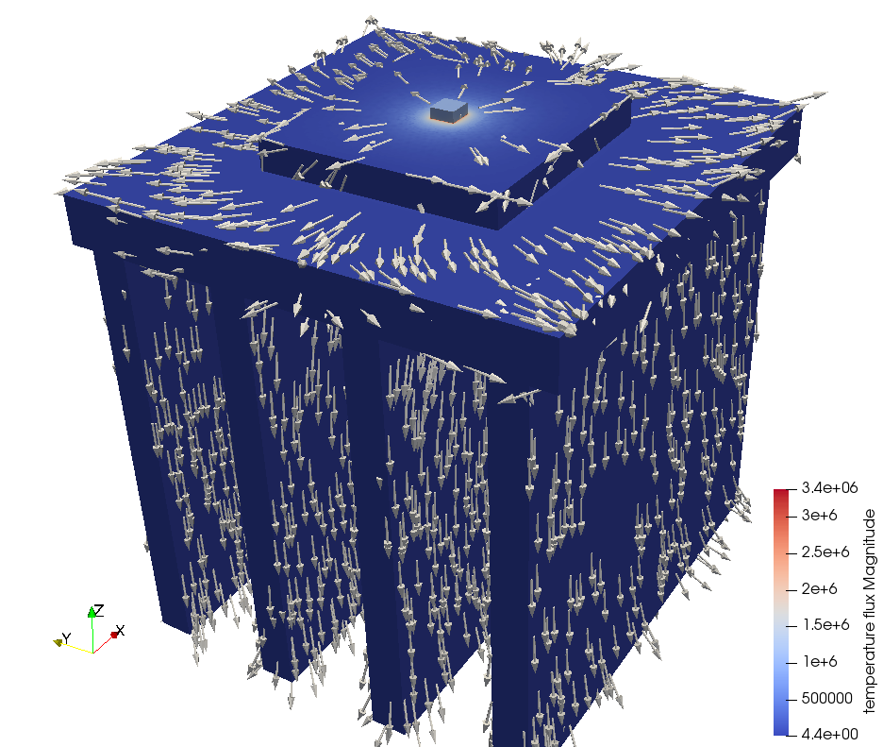
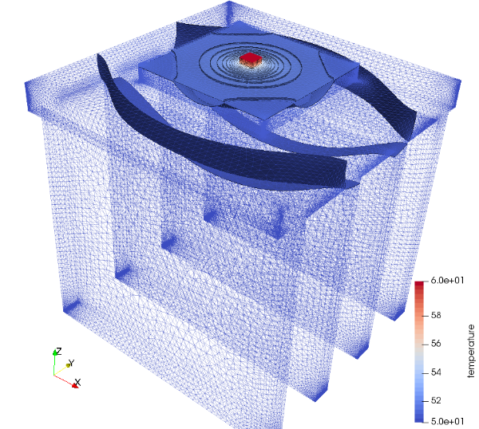
원래 논문과의 결과 비교
Elmer 해석 결과
원래 논문의 결과
원래 논문과 Elmer 해석 결과는 3C 가량의 차이가 나는 것을 확인하였다. 오차의 원인은, 일부 물성치가 다르게 들어갔거나 매쉬 분할 상태의 차이가 있을 수 있고, 사용된 해석자의 차이도 생각해 볼 수 있다.
물성치의 차이는, 원래 논문에 모든 물성치가 공개되어 있지는 않기 때문에 보정하기가 어렵다.
대신 온도 분포의 형태는 거의 동일하게 나타난다.
 | 원래 논문 | Elmer | 오차
최고온도 | 63.688 | 60.437 | 3.251
최저온도 | 53.328 | 50.4997 | 2.8283
Temperature Flux
Temperature Contour

Slide 11
단순화모델 2

Slide 12
Simplified Model 2 of LED Thermal System
Uniform Heat Flux = 1 [W]
Z
Y
GaN, T=150 [um], k=130 [W/m^2K], size=3x0.5x0.5[mm]
LED-chip
Die
LED Package
Si, T=400 [um], k=127 [W/m^2K], size=5x5[mm]
Adiabatic
Copper, T=127 [um], k=385 [W/m^2K]
Copper
Prepreg, T= 75 [um], k=1.1 [W/m^2K]
Dielectric
Aluminium
IMS
Size=10x10 [mm]
Al, T=1000 [um], k=150 [W/m^2K]
Thermal Grease, T=50 [um], k=3 [W/m^2K]
TIM
HeatSink
Size=20x20x2 [mm]
Aluminium, T=? [um], k=150 [W/m^2K]
Uniform h
= 10 [W/m^2K]
Ref.
Natural Conv. = 2-25
Forced Conv.=25-250
18 [mm]
4 [mm]
1.5 [mm]
Ambient = 25C

Slide 13
SIF
Header
CHECK KEYWORDS Warn
Mesh DB "." "."
Include Path ""
Results Directory "case01"
End
Simulation
Max Output Level = 5
Coordinate System = Cartesian
Coordinate Mapping(3) = 1 2 3
Simulation Type = Steady state
Steady State Max Iterations = 1
Output Intervals = 1
Timestepping Method = BDF
BDF Order = 1
Solver Input File = case01.sif
Post File = case01.vtu
End
Constants
Gravity(4) = 0 -1 0 9.82
Stefan Boltzmann = 5.67e-08
Permittivity of Vacuum = 8.8542e-12
Boltzmann Constant = 1.3807e-23
Unit Charge = 1.602e-19
End
Body 1
Target Bodies(1) = 1
Name = "LED1"
Equation = 1
Material = 1
End
Body 2
Target Bodies(1) = 2
Name = "HEATSINK"
Equation = 1
Material = 5
End
Body 3
Target Bodies(1) = 3
Name = "TIM"
Equation = 1
Material = 4
End
Body 4
Target Bodies(1) = 4
Name = "ALUMINIUM"
Equation = 1
Material = 5
End
Body 5
Target Bodies(1) = 5
Name = "DIELECTRIC"
Equation = 1
Material = 3
End
Body 6
Target Bodies(1) = 6
Name = "COPPER"
Equation = 1
Material = 6
End
Body 7
Target Bodies(1) = 7
Name = "SLUG"
Equation = 1
Material = 2
End
Body 8
Target Bodies(1) = 8
Name = "LED2"
Equation = 1
Material = 1
End
Body 9
Target Bodies(1) = 9
Name = "LED3"
Equation = 1
End
Solver 1
Equation = Heat Equation
Procedure = "HeatSolve" "HeatSolver"
Variable = Temperature
Exec Solver = Always
Stabilize = True
Bubbles = False
Lumped Mass Matrix = False
Optimize Bandwidth = True
Steady State Convergence Tolerance = 1.0e-5
Nonlinear System Convergence Tolerance = 1.0e-7
Nonlinear System Max Iterations = 20
Nonlinear System Newton After Iterations = 3
Nonlinear System Newton After Tolerance = 1.0e-3
Nonlinear System Relaxation Factor = 1
Linear System Solver = Iterative
Linear System Iterative Method = BiCGStab
Linear System Max Iterations = 500
Linear System Convergence Tolerance = 1.0e-10
BiCGstabl polynomial degree = 2
Linear System Preconditioning = Diagonal
Linear System ILUT Tolerance = 1.0e-3
Linear System Abort Not Converged = False
Linear System Residual Output = 1
Linear System Precondition Recompute = 1
End
Solver 2
Equation = Flux and Gradient
Calculate Flux = True
Flux Coefficient = "Heat Conductivity"
Calculate Grad = True
Target Variable = Temperature
Procedure = "FluxSolver" "FluxSolver"
Exec Solver = After Simulation
Stabilize = True
Bubbles = False
Lumped Mass Matrix = False
Optimize Bandwidth = True
Steady State Convergence Tolerance = 1.0e-5
Nonlinear System Convergence Tolerance = 1.0e-7
Nonlinear System Max Iterations = 20
Nonlinear System Newton After Iterations = 3
Nonlinear System Newton After Tolerance = 1.0e-3
Nonlinear System Relaxation Factor = 1
Linear System Solver = Iterative
Linear System Iterative Method = BiCGStab
Linear System Max Iterations = 500
Linear System Convergence Tolerance = 1.0e-10
BiCGstabl polynomial degree = 2
Linear System Preconditioning = Diagonal
Linear System ILUT Tolerance = 1.0e-3
Linear System Abort Not Converged = False
Linear System Residual Output = 1
Linear System Precondition Recompute = 1
End
Equation 1
Name = "Equation 1"
Active Solvers(2) = 1 2
End
Material 1
Name = "(LED) GaN"
Youngs modulus = 1.8456863E10
Heat Conductivity = 130
Poisson ratio = 0.352
Youngs modulus = 1.8456863E10
Heat Capacity = 930.37
Youngs modulus = 1.8456863E10
Poisson ratio = 0.352
Heat expansion Coefficient = 6.66e-06
Poisson ratio = 0.352
Porosity Model = Always saturated
Mesh Poisson ratio = 0.352
Density = 6100.0
End
Material 2
Name = "(LED) Si"
Youngs modulus = 185.0e9
Heat Conductivity = 127.0
Poisson ratio = 0.28
Youngs modulus = 185.0e9
Heat Capacity = 555.8
Youngs modulus = 185.0e9
Poisson ratio = 0.28
Heat expansion Coefficient = 4.68e-6
Poisson ratio = 0.28
Porosity Model = Always saturated
Mesh Poisson ratio = 0.28
Density = 2330.0
End
Material 3
Name = "(MCPCB) Prepreg, GlassFiber"
Youngs modulus = 2.5492905E+09
Heat Conductivity = 1.1
Poisson ratio = 0.2
Youngs modulus = 2.5492905E+09
Heat Capacity = 1000.0
Youngs modulus = 2.5492905E+09
Poisson ratio = 0.2
Heat expansion Coefficient = 11.6e-6
Poisson ratio = 0.2
Porosity Model = Always saturated
Mesh Poisson ratio = 0.2
Density = 1850.0
End
Material 4
Name = "(MCPCB) Thermal Grease"
Youngs modulus = 1000.0
Heat Conductivity = 3.0
Poisson ratio = 0.3
Youngs modulus = 1000.0
Heat Capacity = 300.0
Youngs modulus = 1000.0
Poisson ratio = 0.3
Heat expansion Coefficient = 1.0e-6
Poisson ratio = 0.3
Porosity Model = Always saturated
Mesh Poisson ratio = 0.3
Density = 1000.0
End
Material 5
Name = "Aluminium (generic)"
Electric Conductivity = 37.73e6
Relative Permeability = 1.000022
Youngs modulus = 70.0e9
Heat Conductivity = 237.0
Electric Conductivity = 37.73e6
Electric Conductivity = 37.73e6
Poisson ratio = 0.35
Youngs modulus = 70.0e9
Heat Capacity = 897.0
Youngs modulus = 70.0e9
Relative Permeability = 1.000022
Sound speed = 5000.0
Poisson ratio = 0.35
Heat expansion Coefficient = 23.1e-6
Poisson ratio = 0.35
Porosity Model = Always saturated
Mesh Poisson ratio = 0.35
Electric Conductivity = 37.73e6
Density = 2700.0
Relative Permeability = 1.000022
End
Material 6
Name = "Copper (generic)"
Electric Conductivity = 59.59e6
Relative Permeability = 0.999994
Youngs modulus = 115.0e9
Heat Conductivity = 401.0
Electric Conductivity = 59.59e6
Electric Conductivity = 59.59e6
Poisson ratio = 0.34
Youngs modulus = 115.0e9
Heat Capacity = 385.0
Youngs modulus = 115.0e9
Relative Permeability = 0.999994
Sound speed = 3810.0
Poisson ratio = 0.34
Heat expansion Coefficient = 16.5e-6
Poisson ratio = 0.34
Porosity Model = Always saturated
Mesh Poisson ratio = 0.34
Electric Conductivity = 59.59e6
Density = 8960.0
Relative Permeability = 0.999994
End
Boundary Condition 1
Target Boundaries(3) = 34 35 27
Name = "HeatSource"
Heat Flux = $(1.0/(3.0*0.0005*0.0005)) ! [W/m^3]
End
Boundary Condition 2
Target Boundaries(1) = 28
Name = "HeatSink"
Heat Transfer Coefficient = 10
External Temperature = 25
End

Slide 14
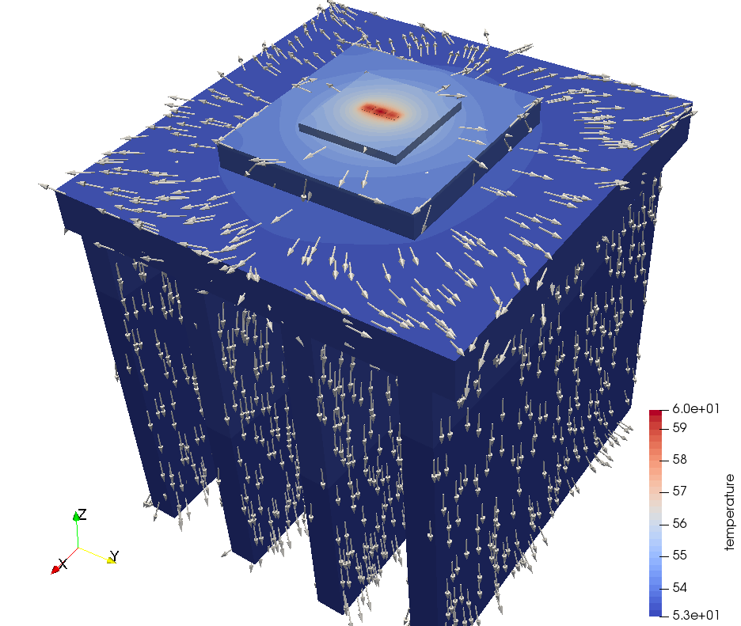
결과
앞선 결과와 큰 차이가 나지 않는다.

Slide 15
fin

