Slide 1


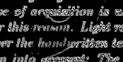
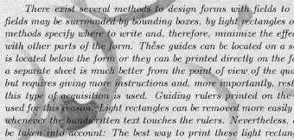
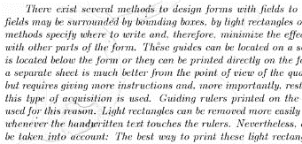
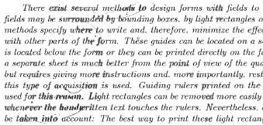
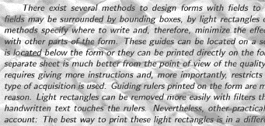
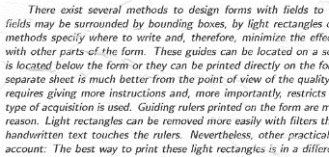
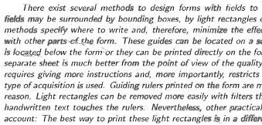
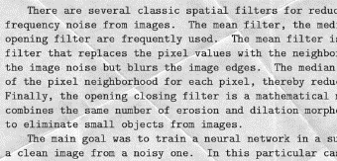
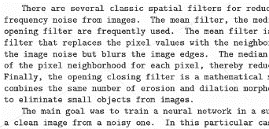
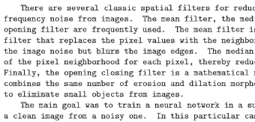
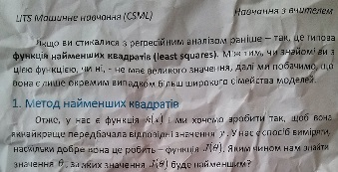
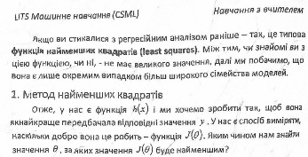
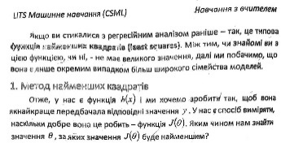
Denoising dirty documents
Iryna Maksymenko, maksymenko.i.o@gmail.com
Idea:
To clean scanned text documents from the noise of any kind. Given images contain various styles of text, to which synthetic noise has been added to simulate real-world, messy artifacts: coffee stains, faded sun spots, dog-eared pages, wrinkles etc.
Specifics:
Noise can be of different type and distributed in different way. The system should be able to automatically remove any noise without human interaction.
Goal
To create an algorithm to automatically clean the images and make text more readable.
Approach
1. Use clustering to distinguish between text, background and noise. Then, process clusters to achieve the goal.
2. Use neural network to ‘predict’ clean image having a dirty one.
Baseline
Manual image filtering using existing image processing tools.
Challenges
Feature selection for clustering
Speed of neural network prediction
Results
The system is able to clean images without manual interaction
The system performs good on real data
Remaining Work
Better feature selection for clusterization
Speed up neural network usage
Apply stack of denoising auto encoders
Neural Network
Clustering
Description:
Features: intensity of a pixel, mean value, standard deviation, variance among neighbours.
Learning algorithm: backpropagation
Activation function: sigmoid
Data:
Training set: 50 image examples
Description:
Image is split into pixels.
Each pixel has several characteristics: own intensity,
mean value, standard deviation, variance among neighbours.
Pixels are grouped into clusters.
Cluster that correspond to background is detected.
Different clusters are processed separately to
achieve best result.
“walls” part
of weights
“sand” part
of weights
“food” part
of weights
“predator” part of weights
Real data
Real data
Practical Value
Both approaches could be useful for scanned documents quality improvement.
Additionally, clustering technique can be applied to mixed text-image documents for text areas detection.

