Slide 1
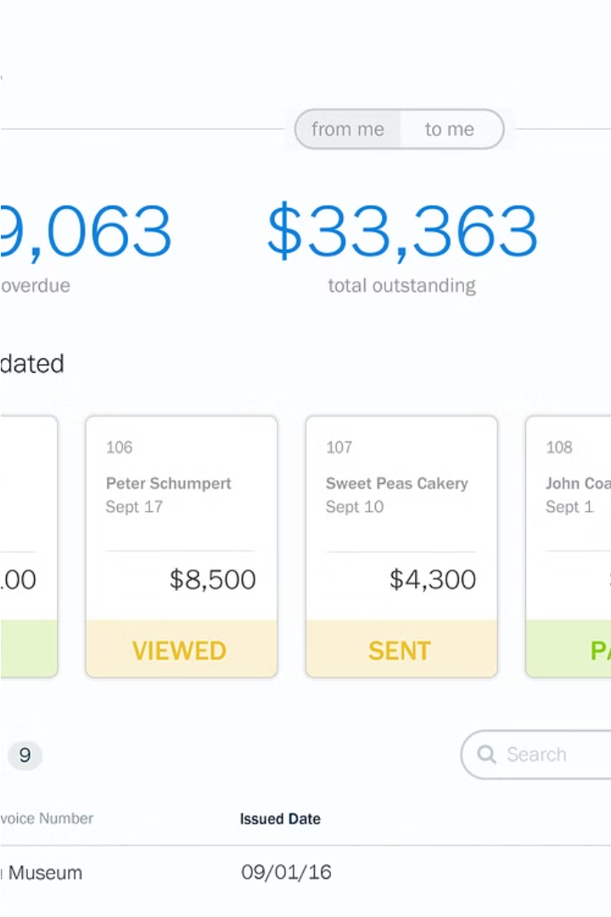

Project Billing and Inventory Management System
A comprehensive software system to streamline billing, track inventory, and manage customer and dealer relationships for businesses.
Muhammad Irteza 15727 Muhammad Hussain 15349

Slide 2
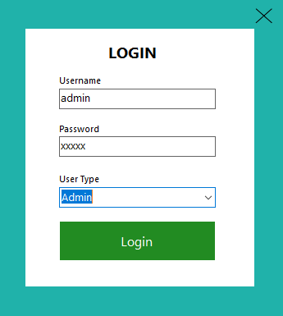
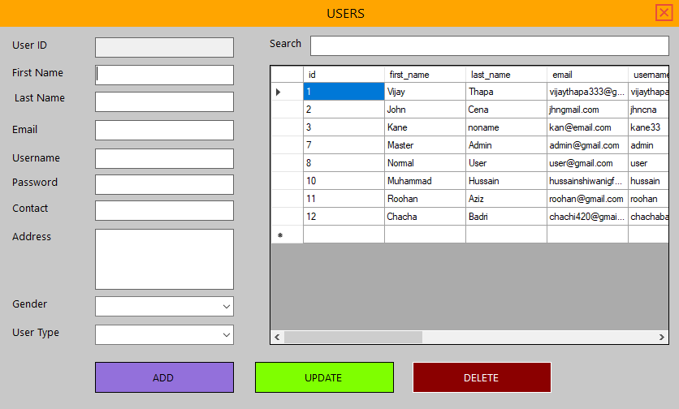
Login & User Management
1
User Registration
Allow customers, dealers, and admins to easily register and create user accounts with a secure and intuitive interface.

Slide 3
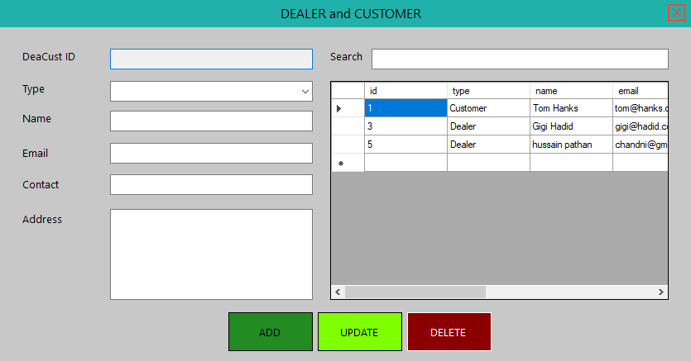
2
Customer and Dealer Management
Maintain detailed records of customers and dealers, including type, name, contact details, address, and creation details.

Slide 4
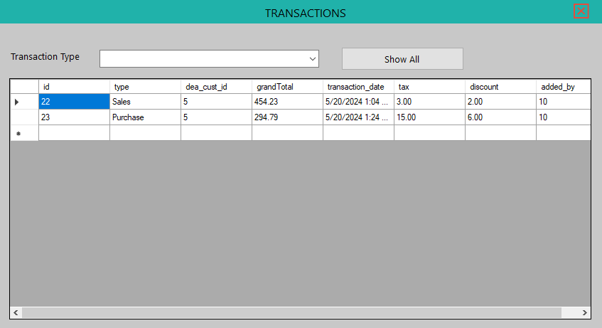
3
Transaction Management
Record transaction details such as transaction type, customer/dealer ID, total amount, transaction date, tax, discount, and user who added the transaction.

Slide 5
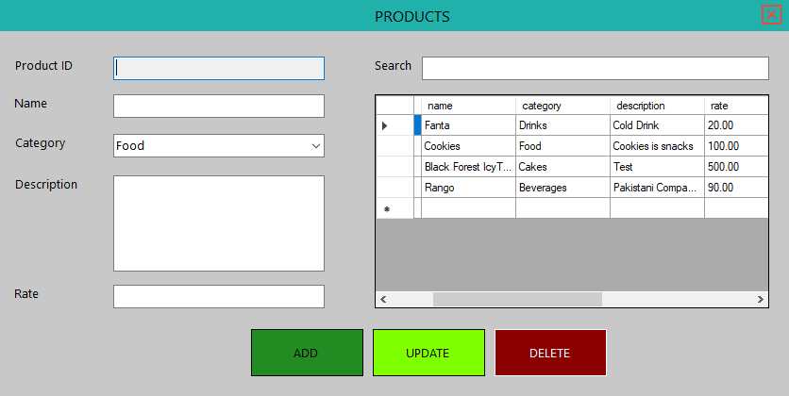
4
Product Management
Maintain a comprehensive list of products with attributes like name, category, description, rate, quantity, and creation details.

Slide 6
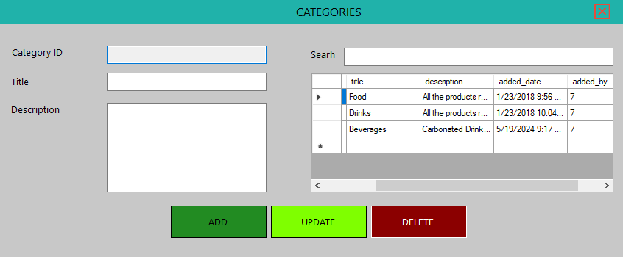
5
Category Management
Organize products into categories with titles, descriptions, and creation details.

Slide 7
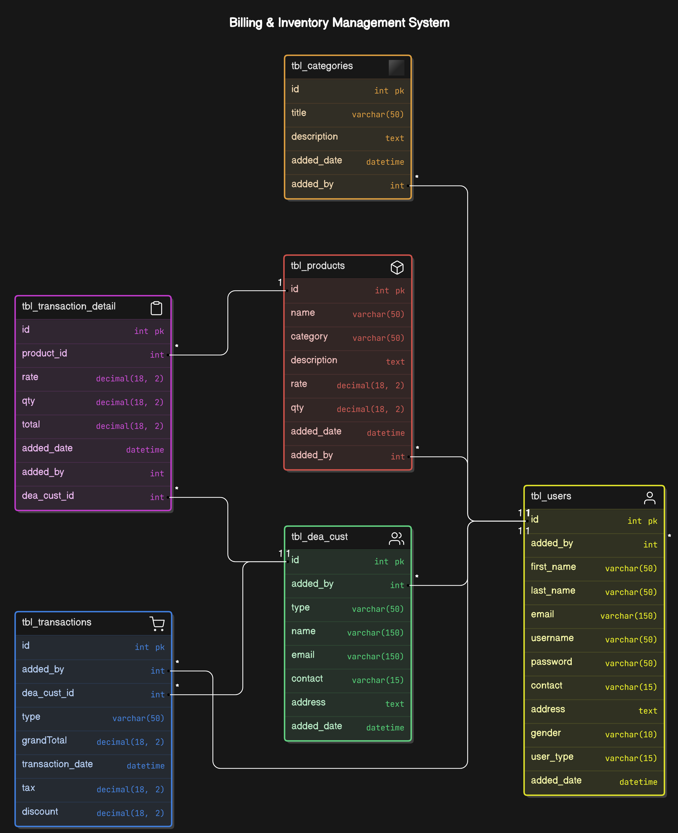
Entity Relationship Diagram (Physical)
The physical entity relationship diagram (ERD) provides a detailed visual representation of the database schema for the project billing and inventory management system. It shows the tables, their relationships, and the data fields within each table.
The ERD helps the development team understand the database structure and how the various components of the system interact with each other, enabling efficient data management and optimization of database performance.

Slide 8
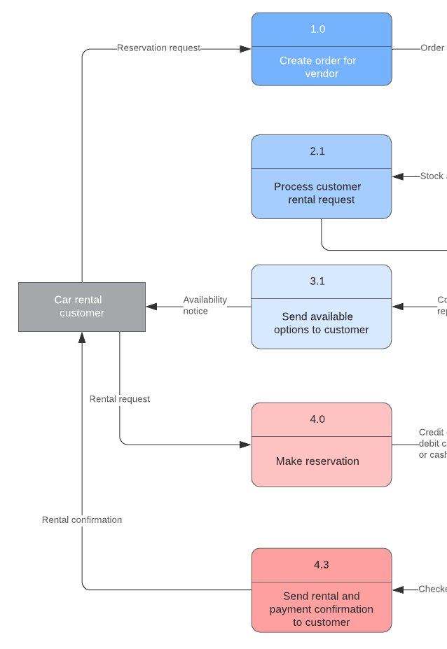
Database Design
The database design for the Project Billing and Inventory Management System is crucial for efficient data storage and retrieval. It involves creating an Entity Relationship Diagram (ERD) to model the relationships between the various entities, such as users, customers, transactions, products, and categories.
The database will be optimized for performance, scalability, and security, ensuring the system can handle the growing needs of the business while maintaining data integrity and protection.

