Slide 1
Data Project: HFTO Association Graph
Isaac Xu: BSc Petroleum Engineering (Austin, TX)
December 18th, 2025

Slide 2
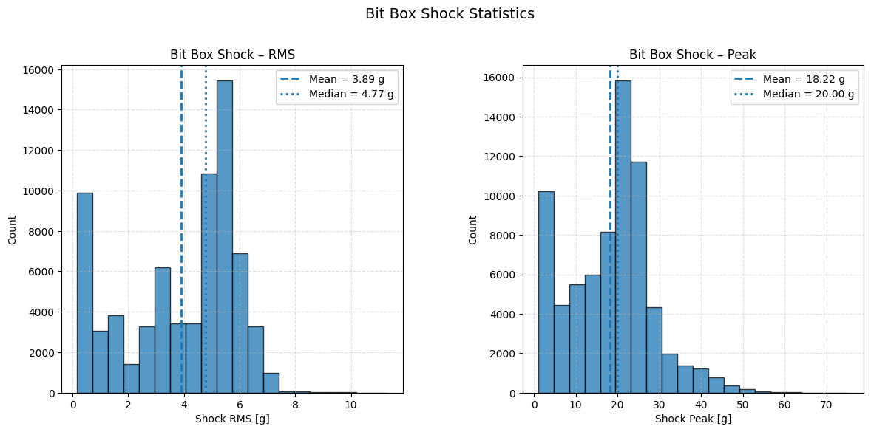
HFTO Definition
Bit_BoxShYrms > 5g, this was decided based on the distribution
Bit_BoxShYrms used for this project as opposed to Bit_BoxShYpeak, vibration graphs for Yifan used peak but the graphs have the same distribution for each drilling condition
Establish this as HFTO_bool and HFTO_onset is when HFTO_bool is true when the previous row is false

Slide 3

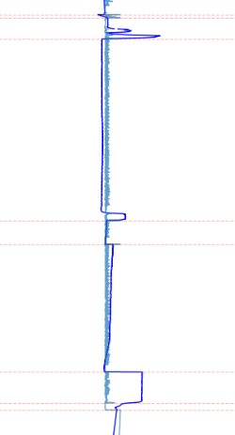
Changepoint Detection
Used Z-score to determine significant change, rolling window of 100, z-threshold of 4 with a cooldown of 200 seconds
This was done for both Augmented RPM (mud flow in multiplied with mud motor’s rotations per gallon) and WOB and collapsed into a single flag

Slide 4
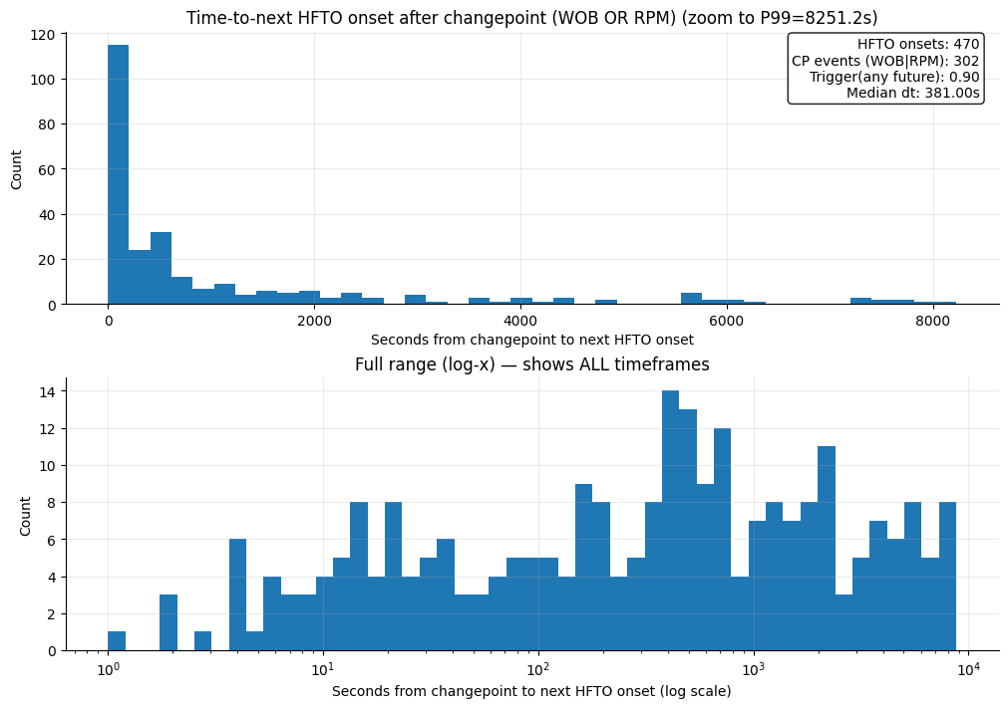
Changepoint to HFTO Onset Time
We see that a lot of HFTO onsets occur within 206 seconds of changepoint occurrences or the leftmost bar
Around 115 onsets occur within this time frame

Slide 5
Future Work
Distinguish between if HFTO occurs after WOB or RPM changepoint, instead of collapsing into single flag make stacked bar chart with both
Could be an association because bit goes from off-bottom to on-bottom, causing a changepoint. If HFTO’s are prevalent in this dataset and occur while drilling at any drilling condition, the cause isn’t the changepoint rather that the bit simply started drilling. Make a graph for start drilling to next HFTO onset
Also might want to reconsider the definition of HFTO, maybe it needs to be consistently above 5g’s for an extended amount of time – depends on industry use case.

Slide 6
Computational Engineering Certificate
Scientific Computing Project
Project supervisor must be a member of the Oden Institute Affiliated Faculty. Review the current list of faculty who are interested in supervising a project: CSE Project Supervisors. The list includes the faculty member's home department and their research areas and potential project topics.
Project is typically completed during the senior year, taken as a Research Methods/Individual Instruction class. The project course may include mentoring by post-doctoral fellows and CSEM graduate students as part of a vertical instruction research team.
SCP Approval Form must be submitted to get credit for the Scientific Computing Project. Enrollment in CSE 370 is restricted until the approval form has been received.

