Slide 1


International Minimum Industry Safety Training (IMIST)
YOU ARE WELCOME!
Sozoilfield Training Institute
www.sozoilfield.com

Slide 2
Aims and Objectives
The aim of the IMIST programme is to introduce delegates to the key safety elements required by all employees working in the oil and gas industry.
•It also ensures the knowledge and understanding of these basic safety elements are maintained and current amongst the existing workforce.

Slide 3
Course Contents
The Learning Outcomes for these Modules which each delegate must demonstrate are as follows:
Module1: Introduction to the Hazardous Environment
Module2: Working Safely including Safety Observations Systems
Module3: Understanding the Risk Assessment Process
Module4: Tasks that Require a Permit to Work
Module5: Personal Responsibility in Maintaining Asset Integrity
Notes:
Examples of Hazards include: moving machine parts, wet floor, dust, moving vehicle, etc.

Slide 4
Module 6: Using Manual Handling Techniques Every Day
Module 7: Controlling the Use of Hazardous Substances
Module 8: Knowledge and Processes of Working at Height
Module 9: Being Aware of Mechanical Lifting Activities
Notes:
Unsafe condition is any situation which increases the likelihood of an accident. E.g. a faulty machine, an untidy work environment, etc. what other examples of unsafe acts and unsafe conditions can you identify in your environment?

Slide 5
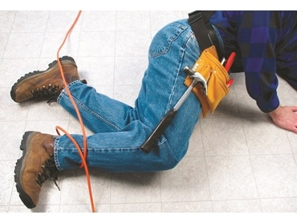
Introduction to the Hazardous Environment

Slide 6
HAZARD
Hazard in a practical term is any condition or activity that if left uncontrolled can result in an injury, illness or death.

Slide 7
TYPES OF HAZARD

Slide 8
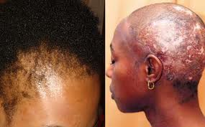
CHEMICAL HAZARD

Slide 9
CHEMICAL HAZARD
These are basically the kinds of threats gotten from chemical substances.

Slide 10
CHEMICAL HAZARD
These threats presents themselves in many dangerous forms such as:
As flammable substances: Flammable substances are those that readily catch fire and burn in air.
Note: some flammable liquids are classified more dangerous. classifications are based on the:
(i) The Flash Points (ii) auto – ignition temperature ( iii) explosive limit and (iv) vapor density.

Slide 11
CHEMICAL HAZARD
These treats presents themselves in many dangerous forms such as:
As Reactive substances: reactive chemicals releases heat in relatively high quantity or at rapid rates.
Note: such reaction can result to explosion.

Slide 12
CHEMICAL HAZARD
These treats presents themselves in many dangerous forms such as:
As Toxic substances: toxic chemicals are very poisonous to health.
Note: such chemicals kill when ingested into the body system, by any means.

Slide 13
CHEMICAL HAZARD
METHOD OF EXPOSURE : INHALATION
Through inhalation: people, out ignorance, inhale poisonous chemicals such as:
Carbon monoxide (CO2 )
smoke from generator,
car and many other sources
Hydrogen Sulfide (H2S), Sulfur Dioxide, Ozone, Phosgene, Nitrogen Dioxide, Ammonia. etc

Slide 14
CHEMICAL HAZARD
METHOD OF EXPOSURE : SKIN CONTACT
Dangerous chemicals burn and rupture the skin when they come in contact with it.
Example: exposure to high conc. Acid.

Slide 15
CHEMICAL HAZARD
METHOD OF EXPOSURE: ABSORPTION
Skin absorption is a route by which substances can enter the body through the skin.
Also harmful substances pass through this medium into the body system.

Slide 16
CHEMICAL HAZARD
CONTROL TO CHEMICAL ABSORPTION
Label all chemicals
Use Protective Gloves
Wash off immediately if the chemical comes in contact with skin.
Lockout Tag out

Slide 17
CHEMICAL HAZARD
METHOD OF EXPOSURES: INGESTION
Poisonous chemicals enter through the mouth into the digestive system, from contaminated food or water and or any other.

Slide 18
CHEMICAL HAZARD
METHOD OF EXPOSURES: INJECTION
harmful chemical can enter into our body or blood stream through a mechanical medium.
Note: This often happens deliberately. However victims are usually not abreast of the full chemical composition of the substance entering their body.

Slide 19
CHEMICAL HAZARD
GENERAL CHEMICAL HAZARD KNOWLEDGE
SYMPTOMS:
Depending on the type of exposure, symptoms can be :
Abdominal pain
Breathing difficulty
Dizziness
Headache
Pain where contact is made with the skin
Weakness
Unconsciousness

Slide 20
CHEMICAL HAZARD
GENERAL CHEMICAL HAZARD KNOWLEDGE
PROTECTION Cont:
Avoid prolonged (even low-level) exposure to chemicals.
Avoid mixing different products that contain toxic chemicals such as ammonia and bleach. The mixture can give off hazardous fumes.
Buy potentially poisonous substance in safety containers, and buy only as much as needed.
Many household products are made of toxic chemicals. It is important to read and follow label instructions, including any precautions.

Slide 21
CHEMICAL HAZARD
GENERAL CHEMICAL HAZARD KNOWLEDGE
PROTECTION:
- Never store household products in food or drink containers. Leave them in their original containers with the labels intact.
Store chemicals safely immediately after use.
- Use paints, petroleum products, ammonia, bleach, and other products that give off fumes only in a well-ventilated area.

Slide 22
CHEMICAL HAZARD
GENERAL CHEMICAL HAZARD KNOWLEDGE
FIRST AID:
Make sure the cause of the burn Is removed
Flush the chemical off the skin using cool running water
Treat the person from shock
Apply wet compresses to release
Wrap the burned area with a dry sterile cloth
Protect the burned area from pressure and friction
Unconsciousness

Slide 23
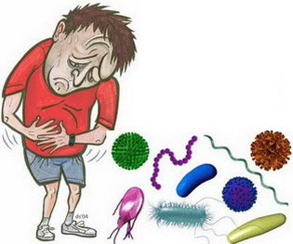
BIOLOGICAL HAZARDS

Slide 24
BIOLOGICAL HAZARDS
These refer to biological substances that pose a threat to the health of humans.

Slide 25
BIOLOGICAL HAZARDS
METHOD OF EXPOSURES : Bloodborne Pathogens:
A pathogen is something that spreads disease
- Bloodborne are diseases that goes through the blood.
Examples are:
Hepatitis B virus (HBV)
Hepatitis C
human immunodeficiency virus (HIV)
And others

Slide 26
BIOLOGICAL HAZARDS
METHOD OF EXPOSURES : Bloodborne Pathogens:
NOTE: objects contaminated with the blood of an infected person will be contagious. Avoid any contact with equipments.
- Do not handle blood with your bare hands always use disposable gloves, and apron in severe instance.

Slide 27
BIOLOGICAL HAZARDS
METHOD OF EXPOSURES : Building Related illness:
building-related illness (BRI) refers to recognized diseases, often infections, eg Legionnaires' disease, caused by being in a sick building.

Slide 28
BIOLOGICAL HAZARDS
METHOD OF EXPOSURES : Building Related illness:
Buildings get sick mostly when :
- There is a Poor ventilation.
- Poisonous Air conditioning.
- Low humidity.

Slide 29
BIOLOGICAL HAZARDS
METHOD OF EXPOSURES : Plant and insect Poison
many plants and their fruits are poisonous and should not be eaten.
Many insects like snakes, spiders, scorpions, ticks and others transmit deadly poisons
also, certain aquatic creatures like jelly fish, sea anemones also transmit poisons.

Slide 30
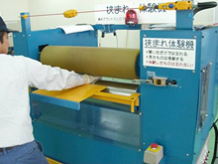
PHYSICAL HAZARD

Slide 31
PHYSICAL HAZARDS
Physical Hazard are those substances or conditions which threaten your physical safety.
THEY ARE:
Electrical shocks
Fire / Explosions
Noise
Thermal
Caught in /on between pinch points
Slip and falls
Struck by

Slide 32

PHYSICAL HAZARDS – Electric Shock

Slide 33
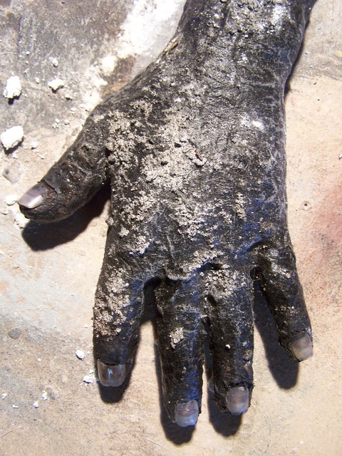
PHYSICAL HAZARDS – Fire Burn

Slide 34

PHYSICAL HAZARDS – Noise

Slide 35
PHYSICAL HAZARDS – Noise
Noise-induced hearing loss is an irreversible condition that can have a terrible impact on a person’s life.
If you are exposed to loud noise continually over a period of time, the nerve receptors in your inner ear may eventually die, and once damage occurs it cannot be repaired.
Hearing loss can also result from exposure to sudden loud noises, such as explosions, gun shots or heavy hammering. These types of noises are commonly referred to as ‘impact’ noises and, if loud enough, can cause immediate, permanent damage.
Permanent hearing loss may also be accompanied by tinnitus or ringing in the ears.

Slide 36
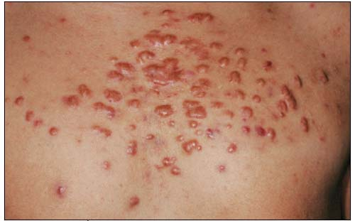
PHYSICAL HAZARDS – Thermal

Slide 37
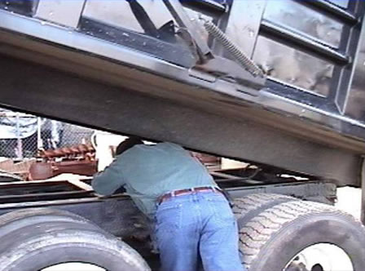
PHYSICAL HAZARDS – Caught in between

Slide 38
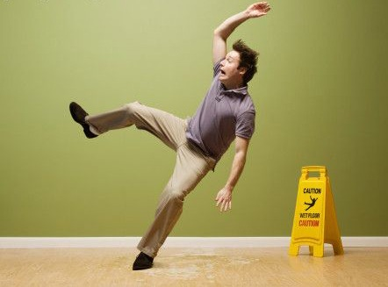
PHYSICAL HAZARDS – Slip and Fall

Slide 39

PHYSICAL HAZARDS – Trip and Fall

Slide 40


Slide 41
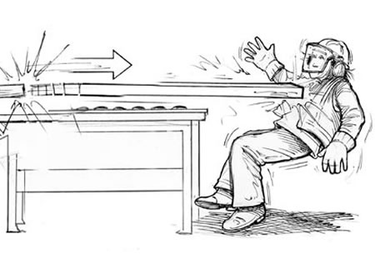
PHYSICAL HAZARDS – STRUCK BY

Slide 42
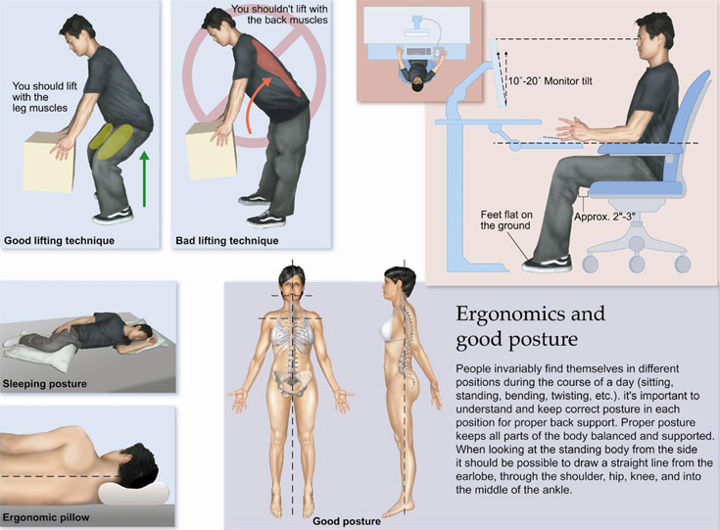
ERGONOMIC HAZARDS

Slide 43
ERGONOMIC HAZARDS
refer to workplace conditions that pose the risk of injury to the musculoskeletal system of the worker.

Slide 44


Slide 45
Working Safely including Safety Observations Systems

Slide 46
INTRODUCTION TO
SAFETY SIGNS

Slide 47
SAFETY SIGNS
Safety signs are means of communicating important information that can be understood by all races, by literate and illiterate people, by all age groups and by all people, locally or globally.
Safety signs are vital in all our workplaces to ensure the safety of our workers.

Slide 48
TYPE OF SAFETY SIGNS THE PROHIBITION SIGNS
Intrinsic features:
a) round shape;
(b) black pictogram on white background, red edging and diagonal line

Slide 49


TYPE OF SAFETY SIGNS THE PROHIBITION SIGNS
No access for unauthorized persons
No access for industrial vehicles

Slide 50


TYPE OF SAFETY SIGNS THE PROHIBITION SIGNS
No access for pedestrians
Do not extinguish with water

Slide 51


TYPE OF SAFETY SIGNS THE PROHIBITION SIGNS
No smoking
Naked flames forbidden

Slide 52
TYPE OF SAFETY SIGNS THE DANGER WARNING SIGNS
Intrinsic features:
triangular shape
(b) black pictogram on a yellow background with black edging

Slide 53


TYPE OF SAFETY SIGNS THE DANGER WARNING SIGNS
General danger
Danger: Electricity

Slide 54


TYPE OF SAFETY SIGNS THE DANGER WARNING SIGNS
Overhead load
Industrial vehicles

Slide 55


TYPE OF SAFETY SIGNS THE DANGER WARNING SIGNS
Drop / Obstacle
Low temperature

Slide 56
TYPE OF SAFETY SIGNS MANDATORY SIGNS
Intrinsic features:
round shape
(b) white pictogram on a blue background

Slide 57


TYPE OF SAFETY SIGNS MANDATORY SIGNS
General mandatory
Ear protection must be worn

Slide 58


TYPE OF SAFETY SIGNS MANDATORY SIGNS
Safety boots must be worn
Safety overalls must be worn

Slide 59


TYPE OF SAFETY SIGNS MANDATORY SIGNS
Face protection
Safety helmet must be worn

Slide 60
TYPE OF SAFETY SIGNS EMERGENCY ESCAPE SIGNS
Intrinsic features:
rectangular or square shape
(b) white pictogram on a green background

Slide 61


TYPE OF SAFETY SIGNS EMERGENCY ESCAPE SIGNS
Emergency Exit
Safety Shower

Slide 62
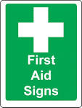

TYPE OF SAFETY SIGNS EMERGENCY ESCAPE SIGNS
Stretcher
First aid

Slide 63
TYPE OF SAFETY SIGNS Firefighting Signs
Intrinsic features:
rectangular or square shape
(b) white pictogram on a red background

Slide 64


TYPE OF SAFETY SIGNS Firefighting Signs
Fire Ladder
Fire Extinguisher

Slide 65


TYPE OF SAFETY SIGNS Firefighting Signs
Fire Hose
Fire Escape Direction

Slide 66
INTRODUCTION TO
SAFETY SIGNS

Slide 67
SAFETY SIGNS
Safety signs are means of communicating important information that can be understood by all races, by literate and illiterate people, by all age groups and by all people, locally or globally.
Safety signs are vital in all our workplaces to ensure the safety of our workers.

Slide 68
TYPE OF SAFETY SIGNS THE PROHIBITION SIGNS
Intrinsic features:
a) round shape;
(b) black pictogram on white background, red edging and diagonal line

Slide 69
TYPE OF SAFETY SIGNS THE PROHIBITION SIGNS
No access for unauthorized persons
No access for industrial vehicles

Slide 70
TYPE OF SAFETY SIGNS THE PROHIBITION SIGNS
No access for pedestrians
Do not extinguish with water

Slide 71
TYPE OF SAFETY SIGNS THE PROHIBITION SIGNS
No smoking
Naked flames forbidden

Slide 72
TYPE OF SAFETY SIGNS THE DANGER WARNING SIGNS
Intrinsic features:
triangular shape
(b) black pictogram on a yellow background with black edging

Slide 73
TYPE OF SAFETY SIGNS THE DANGER WARNING SIGNS
General danger
Danger: Electricity

Slide 74
TYPE OF SAFETY SIGNS THE DANGER WARNING SIGNS
Overhead load
Industrial vehicles

Slide 75
TYPE OF SAFETY SIGNS THE DANGER WARNING SIGNS
Drop / Obstacle
Low temperature

Slide 76
TYPE OF SAFETY SIGNS MANDATORY SIGNS
Intrinsic features:
round shape
(b) white pictogram on a blue background

Slide 77
TYPE OF SAFETY SIGNS MANDATORY SIGNS
General mandatory
Ear protection must be worn

Slide 78
TYPE OF SAFETY SIGNS MANDATORY SIGNS
Safety boots must be worn
Safety overalls must be worn

Slide 79
TYPE OF SAFETY SIGNS MANDATORY SIGNS
Face protection
Safety helmet must be worn

Slide 80
TYPE OF SAFETY SIGNS EMERGENCY ESCAPE SIGNS
Intrinsic features:
rectangular or square shape
(b) white pictogram on a green background

Slide 81
TYPE OF SAFETY SIGNS EMERGENCY ESCAPE SIGNS
Emergency Exit
Safety Shower

Slide 82
TYPE OF SAFETY SIGNS EMERGENCY ESCAPE SIGNS
Stretcher
First aid

Slide 83
TYPE OF SAFETY SIGNS Firefighting Signs
Intrinsic features:
rectangular or square shape
(b) white pictogram on a red background

Slide 84
TYPE OF SAFETY SIGNS Firefighting Signs
Fire Ladder
Fire Extinguisher

Slide 85
TYPE OF SAFETY SIGNS Firefighting Signs
Fire Hose
Fire Escape Direction

Slide 86
SAFETY INSPECTION POINTS

Slide 87
Inspection “Reasoning ?????
Well-planned safety inspections help in detecting hazards
before an accident occurs.
Before an inspection, analyze past accidents to determine
specific causes and high hazard areas or operations.
Both unsafe conditions and unsafe acts are contributing
Factors in most industrial accidents. An unsafe condition, in addition to being a direct cause of accident itself, often requires, or suggests, an unsafe act.

Slide 88
Why Inspect ?????
Removing hazards increases operating efficiency, because
safety and efficiency go hand in hand. A documented self
inspection of all facilities/equipment allows you to detect or
identify unsafe conditions or hazards, initiate corrective
actions as soon as possible and control hazards on an
ongoing basis.
All inspections should be conducted on an ongoing basis,
without interruption

Slide 89
Necessities !!!!!
Management must allocate adequate time and resources to perform the surveys.
Each location should develop and maintain an inspection checklist specific to their operation.
Lists should be developed utilizing a general inspection
checklist, and be evaluated and updated with hazards that are identified during the inspections and other pertinent data as it is acquired.

Slide 90
Gotta Have !!!!!
Each checklist should indicate the location or specific site or areas surveyed
Name and title of the inspector
Date of inspection
Corrective action taken for identified hazards, or violations.
The inspection report will be used in trend analysis and recordkeeping.

Slide 91
A “MUST”
Employees must be notified of hazards that pose an immediate threat of physical harm or property damage
Informed of measures or steps that will be taken to eliminate, correct or control the hazards

Slide 92
Inspection Points
Is the rig cab clean and free of loose material?
Is the rig properly guyed?
Has the appropriate distance (10’) been maintained form overhead power lines
Are guards in place on all moving parts of the motor, draw works & accessory equipment such as a reverse
drilling unit, BOP, mud pumps, etc.?
Are guardrails provided around the rig floor when heights exceed 6’
Are the access stairs equipped with a handrail system
Are the power tongs in good condition?
Is a counterweighted climbing device provided with full body harness?
Is the derrick man tied-off 100% of the time when working from the rod basket & tubing platform.
Is an emergency escape line (Geronimo) provided for the derrick man & equipped with a functional hand brake?
Is the emergency escape line adequately secured and fixed at an appropriate angle?
Are all hand tools (rod wrenches, pipe wrenches, etc.) maintained in good condition?
Is the rig equipped with a functional Hydrogen Sulfide monitor?
Is the monitor calibrated as outlined by the manufacturer?
Are SCBA units provided and positioned outside opposite guy wires of the rig?
Are fire extinguishers provided and positioned outside opposite guy wires of the rig?
Are employees required to utilize appropriate PPE (hard hat, eye protection, gloves steel toe boots, fall protection,
Hydrogen Sulfide Monitors)?
Is the dog house in good condition?
Are local emergency numbers posted in the dog house?
Are Material Safety Data Sheets maintained in the dog house?
Is the dog house equipped with a phone or radio for emergency purposes?

Slide 93
Understanding the Risk Assessment Process

Slide 94
What is Risk Assessment?
Risk Assessment is a systematic approach to identify hazards, evaluate risk and incorporate appropriate measures to manage and mitigate risk for any work process or activity.
Notes:
As a responsible employer and a world class educational institution, it is NUS’ responsibility to ensure the environment in NUS is safe for our staff and students. It is therefore our aim to prevent injuries and accidents. And if accidents do happen, the organization should be able to respond quickly and effectively to bring the situation under control. This would minimise damage and harm to property and most importantly, the save lives. I will be covering three areas in this presentation: Occupational Safety and Health, Emergency Management and Environmental sustainability.

Slide 95
Risk Concepts
What can go Wrong
How likely is it?
What are the Impacts
Risk Level
MANAGE RISK
Risk management also includes control and monitoring of risks, as well as communicating these risks
Notes:
95

Slide 96
WHY we need to do RA?
Protect Ourselves
RA is key to prevention of accident
Everyone deserve to go home safely at the end of the day
Elevate safety awareness & ownership
Aware of hazards, risks and controls and practicing safe science
Compliance with Regulations

Slide 97
Risk Assessment Process
IDENTIFY the hazards
ASSESS the risks and available control measures
MANAGE the risk
CONTROL the risks through implementation of appropriate control measures
MONITOR the controls to evaluate their effectiveness
Communication of Risks & Controls

Slide 98
Risk Assessment Template
Activity or Experiment-Based Risk Assessment Form
Department: |  | Name of Experiment/Activity:
Location: |  | Name of Person in-charge: |  | Name of PI:
Last Review Date: |  | Next Review Date:
1. Hazard Identification |  |  |  | 2. Risk Evaluation & Control
SN | Task | Hazards | Possible Consequences | Existing Risk Control (if any) | S | L | R | Additional / New Risk Control | S | L | R | Action By | Deadline
Conducted by: (Name, designation) |  | Approved by: (Name, designation)
Signature: |  | Signature:
Date: |  | Date:
Notes:
13

Slide 99
Risk Assessment Flowchart
Identify
1. Selecting Experiments
3. Potential Hazards
Assess
6. Evaluate Risk (Severity, Probability)
Manage Risk
7. Hazard Control
8. Additional control measures (Responsible person, timeline)
2. Break Down into Successive Tasks
4. Potential Harm (Ill health condition)
5. Existing Control Measures
Review, Approval, Communicate
Record Keeping and Document Control

Slide 100
Risk Evaluation
Consider existing controls
Engineering controls (Fume hood, glove box, chains for cylinder, others)
Administrative controls (Signage, training, SOPs, others)
Personal Protective Equipment
Existing control will not change the severity but only likelihood

Slide 101
Cont..
Severity & likelihood is based on 3 by 3 matrix and the respective criteria specified
Risk rating is the product of severity by likelihood
Refer to acceptability criteria on the recommended action for different risk rating
For medium & high risk, additional controls will be required

Slide 102
Additional Controls Responsible person and timeline
Additional control for risk rated more than 3 or medium & high risk
Reduce risk to as low as reasonably practicable
Who and When?
Responsible person to implement the identified control measures and
Timeline for completion → update the risk assessment upon completion of the additional control measures

Slide 103
Risk Control Measures
Using Hierarchy of Controls to reduce the risk
Using the concept of As Low As Reasonably Practicable (ALARP)

Slide 104
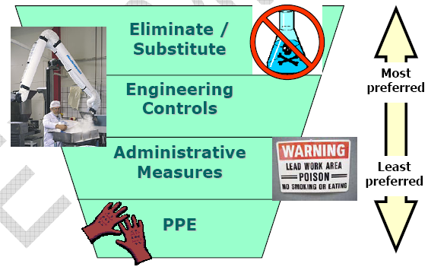
Hierarchy of Risk Control Measures
Notes:
*to re-use recording from previous module

Slide 105
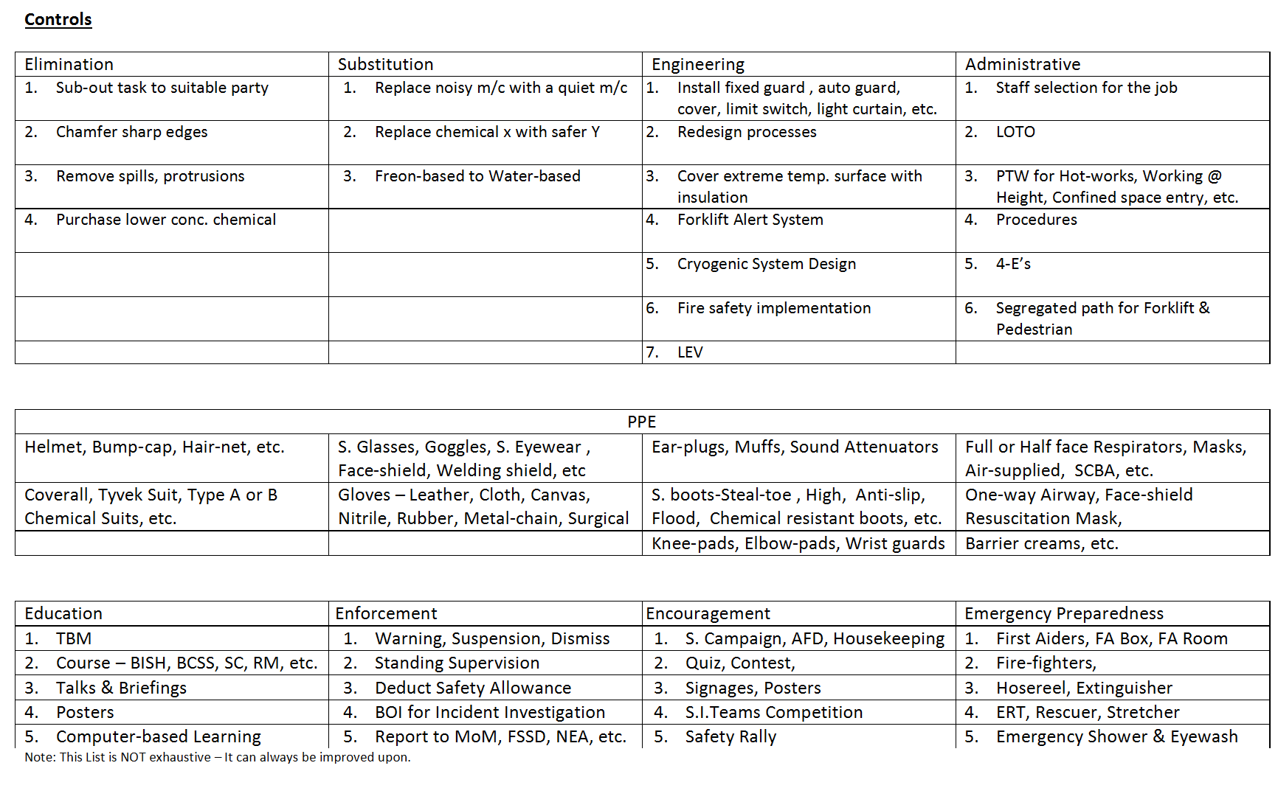

Slide 106
Tasks that Require a Permit to Work

Slide 107
Safe Work Permits
Cutting / Welding
Permit
Location: Job No.
Date: Job No.
Confined Space Entry Permit
Location and description of confined space:
Reason for entry:
Permit issued to:
Supervisor’s Name:
Attendant’s name:
Permit issuer’s name:
% oxygen: % lower explosive limit: ppm CO: H₂S:
Requirements
Emergency Rescuer yes no
Continuous Gas Monitor yes no
Barrier for ground openings yes no
Warning Signs yes no
Safe Work Permit Permit #
Type: (hot work, confined space, line break, etc..... location:
Valid __/___/___ ____ __/___/___ ____ Issued to:
From: M D Y time to M D Y time
Work Description: ________________________________
____________________________________________ Supervisor’s Signature Print name ____________________________________________ ____________________________________________ Work Order No.
Atm Combustible vapors or gases (<10%) Oxygen Concentration (>19.5% & <21%) Toxic Material Concentration
Tests
Precautions Always Required:
There currently are several documents which are called
“safe work permits.” Confined Space Permit, Hot Work
Permit, Hot Work Permit, Lock-Out and Tag Permit or
a General Safe Work Permit that may cover all situations.

Slide 108
Safe Work Permits
Cutting / Welding
Permit
Location: Job No.
Date: Job No.
Location & Building: Floor
Nature of Job:
Welder’s Name:
The above location has been examined. The precautions checked
on the reverse of this card have been taken to prevent fire.
Permission is granted for this work.
Permit Date: Time:
Expires AM
PM
The Hot Work Permit is a form
of Safe Work Permit issued by
the Fire Marshal or other person
responsible for fire safety.
This permit is required for all
situations which may result in
fires or explosions.

Slide 109
Safe Work Permits
Confined Space Entry Permit
Location and description of confined space:
Reason for entry:
Permit issued to:
Supervisor’s Name:
Attendant’s name:
Permit issuer’s name:
% oxygen: % lower explosive limit: ppm CO: H₂S:
Requirements
Emergency Rescuer yes no
Continuous Gas Monitor yes no
Barrier for ground openings yes no
Warning Signs yes no
Safety Harness with life line yes no
Tripod / Hoist / Pulley yes no
CAUTION
Opening in Ground
Keep Out !
The “Confined Space Entry
Permit” is another form of
safe work permit regulating
entry into pits, tanks, and vessels.

Slide 110
Safe Work Permits
Cutting / Welding
Permit
Location: Job No.
Date: Job No.
Confined Space Entry Permit
Location and description of confined space:
Reason for entry:
Permit issued to:
Supervisor’s Name:
Attendant’s name:
Permit issuer’s name:
% oxygen: % lower explosive limit: ppm CO: H₂S:
Requirements
Emergency Rescuer yes no
Continuous Gas Monitor yes no
Barrier for ground openings yes no
Warning Signs yes no
Confined Space Entry Permits, Line Breaking Permits
and Hot Work Permits will be discussed in detail in
other training sessions.

Slide 111
Safe Work Permits
Safe Work Permit Permit #
Type: (hot work, confined space, line break, etc.... location:
Valid __/___/___ ____ __/___/___ ____ Issued to:
From: M D Y time to M D Y time
Work Description: ________________________________
____________________________________________ Supervisor’s Signature Print name ____________________________________________ ____________________________________________ Work Order No.
Atm Combustible vapors or gases (<10%) Oxygen Concentration (>19.5% & <21%) Toxic Material Concentration
Tests
Precautions Always Required:
The objective of the Safe Work Permit system is to
identify hazards associated with a non-routine job, and
to develop precautions required to control each hazard
identified.

Slide 112
Safe Work Permits
Let’s begin with a
look at the hazards
associated with
specific jobs, and
examine how Safe
Work Permits can
help to prevent
them from causing
damage or personal
injury.

Slide 113
Safe Work Permits
Examples of jobs requiring permits are:
1. Hot Work - the use of open flame, oxyacetylene burning,
tar kettles, etc...., and the use of portable spark or heat producing
equipment in flammable storage or handling areas.
2. Lock Out and Tag
3. Confined Space Entry
4. Excavations
5. Blasting
6. Line Breaking
7. Whenever required by existing company or contractor procedures
or required in the contractor’s Project Safety Plan.
8. Use of internal combustion engines, or vehicles
with internal combustion engines inside company buildings.

Slide 114
Safe Work Permits
Excavations can result in:
head Injuries from materials
falling from overhead surfaces,
rupture of high pressure hydraulic
lines used on backhoes, shovels,
and drills.
excessive noise from concrete
breaking and cutting equipment,
and collapse of excavation walls and piles due to poorly secured soil, sudden
weather changes, or other factors.
Permits are written to ensure that necessary equipment is present and in
good working order.

Slide 115
Safe Work Permits
Excavations :
Poorly planned excavations can result in
damage to underground services, such as
electrical lines, natural gas lines, water
lines, sewers and drains.
The consequence of damaged service lines
is often complete shutdown of operations
resulting in major business losses.
Permits are written to prevent damage to
underground equipment and services.

Slide 116
Safe Work Permits
Excavations may expose hazardous materials, which have leaked and are
contaminating the soil.
Permits ensure that procedures to protect workers from exposure to toxic
substances have been identified.

Slide 117
Safe Work Permits
Blasting can cause damage
to adjacent operations and
personnel.
Permits are issued to ensure
procedures are followed that
prevent injury to neighboring
facilities, equipment and
employees.

Slide 118
Safe Work Permits
Internal combustion engines produce poisonous gases
such as carbon monoxide, and oxides of nitrogen.
Permits ensure that procedures are followed that will prevent
equipment emissions from contaminating air inside buildings
and confined spaces.

Slide 119
Safe Work Permits
Unauthorized use of company
equipment can result in lost
production and injury to untrained
operators.
Permits prevent company equipment
from being taken by contractors
without the permission of area
management, and require
verification of equipment operator
training.

Slide 120
Safe Work Permits
Work which ordinarily does not require safe work
permits may be included at the discretion of the
Safety Representative, the Contractor, or the Contract
Administrator.

Slide 121
Safe Work Permits
Following are examples of situations which may require
discretionary safe work permits.
There could be many others:

Slide 122
Safe Work Permits
Movement of
large pieces of equipment,
especially while other personnel
are working nearby, can result
in employee injury.
Permits may be issued to ensure
the use of procedures that will
prevent employee injury from
falling material, or being struck
by rigging equipment.

Slide 123
Safe Work Permits
Abandoned tanks, pipe lines,
drums, and vessels may contain
hazardous vapors and gases.
Permits may be issued to prevent
toxic or corrosive exposures to workers
when working on abandoned
equipment, complementing hot work
and confined space permits.
?

Slide 124
Safe Work Permits
Many construction processes
create noise levels high enough
to cause hearing loss.
Permit requirements may be issued
to reduce noise to acceptable limits,
or to provide both construction and
other employees with required
hearing protection.

Slide 125
Safe Work Permits
Boilers, high pressure
vessels, tanks, and reactors
can undergo sudden failure
resulting in disastrous
consequences.
Permits may be issued requiring
precautions and equipment to
prevent system failures not
covered by safe job procedures
or project safety plans.

Slide 126
Safe Work Permits
Permits may be required
where the consequence
of noncompliance with
fall protection requirements
is severe, or where dropped
materials may endanger
other workers below.

Slide 127
Safe Work Permits
Permits are required
before work begins near
energized lines which cannot
be shut off if there is danger
of fire, shock or electrocution.

Slide 128
Safe Work Permits
CAUTION
Hazardous Materials!
“Safe Work Permit Required!”
Permits are mandatory where signs are
posted which require them.

Slide 129
Safe Work Permits
Safe Work Permit Permit #
Type: (hot work, confined space, line break, etc.... location:
Valid __/___/___ ____ __/___/___ ____ Issued to:
From: M D Y time to M D Y time
Work Description: ________________________________
____________________________________________ Supervisor’s Signature Print name ____________________________________________ ____________________________________________ Work Order No.
Permits are issued:
- for a specific date and time range,
- for a specific job,
- and to specific individuals.

Slide 130
Safe Work Permits
Safe Work Permit Permit #
-------------------------------------------------------------------------------------------------------------------------------------------------------------------
Work Description: ________________________________
____________________________________________ Supervisor’s Signature Print name ____________________________________________ ____________________________________________ Work Order No.
Atm. Combustible Vapors or gases (<10%) Oxygen Concentration ( >19.5% & < 21%) Toxic Material Concentration
Tests
Permit Issued by: _________________________/____/___ Work Area Manager Approval _______________/___/__
Permits must be reviewed and signed by:
- the safety representative issuing the permit,
- the workers’ supervisor,
- affected workers,
- and the work area manager.

Slide 131
Safe Work Permits
Safe Work Permit
----------------------------------------------------------------------
Precautions Always required:
o Emergency procedures review by:
o Emergency equipment & location review by:
o Area inherent hazards review by:
o Material Safety Data Sheet(s) review by:
Workers must be informed of required emergency procedures, location
and operation of emergency equipment, and area inherent hazards.
Material Safety Data Sheets must be supplied and special
precautions reviewed with workers and their supervision.

Slide 132
Safe Work Permits
Safe Work Permit
----------------------------------------------------------------------
Special Precautions Required:
o Buddy System o Sprinklers in Service
o Cleaning of _________ o Purging of ________
o Remove materials from ___________________
o Piping o Drain o Disconnect o Blank off / Capped
o Clean o Ventilate
o Remove combustibles from other side of wall.
o Floor Swept Clean of Combustibles
o Clean area within 35 feet. o Wet down floor.
o Adjacent areas: __________________________
o Cover floor with: __________________________
o Non-combustible Tarpaulins or Metal Shields Over:
o Electrical Switches or Valves off, locked-out, and Tagged:
o Electrical Grounding of: ________________________
o Atmosphere monitored during work for: ____________
periodically: __________ continuously: __________
o Safety Monitor(s) present from _________ to _________
o Fire Watch Present during work and for 30 minutes after...
o Respirator to be worn____ or be readily available ___
Required special precautions
must be clearly indicated and
communicated to workers,
and their supervision.
It is the safety representative’s
responsibility to determine if
and when special measures
are required.

Slide 133
Safe Work Permits
Safe Work Permit
----------------------------------------------------------------------
Safety Equipment Required
o safety glasses
o hard hat
o face shield
o safety shoes
o fire extinguishers - type ___ #___ size ___
o fire hose
o supplementary illumination
o warning signs
o barricades
o non-sparking tools
o explosion proof equipment
o safety harness
o life line
o tripod emergency escape unit
o 2-way radio or phone
o respirators
o impervious gloves
o protective clothing _____________________
o mechanical ventilation
o shower & eyewash
o self contained breathing apparatus
o ground fault circuit interrupter
o ladder / lift / scaffold
o other________________________________
Personal protective equipment
and other safety equipment required
is specified.
For each hazard present at the work
site, the safety representative must
specify a hazard control.

Slide 134
Safe Work Permits
The safety representative must verify
that all underground utilities have
been located and staked out.
Provisions must be made to
barricade the open trench, prevent
collapse of trench walls, provide
employees with a means of exit,
reroute ground water, and all other
requirements of excavating.
If soil is contaminated, the safety
representative will ask for a written
safety and health plan.
Safe Work Permit
----------------------------------------------------------------------
EXCAVATION PRECAUTIONS REQUIRED:
o Underground / Underfloor Utility Hazard Review
o Soil Excavation Reviewed
o Underground Utility Stakeout Performed
o Excavation cut back 1/1, or walls reinforced
o Means of exiting within 25 feet.

Slide 135
Safe Work Permits - SUMMARY
- Hot work, confined space entry, excavations, blasting,
use of internal combustion engines inside of buildings,
use of company owned or leased equipment, and areas where
“Safe Work Permit Required” signs are posted always require
a safe work permit.
- Other safe work permits may be required at the discretion
of the Safety Representative, the Contract Administrator,
or the Contractor.
- Permits will be issued by a qualified safety representative.
- Hot work permits are issued by the Fire Marshal.
- Permits are issued to specific persons for a specific time
period and for a specific job.
- Permits must be signed at the time issued by the safety
representative, job supervisor, affected workers, and
the manager of the area in which work is being done.

Slide 136
Where to Get Help?
Your supervisor is responsible for providing equipment
necessary to comply with Safe Work Permit requirements.
The safety representative is responsible for completing
the job hazard analysis and issuing the permit.

Slide 137
Using Manual Handling Techniques Every Day

Slide 138
What is manual handling? What is Manual Handling
any activity requiring a person to use any part of their muscular or skeletal system in their interactions with their work environment.

Slide 139
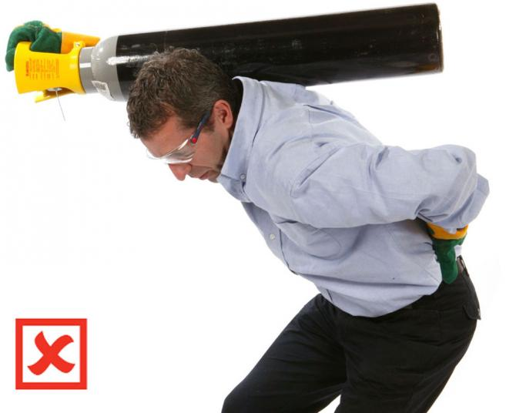
Manual Handling In form Of?
CARRYING.

Slide 140
Manual Handling In form Of
CARRYING.
When is carrying done wrongly?
- When it have heavy impacts on the carrier’s muscles or skeletal system.
When is carrying done Correctly?
When a machine is use to carry load instead.
When a lighter load is carried or when more hands are added.

Slide 141
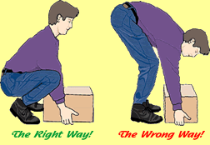
Manual Handling In form Of?
LIFTING.

Slide 142
Manual Handling In form Of
LIFTING.
When is Lifting done wrongly?
When the lifter bends to use his skeletal system.
the danger in doing lifting wrongly is fracture or dislocation to any of the skeletal parts.
When is Lifting done Correctly?
We the lifter squat with his back erect and his knees bend as shown in the picture above.

Slide 143

Manual Handling In form Of?
STRIKING

Slide 144
Manual Handling In form Of
STRIKING.
When is Striking done wrongly?
- When it has heavy impact on the strikers muscles or skeletal system and when its done for long time.
When is Striking done Correctly?
When its done lightly and in a short period of time.
When you engage the use of the right machines.

Slide 145
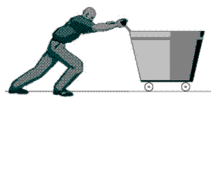
Manual Handling In form Of?
PUSHING.

Slide 146
Manual Handling In form Of
PUSHING.
When is Pushing done wrongly?
- When the pusher’s skeletal system is involved and or when the pusher’s involves too much of his muscles.
When is Pushing done Correctly?
When its done lightly and or the pusher engage the right machines to push to his destination.

Slide 147
NOTE!
- Wrong handling of manual task leads to MSD (musculoskeletal disorder) injuries.
-Poor manual handlings contributes to 30% of workplace injuries.

Slide 148
Example of MSD’s!
strains of ligaments
- strains of muscles or tendons
- injuries to the spine, joints, bones or nerves
- abdominal hernias.

Slide 149
LESSON!
70% of the work we do involves manual handling, its highly advisable that workers take it open themselves to do manual tasks in the right way.
More so, right Manual handling is what recruiters want to watch out for.

Slide 150
PRINCIPLES OF WORKING AT HEIGHT.

Slide 151

WORKING AT HEIGHT ABOVE THE GROUND LEVEL IS USUALLY DANGEROUS

Slide 152
WORKING AT HEIGHT MEANS
Work in any place where, if precautions were not taken, a person could fall down and injure themselves.
Please Note: when you work above ground level where if you fall you can injure yourself, you are working at height already.

Slide 153
THE OIL RIG ITSELF IS A MASSIVE HEIGHT
average offshore rig is above 30 foot (6.5m) in height while an average onshore rig is above 20 foots in height.
To be frank, people fall from oil rigs and die every now and then, these people in high percentage are mostly the onboard new comers with little or no working at height orientation.

Slide 154
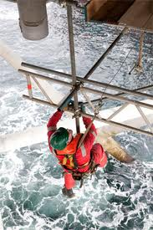
TO WORK AT HEIGHT
You need to know how to properly make use of the climbing mediums such as:
The scaffolds

Slide 155
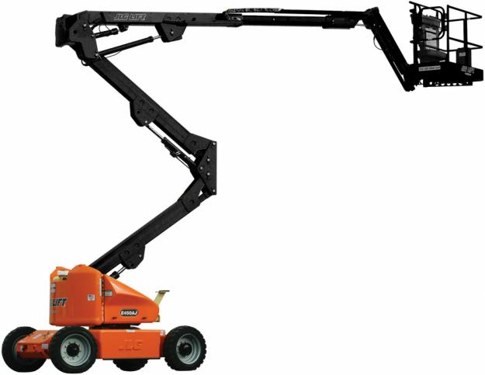
TO WORK AT HEIGHT
You need to know how to properly make use of the climbing mediums such as:
The Cherry Pickers

Slide 156
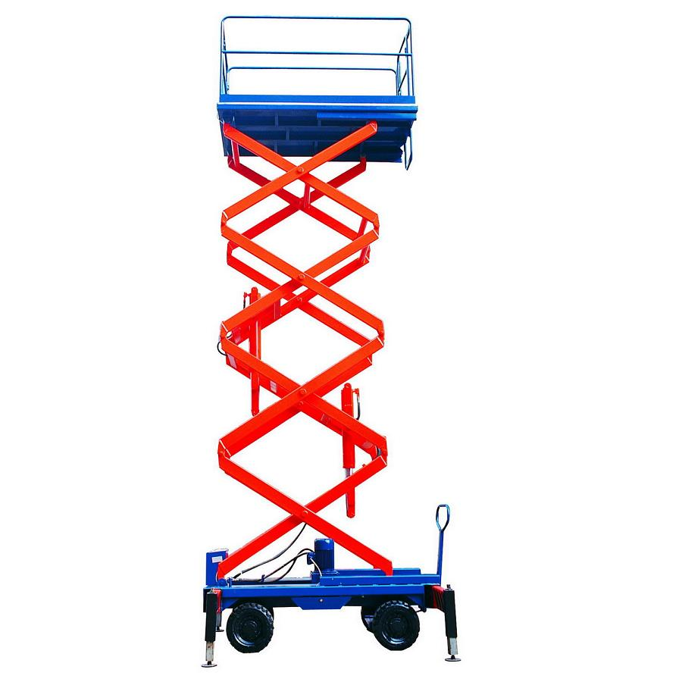
TO WORK AT HEIGHT
You need to know how to properly make use of the climbing mediums such as:
The Scissor Lift

Slide 157
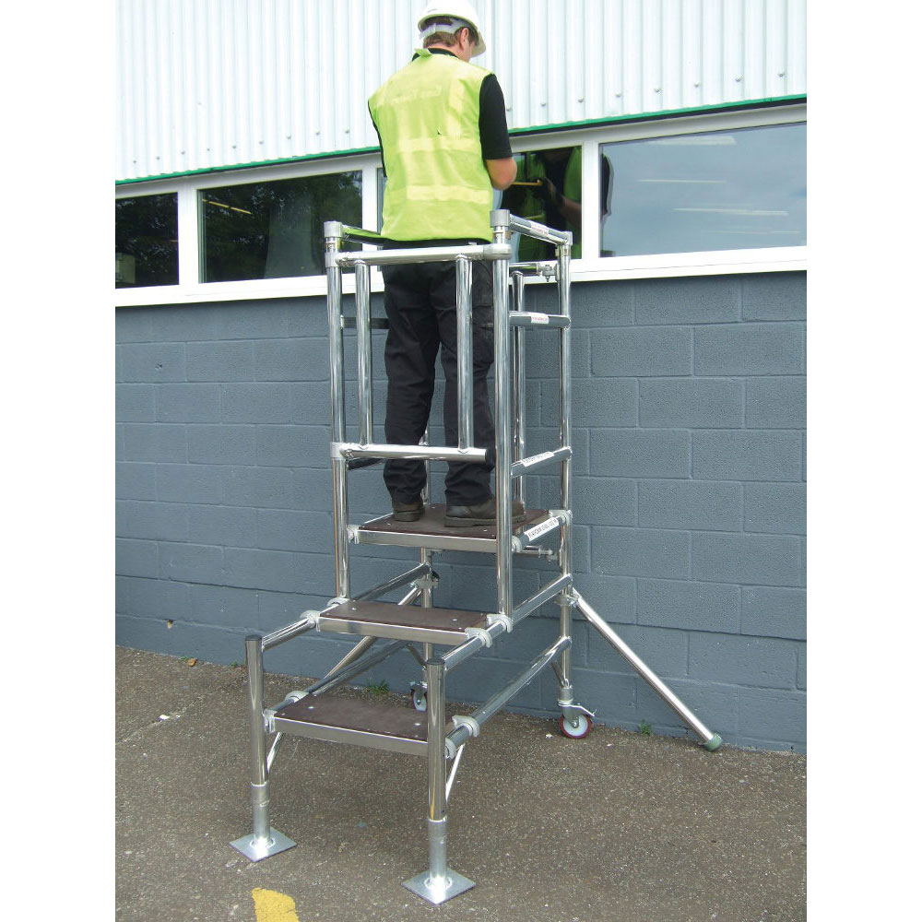
TO WORK AT HEIGHT
You need to know how to properly make use of the climbing mediums such as:
The Step Podium

Slide 158
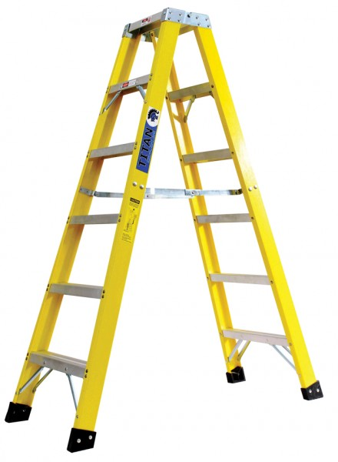
TO WORK AT HEIGHT
You need to know how to properly make use of the climbing mediums such as:
The Stepladders

Slide 159
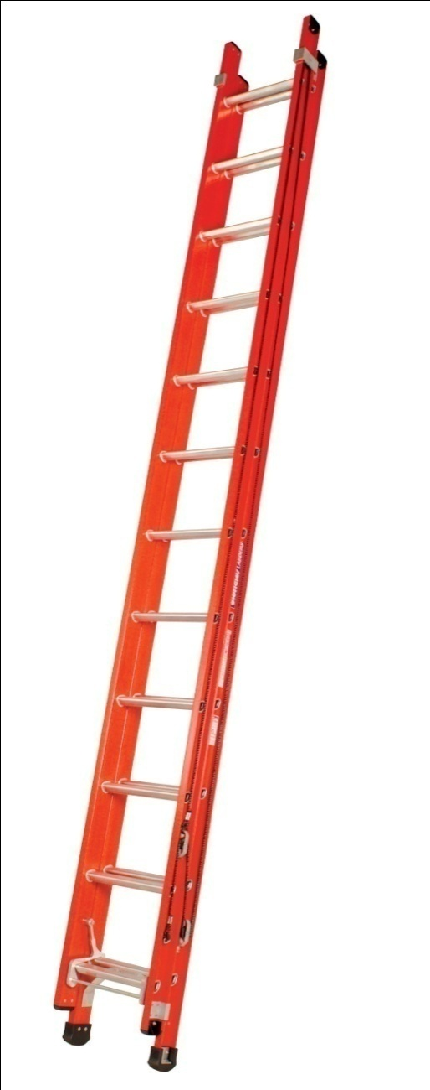
TO WORK AT HEIGHT
You need to know how to properly make use of the climbing mediums such as:
The Ladders

Slide 160
YOU NEED THIS TO WORK AT HEIGHT SAFELY
YOU NEED AWARENESS: first and most important is that you need to acknowledge that you are in a danger zone when you work off the ground.
NOTE: Every point on the platform is considered working at height but when you work from points like the derrick it becomes more dangerous.

Slide 161
YOU NEED THIS TO WORK AT HEIGHT SAFELY
YOU NEED SOUND HEALTH AND SOUND MIND: it takes lots of energy to be stable while work at height, don't work at height when you are not strong enough.
NOTE: Don't work at height when you are heart broken or over joyful.
You need maximum concentration as you may not have a second chance to repent.

Slide 162
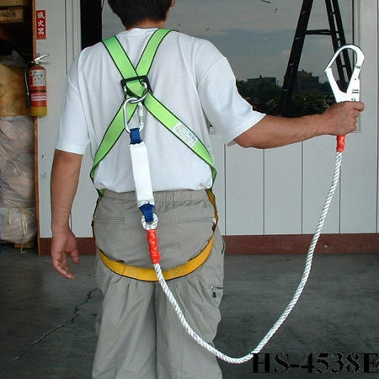
YOU NEED THIS TO WORK AT HEIGHT SAFELY
YOU NEED THE SAFETY HARNESS PPE:

Slide 163

YOU NEED THIS TO WORK AT HEIGHT SAFELY
YOU NEED THE SAFETY HELMET PPE:

Slide 164

Serious Warning!
You must always use your hand rail when ever you work at height.

Slide 165
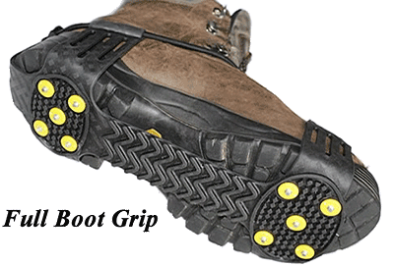
Serious Warning!
You must always inspect your safety boot grip to avoid slip and fall.

Slide 166

Serious Warning!
You must always inspect, identify, avoid and report fragile surfaces .

Slide 167
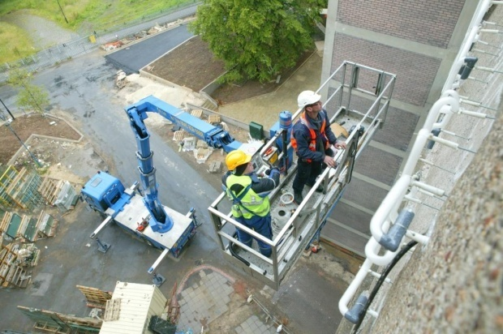
Serious Warning!
Don’t work with extra machine if you are not comfortable with the given position or height.

Slide 168
Finally Before Your At Height!
- Wait to receive the safety officer instructions.
understand every Working at height Job Hazard Analysis (JHA).
Make sure you are working with the right frame of mind.

Slide 169
THANK YOU

