Slide 1
INES-RUHENGERI · FACULTY OF SCIENCES AND INFORMATION TECHNOLOGY
MyTurn
Design and Implementation of an IoT-Based Waiting Line Management and Service-Desk Status System
Your Turn, Made Simple.
TICKET PAGE
WALL DISPLAY
DESK CONSOLE
ESP32 BOARD
Leah NIYODUHORANA
25/27754
Internet of Things (IoT)
Odilla DUKUNDIMANA
25/26987
Lecturer: Joselyne Byukusenge
Isaac MUSHIMIYIMANA
24/25783
Musanze · 23 October 2026

Slide 2
01 — THE PROBLEM
MyTurn
A numbered line is still a line.
1
2
3
Waiting blind
One absent visitor
No record
A visitor cannot tell how long the wait is, so they crowd the service point, leave, or come back at the wrong moment.
The desk calls a number that is not there. Without a rule that recovers, everyone behind it waits.
A paper list cannot say how long service takes, how many visitors never answered, or who changed the desk.
The desk needs a number, a live status, and a fair rule for the person who does not answer.
Your Turn, Made Simple.
02 / 15

Slide 3
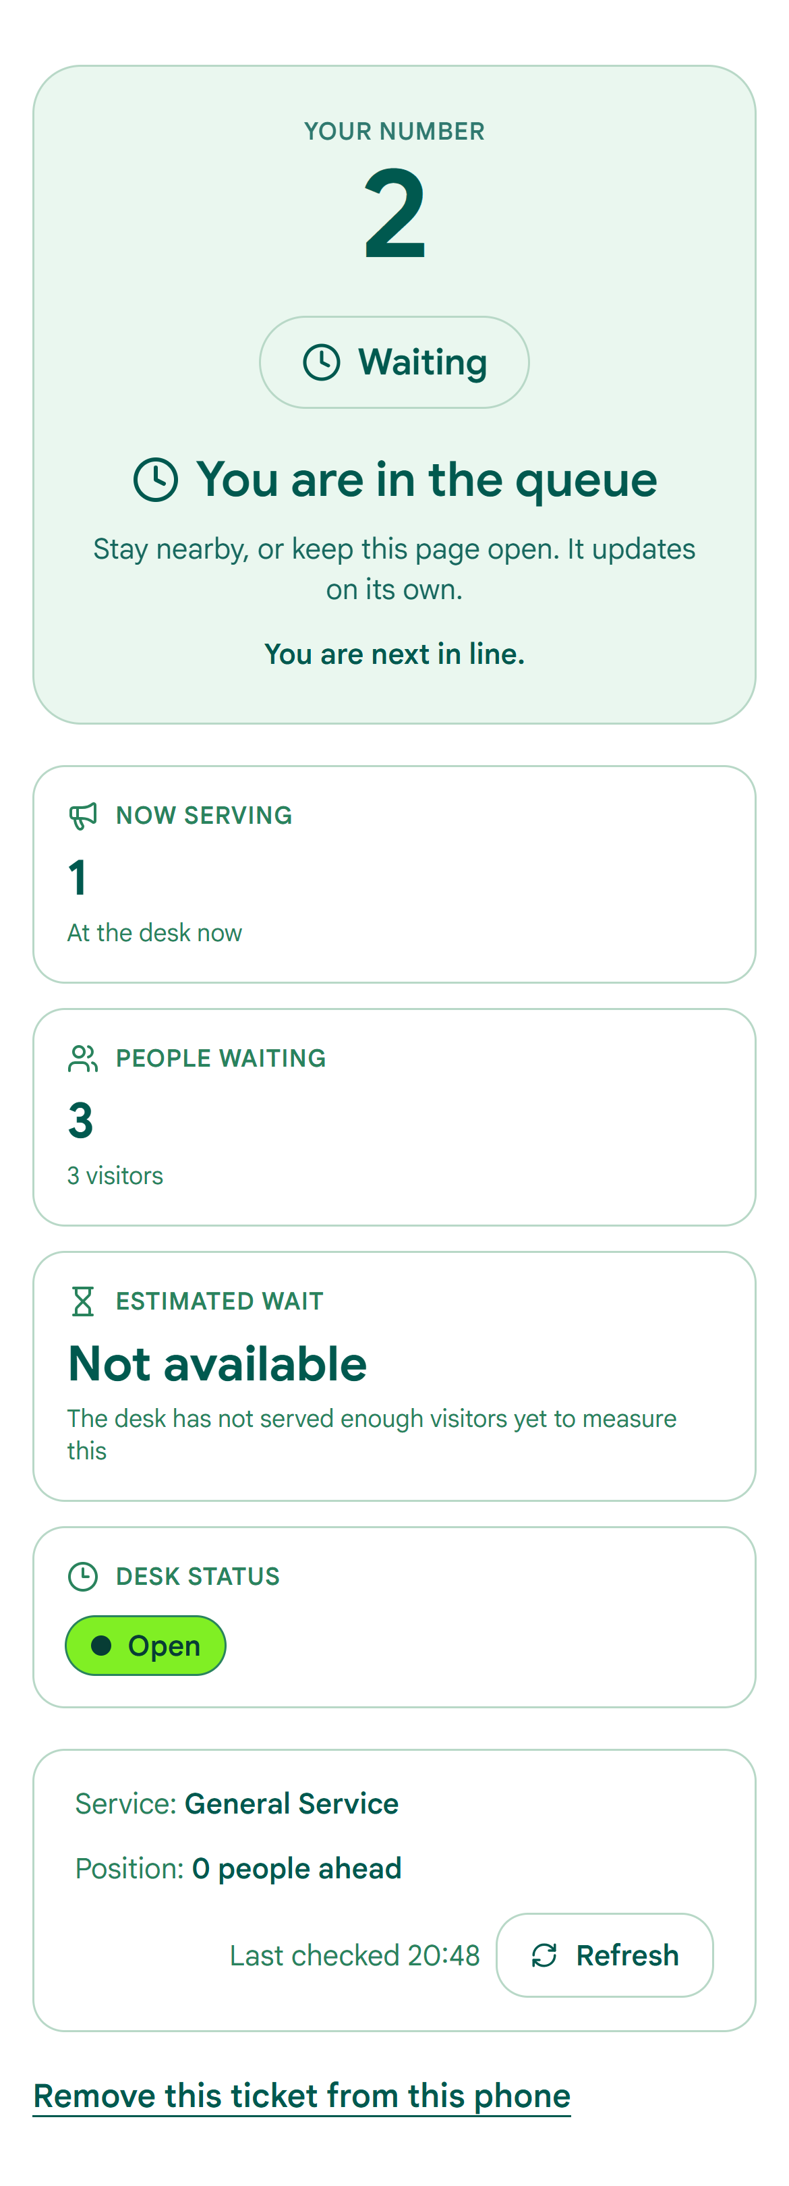
02 — THE SOLUTION
MyTurn
A QR code, a number, and a desk that recovers by itself.
1
Scan
The QR code at the door opens the ticket page. No app, no account.
2
Choose the service
The server issues the next number of that waiting line and a private tracking link.
3
Follow your turn
The page shows the called number, the wait and how many are ahead.
4
Be called
The display and the phone update together, without a refresh.
No name · no phone number · no account
The visitor page, built and running
Your Turn, Made Simple.
03 / 15

Slide 4
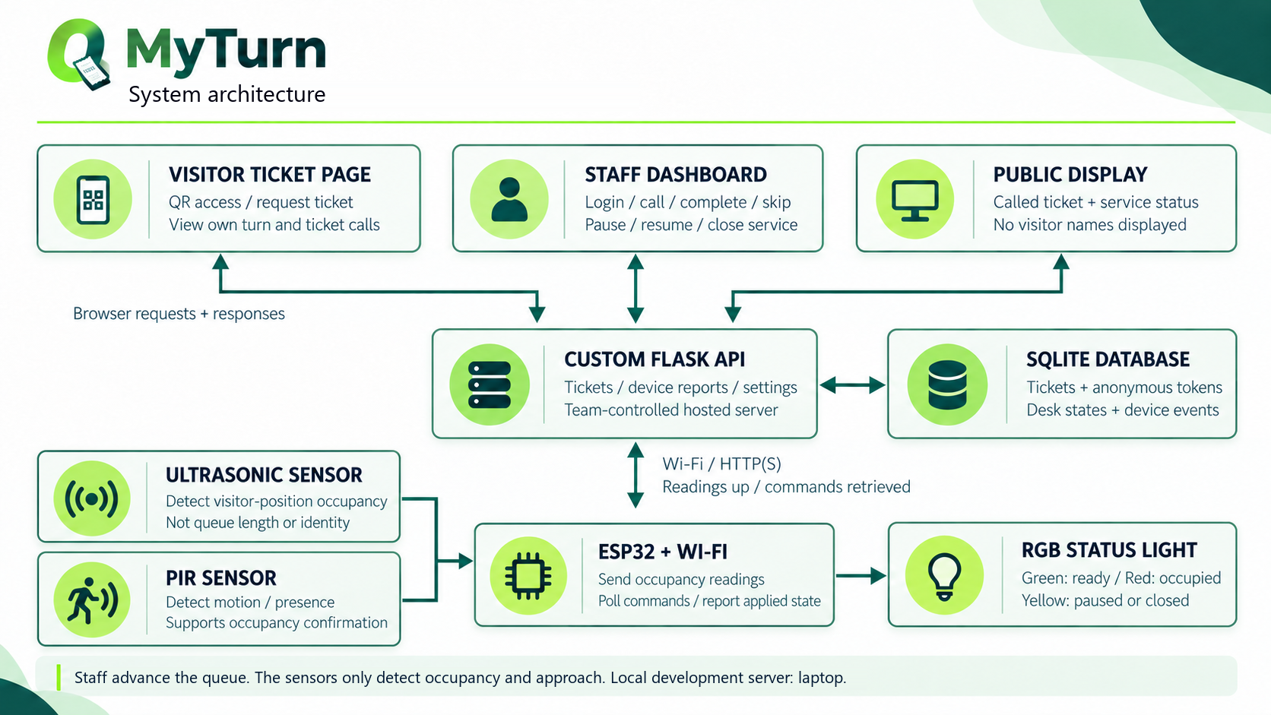
03 — HOW IT IS BUILT
MyTurn
Four parts, one waiting line.
The board measures
An ESP32 reads distance and approach, then applies the desk state to four LEDs.
The API decides
Flask owns the waiting line rules, a counter per service, the desks, the accounts and the event log.
SQLite remembers
Services, waiting lines, desks, board readings and accounts in one file, with every change written down.
The pages show
Next.js: visitor, wall display, staff console and administration.
One origin
The browser reaches the API through the same origin; the board proves itself with a device key.
ESP32 → Flask API → SQLite → Next.js
Your Turn, Made Simple.
04 / 15

Slide 5
04 — THE BOARD
MyTurn
What sits at the service point.
ESP32 DevKitC
the controller
DISTANCE
CONTROLLER
STATUS
HC-SR04 ultrasonic
TRIG 5 · ECHO 21
HC-SR04
ESP32
Four LEDs
HC-SR501 motion
GPIO 19
TRIG 5 · ECHO 21
DevKitC · Wi-Fi
5 V and GND shared
25 · 26 · 27 · 33
Four LEDs
25 · 26 · 27 · 33
MOTION
Buzzer
GPIO 32
HC-SR501
GPIO 19
SOUND
Buzzer
RWF 46,200
estimated prototype budget
GPIO 32
one beep on a call,
two on a recall
The enclosure, the sensor mount and the power supply are part of the same budget.
Wiring at a glance · the full schematic is in the report
Your Turn, Made Simple.
05 / 15

Slide 6
05 — MEASUREMENT, NOT IDENTIFICATION
MyTurn
The sensors measure a place, not a person.
MEASURED
NEVER
✓
Distance from the HC-SR04, turned into occupied or free.
×
No counting people in a line.
✓
An approach from the PIR, held for a short window.
×
No identity, face, phone or name.
✓
The LED state the board actually applied, sent back with every report.
×
No camera, no microphone, no tracking.
✓
A median of five distance readings, trusted only after three, so one bad echo does not change the state.
×
No guess about who deserves priority.
×
No record of a person, a visit or a conversation.
✓
Each reading is stored with its time, distance, occupancy, approach and applied LED state.
A waiting line system does not need to know who you are. The HC-SR04 alone decides occupancy; the PIR only reports that somebody is walking up.
A bag is not a person. An object that has not moved for five minutes, with no approach seen in that window, stops blocking the call. The hold rule is not relaxed: only the call guard is.
Your Turn, Made Simple.
06 / 15

Slide 7
06 — THE RULES
MyTurn
One line per service, one call per desk.
1
The number comes from the server
A TICKET'S LIFE
Each service has its own counter row, updated in the same transaction that inserts the ticket, so two requests cannot share a number.
waiting
called →
called
completed →
completed
2
The link is opaque
called
skipped →
skipped
The tracking URL carries a random token, never the ticket number or a sequential id.
called
cancelled →
cancelled
3
One call per desk
called
hold ends →
waiting
fresh number
A desk serves one service and holds one call; two desks may work the same service at once. A per-desk unique index and a transaction enforce it.
recall restarts the hold; undo takes back the last decision within 10 seconds. The default hold is 60 seconds, and the next slide shows the one case where the board can shorten it.
4
Nobody blocks the desk
After the hold, an unanswered number goes to the back of its own service with a fresh number.
5
Everything is written down
Every change is an event with a time and an actor: a person, or the system.
Your Turn, Made Simple.
07 / 15

Slide 8
07 — INNOVATION · THE BOARD EARNS ITS PLACE
MyTurn
The board can end an unanswered call early. Only with evidence.
Default hold
60 seconds
With evidence
25 seconds
0 s
10 s grace
60 s
0 s
10 s grace
25 s
60 s
Without a fresh reading, the full hold always applies.
The unused part of the hold is given back to the waiting line.
grace
service point empty
full hold
not used
✓ Fresh board
✓ No occupancy
✓ No approach
✓ Past the grace
Otherwise: full hold
The server decides. The board only reports. An offline board, a missing reading, an occupied service point or an approach keeps the full hold, so absence of data is never treated as absence of a person.
Why a floor? A visitor who is walking in needs time to reach the desk. Ten seconds of grace, then a floor of 25, stops the rule from firing before they arrive.
Your Turn, Made Simple.
08 / 15

Slide 9
08 — INNOVATION · A NUMBER OR NOTHING
MyTurn
A wait you can trust, or no number at all.
1
Measured, not modelled
3
Each sample is the time from called_at to closed_at of a ticket that was actually served.
2
The sample count is visible
served tickets before the page offers an estimate.
Below that it says “Not available”.
The visitor sees the average and how many tickets it came from, so a thin average cannot look certain.
MYTURN_ETA_MIN_SAMPLES, not a guess
3
Small demo times are shown
A desk that serves in seconds reports seconds. The figure is not hidden to look better.
estimate = measured average × tickets ahead
4
A target is compared, not promised
If the service sets a target, the statistics page reports how often it was actually met.
Your Turn, Made Simple.
09 / 15

Slide 10
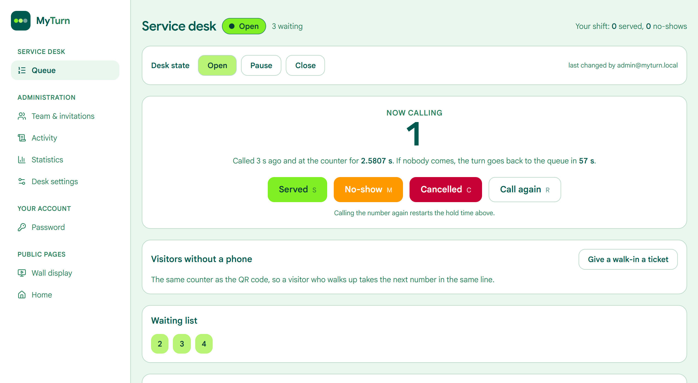
09 — THE DESK AND THE OFFICE
MyTurn
Two views of the same waiting line.
localhost:3000/staff/dashboard
Administration
A
Team & invitations
Invite, promote, switch off; the last administrator cannot be removed.
B
Activity
Ticket, desk and account history in one list, with the reason for each requeue.
C
Statistics
Counts, service-time distribution, busiest hours, target comparison and CSV.
D
Services & desks
Add a service with its letter, edit the wording and target, and see each service point's live state.
Staff: call, complete, skip, cancel, walk-in, recall and undo.
Live: hold countdown, average service time, keyboard shortcuts, per-desk analytics.
Your Turn, Made Simple.
10 / 15

Slide 11
10 — ACCOUNTS AND SAFETY
MyTurn
Rights are granted, checked and recorded.
VISITOR
STAFF
ADMINISTRATOR
DEVICE
No account
Invitation
Promoted
Device key
An opaque ticket token in the link. No name, phone number or email is ever requested.
Single-use, 72 hours. Sign in as a person, or with the shared classroom password.
Created only by the seed script or by another administrator. Never by public registration.
The ESP32 sends a key with every reading. It can report and ask for a setting; it cannot change the waiting line.
Server-side roles. Every admin route is checked twice: the page, and the API.
CSRF on writes. A double-submit token, kept in memory, not in localStorage.
Invitations cannot create admins. Asking for one is a 400.
Guarded last admin. You cannot demote the final administrator or switch off your own account.
No address leaks. A password reset answers the same whether or not the address exists.
Recorded. Account changes land in the activity history with the actor and the time.
A visitor never gets an account. A ticket asks for no name, phone number or email.
Your Turn, Made Simple.
11 / 15

Slide 12
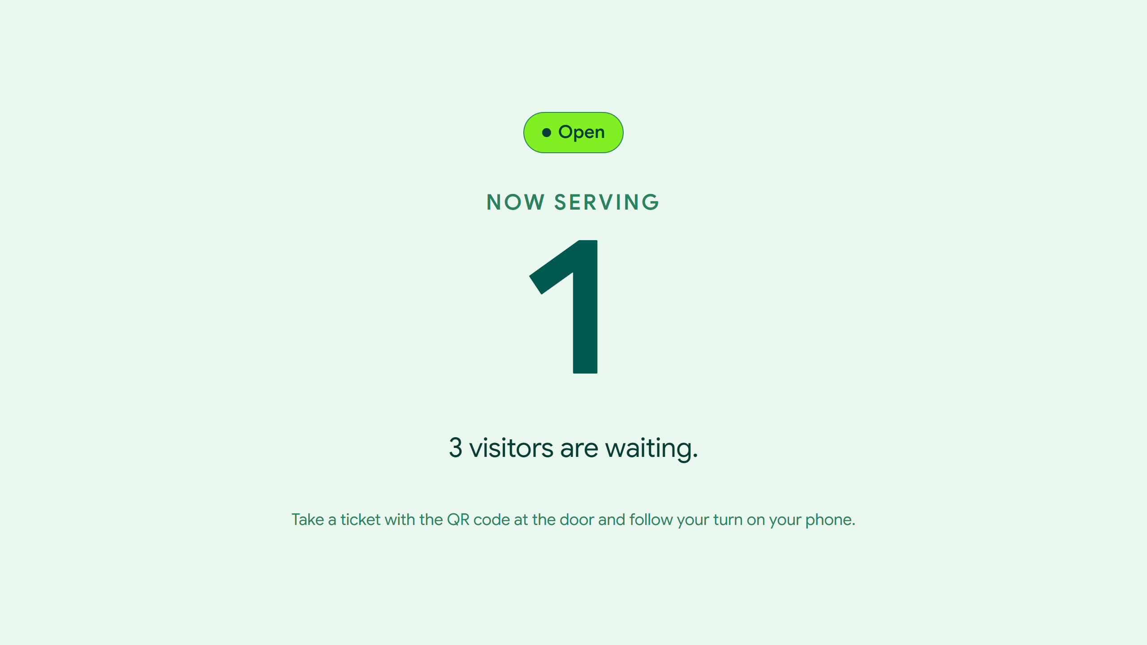
11 — THE DEMONSTRATION
MyTurn
What we will show on the day.
1
Take a ticket on a phone
Pick a service; the number comes from that waiting line's counter and the tracker opens.
2
Watch the display change
Call next at the desk; the wall screen and the phone update together.
3
Serve or record a no-show
Complete, skip or cancel. Undo is available for ten seconds.
4
Let a call expire
The ticket goes to the back of its service with a fresh number, and the reason is logged.
5
Show the board
Distance and approach change the LED; the dashboard shows what the board applied.
The waiting-area display
6
Close the desk
The ticket page says so before a visitor joins, and the LED follows.
Your Turn, Made Simple.
12 / 15

Slide 13
12 — TESTING
MyTurn
Tested, not assumed.
Every check was run against the running prototype, not read off the source.
234
71
API checks: accounts, CSRF, hold, requeue, estimate gate, services and desks
browser checks on the visitor, auth and desk pages
✓
The build is clean
TypeScript, ESLint and the production build all pass; all sixteen pages are generated.
45
8
✓
The rules are exercised
Auth and CSRF, the occupancy requeue with synthetic readings, the estimate gate, undo, recall, CSV, and the board's WebSocket reporting.
console checks: activity, statistics, settings, roles
sidebar checks, including the shared-session rules
!
Still measured by hand
The physical sensor trials and the photograph of the desk rig are the remaining figures; the report leaves them blank rather than inventing them.
358 automated checks. A feature is only finished when a check proves it.
Your Turn, Made Simple.
13 / 15

Slide 14
13 — CHALLENGES AND LIMITATIONS
MyTurn
What it does not do yet.
No daily reset
No separate SERVING state
Sensors measure only
The per-service counter keeps climbing across days. A midnight reset is specified but not built.
A called ticket is treated as being served; the dwell time is the service time. This is documented, not invented.
The PIR can see a passer-by, and the ultrasonic sensor needs a clean mount. Field accuracy is still to be recorded.
NOT BUILT
DELIBERATE
TO MEASURE
No buffering on the board
No mail server
Single process
An offline board keeps the full 60-second hold, by design. Readings taken while the Wi-Fi is down are discarded, not replayed.
Invitation and reset links are shown in the app and logged in development, not emailed. A production deployment needs SMTP.
SSE subscribers and rate-limit counters live in memory, so the API runs one worker. Scaling needs shared state.
NOT BUILT
PROTOTYPE
DEPLOYMENT
Also not built: spoken announcements and SMS alerts.
Your Turn, Made Simple.
14 / 15

Slide 15
14 — DELIVERED AND NEXT
MyTurn
Delivered, and what comes next.
DELIVERED
NEXT
✓
A working prototype: 16 pages, 12 tables, real accounts and roles.
1. Run and record the physical sensor trials; add the desk photograph.
✓
The ESP32 sketch: distance, approach, four LEDs, the buzzer and the desk setting.
2. Fill the measured figures into the report, without estimating them.
✓
Four suites, 358 automated checks, all passing.
3. Buffer readings on the board when the Wi-Fi drops.
✓
A proposal, a 55-page report and the design documents.
4. Add daily number resets for every service.
5. Speak the number aloud for visitors who cannot see the screen.
A working prototype, a tested waiting line, and a clear list of what still needs measuring.
Thank you. Questions?
Your Turn, Made Simple.
MyTurn · Internet of Things · 23 October 2026
15 / 15

