Slide 1
Front-End Development

Slide 2
What is front-end development?
Service integration
HTTP (Methods, status codes, JSON-Model Bindings)
Interface development
HTML, CSS, JavaScript, State
Data Architecture
JSON – Model, Model – JSON, View – JSON/Model.
Testing

Slide 3
What does a front-end project look like?
app/
View/
Model/
Controller/
Util/
templates/
package.json
node_modules/
WebContent/

Slide 4
Leveraging NodeJS for a final product (an App).
NPM for managing dev dependencies.
Testing (Karma)
Compressors (UglifyJS)
Pre-compilers written in JS
LOTS of Node Front-End build tools.
Notes:
NodeJS is a tool we can use to manage front-end project dependencies. There are tools that manage library dependencies of a front-end application itself, but they run on NodeJS.

Slide 5
NPM
For assembling everything you need to get going on a project:
npm install
For testing a project:
npm test
For running a remote device/browser test:
npm run test-remote
For building our final app (compressing, compiling css, etc)
npm run app-build

Slide 6
Testing our JavaScript
Reduce QA – Dev back-and-forth.
Greater confidence in code.
(Afraid a new enhancement is going to break something? Run your tests and find out.)
More Readable code ==(=) More velocity and flexibility in resource allocation.
(If you can’t test it, your code is probably a mess.
i.e. Tim doesn’t need to ask Rob what the VacancyAndMatchesClonerAndSaverAndDataViewerModalGodObject does.)

Slide 7
Karma
We can…
test in multiple browsers!
test on multiple devices!
Write tests for our JavaScript in JavaScript, and run them in real environments.
We can also:
Produce a JUnit-style xml result file.

Slide 8
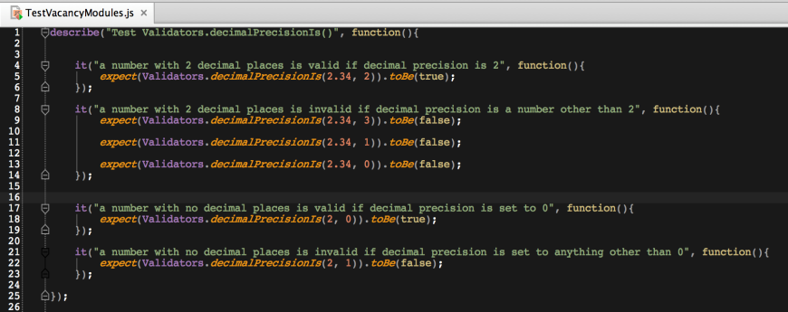
Writing a test in Jasmine

Slide 9
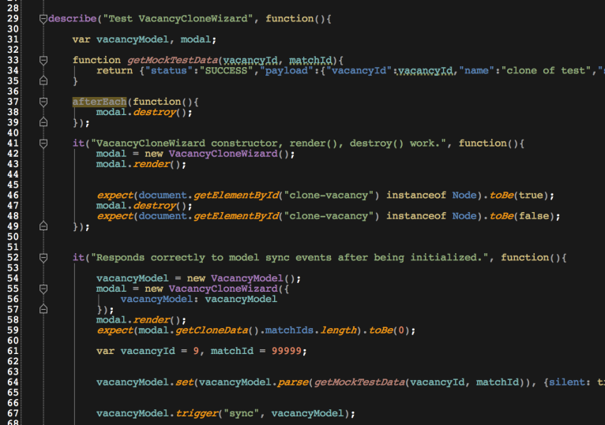

Slide 10
Running a karma test locally

Slide 11
Test configuration
To run our tests, we write a test.conf.js file. This file contains information like:
Reporter plugins to use.
Port and hostname to run the local test server at.
Test resources (where to find the tests, where to find the library dependencies for those tests.)
Which browsers to run the tests in.

Slide 12
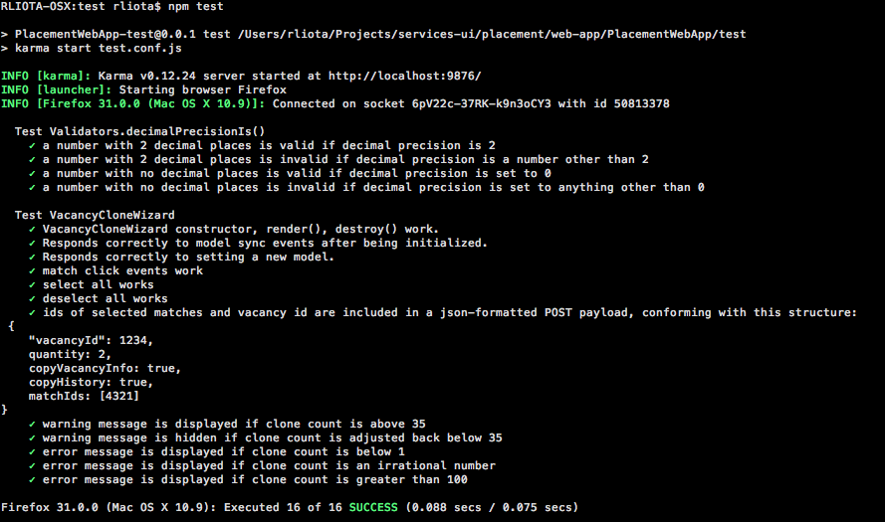
Example Test Run:

Slide 13
Remote tests.
Karma has a WebDriver plugin, which lets us run our tests in browsers on multiple machines.
Testable Browsers:
Firefox (Linux, OSX, & Windows)
Chrome (Linux, OSX, & Windows)
IE (maybe – Windows)

