Slide 1
Operating room planning MAS - Analysis and design
By Pascal Büttiker & Eric Neher

Slide 2
Agenda
Architecture
GAIA Methodoloy
Interaction/Communication
Opposition

Slide 3
Architecture
Hybrid Agent
Reactive event handling
Proactive planning
Layered approach
Bottom Layer → reactive behavior
Top Layer → long term planning

Slide 4
Architecture II
Learning Agents
Artificial Neural Network
Genetic algorithms
Pros
Highly adaptable
Developing own behavior
Self improving
Cons
Ethical problems → Machine decides about life!

Slide 5
GAIA – Subdivision of System
Patient Manager
Patient Departments
Resource Providers
Operating Room Provider
Surgeon Teams Provider
Postoperative Provider

Slide 6
GAIA – Patient Manager
Patients are entities
Health status as attribute
Assignment of patients to departments

Slide 7
GAIA - Patient Departments
Each department is an agent
own goals but also consider global optimum
Provide their patients with resources for surgery
Are willing to help other departments
Based on organizational rules

Slide 8
GAIA – Resource Providers
Provide the departemnts with resources
Auctions for every type of resource
Keep track of available/booked resources

Slide 9
GAIA – Organizational Rules
Patients have to fullfil certain preconditions (unless they fall into emergency case)
Emergency cases always have a higher priority
Care Package definition
Departments have to answer proposal calls for tasks of patients with a higher priority (if they can)

Slide 10
Interaction
Auctions
Departments bid for resources
Price is health status of patient
Contract Net Protocol
Interaction between departments
Task are missing resources

Slide 11
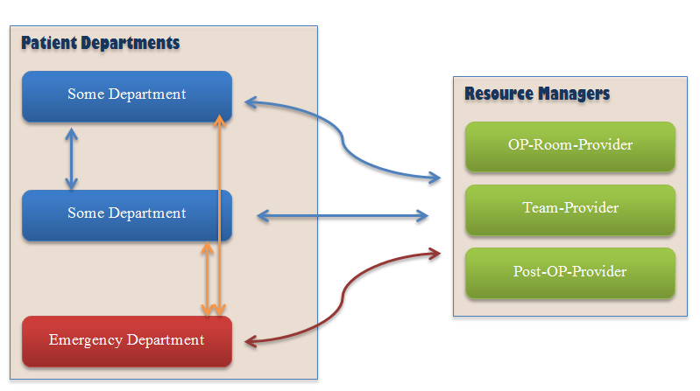
Communication/Interaction Overview

Slide 12
End

Slide 13
Opposition - Hari Sagar Ranjitkar & Jedidiah Waltedji
Organizational Rules
“Staffs should be helping patients even after successful
surgical operations since patient may be too weak for certain
time.”
What is the connection to the MAS?

Slide 14
Opposition - Hari Sagar Ranjitkar & Jedidiah Waltedji
Why are Auctions not suitable?
“Auctions like highest bidding or lowest bidding are not suitable in case of operating system planning system since they are more prices oriented…”
“Also, there is chance of not winning any auctions whereas in CNP there is very less chance that everybody rejects the proposal.”
In a MAS where all work together there is no looser

Slide 15
Opposition - Hari Sagar Ranjitkar & Jedidiah Waltedji
Patient as Agent
Which decision can this agent do?
➔ Is a patient not a simple Entity?

