Slide 1
Operating room planning MAS - Analysis and design
By Pascal Büttiker & Eric Neher

Slide 2
Agenda
Architecture
GAIA Methodoloy
Interaction/Communication
Opposition

Slide 3
Architecture
Hybrid Agent
Reactive event handling
Proactive planning
Layered approach
Bottom Layer → reactive behaviour
Top Layer → long term planning

Slide 4
Architecture II
Learning Agents
Artificial Neural Network
Genetic algorithms
Pros
Highly adaptable
Developing own behavior
Self improving
Cons
Ethical problems → Machine decides about life!

Slide 5
GAIA – Subdivision of System
Patient Manager
Patient Departments
Resource Providers
Operating Room Provider
Surgeon Teams Provider
Postoperative Provider

Slide 6
GAIA – Patient Manager
Patients are entities
Assignment of patients to departments

Slide 7
GAIA - Patient Departments
Each department is an agent
own goals
Provide their patients with resources for surgery
Are willing to help other departments
Based on organizational rules

Slide 8
GAIA – Resource Providers
Provide the departemnts with resources
Auctions for every type of resource
Keep track of available/booked resources

Slide 9
GAIA – Organizational Rules
Patients have to fullfil certain preconditions (unless emergency case)
Emergency cases always have a higher priority
Care Package definition
Departments have to answer proposal calls for tasks of patients with a higher priority

Slide 10
Interaction
Auctions
Departments bid for resources
Price is health status of patient
Contract Net Protocol
Interaction between departments
Task are missing resources

Slide 11
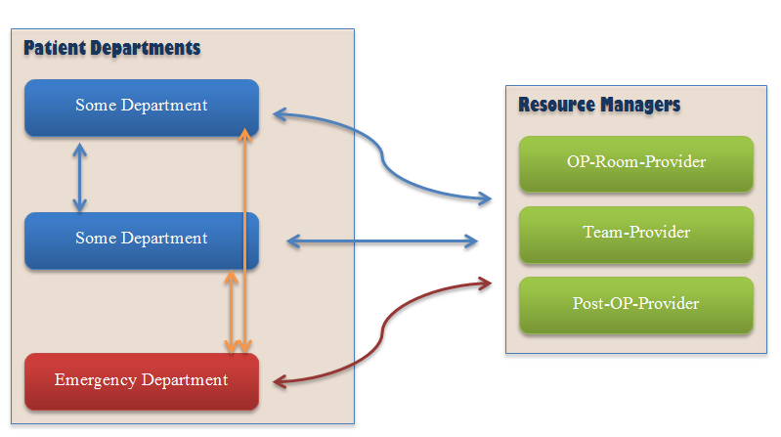
Communication/Interaction Overview

Slide 12
Opposition
They are o perating
room section protocol, emergency section protocol and
Outpatient protocol.
ICU is postoperative?
Why not combine both acutions and CNP?

