Slide 1

Cyclistic Bike-Share Analysis
Understanding User Behavior
Itzhak Elfassi

Slide 2
Introduction
Cyclistic, a prominent bike-share company, aims to shift its focus towards increasing annual memberships over casual riders. Understanding the distinctions between these user groups is paramount for developing tailored marketing strategies aimed at converting casual riders into loyal members.
As the data analyst leading this endeavor, my role is to identify key differentiators and provide actionable insights to the advertising team. Together, we strive to drive Cyclistic's growth by effectively targeting and engaging potential annual members.

Slide 3
Data Sources
My data is 12 excel files containing riding data from the 12 last month: 04/2023-03/2024.
Each table contains the next details for each ride:
Start & end station
Start & end time
Member/casual

Slide 4
Data processing and preparation:
Excel :
- I checked the data is matching to the variable (number/word etc.)
- I checked the values are matching to the variable (hours 00-24 etc.)
- I deleted duplications.
- I added two variables: ride length & weekday.
SQL:
I merged the 12 tables into one annual data table.

Slide 5
Analysis
Do members and casual riders are different in:
Their ride duration?
Their use of rides during the different parts of the day?
Their use of rides during the different days of week?
Their use of rides during the season of the year?
I analyzed the data by SQL
- Code will be followed.

Slide 6
ride length:
members | casuals
00:12:13 | 00:26:53
We can see that the casual rides are longer from the member rides.

Slide 7

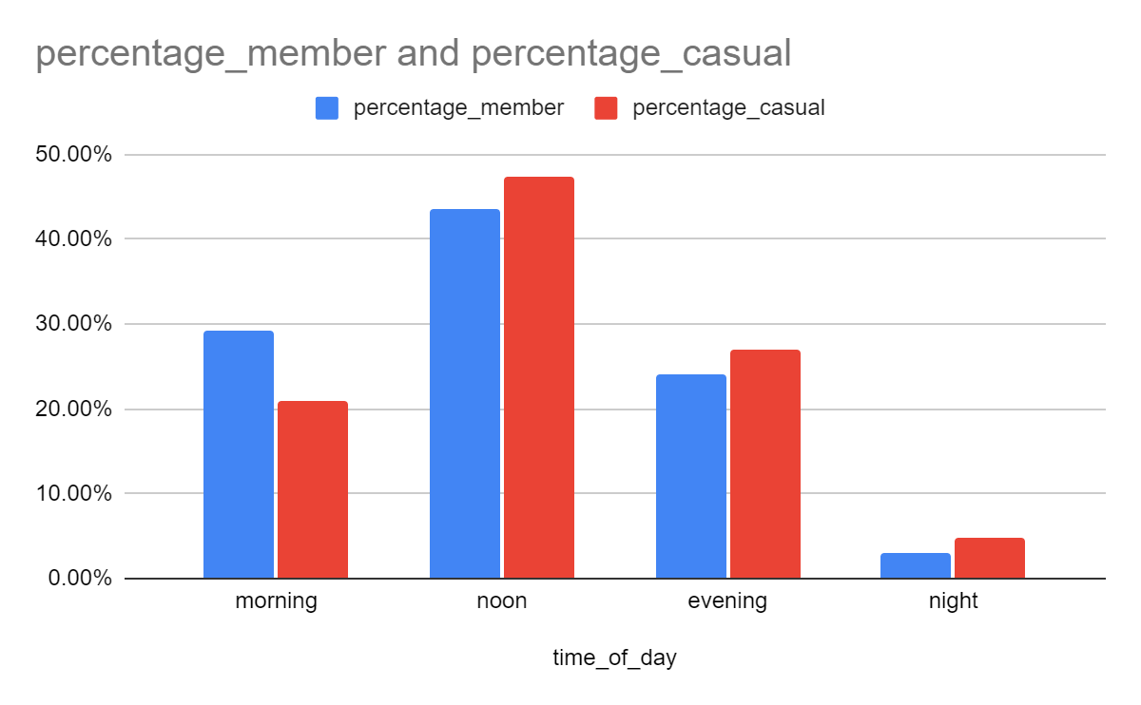
Usage during the day
Time of the day | Member | Casual
Morning (6-12) | 29.22 % | 20.94%
Noon (12-19) | 43.64% | 47.32%
Evening (19-00) | 24.05% | 26.95%
Night (00-06) | 3.09% | 4.79%
In this data we can see:
1. In the morning, members ride more than casuals.
2. In the rest of the day, casuals ride more than members.

Slide 8
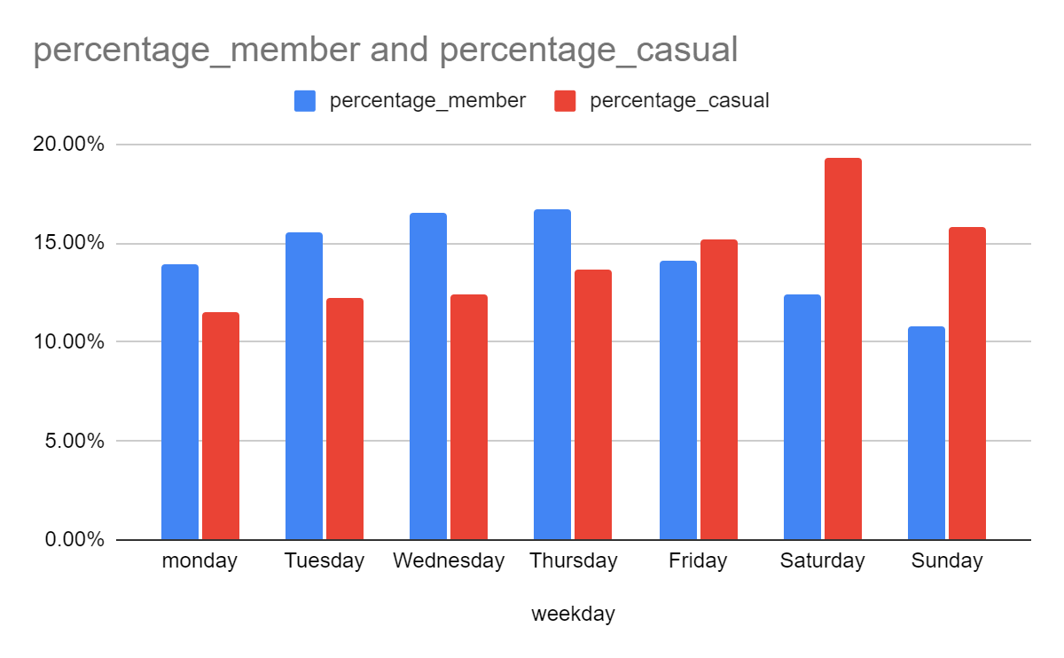
Usage during the week
When looking at this data we can see something more general than specific days. In this analysis we can see that on weekdays member ride more than casuals while on weekends casuals ride more.
Day | Member | Casual
Sunday | 10.75% | 15.77%
Monday | 19.95% | 11.53%
Tuesday | 15.55% | 12.2%
Wednesday | 16.52% | 12.38%
Thursday | 16.71% | 13.66%
Friday | 14.12% | 15.15%
Saturday | 12.4% | 19.3%

Slide 9
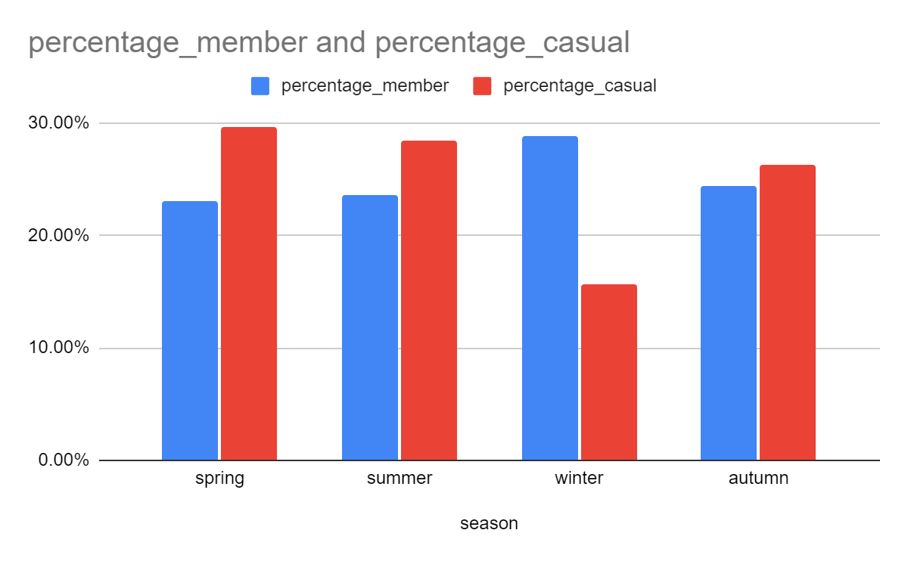
Usage during seasons
Here we can see two major differences:
During spring and summer, casuals ride more than members.
During winter, members ride more than casuals.
season | Member | Casual
spring | 23.1% | 29.6%
summer | 23.6% | 28.38%
winter | 28.85% | 15.7%
autumn | 24.45% | 26.32%

Slide 10
conclusion
Based on the difference I think that the members group has more serious character while the casual group are more spontaneous.
Members seem to have earlier routine and their use is more target-oriented, their rides are shorter and the ride more than casuals in the morning.
In addition we can see that on ‘vocational’ times like weekends, spring and summer the casual group is more active using bikes.

Slide 11
Recommendations
Our goal is to convert more casuals into members. Based on the data I found more free character among this group. This is why I would recommend:
Advertising:
using more casual and trip/vacation features.
focusing on the ‘fun’ of riding than its benefits.
Marketing:
Having member-discounts for weekends, summer and spring vacations.
Based on the data and its analysis these are my recommendations for helping the business and have more casual riders convert into members. Thank you!

Slide 12
SQL CODES: calculating ride length for casual/member:
select member_casual,
format_timestamp('%T', timestamp_seconds(cast(avg(unix_seconds(ended_at)- unix_seconds (started_at))as int64))) as average_ride_length
from molten-smithy-415814.project_coursera.connected
group by member_casual

Slide 13
Calculating the usage during the day:
with member_data as (select
case
when extract(hour from started_at) between 6 and 11 then "morning"
when extract(hour from started_at) between 12 and 17 then "noon"
when extract(hour from started_at) between 18 and 23 then "evening"
else "night" end as time_of_day, count(*) as num_of_rides_member,
concat(round((count(*)/(select count(*)from molten-smithy-415814.project_coursera.connected where member_casual = 'member'))*100,2),"%") as percentage_member
from molten-smithy-415814.project_coursera.connected
where member_casual = 'member'
group by time_of_day
), casual_data as (select
case
when extract(hour from started_at) between 6 and 11 then "morning"
when extract(hour from started_at) between 12 and 17 then "noon"
when extract(hour from started_at) between 18 and 23 then "evening"
else "night" end as time_of_day, count(*) as num_of_rides_casual,
concat(round((count(*)/(select count(*)from molten-smithy-415814.project_coursera.connected where member_casual = 'casual'))*100,2),"%") as percentage_casual
from molten-smithy-415814.project_coursera.connected
where member_casual = 'casual'
group by time_of_day)
select member_data.time_of_day,percentage_member,percentage_casual
from member_data join casual_data on member_data.time_of_day = casual_data.time_of_day

Slide 14
Calculating usage during the week
with member_data as(
select
weekday,
concat(round((count(*)/(select count(*)from molten-smithy-415814.project_coursera.connected where member_casual = 'member'))*100,2),"%") as percentage_member
from molten-smithy-415814.project_coursera.connected
where member_casual = 'member'
group by weekday
order by weekday),
casual_data as ( SELECT
weekday,
CONCAT(ROUND((COUNT(*) / (SELECT COUNT(*) FROM molten-smithy-415814.project_coursera.connected WHERE member_casual = 'casual')) * 100, 2), "%") AS percentage_casual
FROM
molten-smithy-415814.project_coursera.connected
WHERE
member_casual = 'casual'
GROUP BY
weekday)
select member_data.weekday,member_data.percentage_member, casual_data.percentage_casual
from member_data join casual_data on member_data.weekday = casual_data.weekday
order by member_data.weekday

Slide 15
Calculating time during seasons:
with member_data as(
select
case when extract(month from started_at) between 3 and 5 then "spring"
when extract(month from started_at) between 6 and 8 then "summer"
when extract(month from started_at) between 9 and 11 then "autumn"
when extract(month from started_at) in (12,1,2) then "winter" end as season,
concat(round(count(*)/(select count(*) from molten-smithy-415814.project_coursera.connected where member_casual = "member")*100,2),"%") as percentage_member
from molten-smithy-415814.project_coursera.connected
where member_casual = "member"
group by season),
casual_data as(select
case when extract(month from started_at) between 3 and 5 then "spring"
when extract(month from started_at) between 6 and 8 then "summer"
when extract(month from started_at) between 9 and 11 then "autumn"
when extract(month from started_at) in (12,1,2) then "winter" end as season,
concat(round(count(*)/(select count(*) from molten-smithy-415814.project_coursera.connected where member_casual = "casual")*100,2),"%") as percentage_casual
from molten-smithy-415814.project_coursera.connected
where member_casual = "casual"
group by season)
select member_data.season, member_data.percentage_member,casual_data.percentage_casual
from member_data join casual_data on member_data.season = casual_data.season

