Slide 1
ZERAKI SCHOOL EXAM ANALYSIS
BY THE DIRECTOR OF STUDIES
Time Taken 30 minutes

Slide 2
FORM 4 PRE-MOCK SUBJECT GRADES
Grade | ENG | KIS | MAT | BIO | PHY | CHE | HIS | GEO | CRE | HSC | AD | AGR | COM | FRE | GER | MUS | BST
A |  | 8 | 10 | 1 | 4 | 11 | 2 | 24 | 6 | 1 | 2 | 6 | 5 | 1 |  | 1 | 1
A- | 16 | 22 | 18 | 1 | 4 | 44 | 2 | 8 | 28 |  | 4 | 18 | 7 | 2 | 1 | 5 | 9
B- | 7 | 54 | 45 | 23 | 23 | 28 | 9 | 17 | 67 | 1 | 5 |  | 8 |  |  | 3 | 16
B | 130 | 50 | 32 | 98 | 9 | 83 | 8 | 12 | 47 | 3 | 7 | 32 | 24 | 11 | 10 | 5 | 16
B+ | 27 | 27 | 17 | 71 | 5 | 6 | 1 | 11 | 36 |  | 3 | 1 | 22 | 4 | 2 | 3 | 11
C+ | 34 | 52 | 37 | 40 | 30 | 31 | 18 | 25 | 46 | 8 | 3 |  |  |  | 3 |  | 14
C | 64 | 45 | 40 | 69 | 26 | 58 | 15 | 17 | 49 | 14 | 2 | 5 | 2 | 5 | 4 |  | 8
C- | 96 | 33 | 30 | 60 | 28 | 42 | 16 | 8 | 29 | 16 | 6 | 11 |  | 3 | 7 | 8
D+ | 80 | 17 | 34 | 61 | 16 | 55 | 10 | 3 | 11 | 10 | 1 | 14 |  | 1 | 1 | 1 | 1
D | 40 | 18 | 22 | 33 | 15 | 43 | 8 | 2 | 3 | 6 |  | 7 | 11 |  |  |  | 2
D- | 10 | 4 | 20 | 27 | 6 | 24 | 6 | 1 | 5 |  |  | 3
E | 3 | 2 | 29 | 9 | 1 | 36 | 5 | 14
X |  | 2 | 1 | 2 | 1 | 1 | 10 | 1 | 2 |  | 1 |  | 1 |  |  | 1 | 2

Slide 3
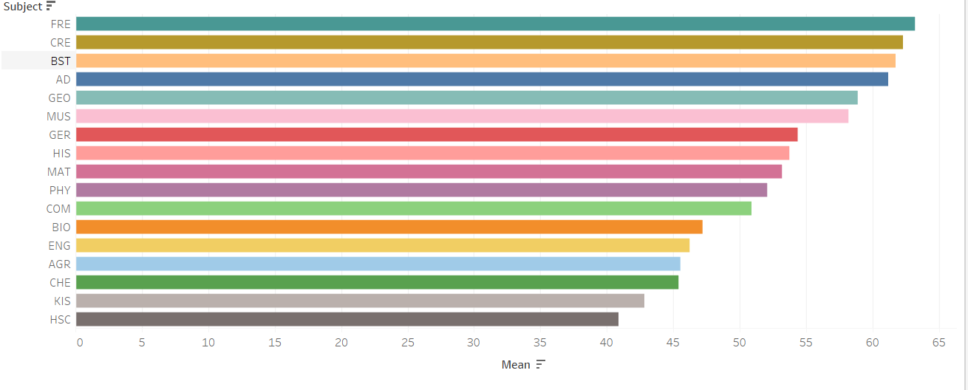
Form 4 Pre-mock subject Mean marks

Slide 4
Observations
French, CRE and Business studies were the most well performed subjects, in that order.
They had higher mean marks than the other subjects
Home Science, Kiswahili and Chemistry recorded the worst performance in that order.
They had the lowest mean marks
Most students (10) missed History exam than any other subject
Mathematics and Chemistry recorded the highest number of grade E

Slide 5
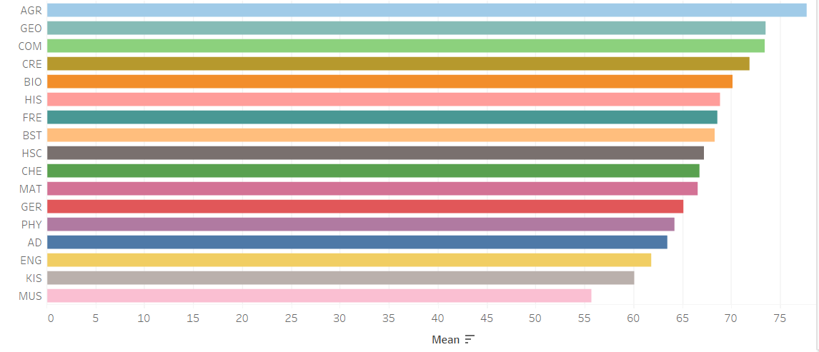
Subject mean marks for form 1

Slide 6
FORM 1 GRADE SUMMARY
GRADE | ENG | KIS | MAT | BIO | PHY | CHE | HIS | GEO | CRE | HSC | AD | AGR | COM | FRE | GER | MUS | BST
A | 8 | 17 | 244 | 329 | 282 | 326 | 187 | 317 | 269 | 166 | 6 | 140 | 261 | 22 | 49 | 20 | 68
A- | 34 | 47 | 98 | 81 | 88 | 193 | 166 | 151 | 194 | 102 | 6 | 44 | 144 | 26 | 11 | 61 | 26
B+ | 98 | 124 | 124 | 123 | 111 | 186 | 168 | 154 | 185 | 89 | 15 | 39 | 165 | 26 | 16 | 84 | 48
B | 175 | 160 | 137 | 86 | 79 | 121 | 154 | 101 | 155 | 56 | 11 | 28 | 101 | 37 | 17 | 95 | 95
B- | 241 | 198 | 103 | 106 | 111 | 80 | 135 | 95 | 107 | 67 | 12 | 15 | 114 | 31 | 20 | 60 | 60
C+ | 197 | 187 | 92 | 88 | 60 | 42 | 89 | 91 | 51 | 52 | 17 | 12 | 165 | 16 | 16 | 16 | 37
C | 137 | 125 | 78 | 80 | 80 | 26 | 49 | 47 | 24 | 42 | 13 | 5 | 70 | 20 | 13 | 17 | 37
C- | 67 | 87 | 53 | 54 | 48 | 16 | 28 | 24 | 16 | 24 | 6 | 1 | 48 | 5 | 8 | 5 | 26
D+ | 34 | 31 | 37 | 21 | 55 | 9 | 11 | 16 | 4 | 14 | 5 | 1 | 21 | 4 | 7 | 7 | 11
D | 7 | 19 | 18 | 18 | 37 | 3 | 9 | 4 | 3 | 8 | 2 | 1 | 11 | 2 | 5 | 5 | 8
D- | 4 | 6 | 15 | 13 | 30 | 1 | 6 | 4 | 1 | 1 | 1 | 1 |  | 3 | 3 | 3 | 6
E | 2 | 2 | 7 | 8 | 23 |  | 1 | 1 |  |  |  |  |  | 4 |  | 4
Y | 1 |  |  |  |  | 1 | 1
X |  |  |  |  |  |  | 1 |  |  |  |  |  | 2

Slide 7
Observations
Agriculture, Geography and Computer recorded the best performance in Form Exams
Music, Kiswahili and English recorded the worst performance in that order
A significant number of students missed the computer exam
Physics recorded the highest number of grade E

Slide 8
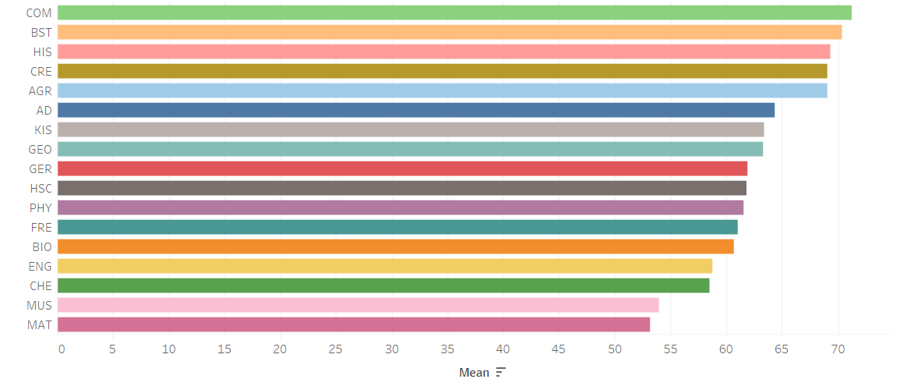
FORM 2 Subject Mean marks

Slide 9
Form 2 Grade Summary
GRADE | KIS | MAT | BIO | PHY | CHE | HIS | GEO | CRE | HSC | AD | AGR | COM | FRE | GER | MUS | BST
A | 33 | 80 | 170 | 52 | 78 | 197 | 29 | 340 | 1 | 3 | 105 | 48 | 9 | 22 | 1 | 76
A- | 117 | 60 | 148 | 52 | 87 | 114 | 40 | 234 | 3 | 14 | 33 | 38 | 16 | 14 | 5 | 30
B+ | 217 |  |  |  | 217 |  |  |  |  |  | 18 | 25 | 6 |  |  | 38
B | 217 | 105 | 158 | 69 | 115 | 69 | 38 | 142 | 8 | 9 | 17 | 12 | 11 | 12 | 3 | 18
B- | 225 | 125 | 144 | 71 | 137 | 44 | 28 | 72 | 8 | 2 | 8 | 9 | 9 | 10 | 6 | 16
C+ | 112 | 99 | 86 | 39 | 121 | 21 | 22 | 27 | 11 |  | 7 | 6 | 5 | 7 | 4 | 6
C | 67 | 111 | 68 | 35 | 121 | 19 | 17 | 10 | 9 | 1 | 3 | 5 | 7 | 1 | 2 | 1
C- | 23 | 113 | 47 | 17 | 34 | 8 | 7 | 6 | 7 |  | 3 | 6 | 6 | 3 | 5 | 1
D+ | 8 | 85 | 34 | 13 | 75 | 5 |  | 1 | 2 |  |  | 1 | 4 | 4 | 2
D | 1 | 59 | 20 | 5 | 47 | 1 |  |  |  |  |  |  |  |  | 2
X | 1 | 1 | 1 | 1 | 1 | 1 | 1 | 1 | 1 |  | 1 |  | 1 | 1 |  | 1

Slide 10
Observations
Form 2 Students performed well in Computer, Business Studies and History
Mathematics, Music and Chemistry performed badly

Slide 11
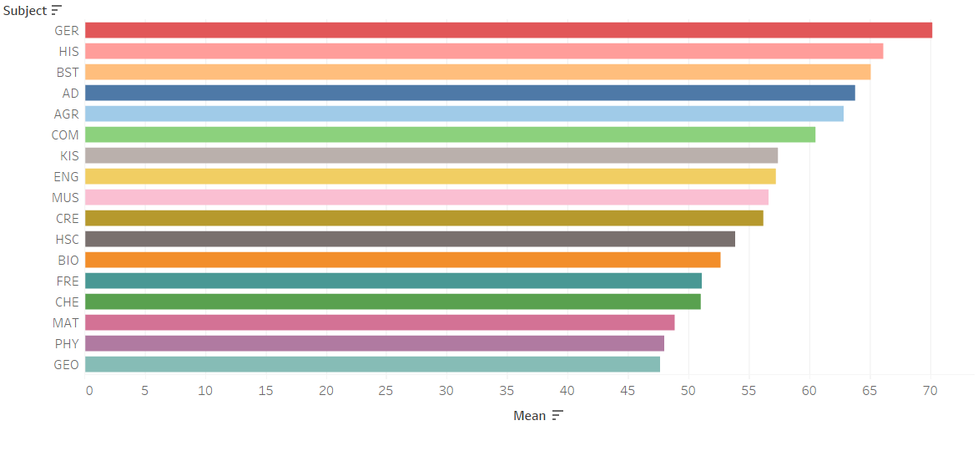
Form 3 Subject mean marks

Slide 12
Form 3 Subject grade summary
GRADE | KIS | MAT | BIO | PHY | CHE | HIS | GEO | CRE | HSC | AD | AGR | COM | FRE | GER | MUS | BST
A | 2 | 22 | 13 | 20 | 11 | 68 | 41 | 48 | 1 | 2 | 10 | 5 |  | 2 | 1 | 24
A- | 16 | 41 | 31 | 13 | 44 | 64 | 31 | 99 |  | 4 | 18 | 11 |  | 4 |  | 34
B+ | 49 | 70 | 71 | 28 | 66 | 56 | 47 | 131 | 5 | 3 | 28 | 22 | 6 | 2 | 6 | 54
B | 130 | 60 | 98 | 43 | 83 | 38 | 51 | 137 | 12 | 7 | 32 | 24 | 5 | 5 | 5 | 36
B- | 205 | 233 | 165 | 56 | 135 | 26 | 57 | 152 | 19 | 9 | 27 | 15 | 12 | 9 | 43
C+ | 175 | 92 | 181 | 62 | 110 | 23 | 29 | 126 | 16 | 7 | 15 | 15 | 12 | 8 | 6 | 23
C | 192 | 140 | 149 | 83 | 153 | 10 | 44 | 128 | 14 | 2 | 7 | 10 | 13 | 10 | 16 | 16
C- | 105 | 116 | 130 | 63 | 118 |  | 35 | 81 | 7 | 1 | 3 | 7 | 10 | 5 | 11 | 11
D+ | 83 | 119 | 81 | 55 | 103 | 5 | 27 | 58 | 8 | 2 |  | 1 | 15 | 1 |  | 7
D | 32 | 74 | 48 | 35 | 64 | 2 | 19 | 22 | 1 |  | 1 | 1 | 8 | 1 | 1
D- | 14 |  | 22 | 18 | 58 |  | 22 | 17
E | 3 | 63 | 15 | 15 | 60 | 4 | 14 | 7 | 1 |  |  |  | 6

Slide 13
Observations
German, History and Business Studies were performed well in Form 3
Form 3 students did not do well in Geography, Physics and Mathematics
Chemistry and Mathematics recorded the highest number of grade E

Slide 14
ASSUMPTIONS
The subject Analysis was done using mean marks as the ranking criteria as mean points would have resulted to ties due to the huge number of students
Form 1-3 exam data were combined and an yearly analysis of three exams was done to get a clearer picture of how the classes were performing on year average
For form 4, the pre-mock exam was used for the analysis as it depicted the expected performance in KCSE
Name does not have any values and Admission number column were removed since they don’t have much relevance in the overall analysis
Grades were initially removed from marks for the assumption that they will interfere with statistical computing of mean marks since they are not numerical
The grades were later added

Slide 15
CONCLUSIONS
The School has trend of recording better performance in Technicals and Humanities and poor performance in Sciences and Mathematics
Therefore more action is needed to improve the performance of Sciences and Mathematics

Slide 16
RECOMMENDATIONS
The Board of Management should hire more Chemistry, Physics and Mathematics teachers as they had the worst performance
The Board to consider improving and stocking the science Laboratories as part of ensuring adequate resources to the students
The board to consider adding music resources to ensure form 1 and form 2 students perform better and end up choosing taking Music in form 3 and form 4

Slide 17
THANK YOU.

