Slide 1


TIME SERIES ANALYSIS: ZILLOW_DATA.CSV
PHASE 4 DATA SCIENCE PROJECT
GROUP MEMBERS ;
MYLES KIGANANE
DIANA OLULO
ISAAC MUNYAKA
MATAEN SURUPAI
ROSALINE MUNGAI

Slide 2
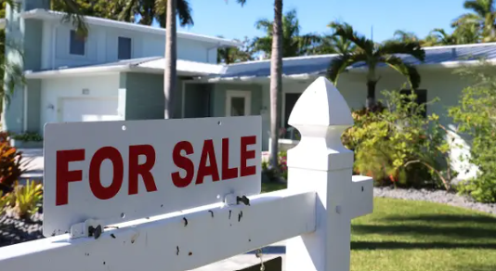
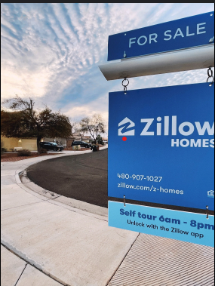
I
INTRODUCTION
Zillow is an online real estate marketplace offering home valuations, sales, rentals, and neighborhood information across the United States.
On this particular project, we have a USA based stakeholder seeking to construct residential homes that provide a return on investment.
By using Zillow data, the stakeholder can gain a deeper understanding of market dynamics, identify growth opportunities and mitigate risks associated with market fluctuations.

Slide 3
II
PROBLEM STATEMENT
Stakeholder ;,real estate investment firm seeking to construct residential homes in the United States. The main aim is to build homes and properties that have a high return on investment.
OBJECTIVES
Identify the top 5 zip codes for the real estate agency to invest in.
Forecast future house prices in these zip codes.
Provide insights and recommendations
BENEFITS
Stakeholders making data-driven decisions and informed decisions on property acquisitions and financial investments.
Getting market Insights in a timely manner.
Policymakers are able to create targeted interventions to promote housing affordability and stimulate economic growth.

Slide 4
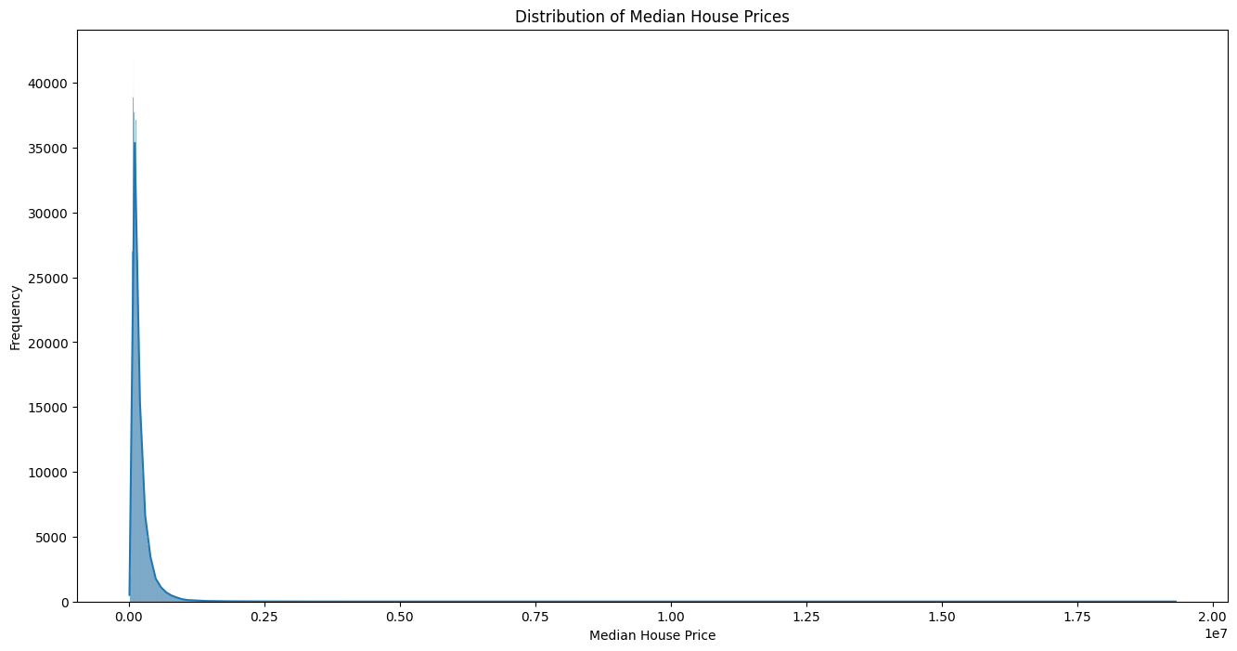
III
DATA UNDERSTANDING
The dataset used in this project comprises historical median house prices from various states in the USA, spanning from April 1996 to April 2018 (22 years).
Most houses in the region cost around 100,000 dollars.

Slide 5
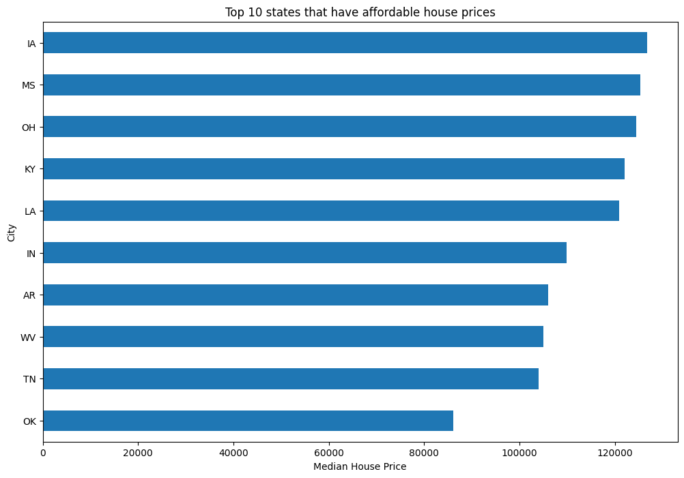
TOP 10 MOST AFFORDABLE STATES
'OK':OKlahoma is the most affordable state .

Slide 6
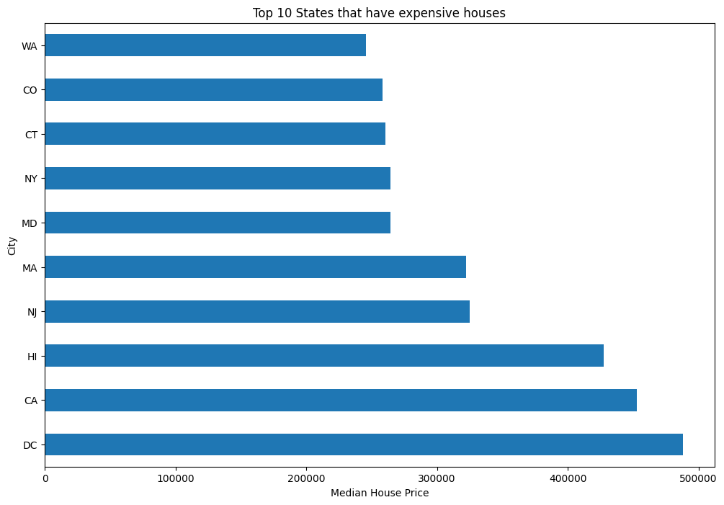
TOP 10 MOST EXPENSIVE STATES
The range of house prices spans from about $250,000 to $500,000. The District of Columbia stands out as the most expensive.

Slide 7
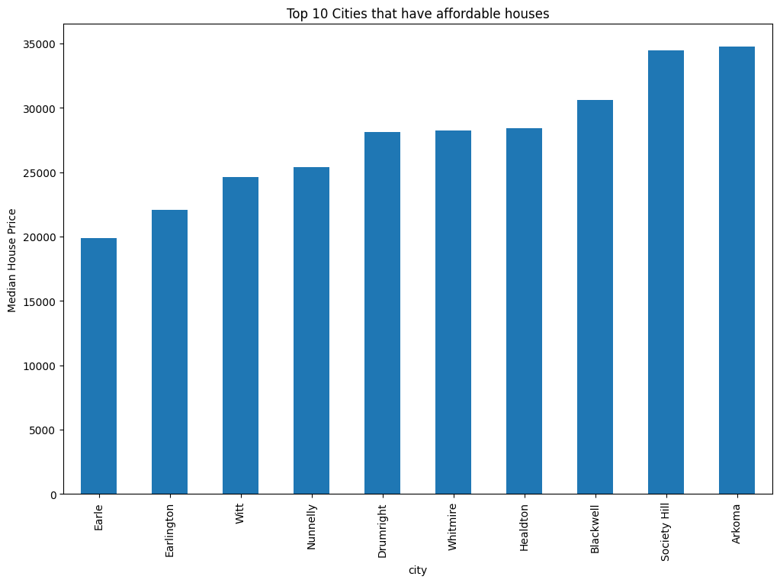
TOP 10 MOST AFFORDABLE CITIES
The range of house prices spans from about $21,000 to $35,000. These cities represent areas where housing is significantly more affordable Earle being the cheapest city

Slide 8
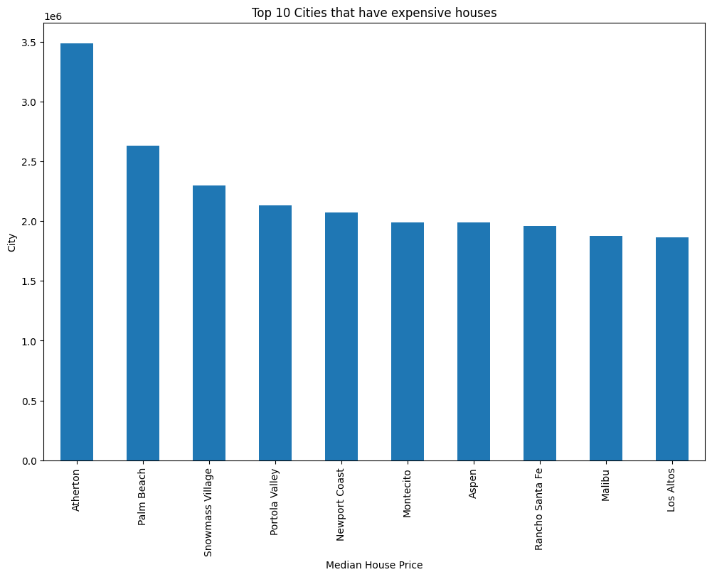
TOP 10 MOST EXPENSIVE CITIES
Atherton is the most expensive city in the USA followed by; Palm Beach
The house prices in these cities range from approximately1,501,827 dollars to 881,347 dollars.

Slide 9
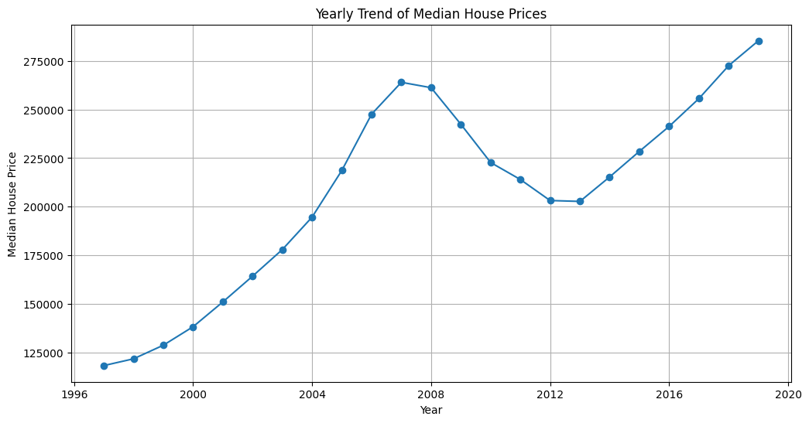
YEARLY TREND OF HOUSE PRICES
From 1996 to 2020: prices increase steadily to 2007, drop till 2012, then consistently rise again through 2020.

Slide 10
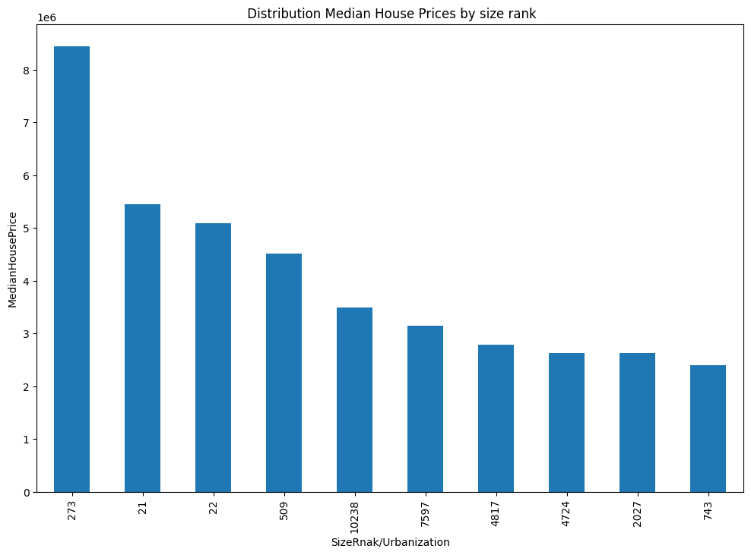
HOUSE PRICES BASED ON URBANIZATION
Based on our data ,urbanization has no effect on the house prices .

Slide 11
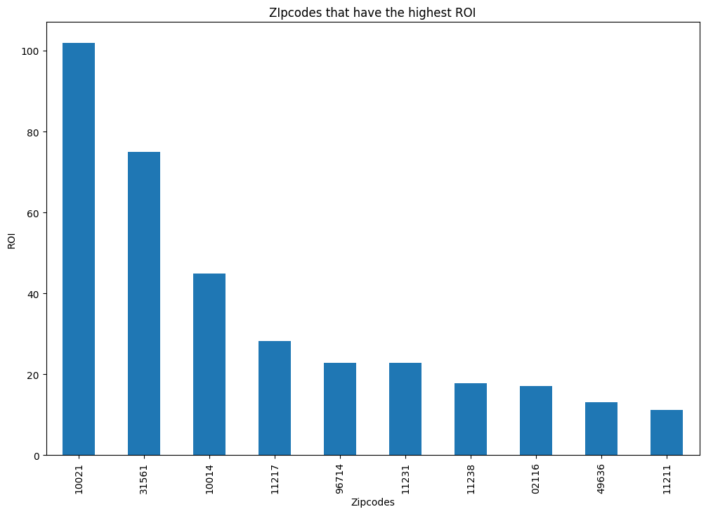
ZIPCODES WITH THE HIGHEST ROI ON HOUSES
The top 5 zipcods with the Highest return on investment is 10021 followed by 31561, 10014, 11217, 96714, 11231, 11238, 02116 ,49636 and 11211.

Slide 12
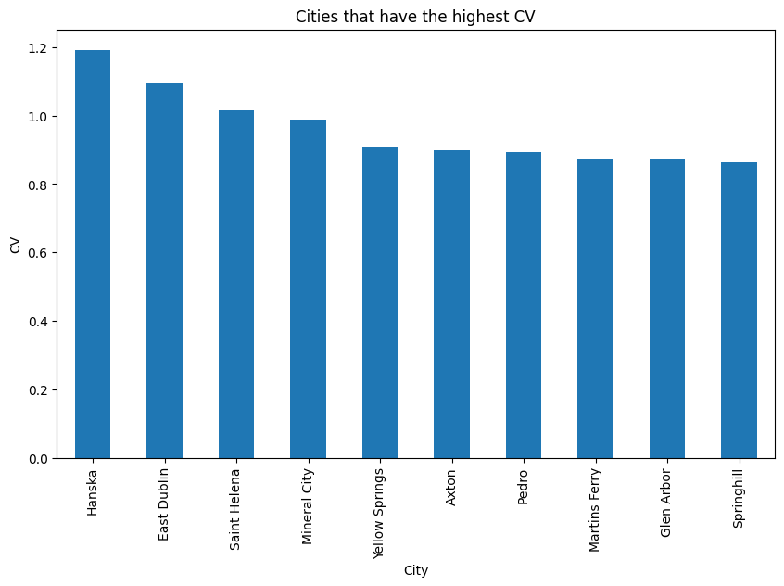
CITIES WITH THE HIGHEST RISK ON INVESTMENT
The cities with the highest price volatility are:
Hansika, East Dublin
Saint Helena, Mineral City
Yellow springs, Axton
Pedro, Martins Ferry
Glen Arbor, Spring Hill.

Slide 13
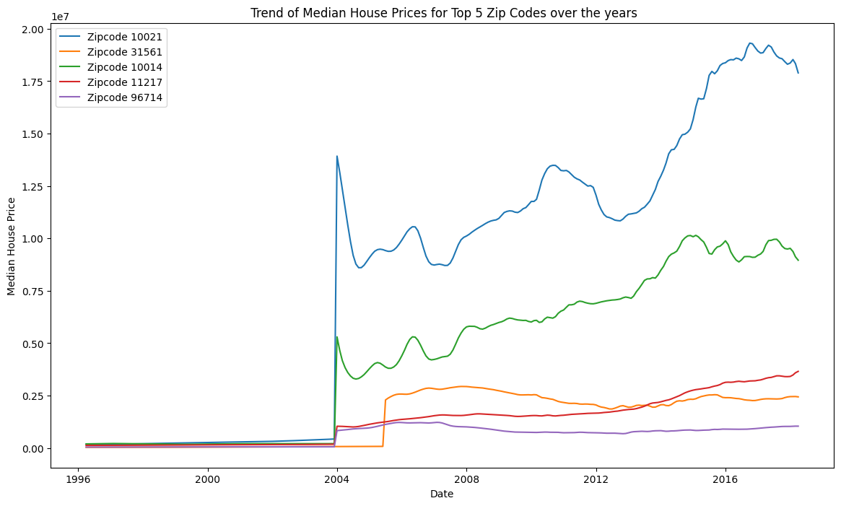
TREND OF HOUSE PRICES FOR THE TOP 5 ZIPCODES OVER THE YEARS
The prices remain constant between 1996 and 2004
The prices start increasing from 2004 then slightly drop in 2012 due to various factors then from there the prices go up.

Slide 14
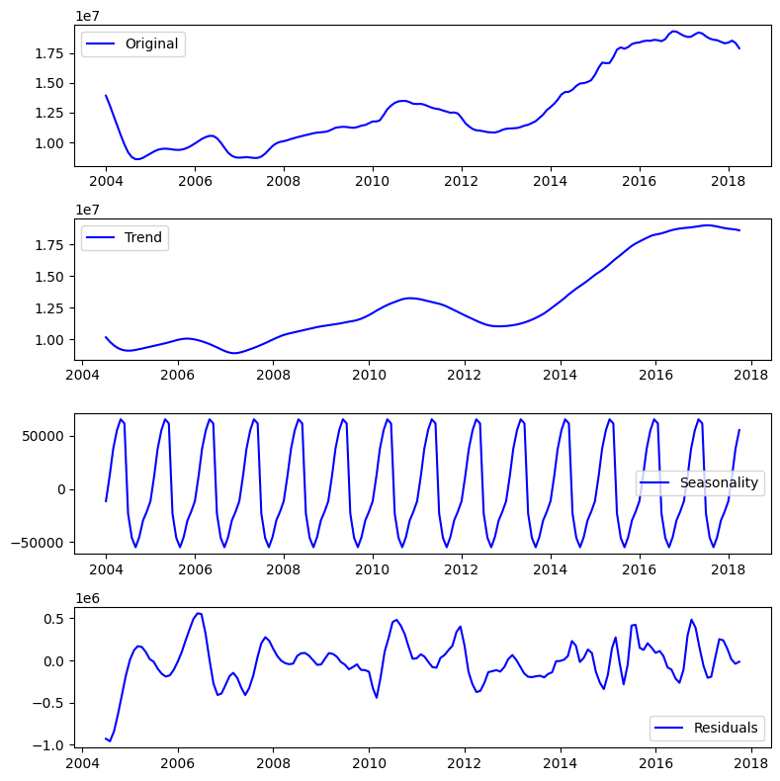
TIME SERIES ANALYSIS
Trend between 1999 and 2004 is quite consistent which was abnormal therefore we focused from the year 2004 to 2018 .

Slide 15
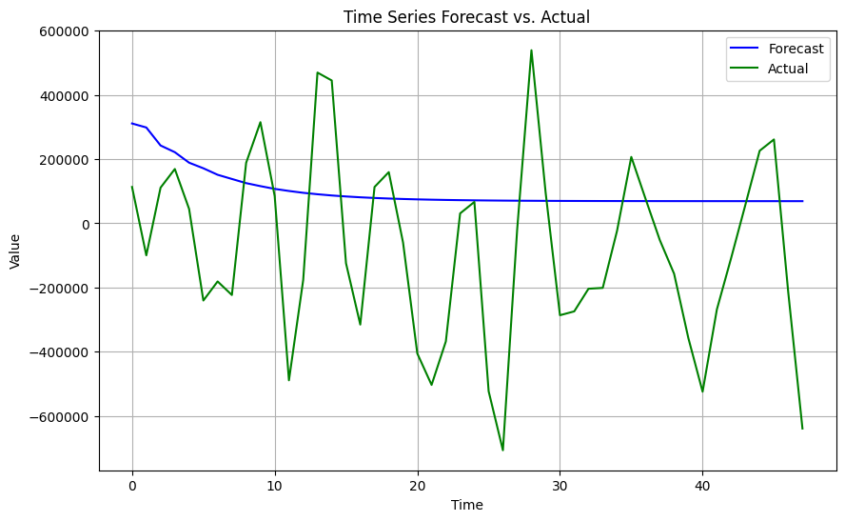
FORECAST VS. ACTUAL DATA
ARIMA MODEL
The forecast fails to accurately predict extreme variations seen in the actual data.

Slide 16
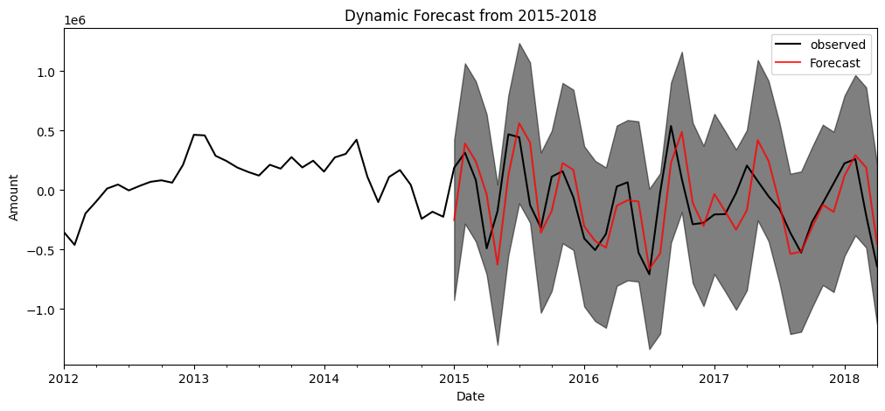
FORECAST VS. ACTUAL DATA
SARIMA MODEL
The forecast performed well in capturing the trend and seasonality over time

Slide 17
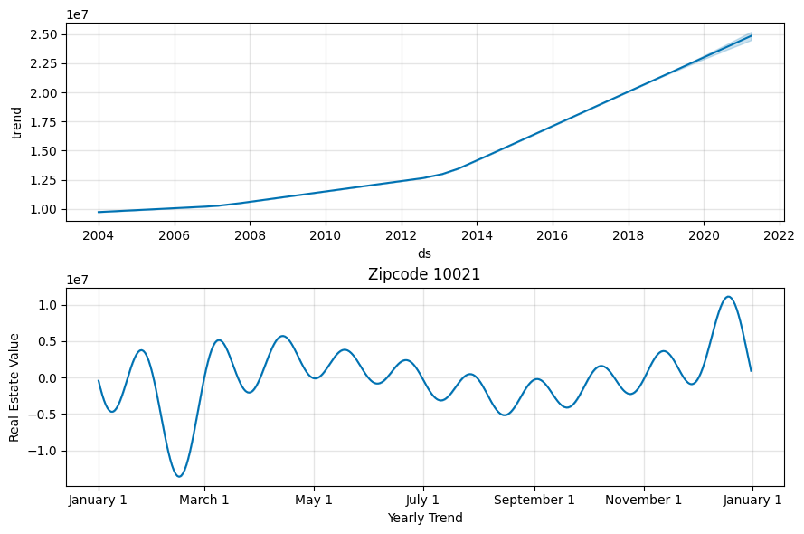
TREND
PROPHET
The trend suggests that real estate values in this zipcode have increased significantly over time. Prices appear to have risen from around $1 million in 2004 to over $10 million by 2022.

Slide 18
IV
EVALUATION
The goal was to identify the top five zip codes with high ROI as well as forecasting future house prices in these zip codes for investment opportunities,
The top 5 zip codes with the highest ROI were observed as follows:10021,31561,10014,11217,96714 /11231 , respectively.
SARIMA model was the best model due to seasonality in the data with minimal errors. The model was able to capture the seasonality spikes when forecasting future prices in the top zip codes.

Slide 19
v
INSIGHTS AND RECOMMENDATIONS
FOCUS ON TOP-PERFORMING ZIP CODES:
Investing in 10021 (Manhattan, NY) specifically covering the neighborhoods of the West Village, Greenwich Village, and a portion of Hudson Square.
31561 (Sea island) is known for luxury resort
10014 (Manhattan, Ny), upper east side.
11217 (Brooklyn, Ny)
96714 (Hanalei, HI) / 11231 (Brooklyn, Ny)
11231: Carroll gardens
Diversification:
Diversify investments across the top zip codes to mitigate risk.
Future Forecasting:
Stay updated with local market trends, economic indicators,

Slide 20

Vi
CONCLUSION
Investing in the identified high Roi zip codes can provide substantial returns due to their historical performance and market desirability.
Prioritizing investments in zip codes 10021 and 31561 while diversifying across the other high-performing areas will help the real estate investment firm maximize its returns while mitigating risks.
Continuing to forecast and monitor market conditions will ensure that investments remain profitable in the long term.

