Slide 1
BAF × STELLAR BUILDER CHALLENGE
PartyPay
High-speed custodial payment infrastructure built on Stellar for live events and high-volume merchants.
Validated B2B Partner: Secrets (Costa Rica)
Stellar Native DEX Rails

Slide 2

Problem Validation
The High Cost of Checkout Friction
Endless Bar & Gate Queues
Multi-second payment latencies stall entrance gates and beverage sales in dense venues.
Direct Revenue Drop-Off
Frustrated event attendees abandon lines, causing immediate unrecoverable sales loss.
Network Outages & Fees
Legacy card terminals fail during peak crowd hours alongside high processing fees.

Slide 3




Market Validation & Partner
Anchor Client Integration: Secrets
Real Venue Partner
2,000 – 5,000 Attendees
Sustainable Business Model
Direct B2B partnership with Secrets, a leading live event organizer in Costa Rica.
High-density audience testing peak payment throughput at venue entrance and bars.
Transaction fee capture co-designed for long-term venue profitability and growth.

Slide 4
Product Usability
Frictionless Custodial Wallet Architecture
Email & Password Auth
Zero Seed Phrases
Local Fiat Rails
Self-Explanatory UX
Instant wallet creation using standard email credentials without web3 complexity.
Custodial key management eliminating technical barriers for general event attendees.
Instant top-ups directly integrated with local Costa Rican banking rails.
One-tap QR checkout allowing attendees to pay without needing guidance.

Slide 5
Technical Infrastructure
Powered by Stellar Settlement Engine
< 1s
Auto
< $0.001
Sub-Second Speed
Path Payments
Ultra-Low Overhead
Instant transaction finality ensuring non-stop entrance & bar processing.
Background asset swaps executed atomically via native Stellar DEX.
Fraction-of-a-cent fees preserving venue and vendor profit margins.

Slide 6
Testing & Adoption Milestones
Real-World Pilot Growth Schedule
PHASE 1 · HALLOWEEN 2026
PHASE 2 · NEW YEAR'S EVE 2026
PHASE 3 · EARLY 2027
10 – 50 Users
50 – 100 Users
100+ Active Users
Initial live deployment during Halloween night event with Secrets venue.
Scaled stress test during peak end-of-year holiday nightlife surge.
Consolidated active user base expanding to recurring venue & retail partners.

Slide 7
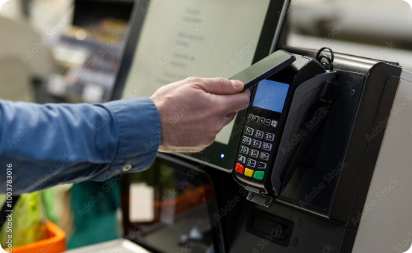
Go-To-Market & Scale
Mainnet Scale via VISA & MoneyGram Anchors
MoneyGram Cash Anchor
Physical cash-in and cash-out liquidity points worldwide for custodial balances.
VISA Anchor Integration
Virtual card issuing enabling mainnet spending at any traditional POS terminal.
Universal Merchant Network
PartyPay evolves from an event feature into a universal daily payment wallet.

Slide 8



Competitive Advantage
Why PartyPay Wins
Real Client Demand
Ultra-Light Rails
Ecosystem Gateway
Co-designed with Secrets to solve verified live venue checkout friction.
Built on Stellar for near-zero fees and instant transaction execution.
Leap from live event payments into a universal custodial daily wallet.

Slide 9
Builder Challenge Criteria
Comprehensive Evaluation Alignment
PROBLEM VALIDATION
BUSINESS FOCUS
PRODUCT FOCUS
TECHNICAL EXECUTION
Secrets Venue
Mainnet Scale
Self-Guided UX
Stellar Engine
Verified directly with a real 2,000–5,000 attendee event operator in Costa Rica.
Clear fee capture model expanding to universal retail via VISA & MoneyGram.
Custodial email login with simple QR flow ready for unassisted user testing.
Sub-second settlement with automated DEX path payments and clean code.

Slide 10
FUTURE OUTLOOK
From Costa Rica Events to Global Mainnet Retail
We have the validated problem, the B2B client (Secrets), and the sub-second power of Stellar.
PartyPay × Stellar

