Slide 1
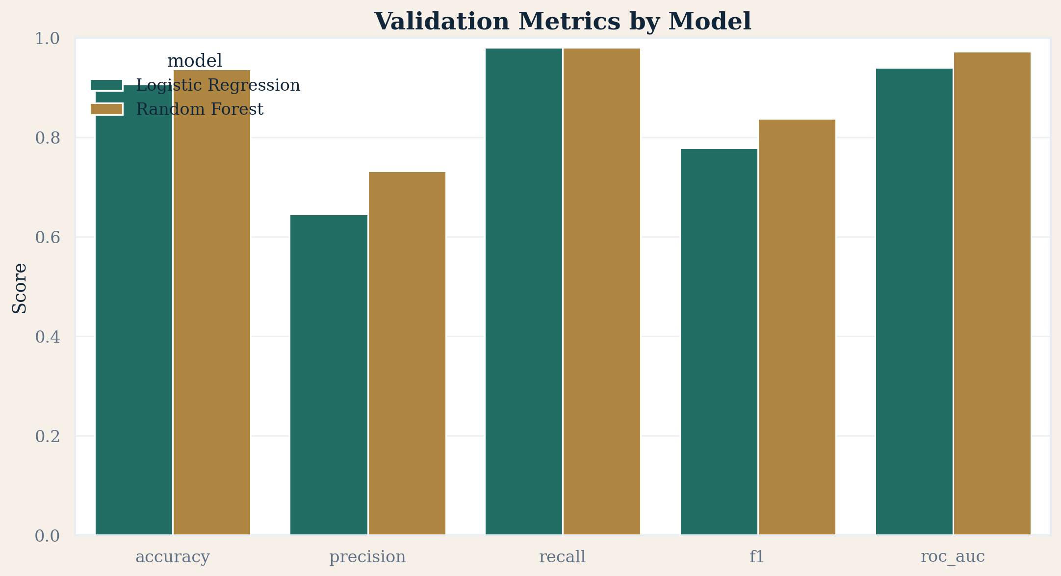
Xente Loan Default Prediction
Prepared by OMODING ISAAC (B31331)
Business, Management and Financial Data Analytics
Leakage-aware machine learning workflow
Jupyter notebooks, premium visuals, and Streamlit deployment

Slide 2
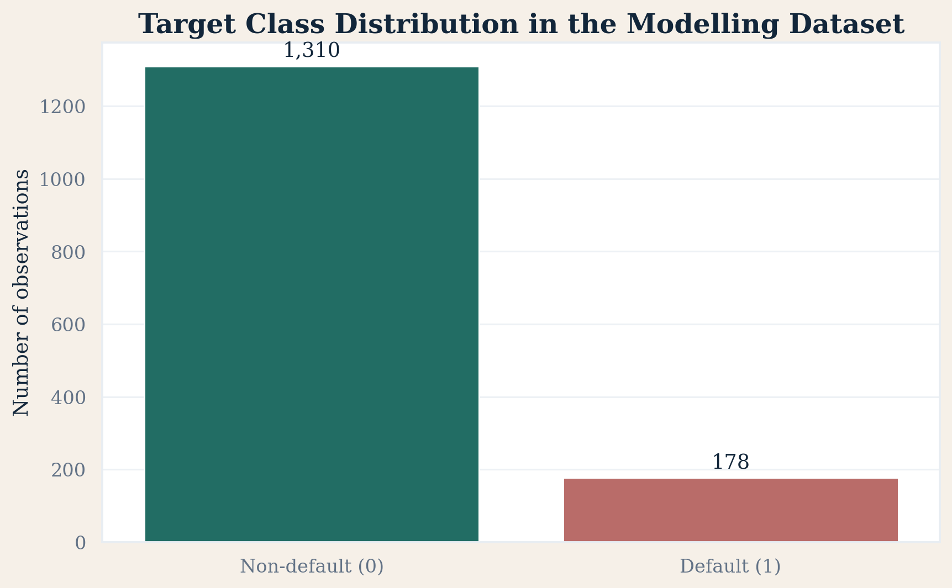
Business Problem and Objective
Xente extends digital credit through a mobile-first financial platform.
Loan default erodes profitability, liquidity, and long-term sustainability.
Objective: predict whether a borrower is likely to default on a loan.
Goal: support earlier and more consistent credit decisions.

Slide 3
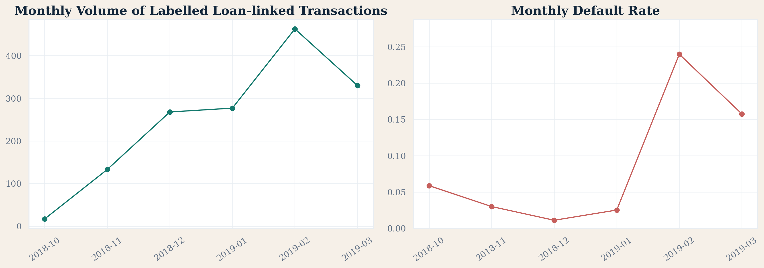
Dataset and Modelling Unit
TRAIN.csv used for EDA, cleaning, feature engineering, and validation.
TEST.csv reserved for final unseen scoring.
unlinked_masked_final.csv used to enrich prior customer behaviour.
A practical row-level model was used while acknowledging repeated customer and loan events.

Slide 4
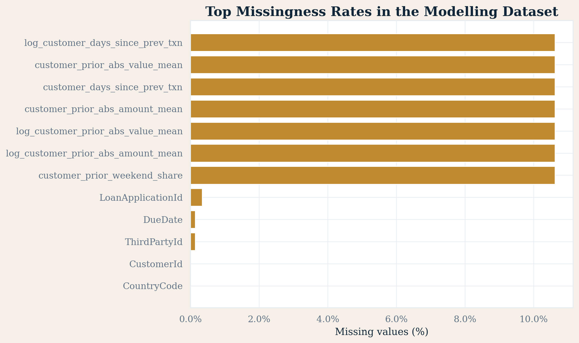
Data Quality and Leakage Control
Only labelled observations were used for supervised learning.
Missingness was profiled column-by-column instead of handled blindly.
Outliers were treated with business-aware log scaling and IQR clipping.
Repayment and payback fields were excluded to prevent leakage.

Slide 5
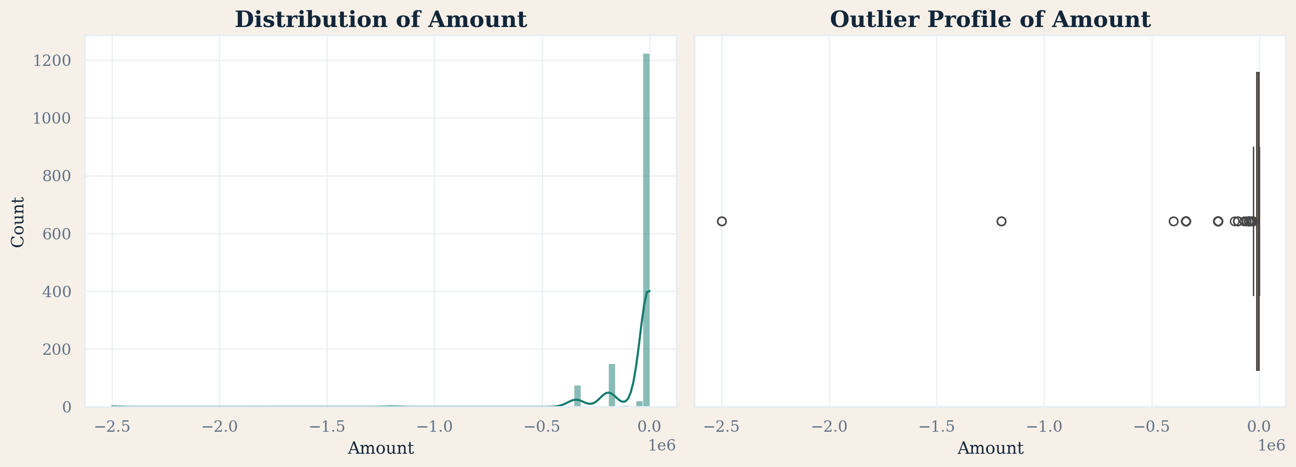
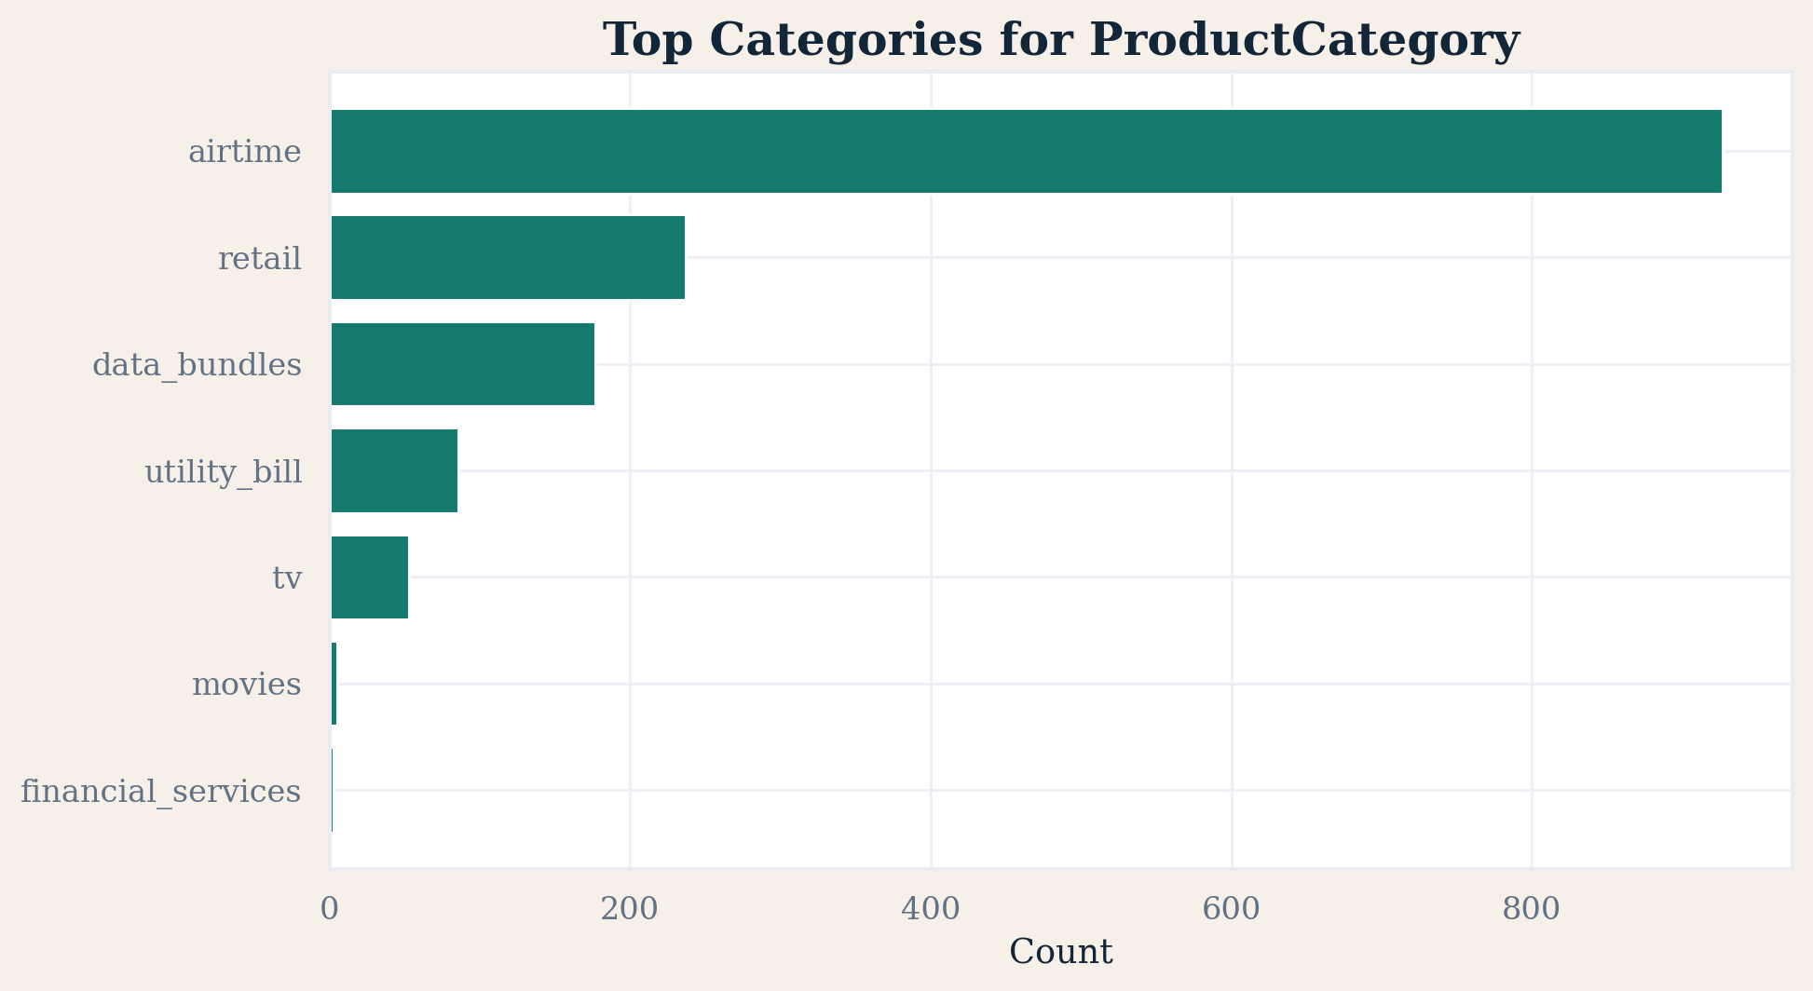
EDA Highlights

Slide 6
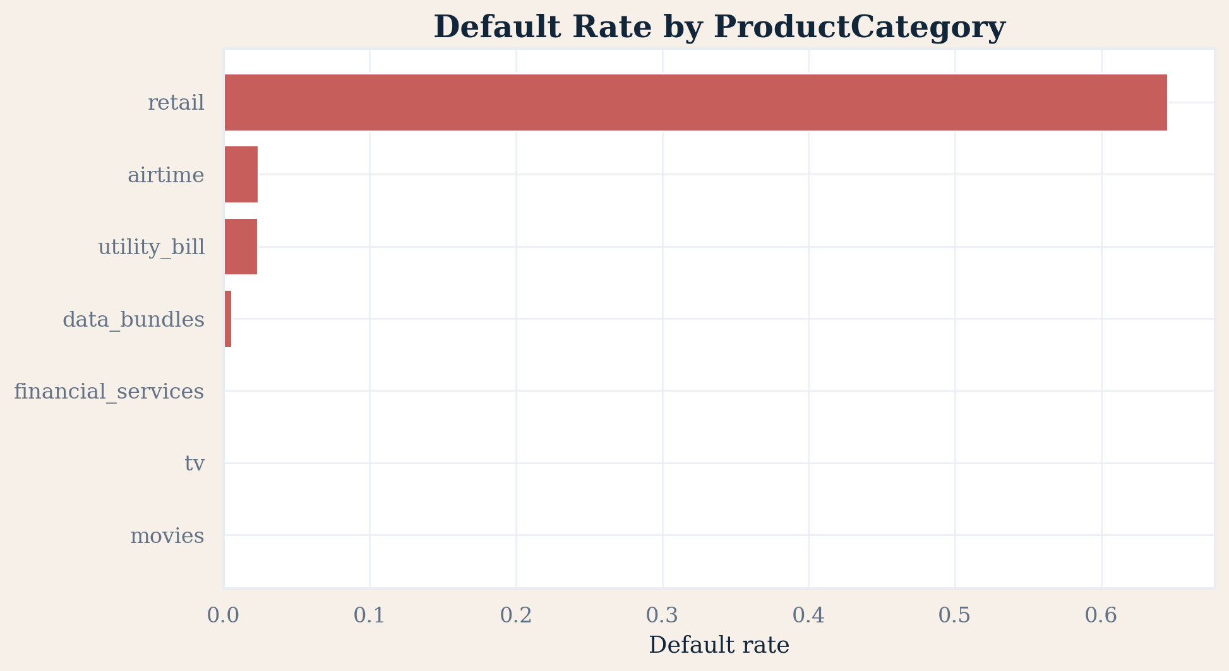
Feature Engineering and Selection
Transaction intensity: amount, value, ratios, and log-scaled variants.
Temporal context: month, day, hour, weekday, and weekend indicator.
Behavioural history: prior counts, prior spending, diversity, recency, and tenure.
Raw IDs were excluded; behaviour summaries were retained.

Slide 7
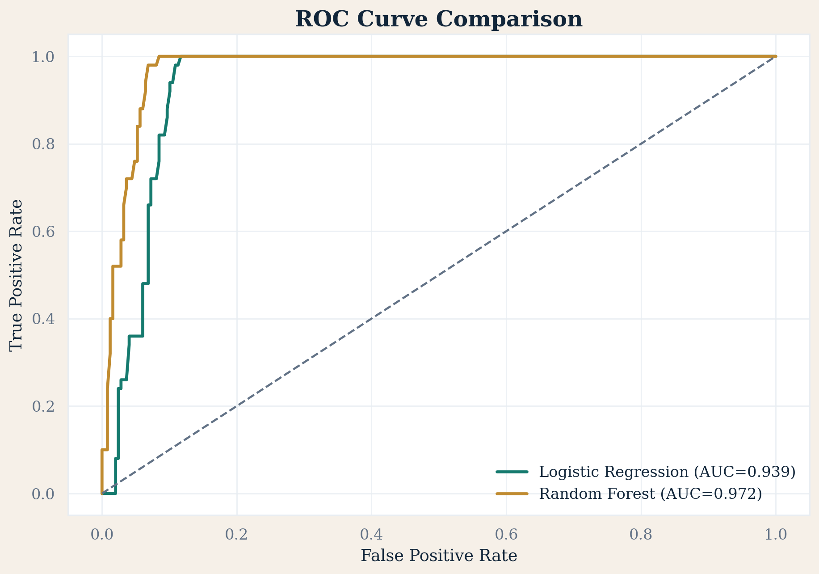
Model Comparison

Slide 8
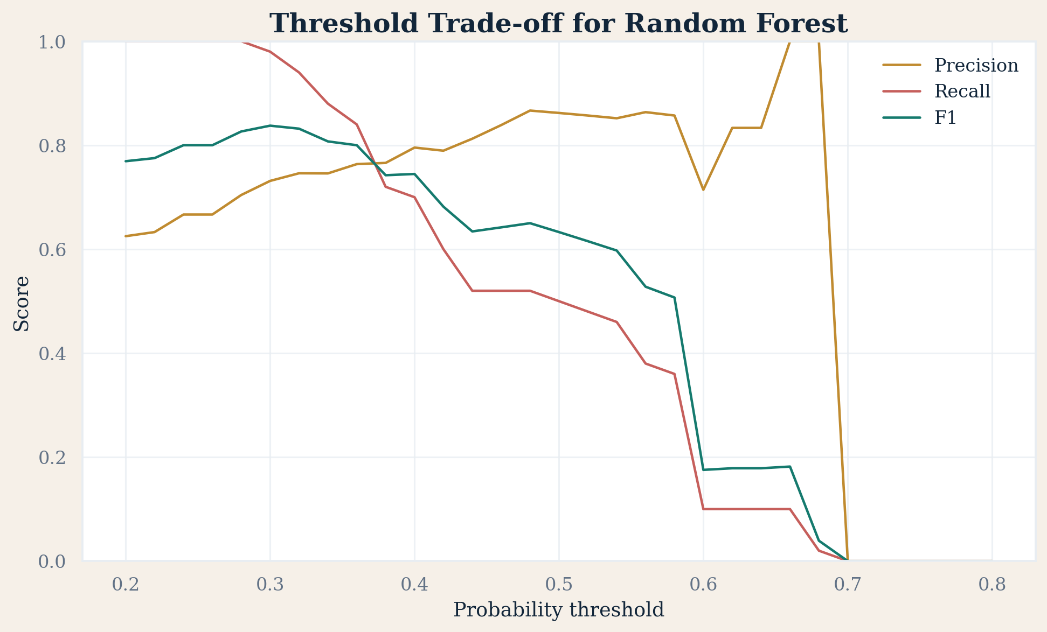
Best Model and Threshold
Best model: Random Forest
F1-score: 0.838
ROC-AUC: 0.972
Recommended threshold: 0.30
Threshold tuning improved the balance between precision and recall.

Slide 9
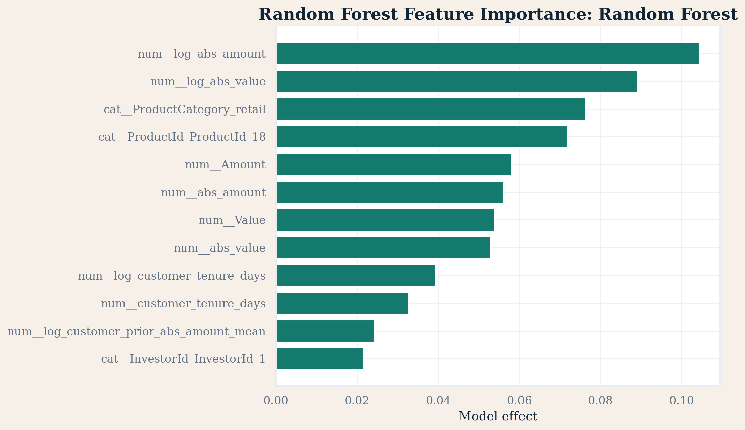
Most Influential Features

Slide 10
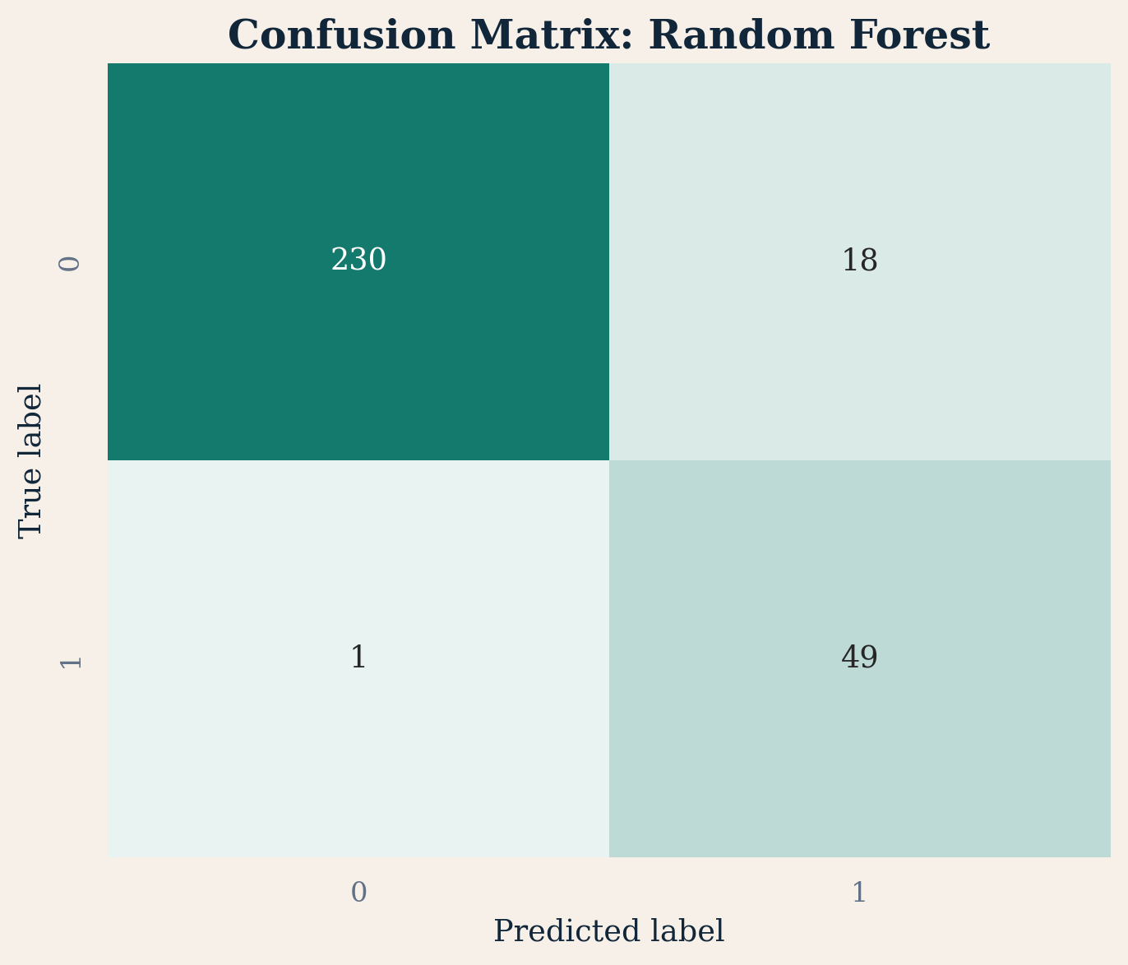
Business Recommendations
Use the score as an early warning signal in digital credit approval.
Flag medium-risk and high-risk cases for manual review.
Combine the model with business rules around product usage and borrower history.
Monitor model drift and recalibrate periodically.

Slide 11
Deployment
Streamlit app includes data overview, EDA, cleaning logic, model performance, and live scoring.
The app loads saved artifacts instead of retraining on every run.
Notebook deliverables document the full analytical workflow.

