Slide 1

Cybersecurity In Washington State
A predictive and inferential analysis

Slide 2

The Data

Slide 3
Original Data
990 Databreaches (rows)
24 descriptive columns ()
Only includes number affected > 500
Several derivative columns
Primarily categorical information

Slide 4
Transformations
Columns Kept: When attacks occurred, how many they affected, the type of breach, and type of organization breached.
Added seasons
Added years
Added an unreported category to attack types

Slide 5

Big Picture Analysis

Slide 6

Predictive/Inferential Models
Attack type
Organization type
Days of exposure
Season

Slide 7
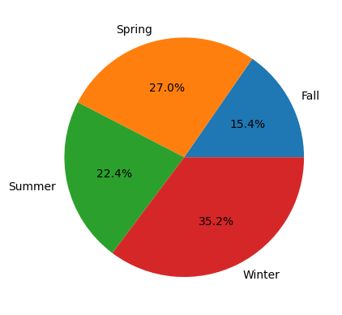
Seasons
“The Federal Bureau of Investigation (FBI) and the Cybersecurity and Infrastructure Security Agency (CISA) have observed an increase in highly impactful ransomware attacks occurring on holidays and weekends.”
(cisa.gov)

Slide 8
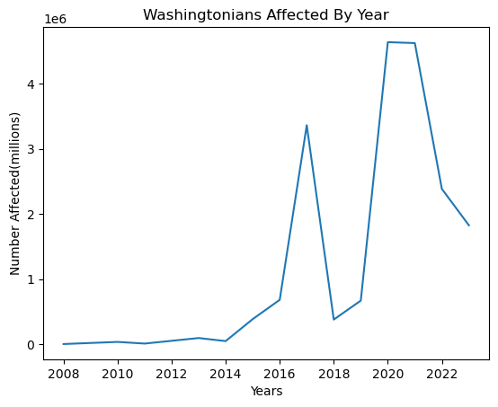
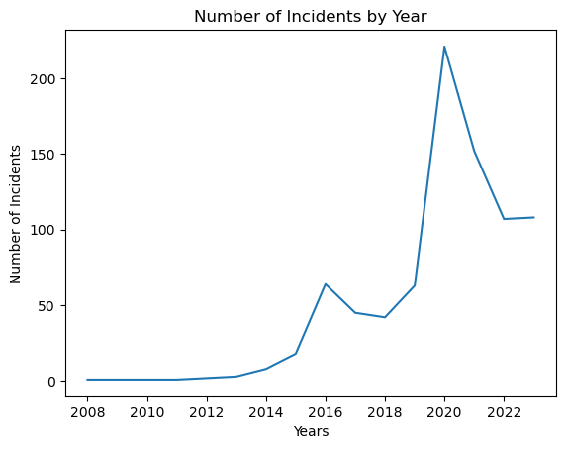
Years
Number of Affected per Year
Number of Incidents per Year

Slide 9
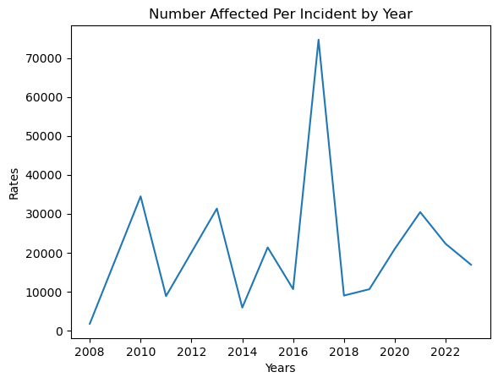
Rate over time
”According to the Online Trust Alliance (OTA), the number of cybersecurity incidents nearly doubled from the previous year. Attributed… to the unprecedented rise of ransomware” (securityintelligence.com, Larry Loeb)

Slide 10
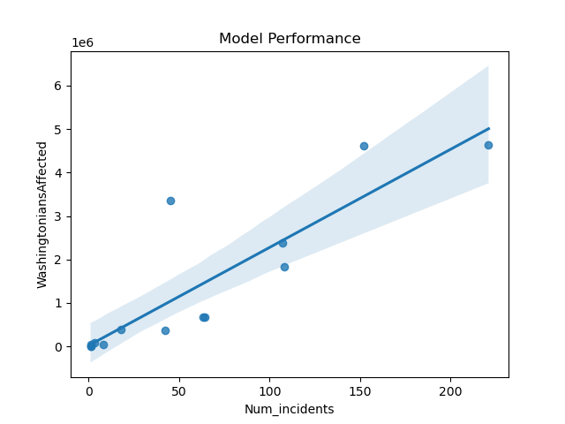
Using Number of Incidents to Predict Number of Affected
Use: End of Year summary predictions
Behavior: Plug in a number of incidents, get out a number of people affected.
Performance: Will improve over time

Slide 11

Focused Exploration

Slide 12
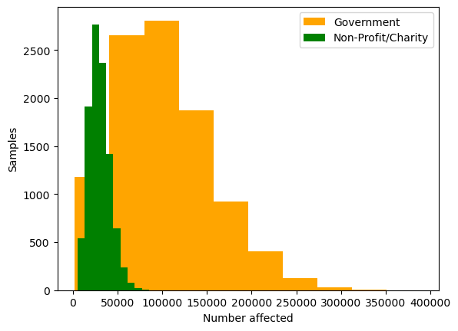
Gov vs. Nonprofit on a case-by-case basis
For an individual breach, government databases are far more likely to affect far more people.

Slide 13
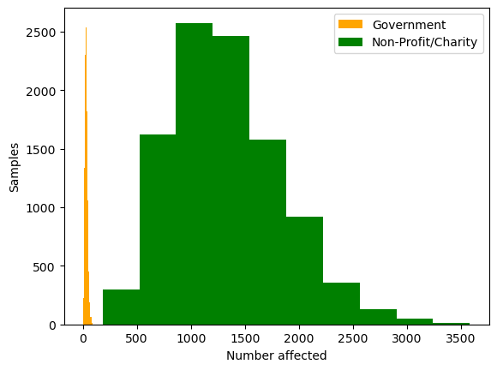
Gov vs. Nonprofit over time
Time is an important factor.
Given the factor of time, far more people are likely to affected by a breach on a Non-Profit/Charity Database.

Slide 14
Conclusion

Slide 15
For You
GitHub Handle: IsaacDaHanes
Repository Name: WA_Databreaches_Predictive_Analysis
Data Found at: Data.Wa.Gov
My Email: isaacdhanes97@gmail.com
Tools Used:
Python(Pandas, SciPy, Numpy, SkLearn, Matplotlib, and more)
Jupyter Notebooks
Github
VSCode

