Slide 1
Predicting Client Churn:
Three Methods for Predicting Client Churn for a Telecom Company
Christian Kolker, Qianyu Rapunzel Chen, and Isaac Field

Slide 2
Explanation of Churn and Reason
As a company, it is important to maintain a consistent customer base for steady business.
Businesses provide services or products for customers so that they establish ongoing relationships to the consumer.
Client retention vs Churn
Retention: Rate at which customers continue to use a product or service.
Churn: Rate at which customers stop using a product or service.
The key question to ask is: Why are we losing customers?
Notes:
Isaac

Slide 3
Customer Churn data and Goal
Our data comes from Kaggle and is from a Telecommunications Company offering many services, with Churn as the target.
Each datapoint is an individual customer listing the services they had and other info like gender, dependents, etc... with a total of 7032 customers.
Goal: Identify key features contributing to Churn and to build an effective model to predict churn
Notes:
Rapunzel/anyone

Slide 4
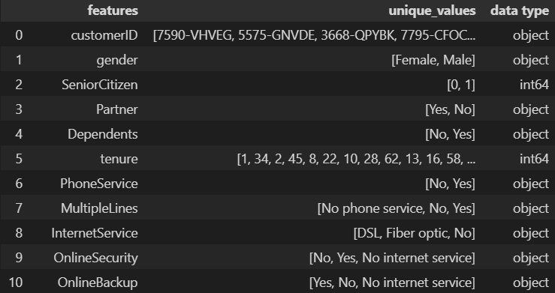
Data Preprocessing: Dtypes and Values
Notes:
Christian: For each feature, we first examined the possible values for each column and data type

Slide 5
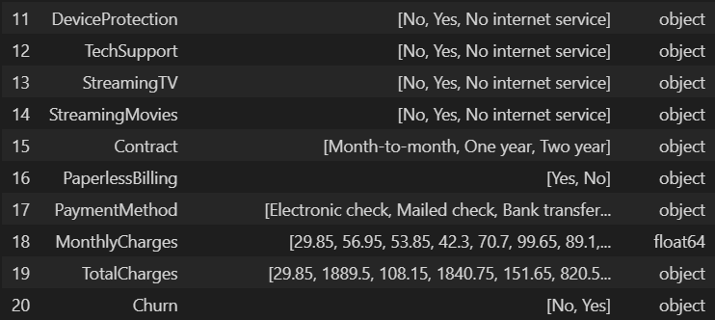
Data Preprocessing: Dtypes and Values
Notes:
Christian:

Slide 6
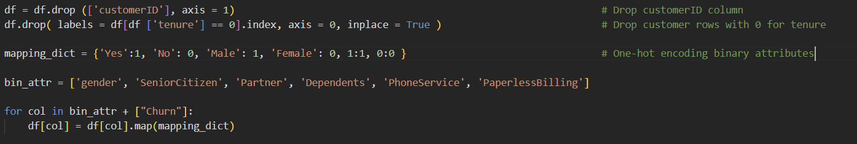
One-Hot Encoding Binary Attributes
Notes:
Christian
Cleaning up an extraneous customerID column
Since tenure is how long the customer was with us, we drop rows where tenure == 0
Settting a mapping dictionary we can use on binary columns and using it in a for loop

Slide 7
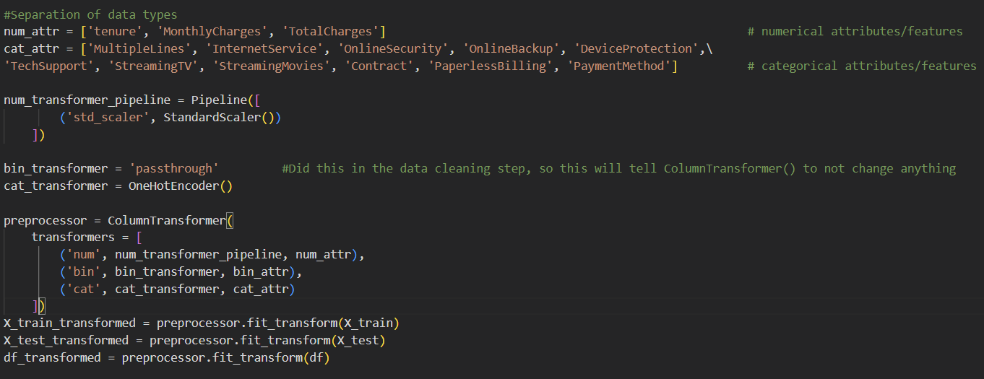
Preprocessing Using ColumnTransformer
Notes:
Christian:
Binary, numerical, and categorical data all changed into their own binary columns. For example, the “Contract” column who used to have entries “Month-to-Month, “One-year” and “Two-year” is now split into three columns, one for each entry. If the customer is Month to Month, they’ll have a 1 in the newly made Month to Month column and 0s in the One-year and Two-year columns

Slide 8






EDA and Feature Analysis

Slide 9
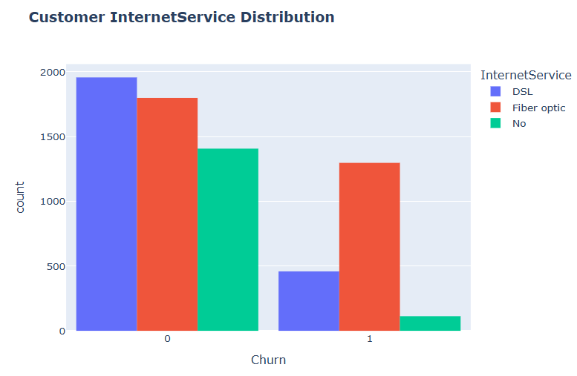
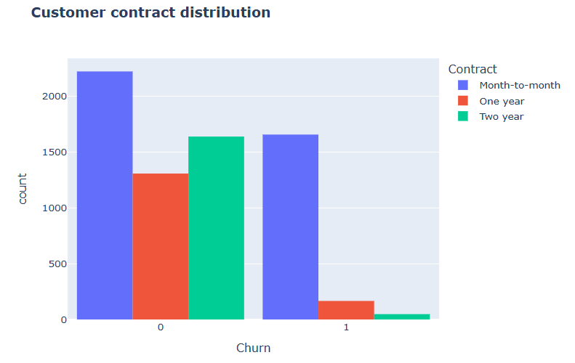
Notes:
Christian?

Slide 10
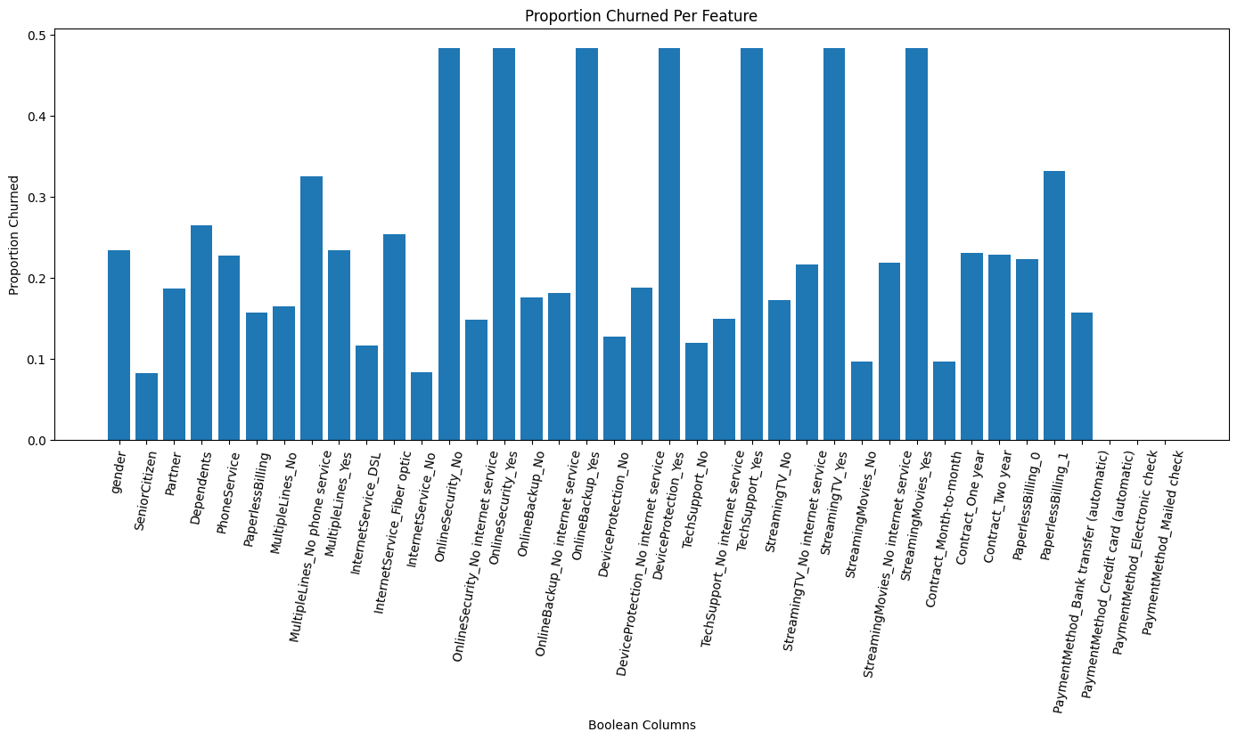
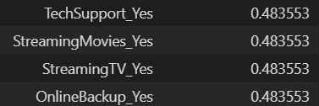

Notes:
Isaac

Slide 11
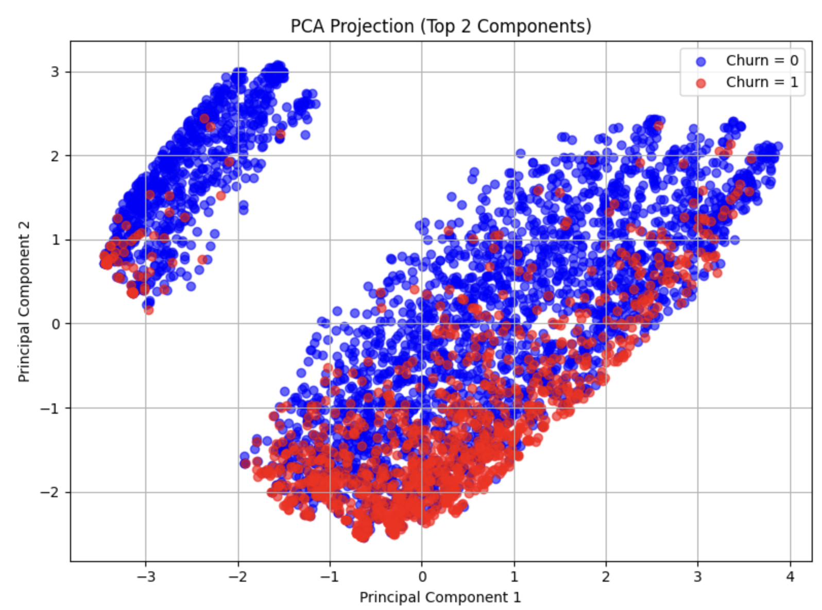
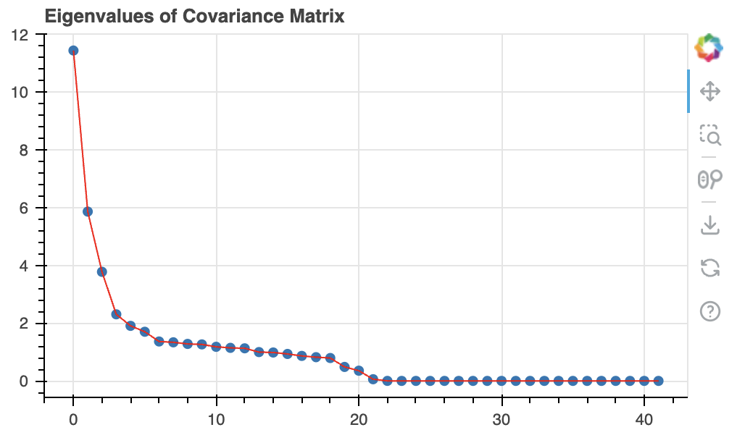
PCA
no
Notes:
Each dot represents a customer
The position is determined by their values projected onto the first two principal components (PC1 and PC2)
Red = customers who churned (Churn = 1)
Blue = customers who did not churn (Churn = 0)
There are two distinct clusters, but there are overlap
While there's overlap, we can see that churned customers (in red) tend to cluster differently compared to retained ones (in blue), especially in the lower part of the plot.

Slide 12
Two Models
Logistic Regression
XGBoost

Slide 13
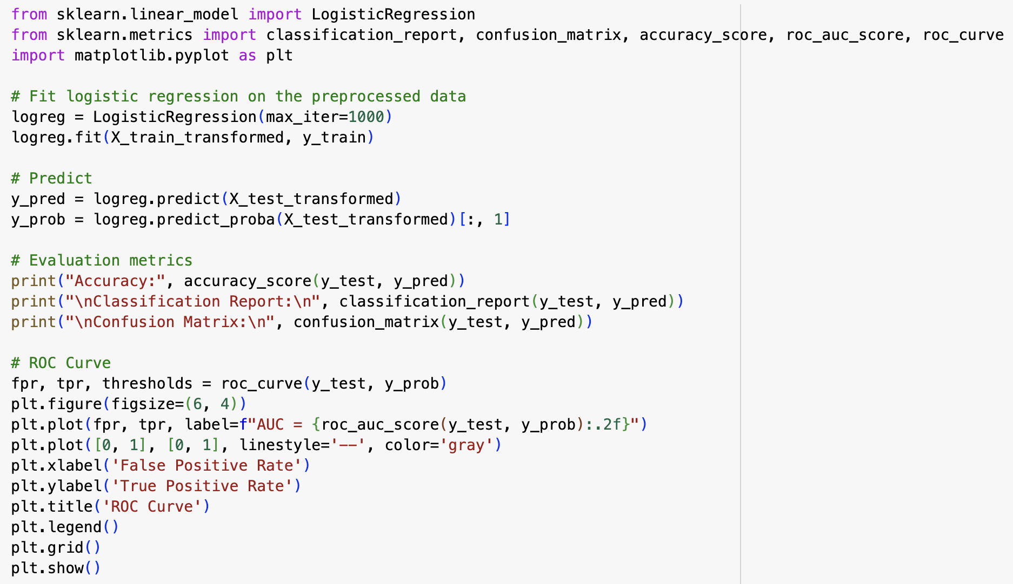
Logistic Regression

Slide 14
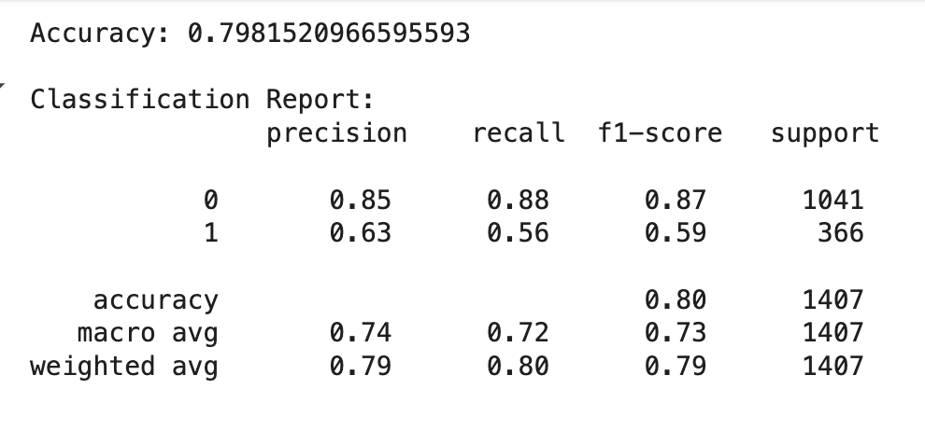
Test:
Notes:
Precision (Class 1 = 0.63): Of all customers predicted to churn, 63% actually did
Recall (Class 1 = 0.56): Of all customers who actually churned, only 56% were identified by the model
F1-score: The harmonic mean of precision and recall (a balanced metric)
“Our model achieved an accuracy of around 80%, and it performs very well at predicting customers who don’t churn, with a precision of 85% and recall of 88%. However, it struggles more with identifying churned customers, with only 56% recall and 63% precision. This suggests the model is biased toward the majority class, which is expected given the class imbalance. Still, the model captures important churn patterns, and with further tuning or balancing, we could improve its sensitivity to churn.”

Slide 15
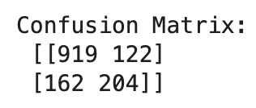
 | No Churn | Churn
Actual: No Churn | 919 True Negative | 122 False Positive
Churn | 162 False Negative | 204 True Positive
Notes:
Our model performs well overall, especially for identifying non-churned customers, but we can still improve its ability to catch actual churners — as seen by the 162 false negatives.

Slide 16
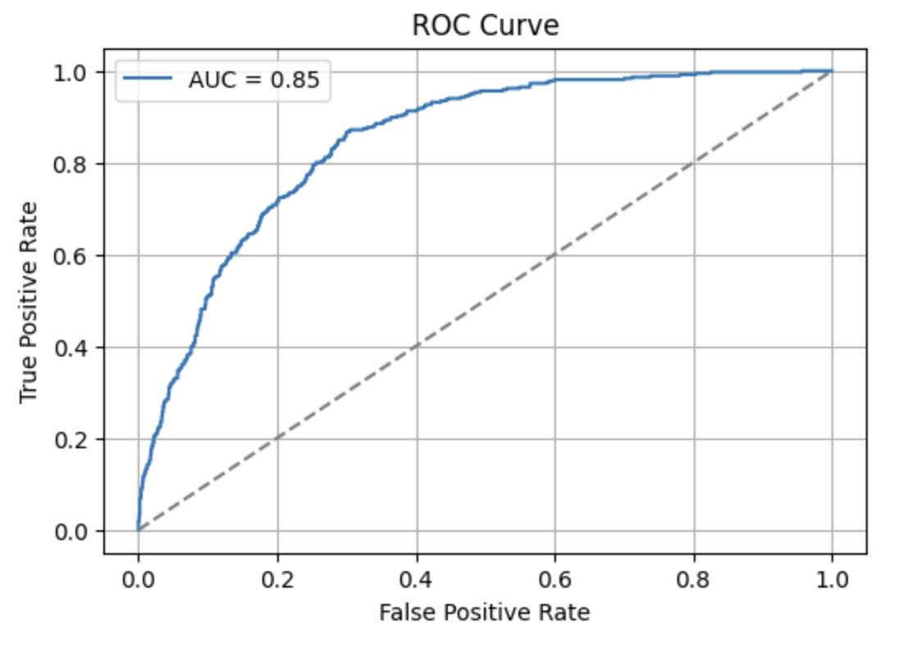
Logistic Regression
Notes:
This ROC curve shows how well our model distinguishes between customers who churn and those who don't. The area under the curve is 0.85, meaning the model is quite good at ranking customers by their likelihood to churn. The closer the curve gets to the top-left corner, the better the model is.

Slide 17
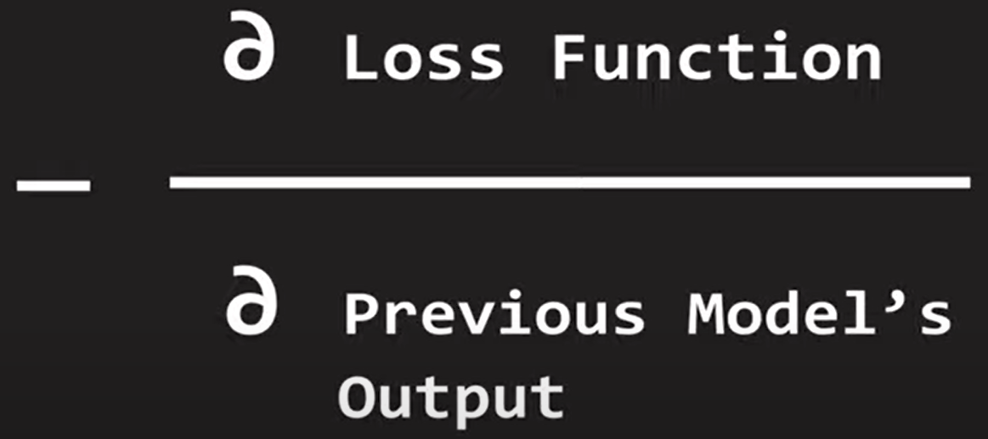
What is XGBoost?
First, what is Gradient Boost?
I’m glad you asked…
Gradient Boost: an ensemble method of machine learning in which:
Multiple decision trees are made, each resulting in a series of weights
Boosting: Each new model’s weights are trained on the inaccuracy/residuals of the previous one- each weak learner helps a new stronger learner
Gradient usage: Each successive tree uses the negative gradient of the loss function with respect to the previous model to adjust the new model’s weights
Source: Vaishak Kumar and Cheshta Dhingra, Econoscent, https://www.youtube.com/watch?v=TyvYZ26alZs

Slide 18
What is XGBoost?
It is eXtreme
eXtreme Gradient Boost: A modified version of Gradient Boost with added parameters to decrease overfitting and increase computational efficiency
introduces regularization parameters into each tree’s formation of branches:
Lambda: parameter that decreases sensitivity to individual data points (L2 regularization)
As each tree forms new branches
Gamma: parameter that increases how strict we are in our prediction accuracy for each tree
After a tree is formed, used to “prune” or get rid of decision tree branches that don’t provide enough similarity
Parallel processing: although each tree is made successively, the branches/nodes of a single tree are made in succession by using a PC’s multiple cores simultaneously
Source: Josh Starmer, StatQuest with Josh Starmer, https://www.youtube.com/watch?v=OtD8wVaFm6E
DataScience Stack Exchange
https://datascience.stackexchange.com/questions/16904/gbm-vs-xgboost-key-differences#:~:text=Both%20xgboost%20and%20gbm%20follows,which%20gives%20it%20better%20performance.

Slide 19
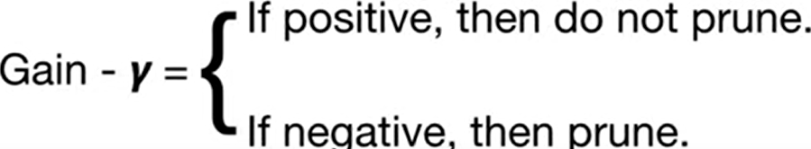
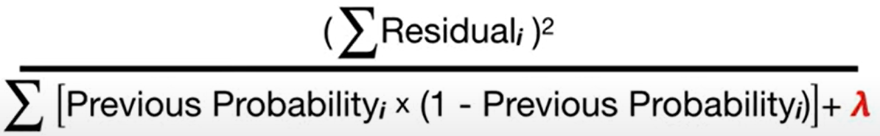
Root
Branch
Left Leaf
Right Leaf
Similarity Score:
Source: Josh Starmer, StatQuest with Josh Starmer, https://www.youtube.com/watch?v=OtD8wVaFm6E

Slide 20
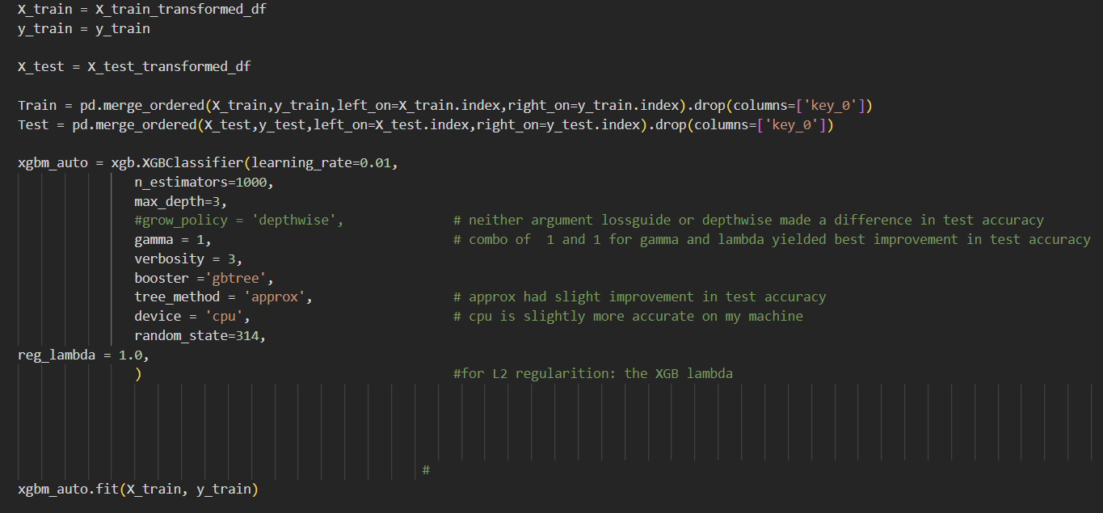
XGBoost

Slide 21
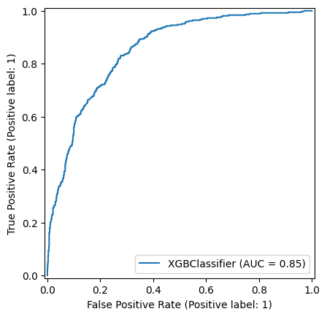
XGBoost ROC Curve
Receiver Operating Curve, a “holdover” from WWII Signal Processing

Slide 22

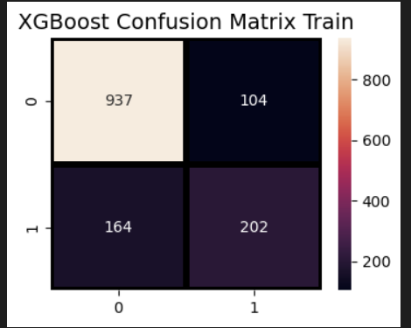
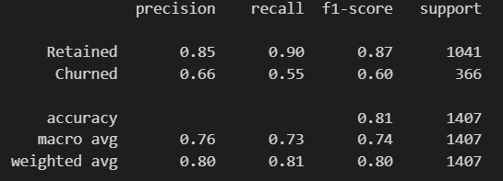
XGBoost Metrics
Notes:
Recall is the ratio of true positives to ALL actual positives
( also expressed as ratio of true positives to the some of true positives and false negatives).
Thus, what we care about for this model is recall on churned
Precision on the other hand is the ratio of true positives to the some of true positives and false positives. Though its nice that this is high, it more reflects on the model itself, and doesn’t help it accomplish our goal of predicting churn like recall does.
BC of this I suspect overfitting
Actual on X, predicted on Y

Slide 23
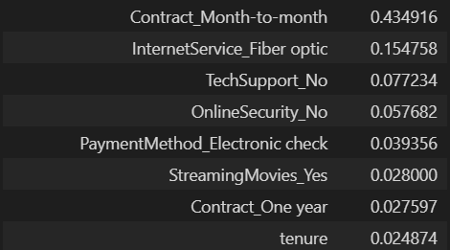
XGBoost: Feature Importance

Slide 24

Evaluation/metrics

Slide 25
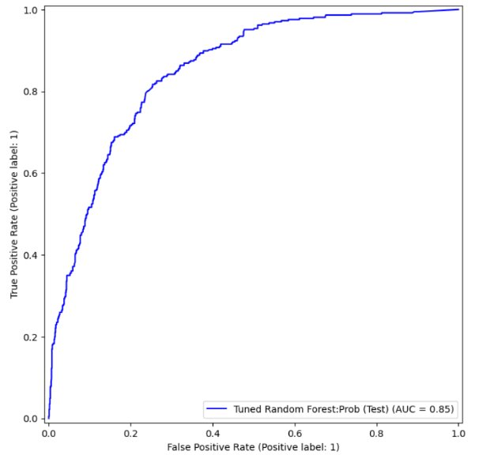
Model Comparison
Model | Logistic Regression | XGBoost | Random Forest
ROC Curve
Test Accuracy | 0.7982 | 0.8095 | 0.79957
Recall | 0.56 | 0.55 | 0.49
Notes:
Roc test accuracy similar, recall different
High for xg boost and logistic regression
So we pick those
Of all customers who actually churned, only 56% were identified by the model

Slide 26
Analysis / Conclusion
Month-to-Month payment plans enable customer churn
Fiber Internet, surprisingly, is correlated with churn
Are these customers “shopping” for the best internet elsewhere? Or is there a problem with our fiber distribution?
A lack of tech support and online security are ranked high for feature importance
Are these customers that are already not committed to our service?
OR are they customers who haven’t been convinced of our value?
Solution: Upselling these features could help retain customers
Notes:
Rapunzel: In future, work to increase test accuracy and reduce overfitting

Slide 27
Improvements
Imbalanced Data Solutions
Get more data: quantity and quality
Bootstrapping samples
Explore correlation of features and introduce interactions
Correlated features can skew models relying on independent features
An interaction combines correlated features and incorporates them into the model

