Slide 1
XGame: Dou Shou Qi
Isaac Mauro, Laura South, Duck Keun Yang, Brian Larson, Yan Wang

Slide 2
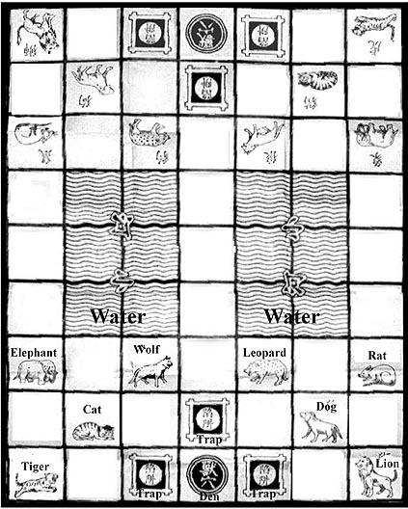
Dou Shou Qi
7x9 game board
Objective is to move a piece into the other players den
Each piece has a power from 1-8
Pieces can capture other pieces if their power is greater than or equal to the other piece
The rat can capture the elephant, and it can also swim in the water
The lion and tiger can jump over the water horizontally and vertically
The dens are surrounded by traps. When a piece is in a trap, its power is reduced to zero.
Image from: http://ancientchess.com/page/play-doushouqi.htm

Slide 3
Dou Shou Qi: Variations
The dog can also swim
The elephant can also capture the rat
Traps also reduce friendly pieces to zero power
A simpler version of the game without water or traps is sometimes played
Thinking ahead, maybe we will add the ability to adjust game rules when creating a game as an additional feature

Slide 4
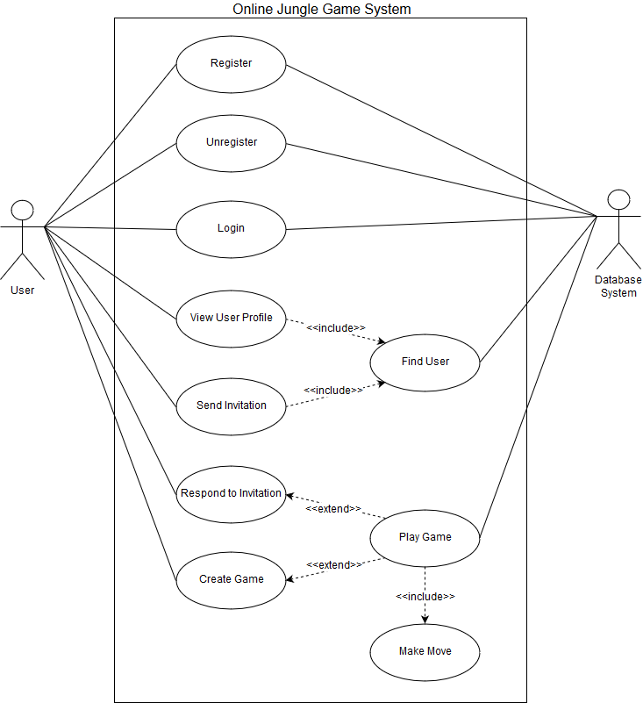
Use Cases
Primary actor is the user
Secondary actor is the database system
Login was not a part of the specifications, but we decided that it was an important use case
Not depicted in this diagram, a user can be a part of multiple active games and switch between them freely
Since we have decided to not implement the list of users online, in order to send an invitation or view user profile, you are required to execute find user first.

Slide 5
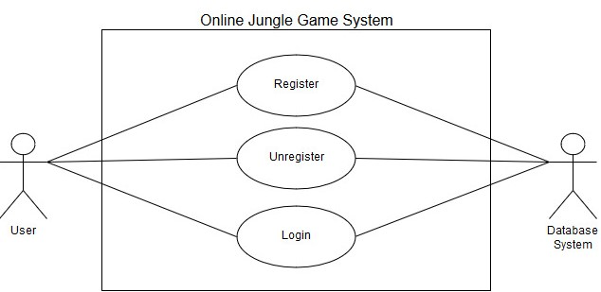
Registration and logging in
The first time a user launches XGame, they need to register a user account with an email, username, and password
Subsequent launches require the user to login to their user account to play games
The user can also unregister their account at any time

Slide 6
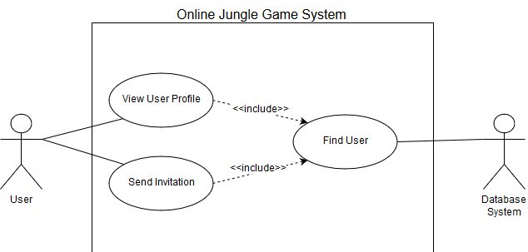
Find User
‘Find User’ checks whether the username is registered in the system or not.
If the username is valid, the user can choose to send invitation or view user profile.

Slide 7
View User Profile
User can view the other user’s profile after ‘Find User’.
The user’s profile is consists of nickname, and a history of played games. The record of a game includes the opponent, start date and time, end date and time, and the end result of the game (i.e., win, loss, tie, draw, abandoned, etc.).

Slide 8
Send Invitation
After a user finds another user, they can send an invitation to another user
The user can only send an invitation if they have created a game, and that game still has an open player slot

Slide 9
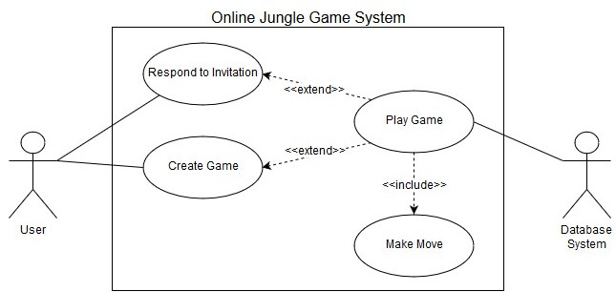
Creating games, responding to invitations, and playing
The user can create a new game instance, which allows them to invite another user
The user can also respond to an invitation and join another users game.
Once both players are in game, they can begin playing
While playing, the players make moves until the win condition is met

Slide 10
Decisions and Open Issues
We have decided to make a desktop application
Logging in was not in the specifications, but we deemed it important
After logging in, a main navigation page is displayed, allowing a user to find other users, create games, and make moves in each of their active games
What should we consider a valid username?
What should we consider an acceptable password?
Should we include password attempt limits?
How many games should we store in a users game history?
How long should a game be stored in a users game history?

