Slide 1
UML
Julito

Slide 2
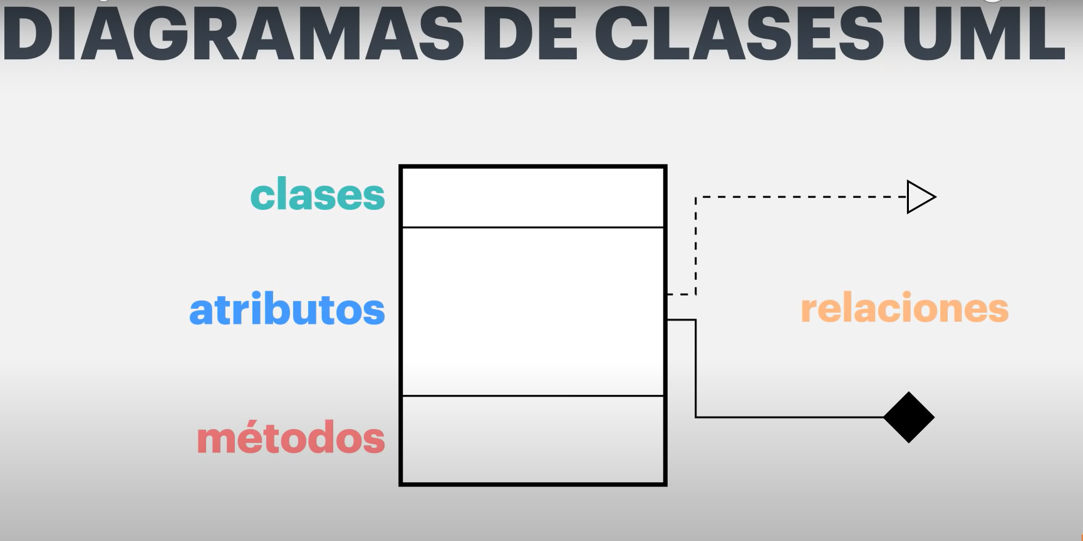
CONTENTS OF THIS TEMPLATE
You can delete this slide when you’re done editing the presentation.

Slide 3
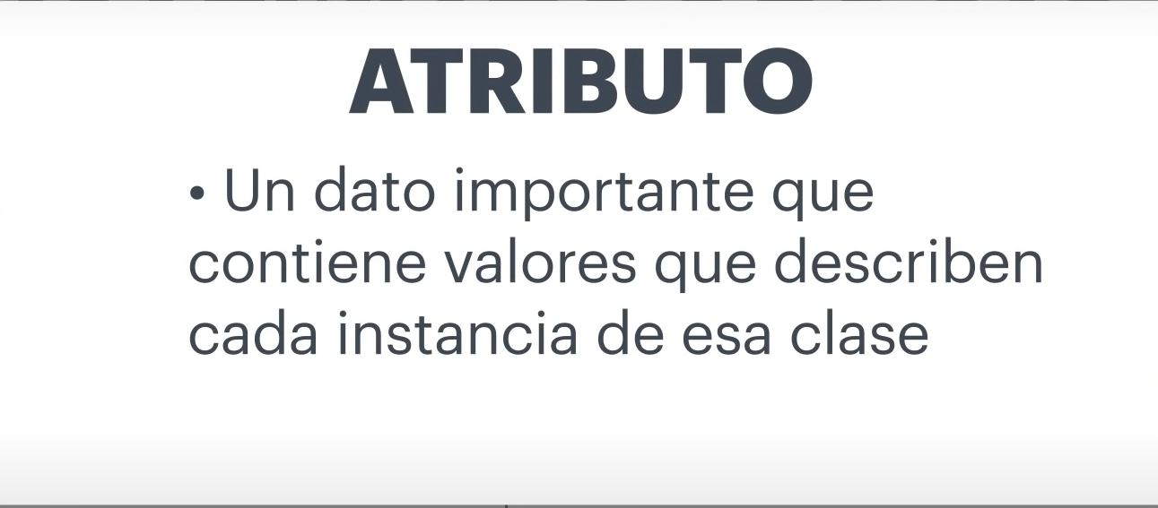
You can delete this slide when you’re done editing the presentation.

Slide 4
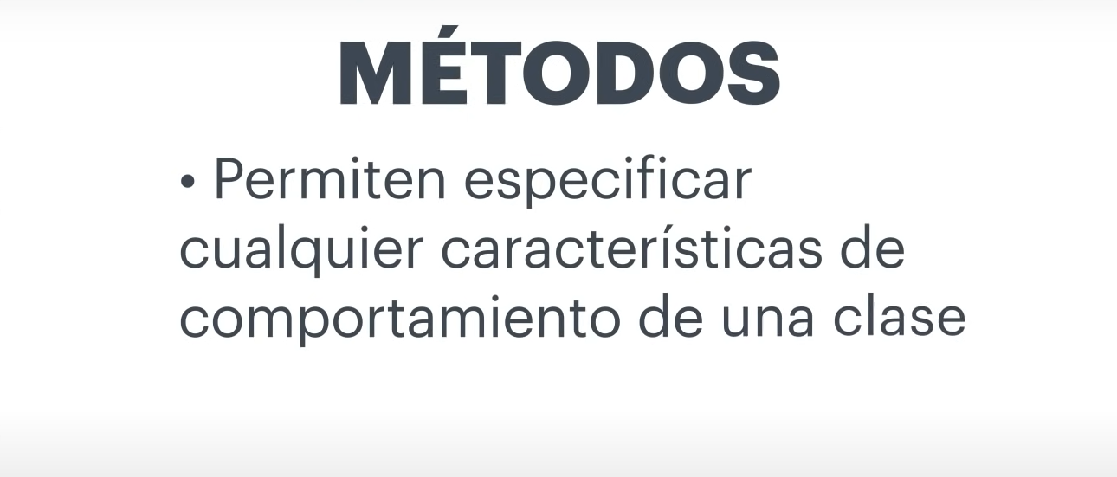
You can delete this slide when you’re done editing the presentation.

Slide 5
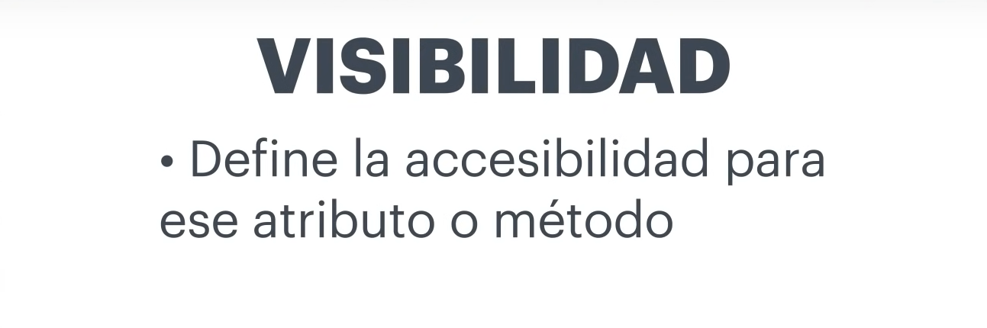
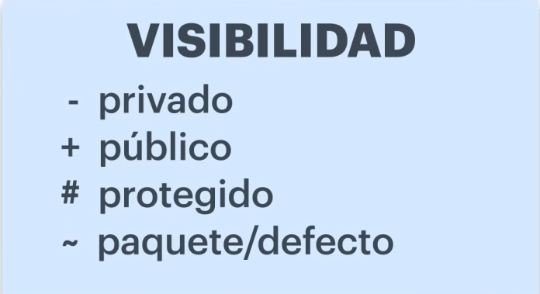

Slide 6
