Slide 1

Isaac K. Gang
Gopal Ratnam
Kammy Sanghera
Data Storytelling for Oversight: From Exploration to Evidence‑Based Narrative
USPS

Slide 2
Agenda
01
Module 1 – Foundation of a Narrative Mindset
5
02
Module 2 – What is the Data Telling Us? Exploratory Analysis, Evidence, and Explanation
03
Module 3 – Writing for Impact: Structure, Audience, and Clarity
04
Module 4 – Strategic Visualization and Dashboard-Driven Storytelling
SECTIONS
-
05
Module 5 – USPS OIG Whitepaper Clinic & Workshop Wrap-Up

Slide 3
01
Module 1
Foundation of a Narrative Mindset: Research & Analytics Perspective

Slide 4
Module 1
Learning Objectives
By the end of this module participants will be able to:
Understand the difference between reporting and storytelling
Think like an investigator instead of a report generator
Frame business problems before opening Excel or Power BI
Connect analysis to organizational decisions
Identify the components of a persuasive analytical narrative

Slide 5
Module 1
Why This Matters?
Many analysts answer: "What happened?"
1
Excellent analysts answer: "What happened, why it happened, why leadership should care, and what should happen next."
2
That difference creates influence.
3

Slide 6
Module 1
Data vs Information vs Insight
Facility | Delivery Time
A | 2.4 days
B | 3.7 days
1
Information:
Average delivery increased 8%.
1
Insight:
The increase occurred only in facilities with staffing shortages.
2
Recommendation:
Increase temporary staffing during seasonal peaks.
3

Slide 7
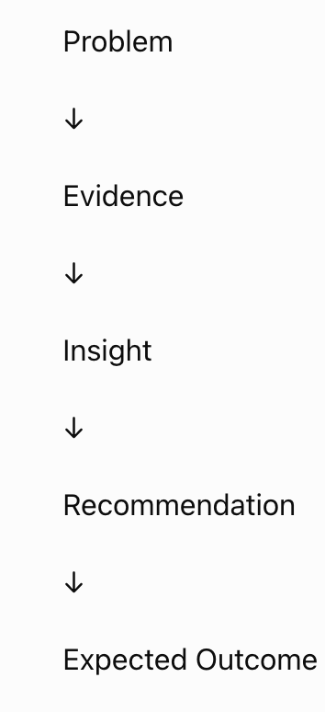
Module 1
Storytelling Framework

Slide 8
Module 1
The Investigator Mindset
What Changed?
What evidence supports this?
1
5
Why?
What should be done?
2
6
Compared to What?
3
Who is affected?
4

Slide 9
Module 1
Exercise: USPS leadership notices increasing package delays
What questions would you ask?
1

Slide 10
Module 1
Exercise: USPS leadership notices increasing package delays
Which facilities?
Since when?
Weather?
Staffing?
Transportation?
Holiday season?
Vendor changes?

Slide 11
Module 1
Takeaways
Demo
INCLUDED · Two reports
Report A:
Average delivery time increased 10%.
Good analysts organize numbers
1
Report B:
Average delivery time increased by 10%, driven primarily by three regional processing centers, experiencing staffing shortages following holiday retirements
Great analysts organize thinking
2
Which report helps leadership?

Slide 12
02
Module 2
What is the Data Telling Us? Exploratory Analysis, Evidence, and Explanation

Slide 13
Learning Objectives
By the end of this module participants will be able to:
Perform exploratory data analysis
Recognize meaningful patterns
Separate signal from noise
Develop evidence-based explanations
Avoid jumping to conclusions

Slide 14
Module 2
The three questions
What happened?
1
Why?
2
How do we know?
3

Slide 15
Module 2
Messy Data
Most real-world data is messy.
Common problems:
Missing values
Duplicate records
Outliers
Inconsistent formatting
Human entry errors
Conflicting data sources

Slide 16
Module 2
Messy Data
Example: Hospital patient dataset:
Patient ID | Age | Blood Pressure
101 | 45 | 120
102 | NULL | 130
103 | 45 | 120
103 | 45 | 120
104 | 450 | 140
Which values look suspicious?
1

Slide 17
Module 2
Messy Data
Missing age
Duplicate record
Age = 450

Slide 18
Module 2
Signal vs Noise
Imagine stock prices:
Day 1: $100
Day 2: $101
Day 3: $99
Day 4: $102
Day 5: $100
Is the stock growing?
1

Slide 19
Module 2
Signal vs Noise
Not necessarily.
These fluctuations may simply be noise.

Slide 20
Module 2
Signal vs Noise
Signal: A consistent, repeatable pattern.
Customer purchases increase every holiday season.
Hospital admissions rise during flu season.
Students attending tutoring score higher.

Slide 21
Module 2
Signal vs Noise
Noise: Random variation that does not represent a meaningful trend.
One unusually large sale.
Temporary website outage.
Single survey response.

Slide 22
Module 2
Exercise: Detecting Signal (monthly sales data)
Month | Sales
Jan | 200
Feb | 205
Mar | 198
Apr | 210
May | 500
Jun | 215
Is May a signal or noise?
What additional evidence is needed?

Slide 23
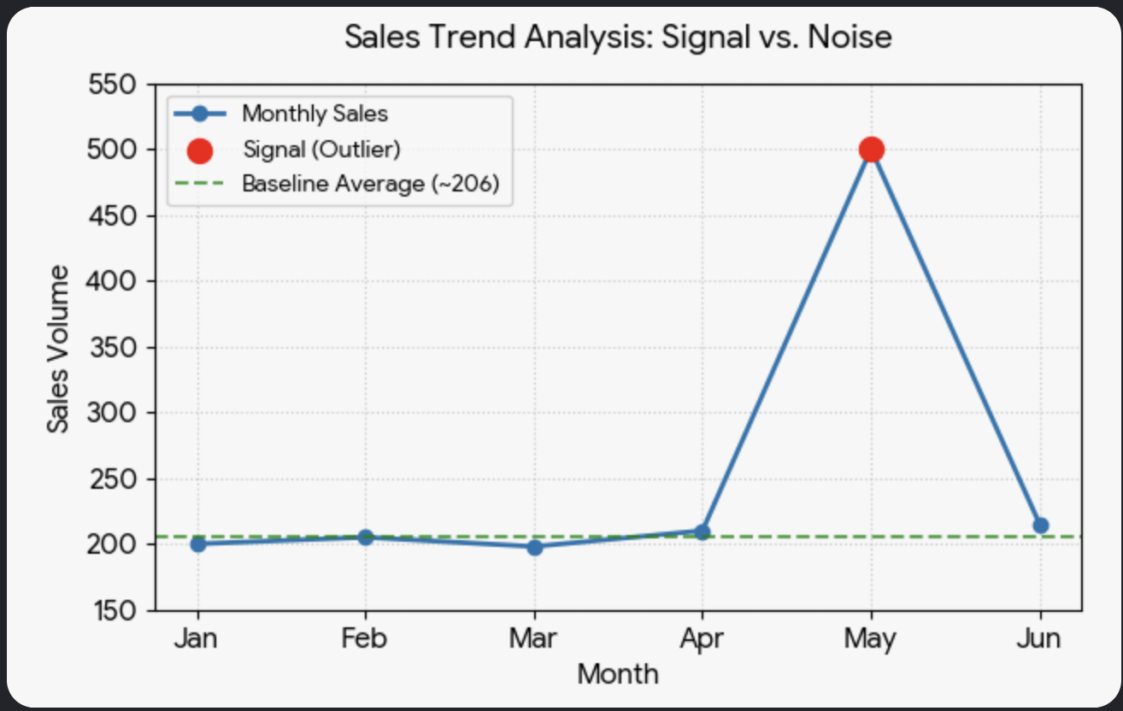
Module 2
Exercise: Detecting Signal (monthly sales data)

Slide 24
Module 2
Exercise: Detecting Signal (monthly sales data)
The sales for Jan, Feb, Mar, Apr, and Jun all cluster tightly within a narrow range between 198 and 215, establishing a clear baseline with a standard deviation (distance from average) of only 7.02
In contrast, May's sales spike to 500, which is more than double the typical baseline. Statistically, this is a massive outlier—sitting nearly 42 standard deviations away from the baseline average of the other months. This degree of extreme variance indicates a significant, non-random event (a signal) rather than normal, everyday fluctuation

Slide 25
Module 2
Data Cleaning (practical steps)
Step 1: Understand data
Step 2: Profile data
Step 3: Detect errors
Step 4: Correct or document
Step 5: Validate results

Slide 26
Module 2
Python Live Demo
import pandas as pd
import numpy as np
# Create a deliberately messy dataset
data = {
"Facility": ["A", "B", "C", "C", "D", "E"],
"Packages_Processed": [1200, 1500, np.nan, np.nan, 1800, 2100],
"Delivery_Time_Hours": [24, 30, 28, 28, -5, 200],
"Customer_Satisfaction": [85, 92, 88, 88, 105, 75]
}
df = pd.DataFrame(data)
print(df)

Slide 27
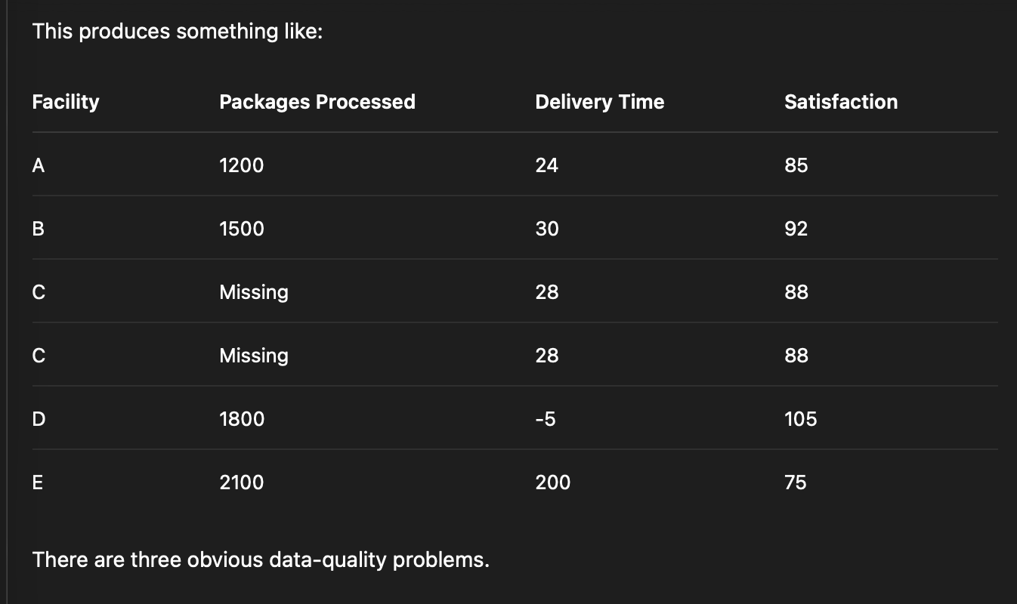
Module 2
Python Live Demo

Slide 28
Module 2
Python Live Demo
Expected results. What do we do?
Missing Values (First, identify missing values)
1
print(df.isnull().sum())
Facility 0
Packages_Processed 2
Delivery_Time_Hours 0
Customer_Satisfaction 0

Slide 29
Module 2
Python Live Demo
One simple treatment is to replace missing numerical values with the median
Missing Values (First, identify missing values)
1
median_packages = df["Packages_Processed"].median()
df["Packages_Processed"] = (
df["Packages_Processed"].fillna(median_packages)
)
print(df)

Slide 30
Module 2
Python Live Demo
Don’t automatically delete every row containing missing data. The appropriate treatment depends on why the value is missing and how the data will be used.
Missing Values (First, identify missing values☺
1

Slide 31
Module 2
Python Live Demo
Find duplicate records:
Duplicates
2
duplicates = df[df.duplicated()]
print(duplicates)

Slide 32
Module 2
Python Live Demo
We can also count them:
Duplicates
2
print("Number of duplicates:", df.duplicated().sum())

Slide 33
Module 2
Python Live Demo
Then remove exact duplicates:
Duplicates
2
df = df.drop_duplicates()

Slide 34
Module 2
Python Live Demo
A duplicate is not automatically an error. Two identical transactions may represent two legitimate events.
Therefore, analysts should first determine what uniquely identifies a record—such as Transaction_ID, Facility_ID + Date, or another business key.:
Duplicates
2

Slide 35
Module 2
Python Live Demo
Suppose the business rules are:
Delivery_Time_Hours:
Valid range = 0 to 120 hours
Customer_Satisfaction:
Valid range = 0 to 100
Invalid ranges
3

Slide 36
Module 2
Python Live Demo
We can detect violations:
invalid_delivery = df[
(df["Delivery_Time_Hours"] < 0) |
(df["Delivery_Time_Hours"] > 120)
]
print(invalid_delivery)
Invalid ranges
3

Slide 37
Module 2
Python Live Demo
This identifies both -5 and 200 as invalid delivery times.
For customer satisfaction:
invalid_satisfaction = df[
(df["Customer_Satisfaction"] < 0) |
(df["Customer_Satisfaction"] > 100)
]
print(invalid_satisfaction)
Invalid ranges
3

Slide 38
Module 2
Python Live Demo
The value 105 is invalid because satisfaction cannot exceed 100%.
We could flag invalid values rather than immediately deleting the records:
df["Delivery_Time_Valid"] = (
df["Delivery_Time_Hours"].between(0, 120)
)
df["Satisfaction_Valid"] = (
df["Customer_Satisfaction"].between(0, 100)
)
print(df)
Invalid ranges
3

Slide 39
Module 2
Python Live Demo
This is often preferable because it preserves the original data for investigation. Putting everything together
Invalid ranges
3

Slide 40
Module 2
Python Live Demo
Invalid ranges
Putting everything together. A compact data-quality check could look like this:
)
import pandas as pd
import numpy as np
data = {
"Facility": ["A", "B", "C", "C", "D", "E"],
"Packages_Processed": [1200, 1500, np.nan, np.nan, 1800, 2100],
"Delivery_Time_Hours": [24, 30, 28, 28, -5, 200],
"Customer_Satisfaction": [85, 92, 88, 88, 105, 75]
}
df = pd.DataFrame(data)
# 1. Check missing values
print("MISSING VALUES")
print(df.isnull().sum())
# 2. Check duplicates
print("\nDUPLICATES")
print(df[df.duplicated()])
# 3. Check invalid ranges
print("\nINVALID DELIVERY TIMES")
print(df[
~df["Delivery_Time_Hours"].between(0, 120)
])
print("\nINVALID SATISFACTION SCORES")
print(df[
~df["Customer_Satisfaction"].between(0, 100)
])
3

Slide 41
Module 2
Python Live Demo
Invalid ranges
The key lesson is that these checks answer three different analytical questions:
3
Problem | Question | Risk if ignored
Missing values | What information is absent? | Biased averages and incomplete conclusions
Duplicates | Are observations being counted more than once? | Inflated totals and frequencies
Invalid ranges | Are values logically/business-rule valid? | Impossible values distort analysis

Slide 42
Module 2
Python Live Demo
Invalid ranges
Final data cleaning framework:
Detect → Investigate → Decide → Document.
3

Slide 43
Module 2
Data Cleaning Challenge
Data Cleanup Challenge
Given a messy dataset containing:
Missing values
Typos
Duplicates
Outliers
Clean the data and justify every decision.
Access the dataset at https://github.com/IsaacKGang/USPS

Slide 44
Module 2
Correlation vs Causation: USPS example
Packages delivered later in winter.
Did winter cause delays?
Maybe.
Need additional evidence:
Snowfall
Employee availability
Transportation
Volume
Equipment failures

Slide 45
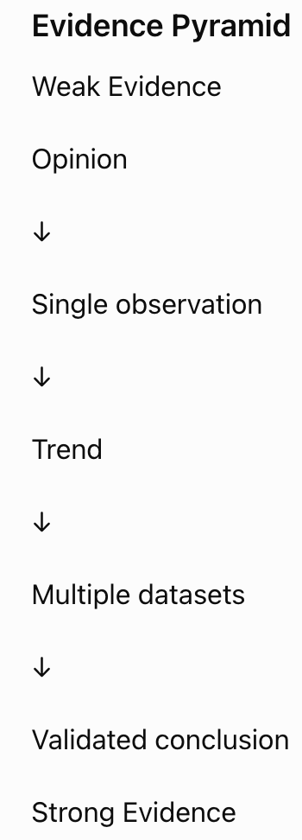
Module 2
Evidence Pyramid

Slide 46
Module 2
Example
Month | Delivery Time | Volume
Jan | 2.2 | 8M
Feb | 2.3 | 8.2M
Mar | 2.5 | 8.9M
Apr | 2.7 | 9.8M
May | 2.8 | 10.4M
What patterns exist?
1

Slide 47
Module 2
Discussion
Higher volume:
Longer delivery
Potential capacity issue
Need staffing data
Need weather
Need transportation metrics

Slide 48
Module 2
Exercise: USPS Operational datasets
Identify:
3 trends
2 anomalies
1 unanswered question
1 hypothesis
Access the postal operations data at https://github.com/IsaacKGang/USPS

Slide 49
Module 2
Patterns
Patterns Are Not Explanations
Month | Crime Rate | Ice Cream Sales
Jan | Low | Low
Jul | High | High
Does ice cream cause crime?
No.
Both increase because of summer weather.:

Slide 50

Module 2
USPS Project Use case: USPS OIG 2026 Project Stochastic Inflation 6/19/2026:
Digital Stories

Slide 51
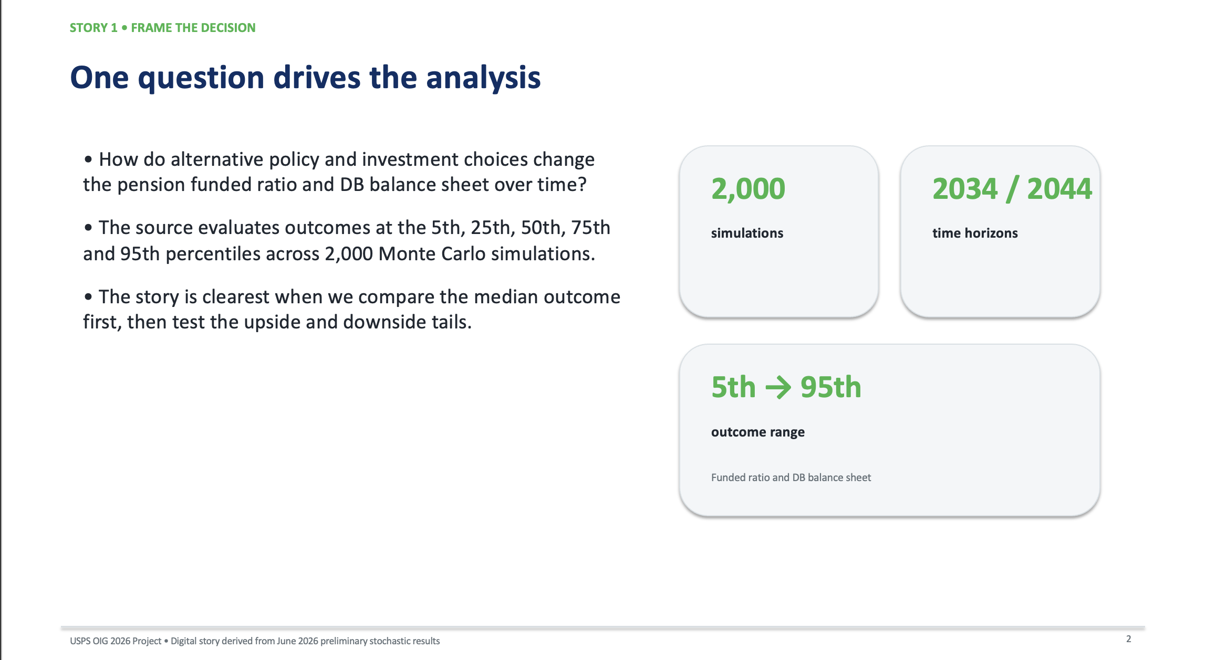
Module 2
USPS Project Use case: USPS OIG 2026 Project Stochastic Inflation 6/19/2026:
Digital Stories

Slide 52
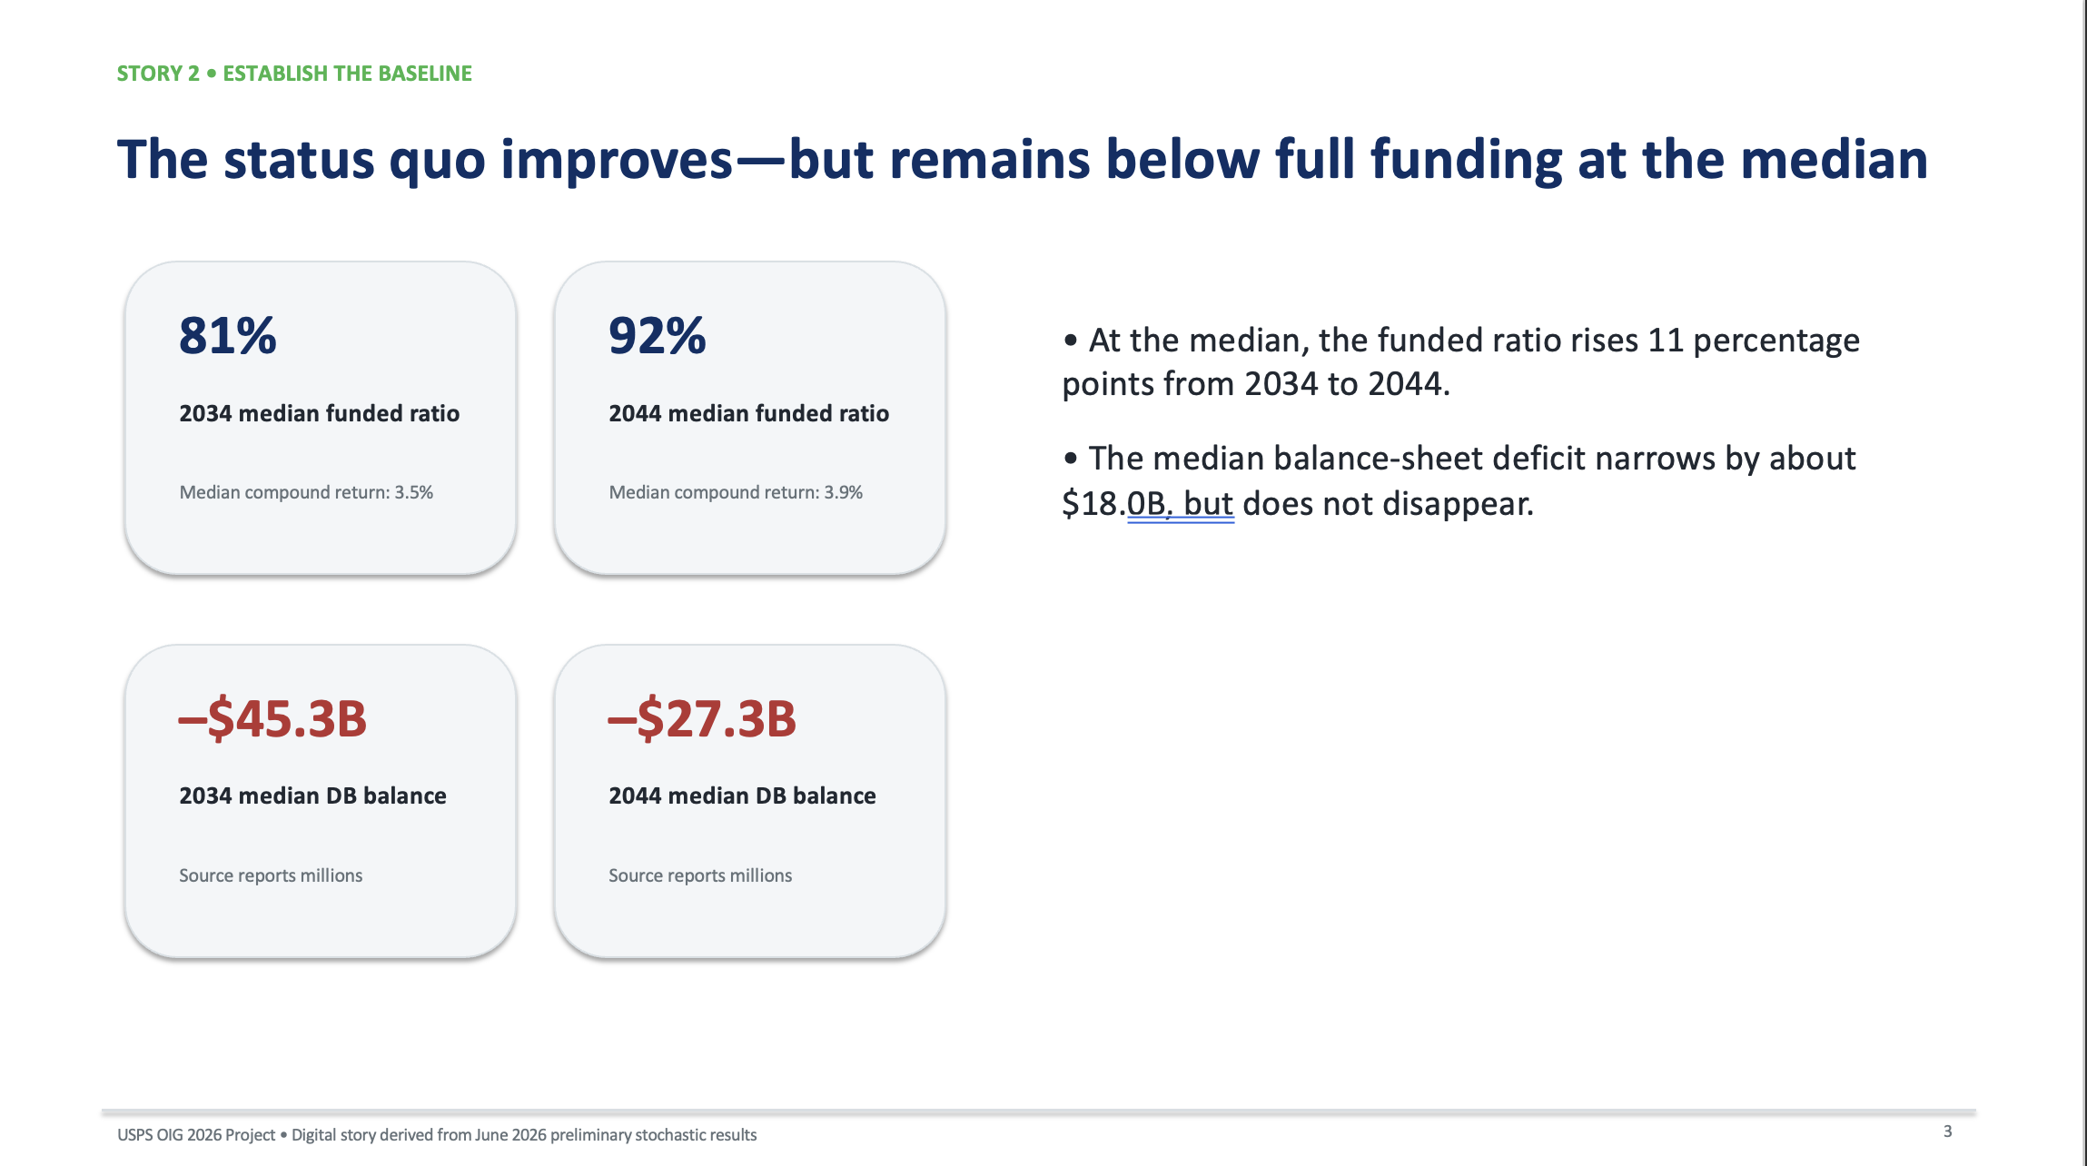
Module 2
USPS Project Use case: USPS OIG 2026 Project Stochastic Inflation 6/19/2026:
Digital Stories

Slide 53
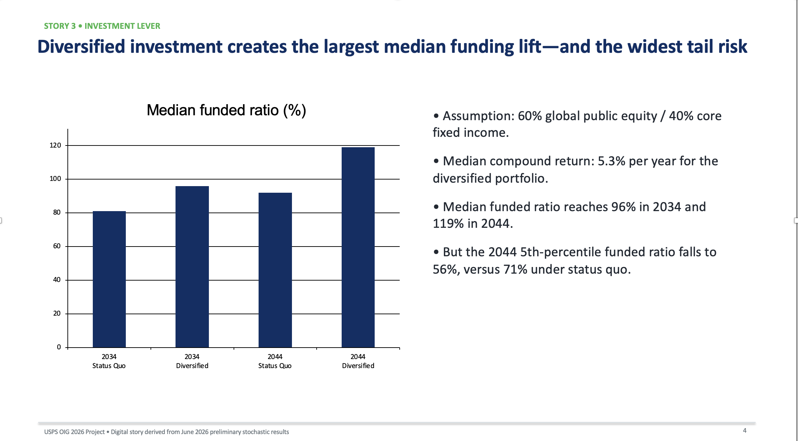
Module 2
USPS Project Use case: USPS OIG 2026 Project Stochastic Inflation 6/19/2026:
Digital Stories

Slide 54
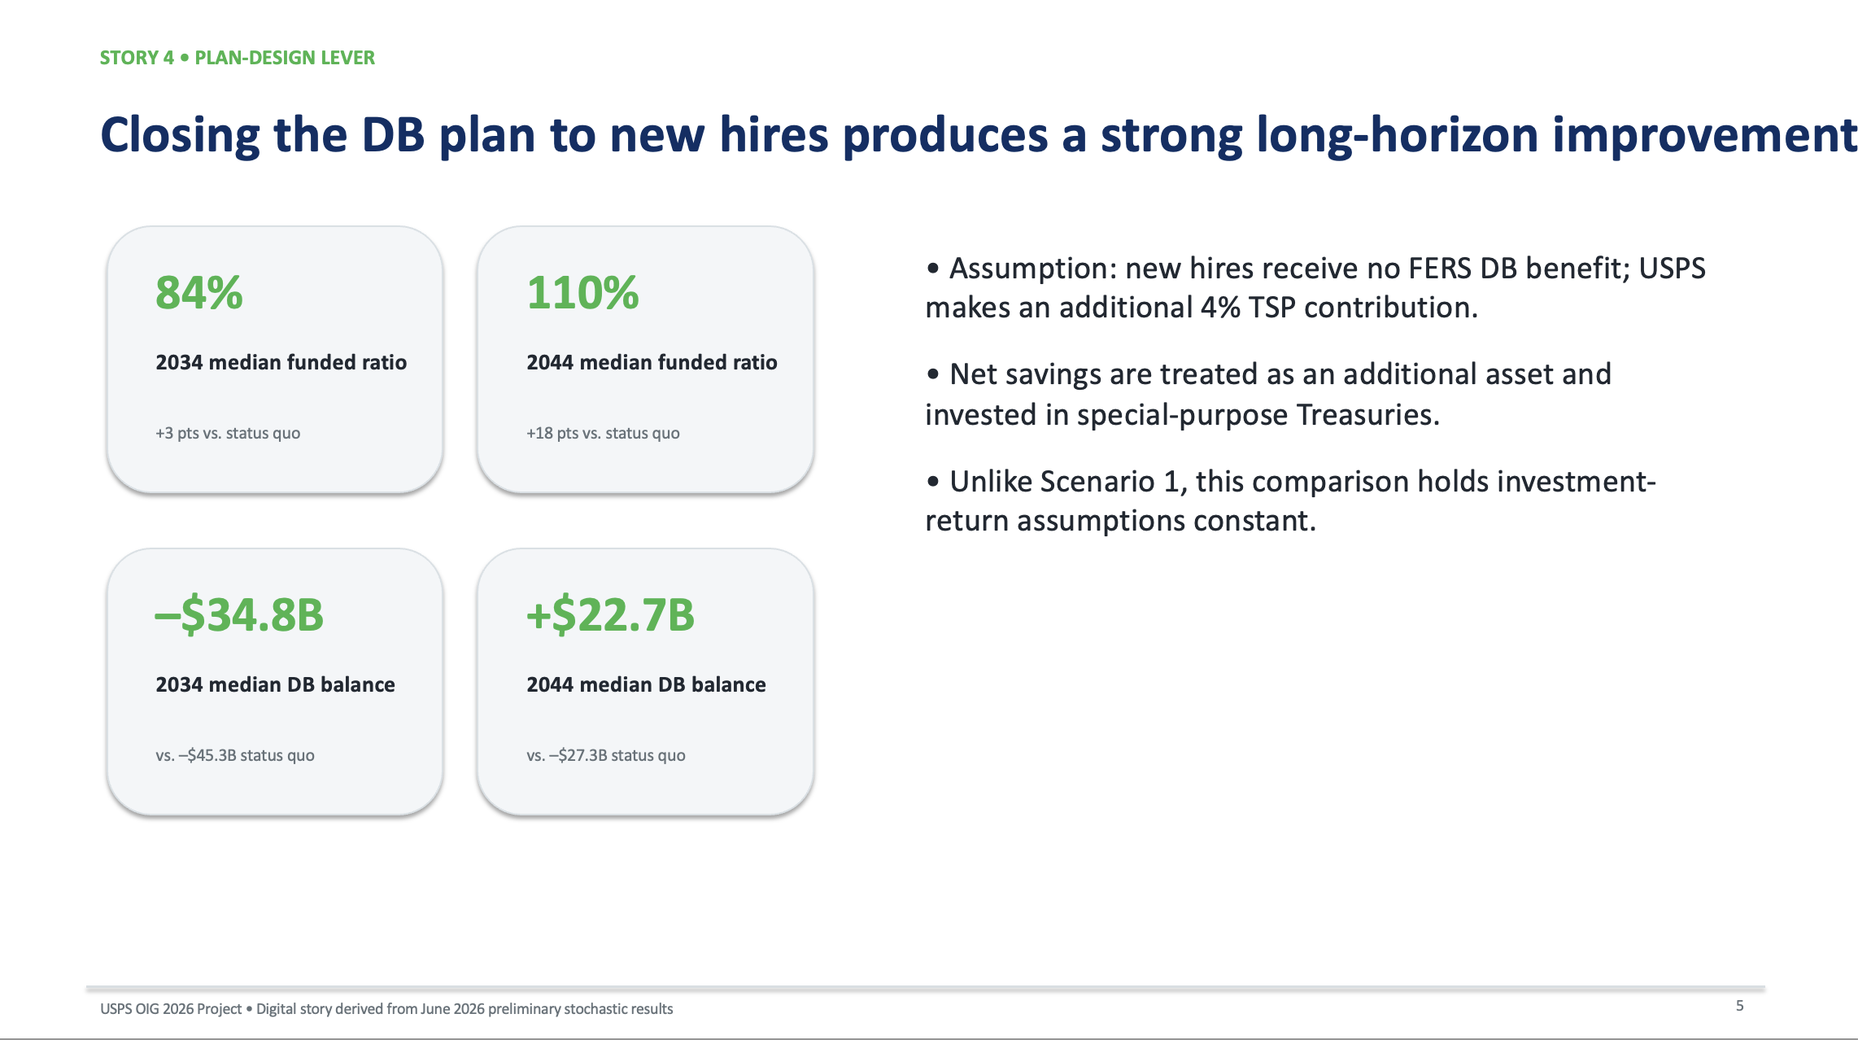
Module 2
USPS Project Use case: USPS OIG 2026 Project Stochastic Inflation 6/19/2026:
Digital Stories

Slide 55
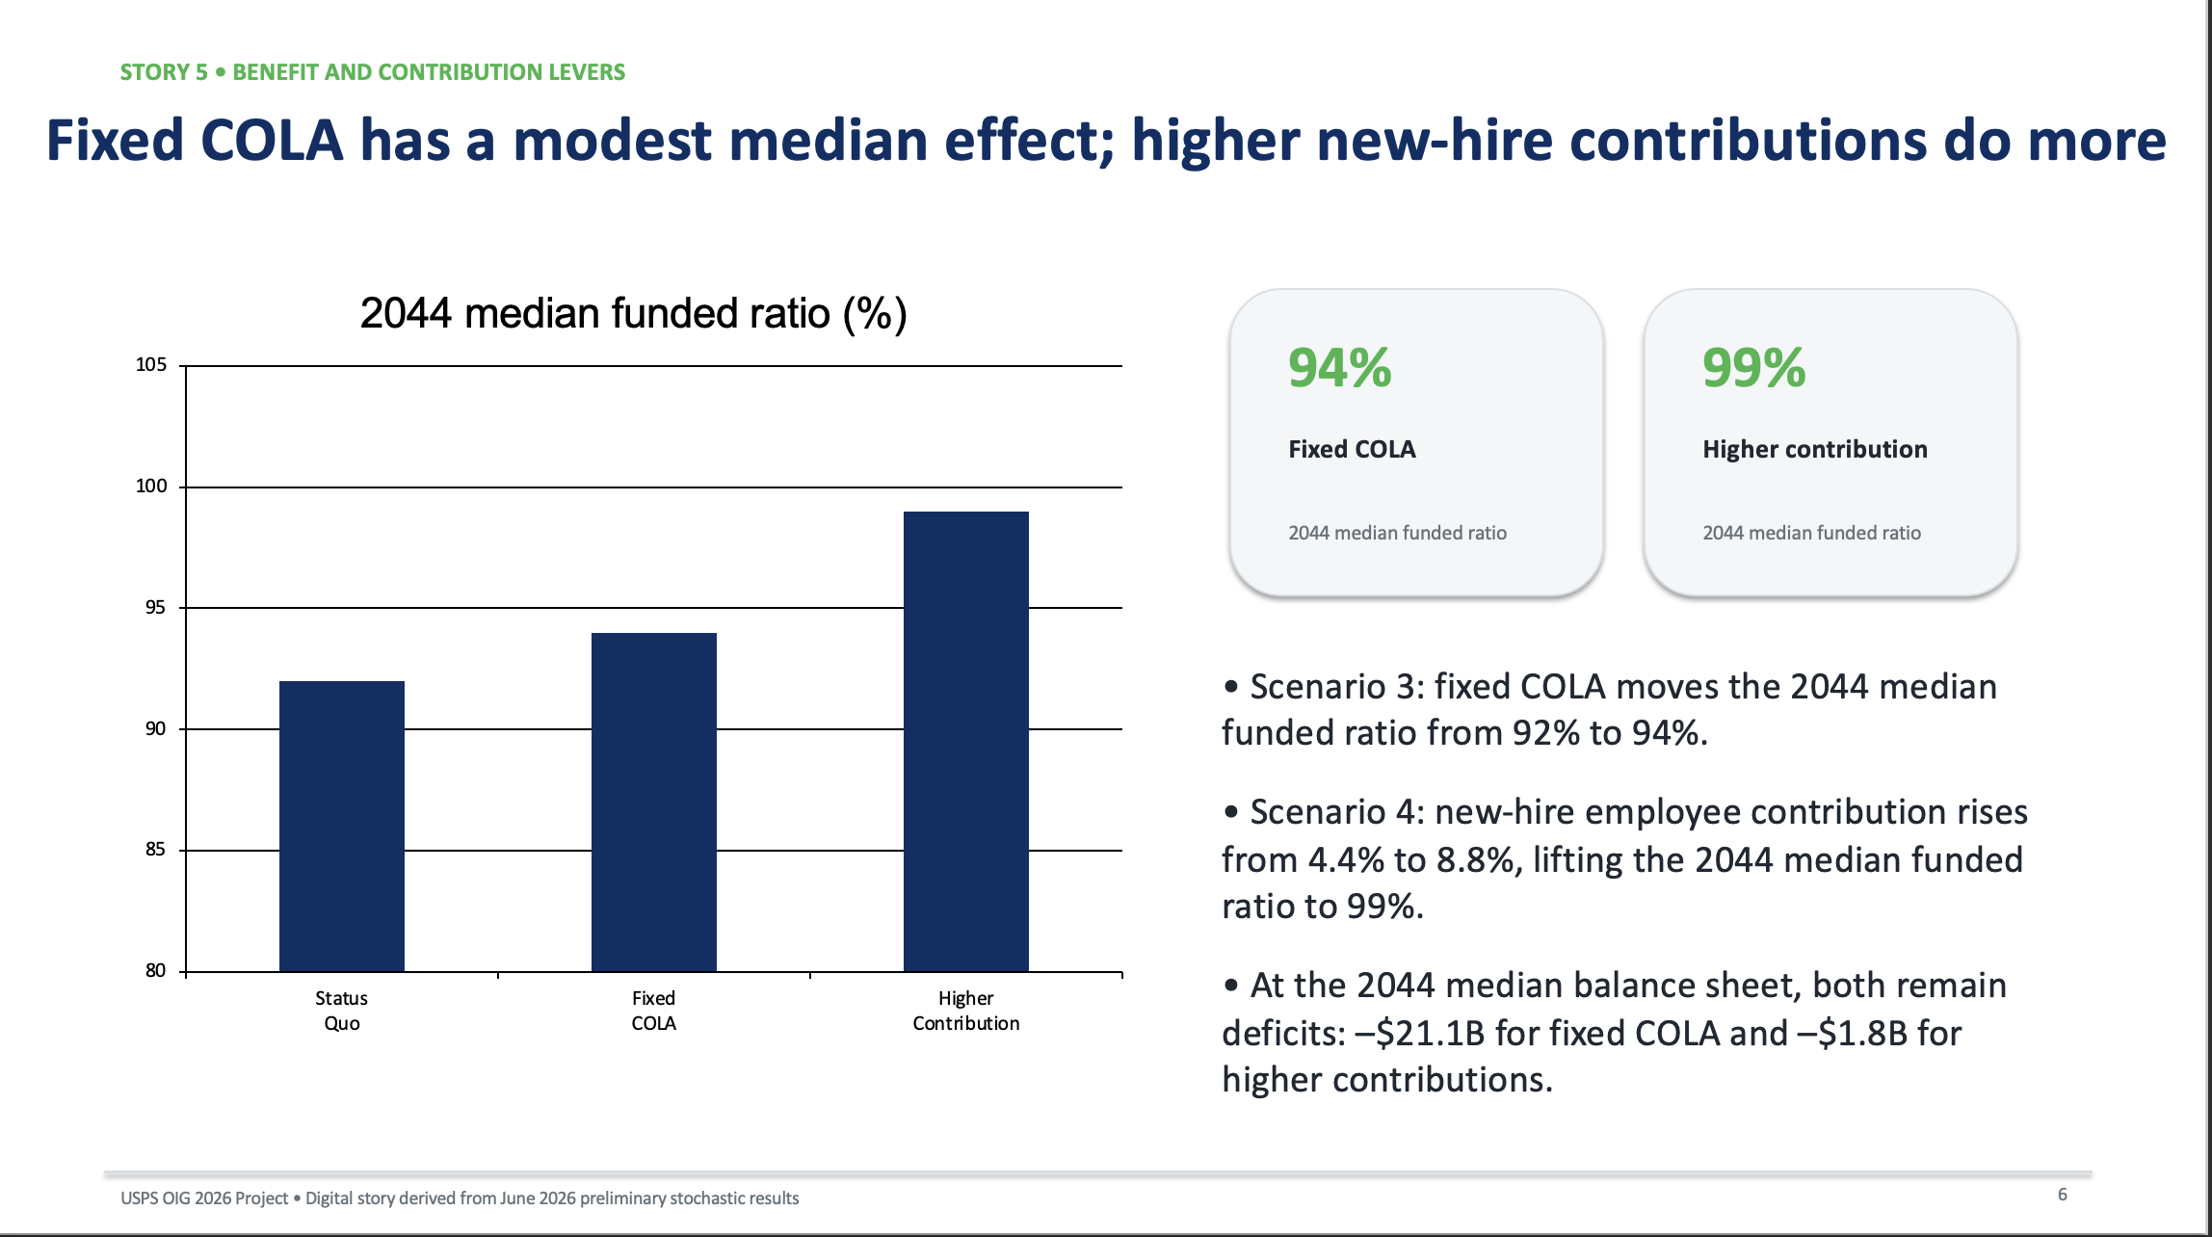
Module 2
USPS Project Use case: USPS OIG 2026 Project Stochastic Inflation 6/19/2026:
Digital Stories

Slide 56
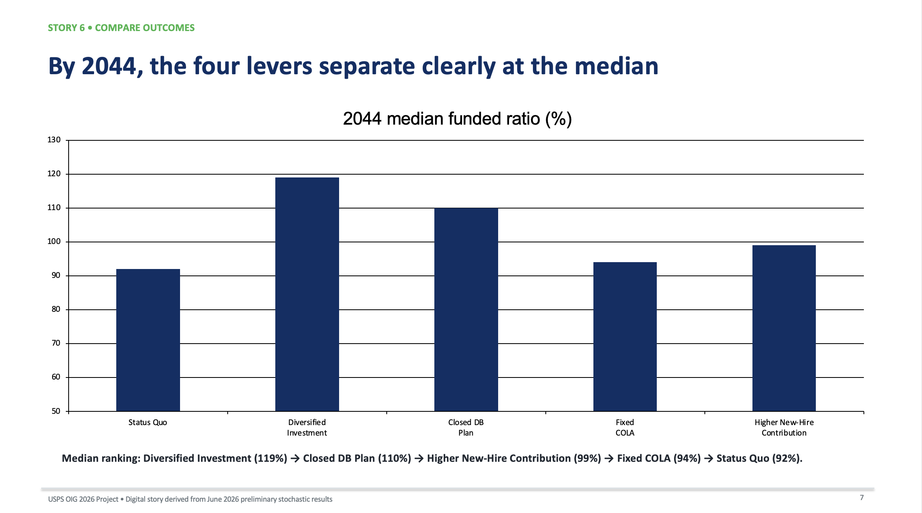
Module 2
USPS Project Use case: USPS OIG 2026 Project Stochastic Inflation 6/19/2026:
Digital Stories

Slide 57
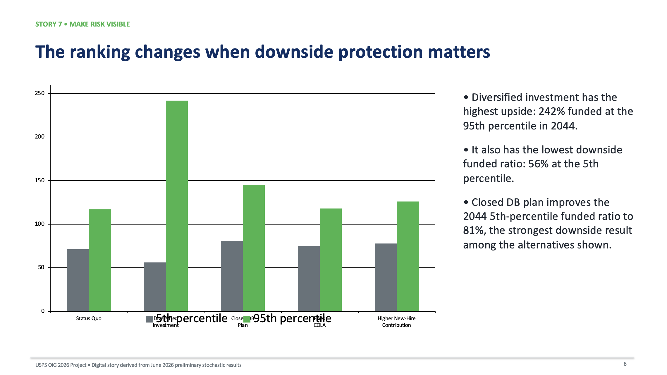
Module 2
USPS Project Use case: USPS OIG 2026 Project Stochastic Inflation 6/19/2026:
Digital Stories

Slide 58
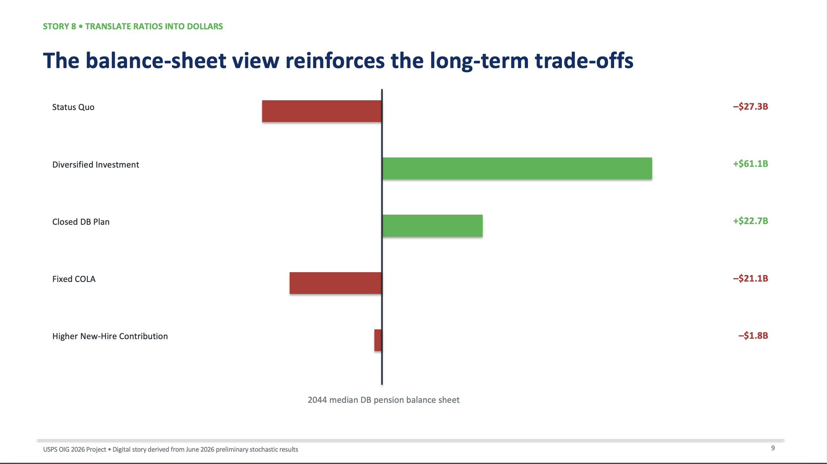
Module 2
USPS Project Use case: USPS OIG 2026 Project Stochastic Inflation 6/19/2026:
Digital Stories

Slide 59
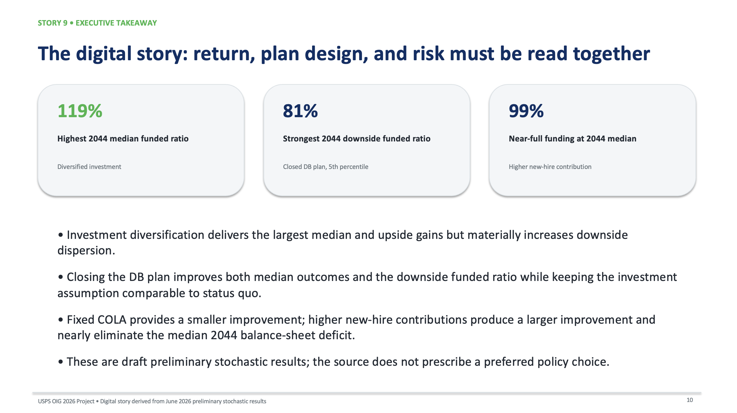
Module 2
USPS Project Use case: USPS OIG 2026 Project Stochastic Inflation 6/19/2026:
Digital Stories

Slide 60
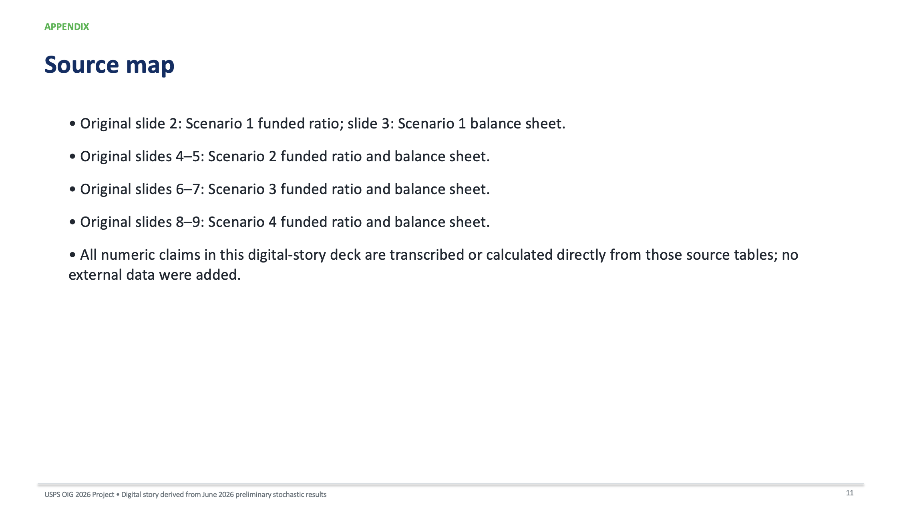
Module 2
USPS Project Use case: USPS OIG 2026 Project Stochastic Inflation 6/19/2026:
Digital Stories

Slide 61
03
Module 3
Writing for Impact: Structure, Audience, and Clarity

Slide 62
Learning Objectives
By the end of this module participants will be able to:
Write concise executive summaries
Avoid Technical jargons
Organize findings logically
Taylor communications to executive
Develop actionable recommendations

Slide 63
Principles
Key Principle:
Executives do not read analyses.
They read conclusions.
1
Pyramid Principle:
Lead with the answer.
Then provide evidence.
Not the other way around.
2
Example:
Weak ->After reviewing 15 datasets...
Strong ->Package delays increased because staffing shortages reduced processing capacity by 12%.
3

Slide 64
Writing Structure
Background
Evidence
Analysis
Findings
Recommendations
Expected Benefits

Slide 65
Before and After Exercise
Before
"The dataset shows multiple changes over several months."
After
"Package delays increased 15% after staffing levels dropped below operational thresholds in three processing centers."

Slide 66
Plain Language Challenge
Convert:
"The multivariate analysis indicates statistically significant variation."
Into
"Several operational factors consistently contributed to delivery delays."

Slide 67
Group Exercise: Rewrite an existing USPS report.
Objectives:
Shorter
Clearer
More persuasive

Slide 68
04
Module 4
Strategic Visualization and Dashboard-Driven Storytelling

Slide 69
Learning Objectives
By the end of this module participants will be able to:
Choose appropriate charts
Avoid misleading graphics
Guide audience attention
Interpret dashboard strategically
Tell stories visually

Slide 70
Core Principle
Every chart must answer one question.
Bad Dashboard
20 charts
15 colors
Tiny text
No hierarchy
No conclusions

Slide 71
Core Principle
Good Dashboard
Three questions:
What happened?
Why?
What action is needed?

Slide 72
Chart Selection Guide
Trend
Line chart
Comparison
Bar chart
Composition
Stacked bar
Distribution
Histogram
Relationship
Scatterplot
Geography
Map

Slide 73
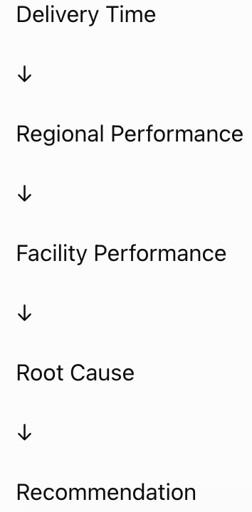
USPS Example

Slide 74
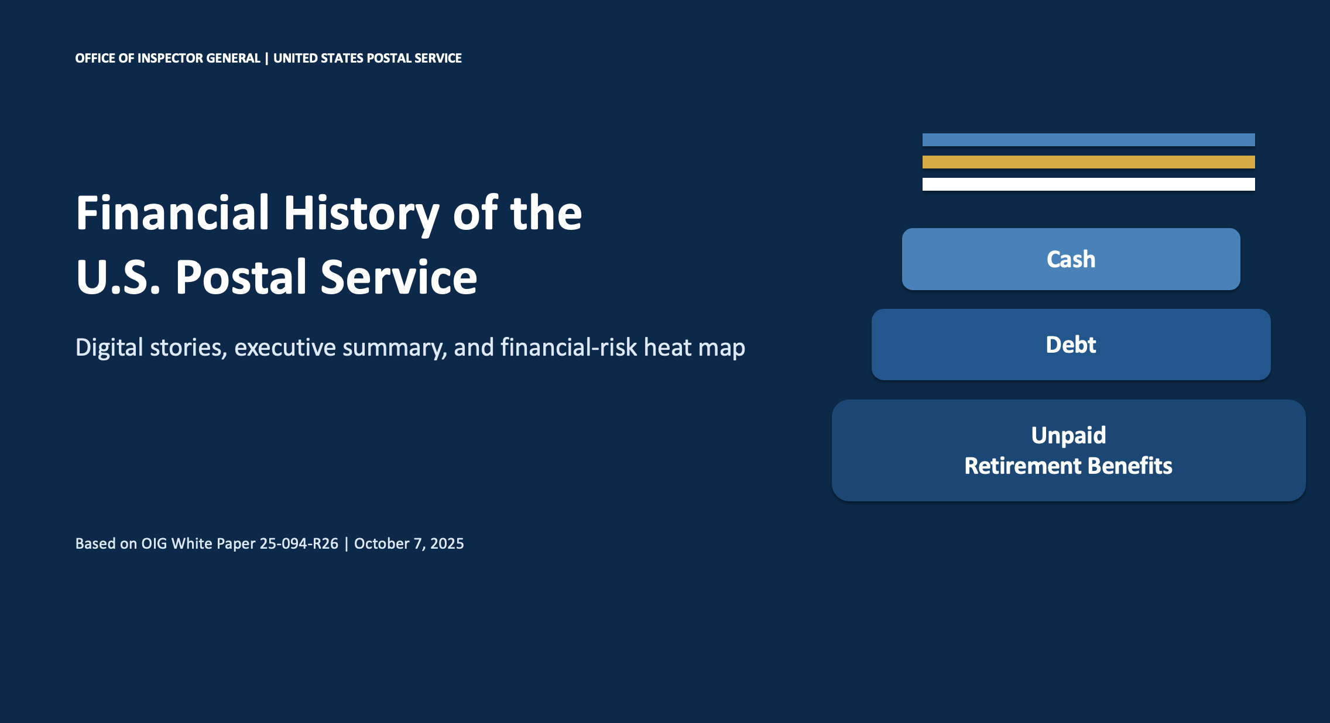
USPS Use Case: Financial History of the U.S. Postal Service

Slide 75
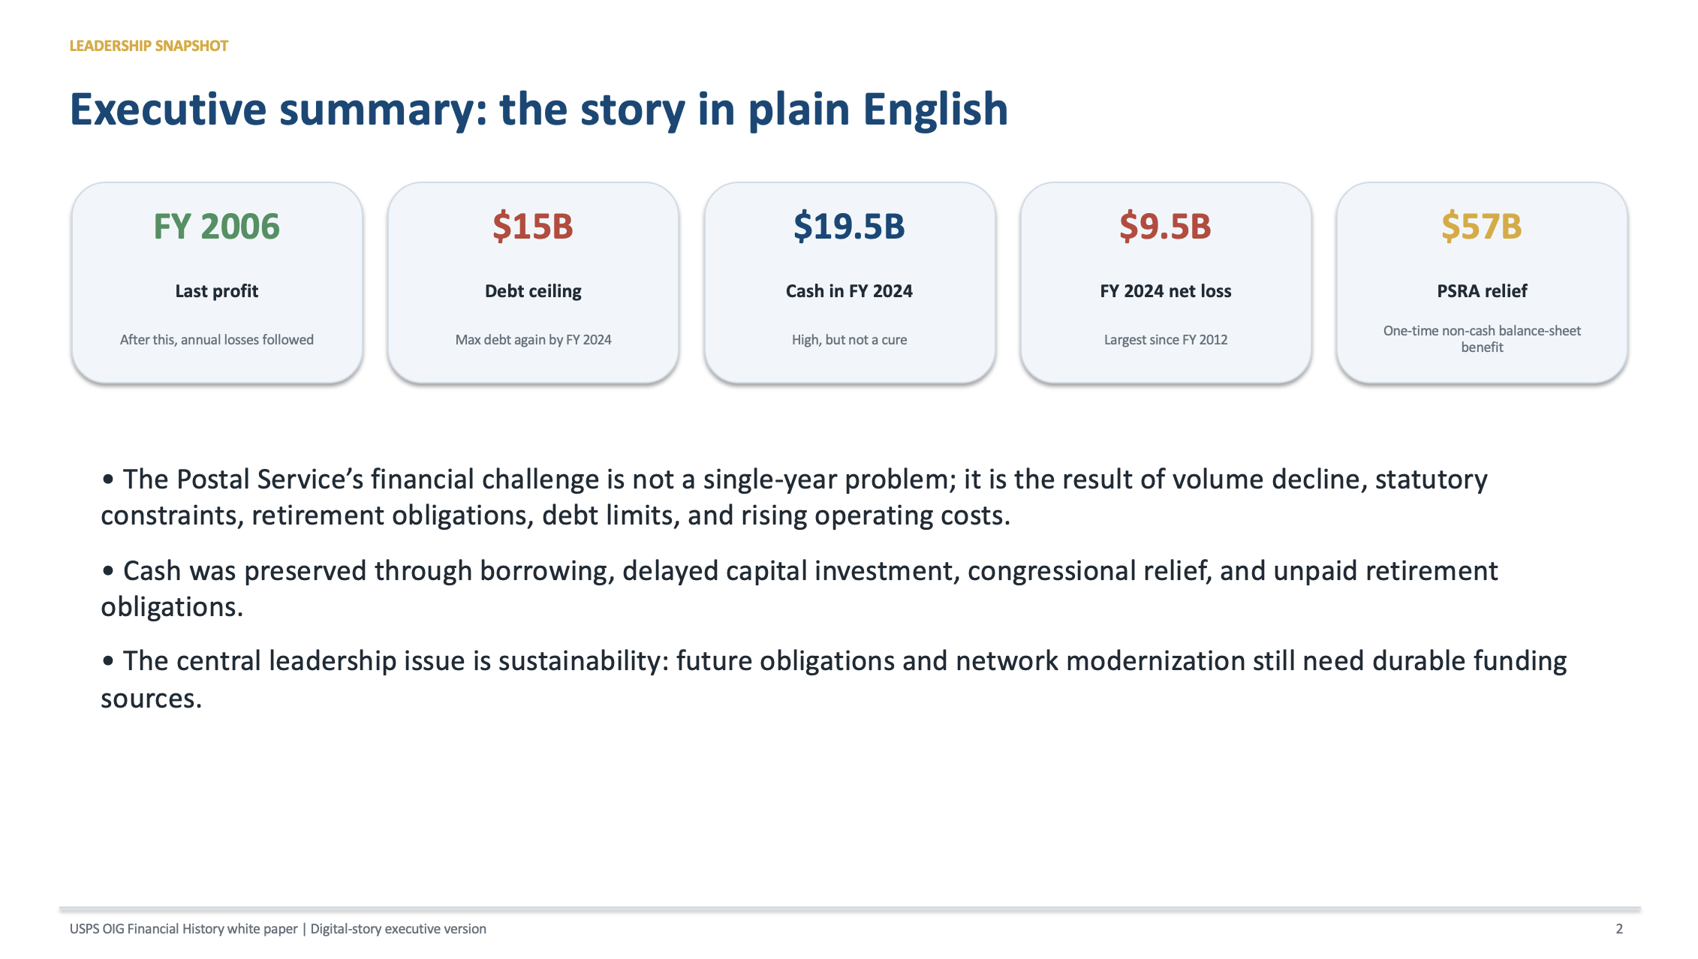
USPS Use Case: Financial History of the U.S. Postal Service

Slide 76
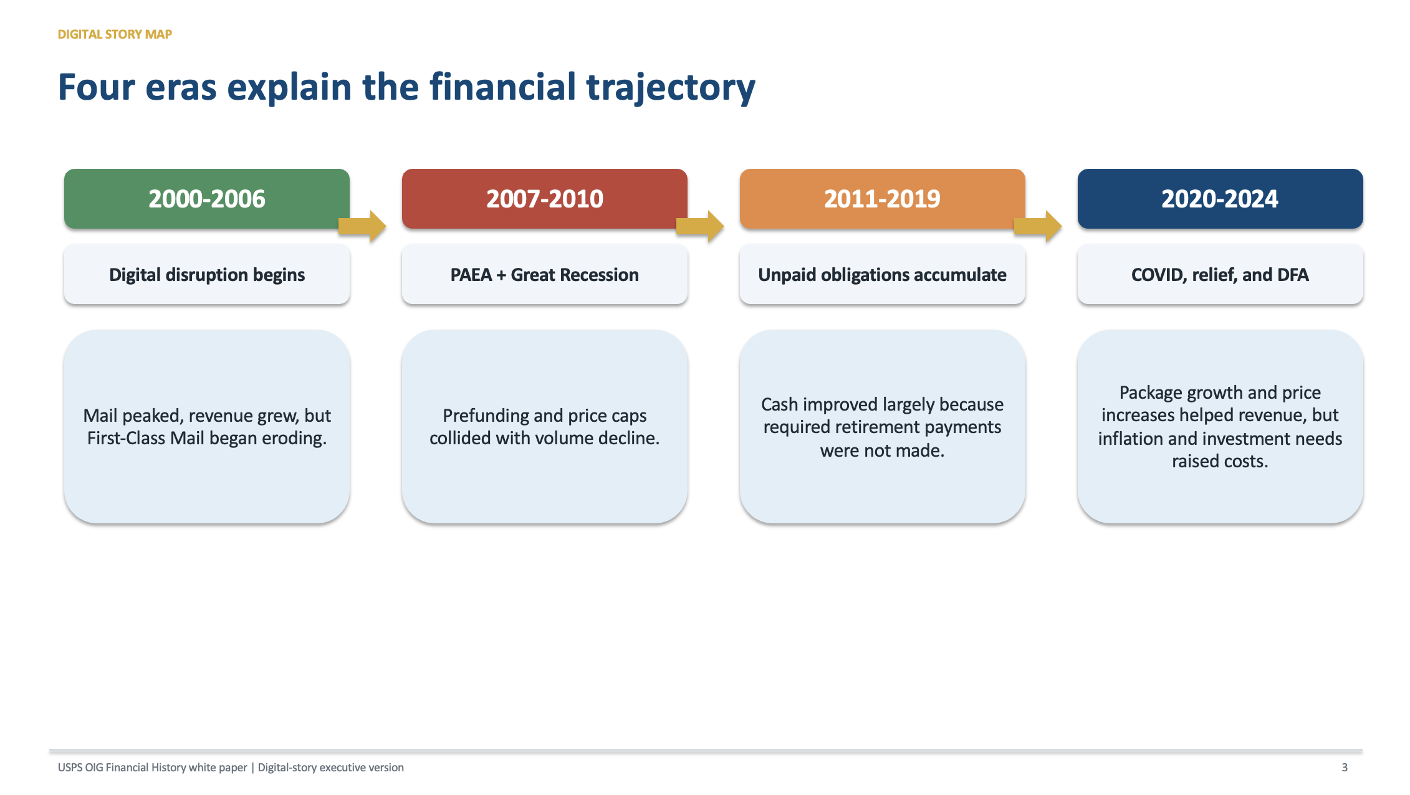
USPS Use Case: Financial History of the U.S. Postal Service

Slide 77
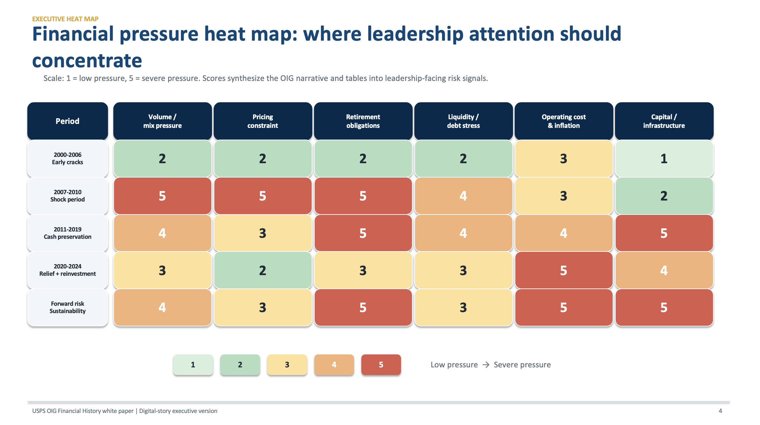
USPS Use Case: Financial History of the U.S. Postal Service

Slide 78
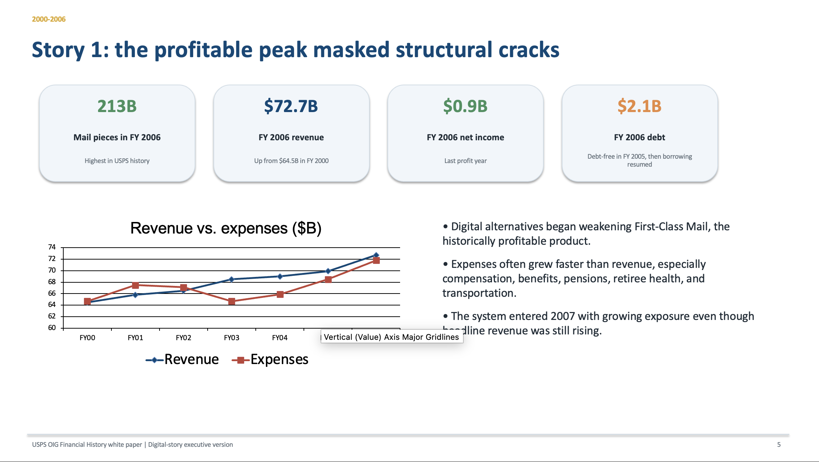
USPS Use Case: Financial History of the U.S. Postal Service

Slide 79
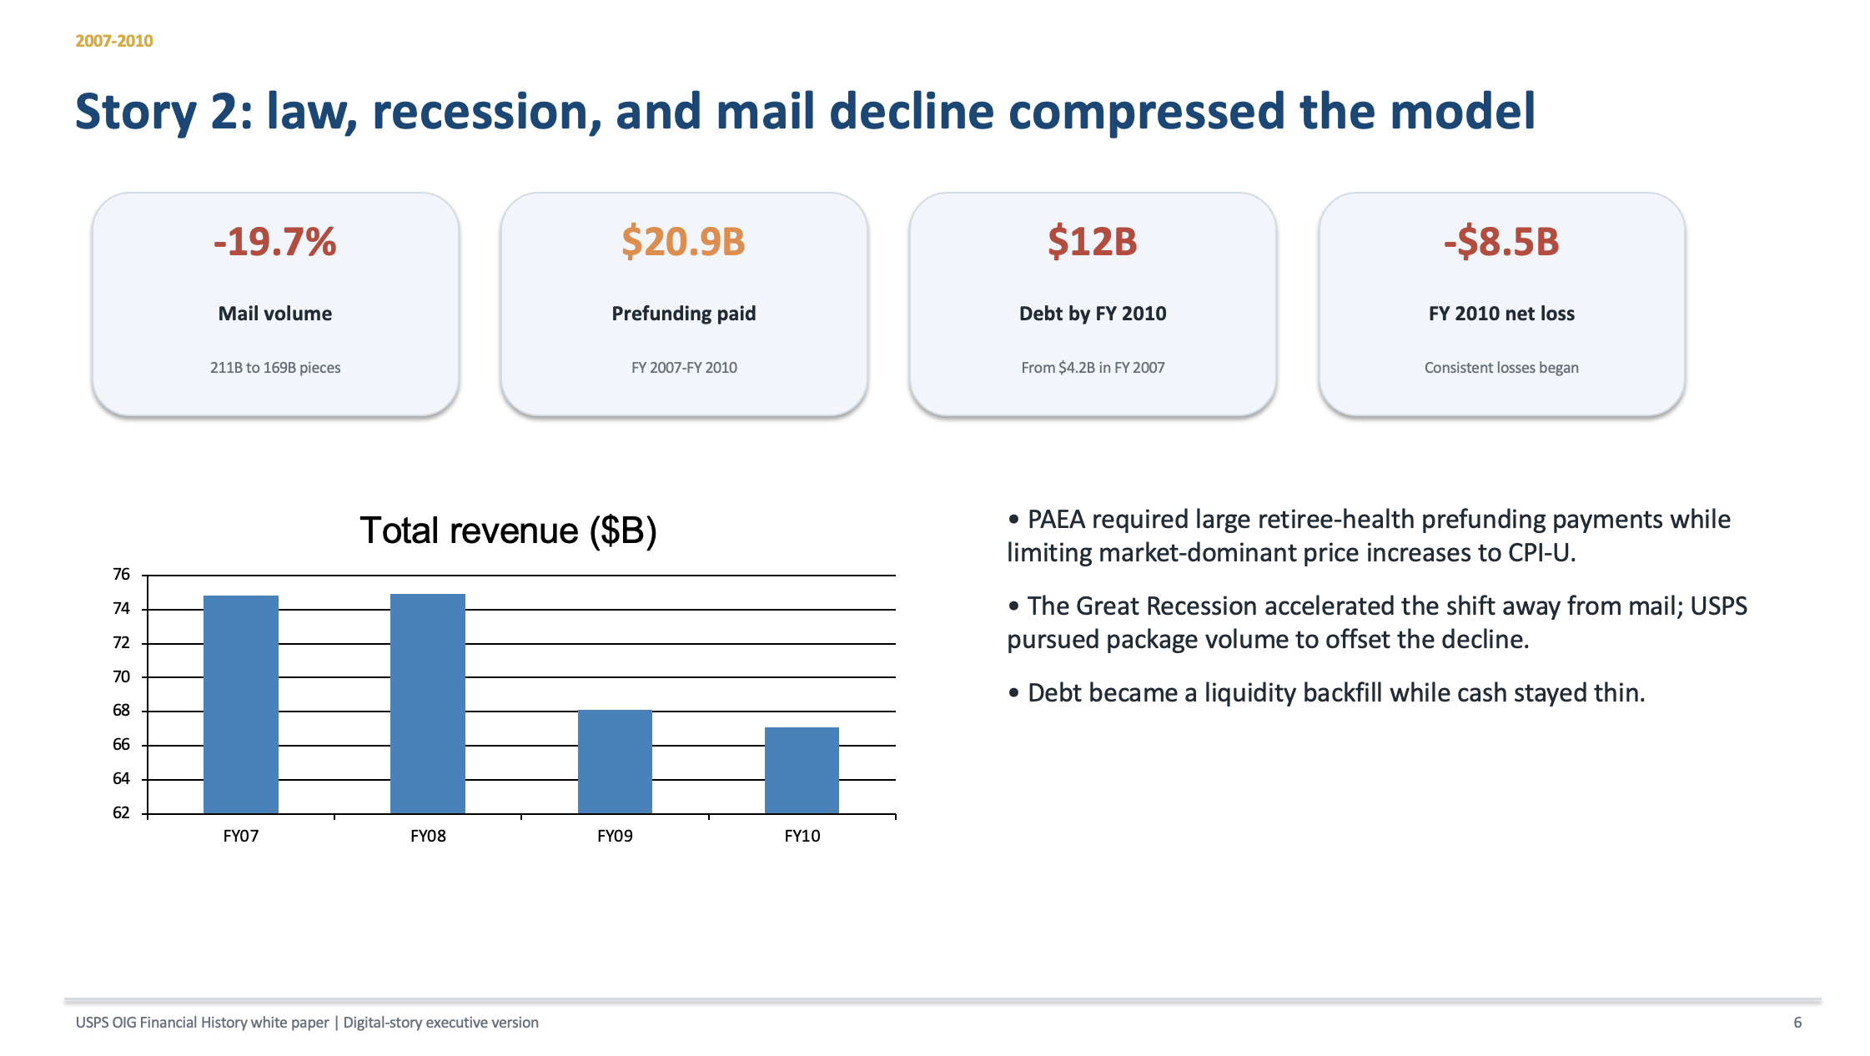
USPS Use Case: Financial History of the U.S. Postal Service

Slide 80
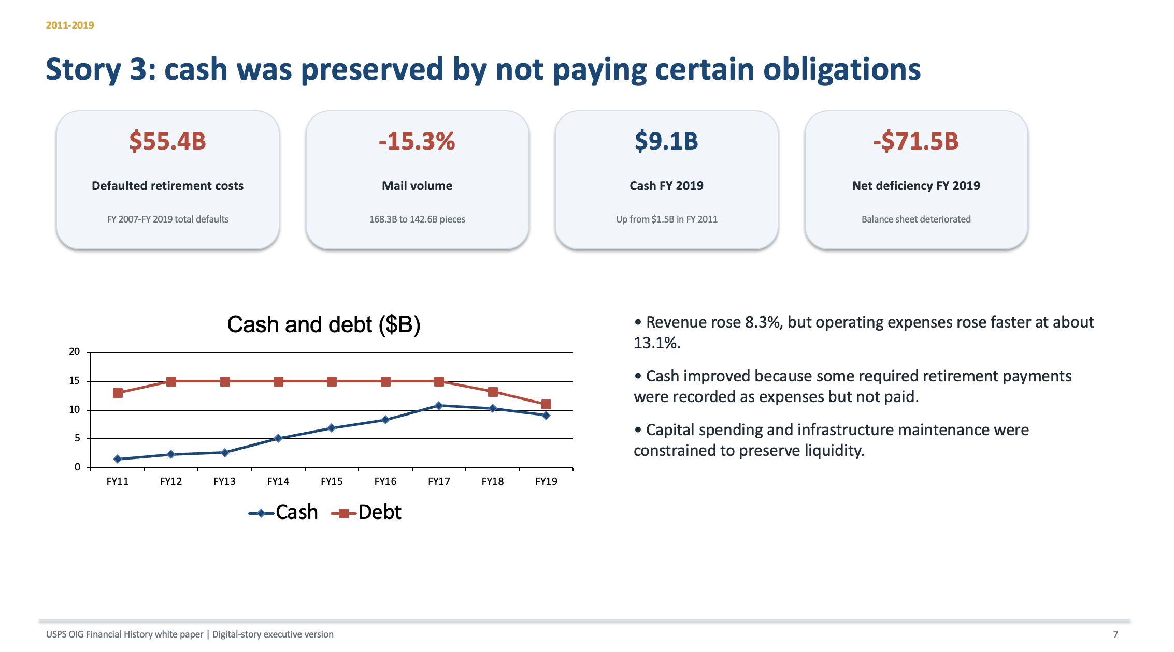
USPS Use Case: Financial History of the U.S. Postal Service

Slide 81
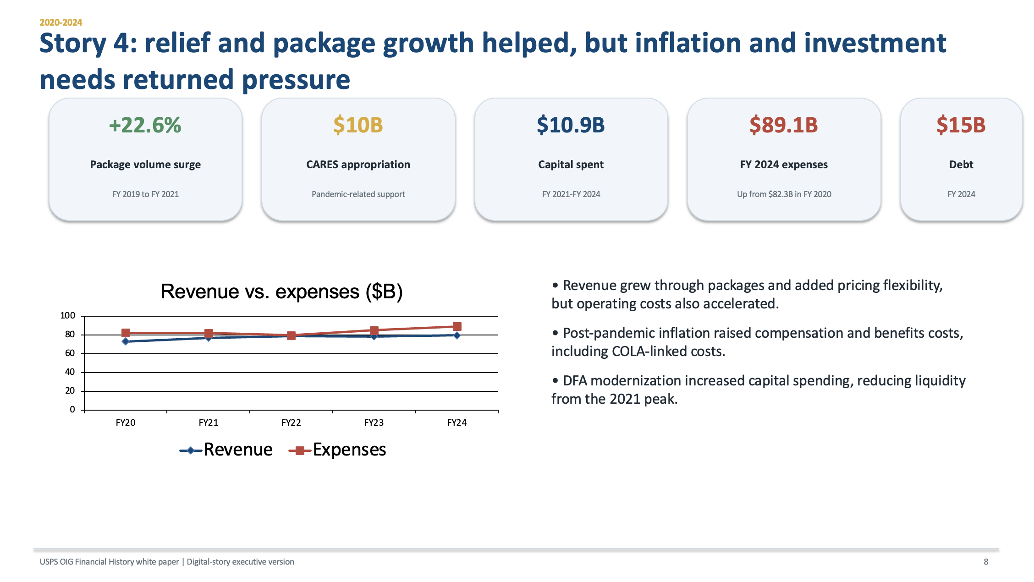
USPS Use Case: Financial History of the U.S. Postal Service

Slide 82
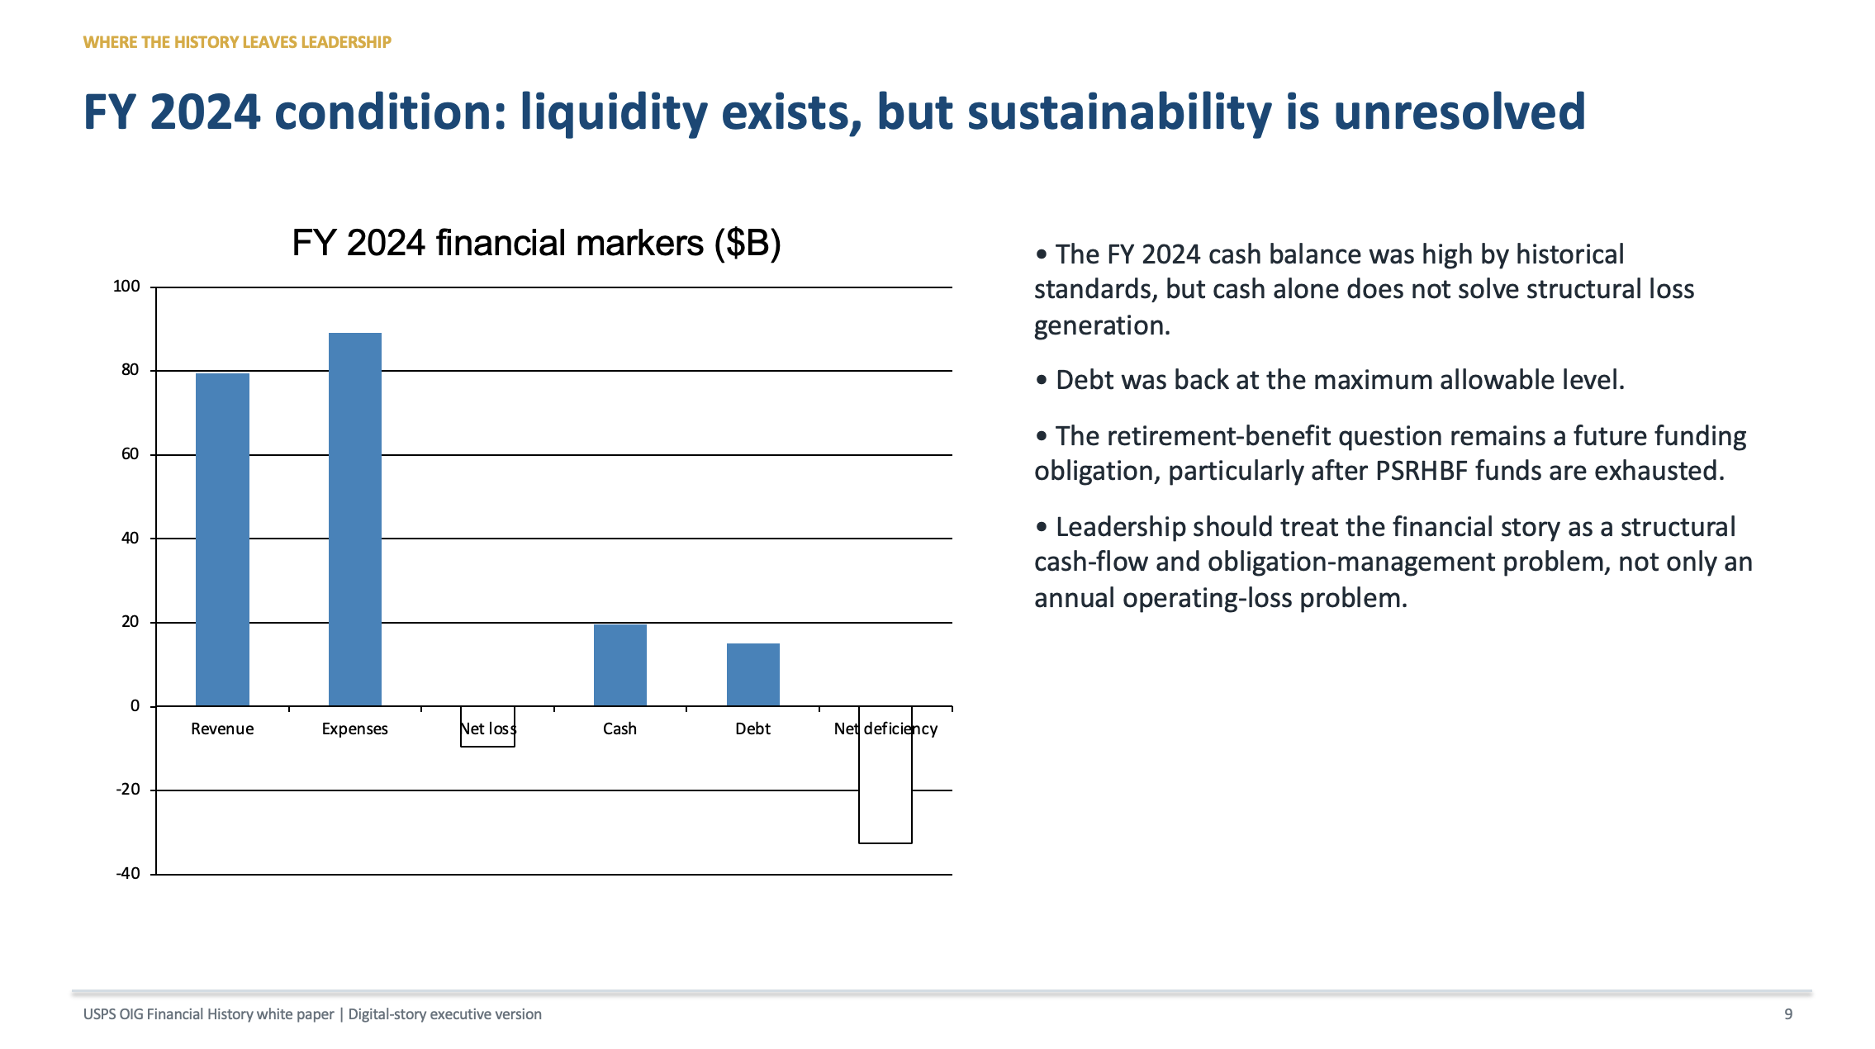
USPS Use Case: Financial History of the U.S. Postal Service

Slide 83
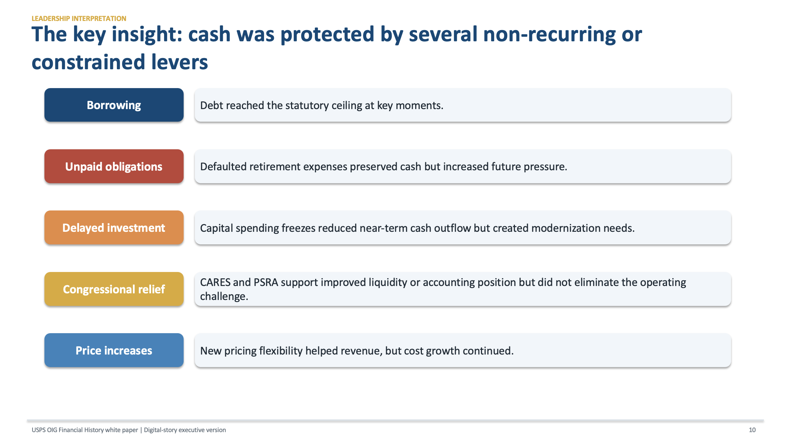
USPS Use Case: Financial History of the U.S. Postal Service

Slide 84
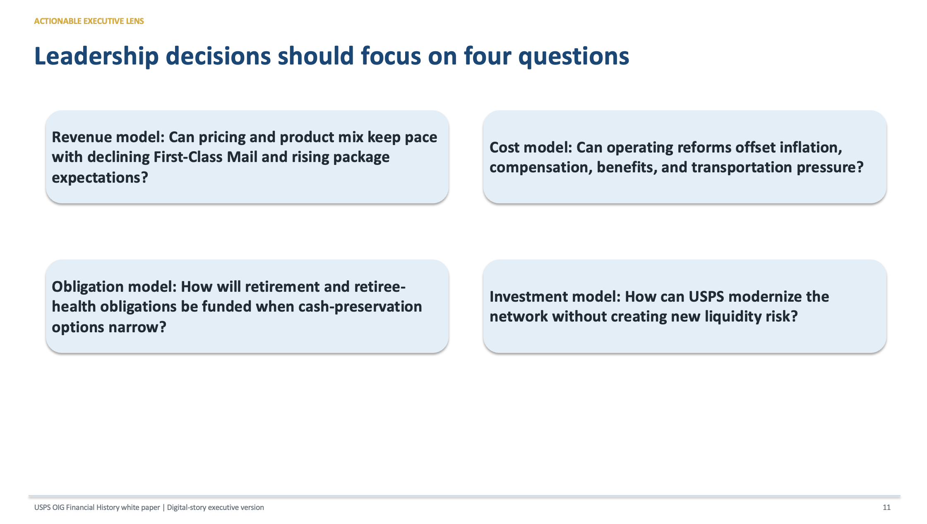
USPS Use Case: Financial History of the U.S. Postal Service

Slide 85
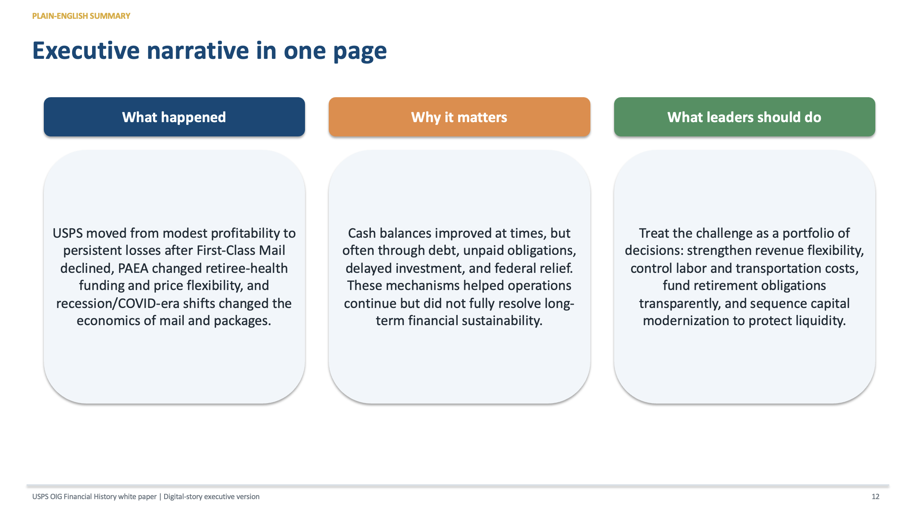
USPS Use Case: Financial History of the U.S. Postal Service

Slide 86
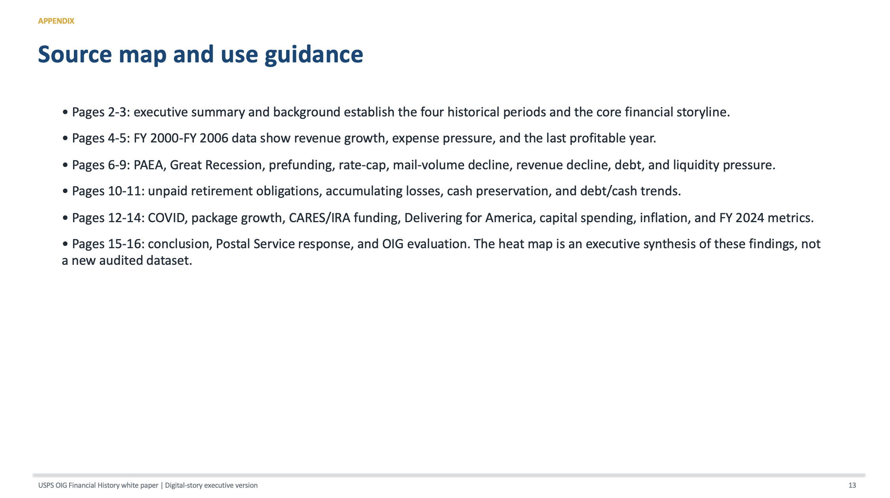
USPS Use Case: Financial History of the U.S. Postal Service

Slide 87
Visualization Exercise
Given one dataset,
Create:
Executive dashboard
Operations dashboard
Field manager dashboard
Discuss why each differs.

Slide 88
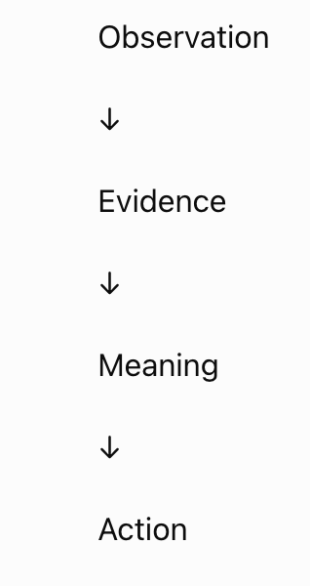
Visual Storytelling Formula

Slide 89
05
Module 5
USPS OIG Whitepaper Clinic & Workshop Wrap-Up

Slide 90
Learning Objectives
By the end of this module participants will be able to:
Apply the complete workflow
Critique analytical narratives
Develop executive recommendations
Present findings professionally
Receive peer feedback

Slide 91
Activity
Work in small teams.
Each team receives USPS OIG dashboard sections.
Tasks:
Analyze
Interpret
Develop recommendations
Create visuals

Slide 92
White Paper Template
Executive Summary
Three paragraphs
Background
Business challenge
Data Sources
Explain evidence
Analysis
Findings
Insights
What matters
Recommendations
Priority actions
Expected Benefits
Operational
Financial
Strategic

Slide 93
Team Presentations
10 minutes
Presentation
5 minutes
Questions
5 minutes
Feedback

Slide 94
Peer evaluation
Criteria:
Evidence quality
Clarity
Visuals
Recommendations
Persuasiveness
Executive readiness

Slide 95
Final Workshop Capstone
Each participant produces a professional analytical briefing that includes:
A clearly defined business problem
Exploratory analysis with supporting evidence
Identification of patterns, anomalies, and possible root causes
A concise executive summary written in plain language
A dashboard or set of visuals that support—not distract from—the narrative
Three actionable recommendations tied directly to the analysis
A five-minute executive presentation that communicates findings and expected organizational impact

Slide 96

USPS Use case: OIG Dashboard with recommendations

Slide 97
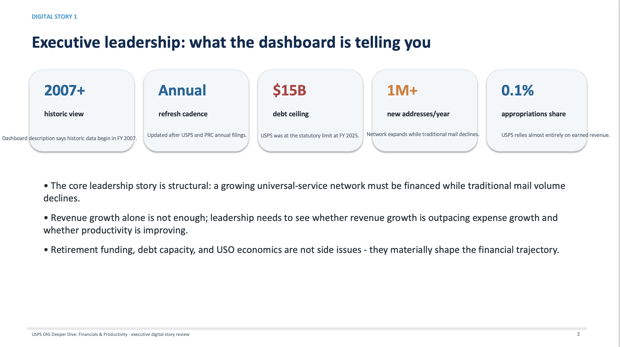
USPS Use case: OIG Dashboard with recommendations

Slide 98
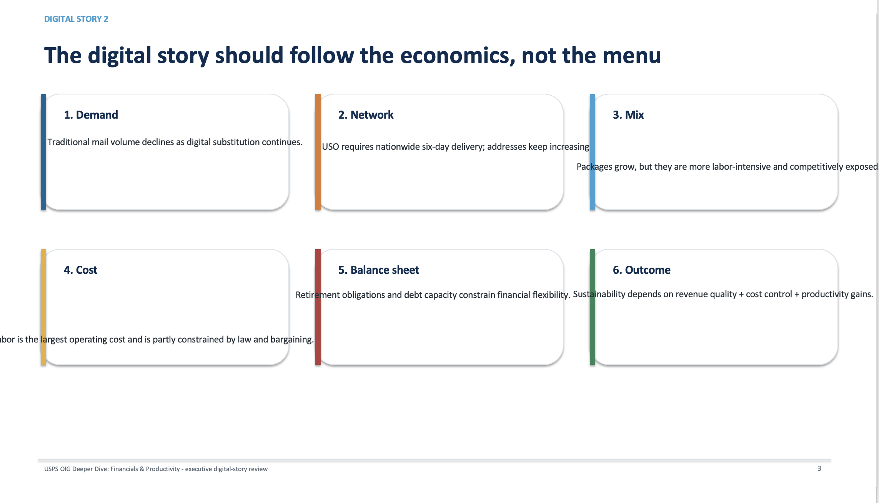
USPS Use case: OIG Dashboard with recommendations

Slide 99
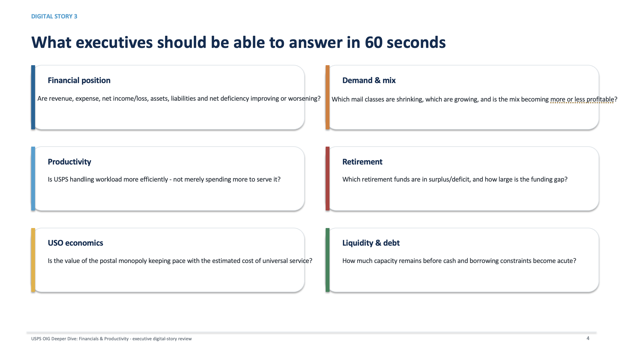
USPS Use case: OIG Dashboard with recommendations

Slide 100
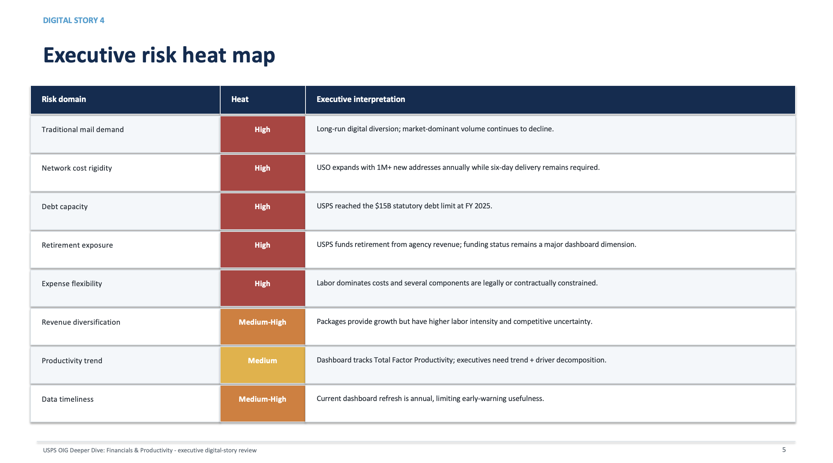
USPS Use case: OIG Dashboard with recommendations

Slide 101
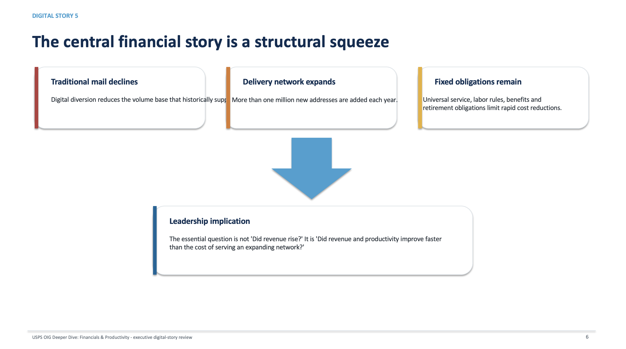
USPS Use case: OIG Dashboard with recommendations

Slide 102
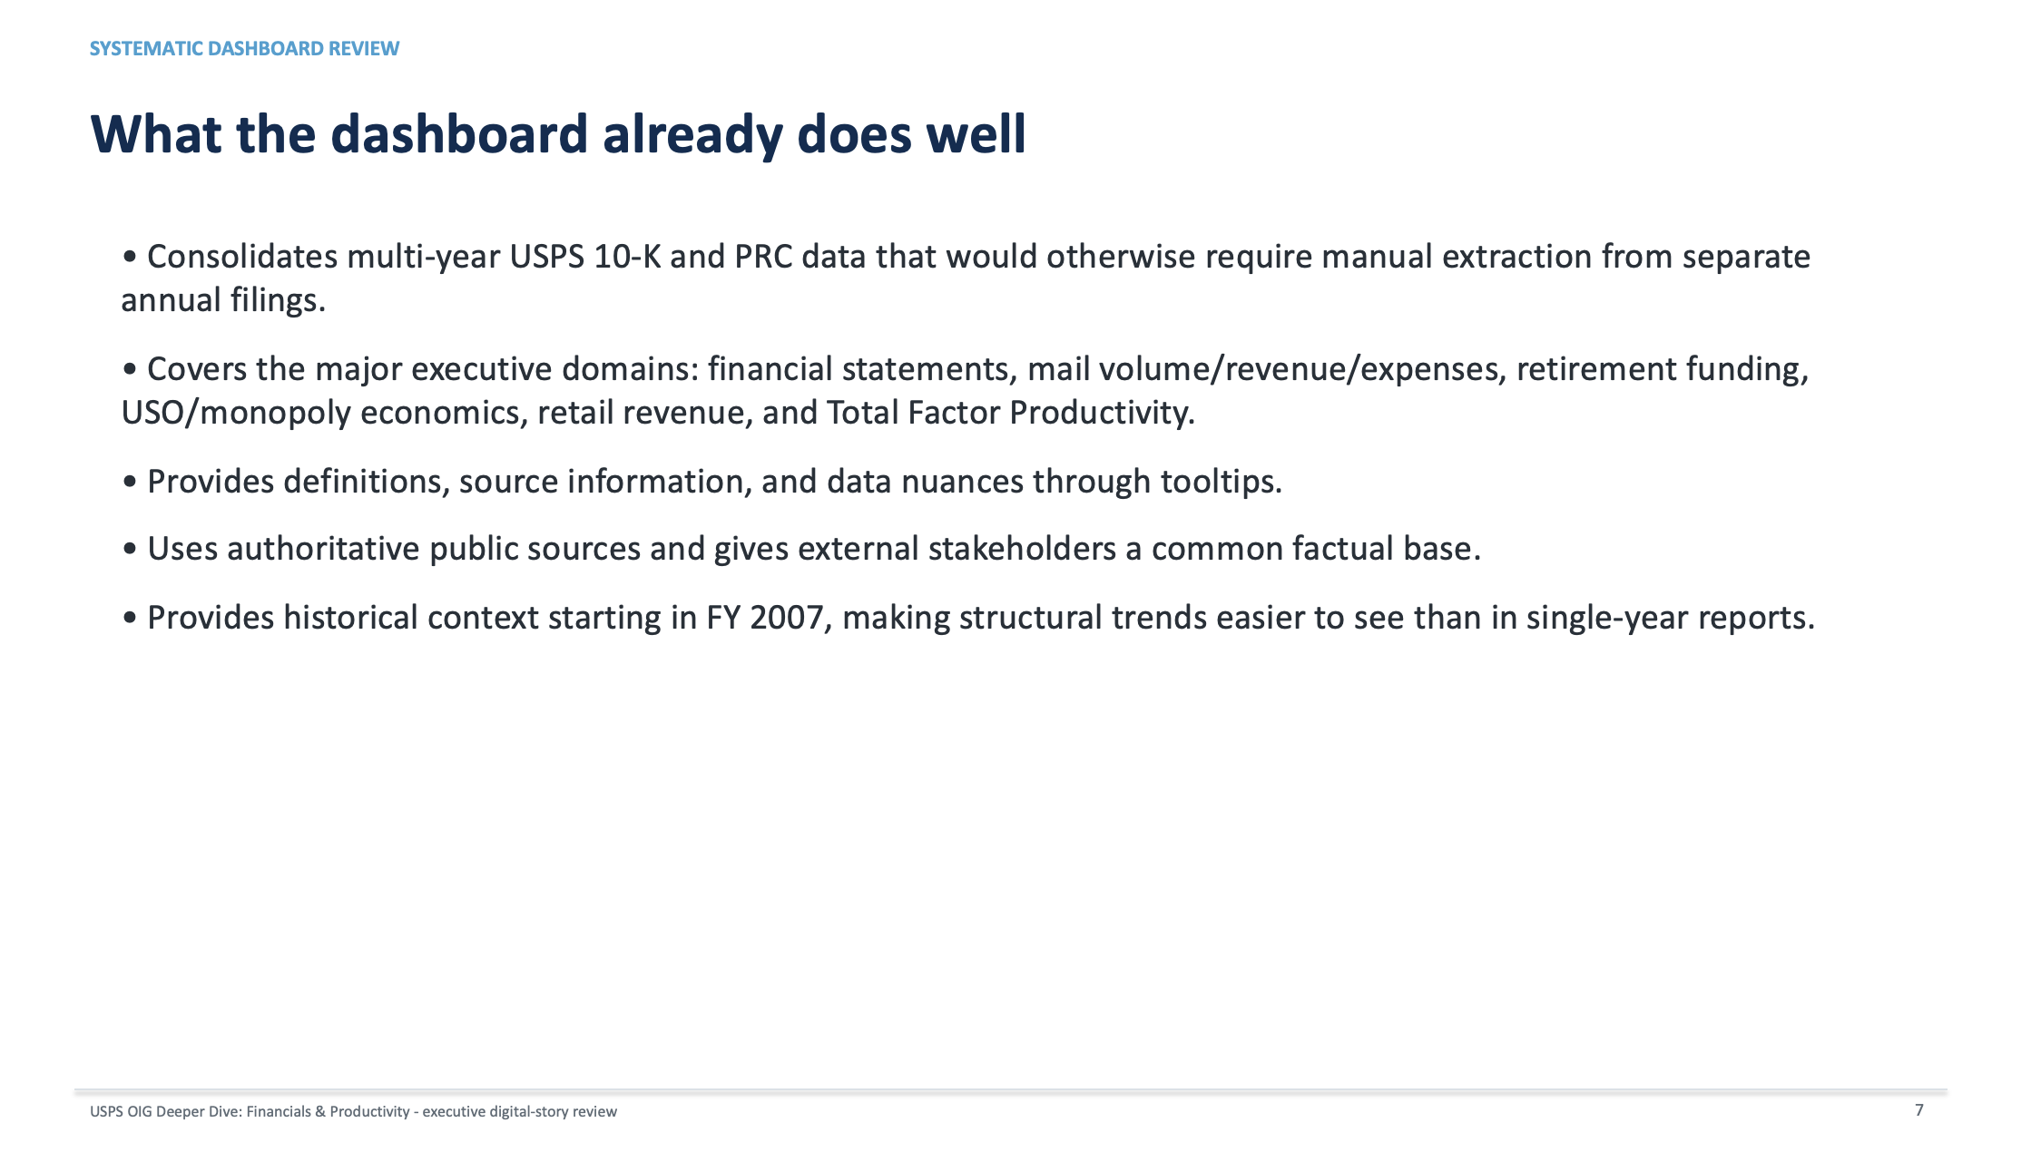
USPS Use case: OIG Dashboard with recommendations

Slide 103
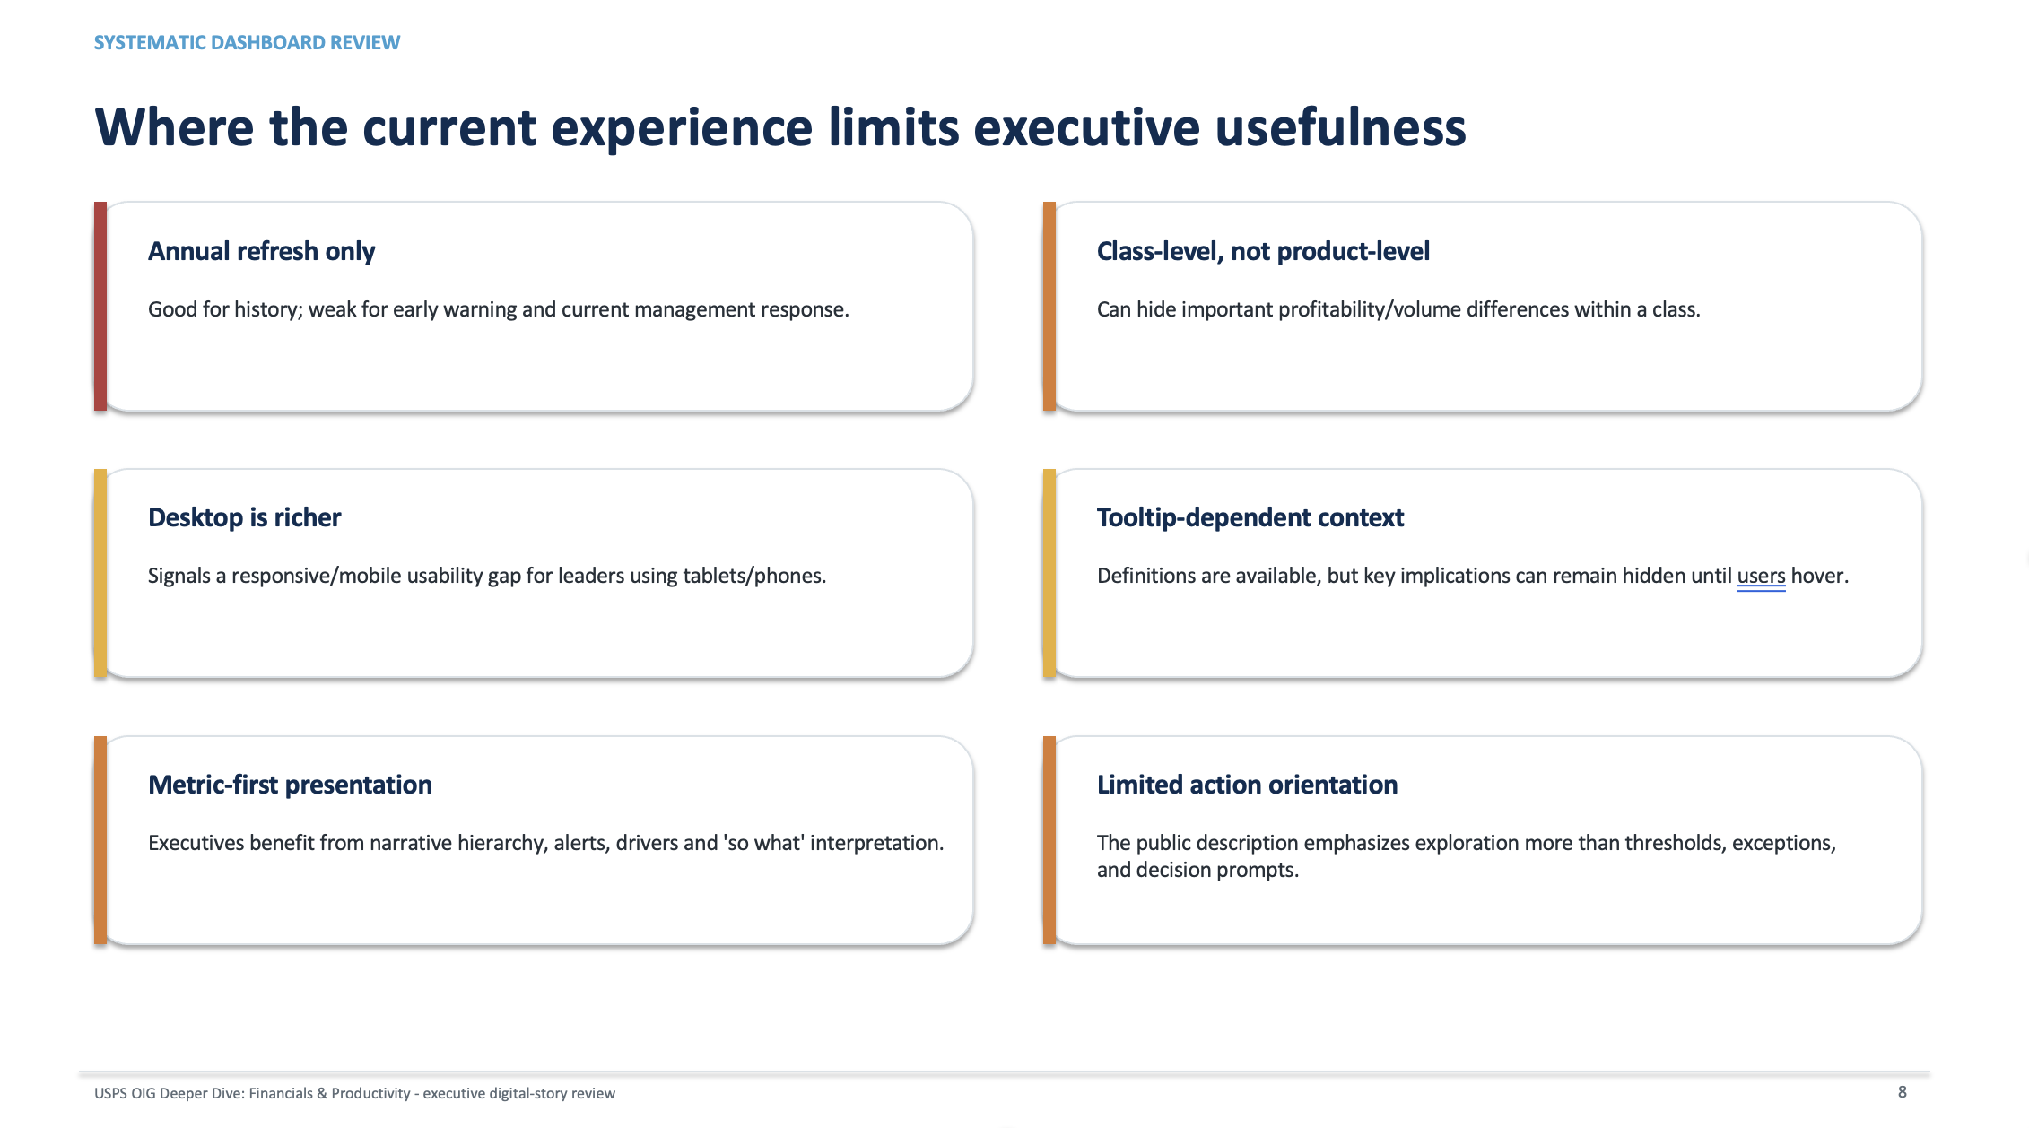
USPS Use case: OIG Dashboard with recommendations

Slide 104
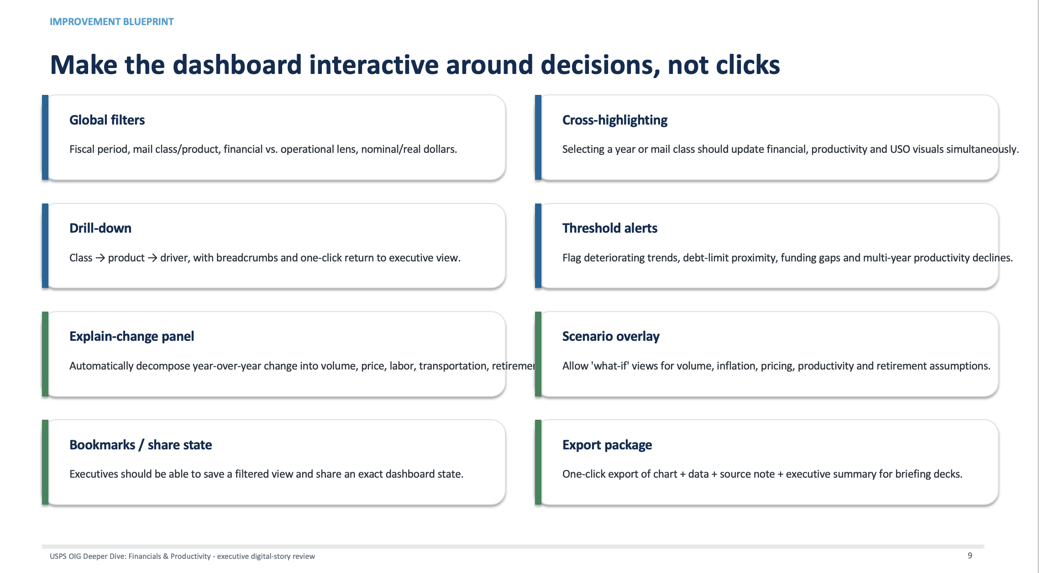
USPS Use case: OIG Dashboard with recommendations

Slide 105
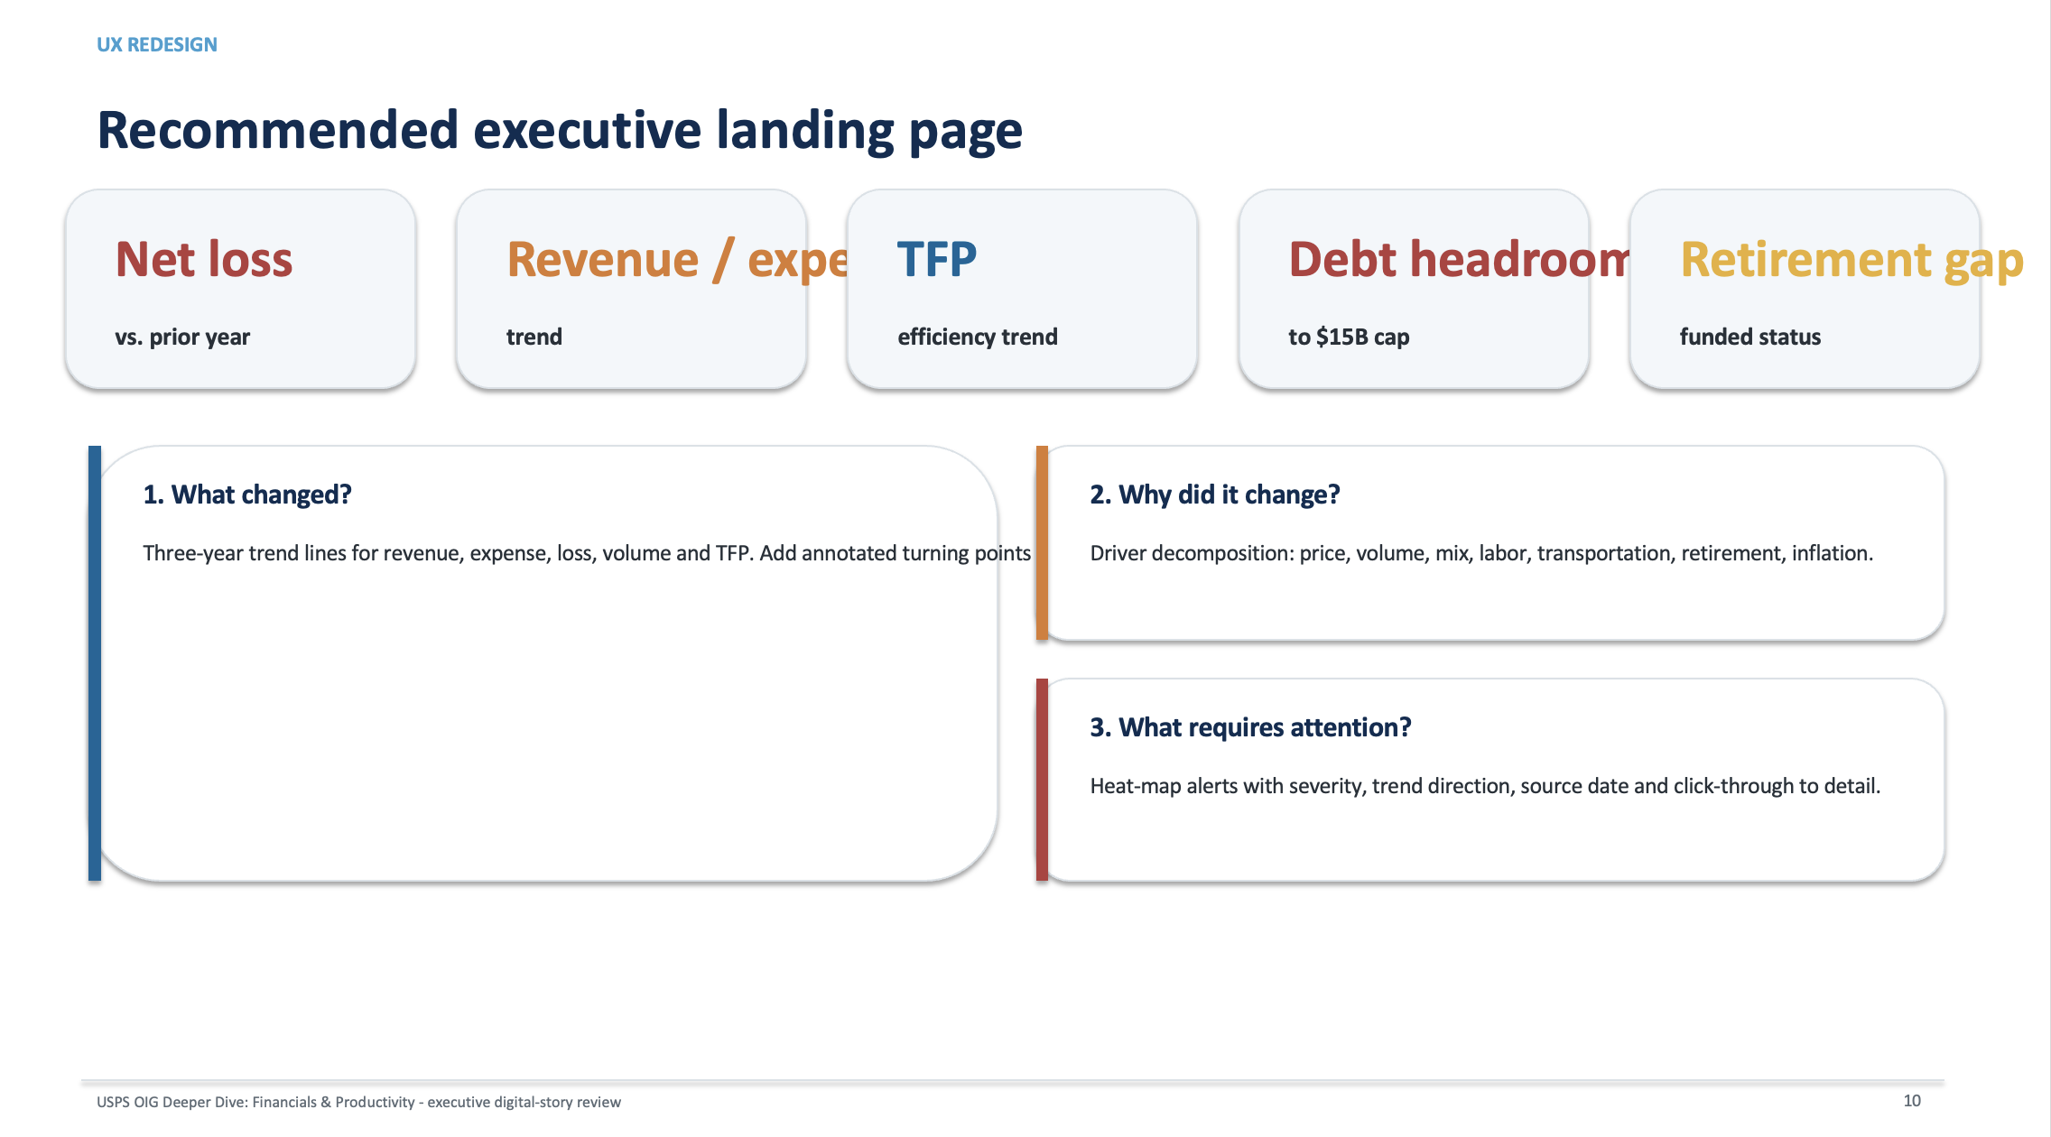
USPS Use case: OIG Dashboard with recommendations

Slide 106
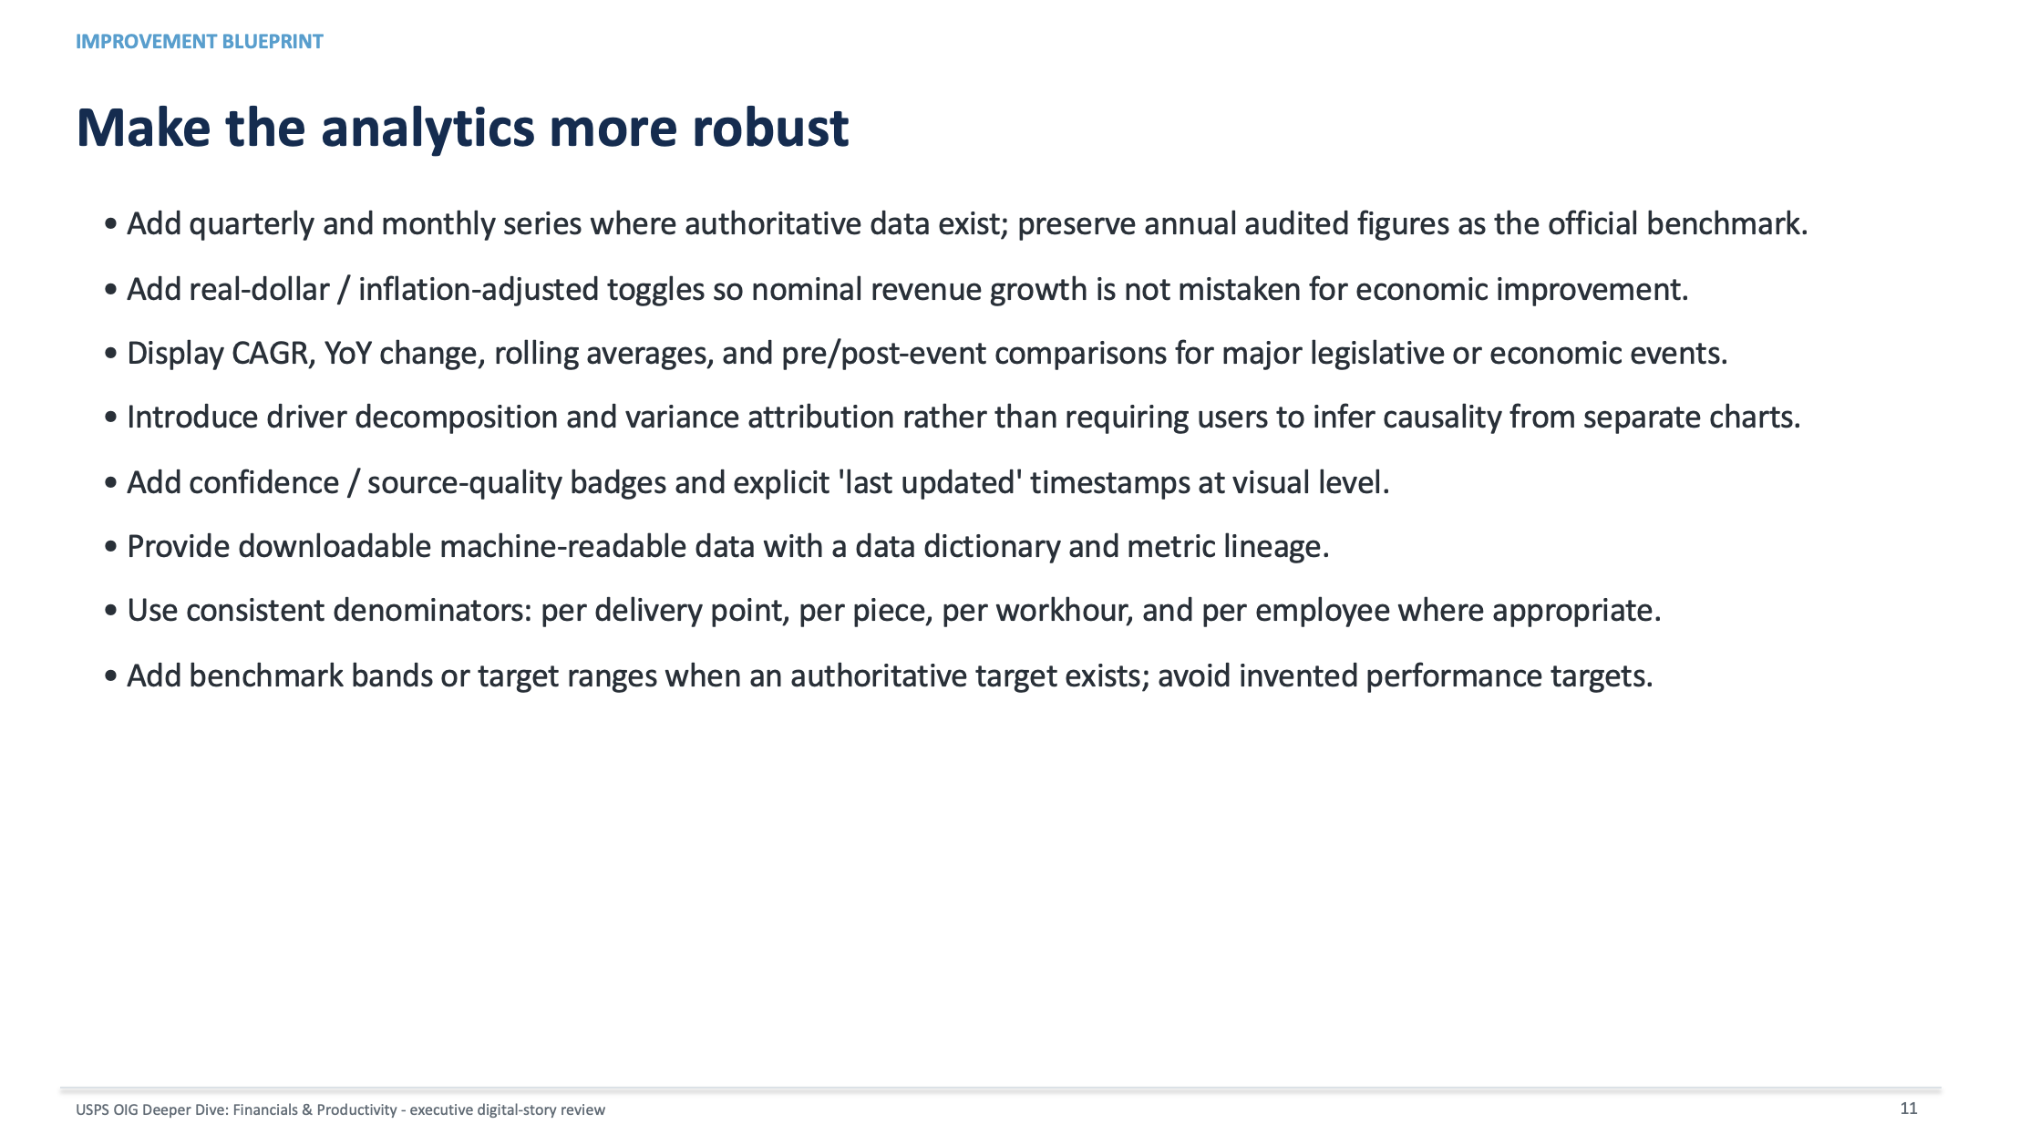
USPS Use case: OIG Dashboard with recommendations

Slide 107
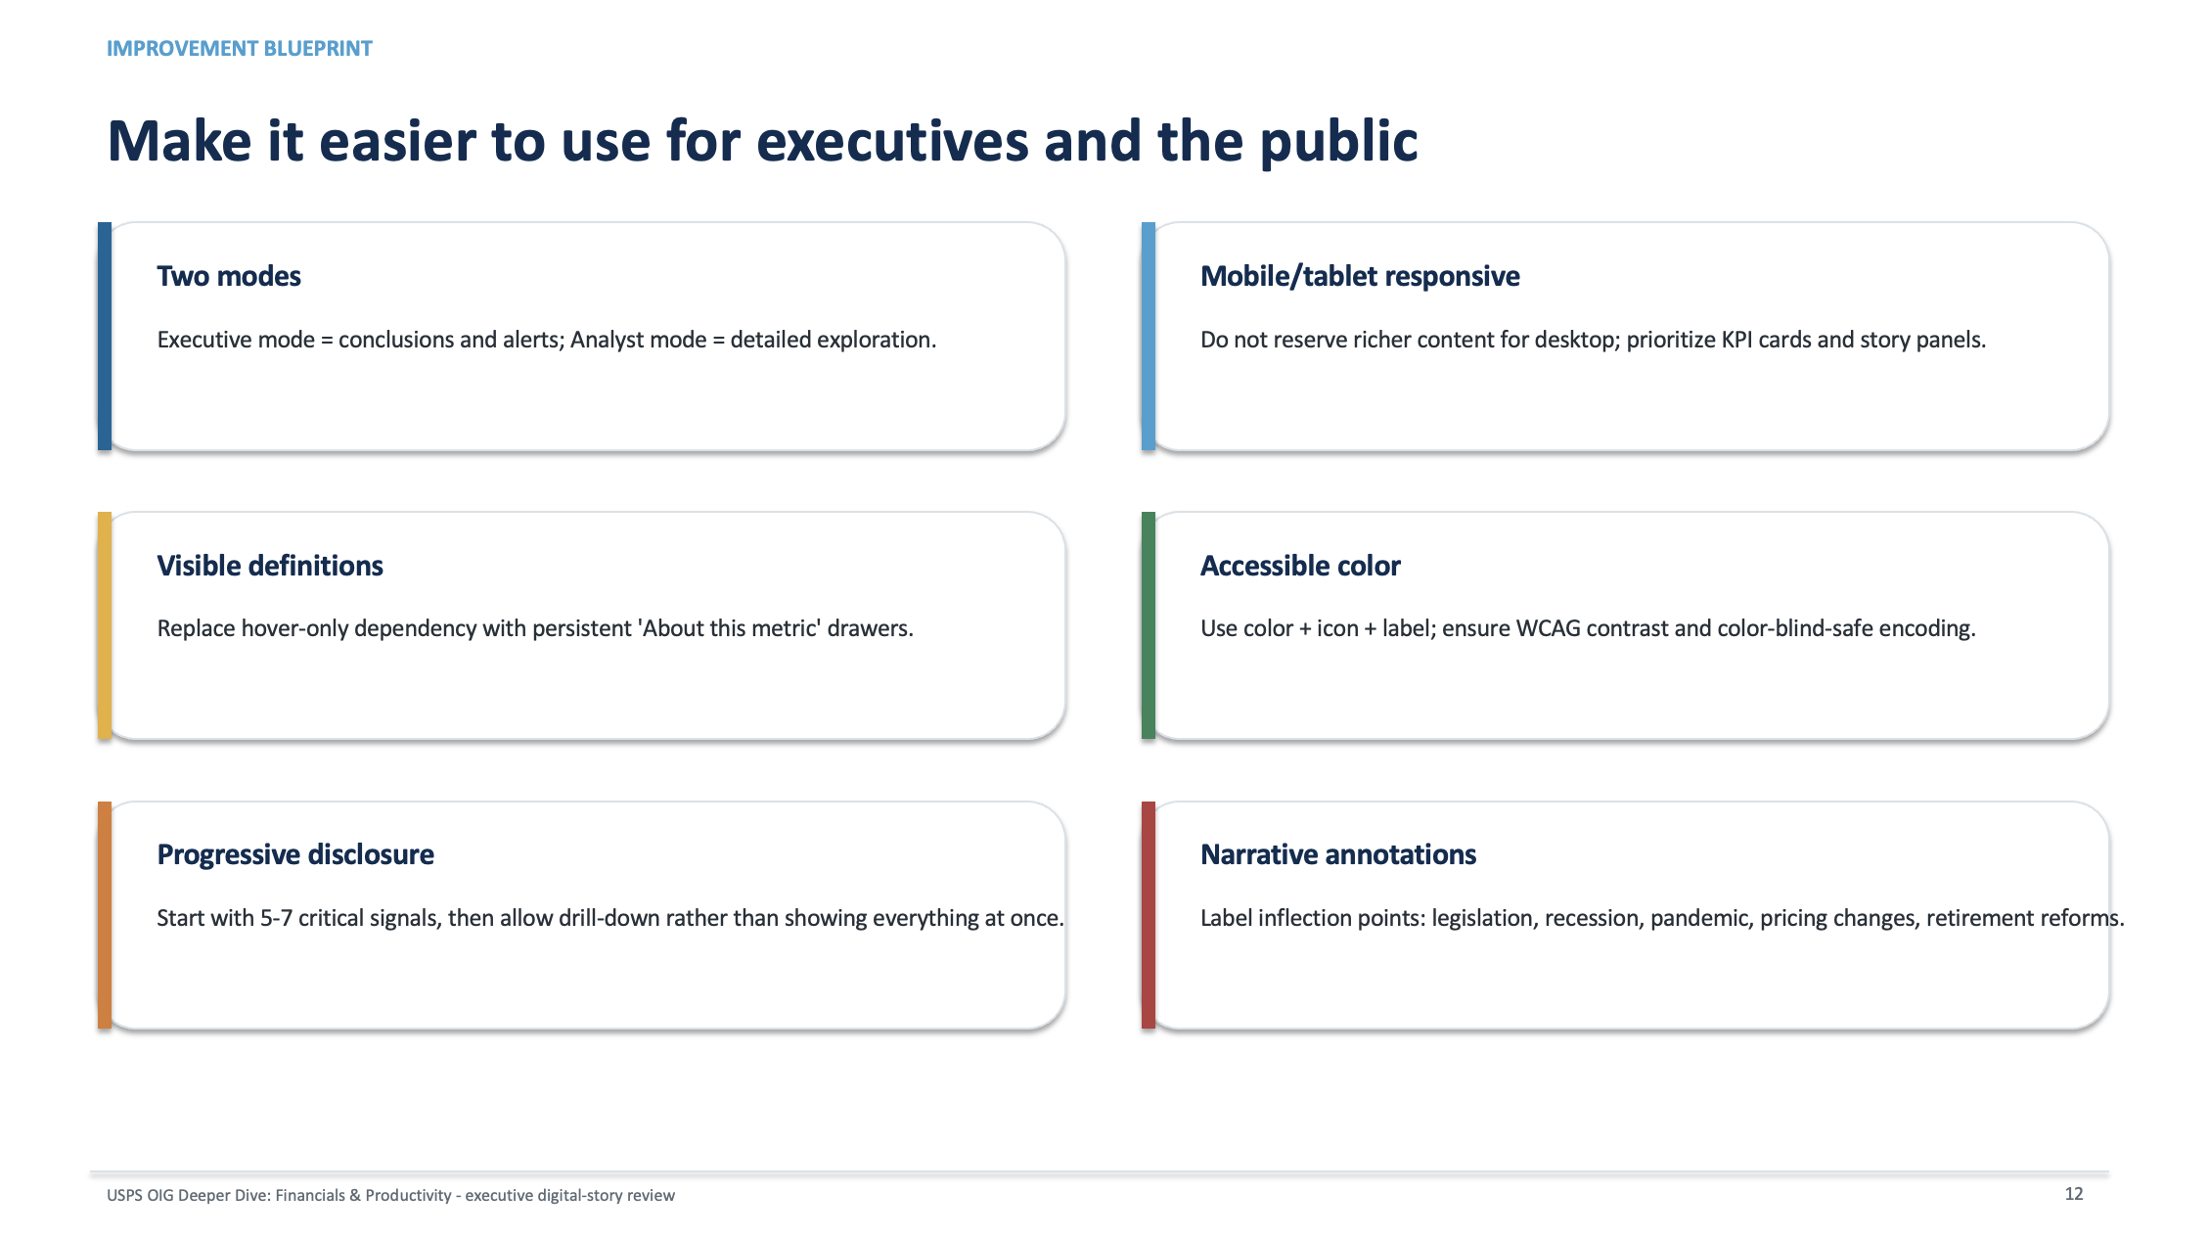
USPS Use case: OIG Dashboard with recommendations

Slide 108
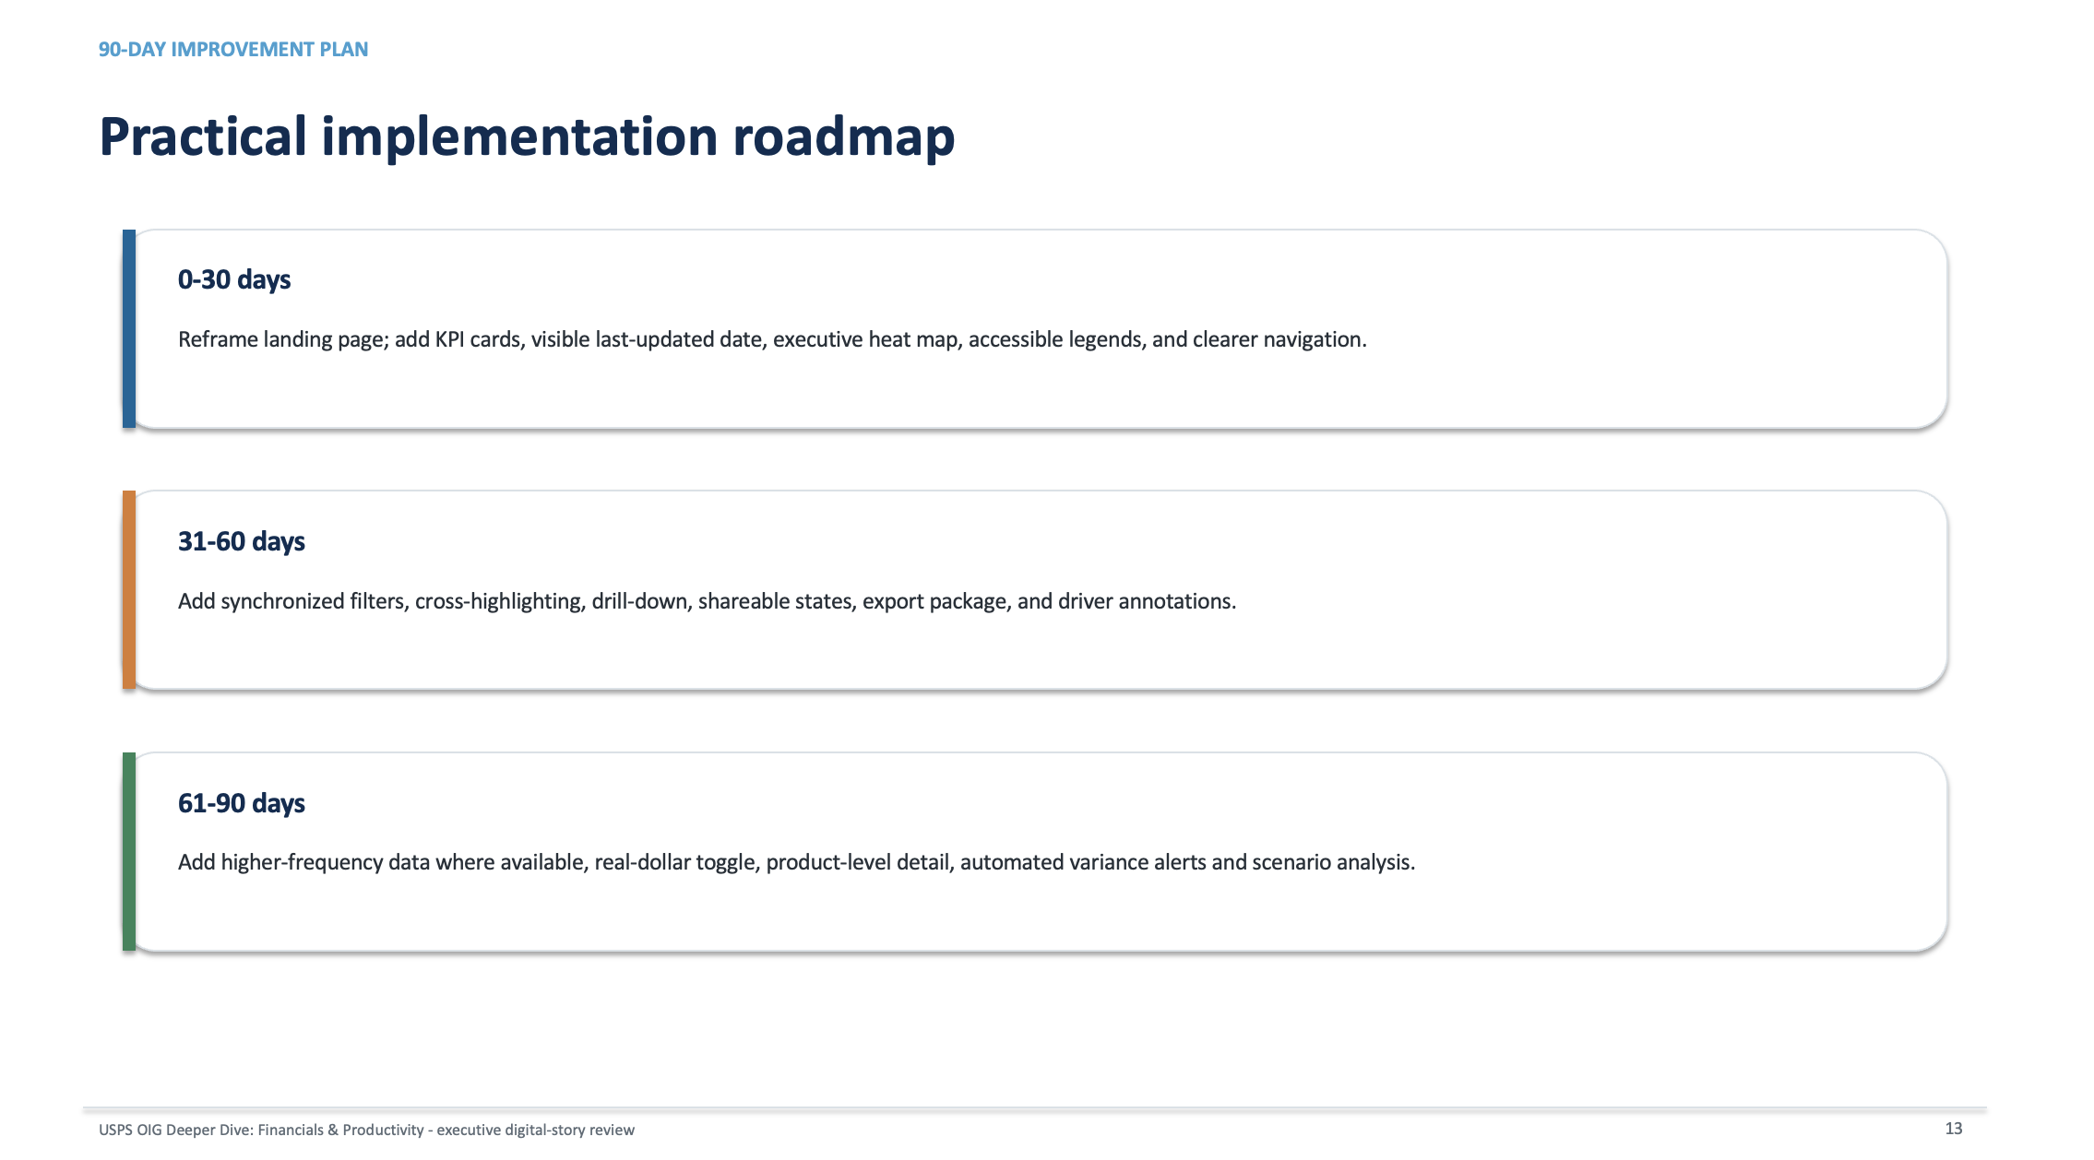
USPS Use case: OIG Dashboard with recommendations

Slide 109
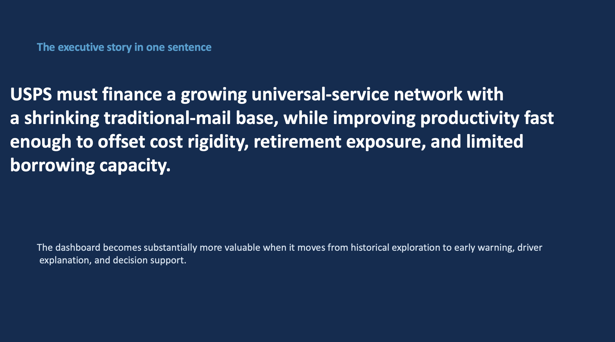
USPS Use case: OIG Dashboard with recommendations

Slide 110
References
[1] https://medium.com/thrivve-partners/signal-vs-noise-how-process-behaviour-charts-can-enable-more-effective-product-operations-e360cf474941
[2] https://americas.hsmai.org/insight/signal-vs-noise-what-revenue-leaders-said-when-we-put-the-question-on-the-table/

Slide 111
Q&A

