Slide 1

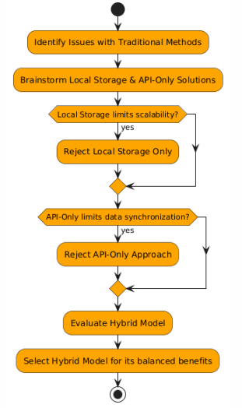
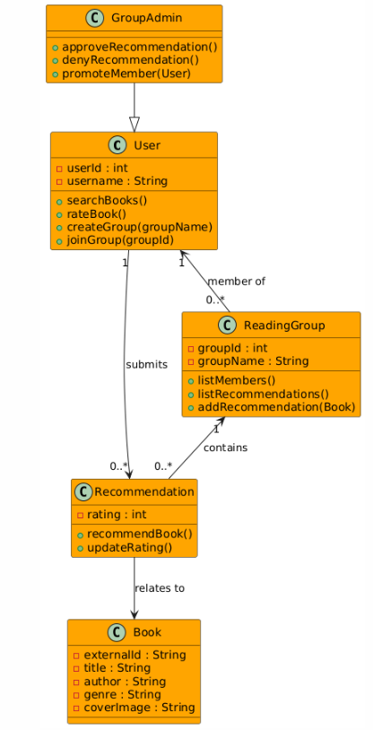
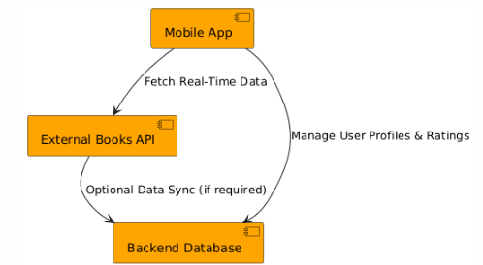
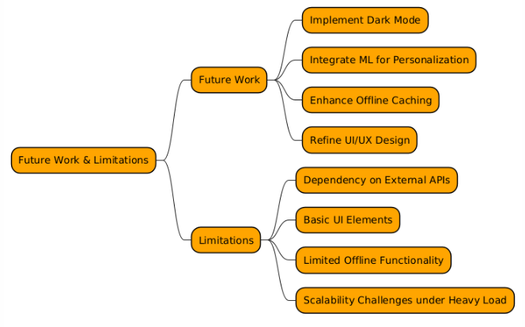
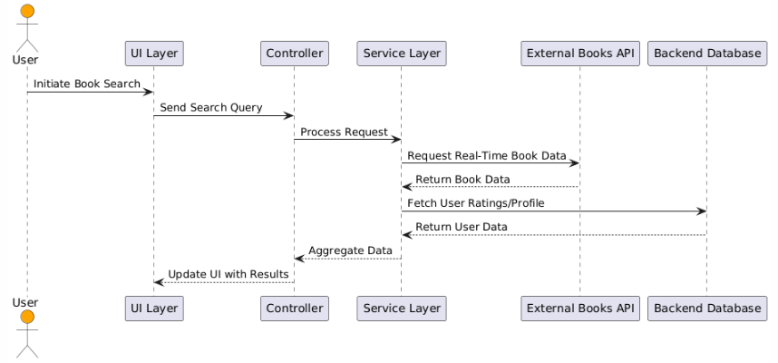
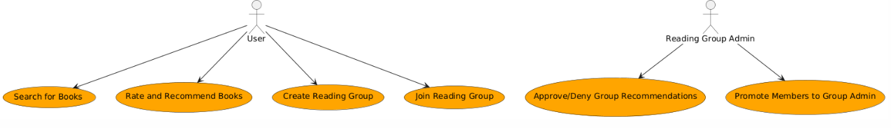
Overview
Design Alternatives & Final Solution
Key Features & Functionalities
Inked is an innovative mobile application built to revolutionize how students and instructors discover and share book recommendations. The system combines the strengths of real-time external book data from APIs (Google Books) with a robust backend database for storing user ratings, profiles, and recommendations. By doing so, Inked overcomes the limitations of traditional methods—such as fragmented email lists and word-of-mouth suggestions—ensuring that recommendations are up-to-date, scalable, and accessible on any Android device.
The project is built using best practices in software engineering, following a modular design that emphasizes maintainability and scalability. This poster highlights the entire process from identifying the problem, evaluating alternatives, finalizing a hybrid design, to planning future enhancements.
Solution 1: Local Storage Only
All data (book entries, ratings, user profiles) is stored locally on the device.
Poor scalability, isolated user experiences (data silos), and no real-time updates.
Solution 2: External Books API Only
Leverages real-time data from external APIs, but user-specific data remains local. Inconsistent user experience due to data synchronization challenges, dependency on API availability without centralized user data management.
Final Hybrid Model
Our final design combines the best of both approaches. It utilizes an external books API for real-time book information while maintaining a central backend database to store user profiles, ratings, and recommendations. This hybrid approach guarantees:
Data Consistency
Real-Time Synchronization
Enhanced User Experience
Scalability
Inked incorporates several core features designed to deliver a robust and engaging book recommendation experience. The application provides a real-time book search functionality that allows users to easily find books by title, author, or genre—leveraging an external API to ensure the most up-to-date information. Users can rate and recommend books. Secure user authentication and role-based access ensure that only authorized individuals can modify sensitive data; for example, administrators have exclusive rights to manage the reading list of the reading group. Thereby maintaining high-quality and current content. Additionally, the app fosters social connectivity through features that enable the creation of reading groups and friend lists, which facilitate the sharing of recommendations and collaborative discussions. Robust error handling and security measures, such as JWT-based authentication and parameterized queries, further ensure that user interactions remain secure and the overall system is resilient against common vulnerabilities.
System Architecture & Interactions
Future Work & Limitations
User Interface (UI)
The mobile app that provides the front-end for users.
Controller
A centralized module that coordinates user actions, managing calls between the UI and the service layer.
Service Layer
Handles interactions with both the external books API and the backend database, ensuring that data is fetched and stored correctly.
External Books API
Provides real-time book details and cover images.
Backend Database
Stores user data, including profiles, ratings, and recommendation histories.
The system employs design patterns such as the Singleton (for central management of state) and the Observer (to notify UI components of state changes), ensuring a responsive and scalable design.
Planned improvements include the implementation of a dark mode to enhance user accessibility and comfort during low-light conditions. Future iterations may also integrate machine learning algorithms to analyze user behavior, thereby providing more personalized book recommendations. Additionally, enhancing offline functionality is a key focus, as this would allow critical features to operate effectively even when network connectivity is limited. However, the current system does face challenges; its heavy reliance on external APIs makes it vulnerable to potential service disruptions, and while the user interface is functional, further refinements could elevate its overall appeal. Moreover, the app’s offline capabilities are still limited, and further optimizations may be necessary to ensure smooth scalability under heavy usage. These areas of future work underscore our commitment to continuous improvement and innovation in mobile book recommendation systems.
Problem Statement
Traditional book recommendation methods, like email threads or casual word-of-mouth suggestions, often result in disorganized and outdated information. They lack the necessary personalization, scalability, and real-time updates that modern users demand. The absence of a centralized platform means that valuable recommendations can be overlooked, and managing book data becomes cumbersome for administrators.
Objectives
Real-Time Book Discovery: Leverage external APIs to provide up-to-date book details and cover images.
User Engagement: Enable users to seamlessly search, rate, and recommend books, fostering an interactive community.
Administrative Efficiency: Provide administrators with secure controls to add, update, or remove book entries.
Social Connectivity: Incorporate features like friend lists and reading groups to encourage collaborative sharing of recommendations.
Robust Architecture: Develop a system that meets performance, security, and scalability standards while remaining modifiable for future enhancements.
Conclusion
The Inked project has successfully delivered a scalable, real-time book recommender system that bridges traditional methods and modern digital solutions. By integrating external APIs with a centralized backend and employing a modular, pattern-based architecture, we have met the core deliverables and exceeded performance, security, and usability criteria. The collaborative engineering process and continuous testing ensured that each phase of the project contributed to a robust final product.

