Slide 1
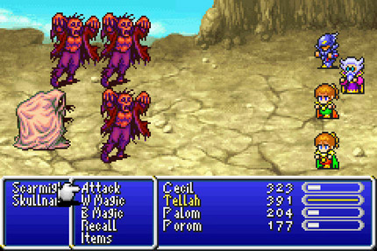
Algorithmic Composition with Markov Chains & Final Fantasy Music
By Isaac Lewis

Slide 2
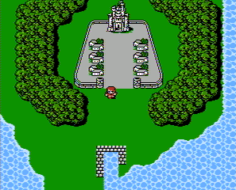
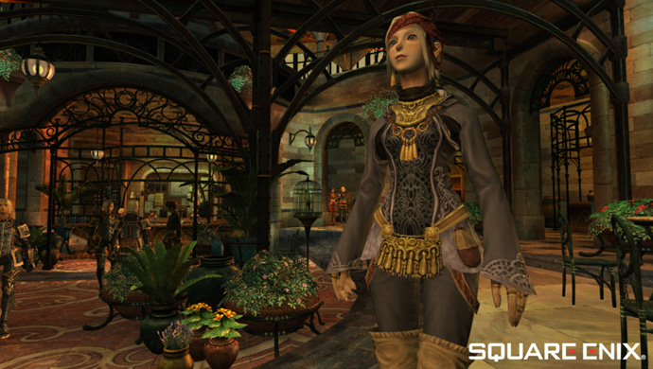
What is Final Fantasy?
A classic series of RPG (role-playing game) video games by Japanese company Squaresoft
FF 1 was released in 1987. FF 14 was released in 2010... things have changed since then!
But some fans still play the old games, both for the storylines and for the music by legendary video game composer, Nobuo Uematsu

Slide 3
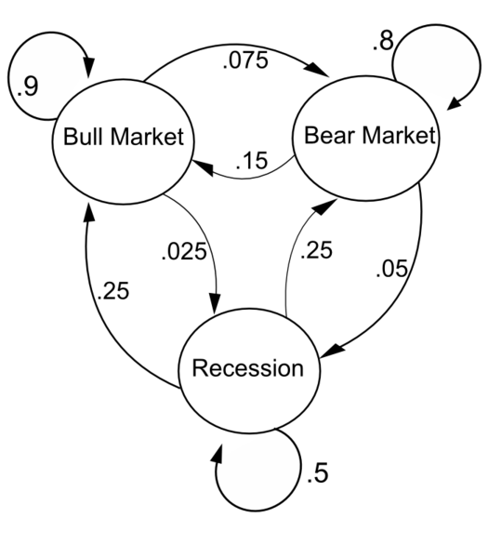
What are Markov chains?
A mathematical system where states are chosen randomly based on the previous state
Lots of practical uses, also sometimes used to generate humorous random text
If we use 2nd-order chains (consider 2 previous states), we get more structure
Can also use 3rd order, 4th order, etc
”The journalist said three helicopters were reported to one of Abbottabad in Pashto to Britain's Sandhurst or having been built in the compound on Twitter at a military sources told reporters that the compound is an elite military training centre, which is an agricultural community, but no phone”

Slide 4
My Project
Opens a MidiFile, reads in the MidiEvents
Converts the MidiEvents into notes (A4, B3, etc)
Feeds the notes into a Markov model
Generates a random sequence of notes from the model
Turns the new notes into MidiEvents
Writes the MidiEvents to a new MidiFile

Slide 5
Demo!
The original song ”Final Fantasy IV Crystal Theme”
Track generated by a 1st order Markov model (pretty random!)
Track generated by a 2nd order Markov model (up-and-down pattern emerges, but still jumps around)
Track generated by a 3rd order Markov model (quite close to the original)

Slide 6
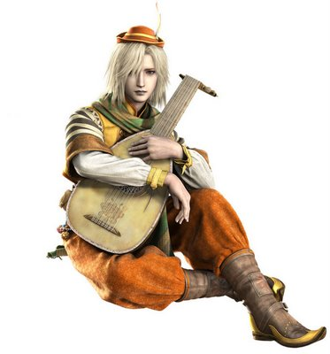
Conclusions
Markov chains can be used to generate some interesting music
The higher the order, we get more structure and less randomness
Converting midi files to discrete notes is tricky, and we lose some information
Any questions?

Slide 7
More info
Written in Clojure (a Lisp language for the Java Virtual Machine)
So we can use Java class libraries, but with a more convenient syntax
(defn get-notes-from-file [file trackno]
(let [seq (get-sequence (File. file))]
[seq (get-notes (nth (. seq getTracks) trackno))]))
(defn write [seq trackno file-name]
(let [wseq seq
tracks (.getTracks seq)
track (nth tracks trackno)]
(doall (map #(if (not (= track %)) (. wseq deleteTrack %)) tracks))
(. MidiSystem write wseq 0 (File. file-name))))

