Slide 1

BT2102 Assignment 1
A0258037B – Isaac Ng Sheng

Slide 2
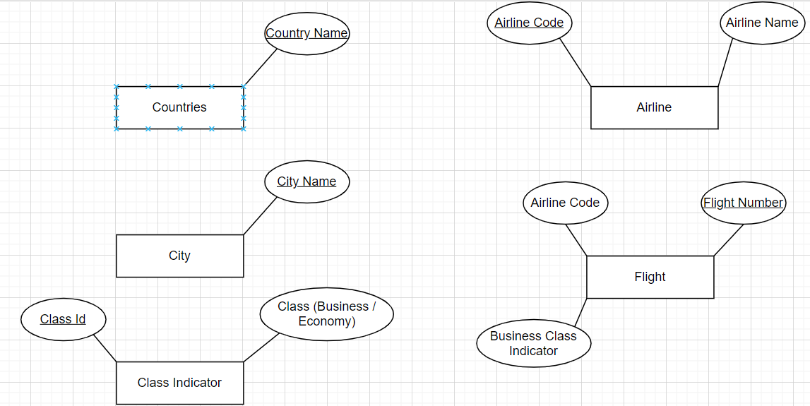
Final Entities and attributes

Slide 3
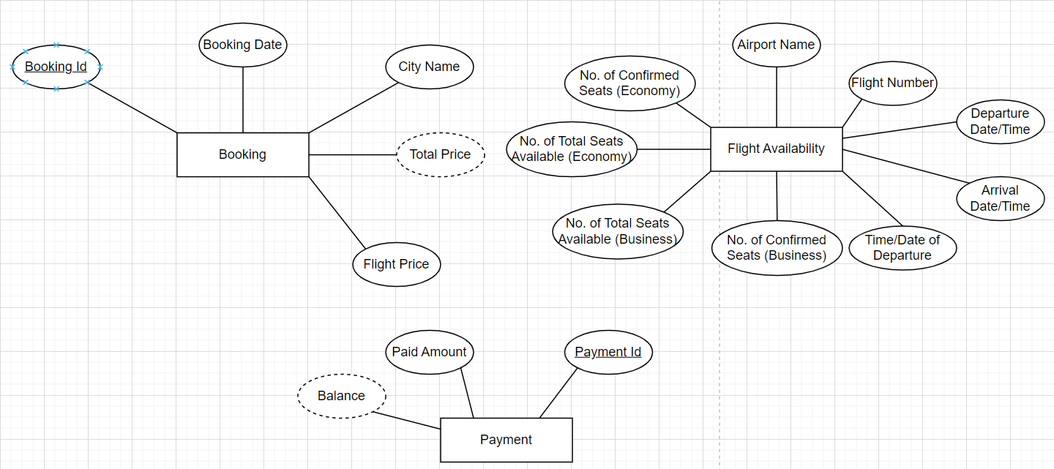

Slide 4
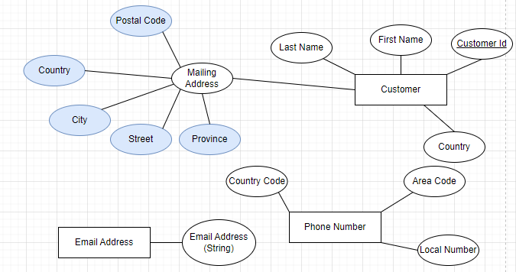

Slide 5
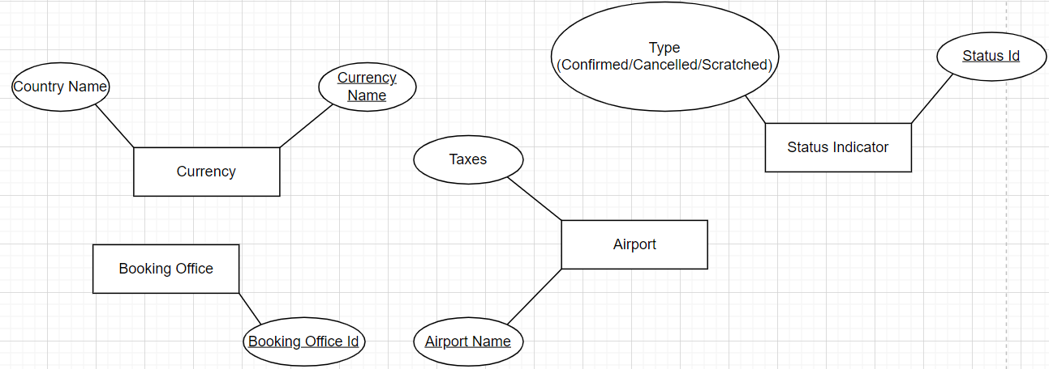

Slide 6
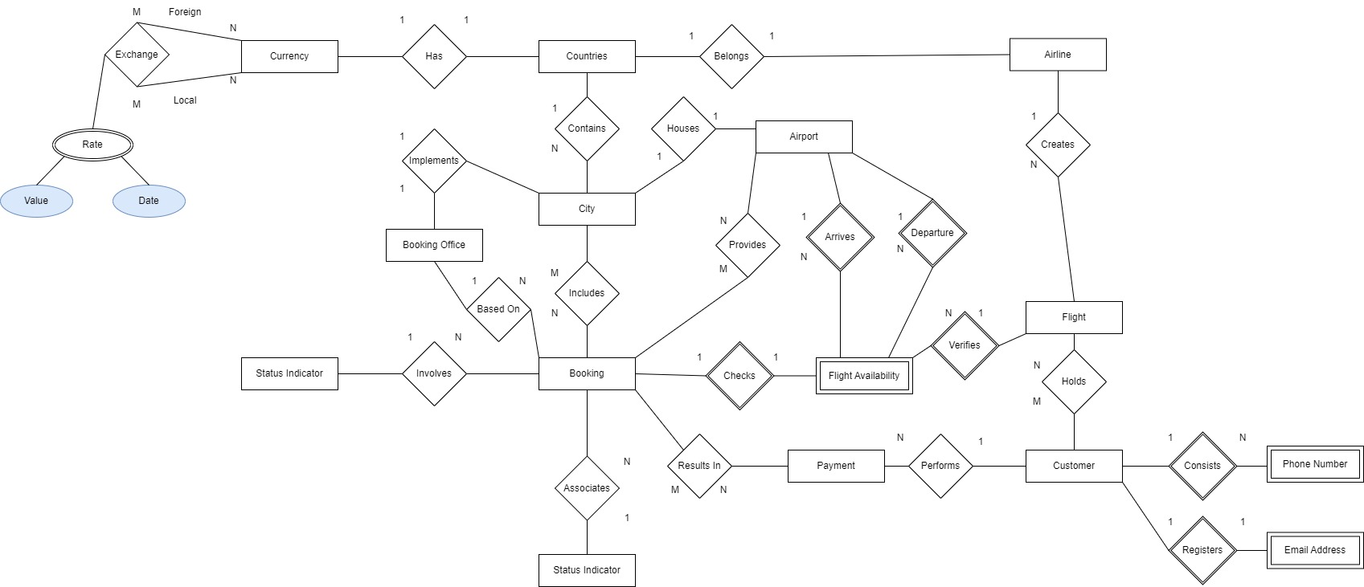
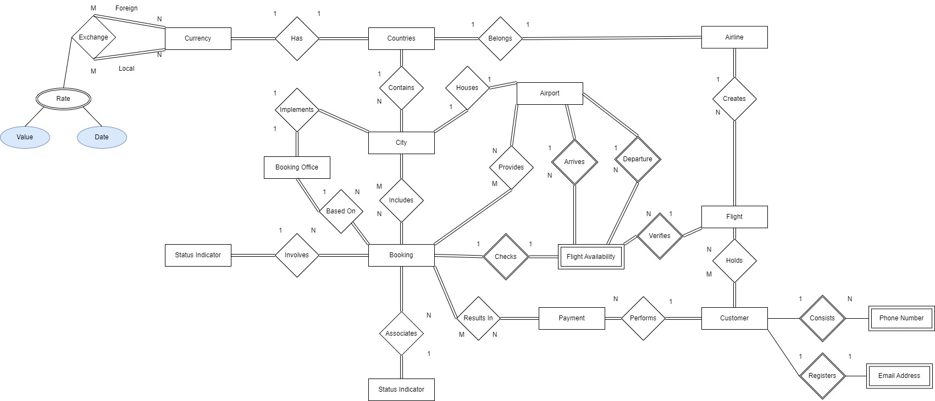
Final Conceptual Data Model

Slide 7
Final Logical Schema
Strong Entities:
Countries (Country Name)
Currency (Currency Name, Country Name)
Exchange (Foreign Name, Local Name, Value, Date, Currency Name)
Airline (Airline Code, Airline Name, Country Name)
Flight (Flight Number, Business Class Indicator, Airline Code)
Customer (Customer Id, First Name, Last Name, Country, Province, Postal Code, Street, City, Country, Flight Number)
City (City Name, Country Name)
Airport (Airport Name, Taxes, City Name)
Booking Office (Booking Office Id, City Name)
Booking (Booking Id, Booking Date, Flight Price, Total Price, City Name, Booking Office Id, Airport Name, Class Id, Status Id, Payment Id)
Status Indicator (Status Id, Type (Confirmed/Cancelled/Scratched))
Class Indicator (Class Id, Class (Business / Economy))
Payment (Payment Id, Paid Amount, Balance, Customer Id)

Slide 8
Final Logical Schema
Weak Entities:
Phone Number (Local Number, Country Code, Area Code, Customer Id)
Email Address (Email Address (String), Customer Id)
Flight Availability (Date/Time of Departure, No. of Confirmed Seats (Business), No. of Total Seats Available (Business), No. of Confirmed Seats (Economy), No. of Total Seats Available (Economy), Departure Date/Time, Arrival Date/Time, Flight Number, Airport Name, Booking Id)

Slide 9
Final Logical Data Model
Country (name) Primary Key name | City (name, countryName) Primary Key name Foreign Key countryName references Country(name)
Currency (name, countryName) Primary Key name Foreign Key countryName references Country(name) | Airport (name, taxes, cityName) Primary Key name Foreign Key cityName references City(name)
Airline (code, name, countryName) Primary Key code Foreign Key countryName references Country(name) | BookingOffice (id, cityName) Primary Key id Foreign Key cityName references City(name)
Flight Availability (dateTimeDeparture, confirmedSeatsBiz, totalSeatsAvailableBiz, confirmedSeatsEcons, totalSeatsAvailableEcons, departureDateTime, arrivalDateTime, flightNumber, airportName, bookingId) Foreign Key flightNumber extends Flight(number) Foreign Key airportName extends Airport(name) Foreign Key bookingId extends Booking(id) | Booking (id, bookingDate, flightPrice, totalPrice, cityName, bookingOfficeId, airportName, classId, statusId, paymentId) Primary Key id Foreign Key cityName references City(name) Foreign Key bookingOfficeId references BookingOffice(id) Foreign Key airportName references Airport(name) Foreign Key classId references Class(id) Foreign Key statusId references Status(id) Foreign Key paymentId references Payment(id)

Slide 10
Final Logical Data Model
Flight (number, businessClassIndicator, airlineCode) Primary Key number Foreign Key airlineCode references Airline(code) | Customer (id, firstName, lastName, country, province, postalCode, street, city, country, flightNumber) Primary Key id Foreign Key flightNumber references Flight(number)
Status Indicator (id, type) Primary Key id | Class Indicator (id, class) Primary Key id
PhoneNumber (localNumber, countryCode, areaCode, customerId) Foreign Key customerId references Customer(id) | EmailAddress (emailAddress, customerId) Foreign Key customerId references Customer(id)
Payment (id, paidAmount, balance, customerId) Primary Key id Foreign Key customerId references Customer(id) | Exchange (foreignName, localName, value, date, currencyName) Primary Key foreignName, localName Foreign Key currencyName references Currency(name)

