Slide 1
Data Science Competition
Team Members: Isaac Kistler and Enyu Li
Mentor: Lee Park

Slide 2
Outline
Background
Dealing with Data
Data Exploration
Geographic Trends
Building Predictive Model
Model Evaluation
Conclusion

Slide 3
Background
Graduate students looking for single room apartments
Rising housing prices
What factors affect cost?
Data from American Community Survey (ACS)
Monthly Median Rent (MMR) for a one bedroom unit, averaged over the past five years

Slide 4
Dealing with Data
Data is county level, but not every county had data in every category
Removed all counties without pertinent MMR information
Evaluate remaining missing data
Checked NA rate for predictors
Due to low rate of NA’s, all missing data was removed
Notes:
Didn’t replace NA’s with means, as that affects distribution

Slide 5
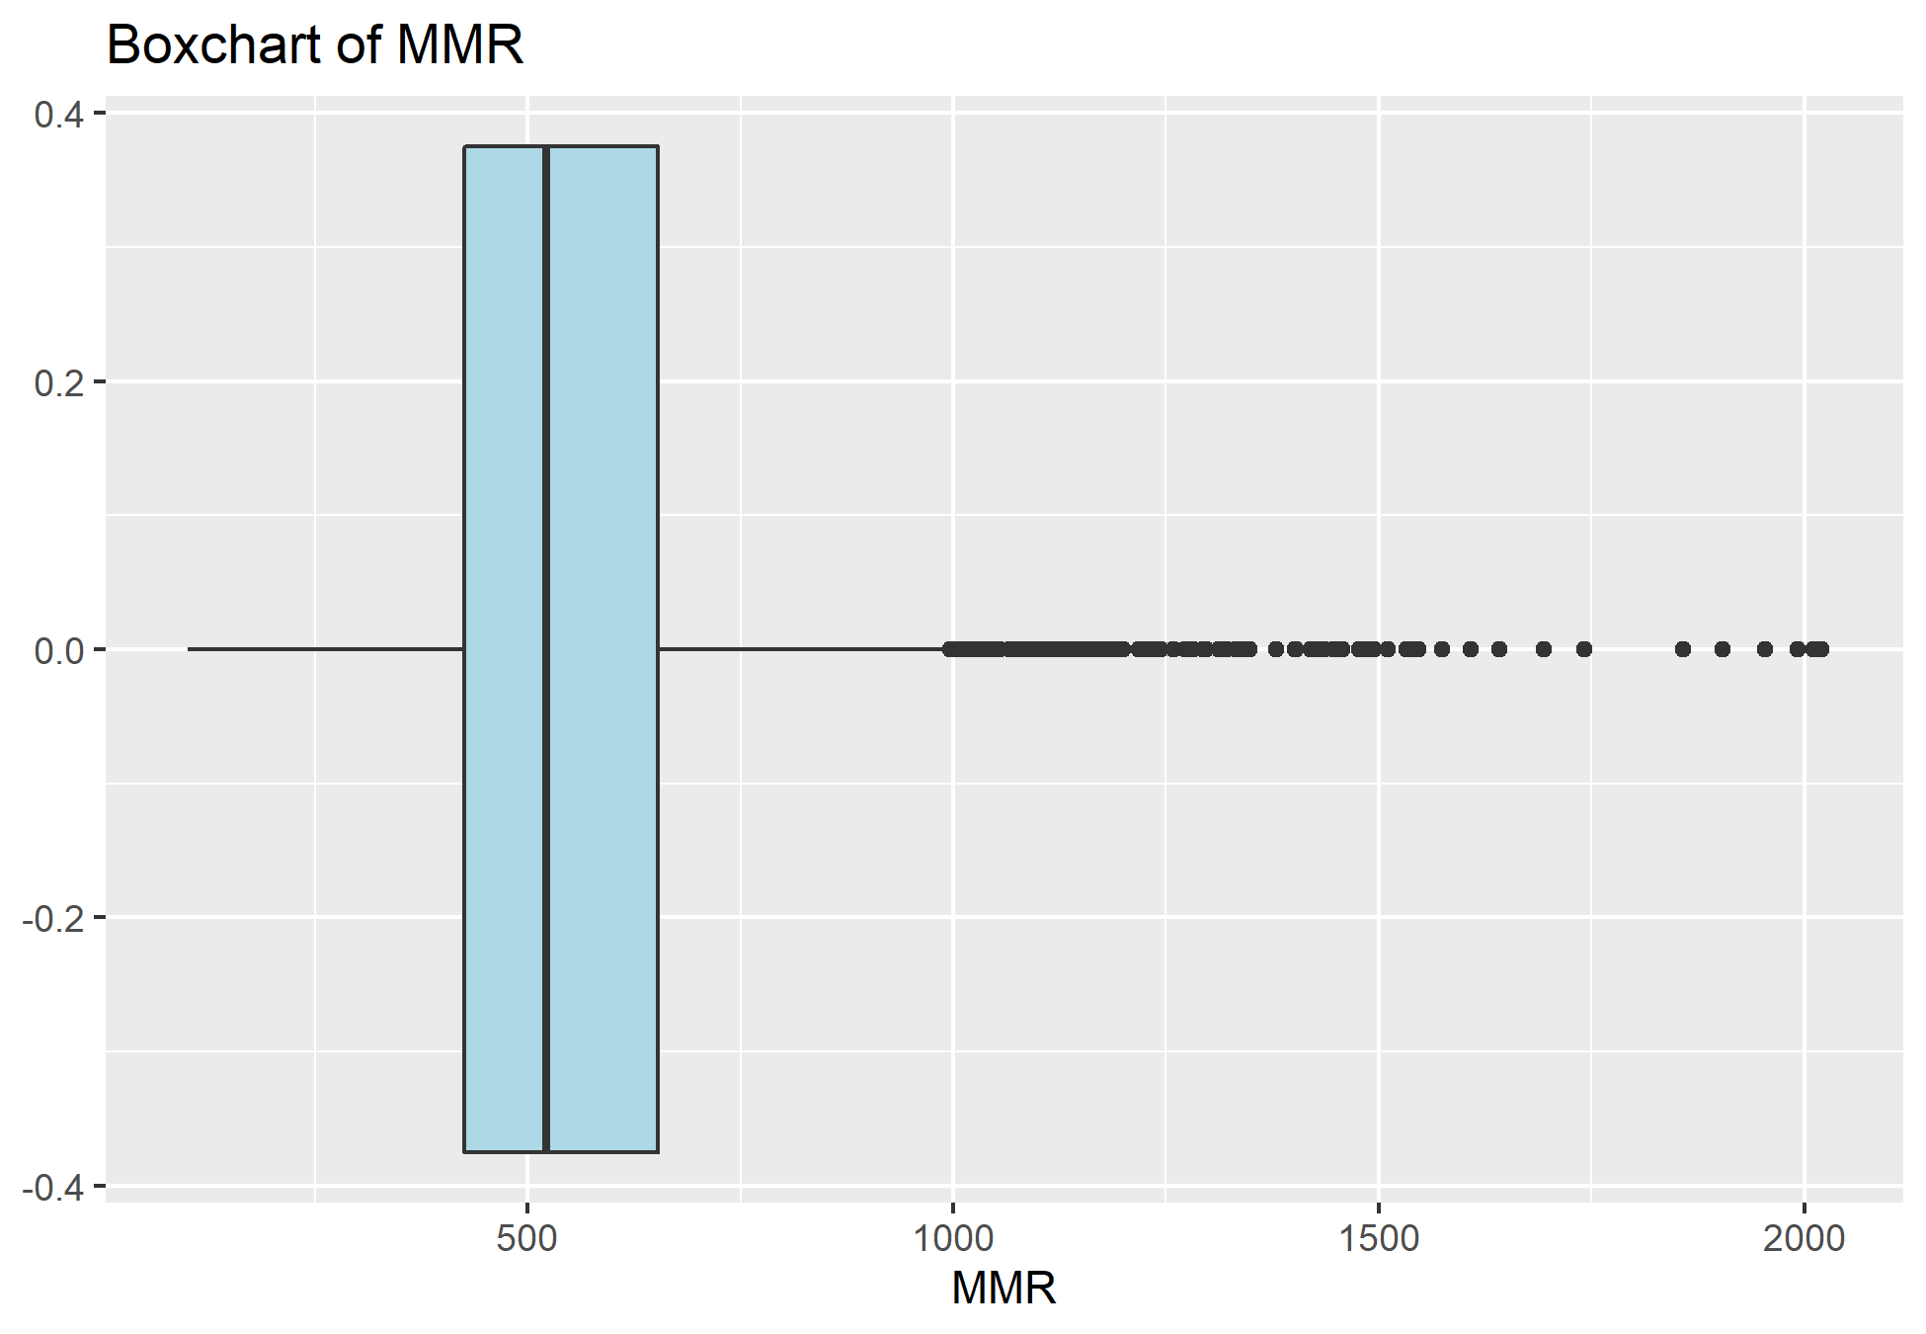
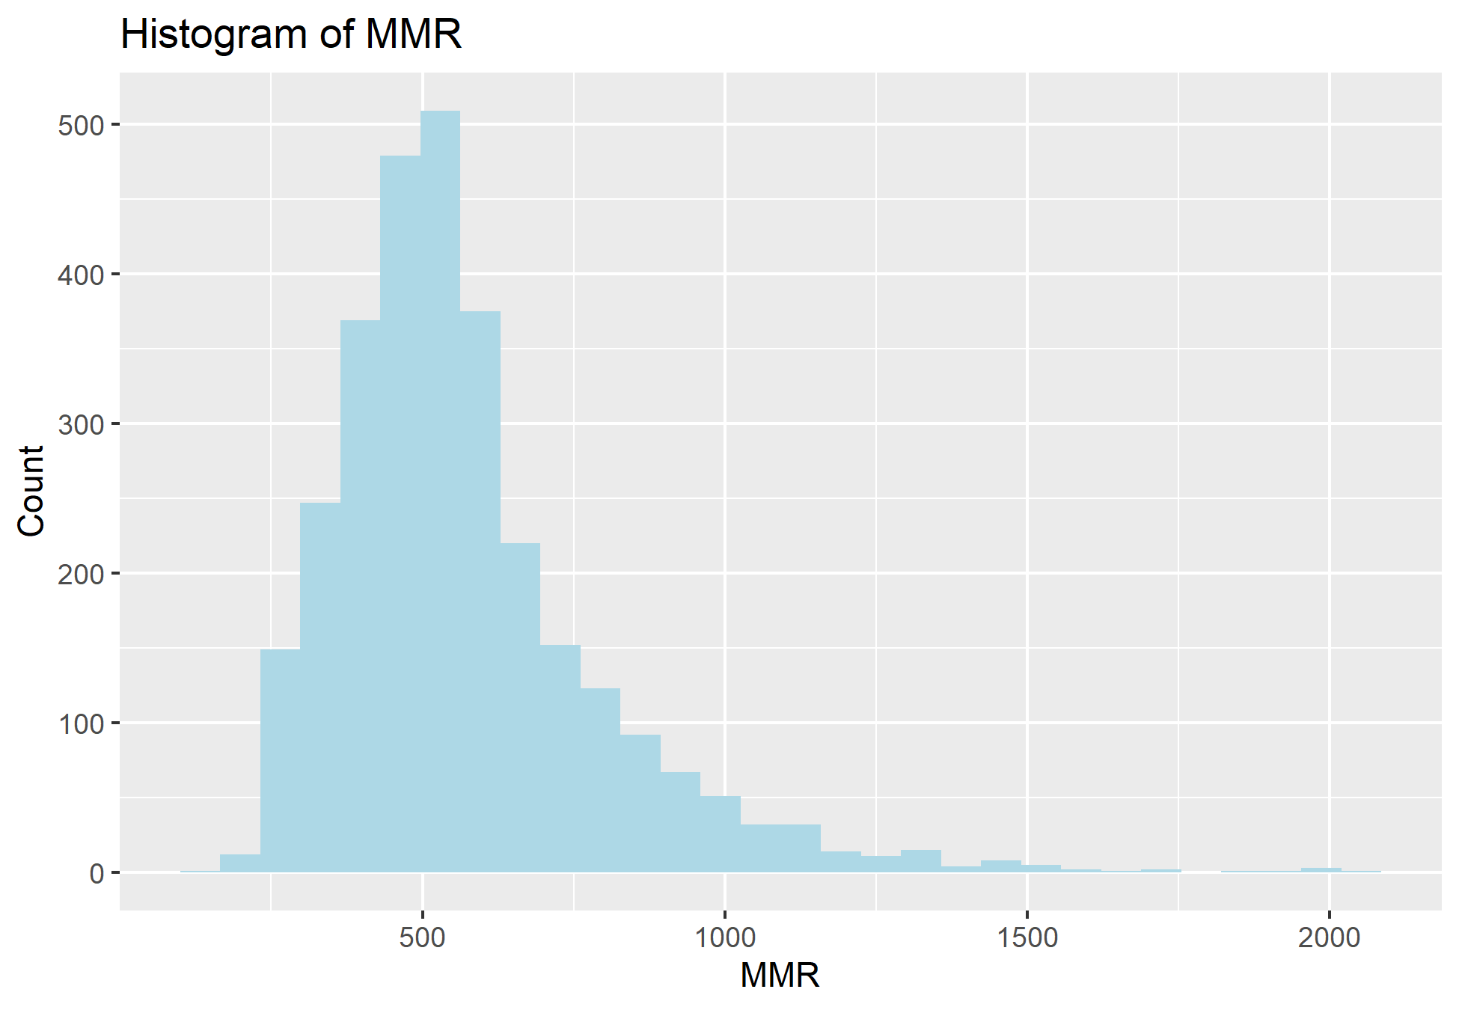
Summarizing MMR

Slide 6
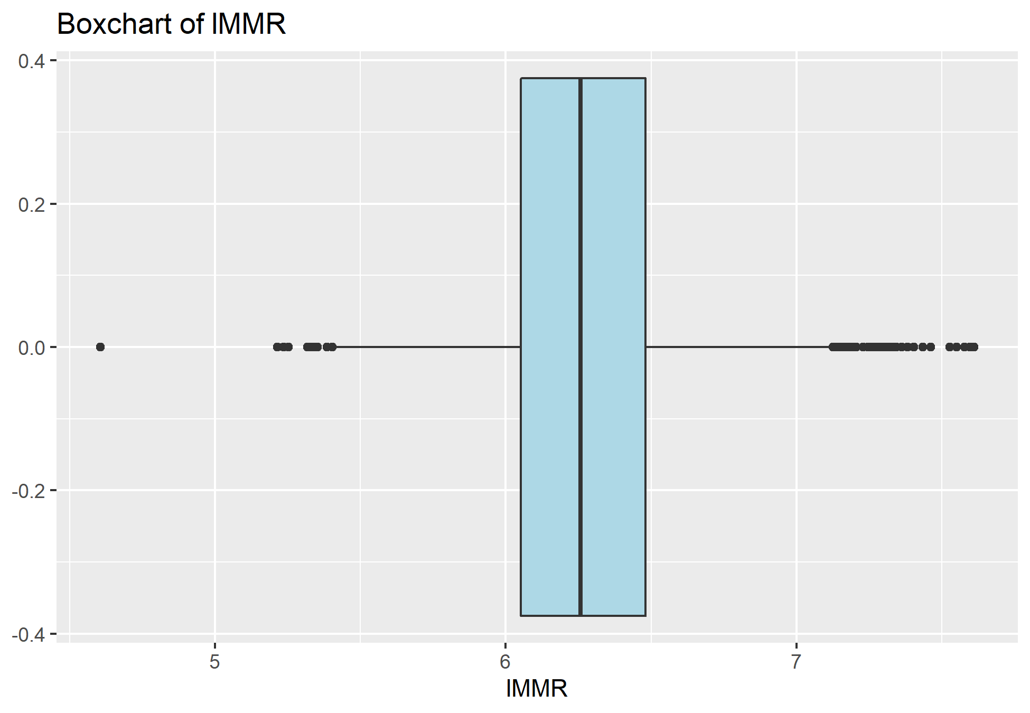
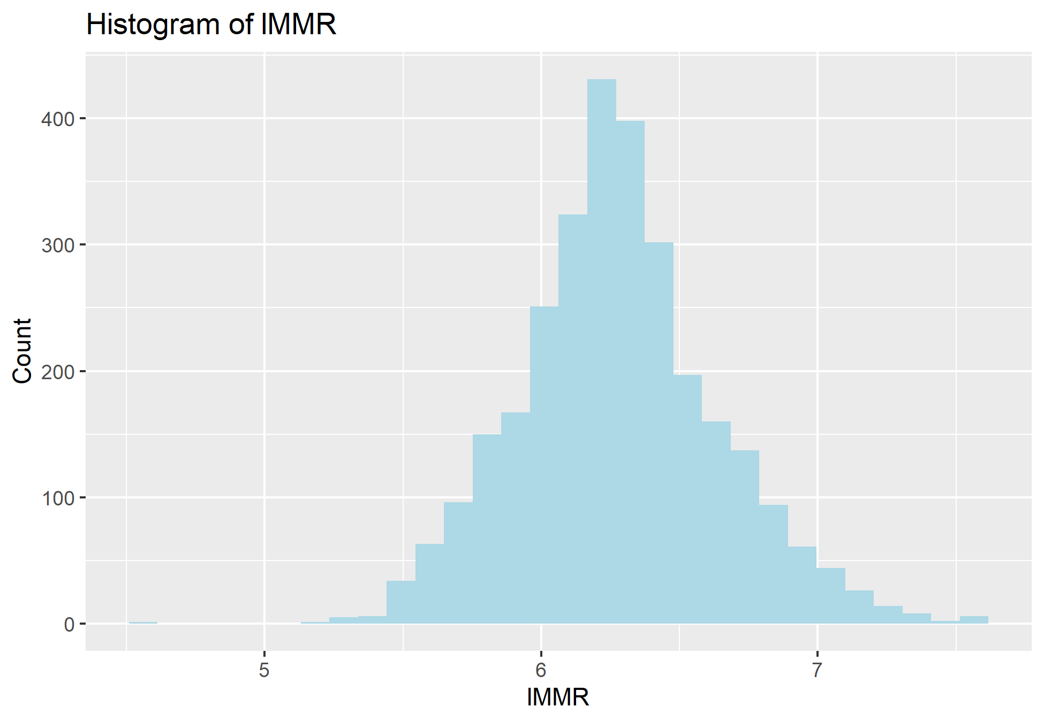
Natural Log Transformation

Slide 7
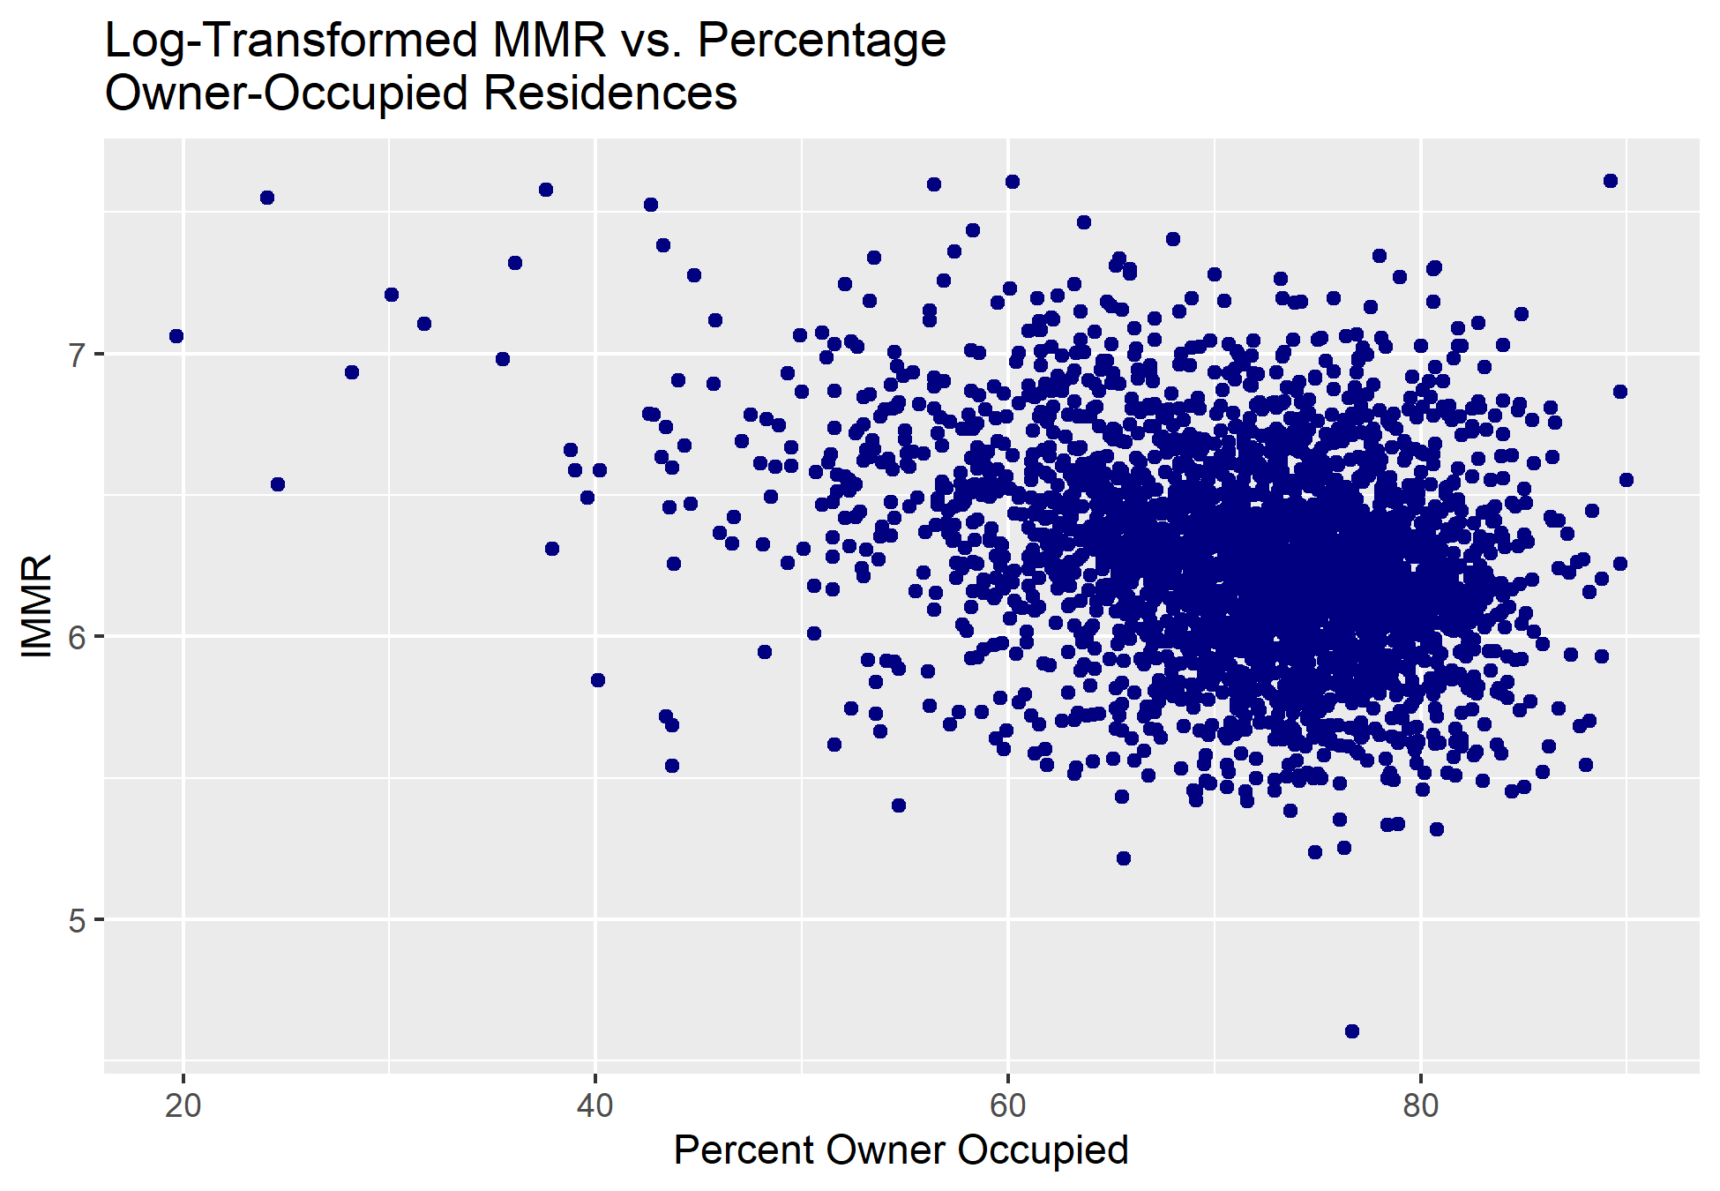
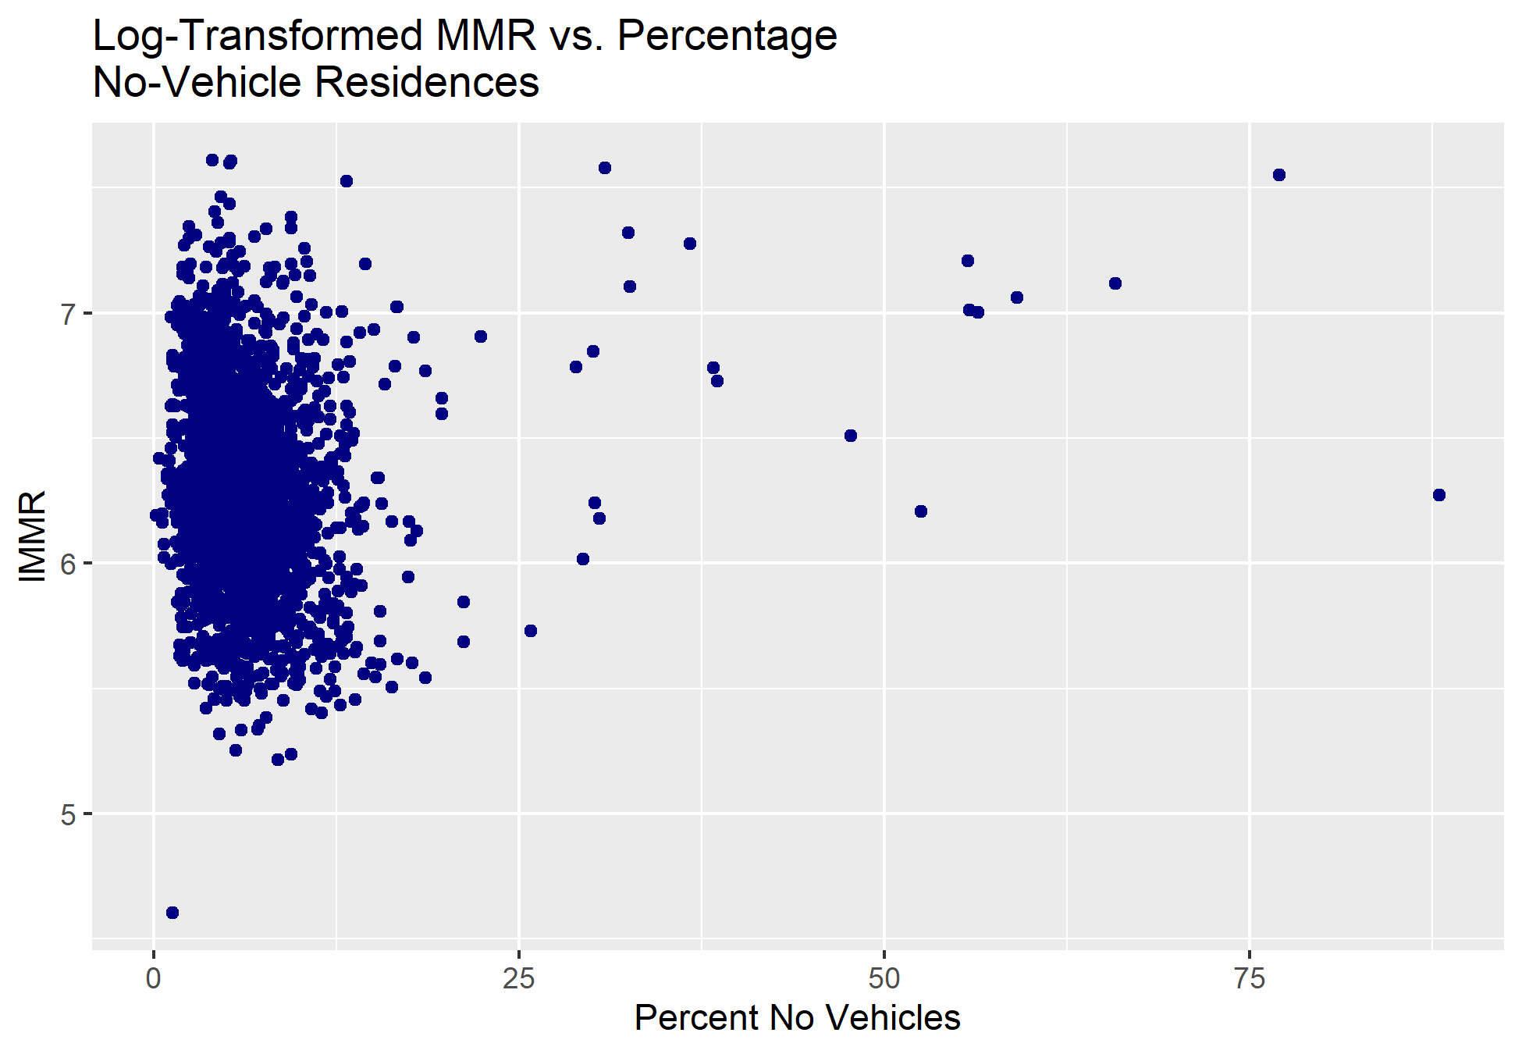
Scatterplots and Trends

Slide 8
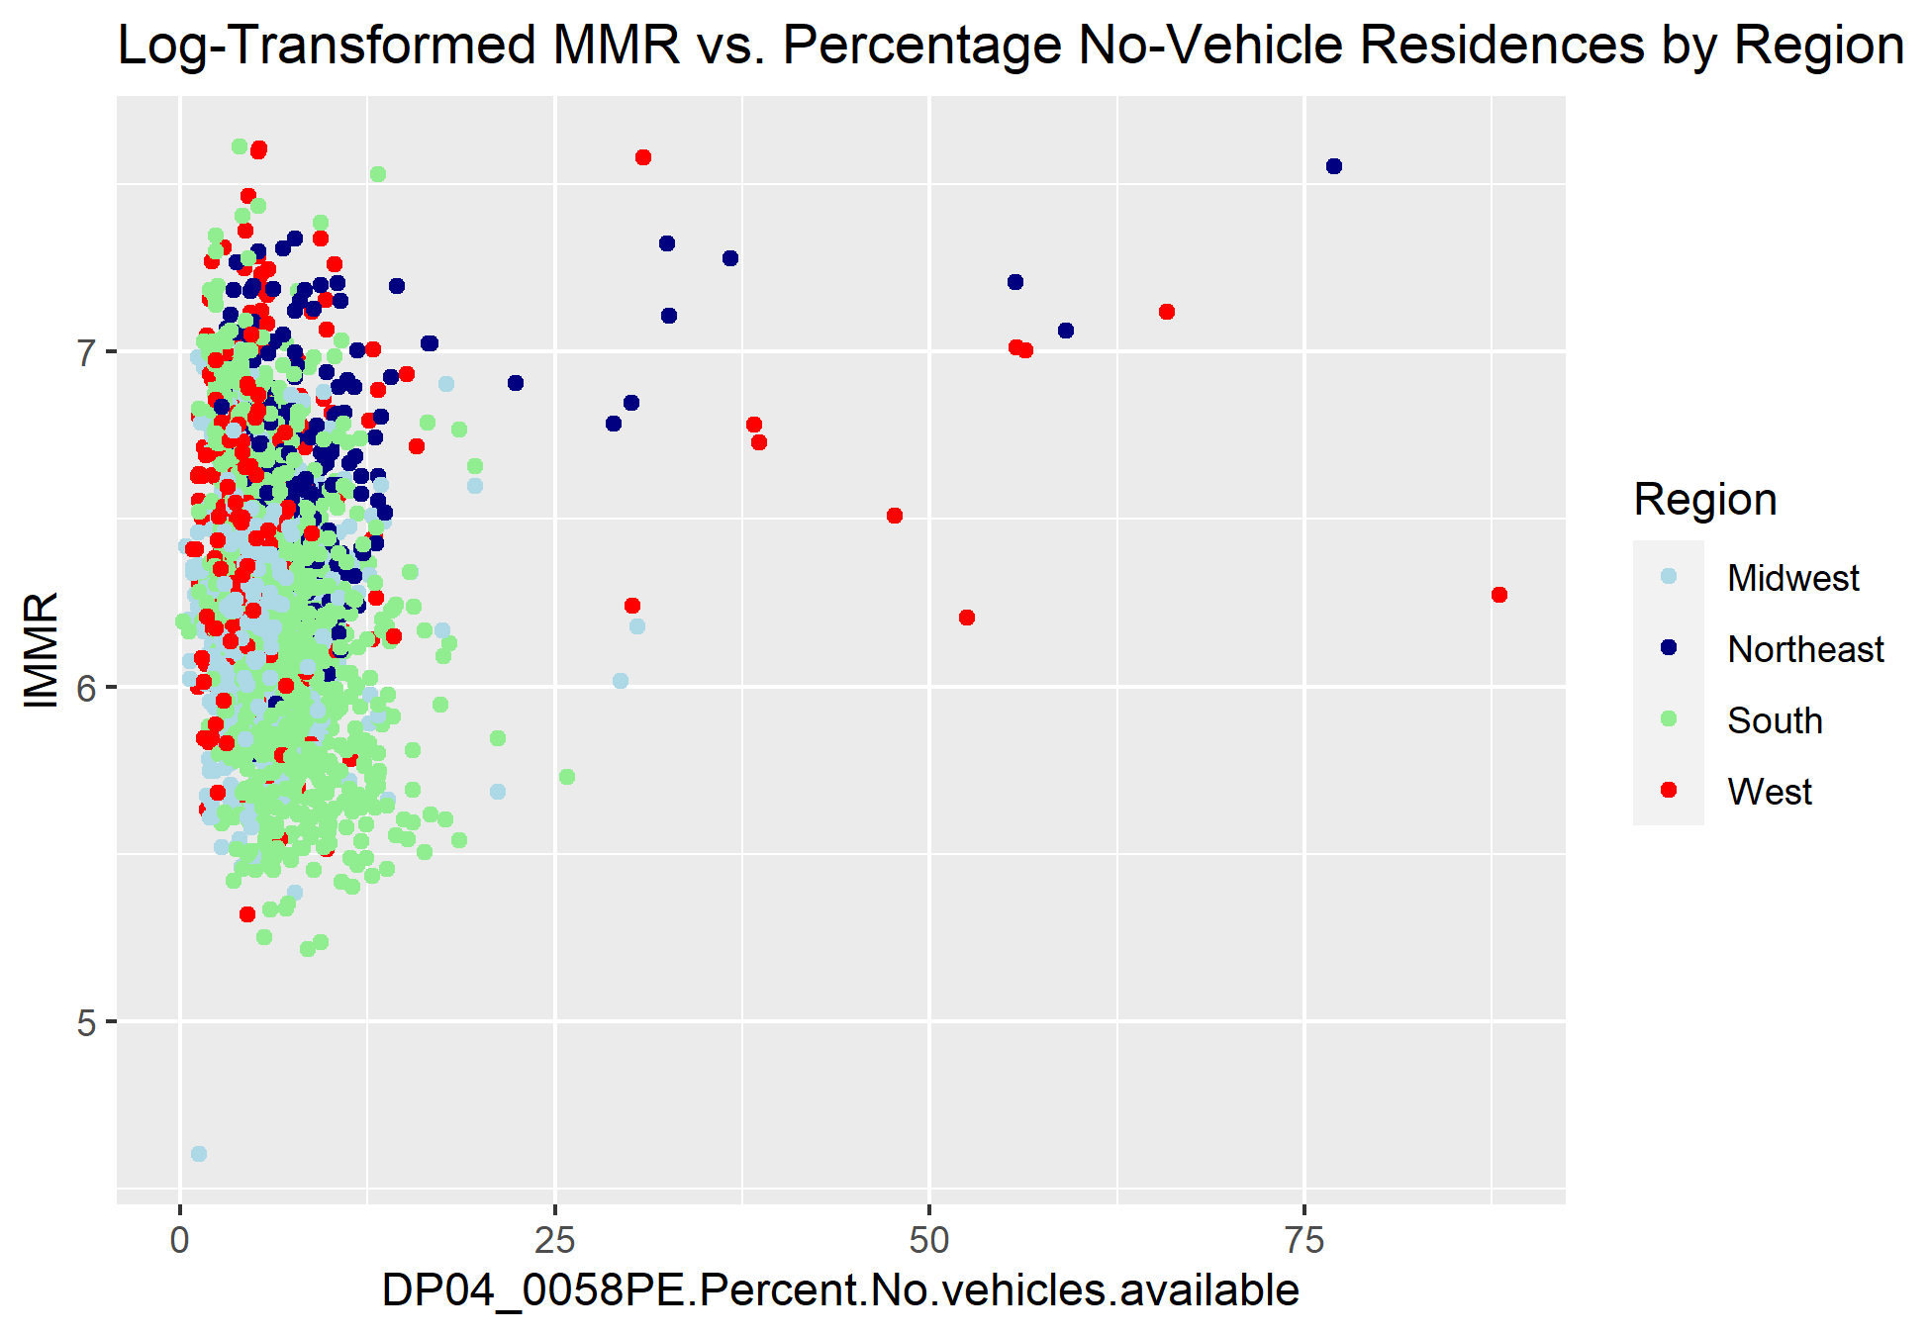
Scatterplots and Trends

Slide 9
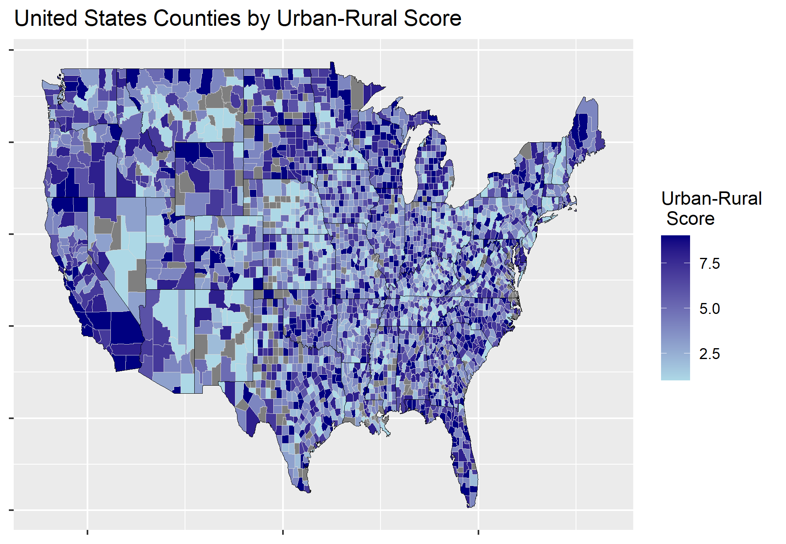
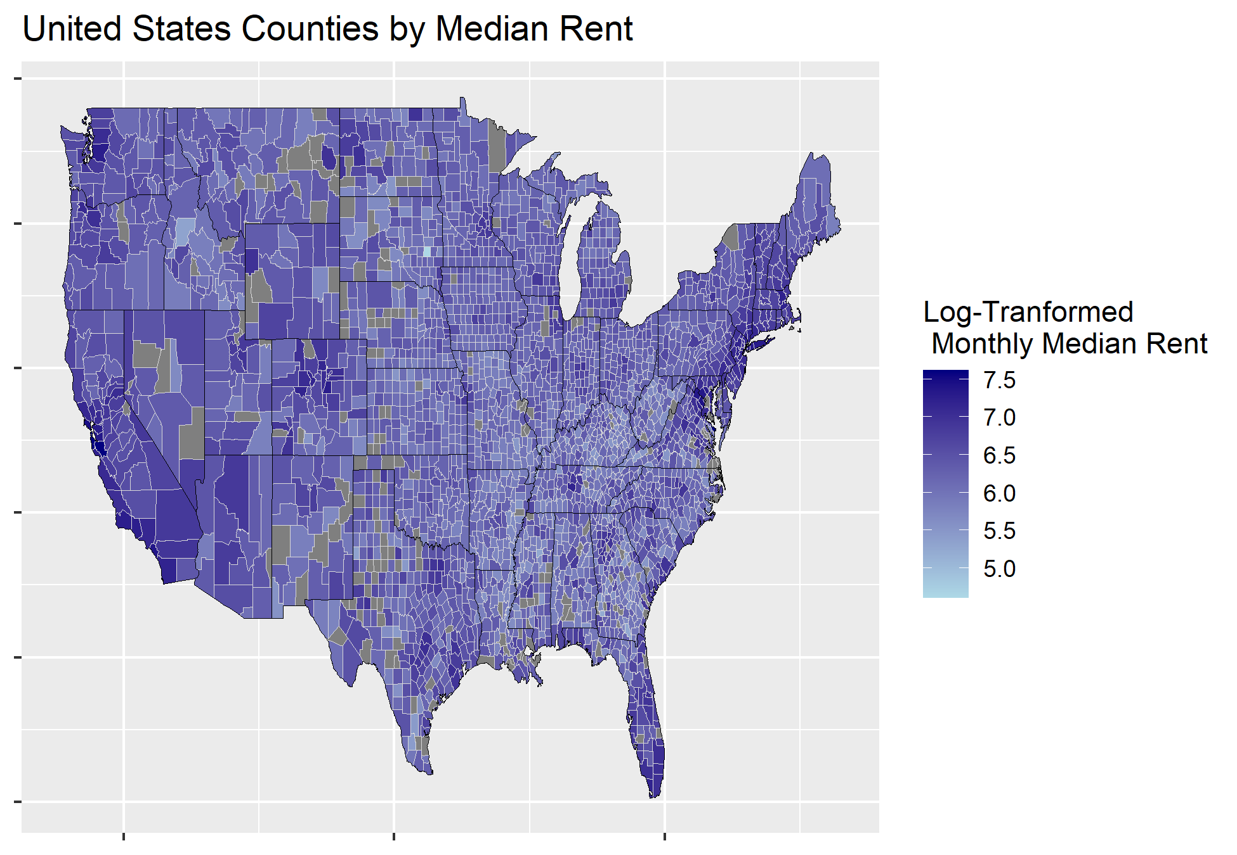
Geographic Trends

Slide 10
Building Predictive Model
Dimensionality Reduction (Ridge Regression) to find out the most important factors
Fitting the linear model (using Ordinary Least Square)
Evaluating collinearity
Fitting interaction
Checking the four assumptions of linear regression
Checking the outliers and most influential points
Fitting alternative models
Understanding the meaning of the model
Notes:
When fitting the linear model (make sure to mention collinearity) delete the variables that give you the highest VIF values
Use the the package of R to give the best interaction term

Slide 11
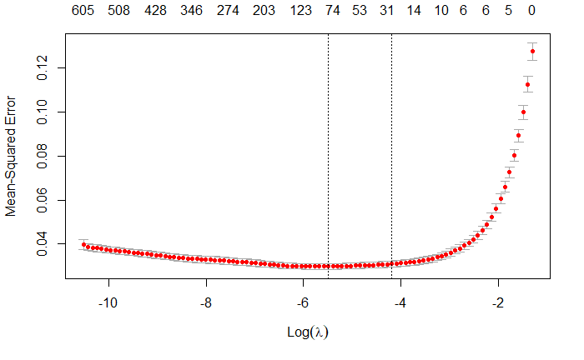
Dimensionality Reduction
(Ridge Regression)
Notes:
I choose the second candidate lambda value as the optimal lambda value because it is customary thing to do so.

Slide 12
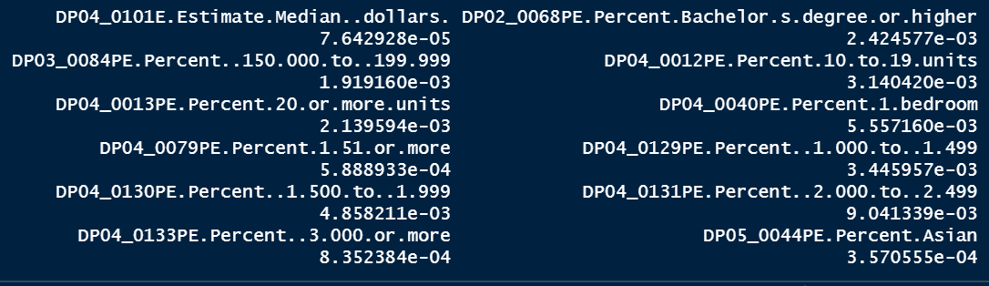
Dimensionality Reduction
(Ridge Regression)
Notes:
Once the lambda value is picked. Running the ridge regression with all variables and pick those who coefficients are not 0.
Those variables who have coefficients value > 10^{-5}

Slide 13
Variable Selection
Run a crude linear regression model by fitting in all the variables.
Evaluate the collinearity by checking the VIF values of each variable.
Re-run the linear regression model by removing the highest VIF value until the VIF values are lowered without affecting the adjusted R-square value too much
Notes:
If an explanatory variable has a VIF value > 5, then that variable is considered

Slide 14
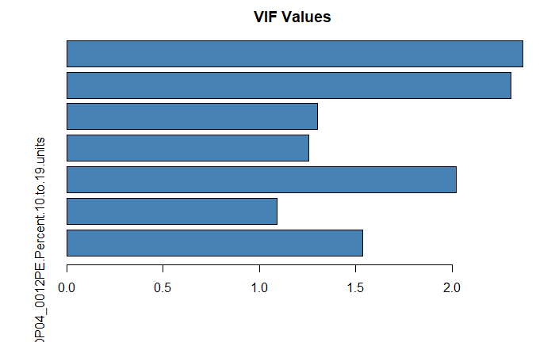
Collinearity (Final VIF Value)

Slide 15
Variable Selection Cont.
To decrease VIF we add two variables, bachelor percentage and internet percentage, together to make one variable.
Plot each remaining variable with the dependent variable to check curvature and see if any form of transformation is necessary
However, it is not necessary to transform anything as the transformed model shows no difference performance compared to the non-transformed model.
Use rFSA package to check for interaction
Use backwards step function to check whether this linear model achieves its lowest AIC value
Notes:
These two variables are very correlated with each other.

Slide 16
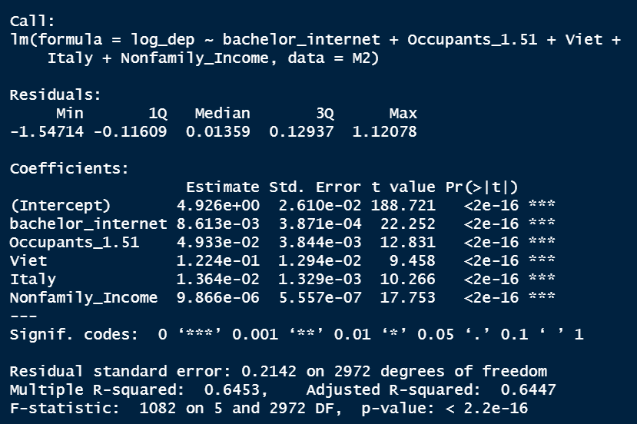
Final Model
Achieved the lowest AIC value

Slide 17
Regression Diagnosis
Linearity, normality, and independence assumptions are met
Equal Variance Assumption is not met by bptest.
(Methods we have tried to fix the unequal variance problem)
Log transform the dependent variable
Use weighted models
Delete some of the non-important outliers
(Yet the problem still exists)
We developed three sub-models according to urban-rural area.

Slide 18
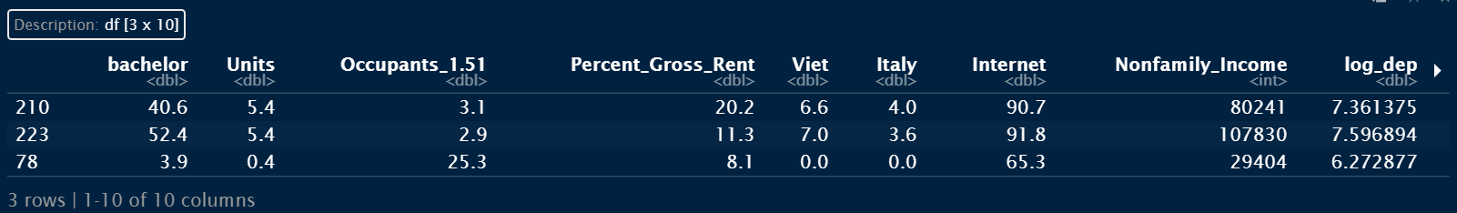
Influential Points Analysis
Issue: Occupants_1.51 should be a percentage, so all of those values are not within the range of (0,1). We should delete them.

Slide 19
Conclusion
Although equal variance assumption is not met, the model is still useful for spotting general trends and finding important predictors
Many factors specifically affect graduate student rent prices, such as bachelor’s degrees and large housing units
Non-family income also plays a large part
Demographic factors such as Vietnamese and Italian population percentages also have an effect

Slide 20
Questions?

Slide 21
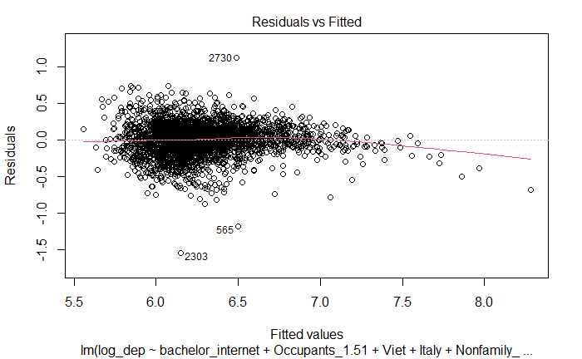
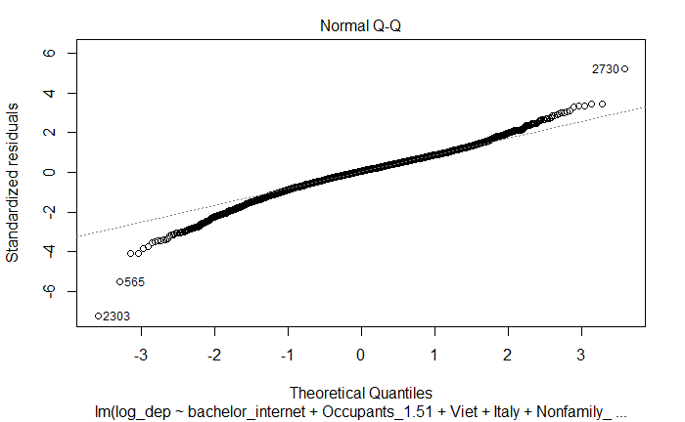
Regression Diagnosis

Slide 22
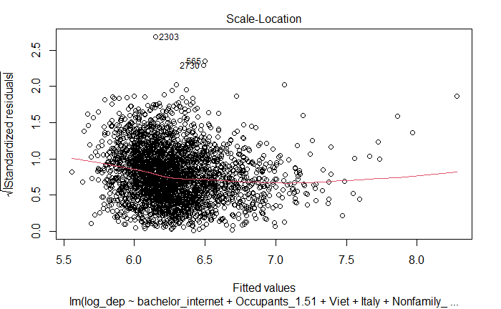
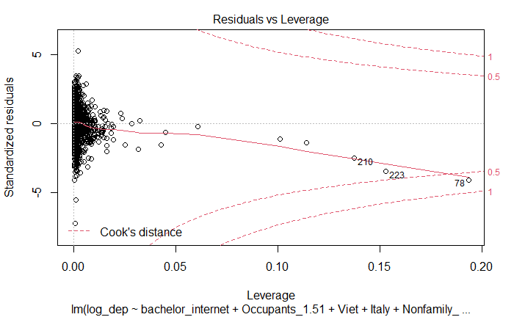
Regression Diagnosis

Slide 23
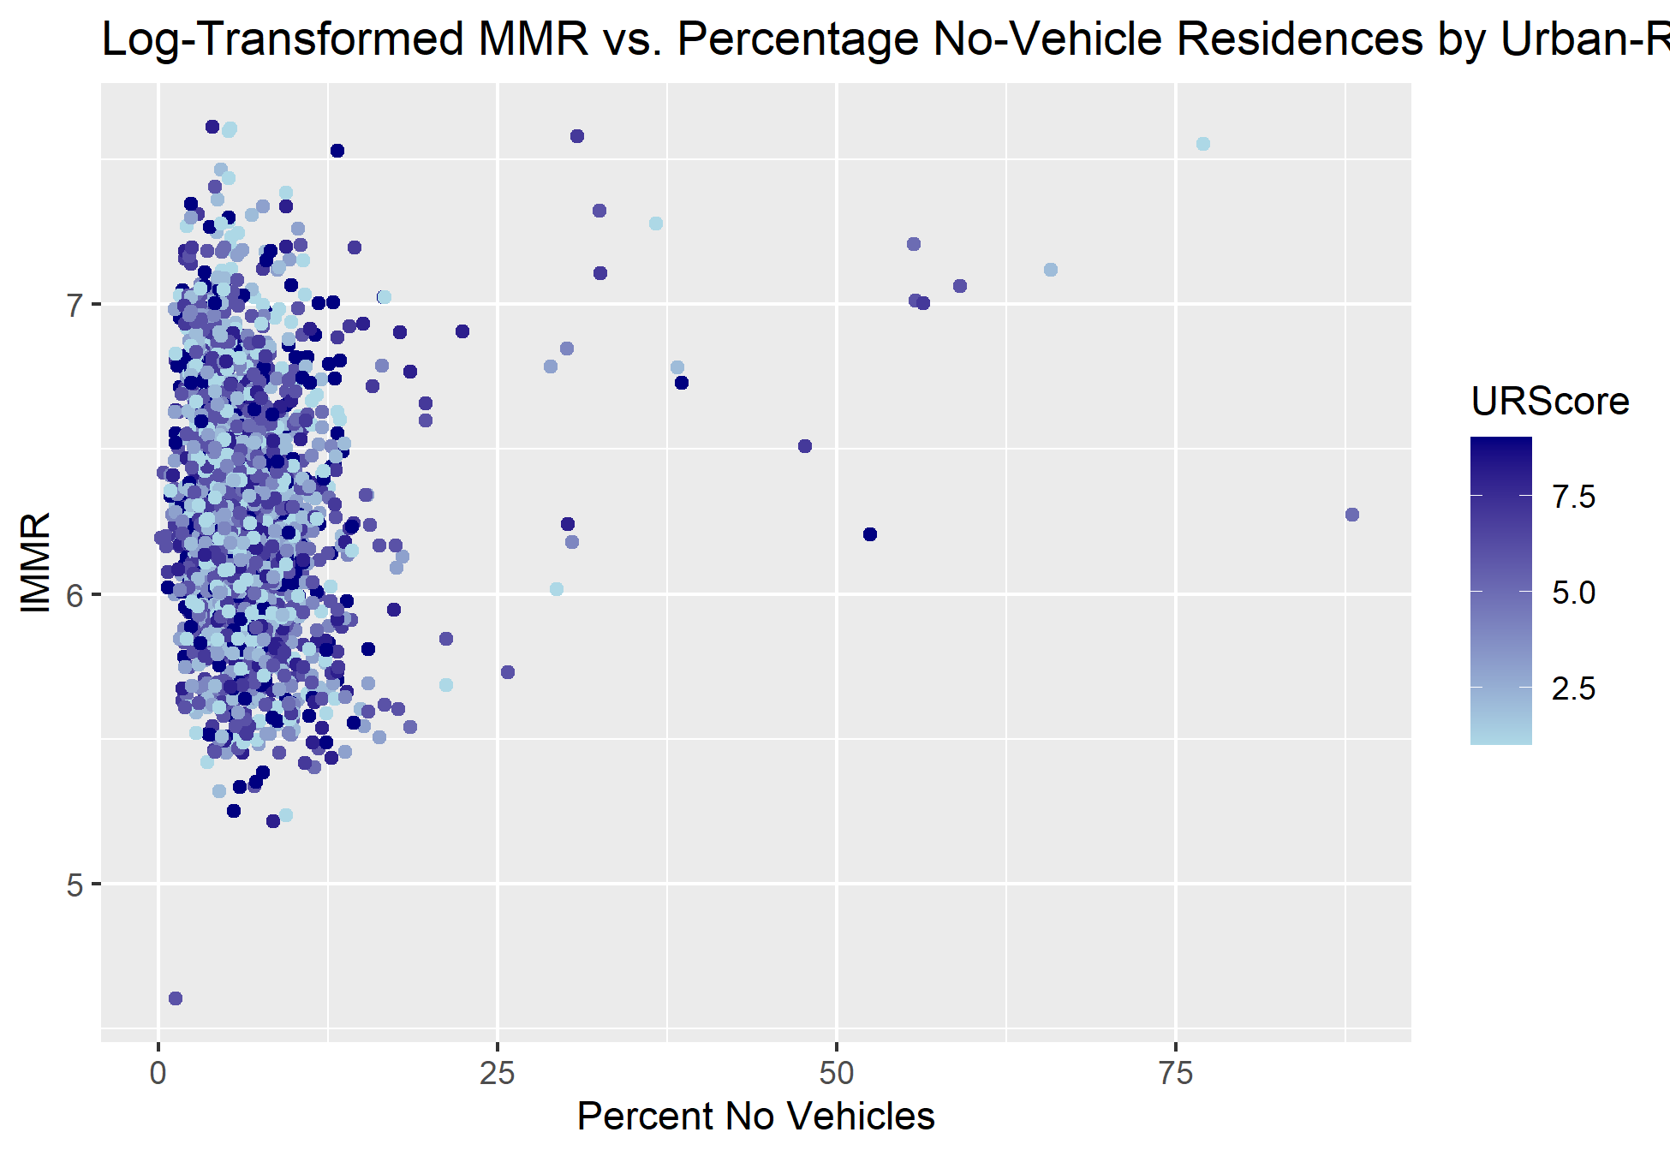
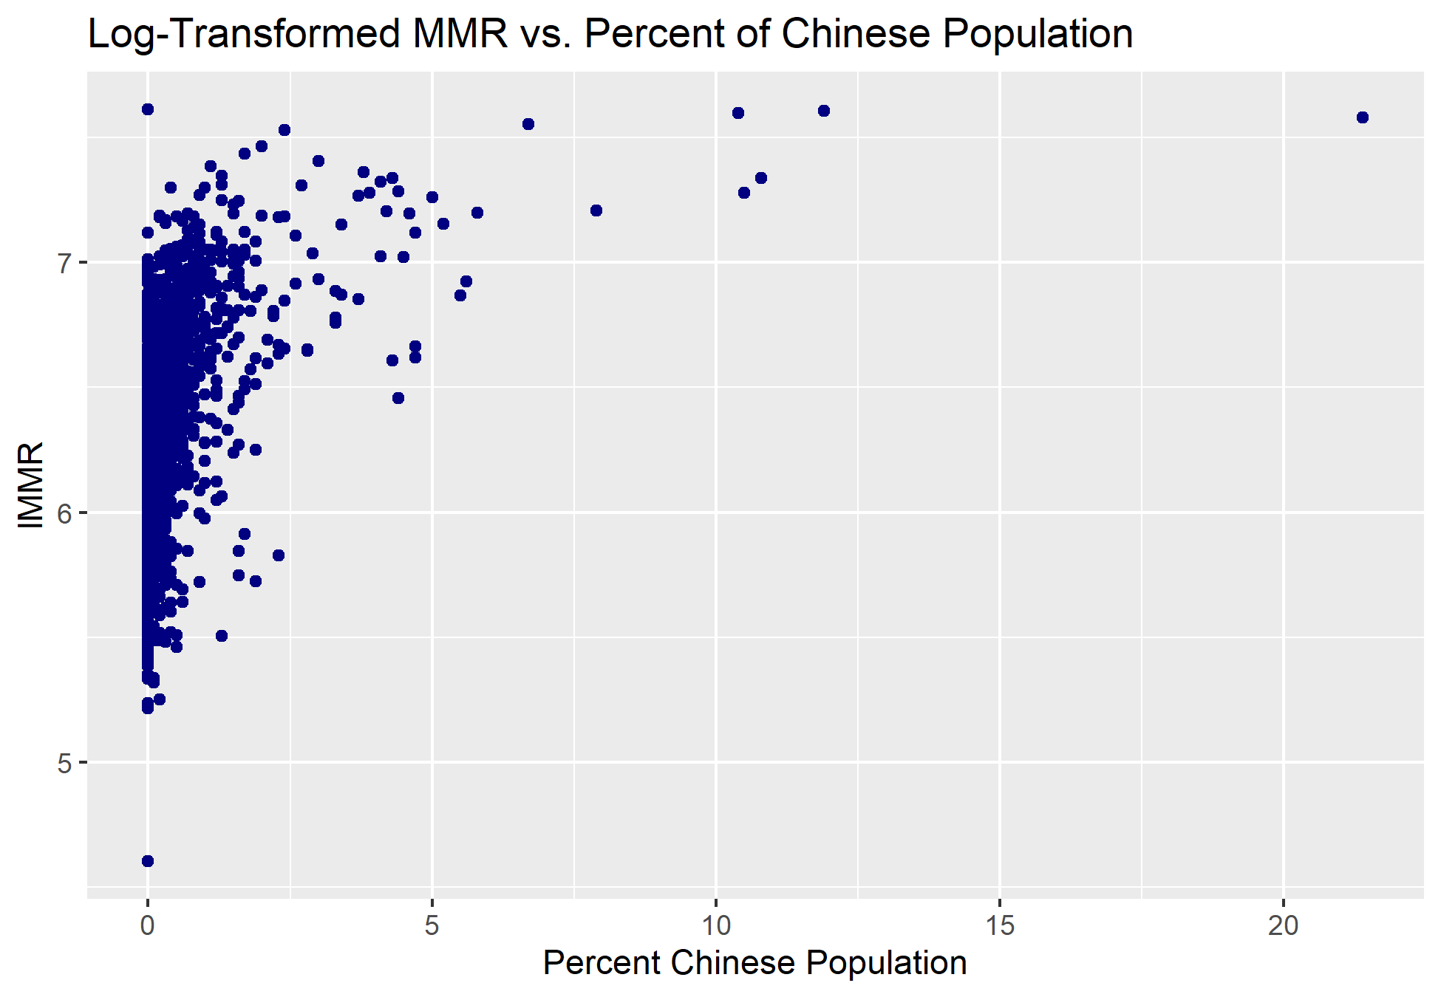
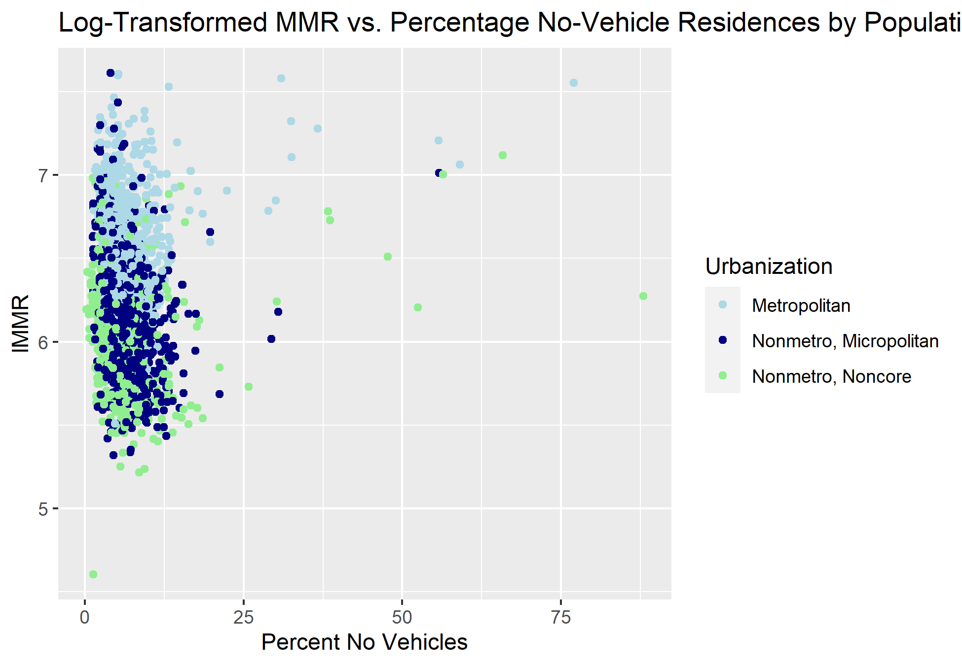
Additional Plots

Slide 24
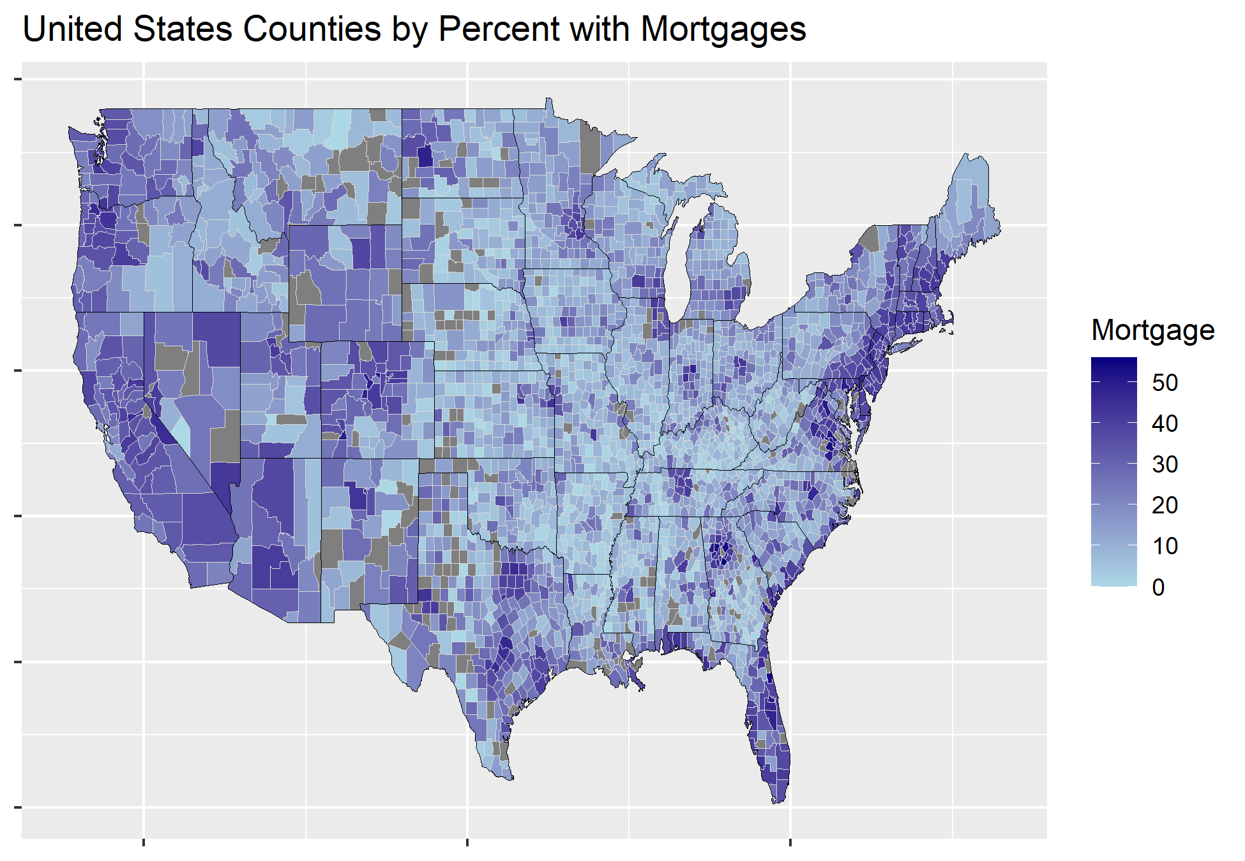
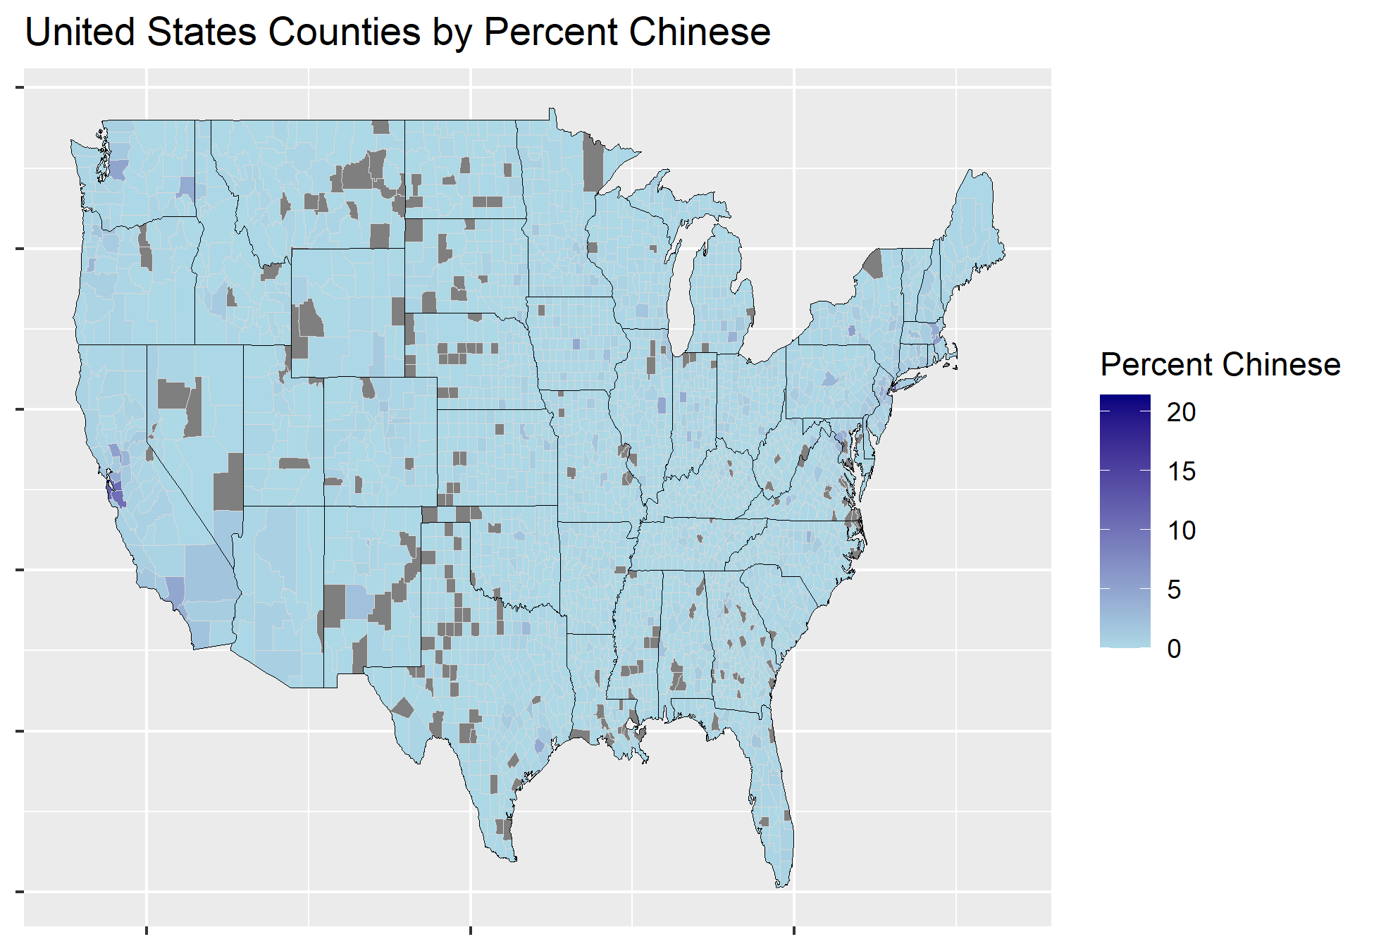
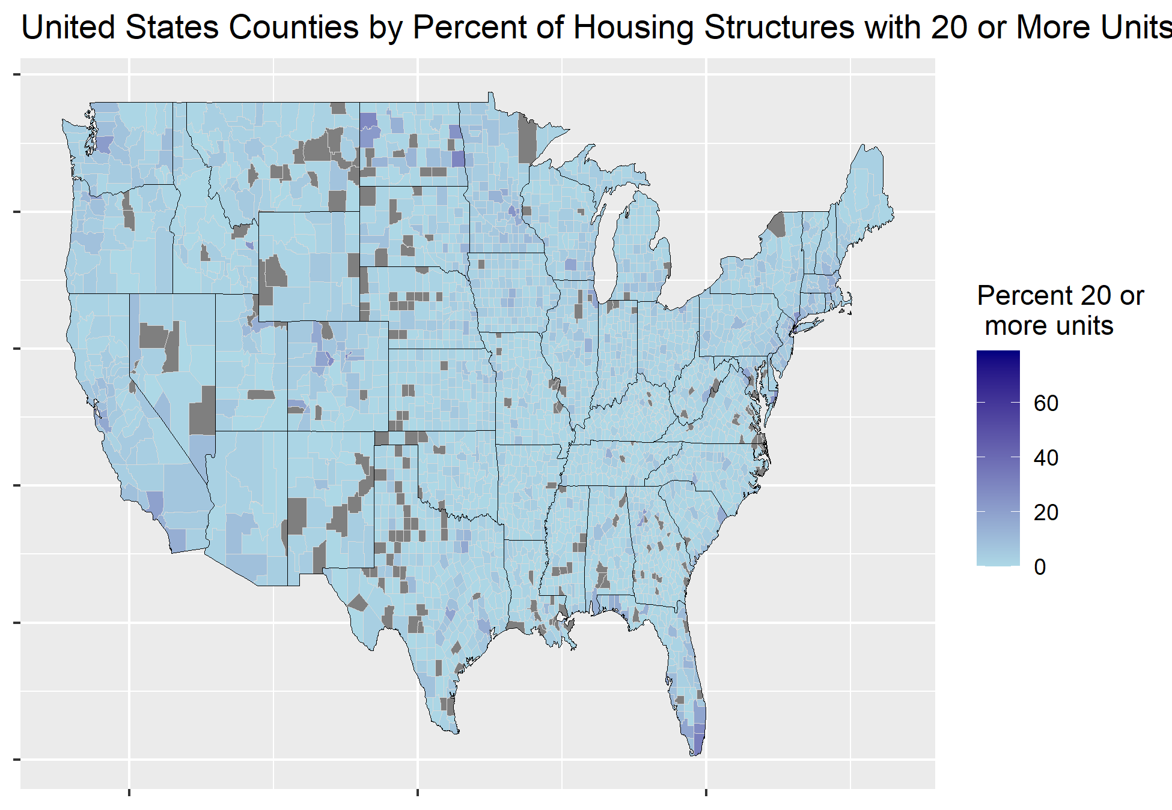
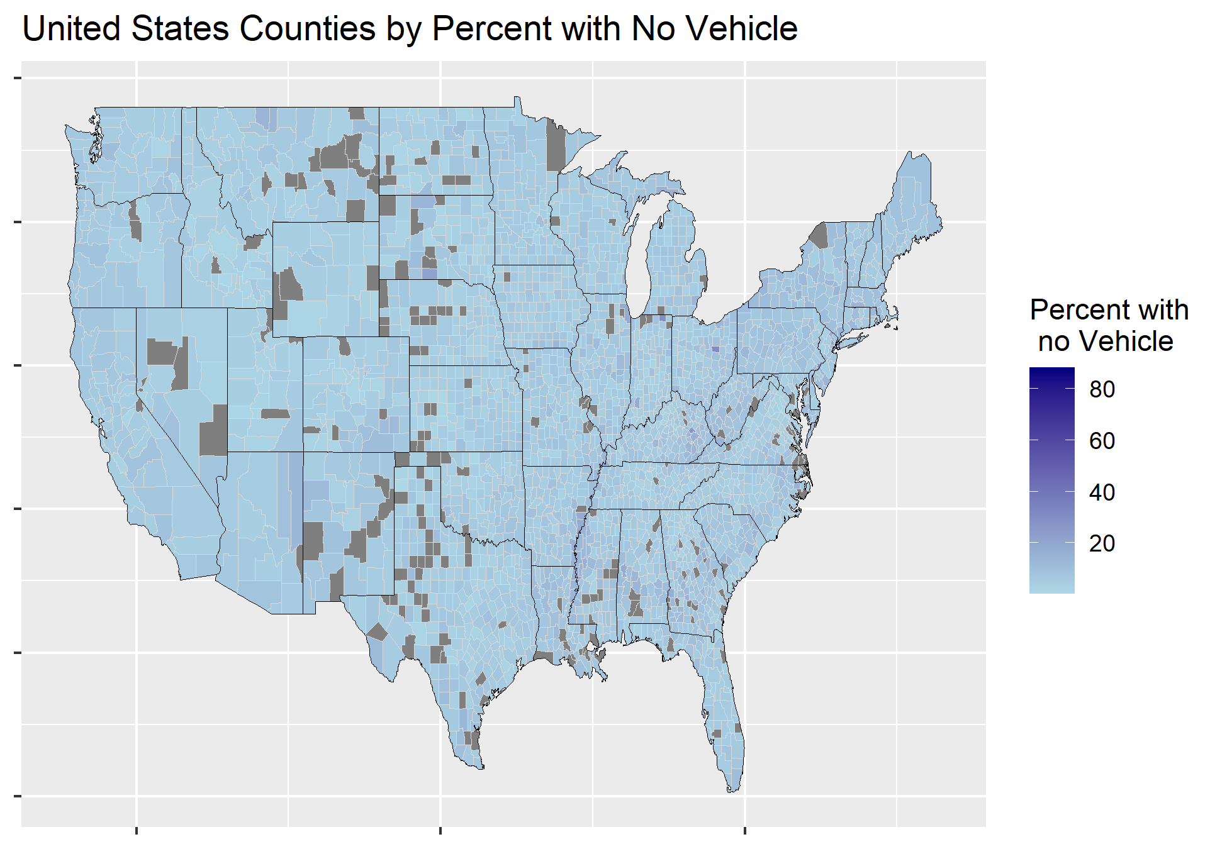
Additional Plots

Slide 25
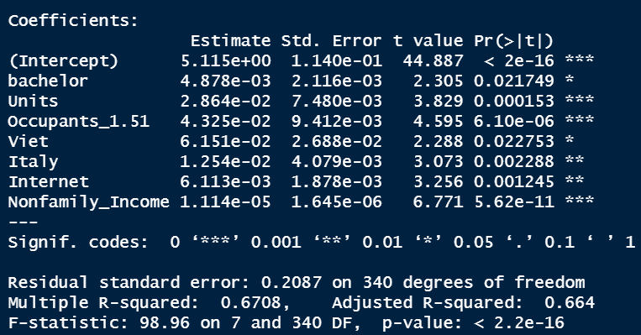
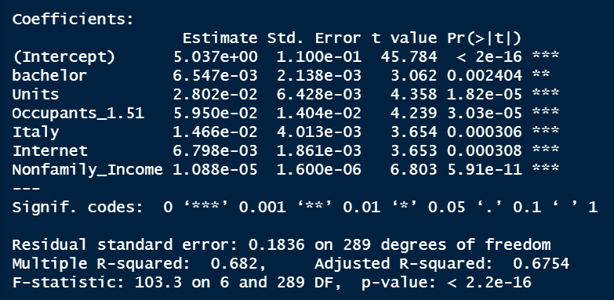
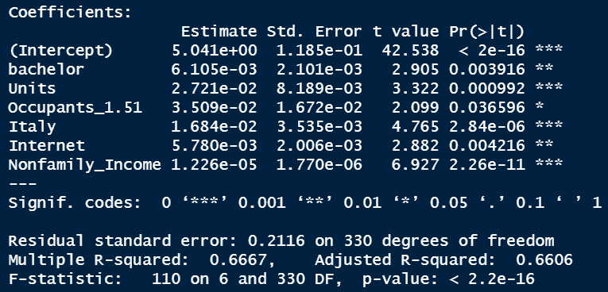
Three SubModels

