Slide 1

Analyzing Reforestation Strategies
By Zachary Stein

Slide 2
Dealing with Climate Change
As the amount of greenhouse gases increase in the atmosphere, we are dealing with changing weather.
This creates economic hardship for people.
Most of the greenhouse gases are carbon dioxide (Others are methane, nitrous oxide, and water).
Carbon dioxide is released into the atmosphere from burning fossil fuels.
Coal, gasoline, diesel, kerosene, LPG.
What can we do?

Slide 3
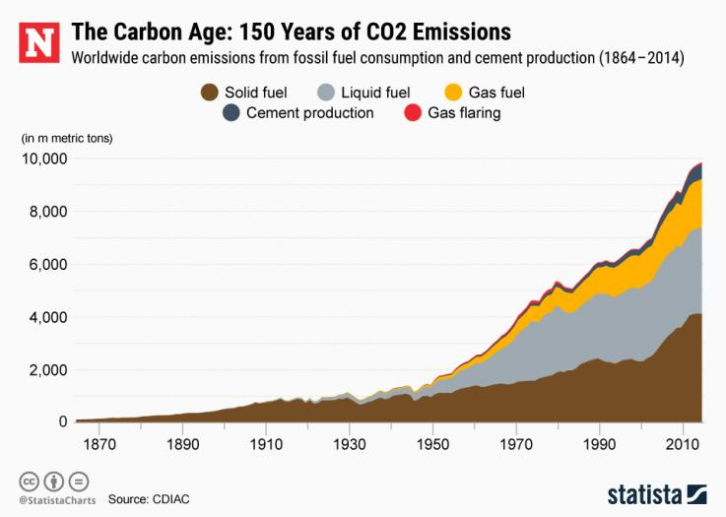
Obvious Solutions
The amount of CO₂ released into the atmosphere is exponential.
We need to reduce the amount of CO₂ released into the atmosphere.
However, this is not easy.
What can we do?
[1]
Notes:
1) https://www.newsweek.com/carbon-dioxide-climate-change-fossil-fuels-906953

Slide 4
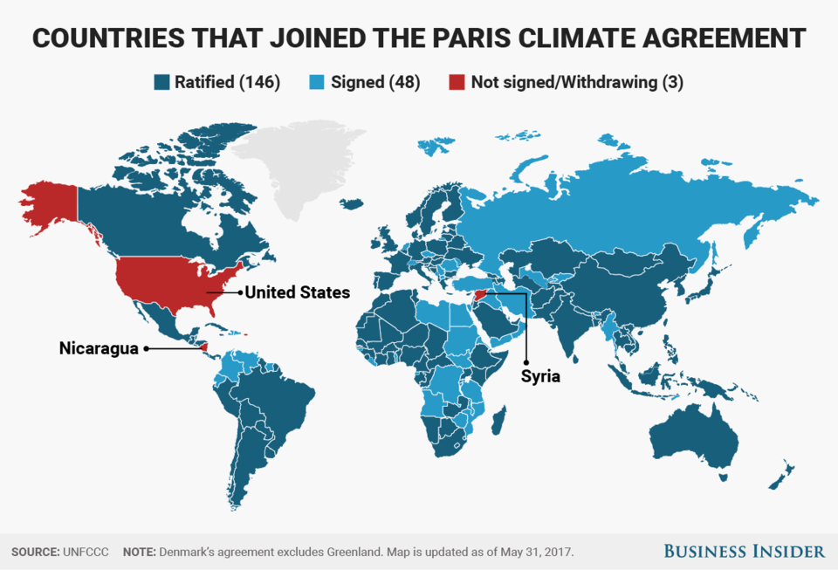
Climate Agreements
Multiple international agreements have been signed in order to reduce greenhouse gas emissions.
Some examples:
Kyoto Protocol (1997)
Paris Agreement (2016)
[2]
Notes:
2) https://www.businessinsider.com/195-countries-that-signed-paris-climate-agreement-accord-deal-2017-5

Slide 5
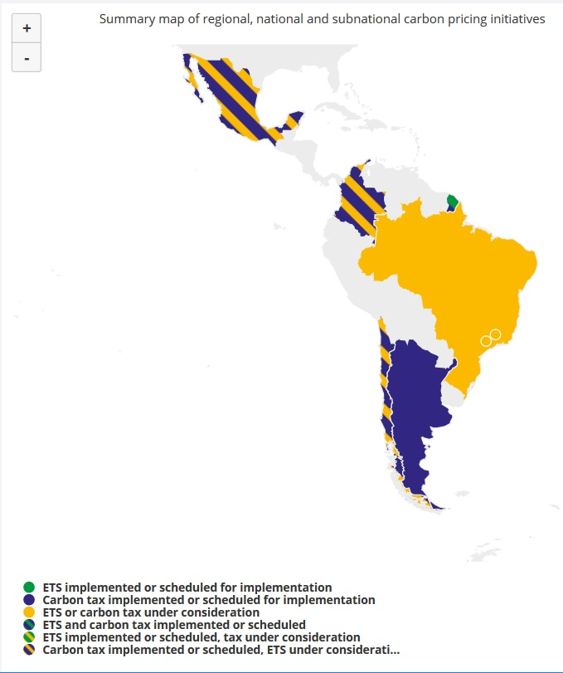
Carbon Taxes
One way to reduce carbon taxes is to tax the sources of emissions.
In my work at the WRI and Climate institute, I have been looking at carbon taxes in Latin America.
Many of them tax various sources of CO₂.
This way, greenhouse gas emissions are decreased, or increase at a slower rate.
Also, some want to promote renewable sources of energy.

Slide 6
Reforestation
An alternative to reducing carbon emissions is capturing carbon from the atmosphere.
One of the best ways to do this is through reforestation.
Besides capturing CO₂, there are other environmental benefits to reforestation.
Reduced flooding and soil erosion.
So, what is the best reforestation strategy?

Slide 7
Goals
What mix of species is best for creating a mixed ecosystem? Is there a range for each species that works well?
We have to keep in mind that with an initial seeding or planting, some species might end up dying while others will thrive. This will result in a change to the mix of the ecosystems. If this happens, will the reforested area become a problem area?
Can we also determine which species are important for the success of a reforestation effort?

Slide 8
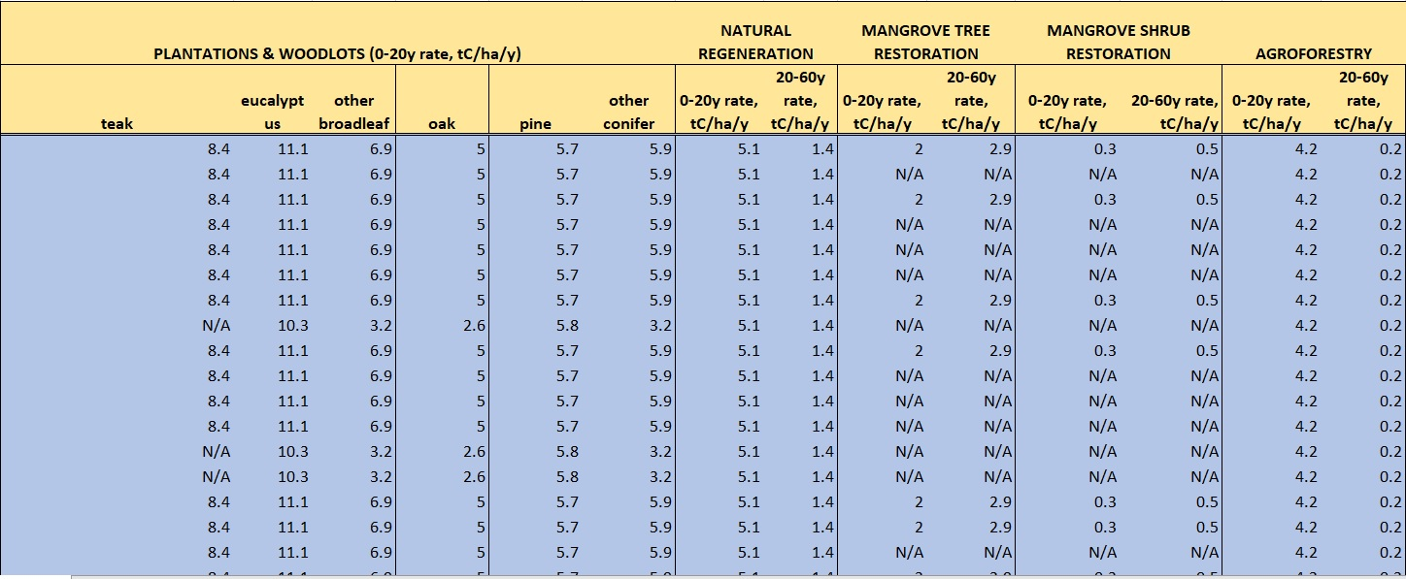
Initial Data

Slide 9
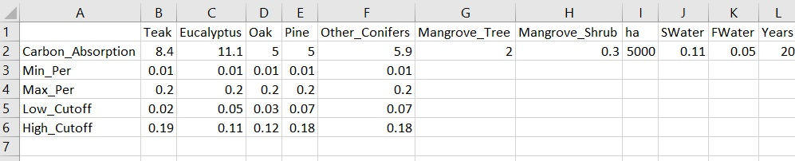
Test Data

Slide 10
Choose and Calculate
Use Min_Per and
Max_Per to randomly
Choose values.
Use Cutoff to check
If it will be viable (0
or 1).
Check if the forest will be viable
(Also 0 or 1).
Repeat multiple times and analyze.

Slide 11
Methods
I used R and Bayesian.
I used MCMC and JAGS for analyzing the data. This produced intercept graphs and ROC curves.
Also, output is generated for the area covered by each species of tree and whether or not it will be viable.

Slide 12
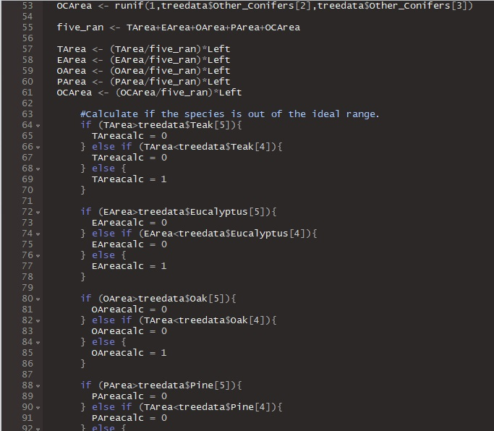
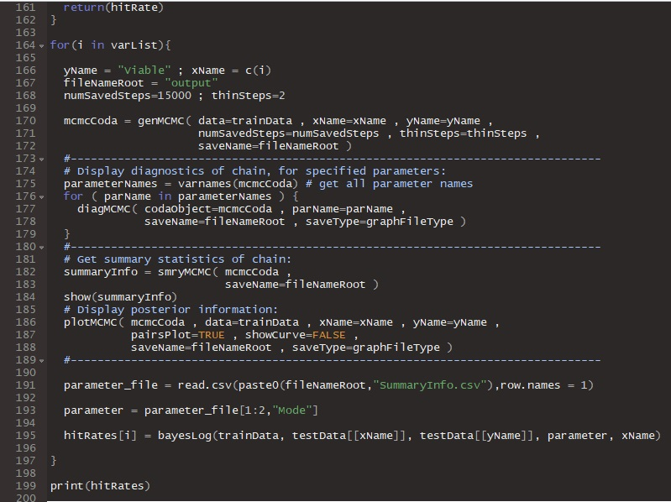
R Code

Slide 13
First Test Data Set
Input | Teak | Eucalyptus | Oak | Pine | Other_Conifers | SWater | FWater
Carbon_Absorption | 8.4 | 11.1 | 5 | 5 | 5.9 | 0.11 | 0.05
Min_Per | 0.01 | 0.01 | 0.01 | 0.01 | 0.01
Max_Per | 0.2 | 0.2 | 0.2 | 0.2 | 0.2
Low_Cutoff | 0.02 | 0.05 | 0.03 | 0.07 | 0.07
High_Cutoff | 0.19 | 0.11 | 0.12 | 0.18 | 0.18

Slide 14
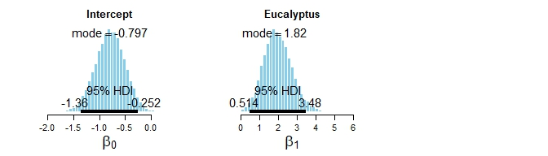
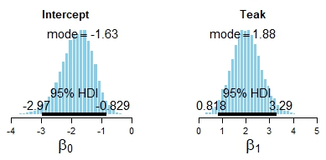
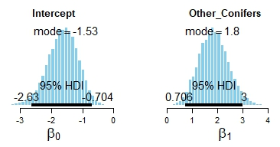
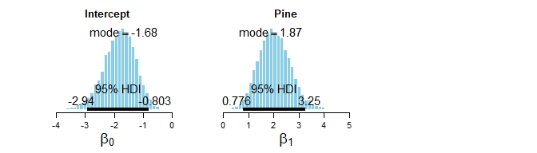
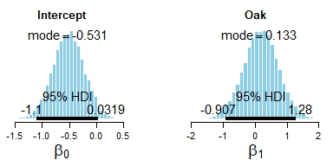
Intercepts

Slide 15
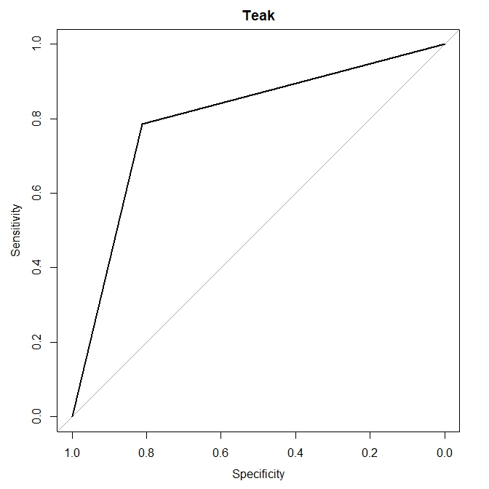
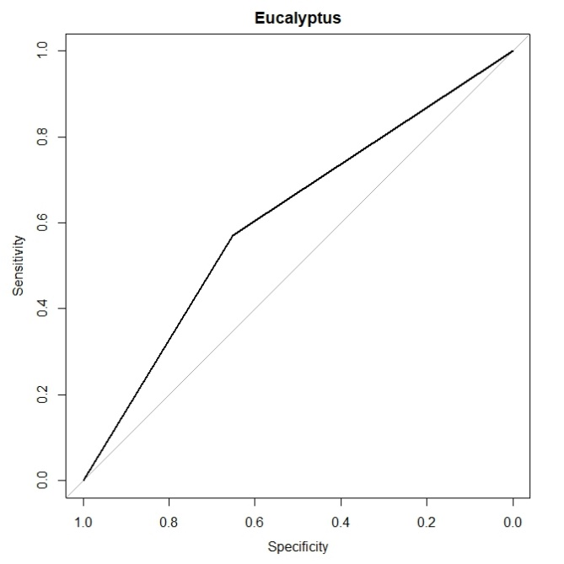
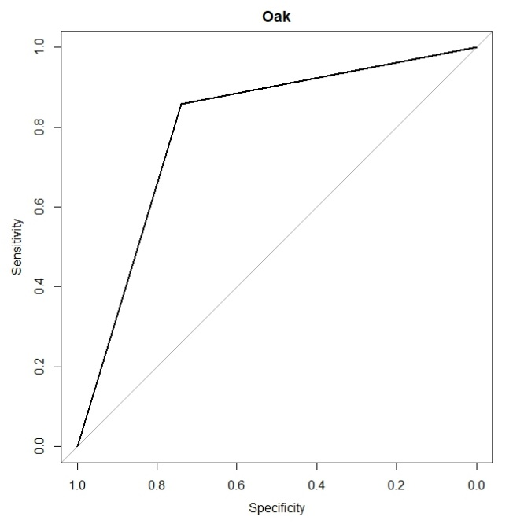
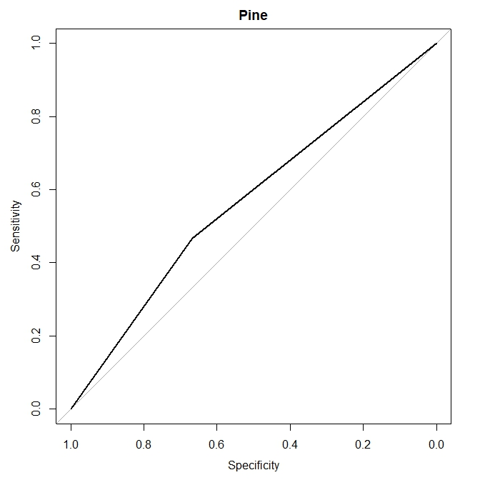
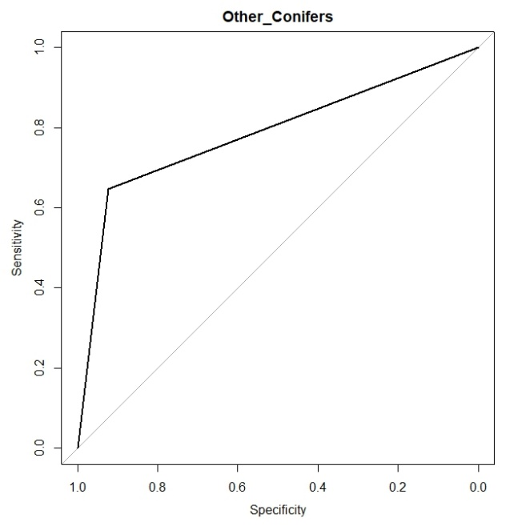
ROC Curves

Slide 16
Second Test Data Set
 | Teak | Eucalyptus | Oak | Pine | Other_Conifers | SWater | FWater
Carbon_Absorption | 8.4 | 11.1 | 5 | 5 | 5.9 | 0.11 | 0.05
Min_Per | 0.01 | 0.01 | 0.01 | 0.01 | 0.01
Max_Per | 0.2 | 0.2 | 0.2 | 0.2 | 0.2
Low_Cutoff | 0.015 | 0.07 | 0.02 | 0.05 | 0.03
High_Cutoff | 0.09 | 0.11 | 0.15 | 0.17 | 0.13

Slide 17
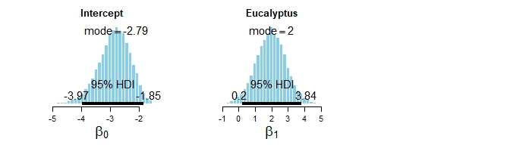
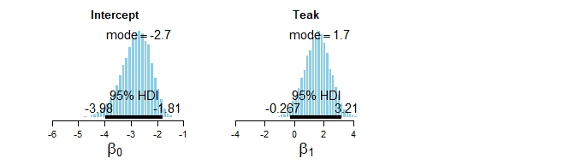
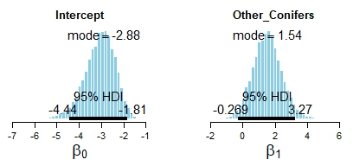
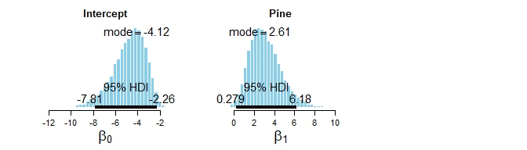
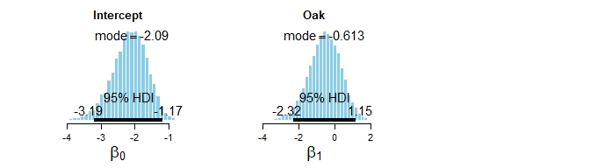
Intercepts

Slide 18
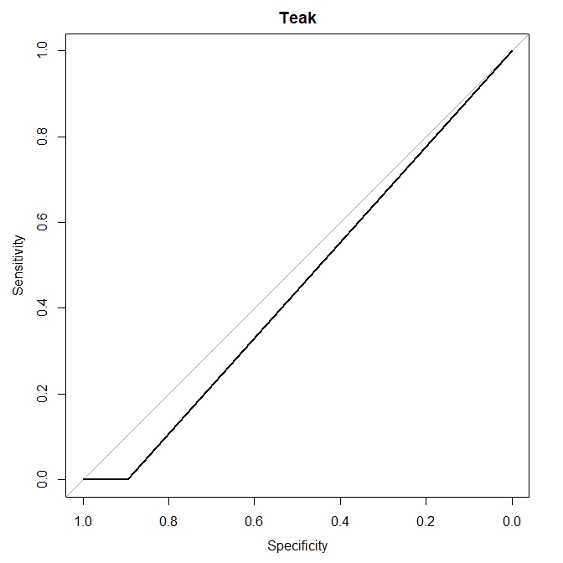
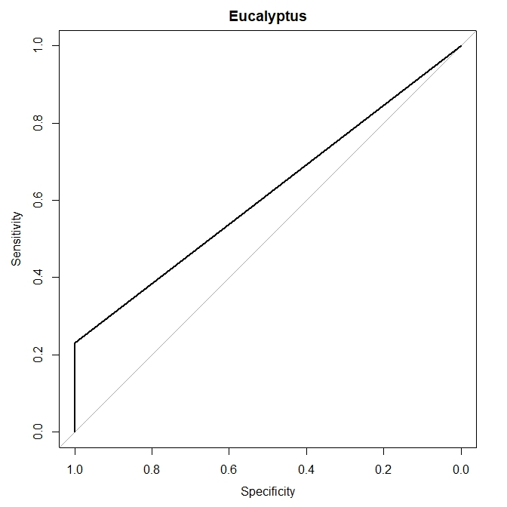

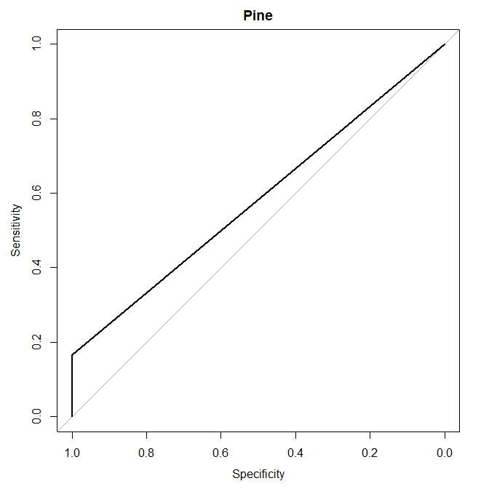
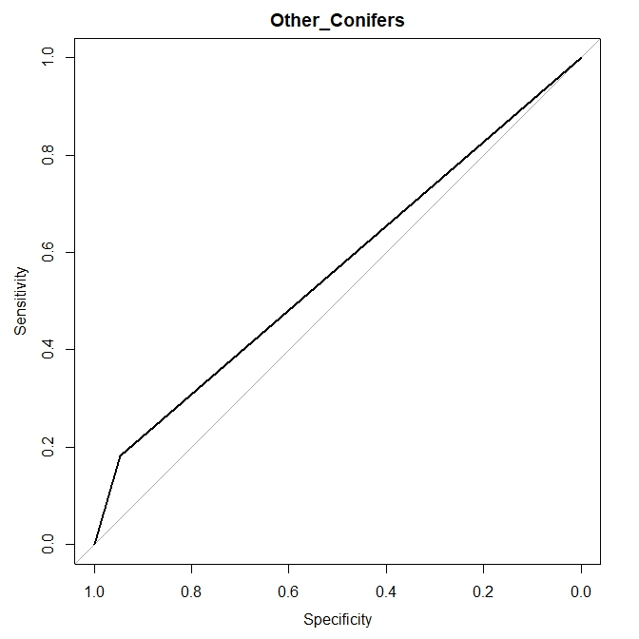
ROC Curves

Slide 19
Third Test Data Set
 | Teak | Eucalyptus | Oak | Pine | Other_Conifers | SWater | FWater
Carbon_Absorption | 8.4 | 11.1 | 5 | 5 | 5.9 | 0 | 0.09
Min_Per | 0.01 | 0.01 | 0.01 | 0.01 | 0.01
Max_Per | 0.2 | 0.2 | 0.2 | 0.2 | 0.2
Low_Cutoff | 0.03 | 0.06 | 0.05 | 0.035 | 0.055
High_Cutoff | 0.13 | 0.1 | 0.15 | 0.139 | 0.19

Slide 20
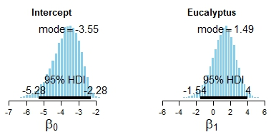
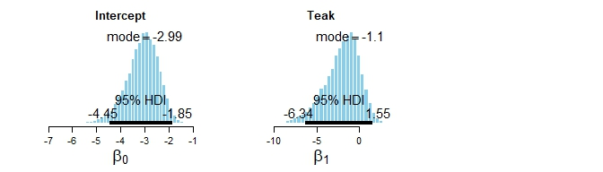
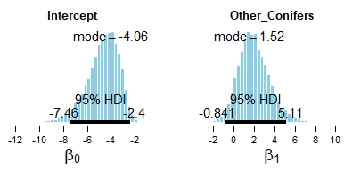
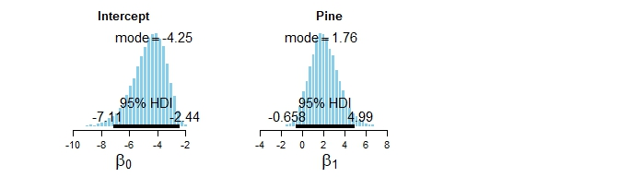
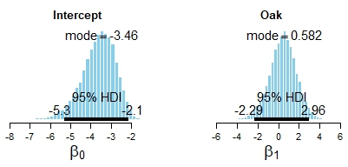
Intercepts

Slide 21
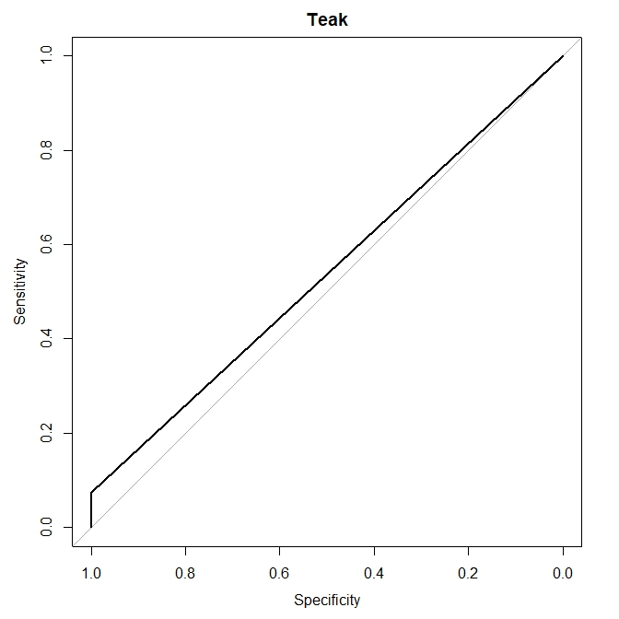
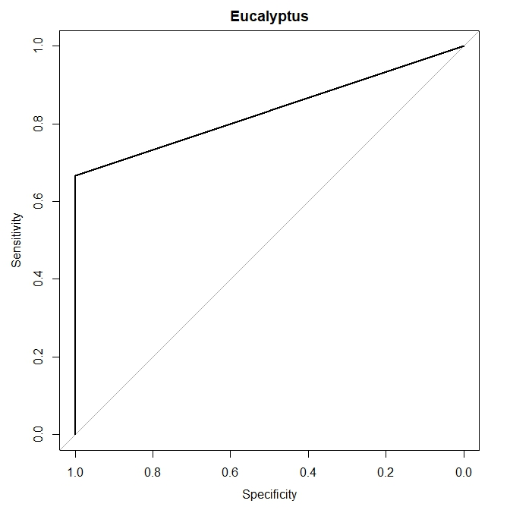
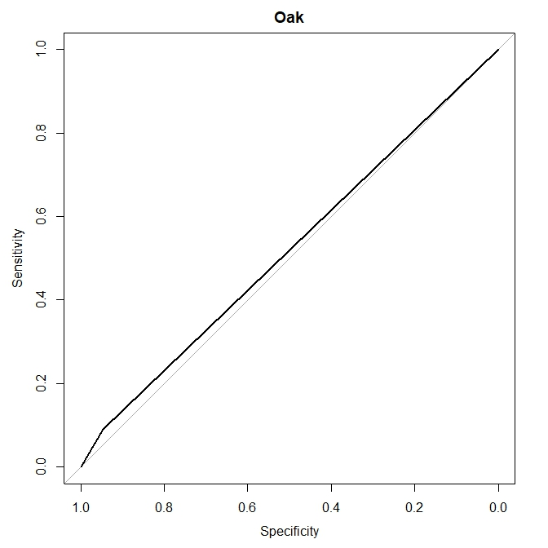
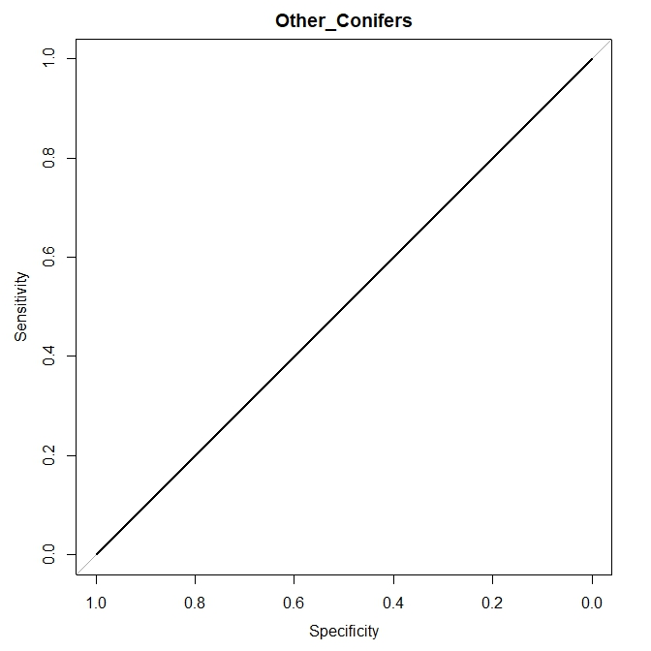
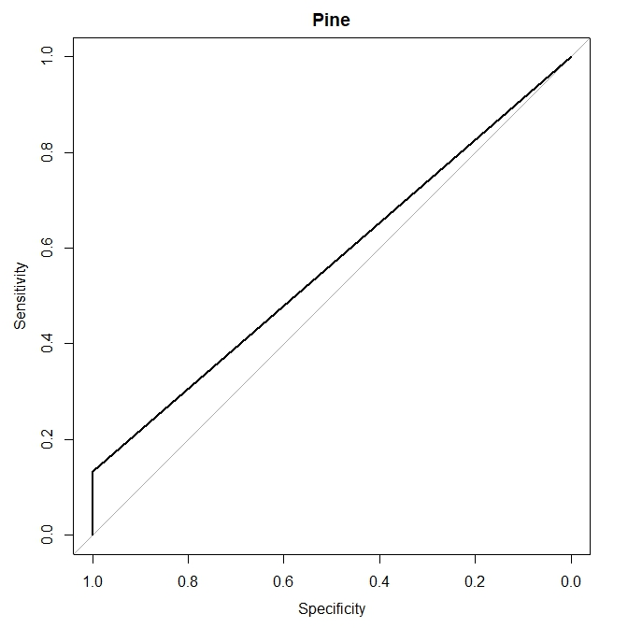
ROC Curves

Slide 22
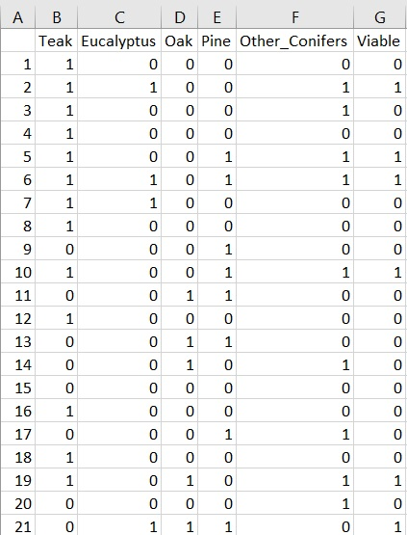
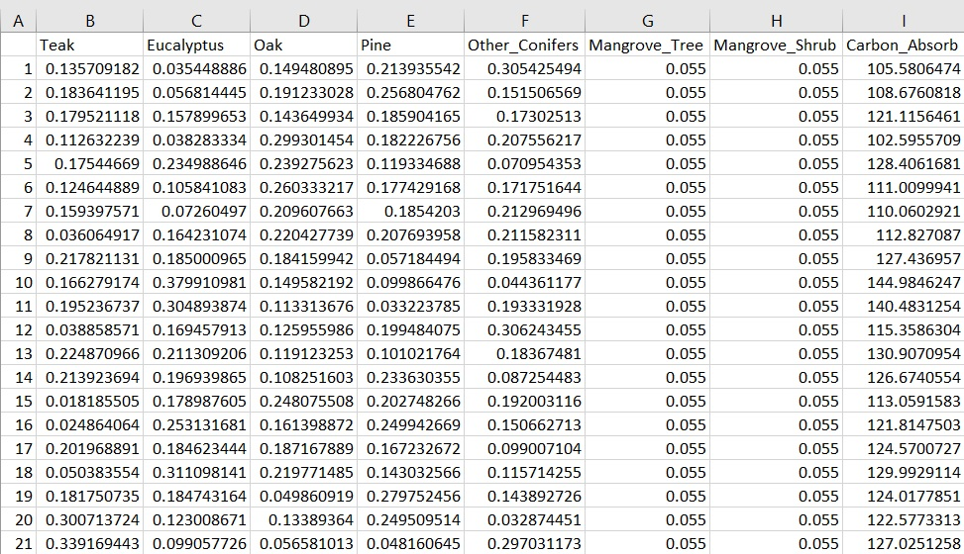
Comparing Results
Test_Data1 | Test_Data2 | Test_Data3
122.87 tC | 122.39 tC | 129.85 tC

Slide 23
Conclusions
Using this code, the following things can be accomplished:
Take in data on a wide variety of species and their habitat, then run them through the code.
Determine what mix of species will be viable, both as a species and for the ecosystem.
Determine which species are most important for a particular habitat.
Calculate the amount of carbon dioxide the area will absorb over a 20 year period.
This looks to be a good initial method, thought it does have room for improvement.

Slide 24
Thank You!

