Slide 1


Blackjack Simulator
By Isaac T. Phillips

Slide 2
Factors
Main factor was based on how I play.
Wanted to think about things that other players don’t most of the time. Ex: hard 16, dealer loss % on 4-6
My card count was based on 2-6 are +1, 7-9 are 0 and, 10-A are –1.
There are 5 decks, I think that is usually standard for Casinos
There are four players, I messed with five but there was only difference in the count for the round.
I didn’t do anything special for A's, only because I treat them like J, Q, K and 10. (hit if hand value is < 15

Slide 3
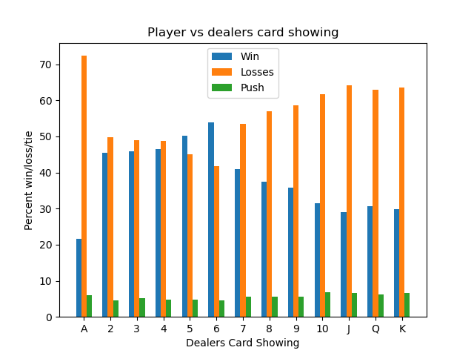
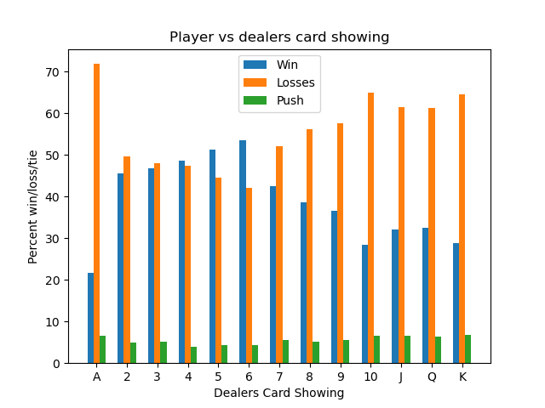
Figures

Slide 4
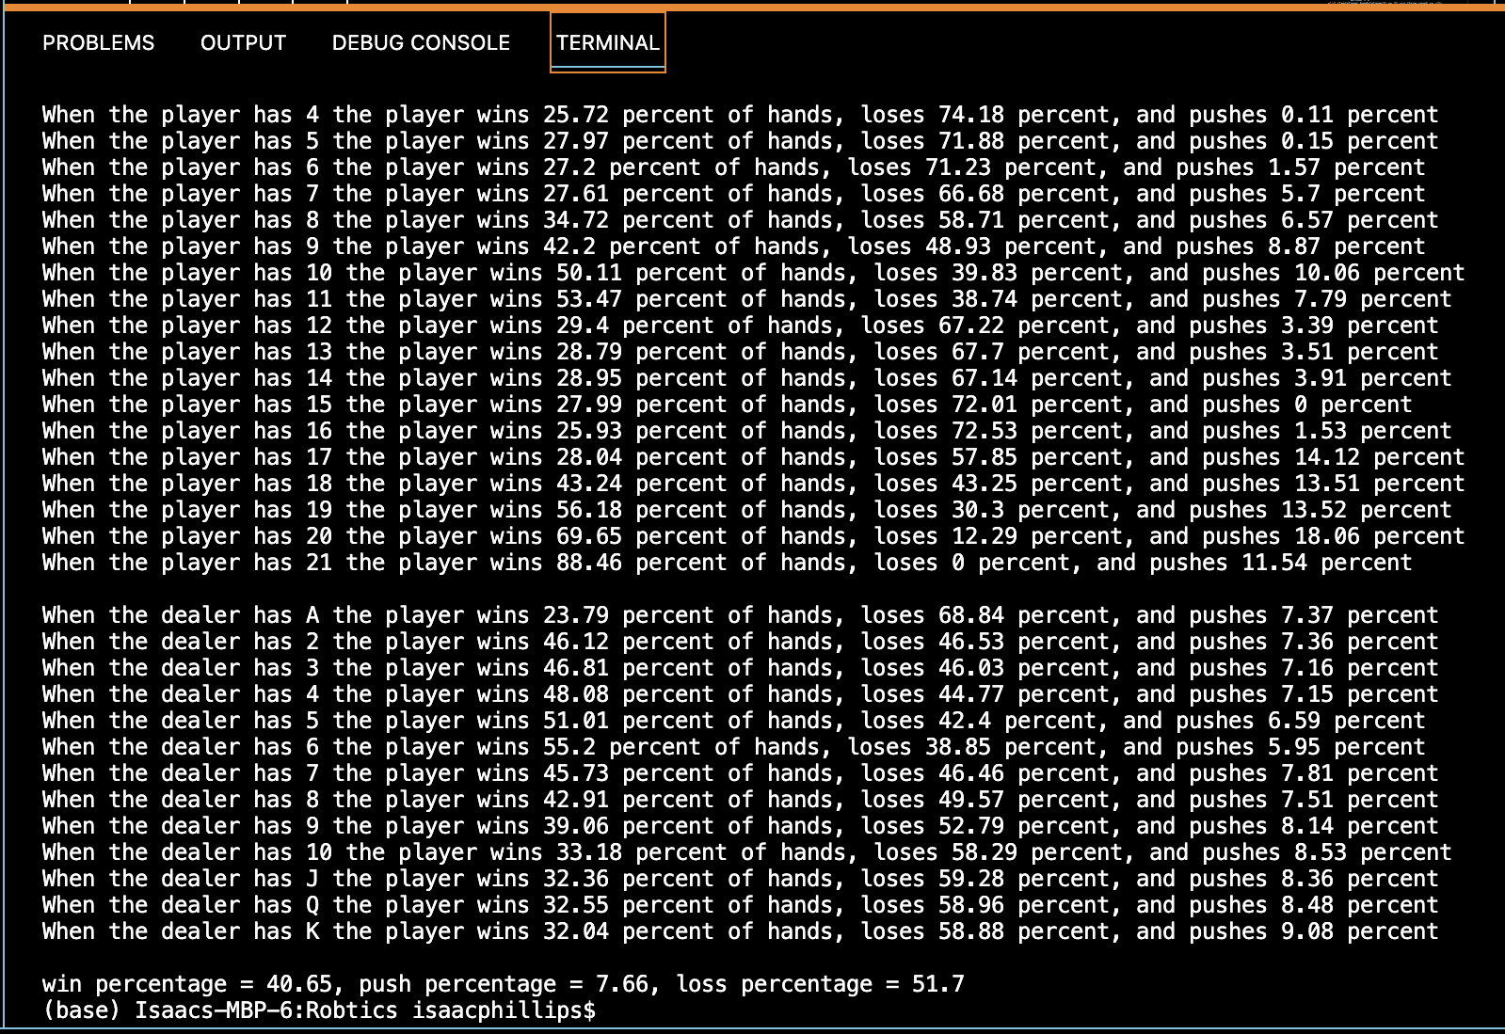
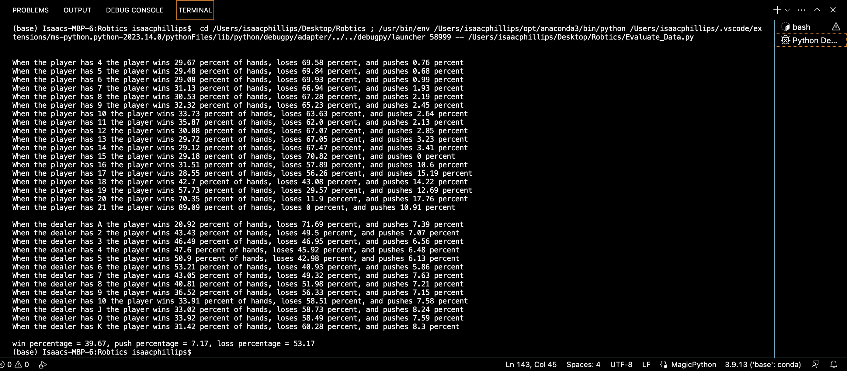
More Figures

Slide 5
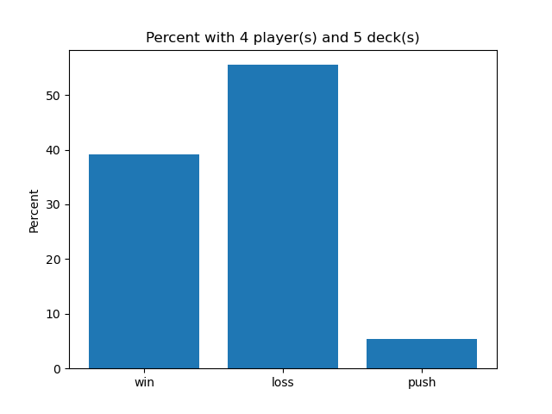
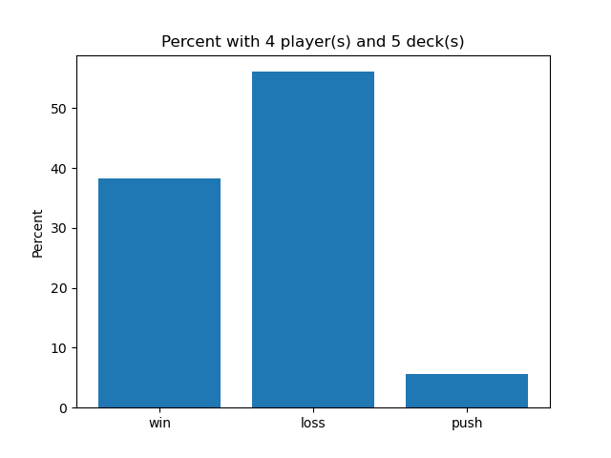
Final Figures

