Slide 1

Evaluating ML Model
Isaac Phillips

Slide 2
Factors for Training Data
I based my training data on a few factors.
First the dealer card
The player’s initial hand
“hit” the hit or stay (1 or 0)
And the true count

Slide 3
Features to train
Focused on getting the actual predictions from the model
What was played vs what should have been played
Used Professors base model
Compared the actual values to the predicted values and plotted how close the predictions are.
Predicted Actual | W/P | Loss
W/P | Correct | Incorrect
Loss | Incorrect | Correct

Slide 4
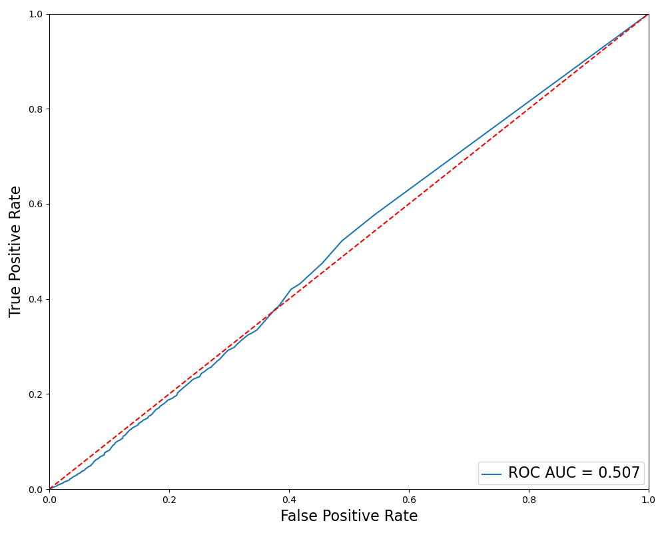
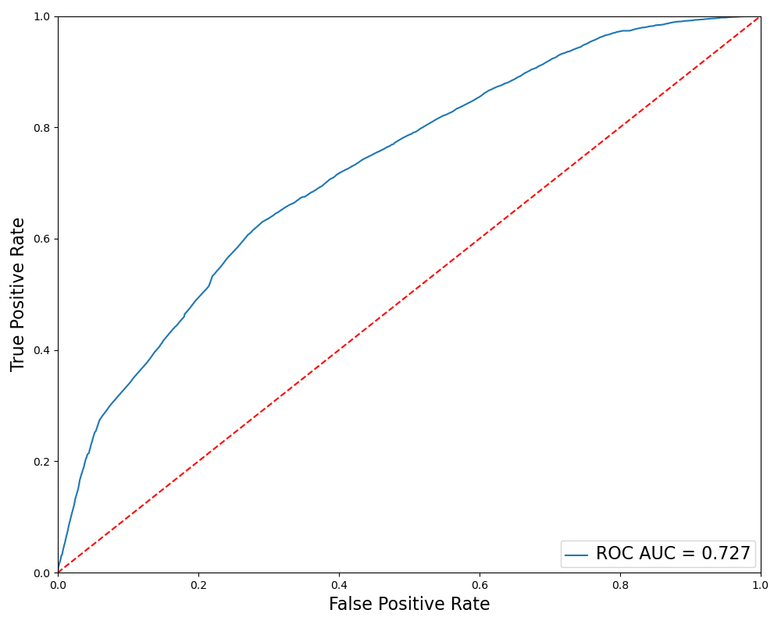
Professor’s graphs
I got varied results with the professor’s graph, but each looked like these.

Slide 5
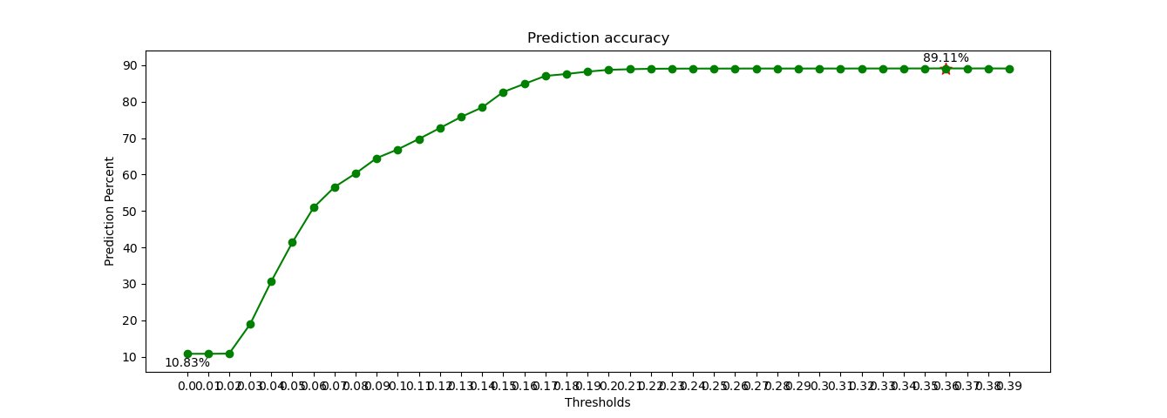
Line Graph

