Slide 1
Paraview
EGR 5703 - Advance Scientific Visualization
M.S. Electrical Engineering
Isaac Trevino

Slide 2
Table of Contents
Assignments
Object Summaries
Sub-System of a Vehicle
Alternator
Human Body Part
Trachea
Custom Object
Volcano
Conclusion

Slide 3
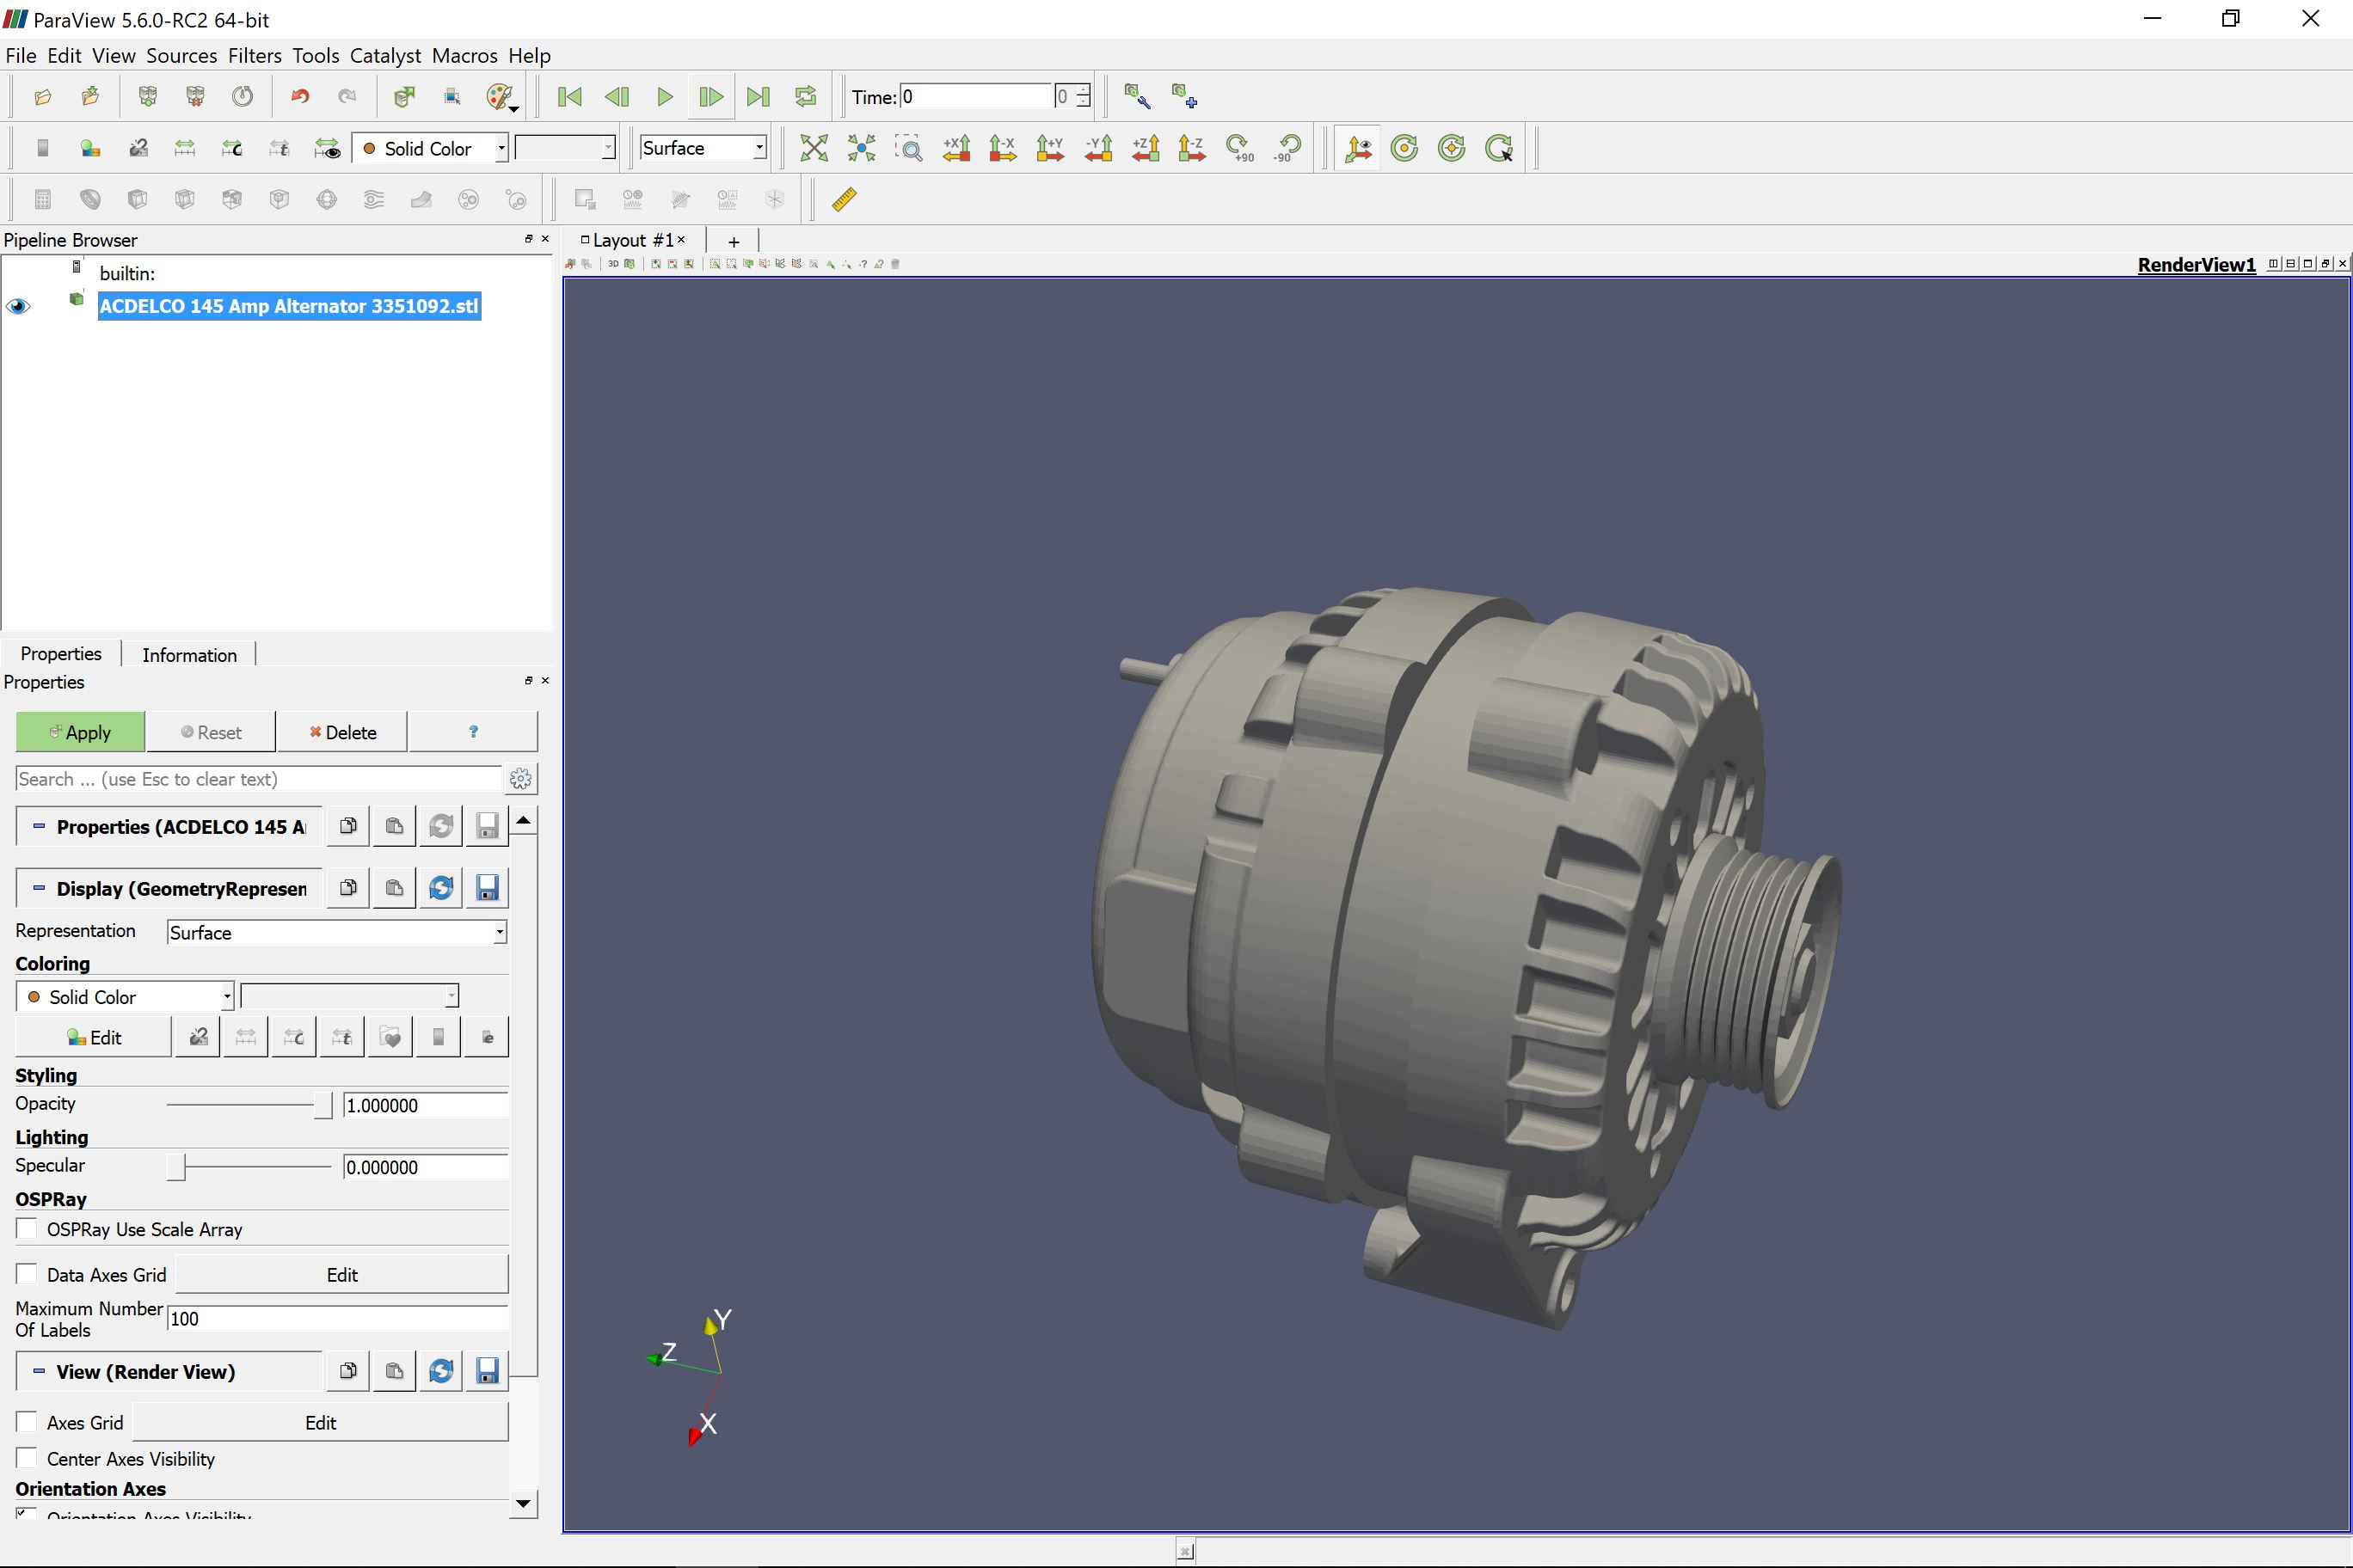
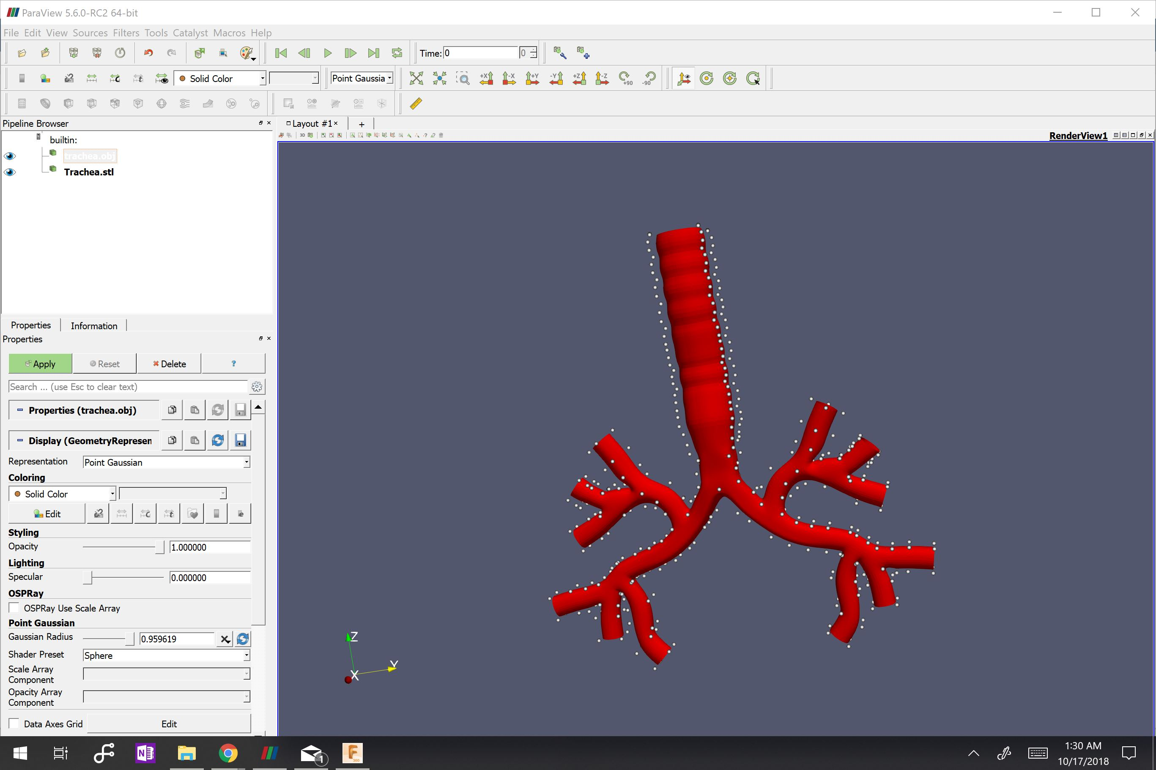
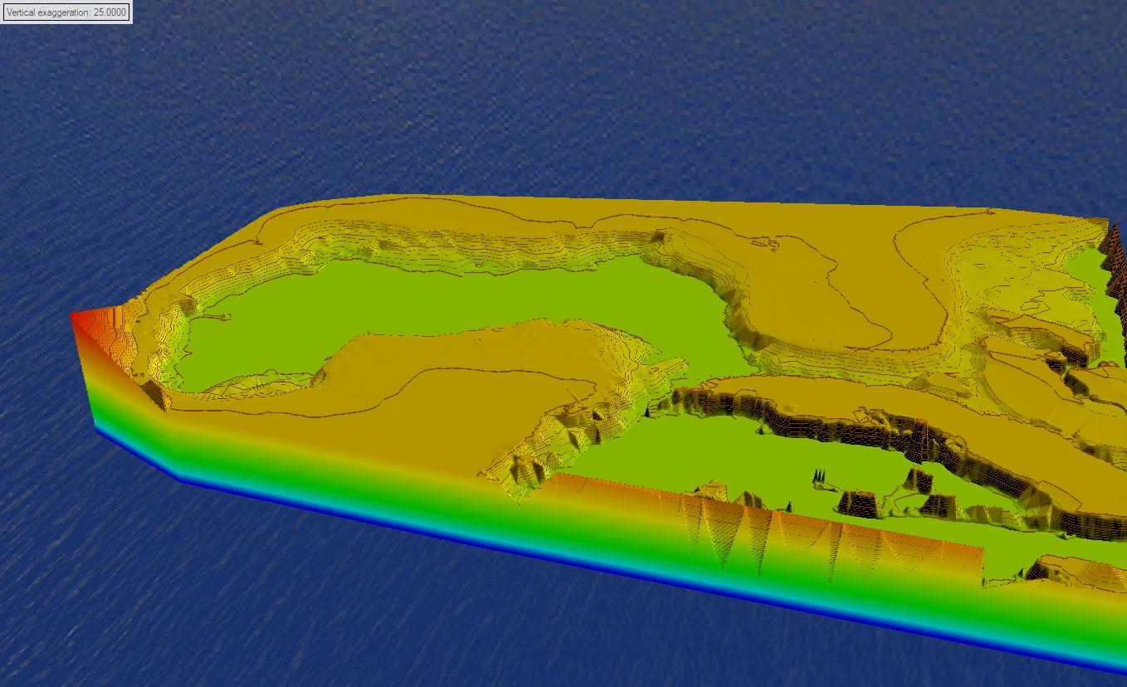
Assignments
Sub-System of Car
Human Body Part
Elevation Model
Borrowed from GrabCAD.com
LINK
Alternator
Made using Fusion 360
Human Trachea, Bronchus,
Made using GlobalMapper
Gulf of Mexico Bathymetric Elevation mapping

Slide 4
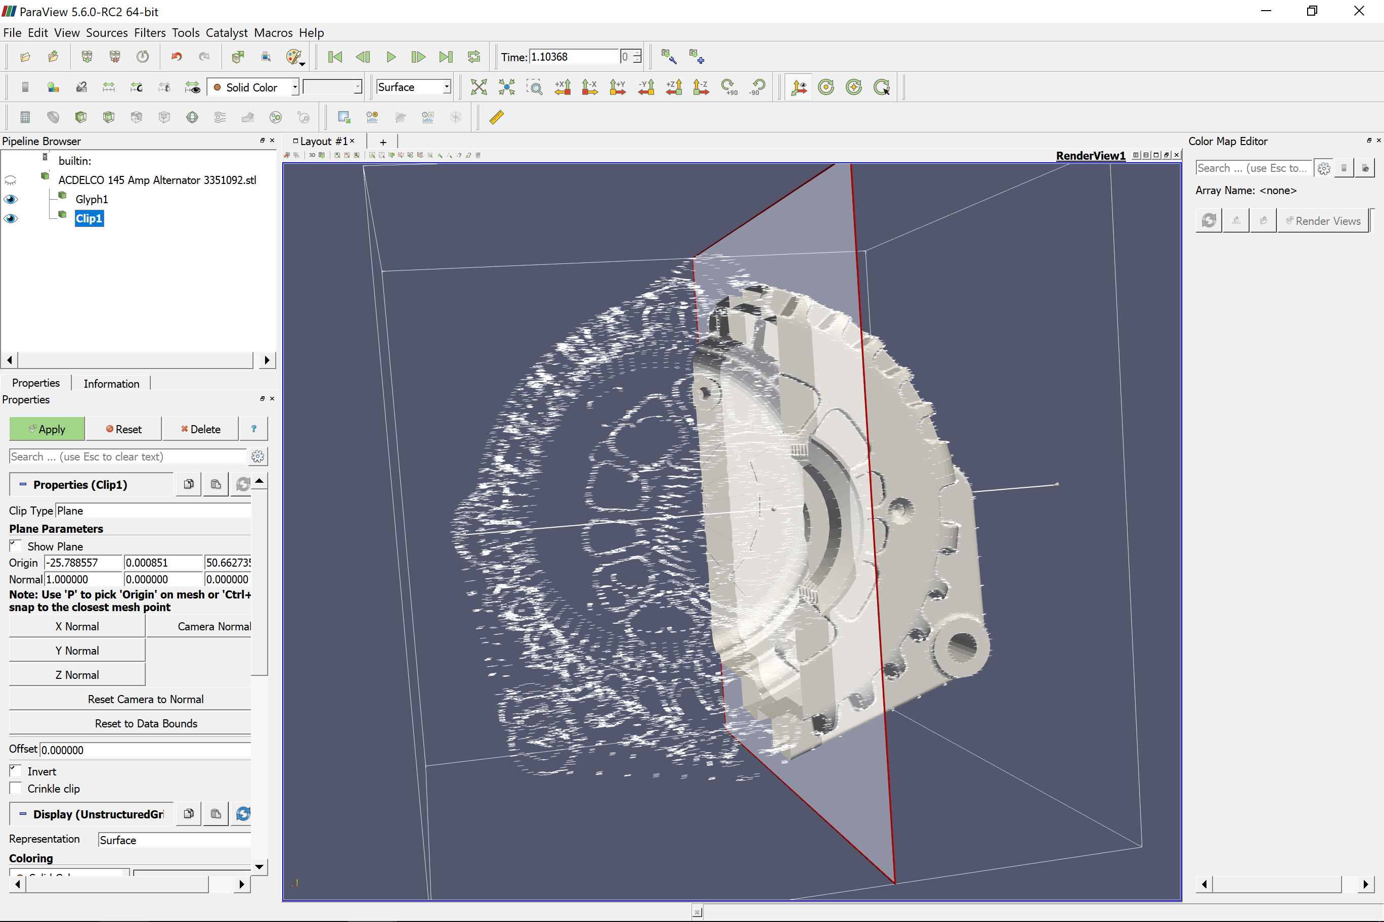
Alternator
The Alternator is used to convert mechanical energy from the engines spin axil to Electrical Energy by using a Generator Configuration.
Using ParaView we are able to view the internal structure of the Alternator, thus giving us an advanced visualization.

Slide 5
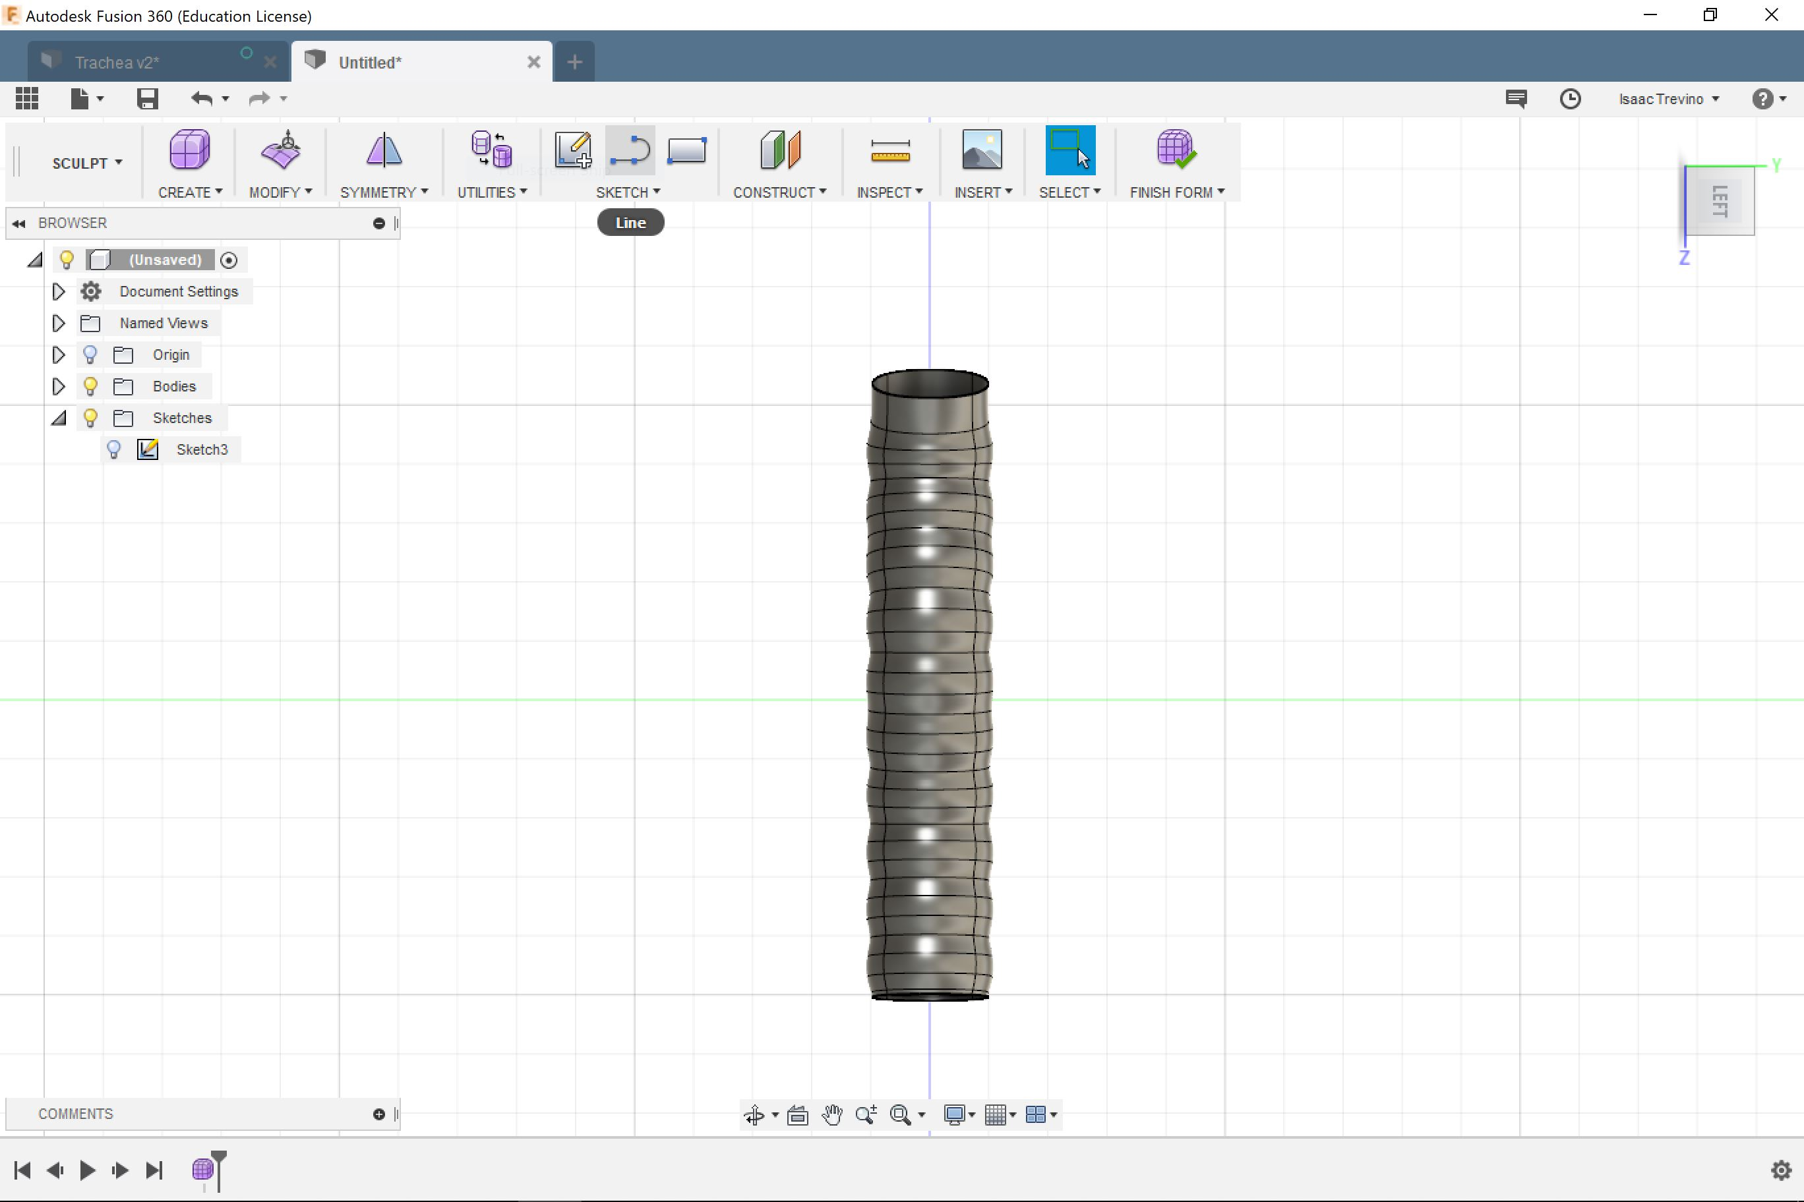
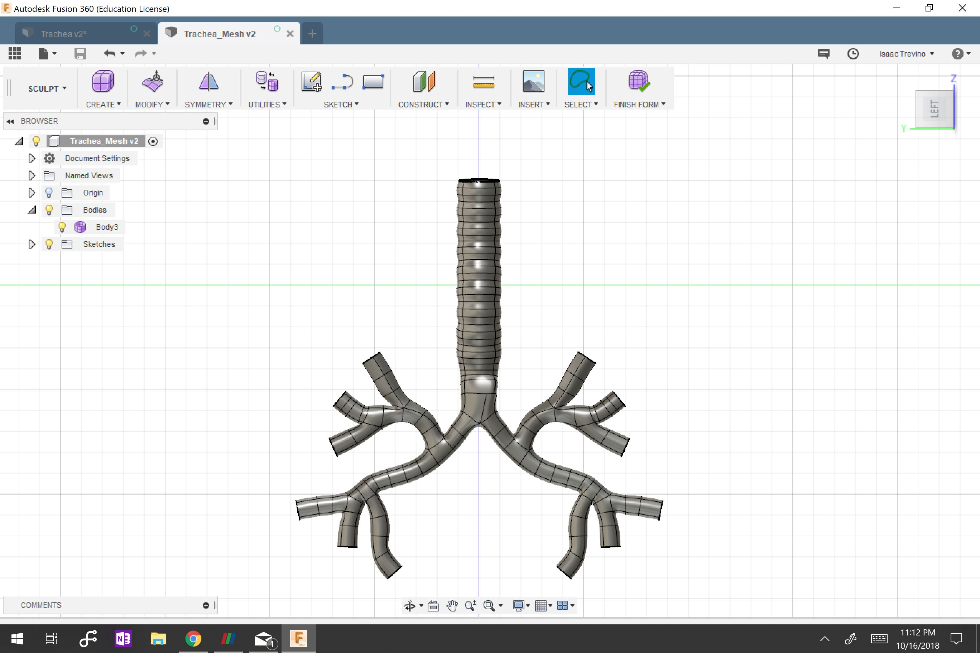
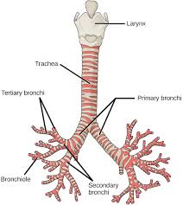
Human Trachea using Fusion 360
Using Autodesk Fusion 360 we were able to develop a cad model that appears as a Trachea as well as the Bronchus Stem.
Developing the Lungs and Larynx would be ideal for a proper breathing simulation

Slide 6
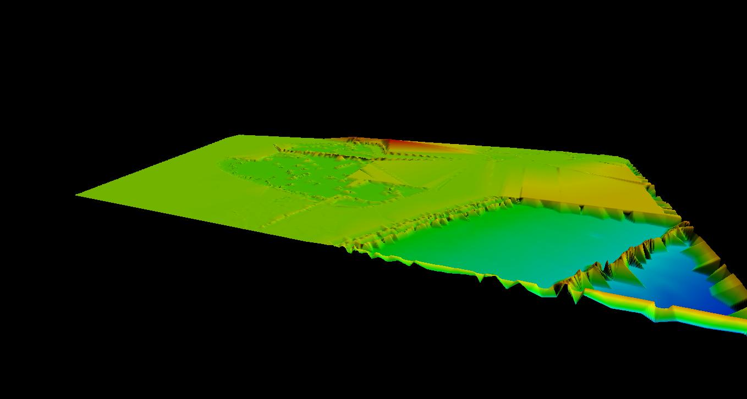
Bathymetric Data of Gulf of Mexico
Using GlobalMapper we are able to produce a 3D image of the Sea Bed of the Gulf of Mexico.
However there where computation errors when converting to Paraview thus needs to be fixed prior to conversion

Slide 7
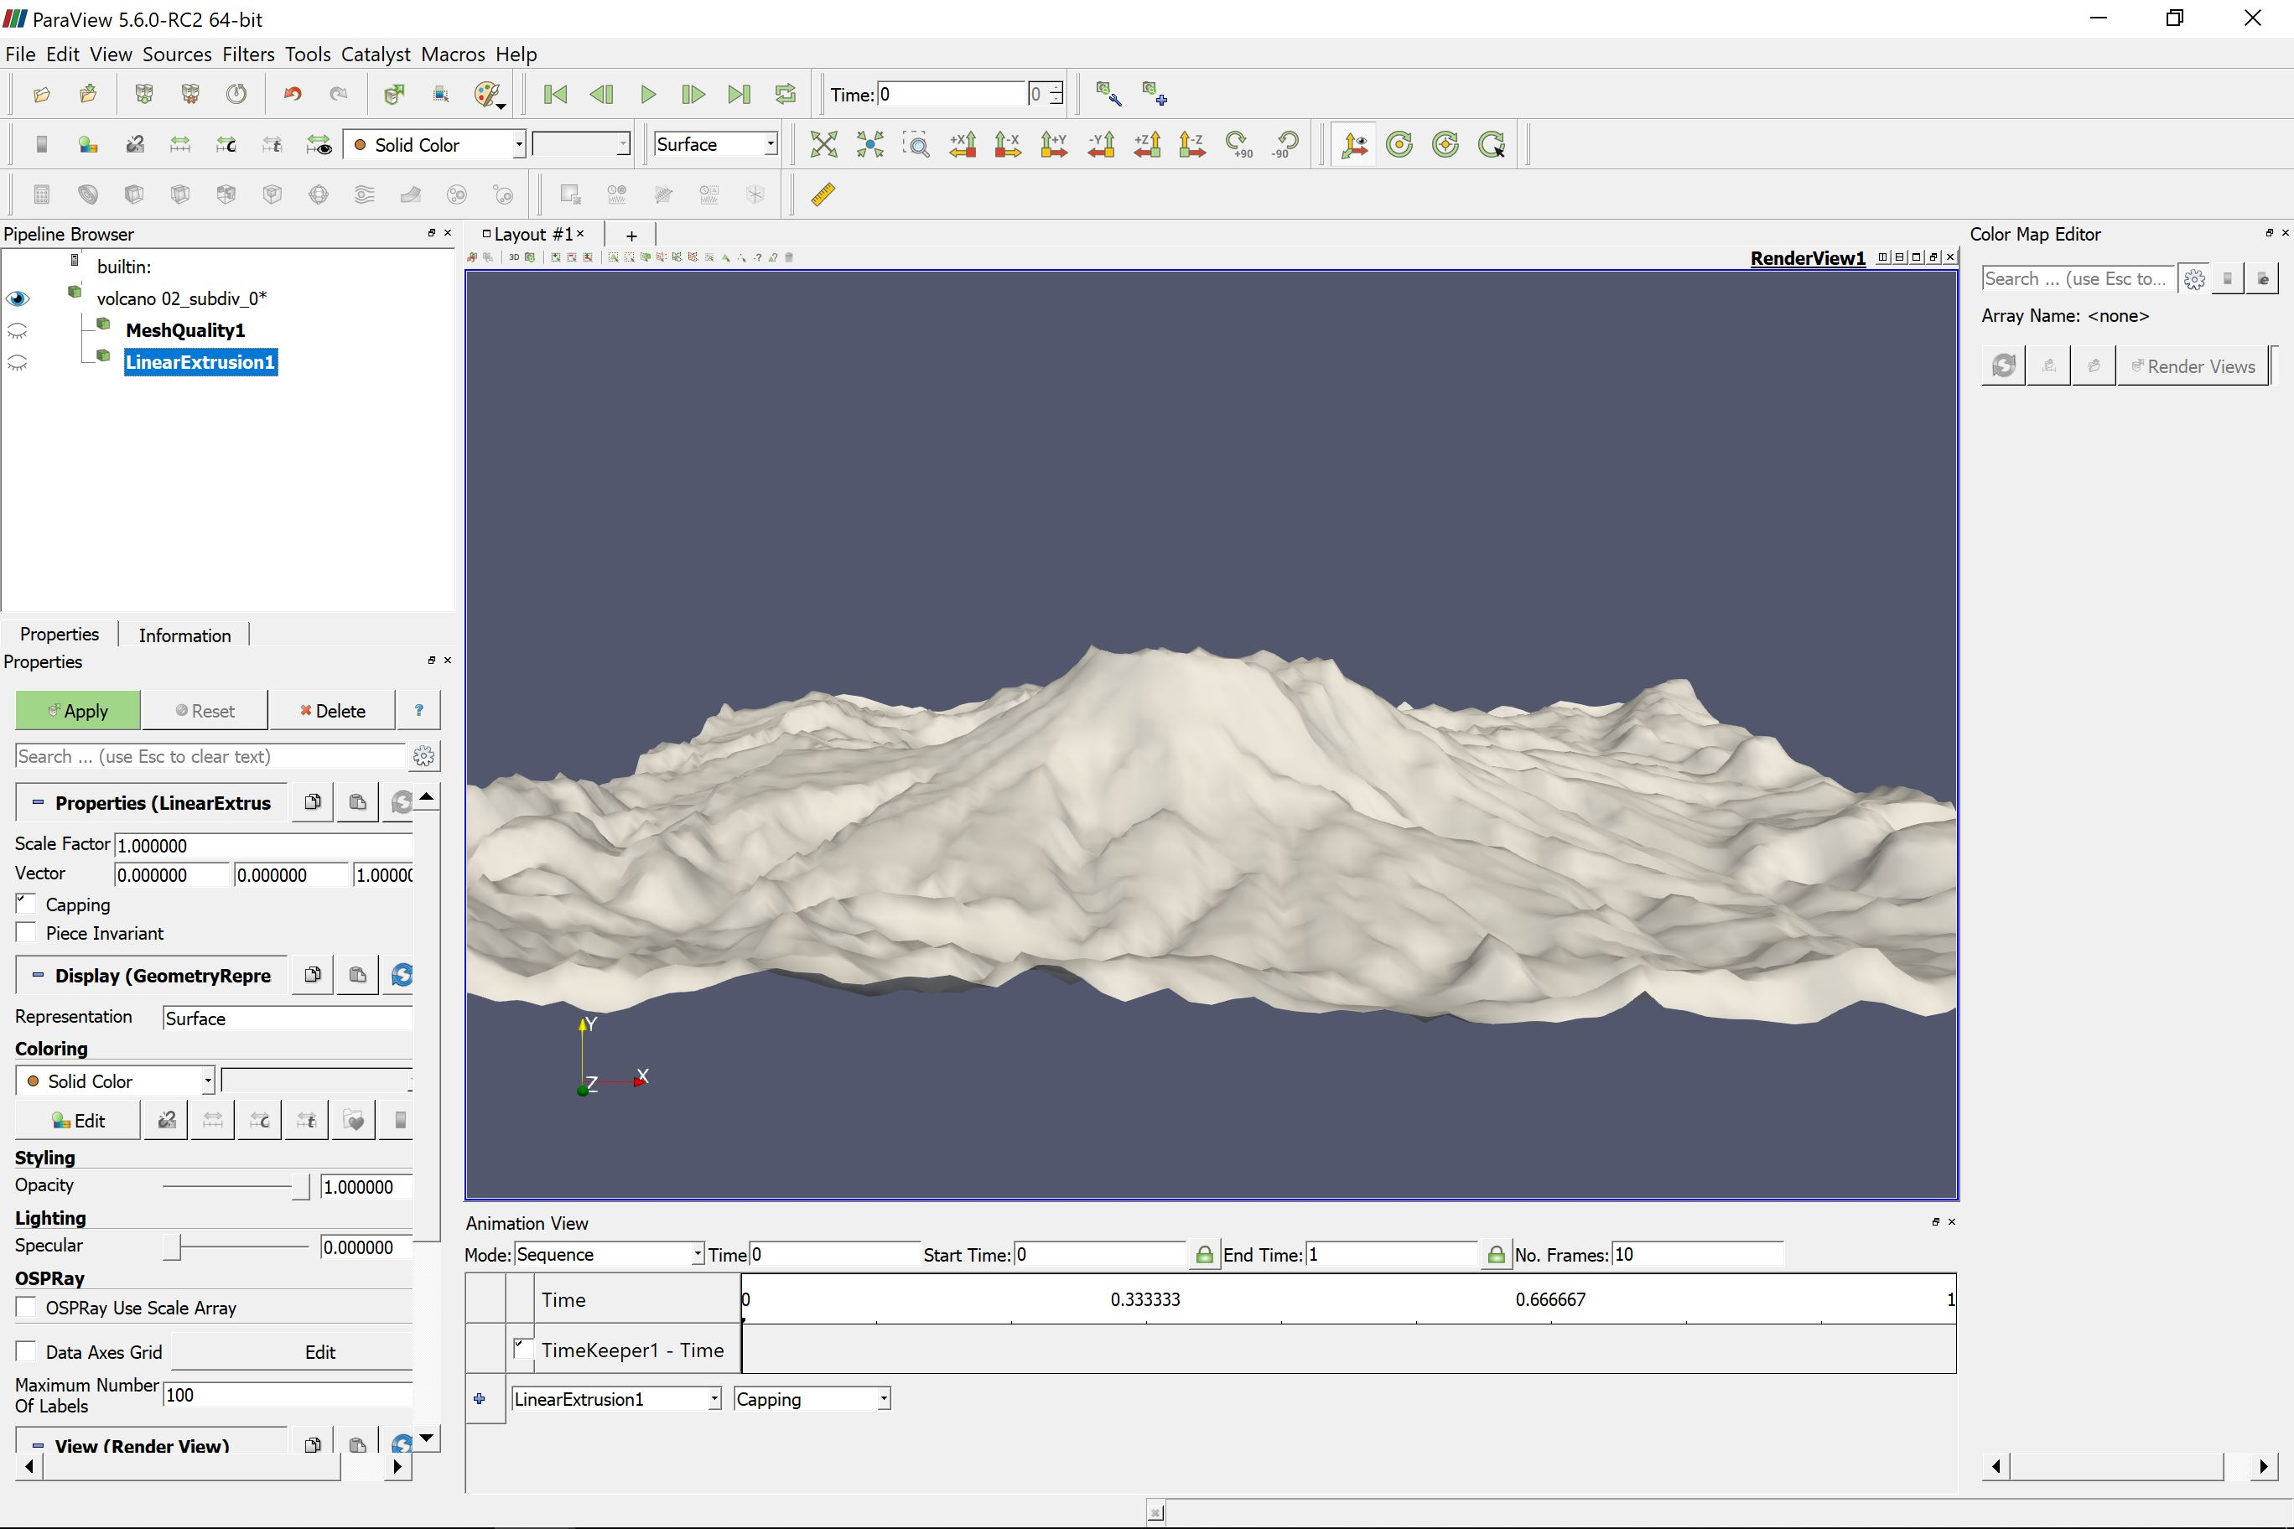
Extinct Volcano

Slide 8
Conclusion
Using ParaView has given insight on how much more of scientific visualization can be analyzed and viewed.
The progress of 3D visualization could be even more enhanced using Augmented Reality Products.
The Potential of viewing your product or project on a scale that allows you to develop more of a precise CAD design.

