Slide 1





Team Sus-tainbility
Team Members:
Teja Gandi
Isaac Trevino
Kishore Giddaluru
Michael Joy

Slide 2

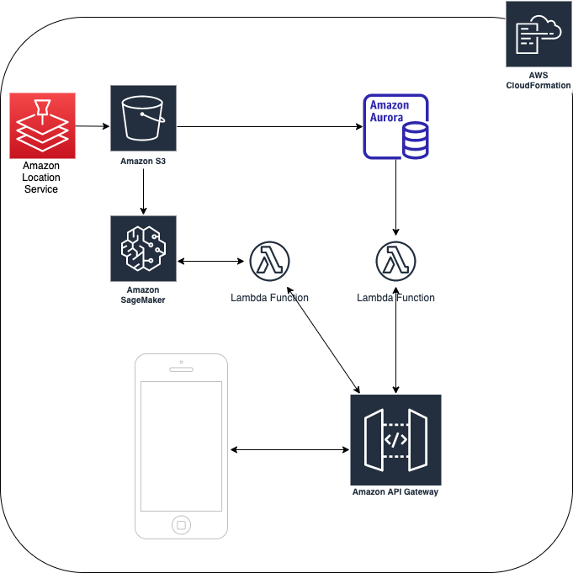
Architecture

Slide 3

Impact Environmental Sustainability
New York State
Recycle Waste across New York State.
Global
Water consumption by Country and Population.
Predictive analysis by Air Pollutant Type.

Slide 4

Impact Economic Sustainability
Waste Economical Revenue
Customer Revenue undervalues the profit of recyclable composite waste.
Global Water Consumption
Trend Analysis outlines areas that have lack of water displaying possible relocation outcomes.
Carbon Emissions
Areas to place CO2 capturing facilities, producing a clean and productive environment for inhabitants.
Notes:
I work in waste management*************

Slide 5

Impact Social Sustainability
Waste Recycling
Reducing the size of landfills would benefit the overall air pollutions involved decomposition.
Water Consumption
Determining water limits for excess water-use countries.
Air Emissions
Predicting long term air pollutants within a nation.

Slide 6

Innovation
Have a forecast predictability model via UI Solution
1
Have pollution analysis displayed real time on UI by Country
2
Have population water consumption data correlating to air emissions by country
3

Slide 7

Data Usage
Air Emissions Data
Water Pollutant Data
Waste Management Data

Slide 8
Application Link
https://video-codegreen.s3.amazonaws.com/Hackathon2019+-+Google+Chrome+2021-11-29+17-10-28.mp4

Slide 9
Questions?

