Slide 1
HPML Final Project · Spring 2026
Multi-objective Model Rotations for Analog In-Memory Compute
Reduced perplexity by 36.2% via custom trained weight rotations in AIMC inference compared to baseline
Team 12
David Wang · DZW2109
William Trost · WIT2102
Alvis Ou · AO2844
GitHub: https://github.com/IsaacTrost/AnalogWeightRotations
Tracking: https://wandb.ai/ao2844-columbia-university/aimc-rotations/
Dr. Kaoutar El Maghraoui · Columbia University · Week of May 4, 2026

Slide 2
Motivation & Problem
Why this matters
Problem statement
AIMC benefit: LLM inference is dominated by large matrix multiplications and bottlenecked by data transfer .Analog in-memory compute (AIMC) performs matrix multiply–accumulates inside memory arrays, greatly reducing data movement and accelerating LLM inference.
Practical challenge: On real analog tiles, physical non-idealities (IR drop across wires, device conductance noise, ADC/DAC quantization and PCM programming noise) distort outputs and degrade model quality.
Opportunity: Orthogonal rotations (SpinQuant, which we reference) re-distribute activation energy across rows/columns and can reduce outliers and sensitivity to these non-idealities.
Why it matters for LLMs: Small per-layer reductions in analog error translate to large end-to-end perplexity / accuracy improvements for deployed LLM inference.
Goal: Recover perplexity to near-baseline fp32 levels in the presence of analog-non idealities on tinyllama
HPML · Spring 2026
2 / 14

Slide 3
Technical Approach — Model & Data
Model
Dataset
Hardware
TinyLlama/TinyLlama-v1.1
wikitext-2-raw-v1
Train
36,718 texts 81.9%
Validation 3,760 texts 8.4%
Test 4,358 texts ~9.7%
Total 44,836 texts 100%
Primarily trained on Nvidia T4, some work was done on 3090 and Grace-Hopper
AIHWKIT/Pytorch running on CUDA was used for validation runs, pytorch running CUDA alone used for most training runs
HPML · Spring 2026
3 / 14

Slide 4
Technical Approach — Analog non-idealities
IR-drop
Quantization
The wires between crossbar tiles have resistance, meaning that signals that have to travel further lose more signal integrity (further from input and outputs)
ADC’s and DAC’s quantize inputs when creating analog signals, and quantize and clamp outputs when when reading analog signals. This works subtly differently from how digital quantization works
DAC
DAC
DAC
DAC
ADC
ADC
ADC
ADC
HPML · Spring 2026
3 / 14

Slide 5
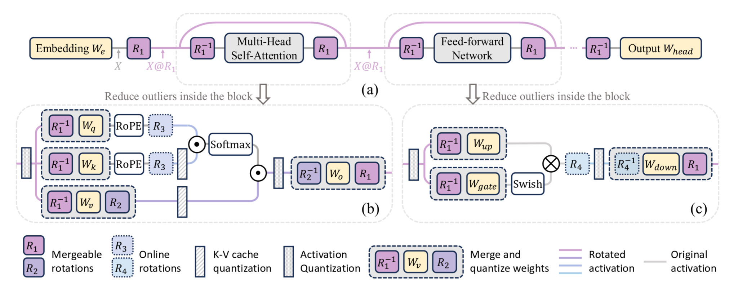
Technical Approach — Spinquant motivation
Core idea: y=Wx = WR⁻¹Rx where W is the weight matrix and R is the rotation matrix. Since R will be orthogonal, R⁻¹ will just be R^{T.}
Liu et al. (2024)

Slide 6
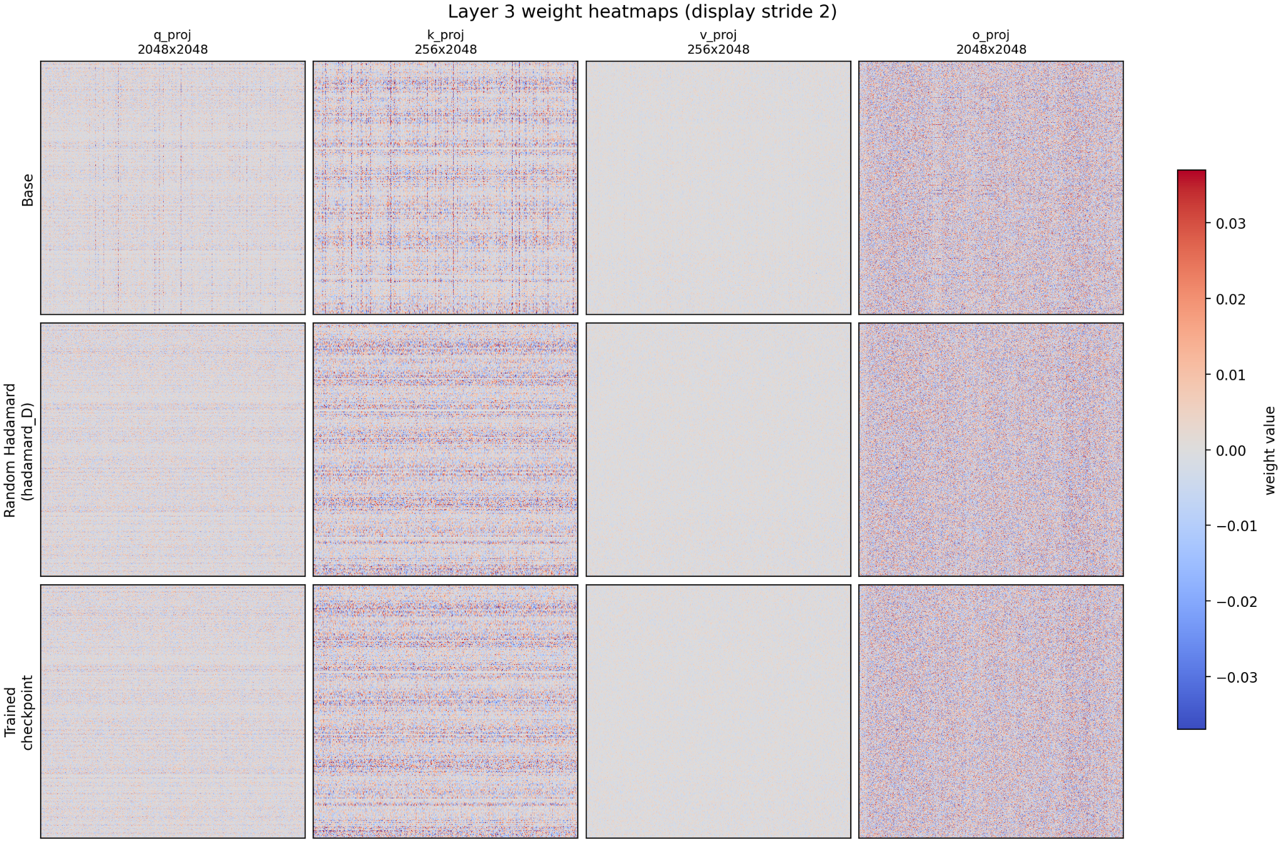
Technical Approach - Effects of the rotations
Core idea: We reduce the number of outliers and transform weight values to a more even distribution to mitigate quantization error
Liu et al. (2024)

Slide 7
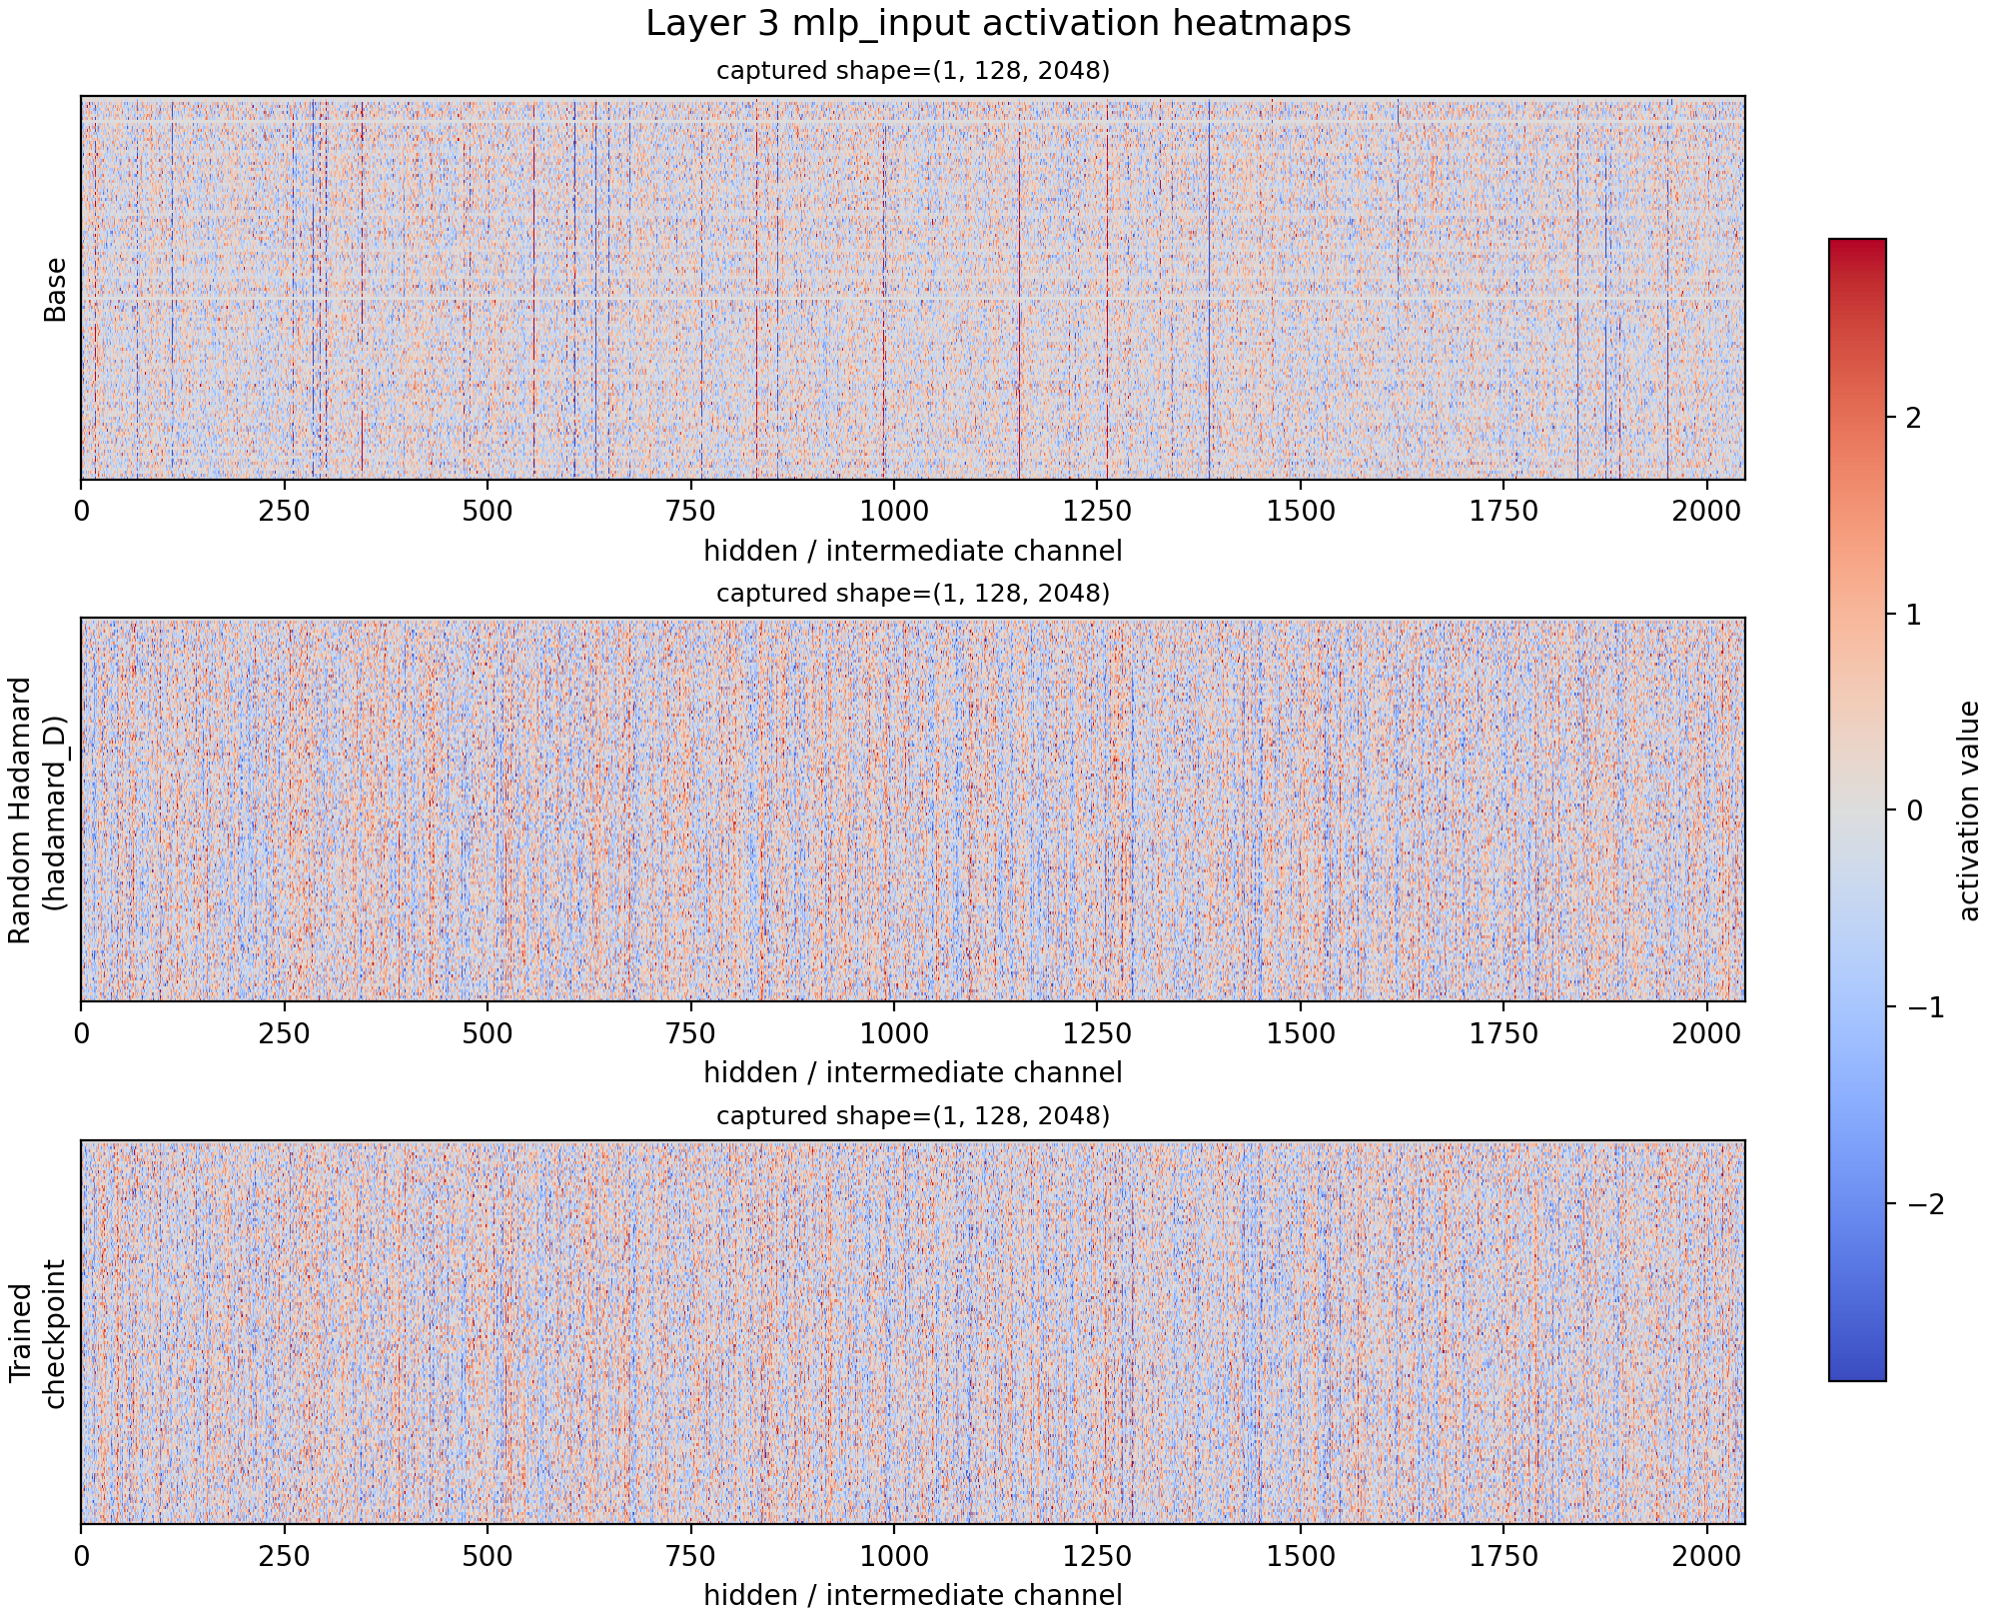
Technical Approach - Effects of the rotations

Slide 8
Technical Approach — Optimizations Applied
1.
Random hadamard rotations to weight matrices
Spreads out energy of weight matrix, reducing outliers and ensuring tighter range for better quantization in ADC,DAC and less extreme IR drop effects.
2.
Analog trained Rotations to weight matrices
Improve on random matrices by introducing rotation matrices trained in analog environments to better capture and counteract analog non idealities’ effects on weights..
3.
Online Rotations(R3,R4) in places where we can’t do offline rotations
Reduces analog effects on input activations in addition to weights via random hadamard rotations to further spread out energy and reduce outliers.
HPML · Spring 2026
4 / 14

Slide 9
Results — Headline Numbers
36.2%
Lower Perplexity
When evaluated on the wikitext dataset with reasonable hardware configs
All measurements averaged over 3 runs on nvidia T4
HPML · Spring 2026
6 / 14

Slide 10
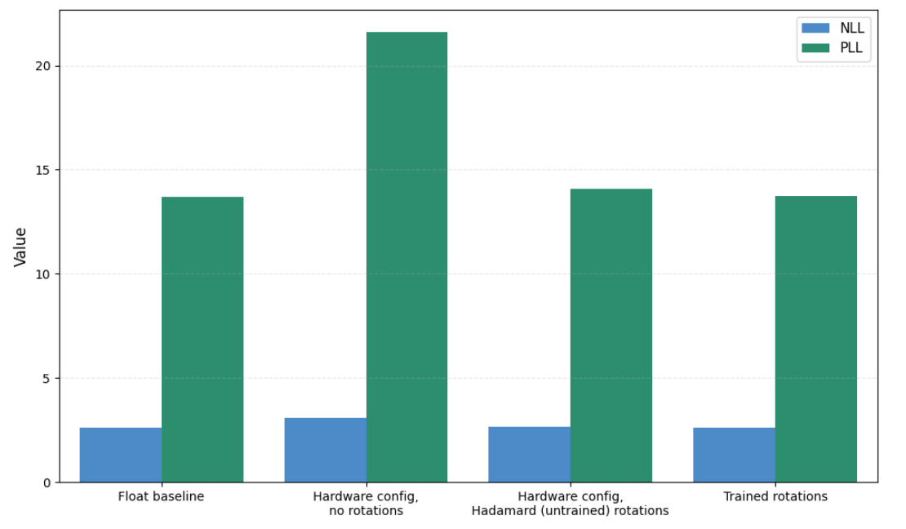
Results — Before vs. After (Ir drop = 2, 6 bit quantization)
Config | nll | ppl
Float baseline | 2.616288 | 13.6848
Hardware config, no rotations | 3.072571 | 21.5974
Hardware config, Hadamard (untrained) rotations | 2.645755 | 14.0941
trained rotations | 2.619262 | 13.7256
Takeaway
Online matrices add miner computational complexity, and contribute only 5% of the 36% improvement
HPML · Spring 2026
7 / 14

Slide 11
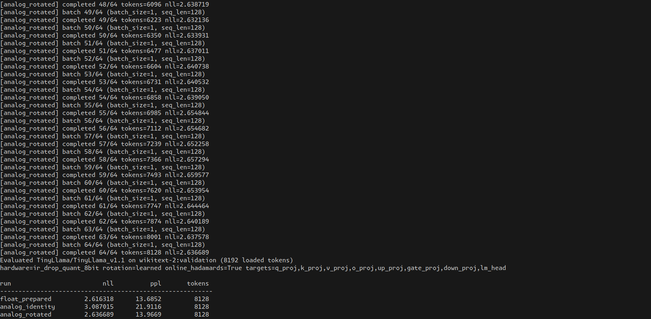
Demo / Visualization
[ Demo / GIF / Screen recording / Live notebook ]
Have a fallback static image in case live demo fails
Pre-load any models or data — do not wait for downloads on stage
Narrate what to look at while it runs
HPML · Spring 2026
9 / 14

Slide 12
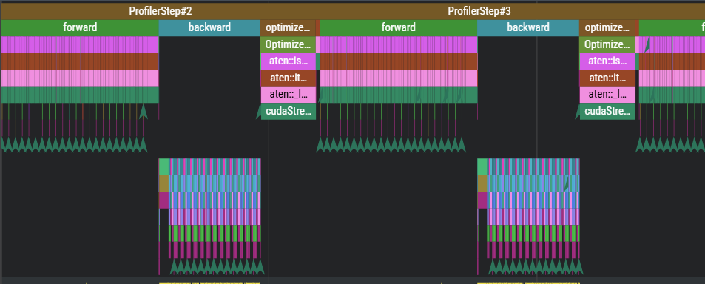
Profiler Evidence with PyTorch Profiler
What to point at
Rotation learning adds negligible runtime overhead relative to transformer compute.
The method integrates into standard training pipelines without introducing new computational bottlenecks.
Because runtime is dominated by GEMMs, any improvement in numerical stability of these operations (via rotation) directly translates to hardware robustness without changing computational structure.
Bottom line: our method is cheap, scalable, and correctly targeted at the dominant compute path
Operation | % of CUDA time
aten::mm | ~99%
backward GEMM | ~48%
forward GEMM | ~49%
optimizer | ~2%
HPML · Spring 2026
8 / 14
Notes:
For this class, profiling is often used to show speedups from optimization.In our case, we use profiling a bit differently — not to speed up the system, but to validate that our method doesn’t introduce new computational bottlenecks, because our goal is improving analog robustness without changing the underlying compute.
This is a Perfetto trace of our training loop. Each block corresponds to a training step — forward pass, backward pass, and optimizer step.
You can see that this pattern is very consistent across steps, which tells us the system is stable and not doing anything unexpected.
The more important takeaway is summarized in this table.
Nearly all of the GPU time — about 99% — is spent in matrix multiplications.
Forward and backward passes each take about half, and the optimizer is only about 2%.
This tells us that our rotation learning is not the bottleneck — the cost is dominated by standard transformer compute. So from a systems perspective, our method integrates into existing pipelines without adding meaningful overhead.
And importantly, since analog errors occur inside these matrix multiplications, optimizing the structure of those operations via rotation directly targets the dominant compute path

Slide 13
Lessons Learned
What worked
What didn't work
Rotation effect: Random and structured orthogonal rotations improve analog-layer fidelity beyond simple quantization fixes (reduced rel‑L2 error, higher SNR).
Training recovery after tooling fix: Training was initially failing because the analog path broke the autograd chain; switching to a custom torch-backed analog tile restored an effective training signal.
Practical engineering fixes: Reworked AIHWKit mapping (avoid default 512×512 fragmentation) and applied CPU-paging / single-tile mapping which kept experiments runnable on limited hardware.
Debuggability & memory fragility: AIHWKit’s C++ backend caused opaque memory growth and subtle inference/training failures that were time-consuming to diagnose.
Hyperparameter sensitivity: Rotation training (learning rates, batch subsampling, auxiliary-loss weights) required extensive tuning; many settings felt like “shot in the dark.”
HPML · Spring 2026
10 / 14
Notes:
The biggest positive result was that rotations consistently improved analog-layer fidelity.
Second thing that worked was, when training completely failed because the AIHWKit analog path broke autograd, we fixed this by implementing a differentiable, torch-based analog simulation, which restored a usable training signal.
We also had to rework how AIHWKit maps weights to tiles — avoiding fragmentation and enabling CPU offloading.
These changes made experiments feasible on limited hardware like ours.
AIHWKit’s C++ backend made debugging difficult — we saw opaque memory issues and subtle failures that were hard to trace.
Rotation training turned out to be very sensitive to hyperparameters — learning rates, sampling, and loss weights. A lot of tuning felt exploratory rather than principled.
So overall, while the method is promising, making it robust and reproducible requires careful engineering.

Slide 14
Next Steps
Test against more analog configurations and non-idealities besides IR drop and ADC/DAC quantization
Run modified LLM on a real IBM analog in memory compute tile
Validate findings on larger, real world models
HPML · Spring 2026
11 / 14
Notes:
So far we focused on IR drop and quantization, but real analog hardware has many more non-idealities. Extending to noise, drift, and device variability is a natural next step.
Ultimately, simulation isn’t enough — we’d like to validate these rotations on an actual IBM analog in-memory compute tile.
We also want to test whether these improvements scale to larger, real-world models. Right now we’re limited by hardware, so this is an important validation step.
The key question going forward is whether these rotation-based improvements persist at scale and under more realistic hardware conditions.

Slide 15
Teamwork & Contributions
Member | Primary contributions | Tools / artifacts (if not listed, assume shared work)
William Trost | Evaluation and plotting, checking and debugging analog conversion and rotation code. | src/train_full_analog.py, src/eval_analog_perplexity.py
Alvis Ou | Hardware-config refactor, shared analog conversion utilities, profiling hooks and config centralization. | src/hardware_configs.py
David Wang | Model forward pass, rotation utilities, groundwork for analog rotation, pass and training | src/full_model_pipeline.py src/rotation_utils.py, src/llama_prepare, src/llama_model…
Collaboration: regular weekly meetings with IBM mentors as well as in-person team meetings, shared iMessage group chat, separate branches and code review/discussion on major changes. Much of the programming was done live, pair-programming
HPML · Spring 2026
12 / 14

Slide 16
Thank you
Special thanks to Charles Mackin and Akul Malhotra from IBM for mentoring this project
Questions?
GitHub: https://github.com/IsaacTrost/AnalogWeightRotations
Tracking: https://wandb.ai/ao2844-columbia-university/aimc-rotations/
HPML · Spring 2026
13 / 14

Slide 17
Citations
Liu, Z., Zhao, C., Fedorov, I., Soran, B., Choudhary, D., Krishnamoorthi, R., Chandra, V., Tian, Y., & Blankevoort, T. (2024). SpinQuant: LLM quantization with learned rotations. arXiv.

