Slide 1
COMP 9154
Ass2

Slide 2
Overview
Concurrency structure of Dart
Byzantine problem
Discussion

Slide 3

Language

Slide 4
Concurrency structure
Isolate
Event loop

Slide 5
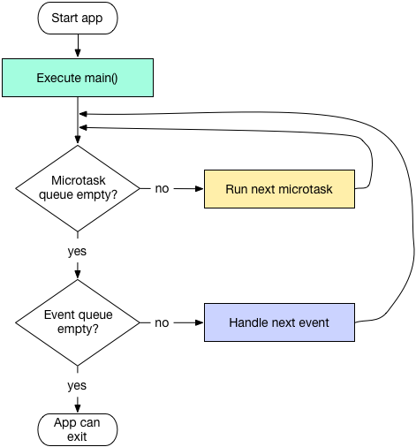
Event loop
Microtask
Event

Slide 6
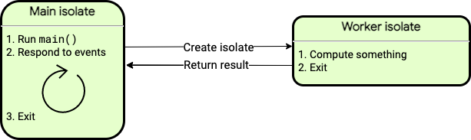
Isolation

Slide 7
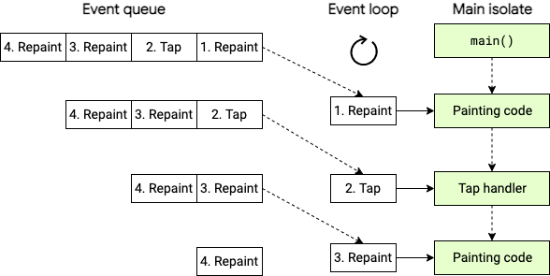
Concurrency structure

