Slide 1
COMP 9154
Ass2

Slide 2
Overview
Concurrency structure of Dart
Byzantine problem
Discussion

Slide 3

Language

Slide 4
Concurrency structure
Isolate
Event loop

Slide 5
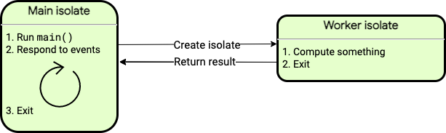
Isolate
Isolated version of Thread:
No shared memory

Slide 6
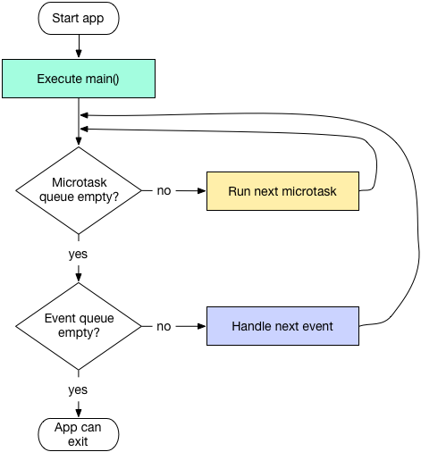
Event loop
Microtask
Event

Slide 7
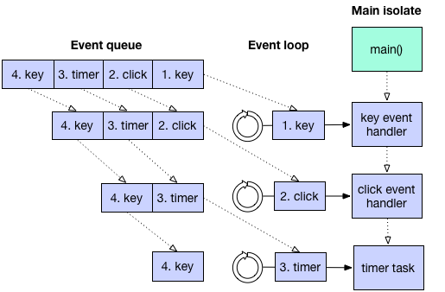
Concurrency structure

Slide 8
Other schemes
Future
async
await

Slide 9
Other schemes
Future<Type> variable

Slide 10
Other schemes
async
await

Slide 11
Conclusion & Discussion
Great usability
Pro & cons of isolate

