Slide 1
Project Topic: University Campus network
Group number yyy
Executives: Student 1, 2, 3
Architects: Students 4, 5, 6
Engineers: Student 7, 8, 9

Slide 2
Business Model Canvas
Key Partners
Government
NICTA (research)
Alumni
Community
Industry
“Service Providers” e.g. banks, cafe
Key Activities
Teaching
Course development
Research
Student Services (e.g. gym/dorm)
Value Proposition
Status (#46 world wide)
Ground breaking research (robotics)
High graduate starting salary
Campus “experience”
Relationships
Direct
Self service
Customers
School leavers
Overseas
Mature Age
Short course (bridging)
Key Resources
Real Estate campus
Staff
$$$
Channel
Distance education
Campus
Social Media
Cost Structure
Staff $760M
NonStaff $470M (water $650k, energy $4.3M 2004 KENS)
Revenue Streams
Teaching $744M
Research $348M
Other $195M
Notes:
From:

Slide 3
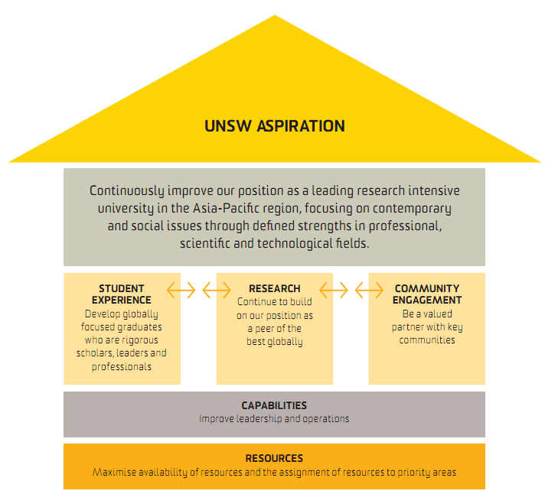
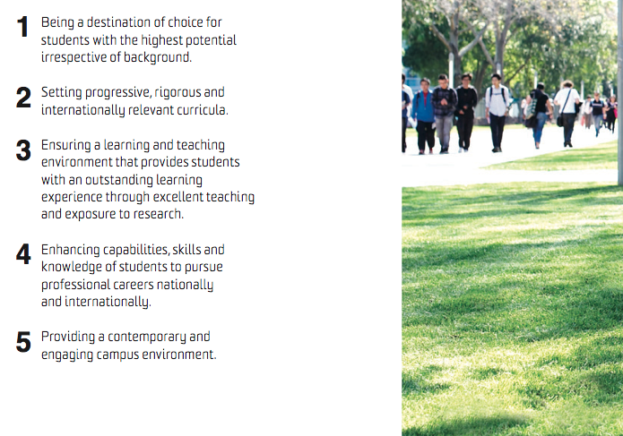
UNSW Aspirations, Objective and Strategies

Slide 4








University Example
V
Be the leading research intensive University in the APAC region, providing a unique student campus experience
G
Improve student satisfaction by 10% each year
Increase research funding by 8% pa
Operational efficiency:
Reduce operational costs 2% pa
R
Physical Safety on Campus
Power Management
Seamless Network
Video Communication
Virtualization
Digital Signage
Results
➲
Achieve #1 Market Share +
Meet financial goals
Notes:
Does DS belong to one goal or two?

Slide 5
Mapping Requirements to Goals
Goals | Requirements
G1. Improve Student Satisfaction by 10% | R1.1 Seamless Network (wired + wifi)
 | R1.2 Physical Safety on Campus
 | R1.3 Digital Signage
G2 Operational Efficiency by 2% | R2.1 Power/Energy Management
 | R2.2 Virtualization of IT services
 | R2.3 Digital Signage
 | R2.4 Video Communication
G3. Research by 8% | R3.1 Video Communication
 | R3.2 Virtualized IT services (shared)

Slide 6
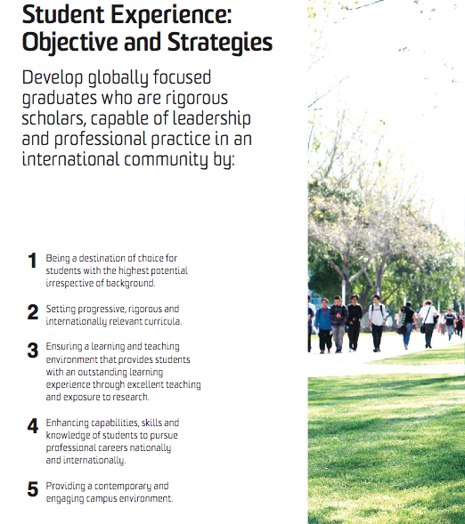
Students: Strategies and Objectives
“Ensuring a learning and teaching environment that provides students with an outstanding learning experience through excellent teaching and exposure to research.”
“Providing a contemporary and engaging campus environment.”
What (networking) capabilities might be required?

