Slide 1
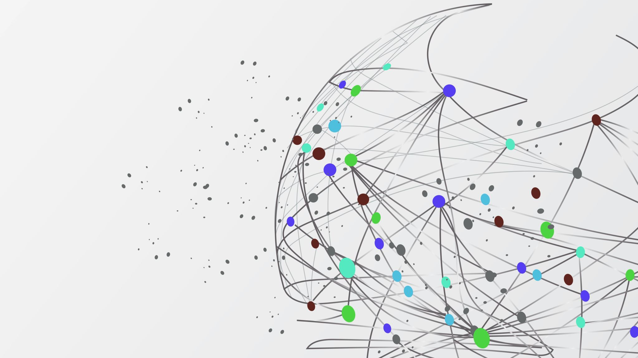
Multivariate Time Series Forecasting & Anomaly Detection
Isaac Burmingham

Slide 2
Research Question
Our daily lives are surrounded by environments driven by time. How can we predict what happens next and use that information to identify anomalous events?

Slide 3
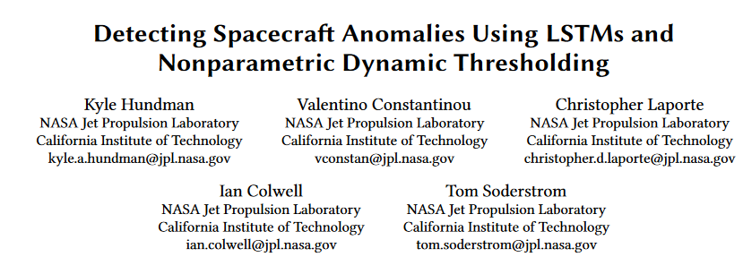
Research Paper – NASA JPL
  The motivation for this problem arose from this paper written by NASA JPL, where they introduced a new anomaly detection method on univariate time series data
  Aimed to improve, adapt and test robustness of methods introduced

Slide 4
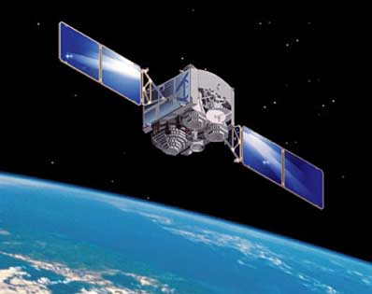
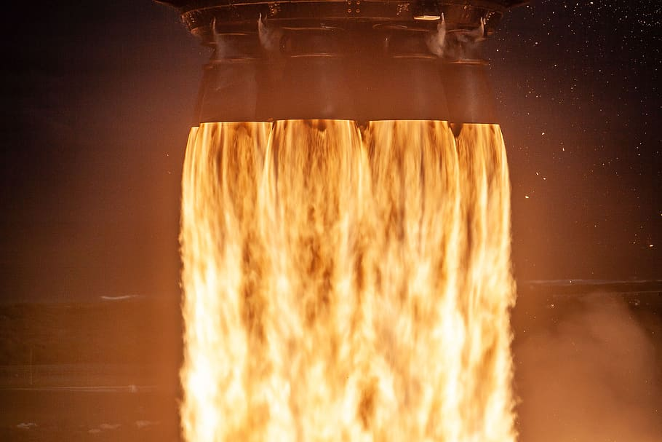


Data Description
4 Multivariate Time Series datasets across multiple industries
  LASP Satellite data (4 inputs, 4 outputs)
  Simulated Rocket thruster data (2 inputs, 2 outputs)
  Energy Consumption by Household Appliances data (27 inputs, 1 output)
  Household Power consumption with Weather data (13 inputs, 1 output)

Slide 5
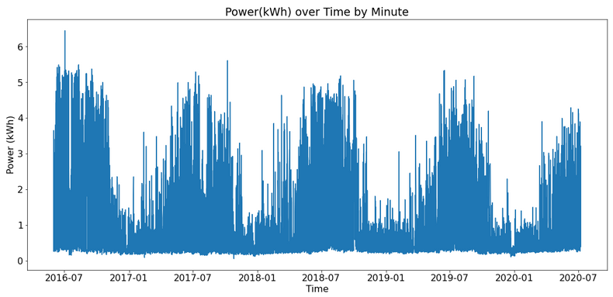

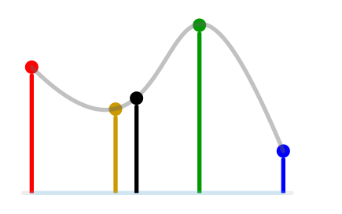
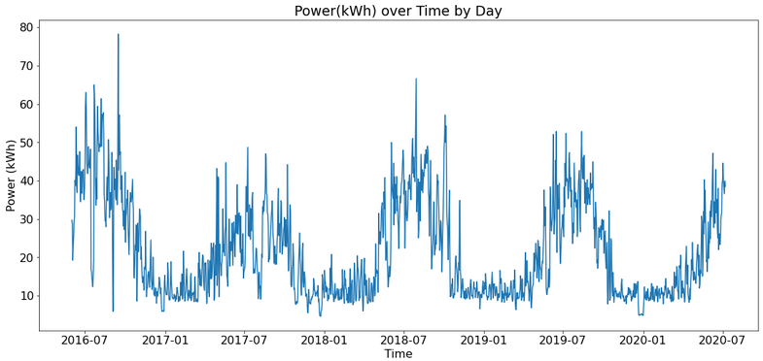
Data Preparation
Resampling
Data Wrangling
Imputation
Notes:
Data Wrangling – datasets had to be reformatted from original data files or merged for desired data output.
Resampling (frequency conversion) – Some data had to be resampled to reduce timestep. Frequency conversion – converting steps from 5 min to 1H
Imputation - Nulls were managed by either cubic interpolation where appropriate or dropped. Cubic chosen bc it is the simplest method that offers true continuity between segments. Linear
Feature Interaction – Checked correlation with time. Checked correlation matrices (with target). The feature interactions are important to keep to help the model produce better predictions (what univariate predictions lack in a non-stable environment)

Slide 6
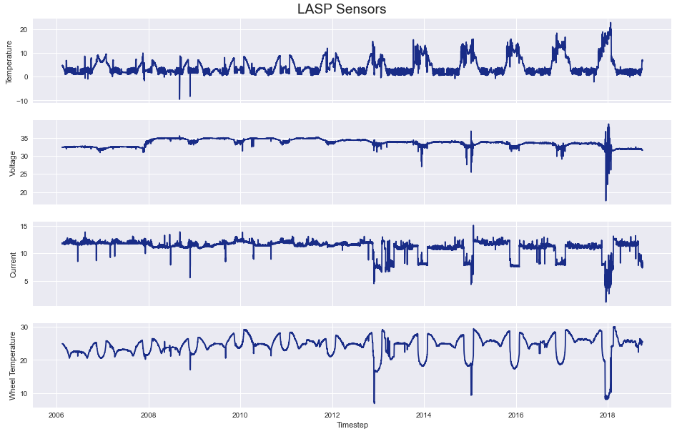
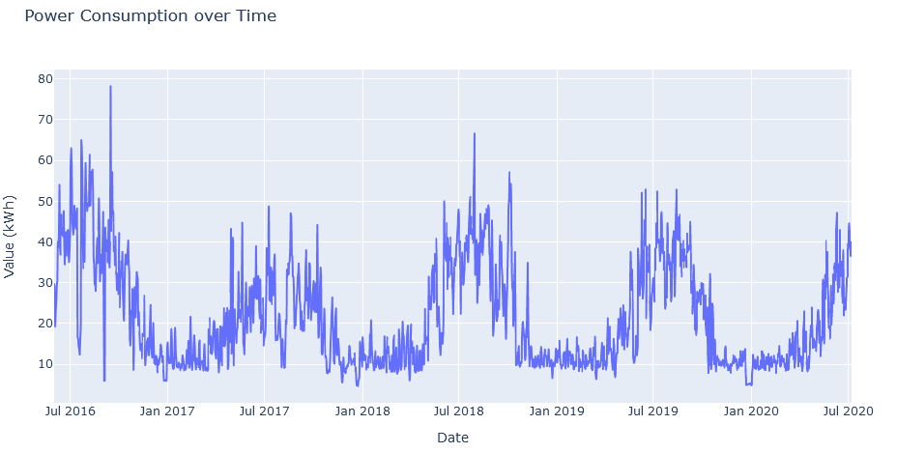
Data Exploration

Slide 7
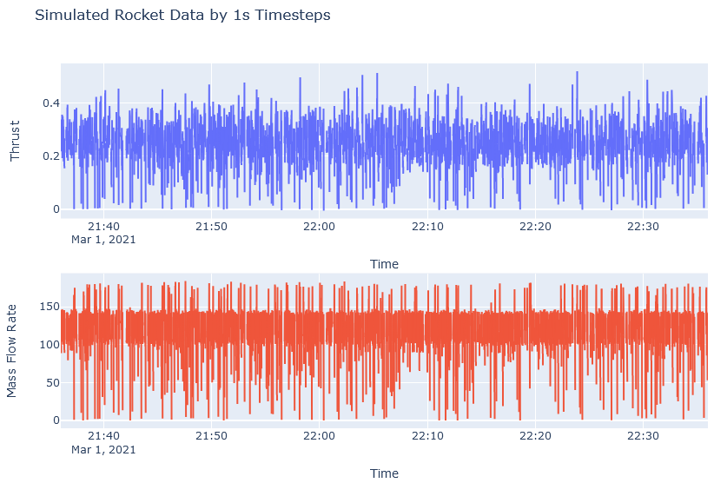
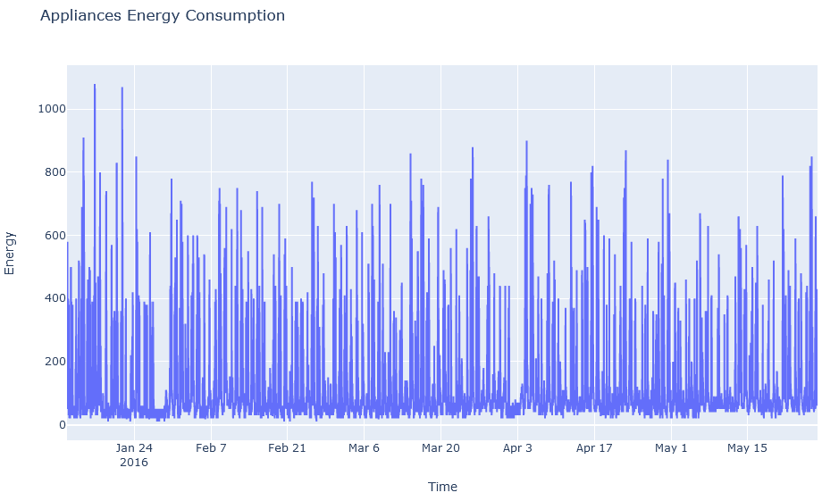
Data Exploration

Slide 8
Time Series Forecasting
Time Series Generators
t1
t2
t3
t4
t5
tn
t1
t2
t3
t4
t5
t6
t7
tn
Vanilla LSTM Model
LSTM Hidden Layer
Output Layer
Input Layer
Dropout
Notes:
Early Stopping also to mitigate overfitting

Slide 9
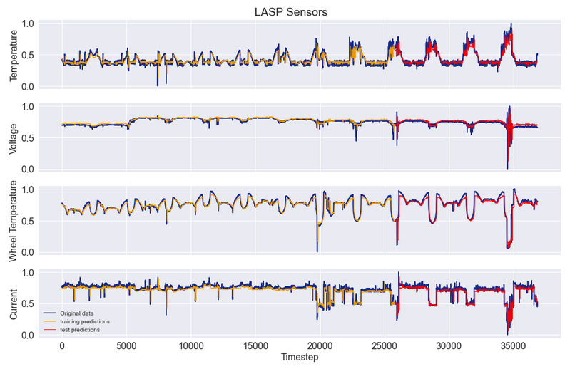
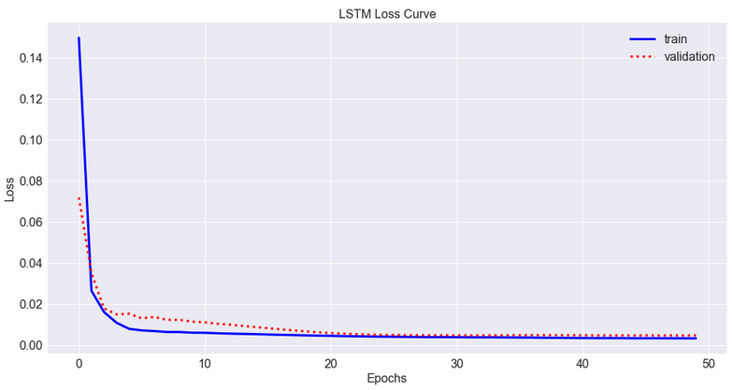
Model Evaluation
Notes:
LOSS – Error on the dataset
Plot of training decreases to a point of stability
Plot of validation loss decreases to a point of stability
The generalization gap is zero
Why is Training loss higher than validation?
Regularization dropout was applied to train, not validation/test set.
Training loss is measured during each epoch, validation loss is measured after the epoch
Validation set is too easy (could be too small)

Slide 10
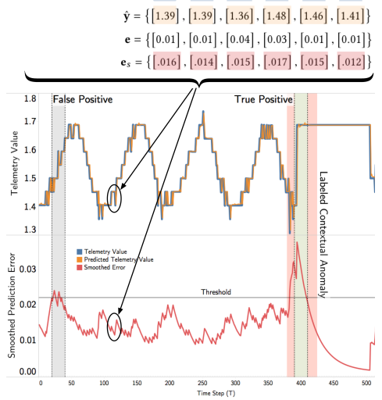
Anomaly Detection Theory
Nonparametric Dynamic Thresholding
The threshold is calculated by determining if all the values above the said threshold were removed, it would cause the greatest % decrease in the mean and standard deviation of the smoothed errors. This threshold value dynamically changes as the algorithm steps through each window of the time series data.
Source: NASA JPL
Notes:
Unsupervised method (no labeled data) and has no statistical assumptions about errors to detect outliers (Nonparametric)
Dynamic based on the window – each window calculates a new threshold. Typically the window was set to 70, so a new threshold was calculated every 70 steps

Slide 11
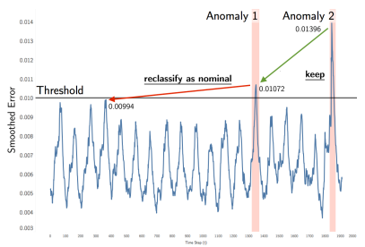
Anomaly Detection Theory
Pruning Process
False positives are mitigated through pruning anomalies, by calculating the minimum percent decrease and comparing to set parameter, p.
p=0.23
p=0.1
p=0.07
Source: NASA JPL

Slide 12
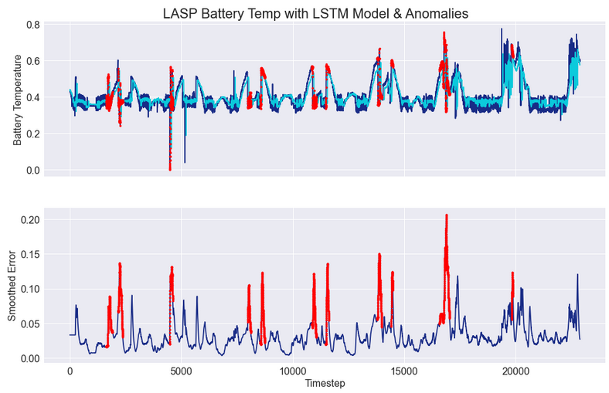
Anomaly Detection
Notes:
Predictions were fed through functions that calculated thresholds and identified anomalies

Slide 13
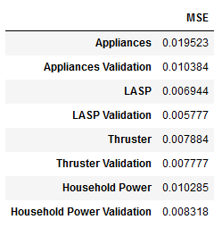
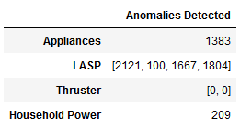
Results
Key Insights
LSTMs are an effective & robust time series prediction technique but did better on some datasets over others
NDT is effective in detecting anomalies across different industries, but further analysis should be done to assess its accuracy
LSTMs & NDT are effective techniques on multivariate time series data
Future Considerations & Limitations
Stronger hyperparameter tuning in NDT for robust parameter selection, such as the pruning parameter for better mitigation of false positives
Fine tuning of the LSTM model – prediction accuracy is critical to the successful of the anomaly detection portion
Limited in assessing accuracy by not having a dataset with pre-labeled anomalies
Notes:
Struggled a little bit with predicting the Appliances target – the predicted value was significantly underestimating throughout

Slide 14
References
[1] Hundman, Kyle and Constantinou, Valentino and Laporte, Christopher and Colwell, Ian and Soderstrom, Tom Detecting Spacecraft Anomalies Using LSTMs and Nonparametric Dynamic Thresholding 2018 https://github.com/khundman/telemanom
[2] Polson, Shawn Unsupervised Machine Learning for Spacecraft Anomaly Detection in WebTCAD June 7 2019 https://github.com/sapols/SatelliteTelemetry-Anomaly-Detection
[3] https://www.kaggle.com/srinuti/power-consumption-time-seriesanalysis/data
[4] https://archive.ics.uci.edu/ml/machine-learning-databases/00374/
[5] https://www.kaggle.com/sylar68/spacecraft-thruster-firing-test-dataset
[6] Jain, Vedant https://databricks.com/blog/2019/09/10/doing-multivariatetime-series-forecasting-with-recurrent-neural-networks.html
[7] Brownlee, Jason https://machinelearningmastery.com/diagnose-overfitting-underfitting-lstm-models/
[8] Narayanappa, Sada https://github.com/sada-narayanappa/NNBook
Notes:
Predictions were fed through functions that calculated thresholds and identified anomalies

Slide 15
Questions?

Slide 16
Backup

Slide 17
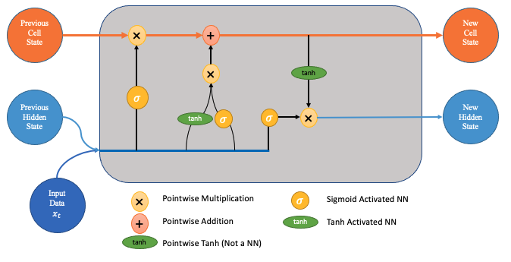
LSTMs
Forget Gate
Input Gate
Output Gate

