Slide 1
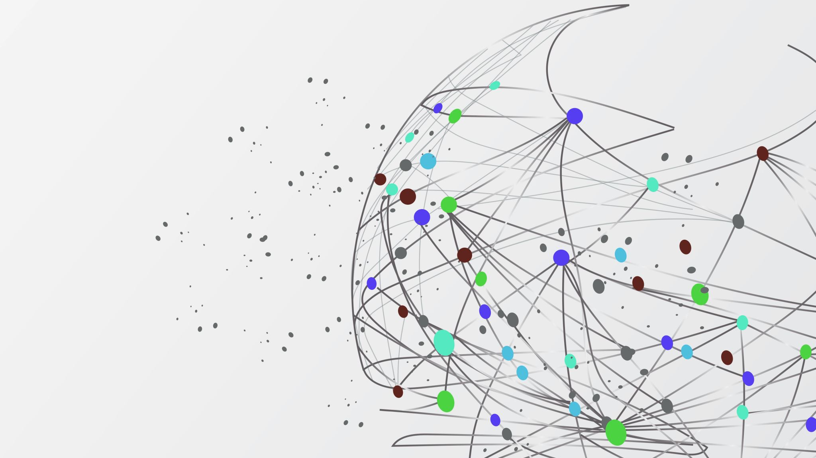
Anomaly Detection in Multivariate Time Series Data
Isaac Burmingham

Slide 2
Research Question
With the multitude of environments oriented around time that surround our daily lives, how can we efficiently predict values in advance to provide key insights?

Slide 3
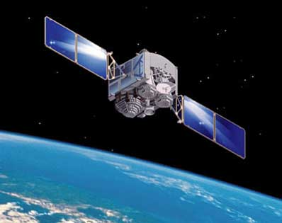
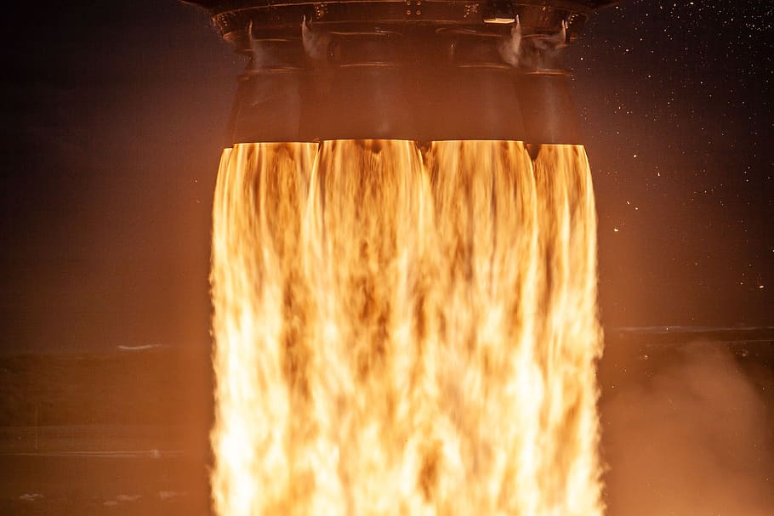


Data Description
4 Multivariate Time Series datasets across multiple industries
LASP Satellite data (4 inputs, 4 outputs)
Simulated Rocket thruster data (2 inputs, 2 outputs)
Household Appliances energy consumption data (27 inputs, 1 output)
Household Power consumption with Weather data (13 inputs, 1 output)

Slide 4
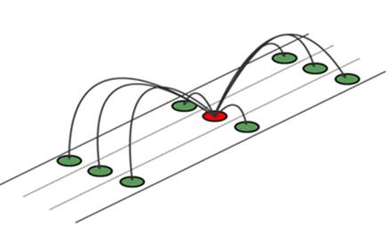
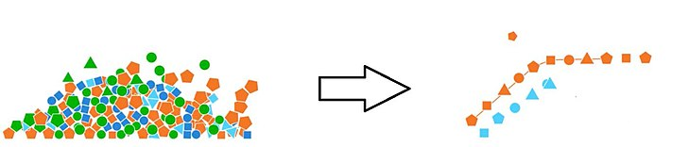
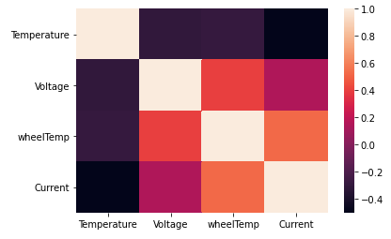
Data Exploration
Resampling & Imputation
Data Wrangling
Feature Interaction
Notes:
Data Wrangling – datasets had to be reformatted from original data files or merged together for desired data output
Feature Interaction – Checked correlation with time. Checked correlation matrices (with target). The feature interactions are important to keep to help the model produce better predictions (what univariate predictions lack in a non-stable environment)
Resampling & Imputation – Some data had to be resampled to reduce timestep. Nulls were managed by either linear interpolation where appropriate or dropped.

Slide 5
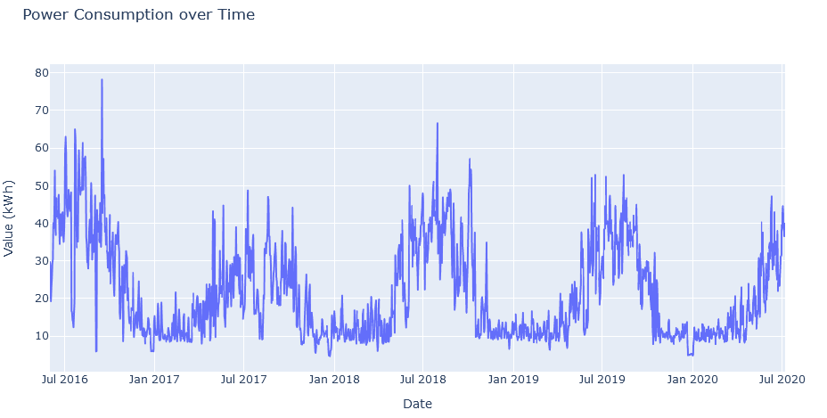
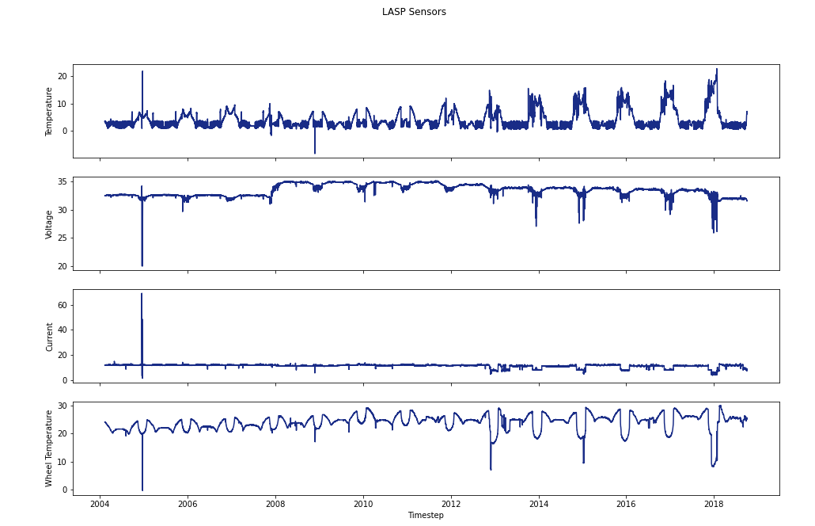
Data Exploration

Slide 6
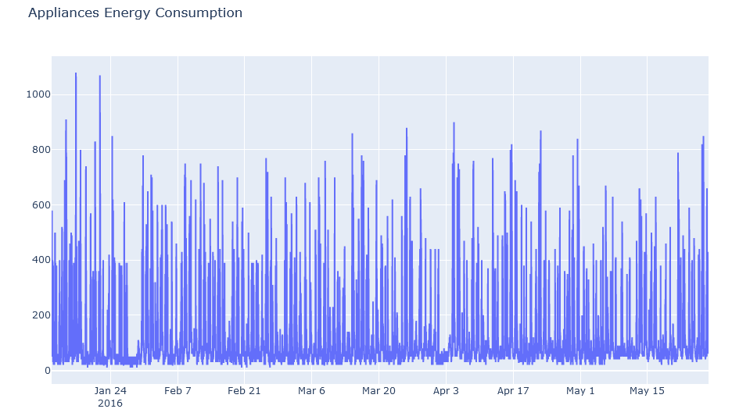
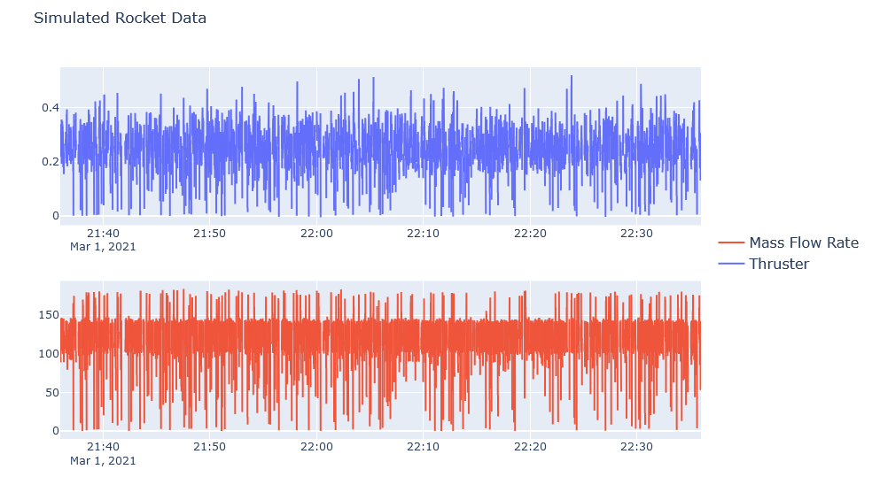
Data Exploration

Slide 7
Modeling
Vanilla LSTM model
Notes:
Struggled with overfitting/underfitting on some datasets more than others

Slide 8
Anomaly Detection
Nonparametric Dynamic Thresholding
Predictions were fed through functions that calculated thresholds and identified anomalies

Slide 9
Anomaly Detection Visualization
x

Slide 10
Key Insights
Results
Future Considerations
Stronger hyperparameter tuning in LSTM & NDT

Slide 11
Questions?
Notes:
Challenges in ADS today
Monitoring burden on Operational Engineers
Operational Risk
Expert Knowledge Required – manual analysis of visualizations and channel statistics
Challenges in targeting the entirety of anomaly types
Current systems use Out-of-Limits approaches such as Nearest Neighbors, but has high false positive rate

Slide 12
Backup
Notes:
Challenges in ADS today
Monitoring burden on Operational Engineers
Operational Risk
Expert Knowledge Required – manual analysis of visualizations and channel statistics
Challenges in targeting the entirety of anomaly types
Current systems use Out-of-Limits approaches such as Nearest Neighbors, but has high false positive rate

Slide 13
Project Flow
Dataset
Time Series Generator
LSTM Neural Network
Nonparametric Dynamic Thresholding

Slide 14
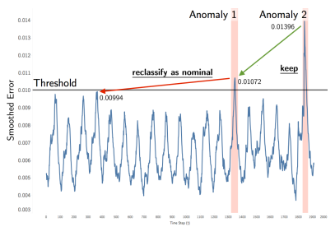
Model Theory
Nonparametric Dynamic Thresholding with Pruning
A threshold is found so that if all values above are removed, it would cause the greatest % decrease in the mean and standard deviation of the smoothed errors. This threshold value dynamically changes as the algorithm steps through all the time series data.
False positives are mitigated through pruning anomalies, by calculating the minimum percent decrease and comparing to set parameter, p.
p=0.1
p=0.07
p=0.23
Notes:
RNNs feed results BACK INTO the network
They are distinguished by their “memory” as they take information from prior inputs to influence the current input and output. While traditional deep neural networks assume that inputs and outputs are independent of each other, the output of recurrent neural networks depend on the prior elements within the sequence.
LSTMs are specifically designed to handle the vanishing gradient problem
Output prediction is generated at each timestep.
Uses an exponentially-weighted average to generate smoothed errors in order to dampen spikes common in LSTM-based predictions
Also added pruning anomalies to mitigate for False Positives

Slide 15
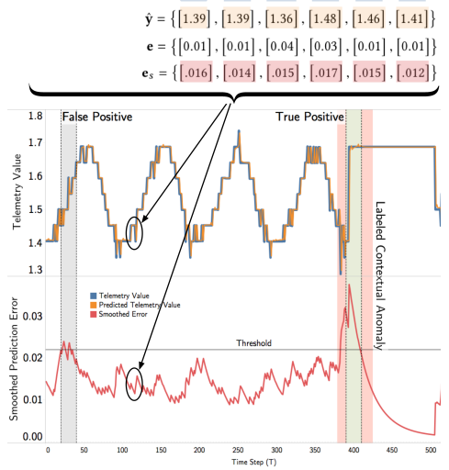
Anomaly Detection Summary

