Slide 1
Positional Number Systems
COSC 102
Camille Crumpton

Slide 2
Topics
Decimal
Binary
Hexadecimal
Converting

Slide 3
What is a Positional Number System?
A way to represent a number and its magnitude using the “position” a digit is placed
Base determines the power base
Decimal 10^{p}
Binary 2^{p}
Hexadecimal 16^{p}
Octal 8^{p}
Place starts with power 0 (just like array index)
Base has digits 0 – (base – 1)
Decimal 0 – 9
Binary 0 – 1
Hexadecimal 0 – F
Octal 0 - 7

Slide 4
Decimal (Base 10)
The weight of each digit of a decimal number depends on its relative position within the number
ex. One thousand, two hundred twenty-four
1
2
3
4
1000s Place
100s Place
10s Place
1s Place

Slide 5
Decimal (Base 10)
Decimal
1234:
1(1000) + 2(100) + 3(10) + 4(1)
Decimal consists of powers of 10
1000 (10³), 100 (10²), 10 (10¹), 1 (10⁰)
For each ascending place, its magnitude grows 10x
1 2 3 4
1s Place
10s Place
100s Place
1000s Place

Slide 6
Fractions (Base 10)
Descending place, its magnitude is divided by 10
27.212
2(10) + 7(1) + 2(10⁻¹) + 1(10⁻²) + 2(10⁻³)
2(10) + 7(1) + 2(.1) + 1(.01) + 2(.001)
10ths Place
100ths Place
1000ths Place

Slide 7
Binary (Base 2)
A digit in binary (0 or 1) is also called a bit. Only these two digits are used in binary.
Like a decimal number, the weight of each binary bit of a binary number depends on its relative position within the number
For each ascending place, its magnitude grows 2x

Slide 8
Binary (Base 2)
Binary (base 2)
1101
1(8) + 1(4) + 0(2) + 1(1)
Binary consists of powers of 2
8 (2³), 4 (2²), 2 (2¹), 1 (2⁰)
For each ascending place, its magnitude grows 2x
1 1 0 1
1s Place
2s Place
4s Place
8s Place

Slide 9
Distinguishing Base 2
Is 1101
One thousand, one hundred, one?
1(1000) + 1(100) + 0(10) + 1(1)
Thirteen?
1(8) + 1(4) + 0(2) + 1(1)
Distinguish from base 10 by prefix or suffix
0b1101 = Binary 1101 (0b means binary)
This is how you represent binary in C++ and assembly
1101₂ = Binary 1101 (subscript 2 means binary)

Slide 10
Fractions (Base 2)
Descending place, its magnitude is divided by 2
10.110₂ = 2.75₁₀
1(2) + 0(1) + 1(2⁻¹) + 1(2⁻²) + 0(2⁻³)
1(2) + 0(1) + 1(.5) + 1(.25) + 0(.125)
1/2ths Place
1/4ths Place
1/8ths Place

Slide 11
Why Binary?
Binary represents on (1) or off (0), true or false, yes or no.
1 = voltage on (typically)
0 = voltage off
Computers use a group of 8 binary digits (bits), which is called a “byte”.
0b0101_0011 = 1 byte

Slide 12
Hexadecimal Digits
Hexadecimal number system has a base of 16… so how do we represent any digit bigger than 9? 10 can’t work for ten – it’s two digits, and we need a single digit.
Digits > 9 are represented by a letter A-F
A = 10
B = 11
C = 12
D = 13
E = 14
F = 15
NOTE: Case does not typically matter and in programming, we use lower-case letters.

Slide 13
Hexadecimal (Base 16)
Hexadecimal
19AC
1(4096) + 9(256) + A(16) + C(1)
Hexadecimal consists of powers of 16
4096 (16³), 256 (16²), 16 (16¹), 1 (16⁰)
For each place, its magnitude grows 16x
1 9 A C
1s Place
16s Place
256s Place
4096s Place

Slide 14
Distinguishing Base 16
Is 16
Sixteen? 1(10) + 6(1)
Twenty-two? 1(16) + 6(1)
Distinguish from base 10 by prefix or suffix
0x16 = Hex 16 (0x means hex)
This is how you represent hex in C++ and assembly
16₁₆ = Hex 16 (subscript 16 means hex)

Slide 15
Fractions (Base 16)
Descending place, its magnitude is divided by 16
2E.1AA₁₆ = 46.10400390625₁₀
2(16) + E(1) + 1(.0625) + A(.00390625) + A(.000244140625)
1/16ths Place
1/256ths Place
1/4096ths Place

Slide 16
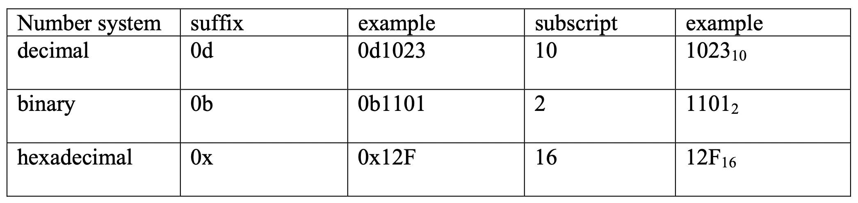
Number System Comparison

Slide 17
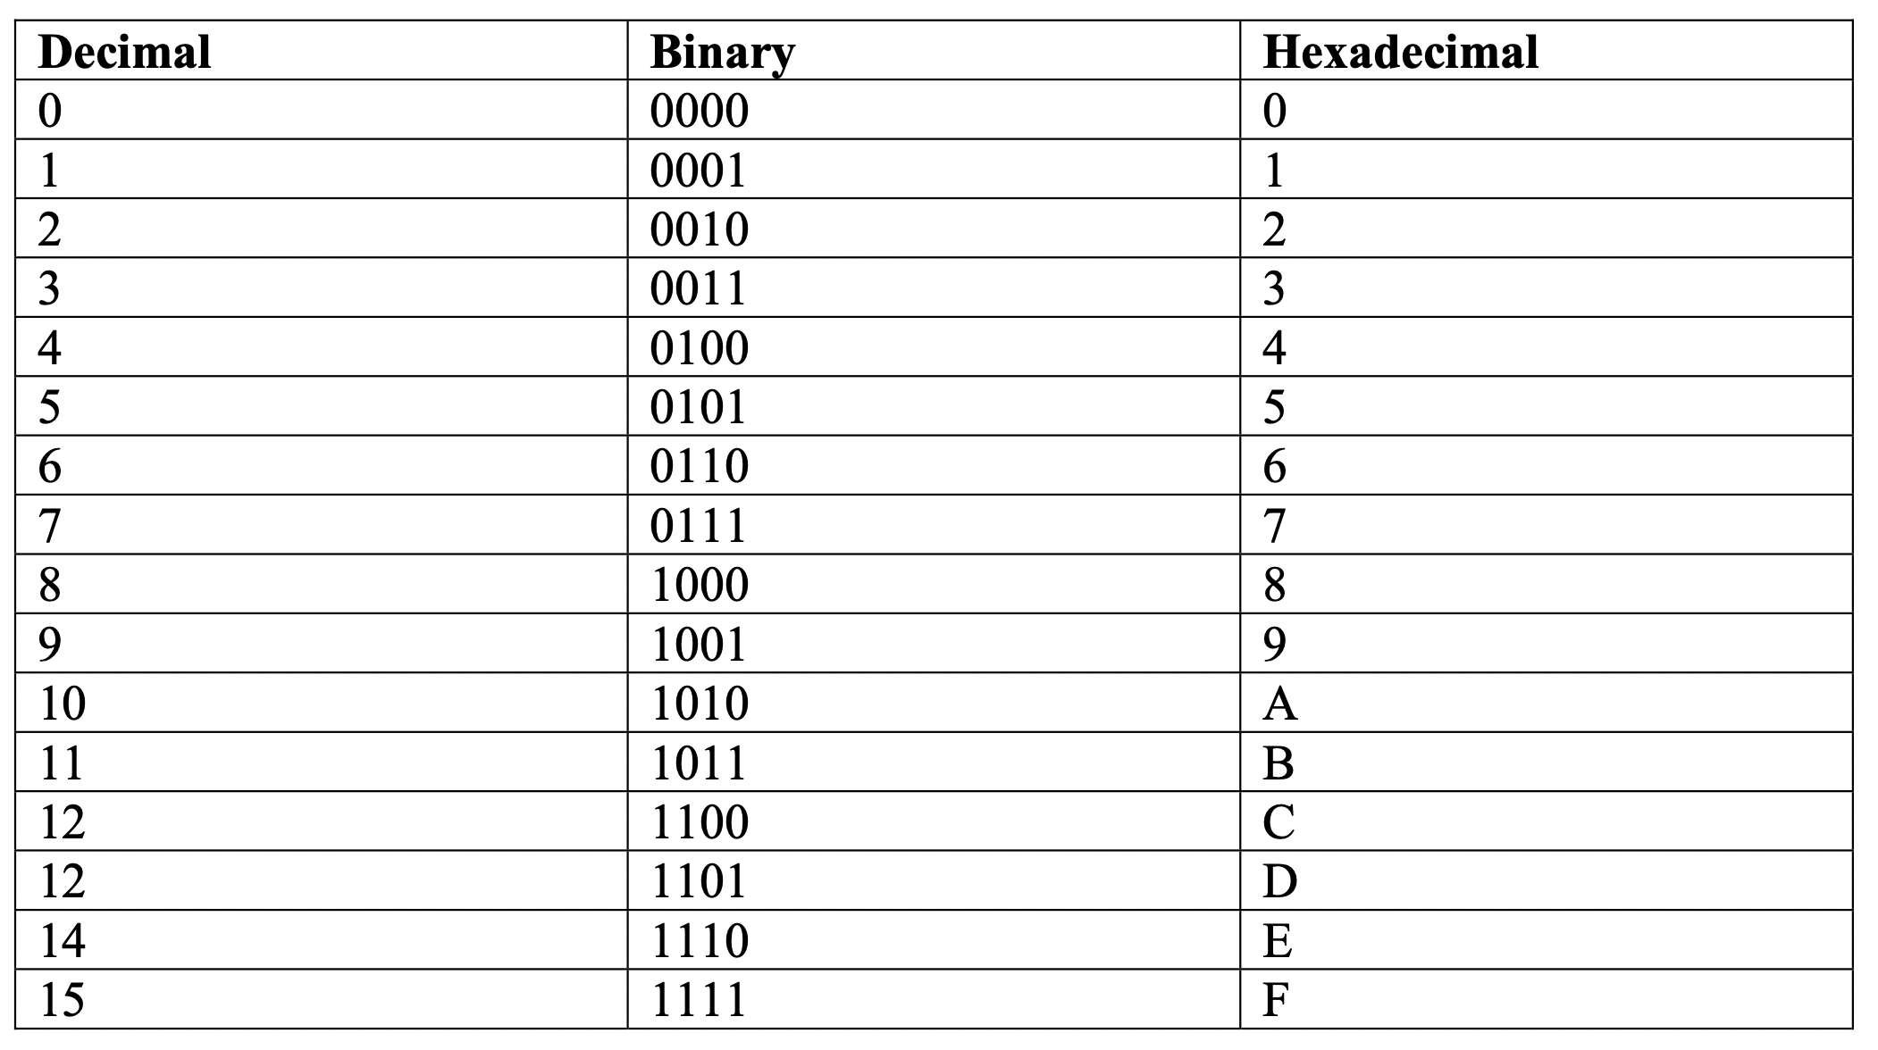
Number System Comparison

Slide 18
Practice
Magnitude of
0xA5
A(16) + 5(1)
10(16) + 5 = 160 + 5 = 165
0x1C
1(16) + C(1)
16 + 12 = 28
0b0001_1001
1(16) + 1(8) + 0(4) + 0(2) + 1(1)
16 + 8 + 1 = 24 + 1 = 25
0b0000_1111
1(8) + 1(4) + 1(2) + 1(1)
8 + 4 + 2 + 1 = 15

Slide 19
Practice
Magnitude of
0xA.2
A(1) + 2(1/16)
10(1) + 2/16 = 10 + 1/8 = 10 + 0.125 = 10.125
0x1.0A
1(1) + 0(1/16) + A(1/256)
1 + 10/256 = 1.0390625
0b11.011
1(2) + 1(1) + 0(1/2) + 1(1/4) + 1(1/8)
2 + 1 + 0.25 + 0.125 = 3 + 0.375 = 3.375
0b1.1111
1(1) + 1(1/2) + 1(1/4) + 1(1/8) + 1(1/16)
1 + 0.5 + 0.25 + 0.125 + 0.0625
1.75 + 0.1875 = 1.9375

Slide 20
Converting To Base 2
84
Need to find powers of two that add up to 84
Find largest power of 2 that comes closest to 84, but not over. Your first 1 will go here. Subtract 84 by the power, repeat.
2⁷ = 128 (too large)
2⁶ = 64 (closest to 84) Index 6 gets 1
84 – 64 = 20 (still need to represent 20)
2⁵ = 32 (bigger than 20) Index 5 gets 0
2⁴ = 16 (closest to 20) Index 4 gets 1
20 – 16 = 4 (still need to represent 4)
2³ = 8 (too large) Index 3 gets 0
2² = 4 (closest to 4) Index 2 gets 1
4 – 4 = 0
2¹ = 2 (too large) Index 1 gets 0
2⁰ = 1 (too large) Index 0 gets 0

Slide 21
Fraction Converting Base 2
0.6875
Start with 2⁻¹ then move to 2⁻² and if the magnitude is <= the value, put a 1, otherwise put a 0.
2⁻¹ = 0.5 1 (.1875 remaining)
2⁻² = 0.25 0 (too big)
2⁻³ = 0.125 1 (.0625 remaining)
2⁻⁴ = 0.0625 1 (0 remaining)
0.6875₁₀ = 0.1011₂

Slide 22
Easy Converting To Base 16
124
First, convert to binary
0b0111_1100
Each 1 hex digit is 4 binary digits
Take groups of four at a time
0111 = 7 = 0x7
1100 = 12 = 0xc
0x7c

Slide 23
Fraction Converting Base 16
Same way!
0x3.A4
0b0011.1010_0100
1(2) + 1(1) + 1(1/2) + 1(1/8) + 1(1/64)
3.(0.5 + 0.125 + 0.015625)
3.640625

Slide 24
Topics
Decimal
Binary
Hexadecimal
Converting

Slide 25
Number Systems COSC 102 Camille Crumpton

