Slide 1
Pointers
COSC 102
Camille Crumpton

Slide 2
Topics
Pointer Introduction
Declaring
What is the data type for?
Address-of
Dereferencing
Dynamically Allocating & De-Allocating Memory
Primitive Types
Objects
Arrays
Pointer Arithmetic
Subscript notation
Base + Offset
Pointers with Classes
Pointers as Function Parameters
Pointer Constants

Slide 3
Pointer introduction

Slide 4
What is a Pointer?
Pointers store a memory location
"pointer" = these "point" to a memory location.
All pointers have the same size:
64-bit machine: 8-bytes (64-bits)
32-bit machine: 4-bytes (32-bits)

Slide 5
Pointer Syntax
Declaring
A pointer is marked by an asterisk
int *my_pointer
An integer resides at the memory address this points to.
Asterisk denotes this variable stores a memory address.
(i.e., it is a pointer)

Slide 6
Address-of Syntax
Address-of
Gets the memory address of a variable.
Use: ‘&’ – The “address-of” operator
int k = 22;
cout << k;
cout << &k;
Prints 22 (value of integer k)
Prints memory address of k

Slide 7
Using Pointers
We use the * in 2 ways: to declare pointers, & dereference
int k;
int *ptr_k;
ptr_k = &k;
*ptr_k = 771;
printf("%d\n", k);
When declaring: Asterisk makes a pointer
Puts memory address of k into pointer ptr_k
Using the * when getting/setting is dereference operator.
This puts the value 771 into the variable located by ptr_k.
Prints 771

Slide 8
Dynamically Allocating Memory

Slide 9
Allocating New Memory
The new keyword creates a new dynamic variable of a specified type and returns a pointer that points to this new variable.
int *ptr;
ptr = new int;
*ptr = 60;
printf("%d\n", *ptr);
Declaring a pointer
Creates a new ”nameless” integer in memory that we can only access via pointer
Dereference ptr to give that new integer a value.
Prints 60

Slide 10
Allocating New Memory: Objects
This is using new with a class (the only difference is we are using the class constructor with the new call, like Java)
Dog *pup;
pup = new Dog();
(*pup).age = 10;
Declaring a pointer to a Dog type
Creates a new ”nameless” Dog in memory using the constructor that we can only access via pointer
Dereference ptr to give access to the object, the use dot operator to access a public field or method

Slide 11
Allocating New Memory: Arrays
This is using new[] with an array – just like the normal new call, only we allocate the size of data type of the array * the number of elements given by the new call.
int *ptr_arr;
ptr_arr = new int[5];
ptr_arr[2] = 10;
*(ptr_arr + 2) = 10;
Declaring an integer pointer
Creates 4 new contiguous integers in memory and returns a pointer to the first one. Allocated sizeof(int) * 5 = 4 bytes * 5 = 20 bytes.
[] automatically dereferences the pointer for us. We can use the int pointer just like an array.
This is equivalent to the statement above. See the pointer arithmetic slides.

Slide 12
De-allocating New Memory
The delete keyword destroys a dynamic variable of a specified type and returns that memory to the freestore to be used by other parts of the program if needed.
*ptr = 70;
delete ptr;
*ptr = 60;
*ptr = NULL;
Same pointer from previous slide
Destroys the “nameless” variable that held 60 then 70.
DON’T DO THIS! To re-use ptr again, we would need to make another new call. We are trying to reference a non-NULL pointer that is in free memory.
This gives us a seg fault now if we try to access ptr – which helps us find our bugs.

Slide 13
De-allocating Memory: Objects
The delete keyword also destroys objects – used just like slide 10. All of the consequences after the “delete” call are the same.
(*pup).age = 5;
delete pup;
(*pup).age = 7;
*pup = NULL;
Same pointer from previous slide
Destroys the “nameless” object of type Dog.
DON’T DO THIS! Same reasons as the last slide
This gives us a seg fault now if we try to access pup – which helps us find our bugs.

Slide 14
De-allocating Memory: Arrays
This is using delete[] with an array – just like the normal delete call, only we make sure we destroy all the elements in the array.
int *ptr_arr;
ptr_arr = new int[4];
ptr_arr[2] = 10;
*(ptr_arr + 2) = 10;
Declaring an integer pointer
Creates 4 new contiguous integers in memory and returns a pointer to the first one
[] automatically deferences the pointer for us. We can use the int pointer just like an array.
This is equivalent to the statement above. See the pointer arithmetic slides.

Slide 15
POINTER ARITHMETIC

Slide 16
Pointer Arithmetic
We can use the subscript operator (brackets []) to treat a pointer like an array
Adding and subtracting from a pointer walks us to the next data type (of the pointer) in contiguous memory.
It does NOT increase/decrease by a single byte, unless the data type is a char (chars are 1 byte).
This is analogous to moving to the next element in the array.

Slide 17
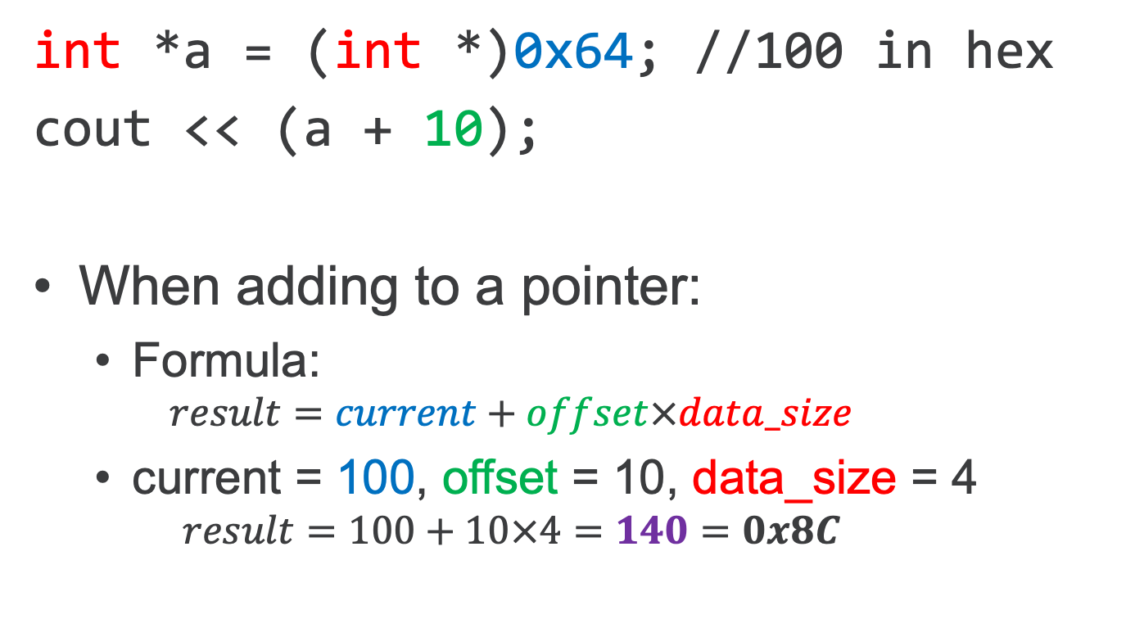
Pointer Arithmetic
int *a = (int *)0x64; //100 in hex
cout << (a + 10);
When adding to a pointer:
Formula:
$$result=current+offset×data_size$$
current = 100, offset = 10, data_size = 4
$$result=100+10×4=140=0x8C$$
Notes:
The data size of an integer is 4 bytes

Slide 18
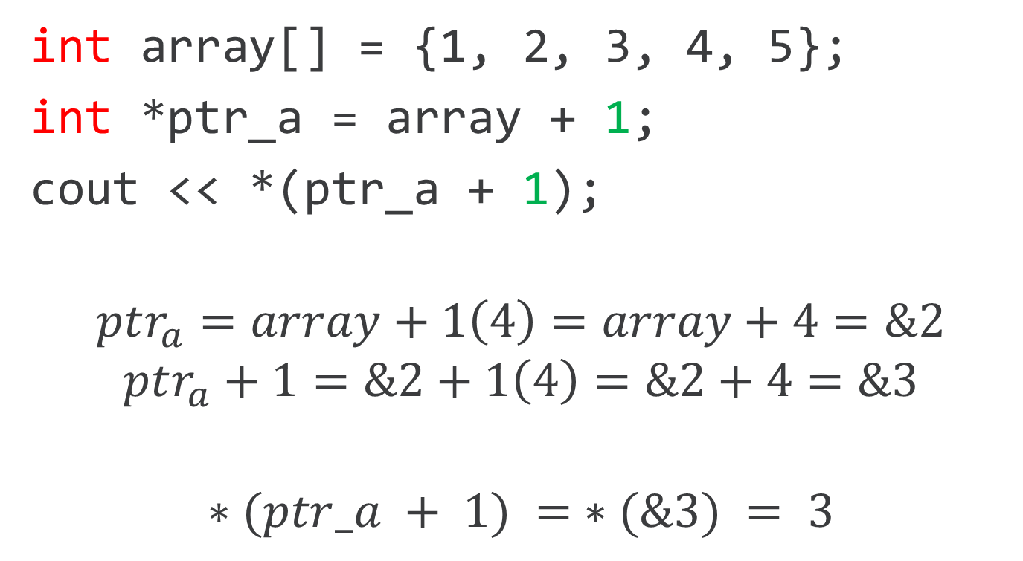
Pointer Arithmetic
int array[] = {1, 2, 3, 4, 5};
int *ptr_a = array + 1;
cout << *(ptr_a + 1);
$$ptr_{a}=array+1\left(4\right)=array+4=\&2$$
$$ptr_{a}+1=\&2+1\left(4\right)=\&2+4=\&3$$
$$∗(ptr_a + 1) = ∗(\&3) = 3$$

Slide 19
Pointer Arithmetic
int array[] = {1, 2, 3, 4, 5};
array + 0
1
array + 1
2
array + 2
3
array + 3
4
array + 4
5
4 bytes

Slide 20
Subscript on a Pointer
int *k = (int *)100;
k[10] = 30;
Subscript automatically dereferences!!
k[10] is equivalent to *(k + 10)

Slide 21
Pointers with Classes

Slide 22
Pointers with Classes
Pointers can point to any data type in memory. String is a class that’s defined in #include <string>, so we’ll use it as an example.
string somestring = "Hello";
string *ptrstring = &somestring;
cout << ptrstring; // prints address
cout << *ptrstring; // prints value

Slide 23
Class Members w/ Dot Operator
You must dereference the pointer to access class members.
string somestring = "Hello";
string *ptrstring = &somestring;
cout << (*ptrstring).length();

Slide 24
Arrow Operator – Easier!
You can use the arrow operator (->) instead of the dot operator to save you time! It will deference the pointer for you, and it is cleaner syntax.
string somestring = "Hello";
string *mystring = &somestring;
cout << (*mystring).length();
//IS EQUIVALENT TO
cout << mystring->length();

Slide 25
Pointers as Function parameters

Slide 26
Pointers as Parameters
The next two slides show a function that has a one-line body.
The first slide is DE-REFERENCING an int pointer parameter, therefore changing an integer.
The second slide is assigning a new address to the pointer. You won’t do this all that often in code. This one is tricky since C++ is pass-by-value by default, so it will only change the address within the scope of the function ONLY. We won’t have examples of this in class or exams, but this is just to show you in case you come across it coding on your own.

Slide 27
Pointer Parameters
void func(int *i)
{
*i = 22;
}
int main()
{
int j = 55;
func(&j);
cout << j;
}
55
j
22
???
???
???
???
4 bytes
See the slide’s notes for detailed explanation
Notes:
In the main program, we are calling the function “func” with the address of ”j”. Since func takes a single address as a parameter, this works just fine.
The function “func” will deference the parameter and change its value to 22. The is changing the value at the ADDRESS OF J.
When we come back to main, j is now 22. Run this slide in presentation mode to see the animation.
Pass-by-reference is a way to avoid using pointer syntax, but getting the same result. To change this to a pass-by-reference integer parameter, we would code everything up as so:
void func(int &i)
{
i = 22;
}
int main()
{
int j = 55;
func(j);
cout << j;
}

Slide 28
Pointer Parameters
The actual pointer is pass-by-value
void func(int *i)
{
i = (int *)0x100;
}
int main() {
int *j = (int *)0x200;
func(j);
cout << j;
}
What is printed?
int *j
0x200
0x10
int *i
0x100
0x18
???
0x20
???
0x28
???
0x30
8 bytes
Notes:
This is the tricky one, in my opinion. The difference between this program and the slide previous is that the one-liner body is changing the DE-REFERNCED address, and the one-liner body in this slide is changing the ADDRESS ITSELF.
Since C++ is pass-by-value by default, this will pass a copy of j (think j_copy = 0x200) to the function “func”. J_copy is ”plugged in” for the parameter i, we change i to 0x100, then j_copy gets destroyed after the function is over.
When we come back to main, we are using OG j again, and it’s still 0x200.

Slide 29
Pointer Constants

Slide 30
Pointer Constant
Three ways to specify "constant"
const char *p;
char * const p;
const char * const p;
const BEFORE the *
const AFTER the *
const BEFORE and AFTER the *

Slide 31
Pointer Constant
const before the *
const int *p;
Makes the VALUE at the memory address being pointed to constant.
const after the *
int * const p;
Makes the MEMORY ADDRESS being pointed to read-only (cannot update the memory address)
const before and after the *
const int * const p;
Makes the MEMORY ADDRESS pointed to constant and the VALUE at the memory address being pointed to constant.

Slide 32
Topics
Pointer Introduction
Declaring
What is the data type for?
Address-of
Dereferencing
Dynamically Allocating & De-Allocating Memory
Primitive Types
Objects
Arrays
Pointer Arithmetic
Subscript notation
Base + Offset
Pointers with Classes
Pointers as Function Parameters
Pointer Constants

Slide 33
Pointers COSC 102 Camille Crumpton

