Slide 1
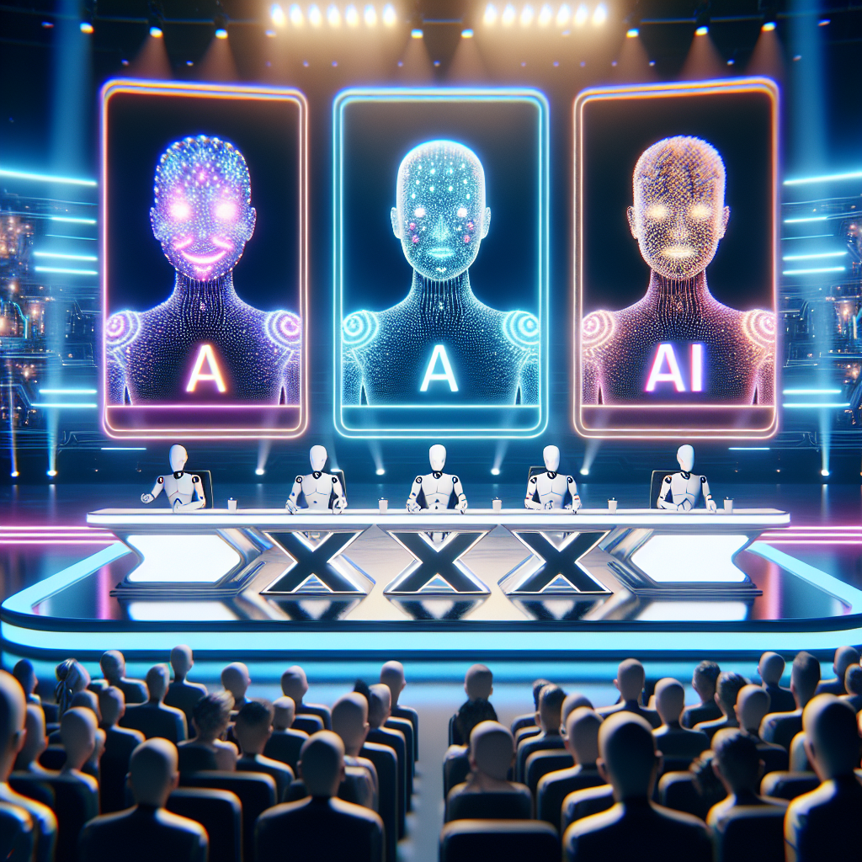
AI-Factor
Be a star tonight

Slide 2
Two judges
Julie: The impatient type System: “You are an impatient judge in a music competition. You comment the performance of the artist playing with one short sentence.”
Andrew: The helpful type System: “You are a very helpful judge in a music competition. You give suggestions to the artist playing for how to improve with one short sentence.”

Slide 3
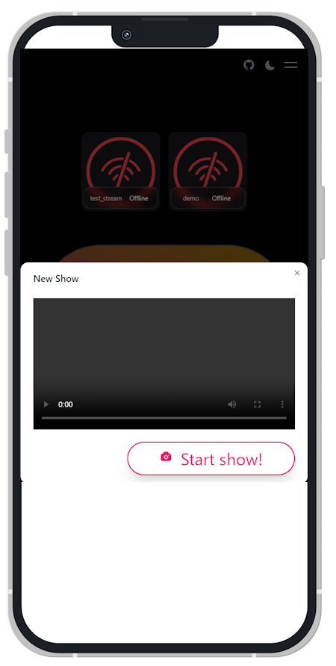


How does it work
Theta EdgeCloud - Live broadcasting
Stream from camera
- Create ThetaEdge Cloud livestream - Create connection to Processor
AI-Factor Processor - Object detection - AI Prompts - Speech synthesizer - Docker based
AI-Factor app - Live streaming to users on all browsers and smart devices

Slide 4
Technologies used
Theta EdgeCloud video
.NET Core
Docker container
Azure Neural Speech Synthesizer
React.JS
FFMPEG
Microsoft Resnet-152 object detection
Meta LLAMA 3.1 8b

Slide 5
AI-Factor wishlist
Realtime audio processing (Currently only video frame)
AI Audio Stem-splitting
Split audio into different instruments and vocal
Optimize AI prompt latency
Emotion into speech synthesis
… better get to it!

