Slide 1
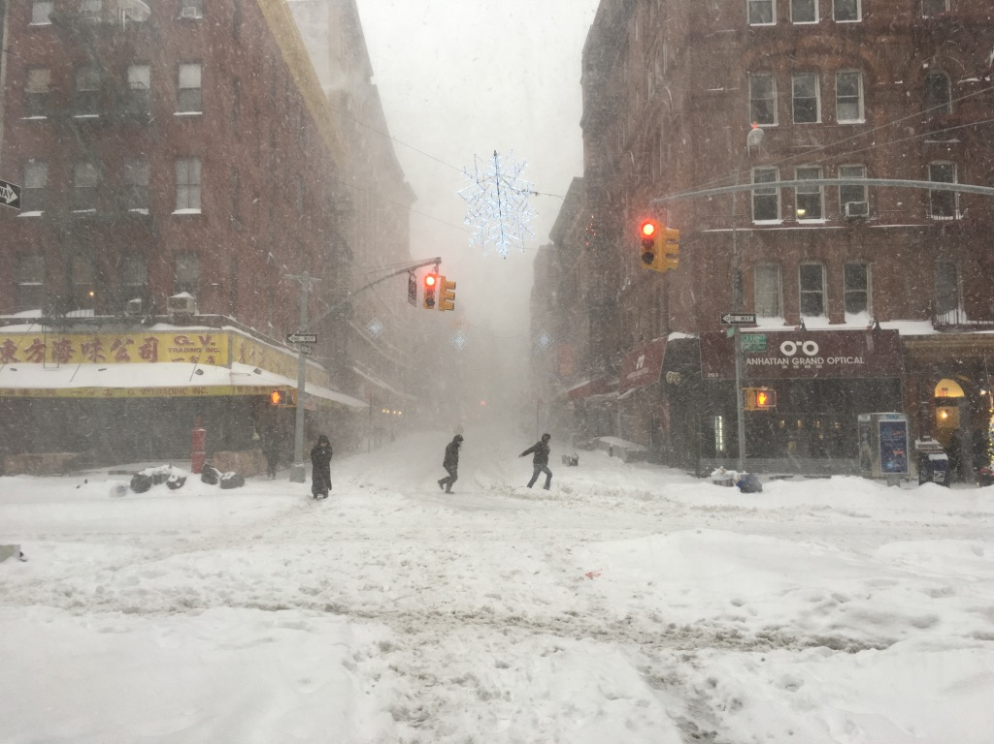
CMP 405: Intro to Networks
M.P. Johnson
Lecture+Lab
2-<number>

Slide 2
Plan
Today: not a snow day ☹
Also: not the exam ☹
So instead:
  Review P2P, bittorent, distributed hash tables
  Start transport layer
  QA for midterm
Next week:
  Midterm (first half)
  Transport layer (second half)
  Last webserver/proxyserver lab…
Application Layer
2-<number>

Slide 3

Review: file distribution via c-s vs P2P
Q: how much time to distribute large file (size F) from one server to n peers?
  peer upload/download capacities are both limited resources
u_{s}: server upload capacity
u₁
d_{i}: peer i download capacity
file, size F
u_{s}
d₁
u₂
d₂
server
d_{i}
u_{n}
network (with abundant
bandwidth)
u_{i}
d_{n}
u_{i}: peer i upload capacity
Application Layer
2-<number>

Slide 4
Review: c-s’s file distribution time
server transmission: must sequentially send (upload) file n times:
  time to send one copy: F/u_{s}
  time to send N copies: NF/u_{s}
F
u_{s}
d_{i}
network
u_{i}
client: each client must download file copy
  d_{min} = min client download rate
  min client download time: F/d_{min}
time to distribute F
to n clients using
client-server approach
D_{c-s} > max{nF/u_{s,},F/d_{min}}
increases linearly in n
Application Layer
2-<number>

Slide 5
Review: P2P’s file distribution time
server transmission: must upload just >= one time
  time to send one copy: F/u_{s}
F
u_{s}
d_{i}
client: each client must download file copy
  min client download time: F/d_{min}
network
u_{i}
clients: collectively must download nF bits
  max upload rate (limiting max download rate) is u_{s} + Σu_{i}
time to distribute F
to n clients using
P2P approach
D_{P2P} > max{F/u_{s,},F/d_{min,},nF/(u_{s} + Σu_{i})}
increases linearly in n …
… but so does this, as each peer brings service capacity
Application Layer
2-<number>

Slide 6
Review: requesting/sending chunks in bittorent
requesting chunks:
at any given time, different peers have different subsets of file chunks
periodically, Alice asks each peer for list of chunks that they have
Alice requests missing chunks from peers, rarest chunks first
sending chunks: tit-for-tat
Alice sends chunks to those four peers currently sending her chunks at highest rate
  other peers are choked by Alice (do not receive chunks from her)
  re-evaluate top 4 every10 secs
every 30s: randomly select another peer, starts sending it chunks
  = optimistically unchoke this peer
  maybe it will join top 4…
Application Layer
2-<number>

Slide 7
Review: index of file chunks
maps (filename.chunk#) → IDs of peers who’ve got it
But we hash (fn.ch#) to get nicer key (a number)
Important: hashes and peer IDs are in the same range
Original Key | Hashed Key | Value
ubuntu.zip.chunk1 | 89 | {8,350,23,253,…}
ubuntu.zip.chunk2 | 786 | {546,34,74,34,…}
ubuntu.zip.chunk3 | 159 | {332,75,3,66,35,…}
ubuntu.zip.chunk4 | 23 | {35,64,345,77,3,…
ubuntu.zip.chunk5 | 5 | {4,6,333,61,3,4,…|
……. |  | ………
ubuntu.zip.chunk999 | 92 | {64,44,22,66,…}

Slide 8
Distributed Hash Table (DHT)
Distribute (key, value) pairs over millions of peers
  Want pairs evenly distributed over peers
Any peer can query the database by key
  database returns value for the key
  value = which peers to request that file chunk from
Efficiency goals:
  Executing query only requires a small #msgs
  Each peer only knows about a small #peers

Slide 9
Assign key-value pairs to peers
Q: for each (key,val) pair, where should it be stored?
  i.e., on which peers?
A: “store it on the peer whose ID = smallest peer ID >= key”
e.g., ID space {0,1,2,3,…,63}
suppose 8 peers: 1,12,13,25,32,40,48,60
  If key = 51, then assigned to peer?
  If key = 60, then assigned to peer?
  If key = 61, then assigned to peer?
  (60)
  (60)
  (1)

Slide 10
Circular DHT: resolving a query
3
What is the value
associated with key 999,852?
value
1002
999,903
…
1905
6000
# msgs on avg to resolve query if n peers: O(n)
Good or bad?
3001
5002
4015

Slide 11
Alternative: clique DHT
Each peer has pointers to all other peers
Advantage?
Disadvantage?

Slide 12
Intermediate: circular DHT w/shortcuts
3
What is the value
associated with key 999,852?
value
1002
999,903
…
1905
6000
3001
5002
4015
Now: each peer keeps track of IDs of shortcuts, pred(s), succ(s)
Can design with: O(log N) shortcuts/peer, O(log N) msgs for query

Slide 13
Peer churn
handling peer churn:
peers may come and go
→ each peer knows address of its 2 successors
each peer periodically pings its
2 successors to check aliveness
if immediate successor leaves → choose next successor as new immediate successor
1
3
15
4
12
5
10
8
example: peer 5 abruptly leaves

Slide 14
Chapter 2: summary
our study of the network layer is now complete
application architectures
  client-server
  P2P
application service requirements:
  reliability, bandwidth, delay
Internet transport service model
  connection-oriented, reliable: TCP
  unreliable, datagrams: UDP
specific protocols:
  HTTP
  FTP
  SMTP, POP, IMAP
  DNS
  P2P: BitTorrent, DHT
Future: socket programming (TCP, UDP sockets)
Application Layer
2-<number>

Slide 15
Chapter 2: summary
most importantly: learned about protocols!
typical request/reply message exchange:
  client requests info or service
  server replies with data, status code
message formats:
  headers: fields giving info about data
  data (“payload”): the actual content
important themes:
stateless vs. stateful
reliable vs. unreliable msg transfer
centralized vs. decentralized
“complexity at network edge” (bootstrapping)
Application Layer
2-<number>

Slide 16
Exam review / Q/A
Natural question candidates: any process that was complicated for us to work through by hand!
E.g.:
  Analyzing time required for c-s / p2p file distrib
  dns: seq of msgs sent to resolve a host name’s IP
  DHTs: seq of msgs sent to look up entry in index
  Layers: seq of msgs sent / passed up/down to deliver msg from app on host 1 to app on host 2
2-<number>

Slide 17
Exam review / Q/A
Other stuff:
  packet-switching vs circuit-switching (benefits?)
  encapsulation
  the actual list of layers
  IP of domain’s name server vs IP of domain
  How/why cookies work
  How/why proxy servers work
  SMTP vs POP/IMAP
  UDP vs TCP
  sockets vs IPs
  state vs stateless (which protocols are which?)
  msgs: header vs payload
  man-in-the-middle attacks: DDoS, dns poisoning
2-<number>

Slide 18
Chapter 3: Transport Layer
our goals:
understand principles behind transport layer services:
  multiplexing, demultiplexing
  reliable data transfer
  flow control
  congestion control
learn about Internet transport layer protocols:
  UDP: connectionless transport
  TCP: connection-oriented reliable transport
  TCP congestion control
Transport Layer
3-<number>

Slide 19
Chapter 3 outline
3.1 transport-layer services
3.2 multiplexing and demultiplexing
3.3 connectionless transport: UDP
3.4 principles of reliable data transfer
3.5 connection-oriented transport: TCP
  segment structure
  reliable data transfer
  flow control
  connection management
3.6 principles of congestion control
3.7 TCP congestion control
Transport Layer
3-<number>

Slide 20

















Transport services and protocols
application
transport
network
data link
physical
provide logical communication between app processes running on different hosts
transport protocols run in end systems
  send side: breaks app messages into segments, passes to network layer
  rcv side: reassembles segments into messages, passes to app layer
The transport protocols:
  TCP and UDP
logical end-end transport
application
transport
network
data link
physical
Transport Layer
3-<number>

Slide 21
Transport vs. network layer
network layer: logical communication between hosts
transport layer: logical communication between processes
  relies on, enhances, network layer services
household analogy:
12 kids in Alice’s house sending letters to 12 kids in Bob’s house:
hosts = houses
processes = kids
app messages = letters in envelopes
transport protocol = Ann and Bill who demux to in-house siblings
network-layer protocol = postal service
Transport Layer
3-<number>

Slide 22
Internet transport-layer protocols
reliable, in-order delivery (TCP)
  congestion control
  flow control
  connection setup
unreliable, unordered delivery: UDP
  no-frills extension of “best-effort” IP
services not available:
  delay guarantees
  bandwidth guarantees
application
transport
network
data link
physical
network
data link
physical
network
data link
physical
network
data link
physical
logical end-end transport
network
data link
physical
network
data link
physical
network
data link
physical
network
data link
physical
application
transport
network
data link
physical
Transport Layer
3-<number>

Slide 23
Chapter 3 outline
3.1 transport-layer services
3.2 multiplexing and demultiplexing
3.3 connectionless transport: UDP
3.4 principles of reliable data transfer
3.5 connection-oriented transport: TCP
  segment structure
  reliable data transfer
  flow control
  connection management
3.6 principles of congestion control
3.7 TCP congestion control
Transport Layer
3-<number>

Slide 24
Multiplexing/demultiplexing
multiplexing at sender:
handle data from multiple
sockets, add transport header (later used for demultiplexing)
demultiplexing at receiver:
use header info to deliver
received segments to correct
socket
application
application
P1
P2
application
socket
P3
transport
P4
process
transport
network
transport
network
link
network
link
physical
link
physical
physical
Transport Layer
3-<number>

Slide 25
How demultiplexing works
host receives IP datagrams
  each datagram has source & dest IPs
    each datagram carries one transport-layer segment
  each segment has source & dest port nums
IP uses IP address to get datagram to right host
Host (transport layer) uses port num(s) (& maybe IPs) to send segment to right socket (→ right process)
32 bits
source port #
dest port #
other header fields
application
data
(payload)
TCP/UDP segment format
Transport Layer
3-<number>

Slide 26
Connectionless demultiplexing
Each datagram sent into UDP socket must specify:
  dest IP
  dest port
UDP socket created w/ port# on local host:
DatagramSocket mySocket1 = new DatagramSocket(12534);
when host receives UDP segment:
  checks its dest port
  directs it to socket with that port
IP datagrams with same dest port #, but different source IP addresses and/or source port numbers will be directed to same socket at dest
Transport Layer
3-<number>

Slide 27
Connectionless demux: example
DatagramSocket serverSocket = new DatagramSocket
(6428);
DatagramSocket mySocket2 = new DatagramSocket
(9157);
DatagramSocket mySocket1 = new DatagramSocket (5775);
application
application
P1
application
P3
P4
transport
transport
network
transport
network
link
network
link
physical
link
physical
physical
source port: 6428
dest port: 9157
source port: ?
dest port: ?
source port: 9157
dest port: 6428
source port: ?
dest port: ?
Transport Layer
3-<number>

Slide 28
Connection-oriented demux
TCP socket identified by 4-tuple:
  source IP
  source port
  dest IP
  dest port
demux: receiver uses all four values to direct segment to appropriate socket
server host may support many simultaneous TCP sockets:
  each socket identified by its own 4-tuple
web servers have different sockets for each connecting client
  (non-persistent) HTTP will have different socket for every single HTTP request!
Transport Layer
3-<number>

Slide 29
Connection-oriented demux: example
application
application
P4
P5
P6
application
P3
P2
P3
transport
transport
network
transport
network
link
network
link
physical
link
physical
server: IP address B
physical
host: IP address A
source IP,port: B,80
dest IP,port: A,9157
host: IP address C
source IP,port: C,5775
dest IP,port: B,80
source IP,port: A,9157
dest IP, port: B,80
source IP,port: C,9157
dest IP,port: B,80
three segments, all destined to IP,port: B,80
are demultiplexed to different sockets
Transport Layer
3-<number>

Slide 30
Chapter 3 outline
3.1 transport-layer services
3.2 multiplexing and demultiplexing
3.3 connectionless transport: UDP
3.4 principles of reliable data transfer
3.5 connection-oriented transport: TCP
  segment structure
  reliable data transfer
  flow control
  connection management
3.6 principles of congestion control
3.7 TCP congestion control
Transport Layer
3-<number>

Slide 31
UDP: User Datagram Protocol [RFC 768]
Bare-bones Internet transport protocol
“best effort” service, UDP segments may be:
  lost
  delivered out-of-order to app
connectionless:
  no handshaking between UDP sender, receiver
  each UDP segment handled independently of others
UDP use:
  sometimes streaming media apps (loss tolerant, rate sensitive)
  DNS (why?)
Want reliable transfer over UDP?
  add reliability at app layer
  (how?)
Transport Layer
3-<number>

Slide 32
UDP: segment header
length, in bytes of UDP segment, including header
32 bits
source port #
dest port #
length
checksum
why is there a UDP?
no need for connection (delay)
simple: no connection state to maintain
small header size
no congestion control: UDP can blast away as fast as desired
application
data
(payload)
UDP segment format
Transport Layer
3-<number>

Slide 33
One UDP feature: checksum
Goal: detect errors (e.g., flipped bits) in transmitted segment
sender:
treats all segment contents, including header, as sequence of 16-bit ints
checksum: sum (one’s complement) of segment contents (16-bit)
sender puts checksum value into UDP checksum field
receiver:
compute checksum of received segment
check if computed checksum equals checksum field value:
  NO - error detected
  YES - no error detected
Actually: check if sum with checksum = 0
Transport Layer
3-<number>

Slide 34
Internet checksum: example
example: compute 1’s comp sum of two 16-bit ints:
  i.e., most signif bit’s carry bit is added to least signif bit
1 1 1 1 0 0 1 1 0 0 1 1 0 0 1 1 0
1 1 1 0 1 0 1 0 1 0 1 0 1 0 1 0 1
1 1 0 1 1 1 0 1 1 1 0 1 1 1 0 1 1
1 1 0 1 1 1 0 1 1 1 0 1 1 1 1 0 0
1 0 1 0 0 0 1 0 0 0 1 0 0 0 0 1 1
wraparound
sum
checksum
when received, sum with checksum should = all 1s (= 0)
If not ➔ error detected
Transport Layer
3-<number>
Notes:
Kurose and Ross forgot to say anything about wrapping the carry and adding it to low order bit

Slide 35
Chapter 3 outline
3.1 transport-layer services
3.2 multiplexing and demultiplexing
3.3 connectionless transport: UDP
3.4 principles of reliable data transfer
3.5 connection-oriented transport: TCP
  segment structure
  reliable data transfer
  flow control
  connection management
3.6 principles of congestion control
3.7 TCP congestion control
Transport Layer
3-<number>

