Slide 1
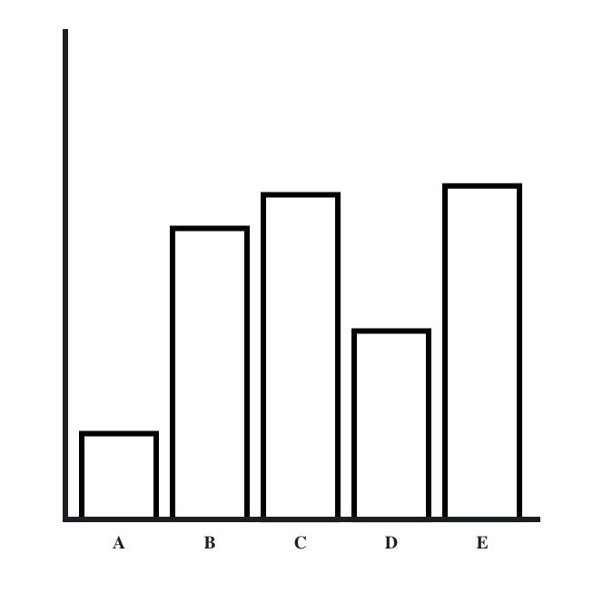
What percentage is B of the longest bar (E)?
Notes:
bar-practice

Slide 2
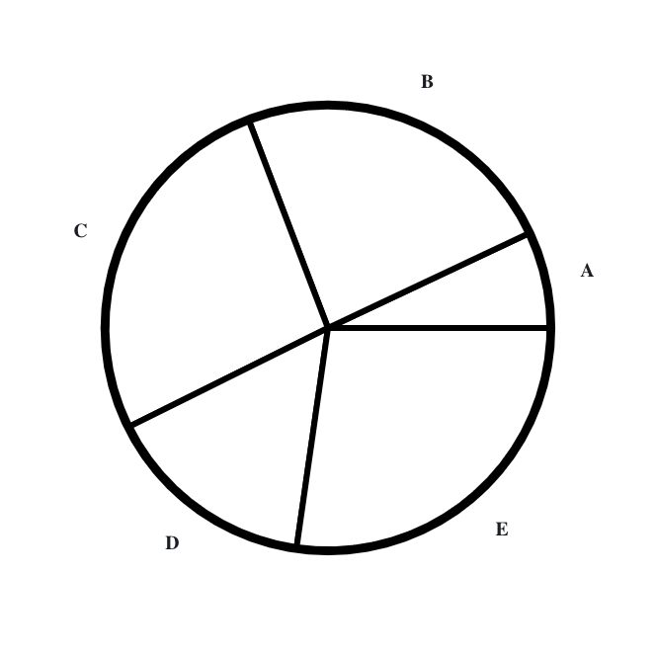
What percentage is C of the largest segment (E)?
Notes:
pie-practice

Slide 3
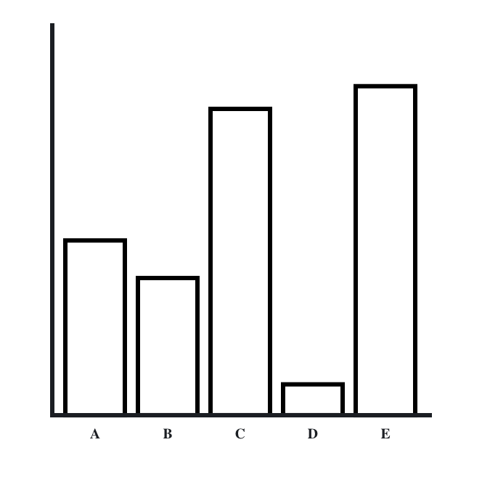
What percentage is bar A of the longest bar (E)?
Notes:
bar1

Slide 4
What percentage is bar B of the longest bar (E)?
Notes:
bar1

Slide 5
What percentage is bar C of the longest bar (E)?
Notes:
bar1

Slide 6
What percentage is bar D of the longest bar (E)?
Notes:
bar1

Slide 7
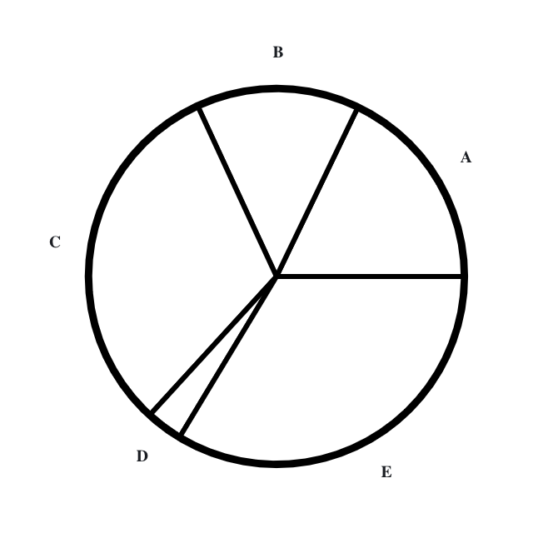
What percentage is segment A of the largest segment (E)?
Notes:
pie1

Slide 8
What percentage is segment B of the largest segment (E)?
Notes:
pie1

Slide 9
What percentage is segment C of the largest segment (E)?
Notes:
pie1

Slide 10
What percentage is segment D of the largest segment (E)?
Notes:
pie1

Slide 11
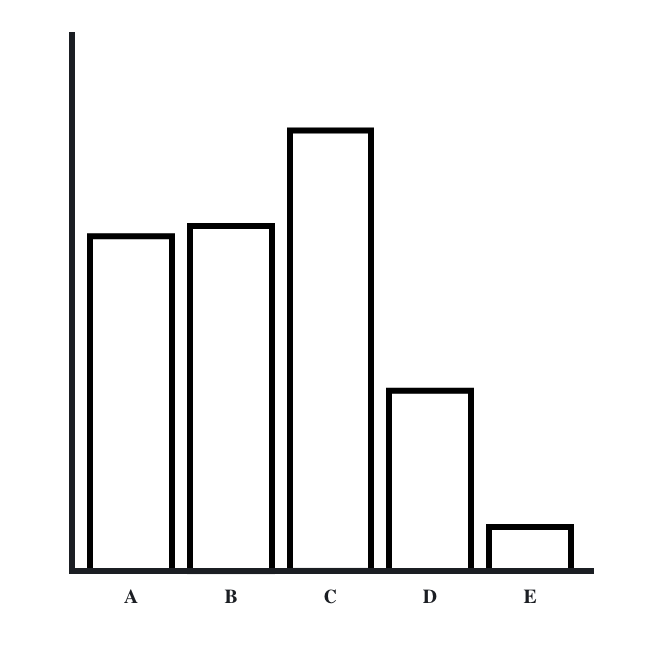
What percentage is bar A of the longest bar (C)?
Notes:
bar2

Slide 12
What percentage is bar B of the longest bar (C)?
Notes:
bar2

Slide 13
What percentage is bar D of the longest bar (C)?
Notes:
bar2

Slide 14
What percentage is bar E of the longest bar (C)?
Notes:
bar2

Slide 15
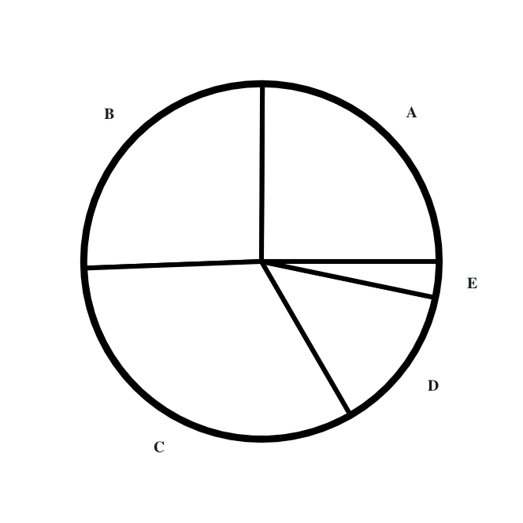
What percentage is segment A of the largest segment (C)?
Notes:
pie2

Slide 16
What percentage is segment B of the largest segment (C)?
Notes:
pie2

Slide 17
What percentage is segment D of the largest segment (C)?
Notes:
pie2

Slide 18
What percentage is segment E of the largest segment (C)?
Notes:
pie2

Slide 19
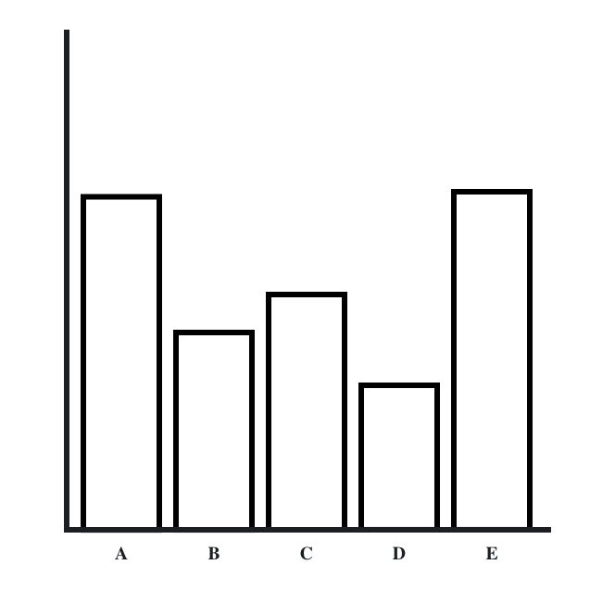
What percentage is bar A of the longest bar (E)?
Notes:
bar3

Slide 20
What percentage is bar B of the longest bar (E)?
Notes:
bar3

Slide 21
What percentage is bar C of the longest bar (E)?
Notes:
bar3

Slide 22
What percentage is bar D of the longest bar (E)?
Notes:
bar3

Slide 23
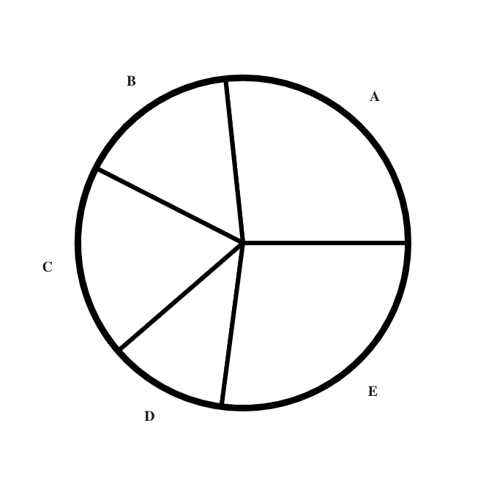
What percentage is segment A of the largest segment (E)?
Notes:
pie3

Slide 24
What percentage is segment B of the largest segment (E)?
Notes:
pie3

Slide 25
What percentage is segment C of the largest segment (E)?
Notes:
pie3

Slide 26
What percentage is segment D of the largest segment (E)?
Notes:
pie3

Slide 27
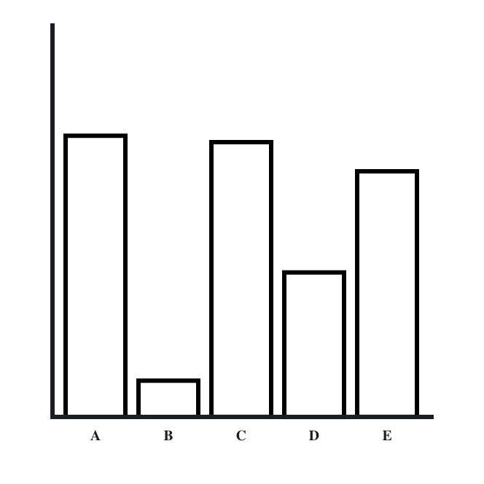
What percentage is bar B of the longest bar (A)?
Notes:
bar4

Slide 28
What percentage is bar C of the longest bar (A)?
Notes:
bar4

Slide 29
What percentage is bar D of the longest bar (A)?
Notes:
bar4

Slide 30
What percentage is bar E of the longest bar (A)?
Notes:
bar4

Slide 31
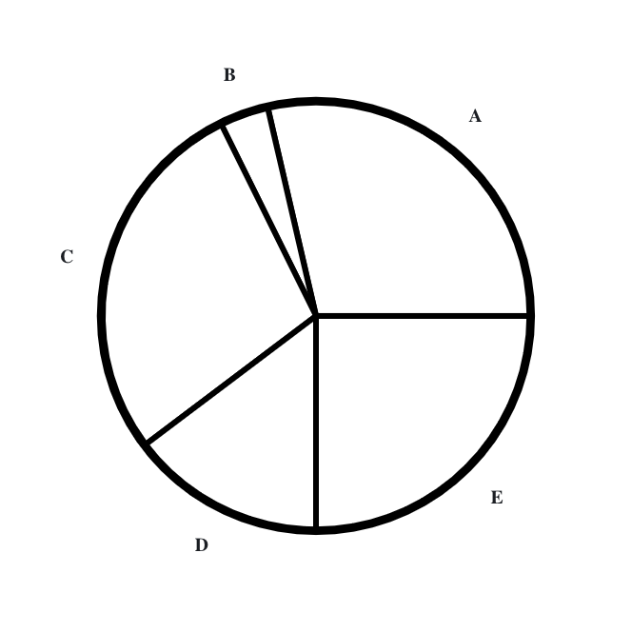
What percentage is segment B of the largest segment (A)?
Notes:
pie4

Slide 32
What percentage is segment C of the largest segment (A)?
Notes:
pie4

Slide 33
What percentage is segment D of the largest segment (A)?
Notes:
pie4

Slide 34
What percentage is segment E of the largest segment (A)?
Notes:
pie4

Slide 35
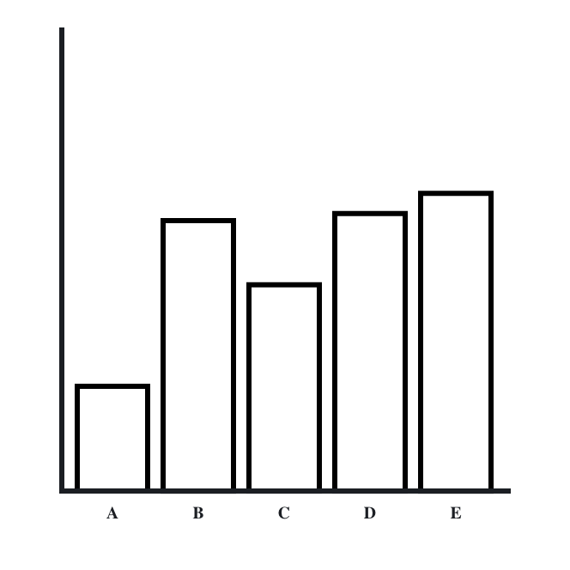
What percentage is bar A of the longest bar (E)?
Notes:
bar5

Slide 36
What percentage is bar B of the longest bar (E)?
Notes:
bar5

Slide 37
What percentage is bar C of the longest bar (E)?
Notes:
bar5

Slide 38
What percentage is bar D of the longest bar (E)?
Notes:
bar5

Slide 39
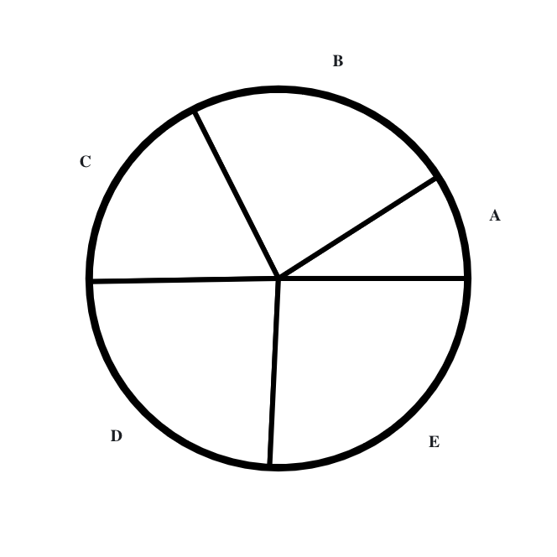
What percentage is segment A of the largest segment (E)?
Notes:
pie5

Slide 40
What percentage is segment B of the largest segment (E)?
Notes:
pie5

Slide 41
What percentage is segment C of the largest segment (E)?
Notes:
pie5

Slide 42
What percentage is segment D of the largest segment (E)?
Notes:
pie5

Slide 43
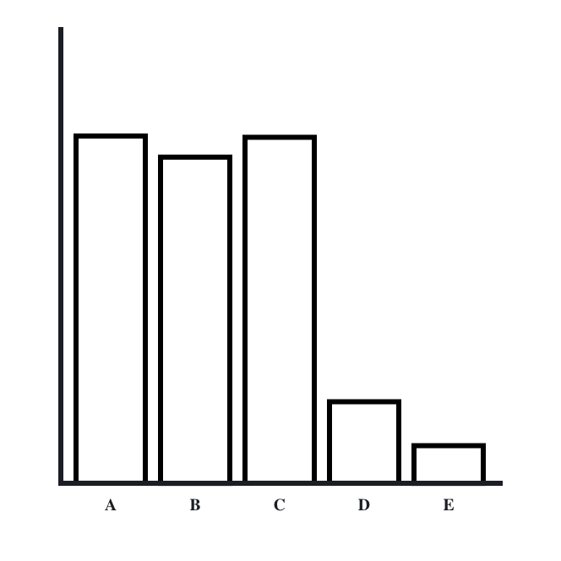
What percentage is bar B of the longest bar (A)?
Notes:
bar6

Slide 44
What percentage is bar C of the longest bar (A)?
Notes:
bar6

Slide 45
What percentage is bar D of the longest bar (A)?
Notes:
bar6

Slide 46
What percentage is bar E of the longest bar (A)?
Notes:
bar6

Slide 47
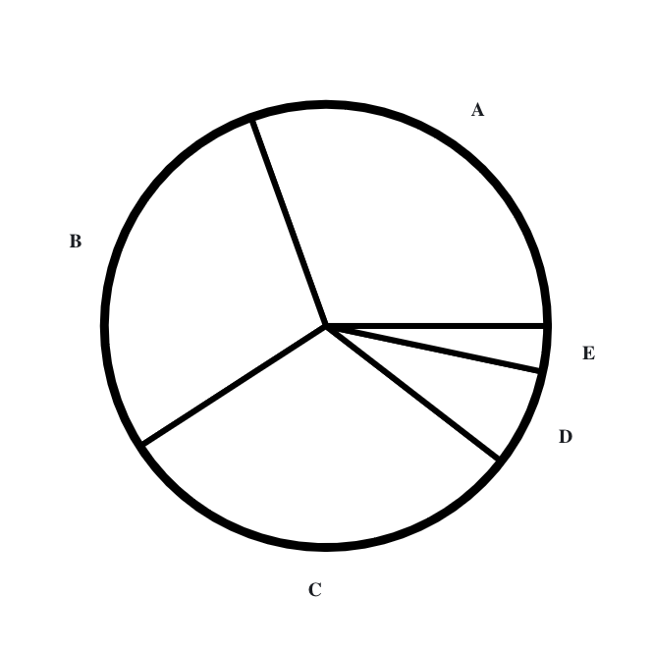
What percentage is segment B of the largest segment (A)?
Notes:
pie6

Slide 48
What percentage is segment C of the largest segment (A)?
Notes:
pie6

Slide 49
What percentage is segment D of the largest segment (A)?
Notes:
pie6

Slide 50
What percentage is segment E of the largest segment (A)?
Notes:
pie6

Slide 51
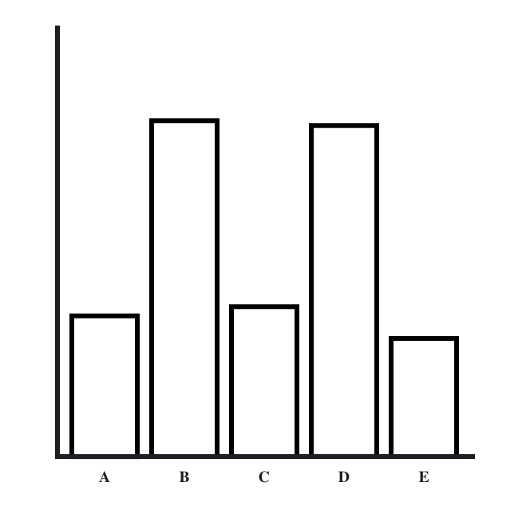
What percentage is bar A of the longest bar (B)?
Notes:
bar7

Slide 52
What percentage is bar C of the longest bar (B)?
Notes:
bar7

Slide 53
What percentage is bar D of the longest bar (B)?
Notes:
bar7

Slide 54
What percentage is bar E of the longest bar (B)?
Notes:
bar7

Slide 55
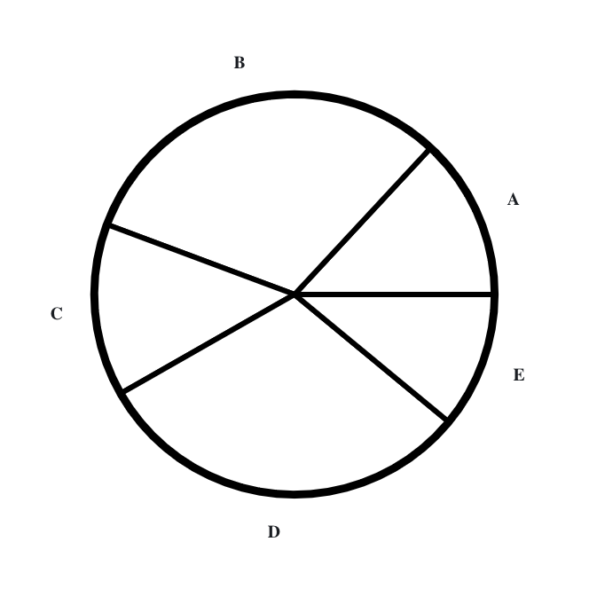
What percentage is segment A of the largest segment (B)?
Notes:
pie7

Slide 56
What percentage is segment C of the largest segment (B)?
Notes:
pie7

Slide 57
What percentage is segment D of the largest segment (B)?
Notes:
pie7

Slide 58
What percentage is segment E of the largest segment (B)?
Notes:
pie7

Slide 59
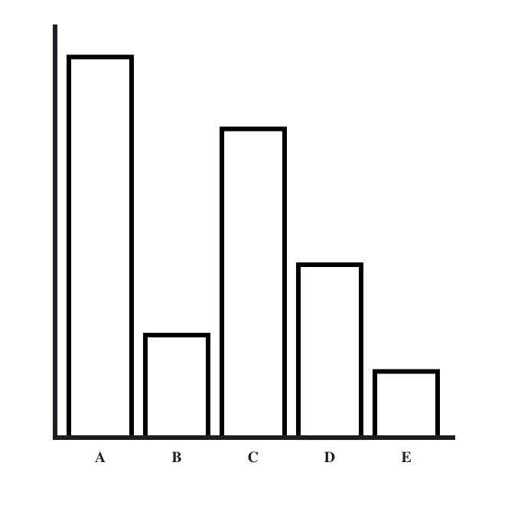
What percentage is bar B of the longest bar (A)?
Notes:
bar8

Slide 60
What percentage is bar C of the longest bar (A)?
Notes:
bar8

Slide 61
What percentage is bar D of the longest bar (A)?
Notes:
bar8

Slide 62
What percentage is bar E of the longest bar (A)?
Notes:
bar8

Slide 63
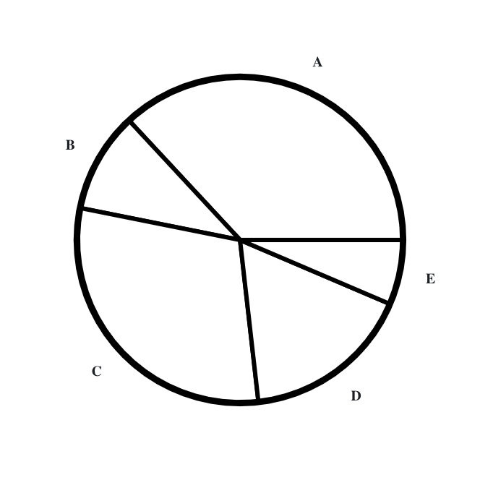
What percentage is segment B of the largest segment (A)?
Notes:
pie8

Slide 64
What percentage is segment C of the largest segment (A)?
Notes:
pie8

Slide 65
What percentage is segment D of the largest segment (A)?
Notes:
pie8

Slide 66
What percentage is segment E of the largest segment (A)?
Notes:
pie8

Slide 67
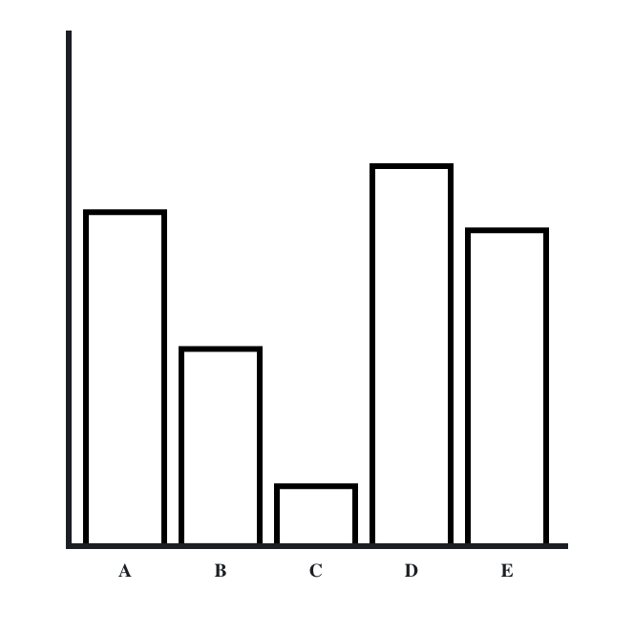
What percentage is bar A of the longest bar (D)?
Notes:
bar9

Slide 68
What percentage is bar B of the longest bar (D)?
Notes:
bar9

Slide 69
What percentage is bar C of the longest bar (D)?
Notes:
bar9

Slide 70
What percentage is bar E of the longest bar (D)?
Notes:
bar9

Slide 71
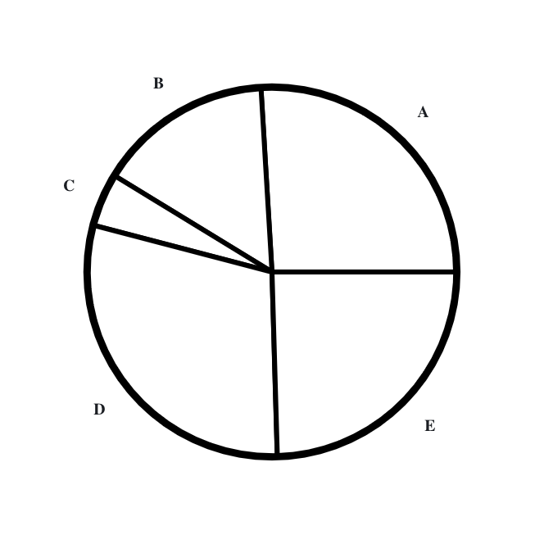
What percentage is segment A of the largest segment (D)?
Notes:
pie9

Slide 72
What percentage is segment B of the largest segment (D)?
Notes:
pie9

Slide 73
What percentage is segment C of the largest segment (D)?
Notes:
pie9

Slide 74
What percentage is segment E of the largest segment (D)?
Notes:
pie9

Slide 75
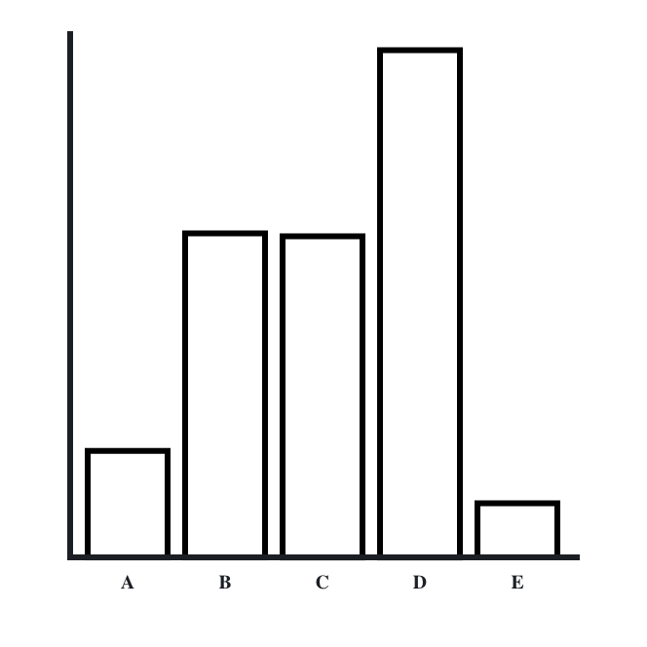
What percentage is bar A of the longest bar (D)?
Notes:
bar10

Slide 76
What percentage is bar B of the longest bar (D)?
Notes:
bar10

Slide 77
What percentage is bar C of the longest bar (D)?
Notes:
bar10

Slide 78
What percentage is bar E of the longest bar (D)?
Notes:
bar10

Slide 79
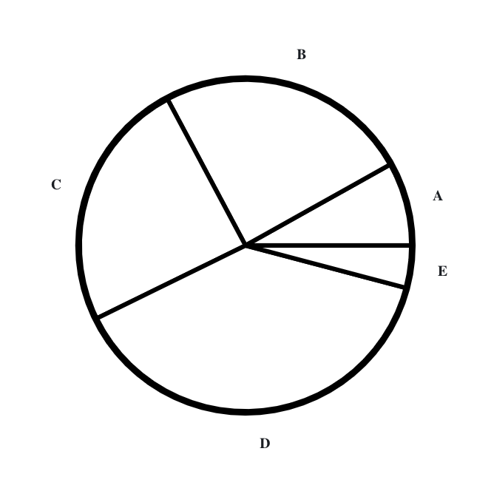
What percentage is segment A of the largest segment (D)?
Notes:
pie10

Slide 80
What percentage is segment B of the largest segment (D)?
Notes:
pie10

Slide 81
What percentage is segment C of the largest segment (D)?
Notes:
pie10

Slide 82
What percentage is segment E of the largest segment (D)?
Notes:
pie10

Slide 83
What percentage is B of the whole bar chart?
Notes:
bar-practice

Slide 84
What percentage is C of the whole pie chart?
Notes:
pie-practice

Slide 85
What percentage is bar A of the whole bar chart?
Notes:
bar1

Slide 86
What percentage is bar B of the whole bar chart?
Notes:
bar1

Slide 87
What percentage is bar C of the whole bar chart?
Notes:
bar1

Slide 88
What percentage is bar D of the whole bar chart?
Notes:
bar1

Slide 89
What percentage is segment A of the whole pie chart?
Notes:
pie1

Slide 90
What percentage is segment B of the whole pie chart?
Notes:
pie1

Slide 91
What percentage is segment C of the whole pie chart?
Notes:
pie1

Slide 92
What percentage is segment D of the whole pie chart?
Notes:
pie1

Slide 93
What percentage is bar A of the whole bar chart?
Notes:
bar2

Slide 94
What percentage is bar B of the whole bar chart?
Notes:
bar2

Slide 95
What percentage is bar D of the whole bar chart?
Notes:
bar2

Slide 96
What percentage is bar E of the whole bar chart?
Notes:
bar2

Slide 97
What percentage is segment A of the whole pie chart?
Notes:
pie2

Slide 98
What percentage is segment B of the whole pie chart?
Notes:
pie2

Slide 99
What percentage is segment D of the whole pie chart?
Notes:
pie2

Slide 100
What percentage is segment E of the whole pie chart?
Notes:
pie2

Slide 101
What percentage is bar A of the whole bar chart?
Notes:
bar3

Slide 102
What percentage is bar B of the whole bar chart?
Notes:
bar3

Slide 103
What percentage is bar C of the whole bar chart?
Notes:
bar3

Slide 104
What percentage is bar D of the whole bar chart?
Notes:
bar3

Slide 105
What percentage is segment A of the whole pie chart?
Notes:
pie3

Slide 106
What percentage is segment B of the whole pie chart?
Notes:
pie3

Slide 107
What percentage is segment C of the whole pie chart?
Notes:
pie3

Slide 108
What percentage is segment D of the whole pie chart?
Notes:
pie3

Slide 109
What percentage is bar B of the whole bar chart?
Notes:
bar4

Slide 110
What percentage is bar C of the whole bar chart?
Notes:
bar4

Slide 111
What percentage is bar D of the whole bar chart?
Notes:
bar4

Slide 112
What percentage is bar E of the whole bar chart?
Notes:
bar4

Slide 113
What percentage is segment B of the whole pie chart?
Notes:
pie4

Slide 114
What percentage is segment C of the whole pie chart?
Notes:
pie4

Slide 115
What percentage is segment D of the whole pie chart?
Notes:
pie4

Slide 116
What percentage is segment E of the whole pie chart?
Notes:
pie4

Slide 117
What percentage is bar A of the whole bar chart?
Notes:
bar5

Slide 118
What percentage is bar B of the whole bar chart?
Notes:
bar5

Slide 119
What percentage is bar C of the whole bar chart?
Notes:
bar5

Slide 120
What percentage is bar D of whole bar chart?
Notes:
bar5

Slide 121
What percentage is segment A of the whole pie chart?
Notes:
pie5

Slide 122
What percentage is segment B of the whole pie chart?
Notes:
pie5

Slide 123
What percentage is segment C of the whole pie chart?
Notes:
pie5

Slide 124
What percentage is segment D of the whole pie chart?
Notes:
pie5

Slide 125
What percentage is bar B of the whole bar chart?
Notes:
bar6

Slide 126
What percentage is bar C of the whole bar chart?
Notes:
bar6

Slide 127
What percentage is bar D of the whole bar chart?
Notes:
bar6

Slide 128
What percentage is bar E of the whole bar chart?
Notes:
bar6

Slide 129
What percentage is segment B of the whole pie chart?
Notes:
pie6

Slide 130
What percentage is segment C of the whole pie chart?
Notes:
pie6

Slide 131
What percentage is segment D of the whole pie chart?
Notes:
pie6

Slide 132
What percentage is segment E of the whole pie chart?
Notes:
pie6

Slide 133
What percentage is bar A of the whole bar chart?
Notes:
bar7

Slide 134
What percentage is bar C of the whole bar chart?
Notes:
bar7

Slide 135
What percentage is bar D of the whole bar chart?
Notes:
bar7

Slide 136
What percentage is bar E of the whole bar chart?
Notes:
bar7

Slide 137
What percentage is segment A of the whole pie chart?
Notes:
pie7

Slide 138
What percentage is segment C of the whole pie chart?
Notes:
pie7

Slide 139
What percentage is segment D of the whole pie chart?
Notes:
pie7

Slide 140
What percentage is segment E of the whole pie chart?
Notes:
pie7

Slide 141
What percentage is bar B of the whole bar chart?
Notes:
bar8

Slide 142
What percentage is bar C of the whole bar chart?
Notes:
bar8

Slide 143
What percentage is bar D of the whole bar chart?
Notes:
bar8

Slide 144
What percentage is bar E of the whole bar chart?
Notes:
bar8

Slide 145
What percentage is segment B of the whole pie chart?
Notes:
pie8

Slide 146
What percentage is segment C of the whole pie chart?
Notes:
pie8

Slide 147
What percentage is segment D of the whole pie chart?
Notes:
pie8

Slide 148
What percentage is segment E of the whole pie chart?
Notes:
pie8

Slide 149
What percentage is bar A of the whole bar chart?
Notes:
bar9

Slide 150
What percentage is bar B of the whole bar chart?
Notes:
bar9

Slide 151
What percentage is bar C of the whole bar chart?
Notes:
bar9

Slide 152
What percentage is bar E of the whole bar chart?
Notes:
bar9

Slide 153
What percentage is segment A of the whole pie chart?
Notes:
pie9

Slide 154
What percentage is segment B of the whole pie chart?
Notes:
pie9

Slide 155
What percentage is segment C of the whole pie chart?
Notes:
pie9

Slide 156
What percentage is segment E of the whole pie chart?
Notes:
pie9

Slide 157
What percentage is bar A of the whole bar chart?
Notes:
bar10

Slide 158
What percentage is bar B of the whole bar chart?
Notes:
bar10

Slide 159
What percentage is bar C of the whole bar chart?
Notes:
bar10

Slide 160
What percentage is bar E of the whole bar chart?
Notes:
bar10

Slide 161
What percentage is segment A of the whole pie chart?
Notes:
pie10

Slide 162
What percentage is segment B of the whole pie chart?
Notes:
pie10

Slide 163
What percentage is segment C of the whole pie chart?
Notes:
pie10

Slide 164
What percentage is segment E of the whole pie chart?
Notes:
pie10

