Slide 1
Workshop: Combined analysis of brain and behavioral recordings
Isabelle Hoxha – MSNE Project Week 2021

Slide 2
Linking neurophysiological data and behavior

Slide 3
Let’s play a game!
http://guessthecorrelation.com/

Slide 4
About EEG

Slide 5
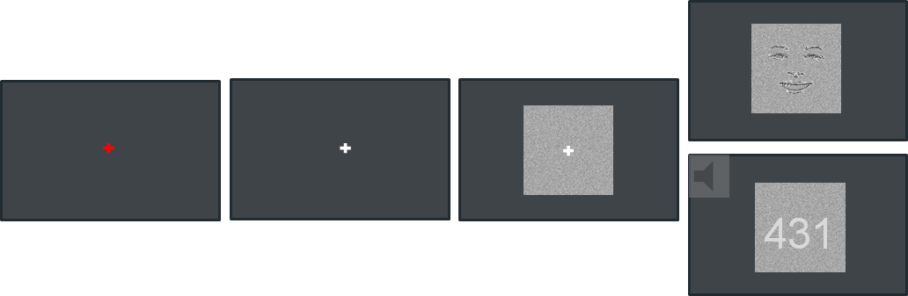

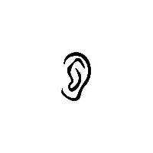

The paradigm
0
1.5
3-4.5
3.9-5.4
Time (s)

Slide 6
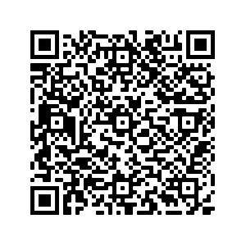
Scan this to go to notebook!
shorturl.at/cewCJ

