Slide 1
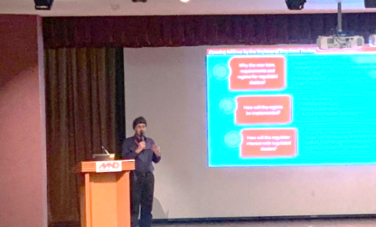
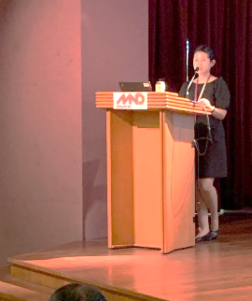
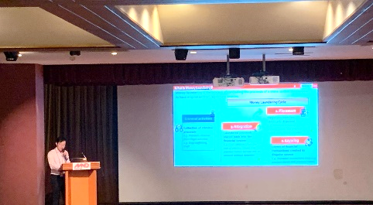
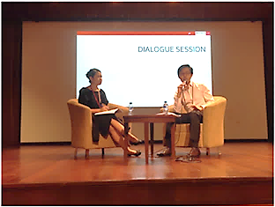
Onboarding Conference for Regulated Dealers in the
Precious Stones and Precious Metals Dealers (“PSMD”) Sector
The Anti-Money Laundering/Countering the Financing of Terrorism Division (“ACD”) of the Ministry of Law held the inaugural onboarding conference for the regulated dealers in the PSMD sector on 6 May 2019.
Attendees:
There were around 150 representatives from the PSMD sector who are members of the industry associations,
these include:
Diamond Exchange of Singapore
Singapore Bullion Market Association
Singapore Clock & Watch Trade Association
Singapore Jewellers Association
Singapore Pawnbrokers’ Association
Programme:
Opening speech from the Registrar of Regulated Dealers.
“The new regulatory regime is part of a series of ongoing preventive actions to safeguard the PSMD sector from money laundering and terrorism financing risks.”
Briefings by the Deputy Directors on the regulatory requirements and the registration process.
Dialogue session between audience and Deputy Directors.
Exhibition booths on commercial database screening solutions.

