Slide 1
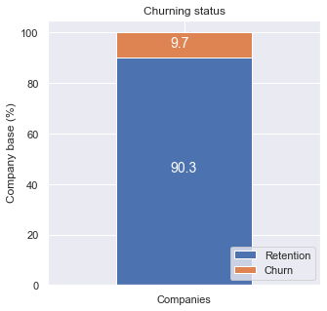
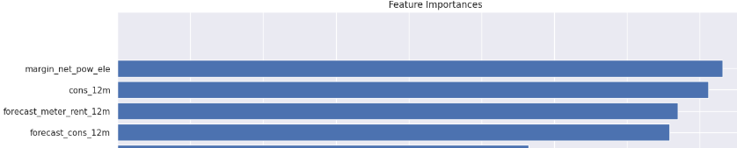

Executive summary
Churn is indeed high in the SME division
9.7% across 14606 customers
Predictive model is able to predict churn but the main driver is not customer price sensitivity
net margin on power subscription, Yearly consumption and forecasted consumption are the 3 largest drivers
Discount strategy of 20% is effective but only if targeted appropriately
Offer discount to only to high -value customers with high churn probability

