Slide 1

Predicting Diabetes Using Health Indicators
Presented by the Data Ninjas:
Isabel Garrido, Noemi Montelongo, Jack Pan, Garima Rajbhandari, & Gretta Uwamwiza

Slide 2
Introduction
According to the CDC, the number of people who have diabetes in America is the highest it has ever been.
People with diabetes have a deficiency in how their body makes or uses insulin
Insulin is an important hormone that regulates glucose.
Diabetes can be a gateway towards serious complications such as heart disease, vision loss, lower-limb amputation and kidney disease.
It is essential that healthcare providers have the tools to screen patients for prediabetes or diabetes.
By using supervised machine learning, we built a prediction model that can assist clinicians predict diabetes.

Slide 3
Contents
Introduction
Technologies
Method
Exploratory Analysis
Results/Model
Set Backs
Limitations
Conclusion
Further Considerations
Sources

Slide 4
Technologies
Python 3.9.12
Javascript
HTML
Form & Postman
Flask
Tableau
SQLite

Slide 5
Method
We used the Diabetes Health Indicators Dataset from 2015 provided by Kaggle.
The dataset was obtained by surveying hundreds of thousands of Americans for diabetes or prediabetes predictors with The Behavioral Risk Factor Surveillance System (BRFSS).
We decided to explore 10 of the 22 variables for our prediction based mostly on their importance values:
Education
Age
High BP
Gender
BMI
Cholesterol check
No Doc bc Cost
Stroke
Smoker
Physical Activity

Slide 6
Method (Might remove this slide)
Extensive clean-up such as dropping NaN or columns therefore we were able to proceed in creating the model.
Some of the questions that we explored were age, diet, physical activity and health history.
The data that we chose did not require extensive clean-up.
Before we were able to work with the dataset, we had to label the categories in some of the columns. For example. the income column had 8
It was felt that a supervised machine learning was the best approach to classify and predict diabetes. We used the tensorflow deep learning module. To compare for accuracy, we used the random forest method for this prediction. We then began to build the webpage using HTML, Javascript, and Flask. To be continued...
Demonstrate and expand further the logistic model prediction since we had a higher accuracy... and then use tensorflow and random forest as additional analysis.

Slide 7
Binary Variables
VARIABLE | NO | YES
Diabetes | 0 | 1
High BP | 0 | 1
Cholesterol check | 0 | 1
Smoker | 0 | 1
Stroke | 0 | 1
Physicial Activity | 0 | 1
No Doctor Because Cost | 0 | 1
Gender | 0 | 1
Cholesterol check (within 5 years) | 0 | 1
Heart Disease/Attack | 0 | 1

Slide 8
Exploratory Analysis

Slide 9
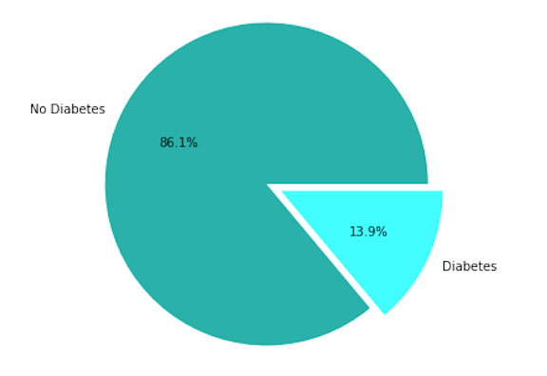
Population sample: 253,681
No Diabetes: 218,334
With Diabetes: 35,346
Prediction:
0= No diabetes
1= diabetes or prediabetes

Slide 10
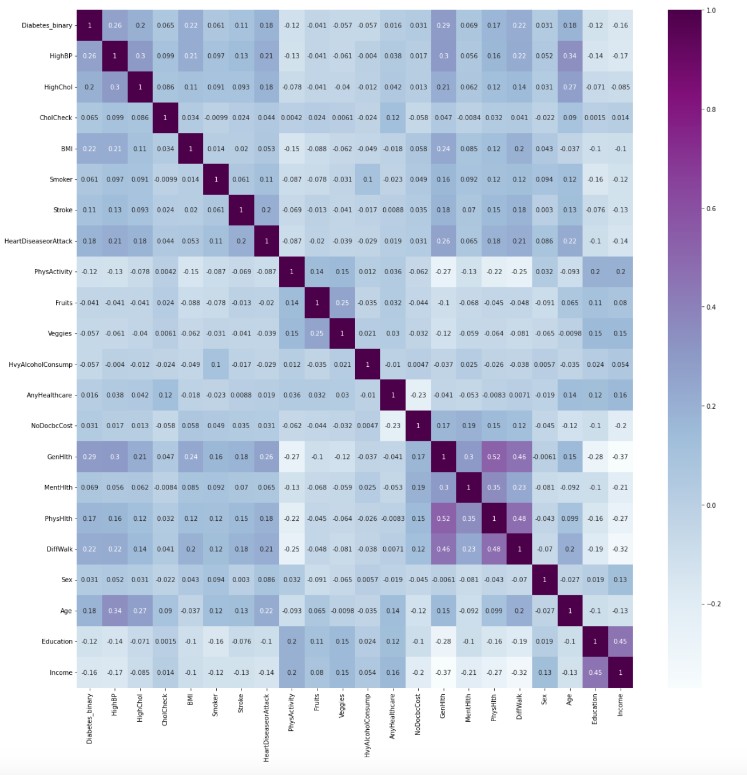
Heatmap (All 22 variables)

Slide 11
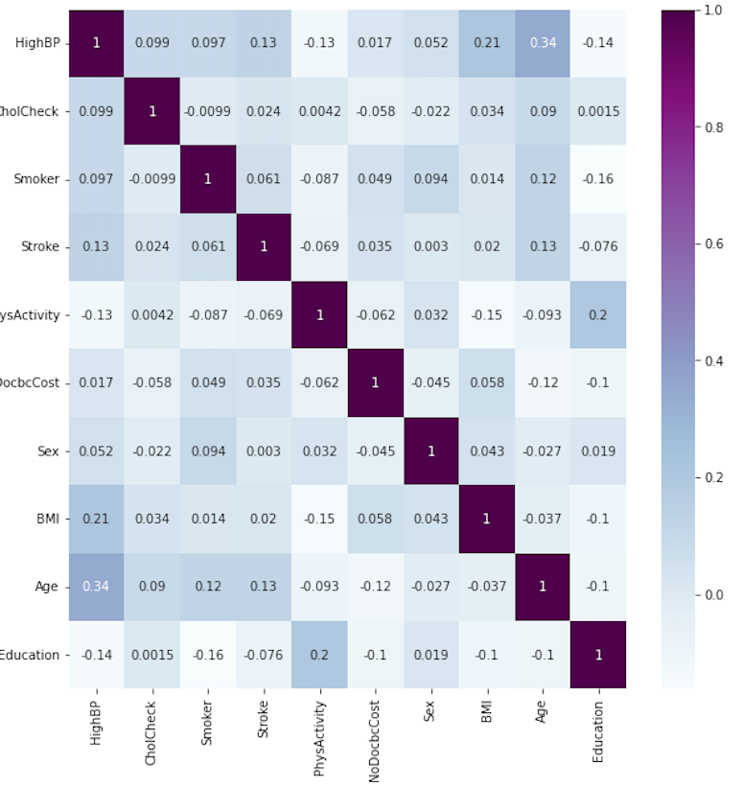
Heatmap (10 variables)

Slide 12
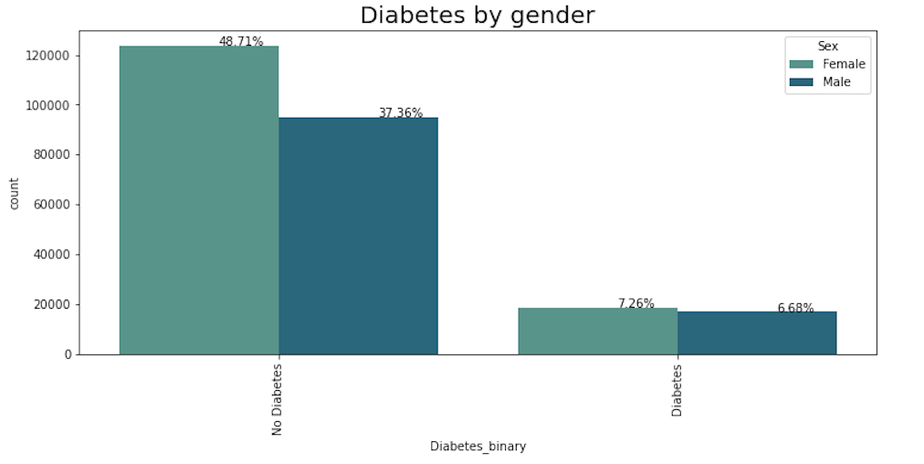
Gender

Slide 13
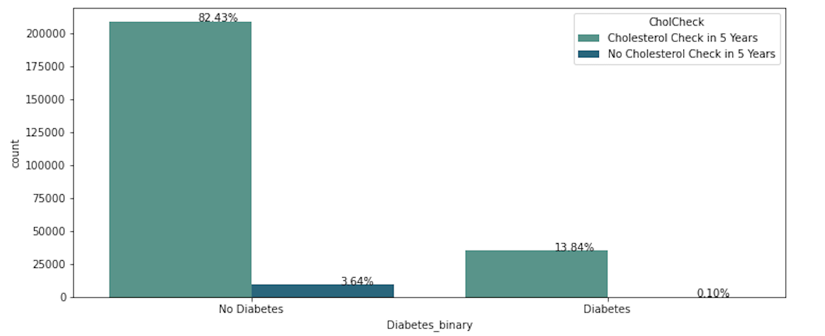
Cholesterol Check

Slide 14
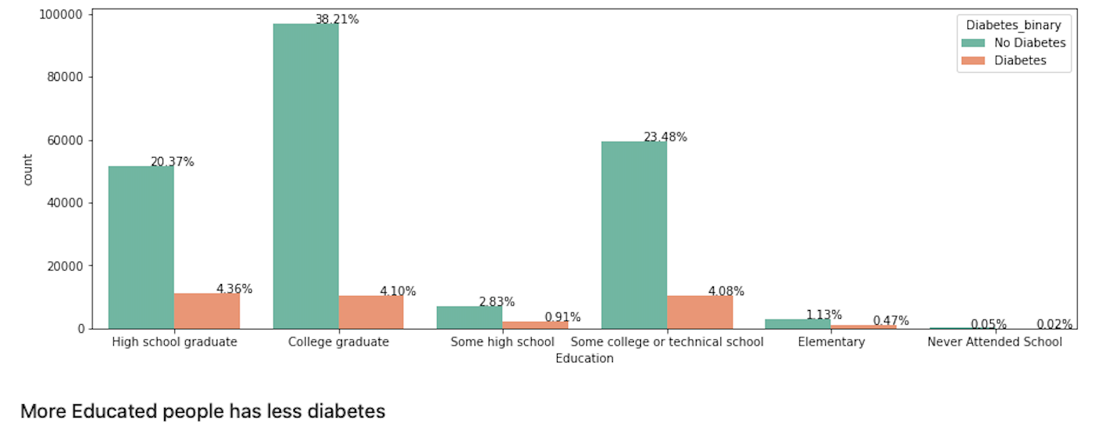
Education
CATEGORY | EDUCATION
1 | Never attended school/only kindergarten
2 | Grade 1-8 (Elementary)
3 | Grade 9 – 11 (Some high school)
4 | Grade 12 or GED ( High school graduate
5 | College 1 to 3 years (Some college)
6 | College 4 years or more (College graduate)

Slide 15
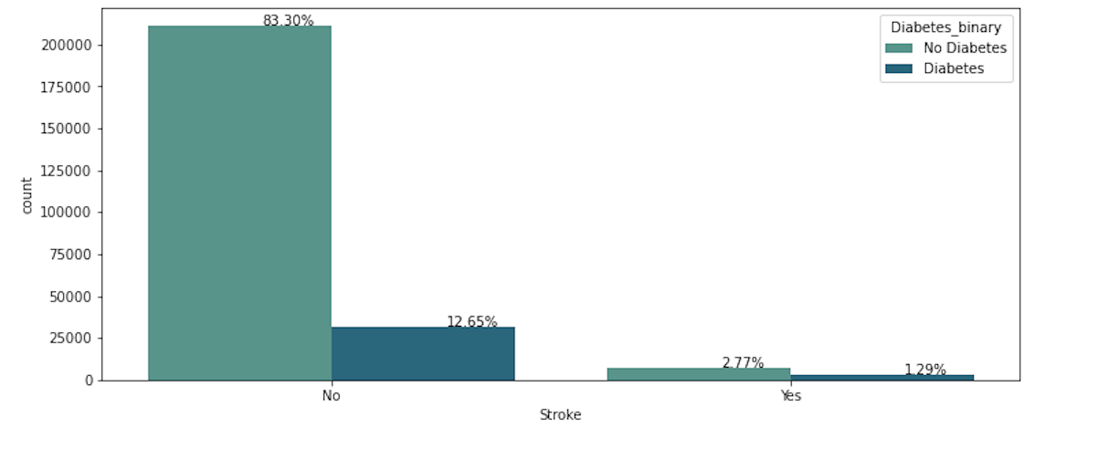
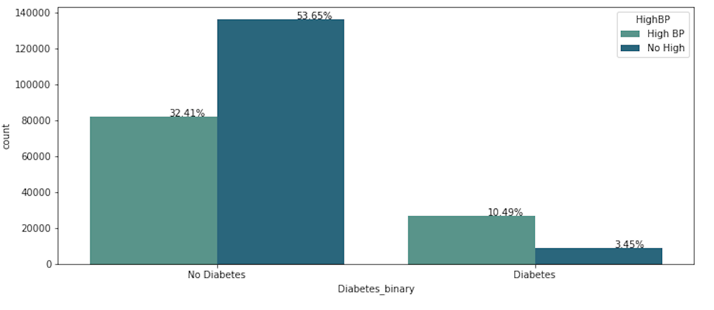
Stroke
High Blood Pressure

Slide 16
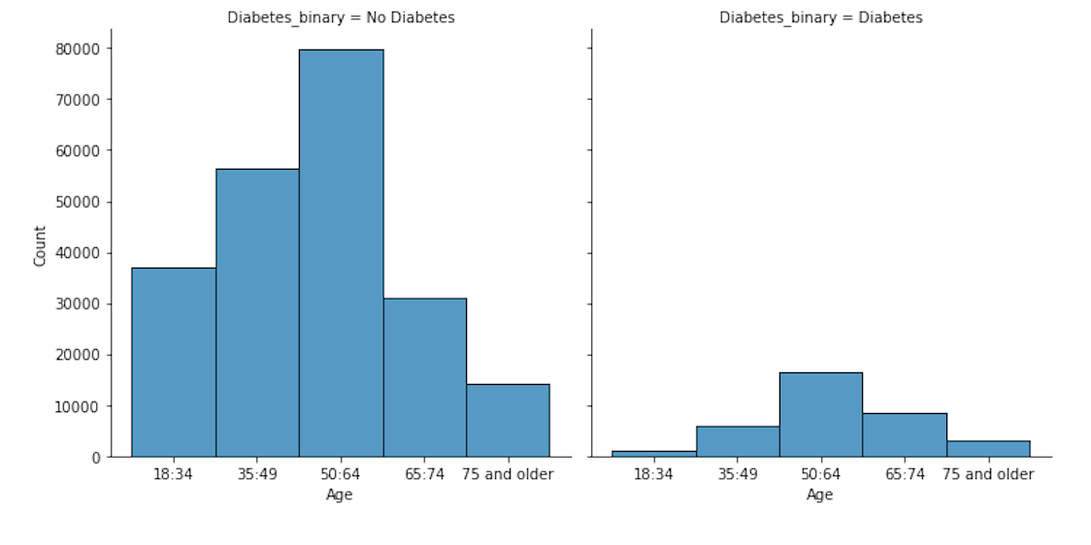
Age
AGE | CATEGORY
18-24 | 1
60-64 | 9
80 or older | 13

Slide 17
Exploratory Analysis
Do we include :
Gender gap ?
Box plot?

Slide 18
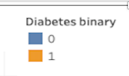
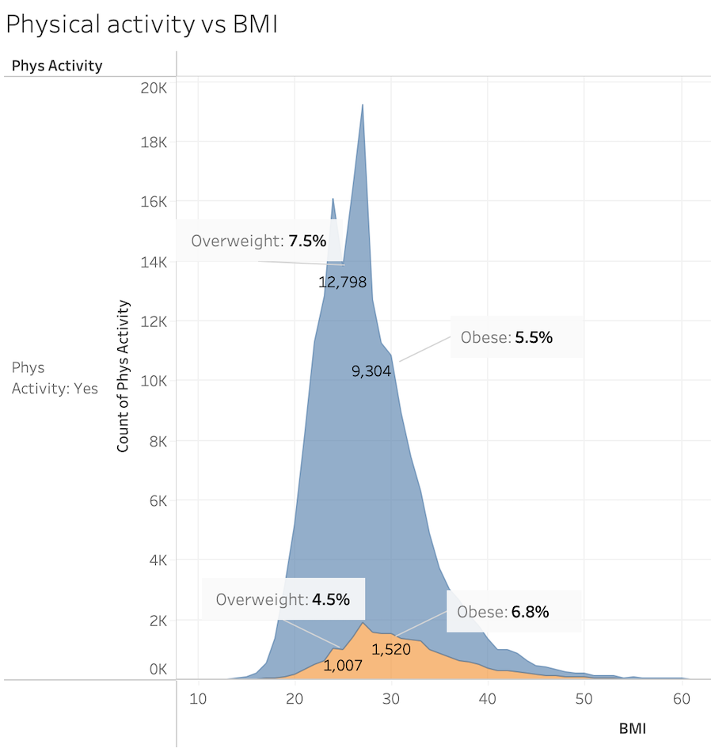
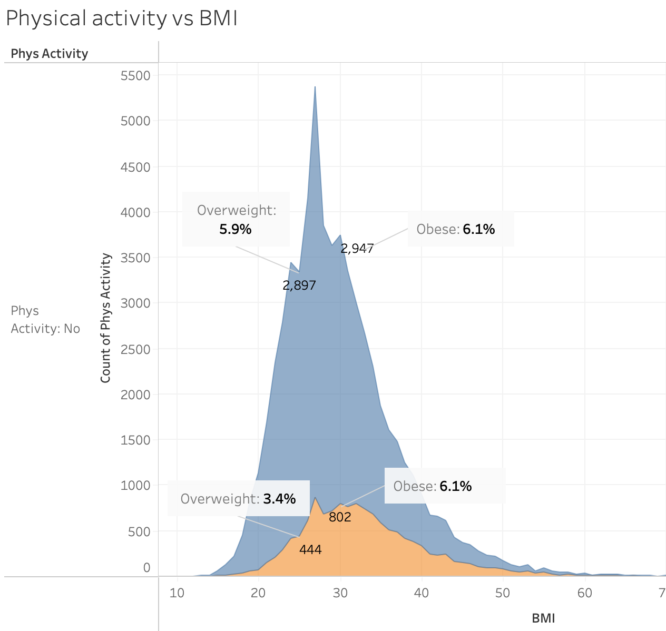
BMI | Range
< 18.5 | Underweight
18.5 to < 25 | Healthy weight
25 to < 30 | Overweight
30 or greater | Obesity

Slide 19
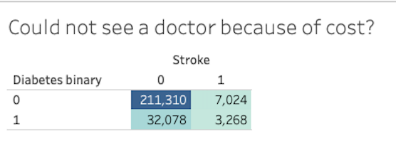
Exploratory Analysis
Add %

Slide 20
Future Analysis

Slide 21
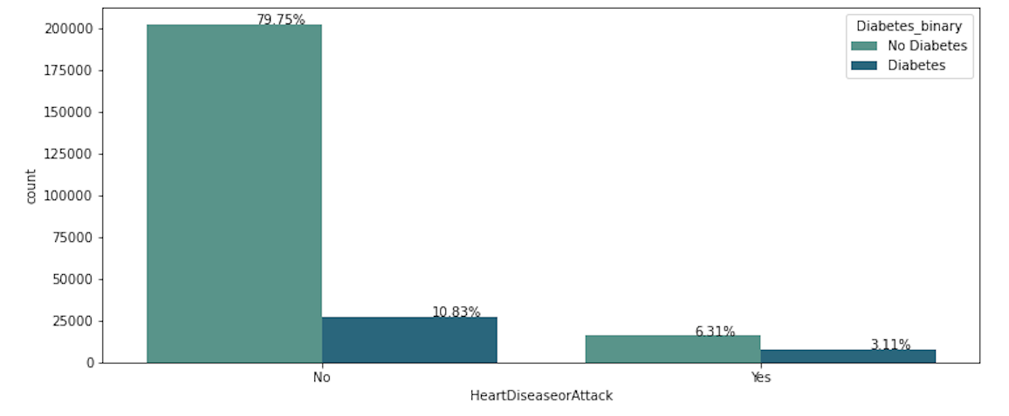
Heart Disease or Attack

Slide 22
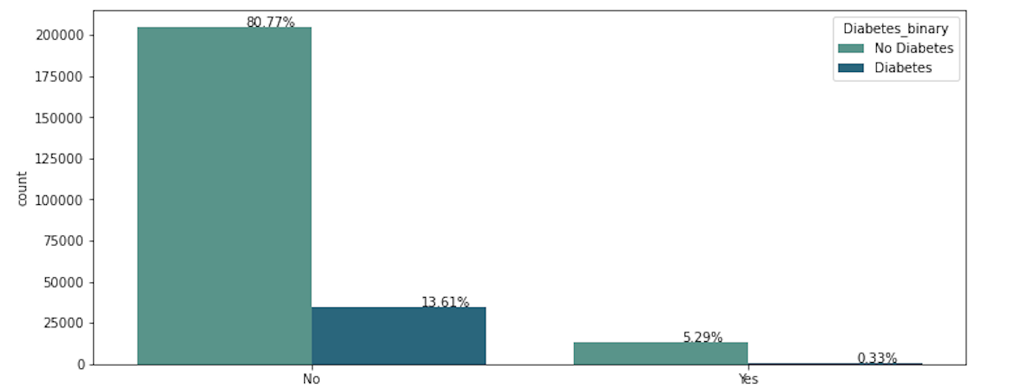
Alcohol Consumption

Slide 23
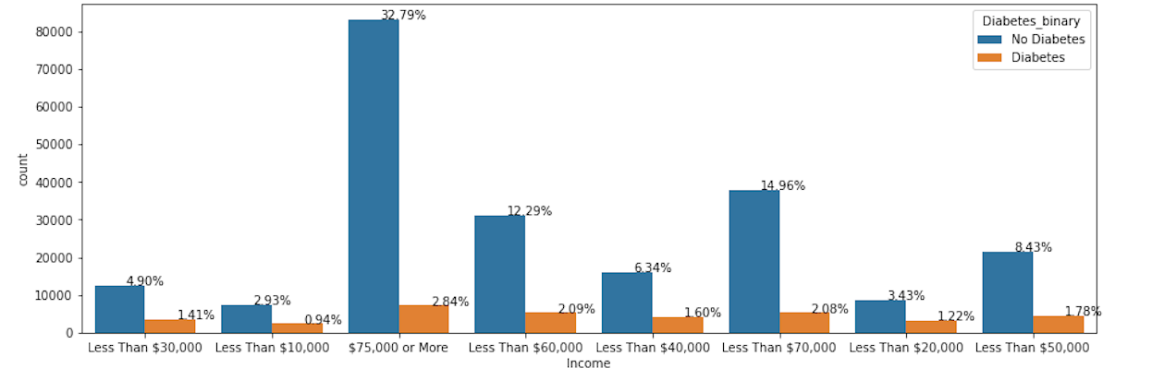
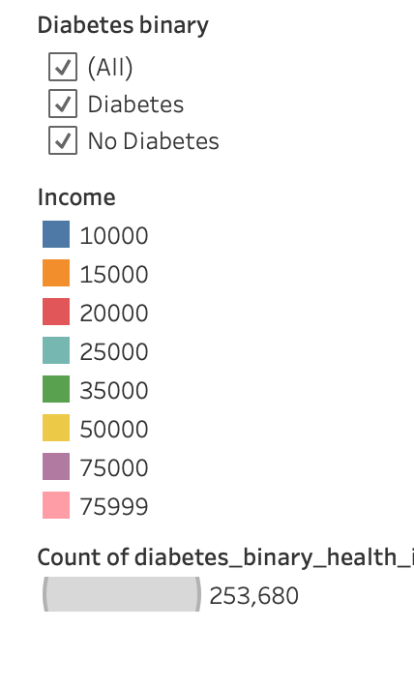
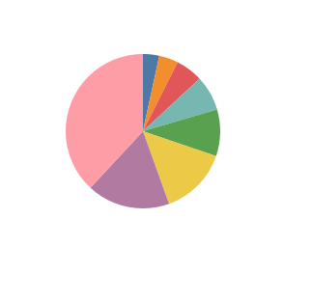
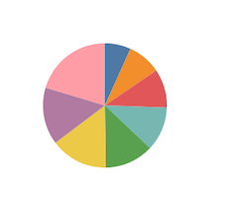
Diabetes vs Non-diabetes Income
INCOME | CATEGORY
$10,000 | 1
$15,000 | 2
$20,000 | 3
$25,000 | 4
$35,000 | 5
$50,000 | 6
$75,000 | 7
> $75,000 | 8
No Diabetes
With Diabetes

Slide 24
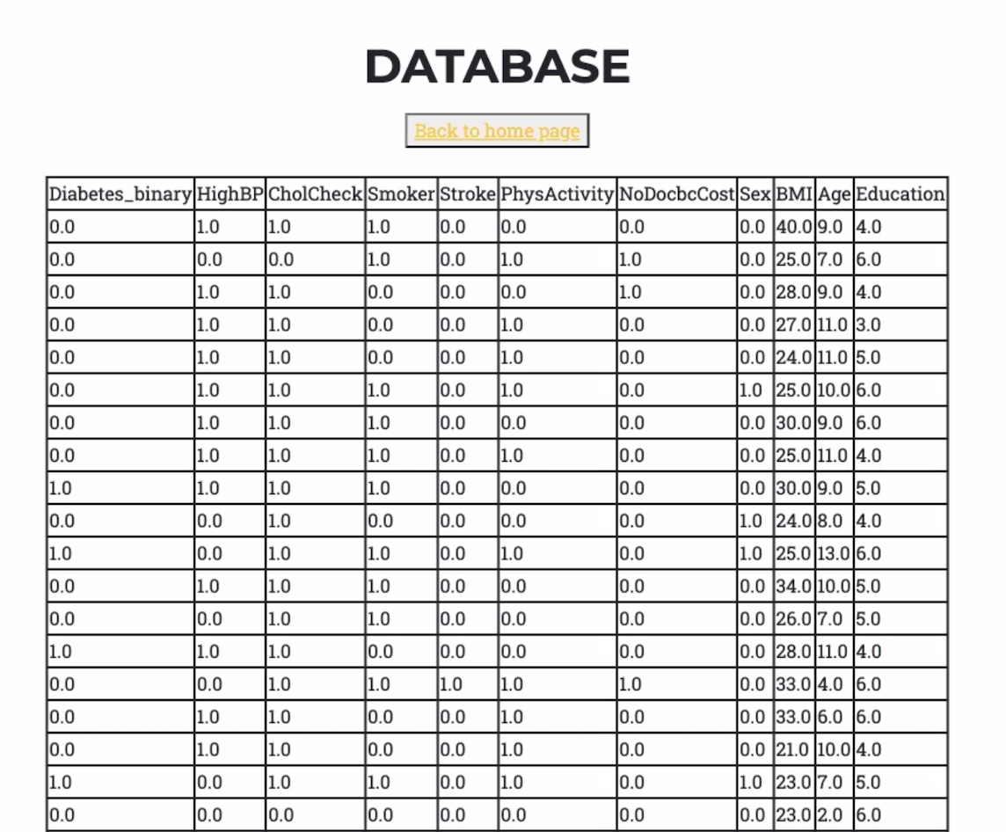
SQLite3
Python

Slide 25
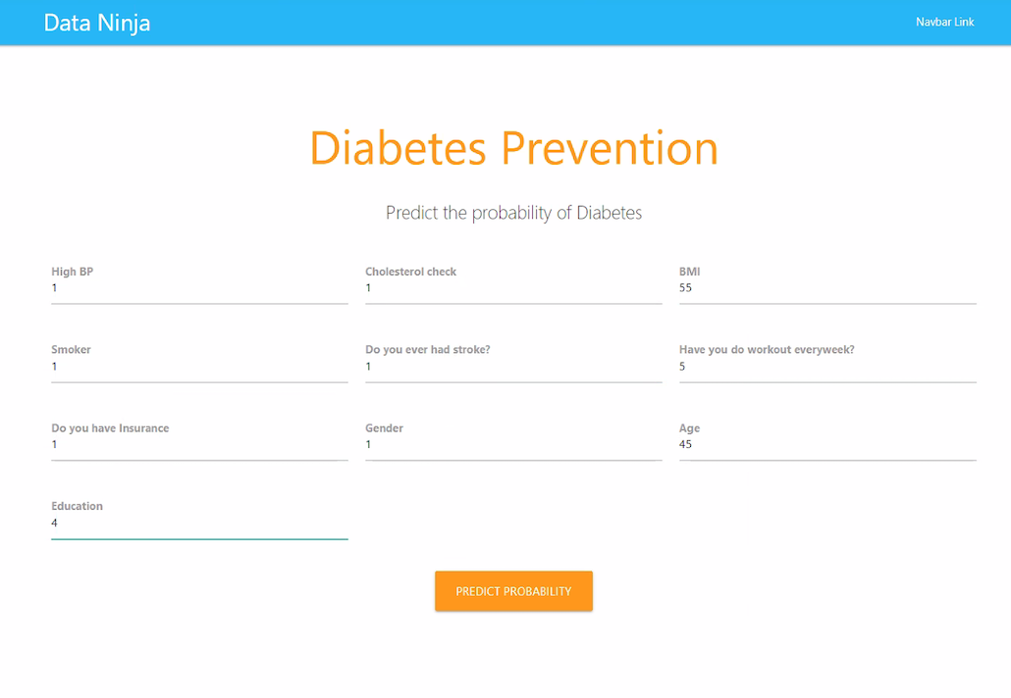
Deep Learning Sigmoid Function with TensorFlow
Accuracy: 86%
Layers: 3 hidden layers
> 20% chance of getting diabetes
< 20 % chance of getting diabetes

Slide 26
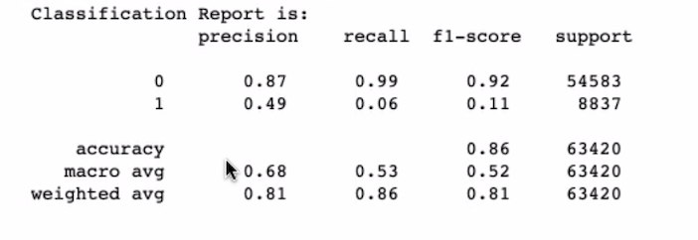
Logistic Regression Model
Confusion matrix, Recall, Precision, F1-score, balance accuracy score
Accuracy: 86%

Slide 27
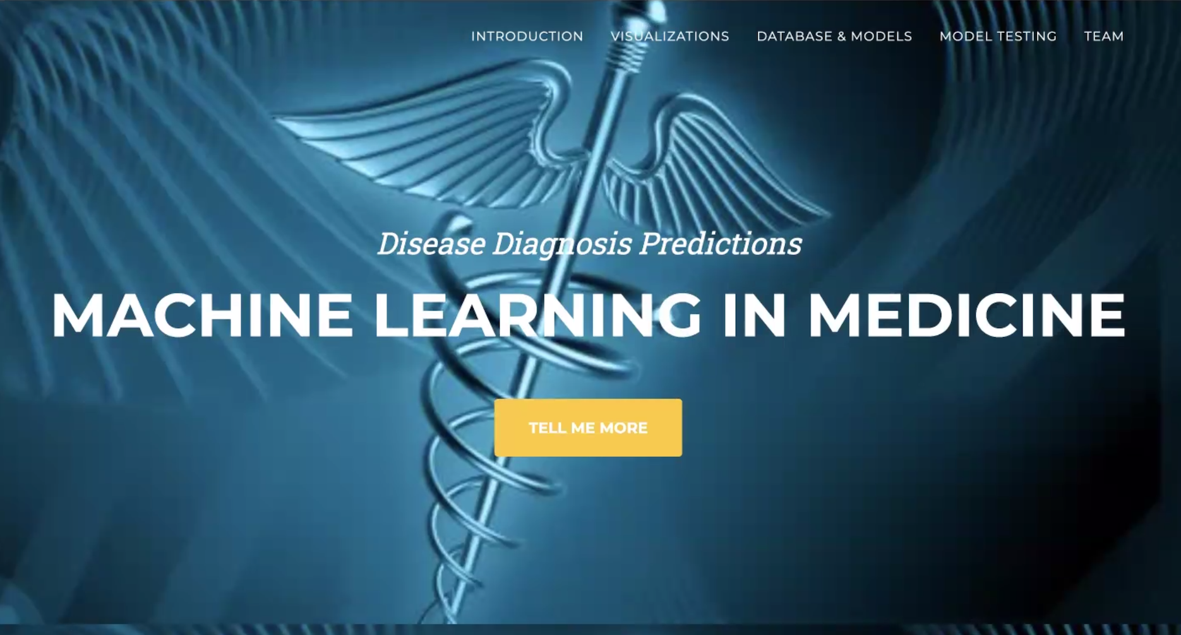

Slide 28
Set Backs
Connecting Flask with the database
Limited knowledge of the functions to make machine model connections with HTML and random forest
Deciding which of the 22 variables to work with.

Slide 29
Limitations
Time constraint did not allow to explore the deep learning method and random forest models because it required in depth exploration on making the comparisons.
Heat map and comparing/correlating the 22 variables.
Uncoding the binary code.
Working with several binary variables limited chart functions, i.e., 1 or 0.
Imbalanced sample. Diabetes sample was a lot less than the No Diabetes sample.

Slide 30
Conclusions
A diabetes prediction model will

Slide 31
References
GitHub
Stack Overflow
Scikitlearn
Numpy & python documentation

Slide 32
Questions?

Slide 33
THANK YOU!

