Slide 1

Predicting Diabetes Using Health Indicators
Presented by the Data Ninjas:
Isabel Garrido, Noemi Montelongo, Jack Pan, Garima Rajbhandari, & Gretta Uwamwiza

Slide 2
Contents
Introduction
Technologies
Method
Exploratory Analysis
Results/Model
Set Backs
Limitations
Conclusion
Further Considerations
Sources

Slide 3
Introduction
According to the CDC, the number of people who have diabetes in America is the highest it has ever been.
People with diabetes have a deficiency in how their body makes or uses insulin
Insulin is an important hormone that regulates glucose.
Diabetes can be a gateway towards serious complications such as heart disease, vision loss, lower-limb amputation and kidney disease.
It is essential that healthcare providers have the tools to screen patients for prediabetes or diabetes.
By using supervised machine learning, we built a prediction model that can assist clinicians predict diabetes.

Slide 4
Method
We used the Diabetes Health Indicators Dataset from 2015 provided by Kaggle.
The dataset was obtained by surveying hundreds of thousands of Americans for diabetes or prediabetes predictors with The Behavioral Risk Factor Surveillance System (BRFSS).
We decided to explore 10 of the 22 variables for our prediction based mostly on their importance values:
Education
Age
High BP
Gender
BMI
Cholesterol check
No Doc bc Cost
Stroke
Smoker
Physical Activity

Slide 5
Binary Variables
VARIABLE | NO | YES
Diabetes | 0 | 1
High BP | 0 | 1
Cholesterol check | 0 | 1
Smoker | 0 | 1
Stroke | 0 | 1
Physicial Activity | 0 | 1
No Doctor Because Cost | 0 | 1
Gender | 0 | 1
Cholesterol check (within 5 years) | 0 | 1
Heart Disease/Attack | 0 | 1

Slide 6
Non-binary Variables
AGE | CATEGORY
18-24 | 1
60-64 | 9
80 or older | 13
BMI | Range
< 18.5 | Underweight
18.5 to < 25 | Healthy weight
25 to < 30 | Overweight
30 or greater | Obesity
INCOME | CATEGORY
$10,000 | 1
$15,000 | 2
$20,000 | 3
$25,000 | 4
$35,000 | 5
$50,000 | 6
$75,000 | 7
> $75,000 | 8
CATEGORY | EDUCATION
1 | Never attended school/only kindergarten
2 | Grade 1-8 (Elementary)
3 | Grade 9 – 11 (Some high school)
4 | Grade 12 or GED ( High school graduate
5 | College 1 to 3 years (Some college)
6 | College 4 years or more (College graduate)

Slide 7
Method
Extensive clean-up such as dropping NaN or columns therefore we were able to proceed in creating the model.
Some of the questions that we explored were age, diet, physical activity and health history.
The data that we chose did not require extensive clean-up.
Before we were able to work with the dataset, we had to label the categories in some of the columns. For example. the income column had 8
It was felt that a supervised machine learning was the best approach to classify and predict diabetes. We used the tensorflow deep learning module. To compare for accuracy, we used the random forest method for this prediction. We then began to build the webpage using HTML, Javascript, and Flask. To be continued...
Demonstrate and expand further the logistic model prediction since we had a higher accuracy... and then use tensorflow and random forest as additional analysis.

Slide 8
Technologies
Python 3.9.12
Javascript
HTML
Form & Postman
Flask
Tableau
SQLite

Slide 9
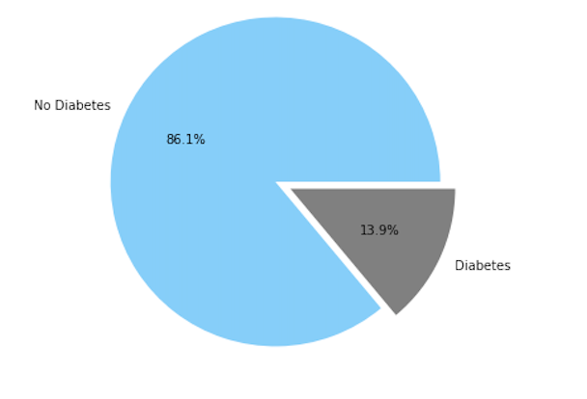
Exploratory Analysis
Population sample: 253,681
Prediction:
0= No diabetes (total)
1= diabetes or prediabetes (total)

Slide 10
Heatmap

Slide 11
Exploratory Analysis
Cholesterol Check

Slide 12
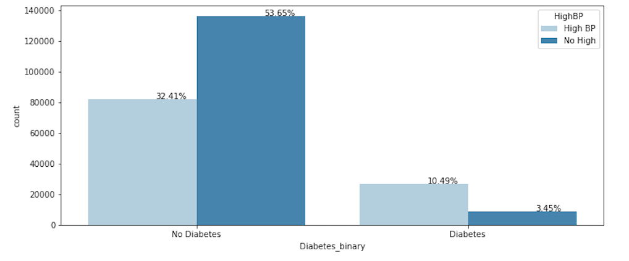
Exploratory Analysis
High BP

Slide 13
Exploratory Analysis
Gender gap

Slide 14
Education

Slide 15
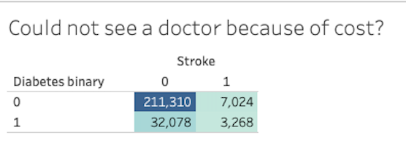
Exploratory Analysis
Add %

Slide 16
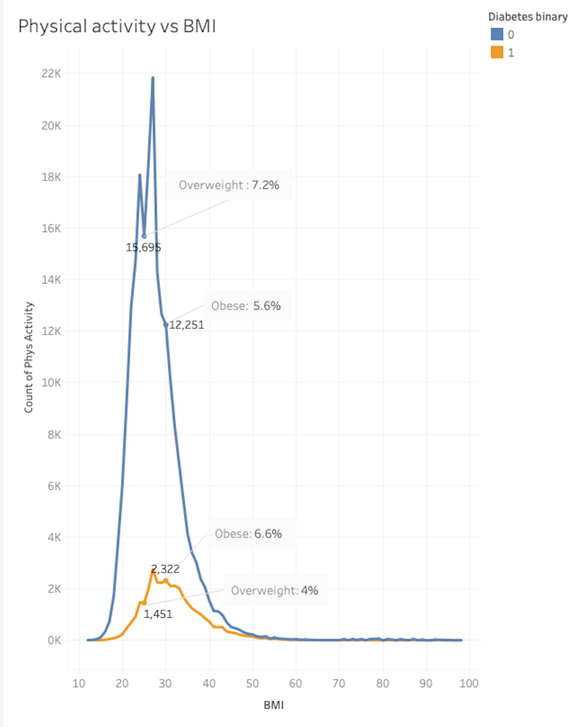
Exploratory Analysis

Slide 17
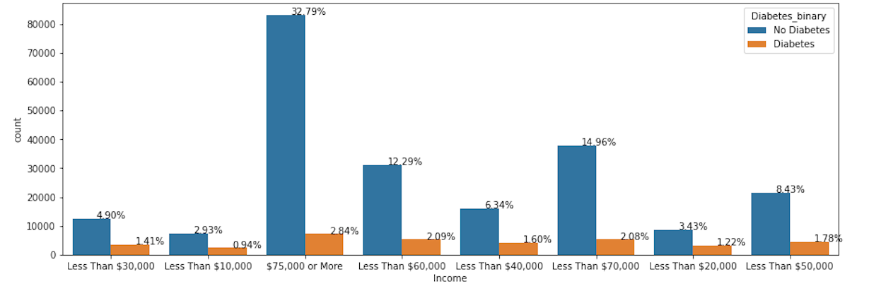
Future Analysis
Diabetes vs Non-diabetes Income

Slide 18
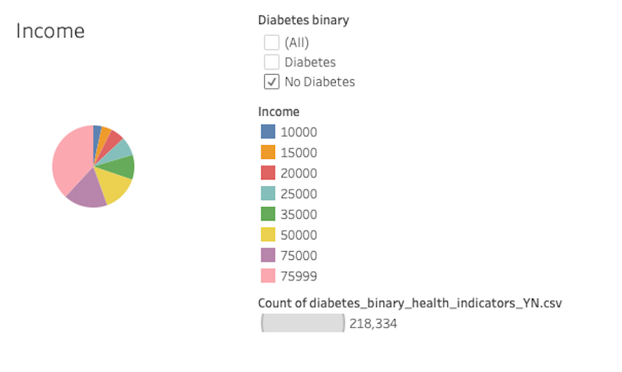
Future Analysis

Slide 19
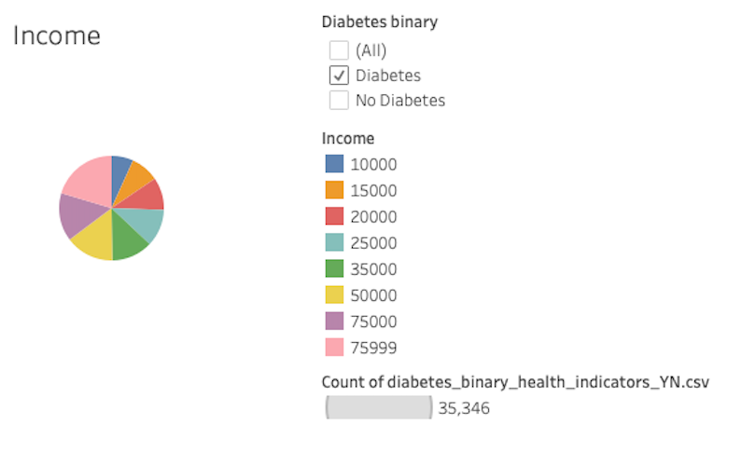
Future Analysis

Slide 20
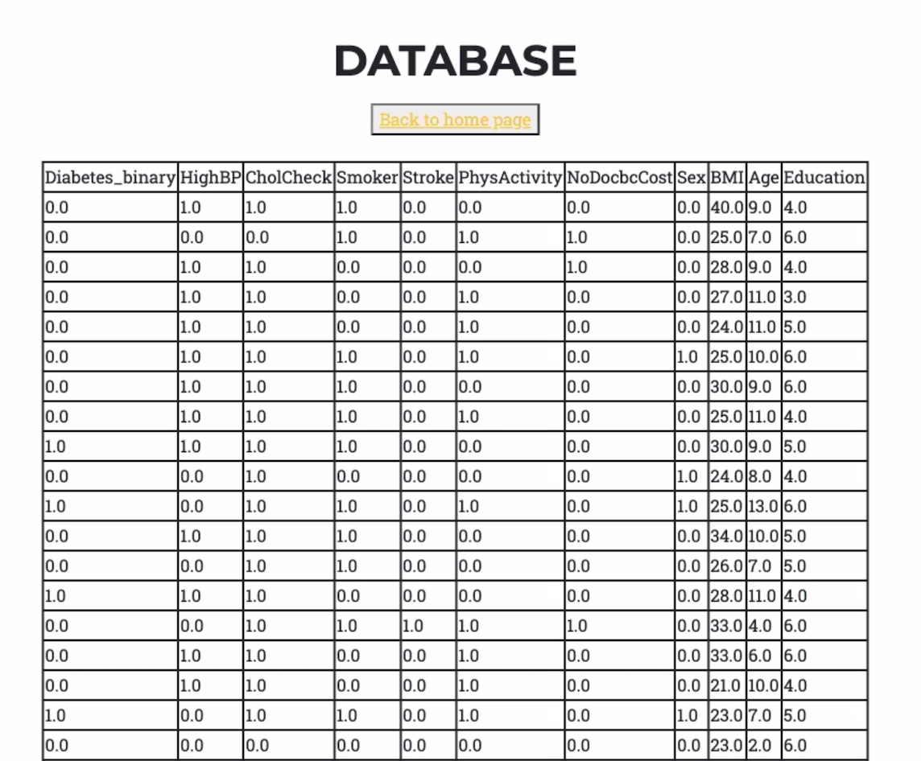
SQLite3
Python

Slide 21
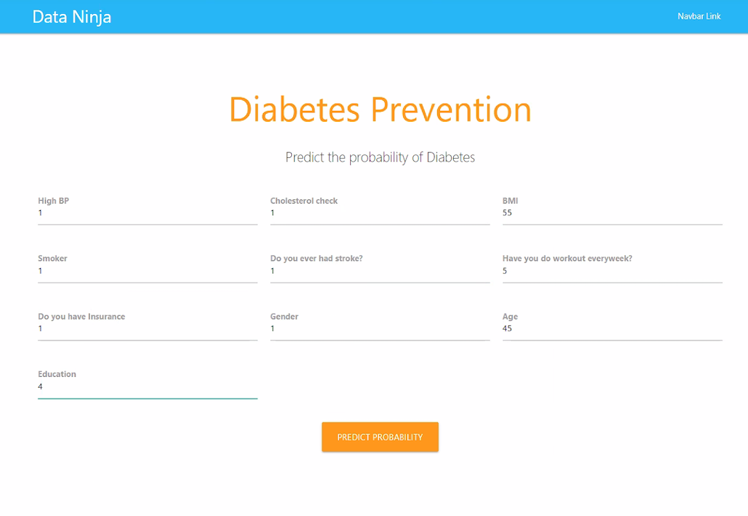
Deep Learning Sigmoid Function with TensorFlow
Accuracy: 86%
Layers: 3 hidden layers
> 20% chance of getting diabetes
< 20 % chance of getting diabetes

Slide 22
Logistic Regression Model
Confusion matrix, Recall, Precision, F1-score, balance accuracy score
Accuracy: 86%

Slide 23


Slide 24
Set Backs
Connecting Flask with the database
Limited knowledge of the functions to make machine model connections with HTML and random forest
Deciding which variables out of the 22 columns to use

Slide 25
Limitations
Time constraint did not allow to explore the deep learning method and random forest models because it required in depth exploration on making the comparisons.
Heat map and comparing/correlating the 22 variables.
Uncoding the binary code.
Working with several binary variables limited chart functions, i.e., 1 or 0.
Imbalanced sample. No diabetes sample is much greater than sample with diabetes.

Slide 26
Conclusions
A diabetes prediction model will

Slide 27
References
GitHub
Stack Overflow
Scikitlearn
Numpy & python documentation

Slide 28
Questions?

Slide 29
THANK YOU!

