Slide 1

Predicting Diabetes Using Health Indicators
Presented by the Data Ninjas:
Isabel Garrido, Noemi Montelongo, Jack Pan, Garima Rajbhandari, & Gretta Uwamwiza

Slide 2
Introduction
According to the CDC, the number of people who have diabetes in America is the highest it has ever been.
People with diabetes have a deficiency in how their body makes or uses insulin
Insulin is an important hormone that regulates glucose.
Diabetes can be a gateway towards serious complications such as heart disease, vision loss, lower-limb amputation and kidney disease.
It is essential that healthcare providers have the tools to screen patients for prediabetes or diabetes.
By using supervised machine learning, we built a prediction model that can assist clinicians and individuals predict diabetes.

Slide 3
Contents
Introduction
Technologies
Method
Exploratory Analysis
Future Analysis
Models
Limitations
Setbacks
Conclusion
Sources

Slide 4
Tools and Technologies
Python 3.9.12 | Tableau | Pickle
JavaScript | SQLite3 | Joblib
HTML | Matplotlib | Google Collab
Form & Postman | Hvplot | Microsoft Powerpoint
Flask | Plotly | Pathlib

Slide 5
Method
We used the Diabetes Health Indicators Dataset from 2015 provided by Kaggle.
The dataset was obtained by surveying hundreds of thousands of Americans for diabetes or prediabetes predictors with The Behavioral Risk Factor Surveillance System (BRFSS).
We decided to explore 10 of the 22 variables for our prediction based mostly on their importance values:
Education
Age
High BP
Gender
BMI
Cholesterol check
No Doc because of Cost
Stroke
Smoker
Physical Activity

Slide 6
Method
Some of the questions that we explored were age, diet, physical activity and health history.
The data that we chose did not require extensive clean-up but we did have to label the categories in some of the columns.
It was felt that a supervised machine learning was the best approach to classify and predict diabetes. To compare for accuracy, we used We used the Tensorflow deep learning module and logistic regression models.
We built the database and a webpage using HTML, Javascript, Python and Flask.
In addition, we explored the data with analytical tools.

Slide 7
Exploratory Analysis

Slide 8
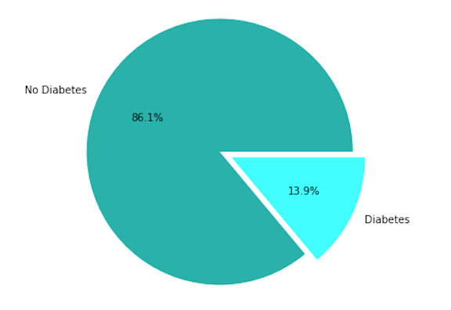
General Overview of Sample Population
Population sample: 253,681
No Diabetes: 218,334
With Diabetes or Pre-diabetes: 35,346
Prediction:
0= No diabetes
1= diabetes or prediabetes

Slide 9
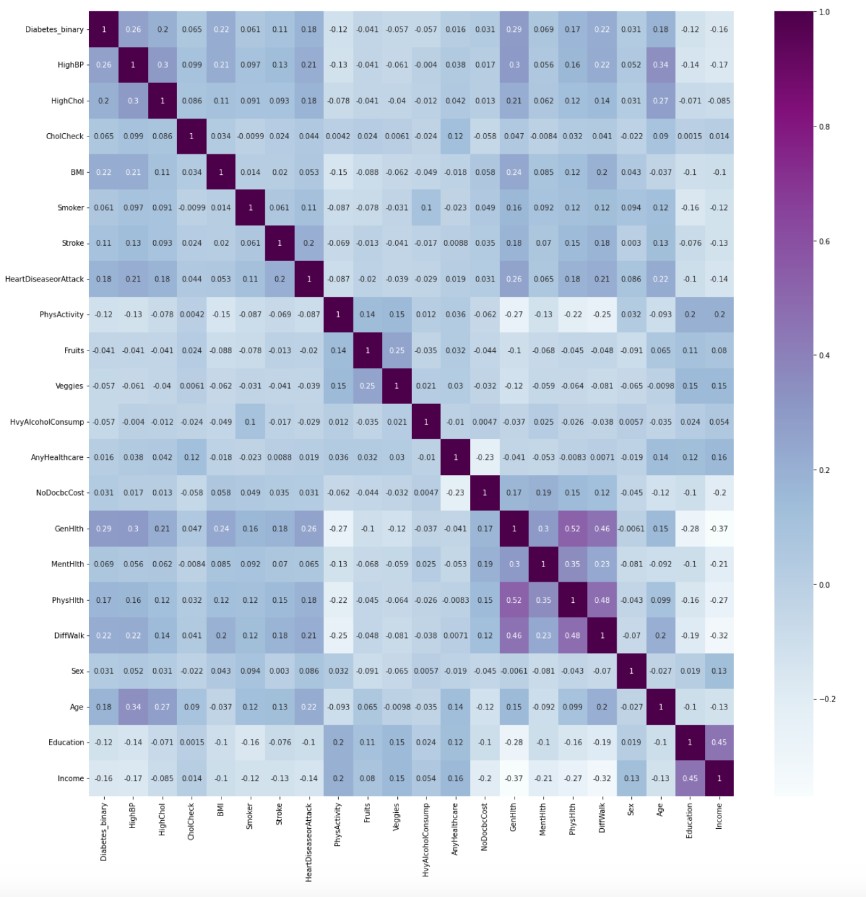
Heatmap (All 22 variables)

Slide 10
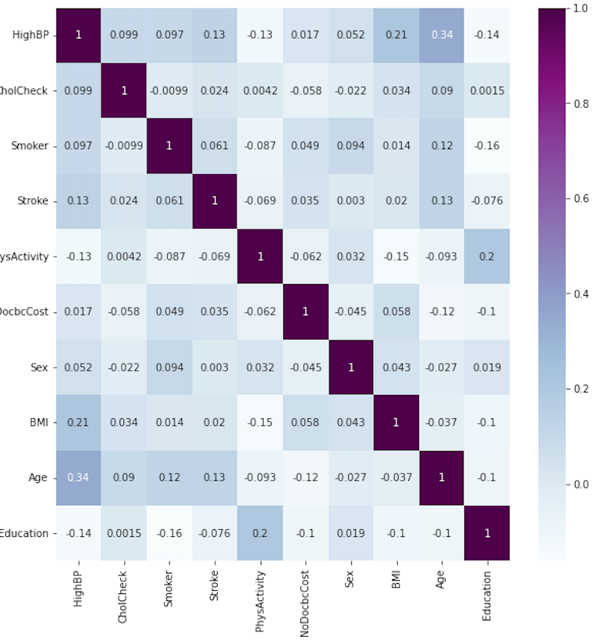
Heatmap (Focused on 10 variables)

Slide 11
List of Binary Variables
VARIABLE | NO | YES
Diabetes | 0 | 1
High BP | 0 | 1
Cholesterol check | 0 | 1
Smoker | 0 | 1
Stroke | 0 | 1
Physicial Activity | 0 | 1
No Doctor Because Cost | 0 | 1
Gender | 0 | 1
Cholesterol check (within 5 years) | 0 | 1
Heart Disease/Attack | 0 | 1

Slide 12
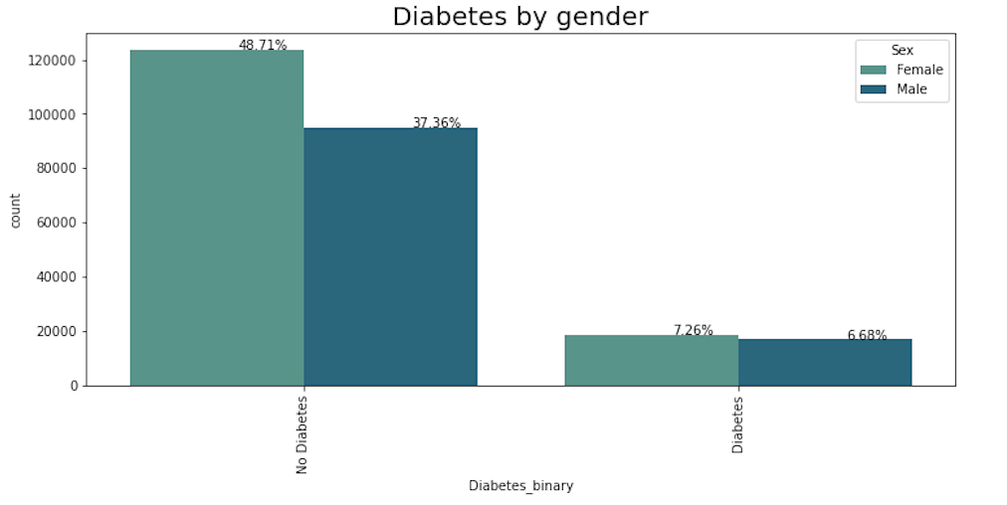
Gender

Slide 13
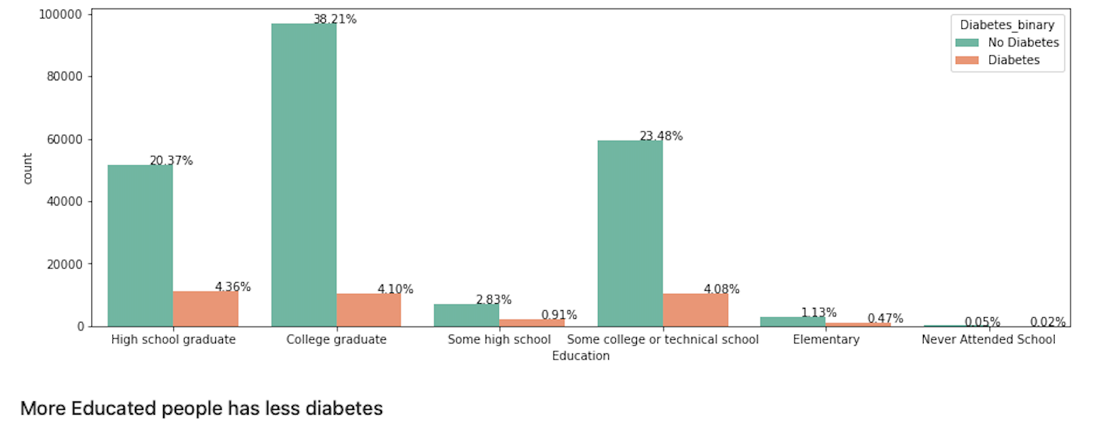
Education distribution in people with diabetes

Slide 14
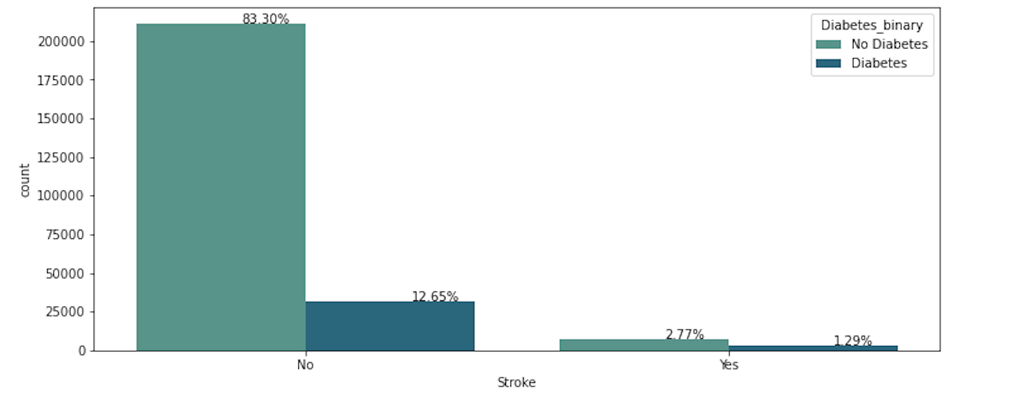
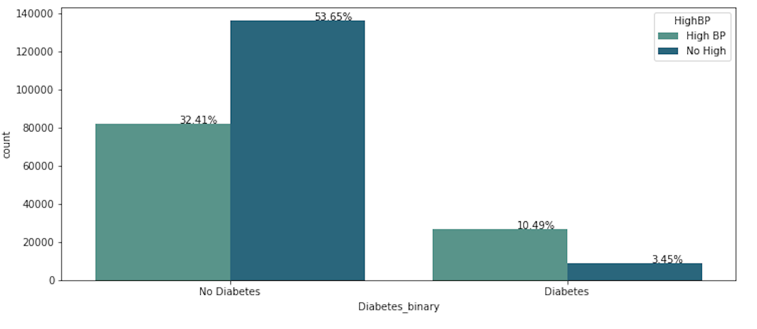
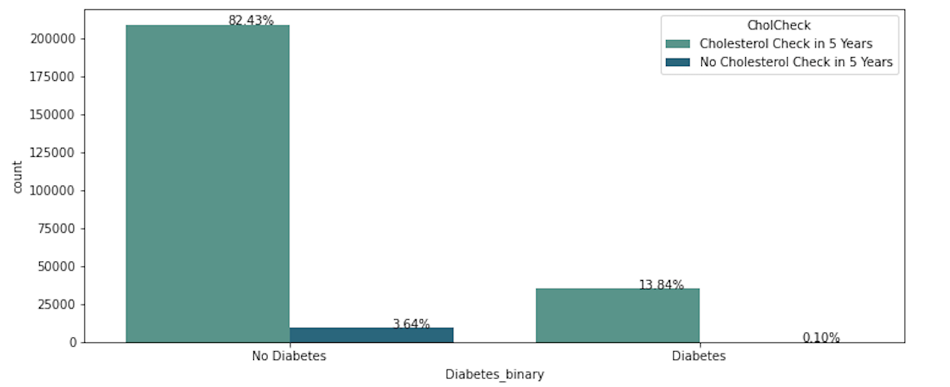
Stroke
Overview of stroke, high blood pressure, & cholesterol check predictors
High Blood Pressure
Cholesterol Check

Slide 15
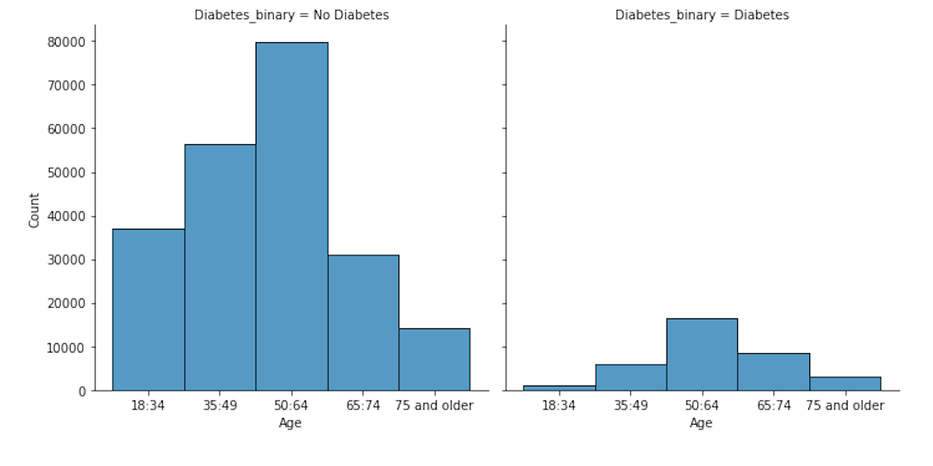
How is diabetes distributed by age?

Slide 16
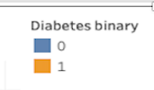
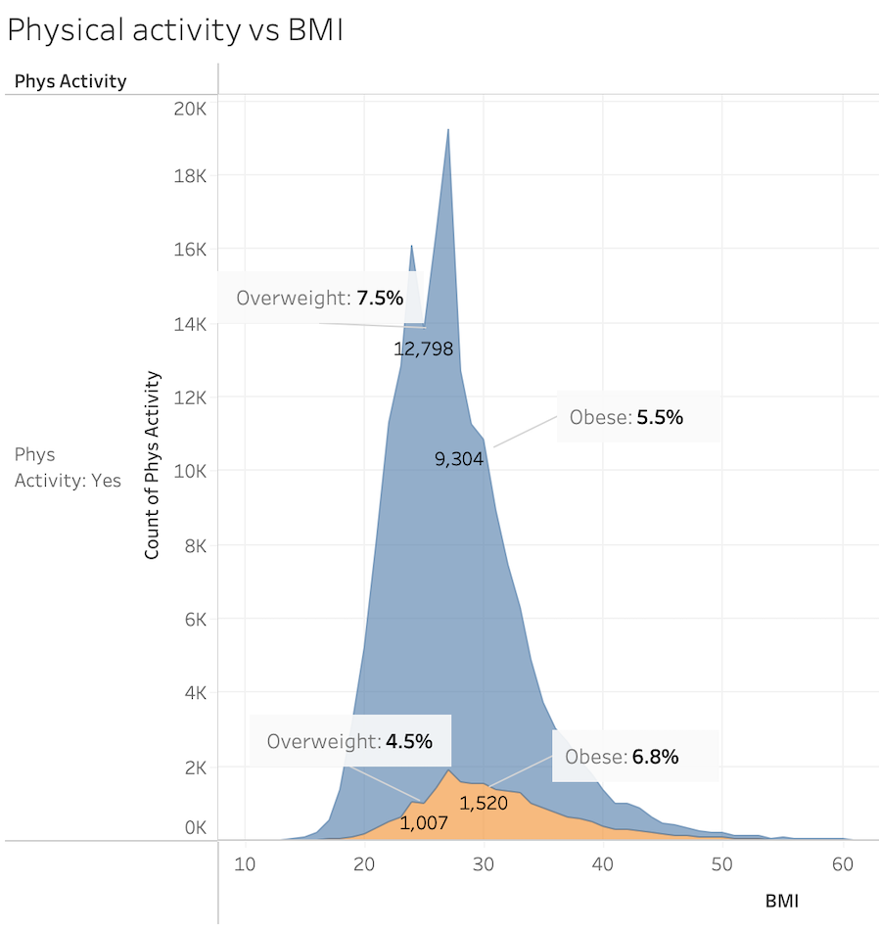
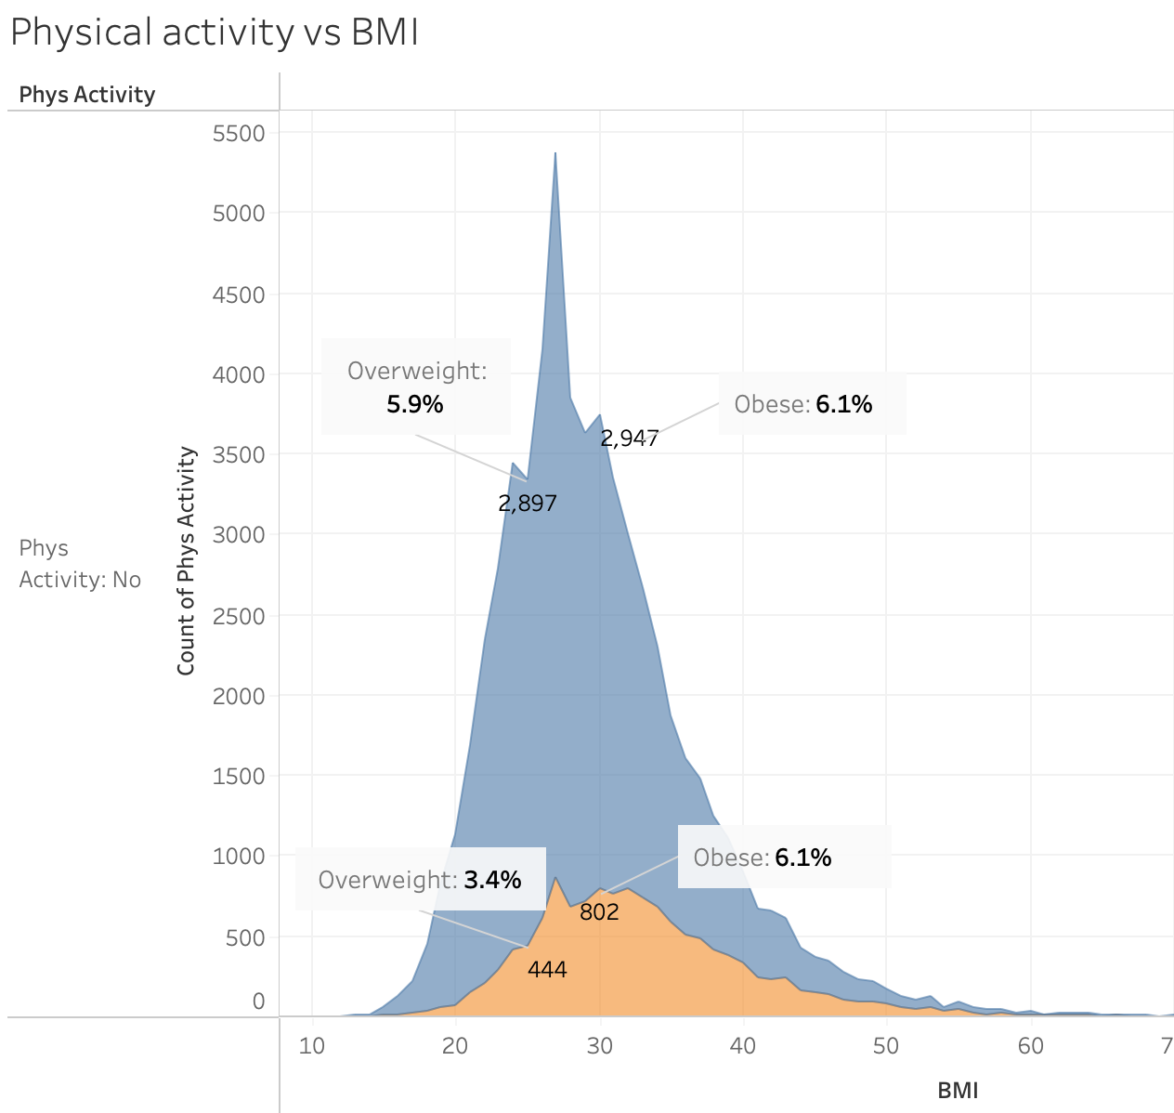
Does physical activity affect the BMI?
BMI | Range
< 18.5 | Underweight
18.5 to < 25 | Healthy weight
25 to < 30 | Overweight
30 or greater | Obesity

Slide 17
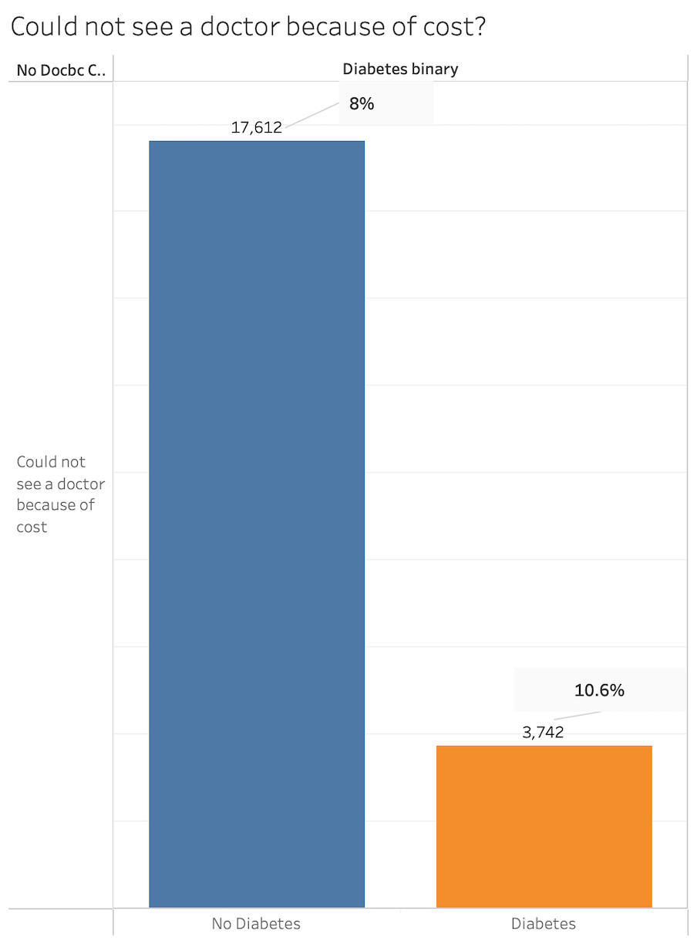

Slide 18
Future Analysis

Slide 19
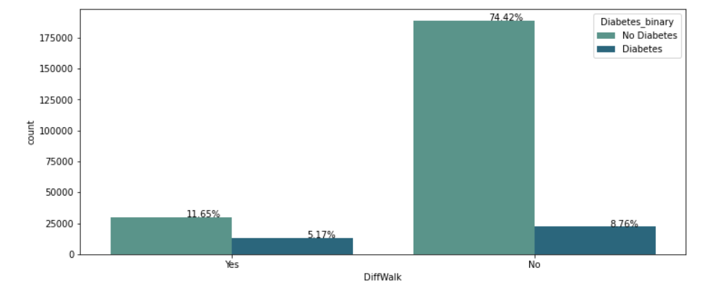
How does difficulty walking compare in the diabetic population?

Slide 20
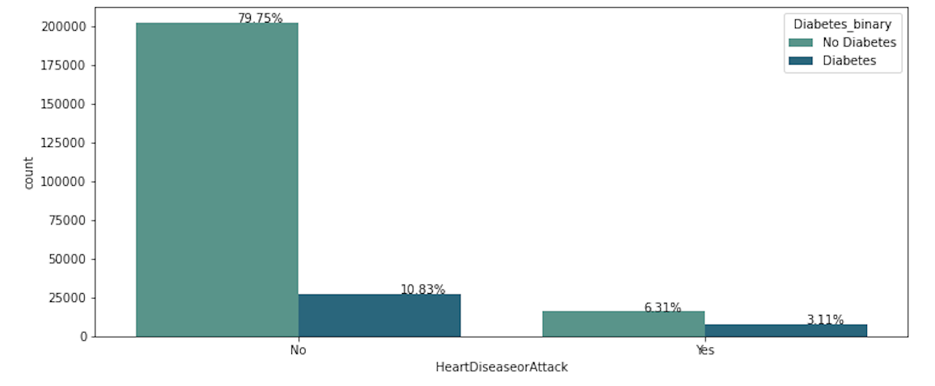
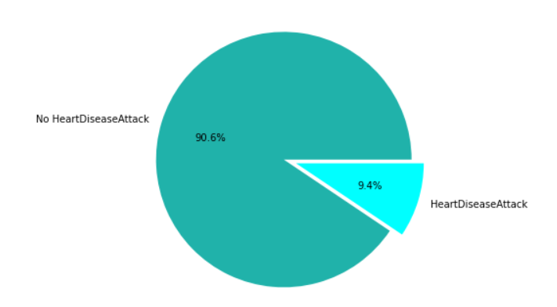
Do people with diabetes have a higher prevalence of heart disease or heart attack?
No Heart Attack: 229787
Heart attack: 23893
6/79 and 3/10

Slide 21
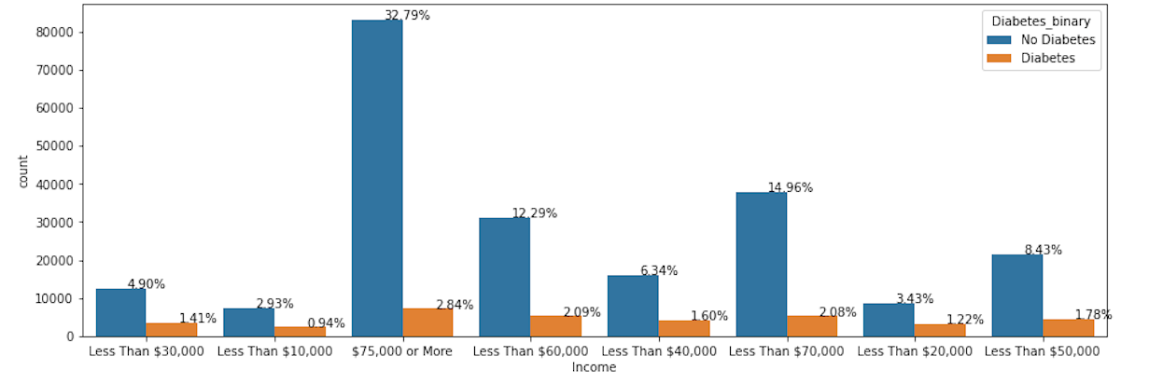
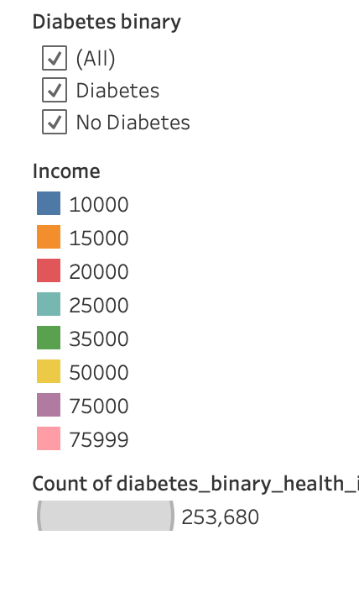
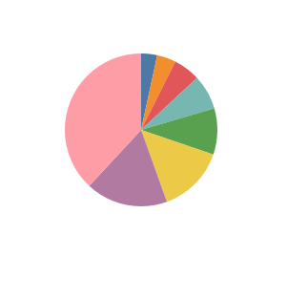
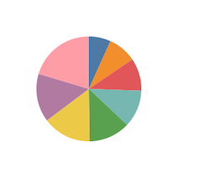
Diabetes vs Non-diabetes Income
INCOME | CATEGORY
$10,000 | 1
$15,000 | 2
$20,000 | 3
$25,000 | 4
$35,000 | 5
$50,000 | 6
$75,000 | 7
> $75,000 | 8
No Diabetes
With Diabetes

Slide 22
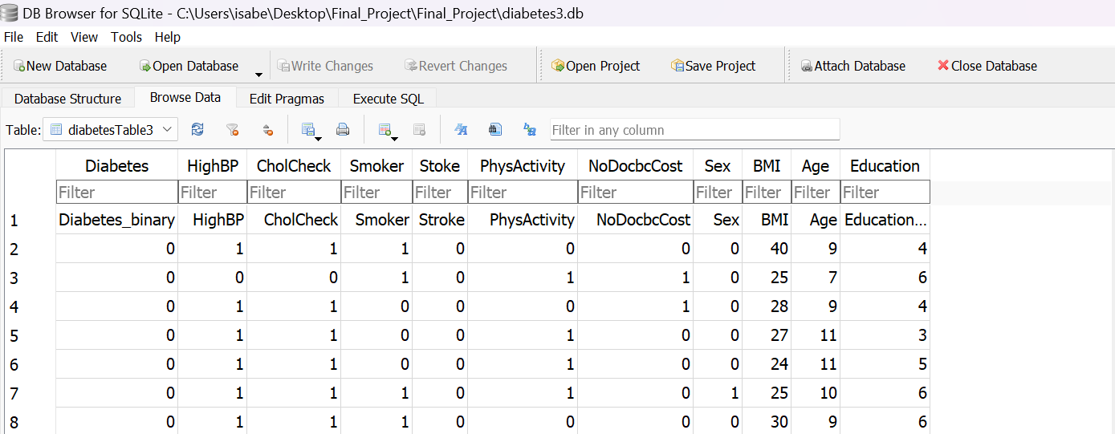
SQLite and Database Table
Some of the functions include:
connection
cursor

Slide 23
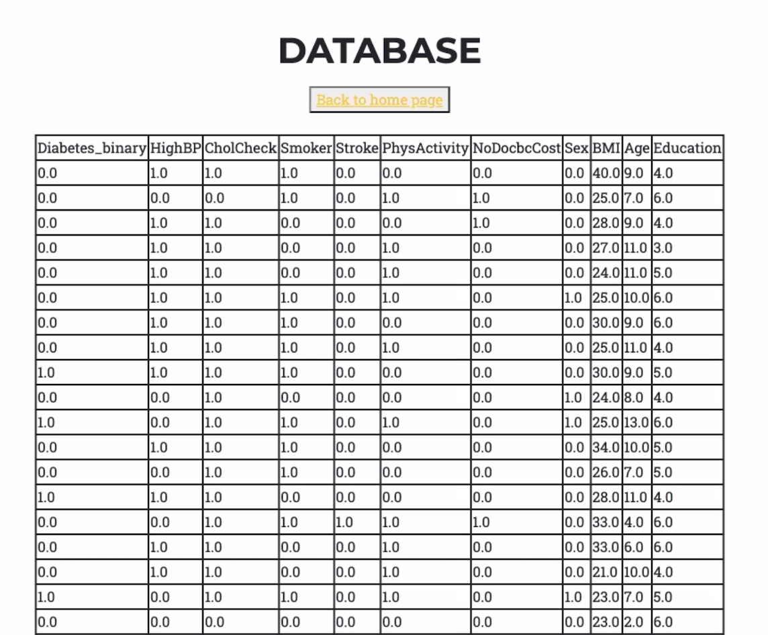

Slide 24
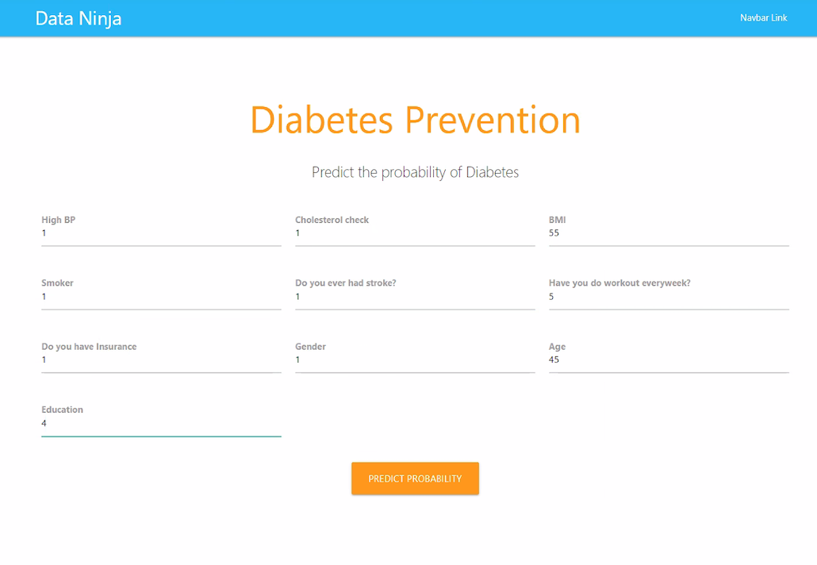
Deep Learning Sigmoid Function with TensorFlow
Accuracy: 86%
Layers: 3 hidden layers
> 20% chance of getting diabetes
< 20 % chance of getting diabetes

Slide 25
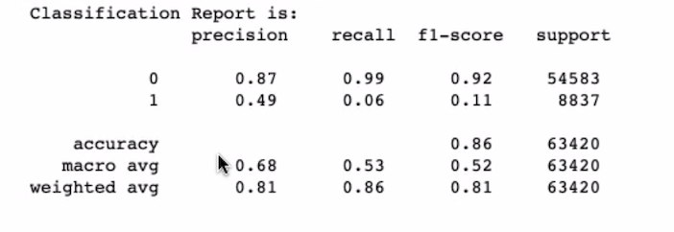
Logistic Regression Model
Confusion matrix, Recall, Precision, F1-score, balance accuracy score
Accuracy: 86%
AGE | CATEGORY
18-24 | 1
60-64 | 9
80 or older | 13
CATEGORY | EDUCATION
1 | Never attended school/only kindergarten
2 | Grade 1-8 (Elementary)
3 | Grade 9 – 11 (Some high school)
4 | Grade 12 or GED ( High school graduate
5 | College 1 to 3 years (Some college)
6 | College 4 years or more (College graduate)

Slide 26
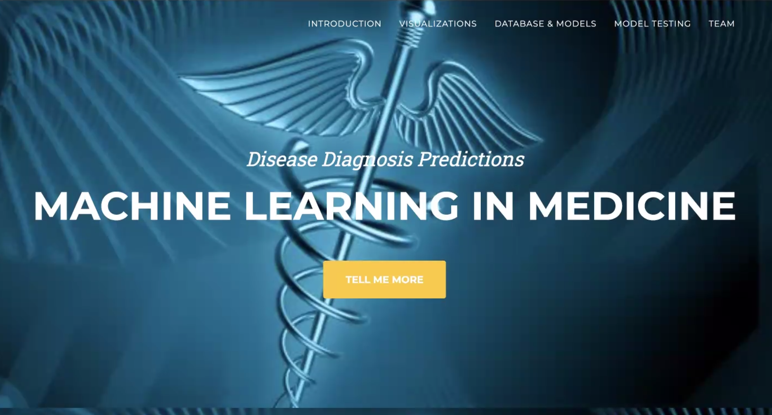

Slide 27
Setbacks
Connecting Flask with the database
Limited knowledge of the functions to make machine model connections with HTML and random forest
Deciding which of the 22 variables had the most significance.

Slide 28
Limitations
Time constraint did not allow to explore the deep learning method and random forest models because it required in depth exploration on making the comparisons.
Heat map and comparing/correlating the 22 variables.
Uncoding the binary code.
Working with several binary variables limited chart functions, i.e., 1 or 0.
Imbalanced sample. Diabetes sample was a lot less than the No Diabetes sample.

Slide 29
Conclusion
Our group utilized a variety of technologies to create a diabetes prediction tool for a healthcare setting or individual use.
We found that some health indicators have a greater influence in determining whether someone is at risk for diabetes.
Developer and teamwork skills were exercised while creating a database and an HTML using Flask.
We used a deep learning method involving TensorFlow and logistic regression to validate the data and both showed an accuracy score of 86%.
Data analysis was performed to understand the underlying indicators that lead to developing pre-diabetes or diabetes.
Setbacks creating the models, HTML pages, and analysis were addressed through trial and error and with the guidance of teacher assistants.

Slide 30
Next Steps
To explore other health indicators such as difficulty walking, nutritional intake such fruits and vegetables.
Additional analysis on heart disease, income, and alcohol consumption.
Future use of our deep learning and logistic classification models to triage centers in emergency rooms.

Slide 31
References
GitHub
Stack Overflow
Scikitlearn
Numpy & python documentation
Pubmed
CDC

Slide 32
Questions?

Slide 33
THANK YOU!

