Slide 1

Predicting Diabetes Using Health Indicators
Presented by the Data Ninjas:
Isabel Garrido, Noemi Montelongo, Jack Pan, Garima Rajbhandari, & Gretta U.

Slide 2
Contents
Introduction
Method
Technologies
Results
Set Backs
Limitations
Conclusion
Further Considerations
References

Slide 3
Introduction
According to the CDC, the number of people who have diabetes in America is the highest it has ever been.
People with diabetes have a deficiency in how their body makes or uses insulin
Insulin is an important hormone that regulates glucose.
Diabetes can be a gateway towards serious complications such as heart disease, vision loss, lower-limb amputation and kidney disease.
It is essential that healthcare providers have the tools to screen patients for prediabetes or diabetes.
By using supervised machine learning, we built a prediction model that can assist clinicians predict diabetes.

Slide 4
Method
We used the Diabetes Health Indicators Dataset from 2015 provided by Kaggle.
The dataset was obtained by surveying hundreds of thousands of Americans for diabetes or prediabetes predictors with The Behavioral Risk Factor Surveillance System (BRFSS).
We decided to explore 10 of the 22 variables for our prediction based mostly on their importance values:
Education
Age
High BP
Gender
BMI
Cholesterol check
No Doc bc Cost
Stroke
Smoker
Physical Activity

Slide 5
Method
Extensive clean-up such as dropping NaN or columns therefore we were able to proceed in creating the model.
Some of the questions that we explored were age, diet, physical activity and health history.
The data that we chose did not require extensive clean-up.
Before we were able to work with the dataset, we had to label the categories in some of the columns. For example. the income column had 8
It was felt that a supervised machine learning was the best approach to classify and predict diabetes. We used the tensorflow deep learning module. To compare for accuracy, we used the random forest method for this prediction. We then began to build the webpage using HTML, Javascript, and Flask. To be continued...
Demonstrate and expand further the logistic model prediction since we had a higher accuracy... and then use tensorflow and random forest as additional analysis.

Slide 6
Technologies
Python 3.9.12
Javascript
HTML
Form & Postman
Flask
Tableau

Slide 7
Set Backs
Connecting Flask with the database.
We cannot expand on tensorflow (limited knowledge of the functions to make machine model connections with HTML) and random forest

Slide 8
Limitations
Greta: Time constraint did not allow to explore the deep learning method and randon forest models because it required in depth exploration on making the comparisons.
Garima: Heat map and comparing/correlating the 22 variables. Uncoding the binary code.
Analysis:

Slide 9
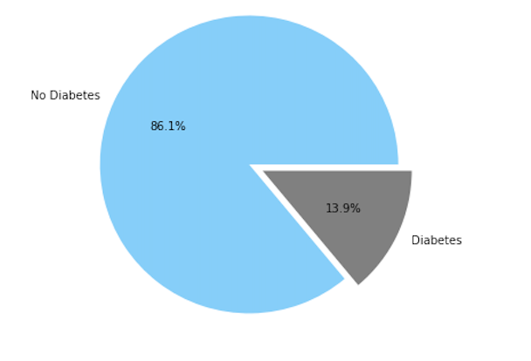
Results
Population: 253,681
Prediction:
0= No diabetes
1= diabetes or prediabetes
Accuracy: 86%

Slide 10
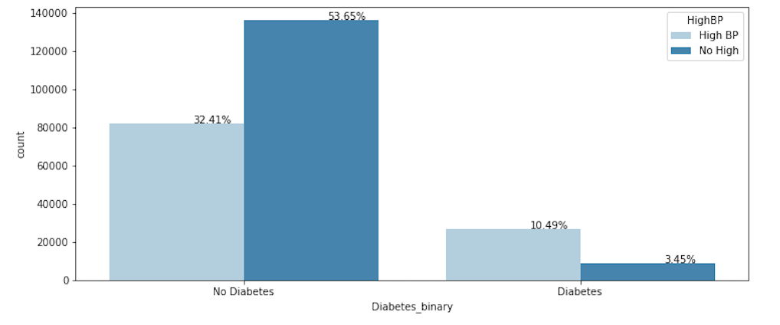
Results continued
High Blood Pressure Predictions
Discuss porportions

Slide 11
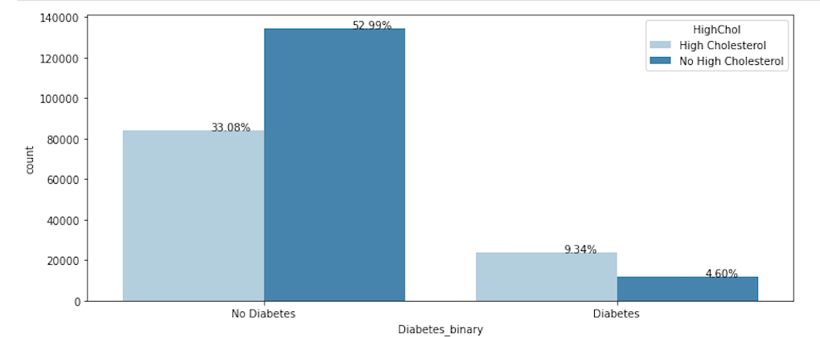
Results continued
High Cholesterol

Slide 12
Results continued
Screenshot of HTML/ Dashboard/Database

Slide 13
Conclusions

Slide 14
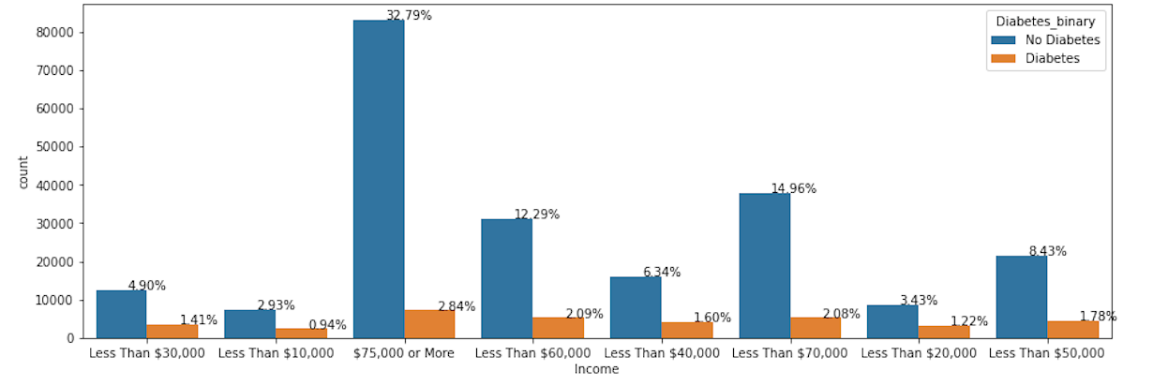
Further Considerations
Explore income analysis

Slide 15
References
GitHub url:

Slide 16
THANK YOU!

