Slide 1


Slide 2


WEBSITES
Universidad de Granada
https://www.ugr.es/
Universidad de Salamanca
https://www.usal.es/

Slide 3
Kiviat Diagram

Slide 4
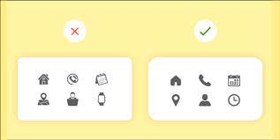
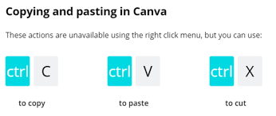
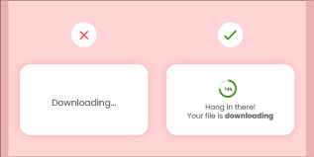
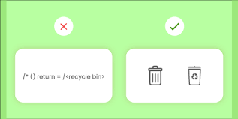
Golden Rules
1. Strive for Consistency
Enable Frequent Users to Use Shortcuts
Offer Informative Feedback
Design Dialog to Yield Closure

Slide 5
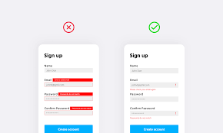
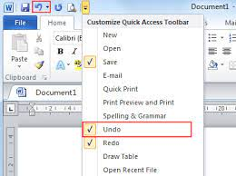
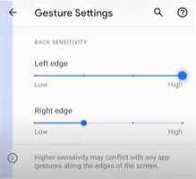
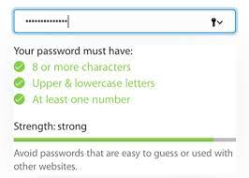
Offer Simple Error Handling
Permit Easy Reversal of Actions
Support Internal Locus of Control
Reduce Short-Term Memory Load

